Slide 1
Analysis of Sentiment towards Donald Trump
Udit Sharma
uditsharma16@gmail.com
Notes:
Please enter project details and your details here.

Slide 2
A bit about Me☺
Software Developer with 1 year of work experience
Interest/hobbies- Coding, Guitar, Cooking and Physics
Studying – Master of Computer and Information Science
Best part of MSA – Community interaction, Resource videos
MSA improvement – More time for phase 2
Future Goals – Want to work as Software Developer or Machine learning engineer
Notes:
This section is NOT assessed. We just want to get to know you ☺.

Slide 3
The Problem and Motivation
Business Problem- The business problem I am looking at is the sentiments of people towards Trump and his policies during the pandemic. This problem can be used to analyze sentiments of people in generality and can also be used to look at specific policy discussion. Republicans can use it to improve their standings whereas democrats can exploit it in a campaign against him for the upcoming USA presidential election
Assumptions- I have taken only top recent discussions to see the current emotions of the people. I think this is okay as right now campaign can be built on those emotions. I am also assuming that both Pro and Anti Republican people are part of this discussion.
Notes:
User Experience

Slide 4
Data Extraction and Cleaning
Used Reddit API given in the MSA example
Data Cleaning- Tokenization, Stop word removal, Lemmatization, TF-IDF Vectorizer and Website removal
- Extra Data cleaning- Special character removal, email removal, removing numbers
Notes:
Talk about your database, what schema you used and what data you used

Slide 5
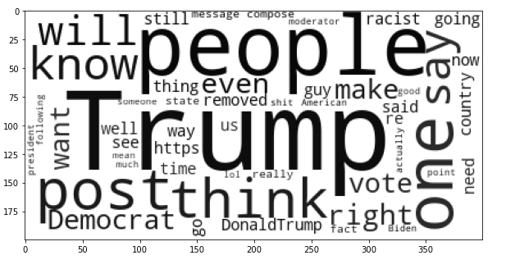
Word Cloud Topics

Slide 6
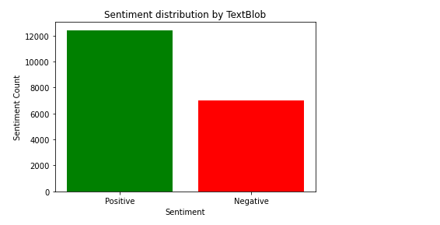
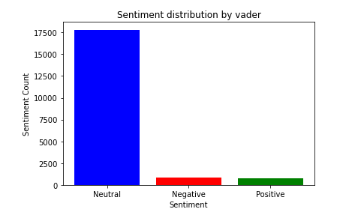
Sentiment Analysis
Notes:
Explain your Azure features here

Slide 7
Analysis and Results
Textblob shows generally positive reviews about trump whereas Vader shows more neutral ones.
The sentiments of people on trump is generally neutral and somewhere leaning towards positive.
Word cloud shows people are talking about upcoming elections.
Notes:
Advanced features…

Slide 8
Kaggle Challenge
Kaggle challenge was very fun for me. I have done text mining as a paper and done topic modeling, so sentiment analysis was something like that and fun. I used lemmatization, tokenization and stop word removal to achieve cleaning and used SGD Classifier for classification. I also used pipeline to optimize the hyper parameters of SGD classifier.
Problem- The issue I faced was testing and training data had different lengths after vectorization and classifier can't allow that. I combined them to clean and had to manually break them later.
What I would do different- I did try to refactor the testing data length using prebuilt functions to induce Null columns, but it didn't work due to memory constraint errors. I would like to first solve that and try other classifiers like RNN. I avoided neural networks as optimizing them sometime can be much more time taking.
Notes:
Advanced features…

Slide 9
Advanced Requirement
Achieved 69.7 percent accuracy in Kaggle challenge using SGD classifier after optimizing hyper parameters by use of pipeline
Notes:
Advanced considerations…

Slide 10
Final Comments
Would have loved some online video discussions and classes.
Overall it was fun and challenging. Resources provided were spot on.
Got to learn a lot like- How to use API for collecting data, Cleaning methods for text data and how to perform sentiment analysis
Notes:
Any final things you want to tell us

