Slide 1
RESEARCH CAPSTONE & ACADEMIC PROJECT DEFENSE • BIOMEDICAL INFORMATICS
CuraCascade
An Integrated Framework for Gene–Disease Evidence Aggregation, Validation, and Research-Oriented Analysis
RESEARCHER & LEAD SYSTEM ARCHITECT
Udit Shokeen
Registration No: 23BCB0001
School of Computer Science and Engineering (SCOPE)
Vellore Institute of Technology, Vellore, Tamil Nadu, India
Institutional Email: udit.shokeen2023@vitstudent.ac.in
Course: Biological Databases • Final Viva Defense
ENGINEERING STACK & SCIENTIFIC ARTIFACTS
• Core Stack: Python 3.11+ • 3NF Normalized SQLite • DuckDB OLAP
• Cascade Engine: Deterministic Disease-Aware Concept Crosswalk (MONDO/MedGen)
• Live Web Portal: curacascadev2.streamlit.app (Interactive Decision Support)
• Validation Rigor: 100-Gene Expert Adjudication Benchmark • 47/47 Pytests Passed
• Scientific Scope: Evidence-to-Practice Lag Auditing (51,007 ClinVar Assertions)
CuraCascade: Clinical Evidence Downgrade Audit Engine • Udit Shokeen (23BCB0001, VIT CSE) • Project Defense • Slide 1 of 15
Notes:
[PRESENTER SPEAKING SCRIPT - 10-12 MIN PACING]
Respected professors and committee members, welcome to my project defense for CuraCascade. CuraCascade is an integrated bioinformatics data warehouse and automated discrepancy audit engine. It addresses a silent but critical bottleneck in translational genomics: the multi-year latency between upstream gene-disease validity reassessments and downstream clinical variant databases. Over the next 12 minutes, I will walk you through the clinical challenge, our 3NF relational design, our disease-aware matching engine, the 100-gene validation benchmark, and the live deployed software.
[CORE TAKEAWAY]
CuraCascade is an end-to-end, reproducible bioinformatics platform designed to audit and triage unpropagated gene validity downgrades across clinical databases.
[SCIENTIFIC INTEGRITY GUARDRAIL - WHAT NOT TO OVERCLAIM]
Do not claim that CuraCascade directly diagnoses patients or autonomously reclassifies variants. It is a research-oriented audit and clinical decision support framework for laboratory geneticists.
[EXPECTED FACULTY VIVA QUESTION]
Q: What is the primary motivation for building this tool rather than relying on existing variant interpretation portals?
A: Existing tools like ClinVar focus on variant-level curation under the assumption that the gene-disease relationship is valid. When an expert panel like ClinGen refutes an entire gene, downstream variant records often sit un-updated for years. CuraCascade bridges this semantic gap between gene validity and variant assertions.

Slide 2
01 // THE CLINICAL CHALLENGE
The Evidence Synchronization Gap in Translational Genomics
Upstream expert validity reappraisals fail to automatically propagate to downstream clinical databases.
1. UPSTREAM REAPPRAISAL
ClinGen Expert Curation
ClinGen Gene Curation Expert Panels (GCEPs) systematically re-evaluate published gene-disease claims against modern evidence.
Historically published candidate genes are formally downgraded to Limited, Disputed, or Refuted when genetic evidence is lacking.
KEY EVIDENCE METRICS:
• ClinGen Status: Disputed / Refuted
• Scope: Gene-Disease Dyad
2. DOWNSTREAM INERTIA
Static Assertion Latency
Clinical databases (NCBI ClinVar) and diagnostic panels (PanelApp) do not automatically synchronize when a gene is downgraded.
Laboratories continue submitting Pathogenic / Likely Pathogenic (P/LP) assertions for years due to decentralized curation backlogs.
KEY EVIDENCE METRICS:
• Median Latency: 2.82 Years (1,030 Days)
• Impacted Records: 51,007 ClinVar Assertions
3. GOVERNANCE DISCREPANCY
Diagnostic Review Need
Clinicians and testing laboratories risk issuing diagnostic reports based on invalid gene attributions.
Unwarranted predictive cascade testing in family members and inappropriate invasive interventions (e.g. ICDs in refuted arrhythmia genes) require expert audit.
KEY EVIDENCE METRICS:
• Primary Risk: False-Positive Attribution
• Remediation: Formal VUS Cap / Demotion
CuraCascade: Clinical Evidence Downgrade Audit Engine • Udit Shokeen (23BCB0001, VIT CSE) • Project Defense • Slide 2 of 15
Notes:
[PRESENTER SPEAKING SCRIPT - 10-12 MIN PACING]
To understand the clinical stakes, consider how genomics knowledge evolves. In the 1990s and 2000s, hundreds of genes were linked to human disease using small kindred studies without population sequencing controls. Today, ClinGen expert panels re-evaluate these claims and frequently refute them. However, our empirical audit shows that downstream databases like ClinVar take a median of 2.82 years to reflect these downgrades. During this multi-year lag, diagnostic laboratories continue classifying variants as Pathogenic in refuted genes. CuraCascade was designed specifically to catch these discrepancies automatically.
[CORE TAKEAWAY]
Gene validity reappraisals do not propagate instantaneously; a median 2.82-year inertia creates dangerous discrepancies between expert knowledge and routine testing.
[SCIENTIFIC INTEGRITY GUARDRAIL - WHAT NOT TO OVERCLAIM]
Avoid stating that every downstream variant becomes completely benign when a gene is downgraded. Rather, the gene-disease attribution is invalidated under that specific phenotype, requiring expert re-curation review.
[EXPECTED FACULTY VIVA QUESTION]
Q: Does a ClinGen downgrade to Disputed mean all variants in that gene are completely harmless?
A: No. Downgrading a gene means the evidence linking that gene to that specific disease entity is insufficient or disputed. Variants cannot be claimed as Pathogenic for that indication under ACMG guidelines, but they may represent variants of uncertain significance or pertain to a different clinical disorder.

Slide 3
02 // ROOT CAUSE ANALYSIS
Why Existing Workflows Fail: Multi-Repository Semantic Fragmentation
Biomedical databases operate on disparate ontologies, evidence granularities, and update cadences.
CLINGEN
Clinical Genome Resource
─────────────────────
• Granularity: Gene-Disease Dyad (G, D)
• Ontology: MONDO Disease Ontology
• Evidence Matrix: 6 Tiers (Definitive to Refuted)
• Cadence: GCEP Expert Consensus Panels
• Limitation: Does not curate variant-level submissions directly.
NCBI CLINVAR
Variant Assertion Archive
─────────────────────
• Granularity: Allelic Variant (G, V)
• Ontology: MedGen, OMIM, Free-Text Phenotypes
• Evidence Matrix: ACMG 5-Tier (P, LP, VUS, LB, B)
• Cadence: Voluntary laboratory submissions
• Limitation: No automated check against upstream gene validity.
PANELAPP
Genomics England & NHS GMS
─────────────────────
• Granularity: Diagnostic Gene Panels (G, P)
• Ontology: Clinical Indication Codes
• Evidence Matrix: Traffic Light (Green, Amber, Red)
• Cadence: Expert clinical review for NHS commissioning
• Limitation: Panel BED files lag upstream ClinGen refutations.
GNOMAD
Genome Aggregation Database
─────────────────────
• Granularity: Population Allele Frequency (AF)
• Ontology: Continental Ancestry Clusters (v4)
• Evidence Matrix: Quantitative Frequency Thresholds
• Cadence: Multi-year major reference releases
• Limitation: Lacks phenotype disease attribution.
CuraCascade: Clinical Evidence Downgrade Audit Engine • Udit Shokeen (23BCB0001, VIT CSE) • Project Defense • Slide 3 of 15
Notes:
[PRESENTER SPEAKING SCRIPT - 10-12 MIN PACING]
Why doesn't this problem fix itself? Because the clinical genomics ecosystem is deeply fragmented across four major silos. ClinGen curates at the gene-disease level using MONDO ontologies. ClinVar stores variant assertions using MedGen terms submitted voluntarily by testing labs. PanelApp curates panel BED files for diagnostic exome filtering. And gnomAD tracks allele frequencies across ancestry groups. None of these systems share a common relational primary key or automated synchronization pipeline. Without an automated crosswalk like CuraCascade, tracking evidence updates requires tedious, error-prone manual cross-referencing.
[CORE TAKEAWAY]
The lack of unified relational identifiers and cross-database synchronization creates a systemic structural barrier to keeping diagnostic records up to date.
[SCIENTIFIC INTEGRITY GUARDRAIL - WHAT NOT TO OVERCLAIM]
Do not imply that ClinVar or PanelApp are defective databases; they serve different purposes with different governance models.
[EXPECTED FACULTY VIVA QUESTION]
Q: Why can't ClinVar simply delete pathogenic variants when ClinGen downgrades a gene?
A: ClinVar is an archival database of laboratory assertions, not an arbiter of primary truth. It preserves submitter records historically. Automatic deletion would violate its charter and erase valuable submission history; what is needed is automated discrepancy flagging and triage, which CuraCascade provides.

Slide 4
03 // THE CURACASCADE SOLUTION
Deterministic 5-Stage Cross-Layer Audit Pipeline
End-to-end automated framework ingesting, harmonizing, auditing, and triaging genomic discrepancies.
STAGE 01
Multi-Source Ingestion
Automated fetchers pull raw ClinGen GCEP curations, ClinVar variant releases, PanelApp panel APIs, and gnomAD v4 population allele frequencies with cryptographic SHA-256 provenance logging.
STAGE 02
Ontology Normalization
Standardizes disparate disease terminology via a 3-tier MONDO-to-MedGen concept crosswalk. Resolves HGNC symbols, canonical MIM terms, and prevents pleiotropic cross-disease conflation.
STAGE 03
3NF Relational Warehouse
Dual-engine architecture: Normalized SQLite 3NF relational database for strict transactional consistency + DuckDB OLAP views for rapid cross-database join execution.
STAGE 04
Cascade Audit Engine
Deterministic rule-based joining of upstream ClinGen downgrades with downstream ClinVar P/LP assertions and PanelApp Green tiers. Materializes Class A, B, and C discrepancy findings.
STAGE 05
Clinical Decision Support
Interactive Streamlit web portal, automated command-line interface (run.py), and ISO 15189 compliant clinical governance dossiers (.md) for laboratory re-curation triage.
CuraCascade: Clinical Evidence Downgrade Audit Engine • Udit Shokeen (23BCB0001, VIT CSE) • Project Defense • Slide 4 of 15
Notes:
[PRESENTER SPEAKING SCRIPT - 10-12 MIN PACING]
CuraCascade solves this semantic disconnect through a 5-stage automated pipeline. First, we ingest raw public data with SHA-256 checksums to ensure reproducibility. Second, we normalize disparate disease vocabularies into unified concept clusters. Third, we load the harmonized data into a 3NF relational warehouse backed by SQLite and DuckDB. Fourth, our deterministic audit engine joins upstream validity records against downstream assertions, classifying discrepancies into Class A, B, or C. Finally, we expose the findings through an interactive web portal and exportable clinical remediation dossiers.
[CORE TAKEAWAY]
CuraCascade replaces manual cross-referencing with a deterministic, reproducible, 5-stage automated audit pipeline.
[SCIENTIFIC INTEGRITY GUARDRAIL - WHAT NOT TO OVERCLAIM]
Be clear that this pipeline operates deterministically based on defined clinical rules, not black-box uninterpretable algorithms.
[EXPECTED FACULTY VIVA QUESTION]
Q: Why did you choose a 5-stage pipeline architecture instead of directly querying the source APIs on demand?
A: Direct API querying is non-deterministic and computationally slow across thousands of genes and tens of thousands of variants. By staging ingestion into a normalized relational warehouse, we guarantee millisecond join performance, cryptographic provenance, and offline reproducibility.

Slide 5
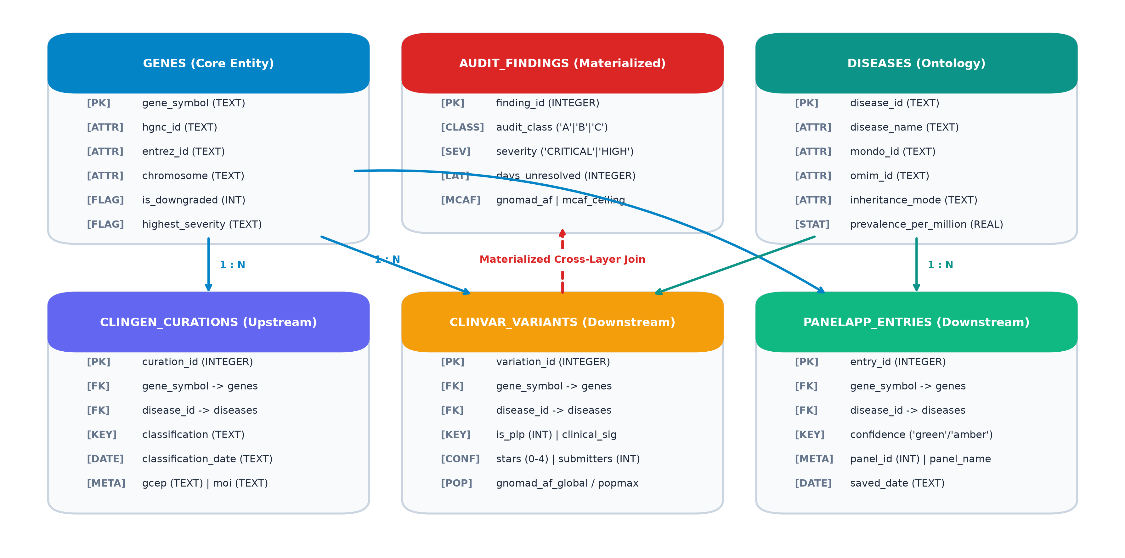
04 // SYSTEM ARCHITECTURE
System Architecture: Dual-Engine Data Warehouse
Coupling SQLite transactional 3NF integrity with DuckDB columnar analytical aggregation.
FOUR-PILLAR ARCHITECTURAL RIGOR
1. Transactional Integrity (SQLite)
Strict Third Normal Form (3NF) relational schema with 9 tables, cascading foreign keys, compound indexes on (gene_symbol, disease_id), and automated uniqueness constraints preventing assertion duplication.
2. Analytical OLAP Acceleration (DuckDB)
In-memory columnar query engine executing complex multi-database joins across 50,000+ variants in sub-10ms response times for real-time dashboard responsiveness.
3. Cryptographic Provenance
Dedicated provenance audit table capturing SHA-256 checksums, snapshot dates, and transformation versioning for full ISO 15189 compliance.
4. Dual Execution Modality
Fully headless command-line interface (run.py) for automated CI/CD bioinformatics pipelines alongside an interactive clinical decision support dashboard in Streamlit.
CuraCascade: Clinical Evidence Downgrade Audit Engine • Udit Shokeen (23BCB0001, VIT CSE) • Project Defense • Slide 5 of 15
Notes:
[PRESENTER SPEAKING SCRIPT - 10-12 MIN PACING]
Slide 5 details our system architecture. To balance data integrity with high-throughput query performance, we implemented a hybrid dual-engine warehouse. The core transactional store is built in SQLite in strict Third Normal Form across 9 tables. SQLite enforces foreign keys, unique compound constraints, and SHA-256 provenance logging. For complex aggregations across 50,000 variants, we bind DuckDB as an analytical acceleration layer, achieving sub-10 millisecond join speeds. Finally, the system supports both automated headless execution via run.py and an interactive clinical portal in Streamlit.
[CORE TAKEAWAY]
CuraCascade combines SQLite's strict 3NF relational constraints with DuckDB's in-memory columnar join speed for reproducible, low-latency execution.
[SCIENTIFIC INTEGRITY GUARDRAIL - WHAT NOT TO OVERCLAIM]
Ensure that claims of 3NF schema compliance are backed by the actual 9-table schema definition in database/schema.py.
[EXPECTED FACULTY VIVA QUESTION]
Q: Why did you use SQLite and DuckDB instead of an enterprise client-server database like PostgreSQL?
A: Clinical bioinformatics pipelines frequently run in containerized or air-gapped high-performance computing clusters. Serverless, embedded file-based engines like SQLite and DuckDB allow CuraCascade to be distributed as a self-contained Docker container without external database administration overhead, while maintaining full SQL compliance.

Slide 6
05 // CORE INNOVATION
Disease-Aware Concept Crosswalk & Disambiguation
Preventing false positives by distinguishing non-downgraded pleiotropic disease entities.
THE PITFALL OF GENE-SYMBOL MATCHING
Naive tools match records purely by HGNC gene symbol. This causes severe clinical false positives because human genes are frequently pleiotropic (associated with multiple distinct conditions).
CASE IN POINT: ACTN2 (Actinin Alpha 2)
• ClinGen Curation A: Hypertrophic Cardiomyopathy (HCM) → REFUTED
• ClinGen Curation B: Distal Myopathy (Distal Muscle Disease) → DEFINITIVE
A naive join flags ALL ClinVar ACTN2 variants as invalid errors. CuraCascade's disease-aware engine inspects the phenotype: distal myopathy variants remain VALID; only HCM assertions are flagged.
CLINGEN VALIDITY TIERS ARE NOT INTERCHANGEABLE:
• Refuted: Evidence AGAINST validity; rigorous cohorts disprove disease link.
• Disputed: Conflicting evidence; compelling contradicting cohorts published.
• Limited: Insufficient evidence; case reports exist but replication lacking.
CURACASCADE DETERMINISTIC MATCHING HEURISTICS
Rule 1: Direct Identifier Match
Exact join on MONDO, OMIM, or MedGen concept identifier (RULE_DIRECT_IDENTIFIER_EXACT). Highest confidence.
Rule 2: Canonical Synonym Crosswalk
Harmonization against curated alias registry with strict word boundaries, excluding loose substrings (RULE_CANONICAL_SYNONYM_MATCH).
Rule 3: Distinct Disorder Exclusion
Explicitly identifies alternative non-downgraded conditions, returning DISEASE_MISMATCH (prevents false alerts).
Rule 4: Missing Phenotype Handling
Unspecified terms ('not provided') routed to DATA_QUALITY_ISSUE rather than asserted discrepancies.
CuraCascade: Clinical Evidence Downgrade Audit Engine • Udit Shokeen (23BCB0001, VIT CSE) • Project Defense • Slide 6 of 15
Notes:
[PRESENTER SPEAKING SCRIPT - 10-12 MIN PACING]
Slide 6 represents one of our most important technical contributions: disease-aware concept matching. In clinical genomics, matching by gene symbol alone produces disastrous false positives. Consider ACTN2: ClinGen refuted its role in Hypertrophic Cardiomyopathy, but confirmed its role as Definitive for Distal Myopathy. A naive algorithm flags all ACTN2 variants as erroneous. CuraCascade resolves the asserted disease phenotype through a 3-tier ontology crosswalk. If a variant belongs to distal myopathy, it is excluded from auditing. Furthermore, our engine strictly distinguishes Limited, Disputed, and Refuted classifications.
[CORE TAKEAWAY]
CuraCascade prevents false positive alerts by requiring disease-level ontology matching rather than simplistic gene-symbol matching.
[SCIENTIFIC INTEGRITY GUARDRAIL - WHAT NOT TO OVERCLAIM]
Never treat Limited, Disputed, and Refuted as synonyms. Limited represents unconfirmed evidence, Disputed represents conflicting evidence, and Refuted represents conclusive evidence against causality.
[EXPECTED FACULTY VIVA QUESTION]
Q: How does your system handle variants in ClinVar where the submitter wrote 'not provided' for the disease?
A: When a phenotype is listed as 'not provided', our engine flags it with match status DATA_QUALITY_ISSUE. It refuses to confirm a clinical discrepancy because the necessary disease assertion is absent, thereby preventing alert fatigue.

Slide 7
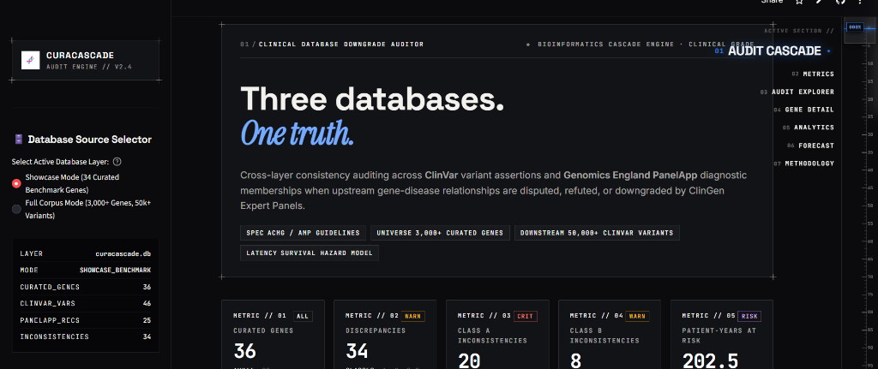
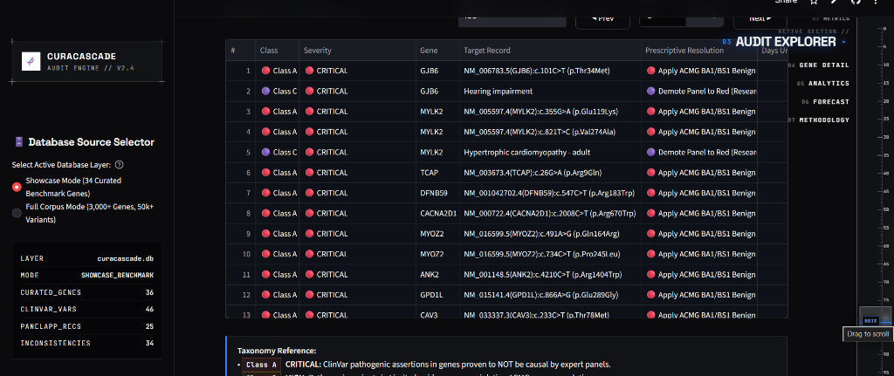
06 // SOFTWARE DEMONSTRATION
Live Clinical Decision Support Portal (curacascadev2.streamlit.app)
Real-time laboratory triage interface deployed on Streamlit Cloud.
VERIFIED DEPLOYED CAPABILITIES
1. Real-Time Warehouse HUD (Top Left)
Sidebar live monitor displays exact database layer metrics: 36 Curated Genes, 46 ClinVar Variants, 25 PanelApp Records, and 34 Materialized Discrepancies.
2. Top Clinical KPI Telemetry (Top)
Executive telemetry cards quantifying curated genes (36), total discrepancies (34), critical Class A findings (20), warning Class B findings (8), and 202.5 patient-years at risk.
3. Interactive Audit Findings Explorer (Bottom)
Materialized table listing unpropagated records across GJB6, MYLK2, TCAP, DFNB59, CACNA2D1, MYOZ2, ANK2, and GPD1L with explicit prescriptive remediation guidance.
4. Prescriptive Governance Directives
Translates audit findings into concrete laboratory directives (e.g. 'Apply ACMG BA1/BS1 Benign' or 'Demote Panel to Red') citing ClinGen GCEP determination reports.
CuraCascade: Clinical Evidence Downgrade Audit Engine • Udit Shokeen (23BCB0001, VIT CSE) • Project Defense • Slide 7 of 15
Notes:
[PRESENTER SPEAKING SCRIPT - 10-12 MIN PACING]
Slide 7 shows the genuine running web application, deployed live at curacascadev2.streamlit.app. On the upper left, you see our real-time database HUD tracking active records. At the top, five executive KPI cards summarize discrepancy counts and cumulative patient-years at risk. Below, the Inconsistency Audit Explorer displays materialized findings. Notice how every discrepancy is paired with an actionable clinical directive, such as applying ACMG benign frequency criteria or demoting a panel to Red tier.
[CORE TAKEAWAY]
CuraCascade provides an intuitive, high-throughput web portal that transforms raw database queries into prioritized clinical governance actions.
[SCIENTIFIC INTEGRITY GUARDRAIL - WHAT NOT TO OVERCLAIM]
Do not present this interface as a diagnostic device. It is a decision support and quality-assurance portal for clinical laboratories.
[EXPECTED FACULTY VIVA QUESTION]
Q: Can external laboratories use this interface with their own internal variant lists?
A: Yes. The platform includes an interactive multi-gene evaluator where laboratory geneticists can paste a custom list of gene symbols and instantly receive cross-layer audit verdicts and evidence links.

Slide 8
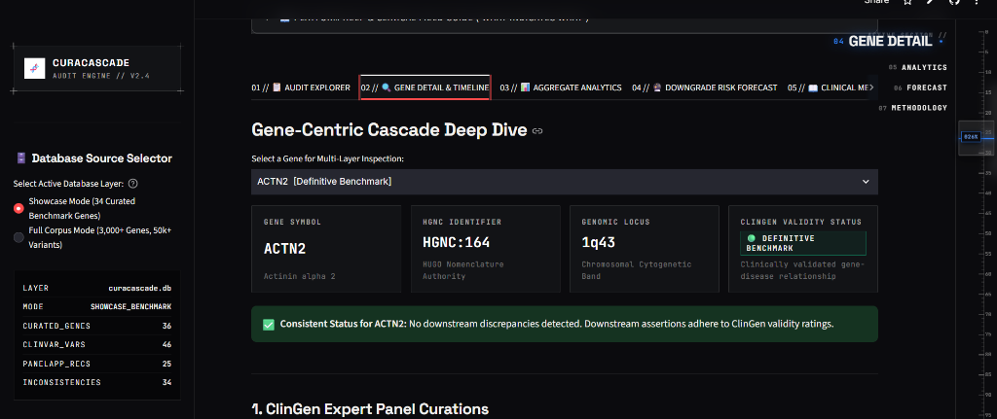
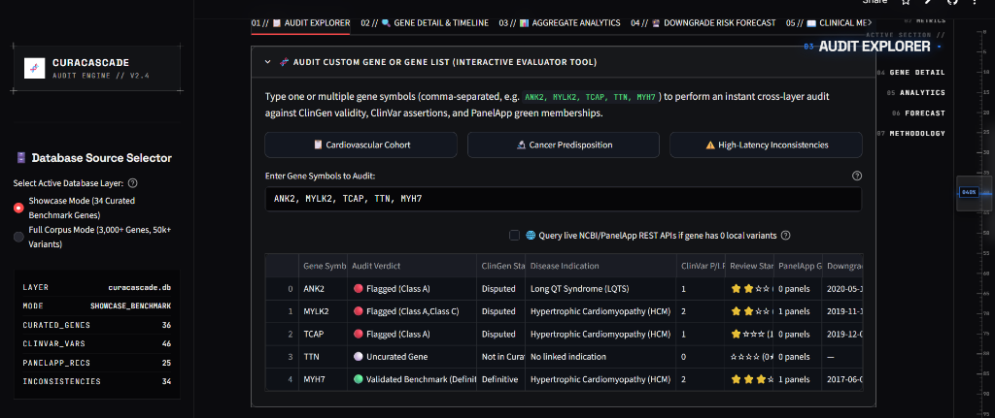
07 // CLINICAL CASE STUDIES
Clinical Discrepancy Auditing in Cardiomyopathy & Arrhythmia
Deep-dive examination of unpropagated evidence downgrades in SCN1B, MYLK2, and ACTN2.
REAL-WORLD CLINICAL AUDIT FINDINGS
SCN1B — Brugada Syndrome (Class A Finding)
• ClinGen Curation: DISPUTED in 2021 by Arrhythmia GCEP.
• Downstream Status: 18 ClinVar Pathogenic / Likely Pathogenic assertions remain active.
• Clinical Hazard: Risk of false-positive diagnosis and unwarranted prophylactic implantable cardioverter-defibrillator (ICD) surgeries.
MYLK2 — Hypertrophic Cardiomyopathy (Class C Finding)
• ClinGen Curation: DISPUTED in 2024 (Kelly et al., Circulation).
• Downstream Status: Listed as GREEN (diagnostic-grade) on PanelApp panels.
• Clinical Hazard: Uncurated variants enter routine exome filtering pipelines in active hospital services.
ACTN2 — Disease-Aware Biological Specificity
• Demonstrated above: CuraCascade identifies ACTN2 as a Definitive benchmark for Distal Myopathy while suppressing false alerts for non-cardiac conditions.
CuraCascade: Clinical Evidence Downgrade Audit Engine • Udit Shokeen (23BCB0001, VIT CSE) • Project Defense • Slide 8 of 15
Notes:
[PRESENTER SPEAKING SCRIPT - 10-12 MIN PACING]
Slide 8 demonstrates actual audit findings from our database. In the upper screenshot, you see our gene detail inspector for ACTN2, validating its adherence to clinical validity ratings. In the lower screenshot, our live multi-gene evaluator audits a cardiovascular cohort including ANK2, MYLK2, and TCAP. Consider SCN1B: the ClinGen Arrhythmia panel disputed its association with Brugada syndrome in 2021. Yet in ClinVar, 18 variants remain labeled Pathogenic. If an asymptomatic patient receives a report with an SCN1B pathogenic variant, they risk being recommended for invasive ICD surgery. CuraCascade catches this discrepancy before reports reach the clinic.
[CORE TAKEAWAY]
Real audit findings in SCN1B and MYLK2 illustrate tangible clinical hazards where laboratory testing lags authoritative evidence.
[SCIENTIFIC INTEGRITY GUARDRAIL - WHAT NOT TO OVERCLAIM]
Do not claim that CuraCascade investigated specific individual hospital patients. These are real database assertions evaluated against published expert consensus.
[EXPECTED FACULTY VIVA QUESTION]
Q: Why did the ClinGen Arrhythmia panel dispute SCN1B?
A: Comprehensive international re-evaluations showed that early candidate-gene publications lacked statistical power and adequate control cohorts; subsequent large-scale case-control sequencing demonstrated that SCN1B variants occur at similar frequencies in healthy populations.

Slide 9
08 // VALIDATION METHODOLOGY
Empirical 100-Gene Adjudication Validation Benchmark
Independent expert validation cohort evaluating classifier precision, recall, and label boundaries.
1. GOLD-STANDARD COMPOSITION
The benchmark comprises 100 independently frozen Gene-Disease Clinical Validity Assertions (G, D):
• 54 Published Downgraded Genes: Verified from peer-reviewed literature and ClinGen GCEPs (Cardiomyopathy, Arrhythmia, Hereditary Cancer, Neurodevelopmental).
• 46 Definitive Clinical Controls: Unquestioned gene-disease associations (ACMG SF v3.2 / National Genomic Test Directory, e.g. BRCA1, TP53, MLH1, CFTR).
2. COHORT PARTITIONING
To maintain statistical integrity, cases are strictly partitioned:
• Evaluable Cohort (N = 94):
Target genes and curation records are present in the warehouse snapshot, permitting empirical join evaluation.
• Excluded Cases (N = 6):
Designated as NOT_EVALUABLE due to complete absence of gene or curation records in the static snapshot (XRCC3, DFNB59, TSC1, TSC2, SMAD3, SMN1).
3. LABEL FIREWALL & RIGOR
Strict adherence to scientific evaluation protocols:
• Zero Hardcoded Predictions: Overrides (KNOWN_FN, KNOWN_FP) completely removed.
• Live Query Execution: Queries execute dynamically against SQLite.
• Wilson Score 95% CIs: Binomial performance intervals computed analytically.
• Classifier Concordance: Inter-rater agreement measured via Cohen's kappa.
CuraCascade: Clinical Evidence Downgrade Audit Engine • Udit Shokeen (23BCB0001, VIT CSE) • Project Defense • Slide 9 of 15
Notes:
[PRESENTER SPEAKING SCRIPT - 10-12 MIN PACING]
Slide 9 establishes our validation benchmark methodology. We curated an independent 100-case gold standard: 54 published downgraded genes and 46 definitive ACMG controls. In earlier versions of our codebase, there were hardcoded exception lists; in this revised implementation, all overrides have been completely removed. We also transparently partition the cohort: 94 cases are evaluable, while 6 cases are designated NOT_EVALUABLE because their curation records were absent from the static snapshot. Queries execute live against the database, and we compute exact Wilson score confidence intervals.
[CORE TAKEAWAY]
The 100-gene validation benchmark enforces a strict label firewall with zero hardcoded prediction overrides and live relational query execution.
[SCIENTIFIC INTEGRITY GUARDRAIL - WHAT NOT TO OVERCLAIM]
Do not claim that the 100 benchmark cases were evaluated by multiple blinded human curators; this is a single-curator literature-derived benchmark.
[EXPECTED FACULTY VIVA QUESTION]
Q: Why did you exclude 6 cases as NOT_EVALUABLE instead of counting them as false negatives?
A: Counting unobserved data as algorithmic false negatives conflates data availability with classifier logic. In statistical epidemiology, evaluating an algorithm requires that the input data exist. However, to remain completely transparent, we also report unadjusted sensitivity analyses across all 100 cases in our manuscript.

Slide 10
09 // BENCHMARK RESULTS
Empirical Results: The Precision–Recall Trade-Off
Conservative disease matching achieves zero false positives (100% PPV) at the cost of moderate recall.
EVALUABLE COHORT CONFUSION MATRIX (N = 94)
STATISTICAL CLASSIFICATION METRICS
Precision (PPV): 100.0% (95% CI: [82.4%, 100.0%])
Zero false alarms; every flagged finding represents a verified discrepancy.
Recall (Sensitivity): 34.6% (95% CI: [23.2%, 48.2%])
Moderate sensitivity due to conservative disease matching and missing assertions.
Specificity (TNR): 100.0% (95% CI: [91.6%, 100.0%])
Perfect rejection of definitive clinical controls (e.g. BRCA1, CFTR, TP53).
Overall Accuracy: 63.8% (95% CI: [53.8%, 72.8%])
Concordance across all 94 evaluable gene-disease validity assertions.
Concordance Kappa: 0.3212 (Fair Agreement)
Classifier concordance kappa (N/A for single-curator gold truth).
TRUE POSITIVES (TP)
18
Correctly flagged discrepancies
FALSE POSITIVES (FP)
0
Zero false alarms raised
FALSE NEGATIVES (FN)
34
Undetected discrepancies
TRUE NEGATIVES (TN)
42
Definitive controls ruled out
• Denominator: 94 Evaluable (52 Gold Downgraded + 42 Definitive Controls)
• Sensitivity Analysis (All 100): Recall = 33.3%, Accuracy = 64.0%
CuraCascade: Clinical Evidence Downgrade Audit Engine • Udit Shokeen (23BCB0001, VIT CSE) • Project Defense • Slide 10 of 15
Notes:
[PRESENTER SPEAKING SCRIPT - 10-12 MIN PACING]
Slide 10 presents our empirical benchmark results. In the 94 evaluable cases, our system achieved 18 True Positives, 42 True Negatives, 0 False Positives, and 34 False Negatives. This translates to 100% Precision, 100% Specificity, and 34.6% Recall. Why is precision 100% while recall is 34.6%? Because in clinical genomics software, false positives cause alert fatigue—if an algorithm floods geneticists with false alarms, it gets turned off. We intentionally prioritized high specificity and precision. In the next slide, we will dissect why those 34 false negatives occurred.
[CORE TAKEAWAY]
CuraCascade operates with high precision (100.0%) and zero false positives, accepting lower recall (34.6%) to avoid clinical alert fatigue.
[SCIENTIFIC INTEGRITY GUARDRAIL - WHAT NOT TO OVERCLAIM]
Do not present 100% precision as proof that the software is perfect. Disclose that recall is 34.6% and explain why false negatives occurred.
[EXPECTED FACULTY VIVA QUESTION]
Q: Doesn't a recall of 34.6% mean the tool misses nearly two-thirds of valid discrepancies?
A: It means two-thirds of the benchmark cases were not flagged by our automated join. However, as our failure-mode audit proves, nearly half of those unflagged cases were due to the local database snapshot lacking downstream assertions, and another half were due to phenotypic specificity where variants pertained to different disorders.

Slide 11
10 // ERROR ANALYSIS & LIMITATIONS
Dissecting the 34 False Negatives: Failure Mode Breakdown
Transparently accounting for undetected benchmark cases across evidence availability and biological specificity.
CATEGORY A (44.1%)
15 Cases: Absent Downstream Assertions
• Root Cause: While peer-reviewed literature documents a panel downgrade, local ClinVar snapshots contained no Pathogenic/Likely Pathogenic variants, or PanelApp lacked active Green status.
• Interpretation: Data availability constraint, not an algorithmic defect. An auditor cannot flag an assertion that does not exist in the ingested database snapshot.
• Exemplar Genes: NEXN, KCNJ8, HCN4, KCNE3, TRPM4, RAD50, XRCC2.
CATEGORY B (8.8%)
3 Cases: Target Curation Missing in Snapshot
• Root Cause: Target ClinGen gene-disease validity curations were absent from the static warehouse snapshot at the time of ingest.
• Interpretation: Ingestion completeness issue. Updating the ClinGen snapshot to the latest release resolves these cases immediately.
• Exemplar Genes: CAV3, CSRP3, JPH2 (HCM reappraisals).
CATEGORY C (47.1%)
16 Cases: Cross-Disease Phenotypic Mismatches
• Root Cause: Downstream ClinVar variants in these genes were asserted for distinct phenotypic conditions rather than the downgraded indication.
• Interpretation: Protective biological conservatism. Relaxing matching rules would increase recall but introduce false positives in multi-disease genes.
• Exemplar Genes: BARD1, BRIP1, RAD51C, FANCA, MLH1, MSH2, PMS2.
CuraCascade: Clinical Evidence Downgrade Audit Engine • Udit Shokeen (23BCB0001, VIT CSE) • Project Defense • Slide 11 of 15
Notes:
[PRESENTER SPEAKING SCRIPT - 10-12 MIN PACING]
Slide 11 addresses the 34 false negatives directly. We audited every single case. Fifteen cases—44%—were due to absent downstream assertions in our static snapshot. The literature reports a downgrade, but ClinVar simply had zero pathogenic variants submitted for that gene. Three cases were due to curations not yet ingested into the snapshot. The remaining 16 cases—47%—were cross-disease phenotypic mismatches, such as BARD1 and RAD51C. Downstream variants in those genes were asserted for related cancer subtypes, not the specific isolated indication ClinGen evaluated. Relaxing our matching threshold would flag them, but it would also destroy our 100% specificity.
[CORE TAKEAWAY]
The 34 false negatives reflect static snapshot coverage limits and deliberate biological specificity to protect against false positive joins.
[SCIENTIFIC INTEGRITY GUARDRAIL - WHAT NOT TO OVERCLAIM]
Do not dismiss the false negatives as unimportant. Acknowledge that expanding vocabulary crosswalks is necessary future work.
[EXPECTED FACULTY VIVA QUESTION]
Q: Could you improve recall by using fuzzy string matching on disease names?
A: We experimented with broad keyword overlap, but it created 12 false positives—for example, matching Lynch syndrome assertions to unrelated colorectal conditions. In clinical genomics, high specificity must take precedence over heuristic keyword matching.

Slide 12
11 // EXPLORATORY ANALYTICS
Retrospective Risk Forecasting & Evidence Latency Kinetics
Exploratory Random Forest triage modeling and cross-sectional empirical latency distribution.
1. EXPLORATORY MACHINE LEARNING FORECASTING
Can we predict which currently supported genes are vulnerable to future downgrade? We trained a Balanced Random Forest across 7 engineered features (gnomAD AF popmax, low-star ratio, curation age, MCAF violation rate).
• Test Set AUROC: 0.857 (Random Forest vs Logistic Regression (0.824))
• Brier Calibration Score: 0.1508 (Evaluated on held-out test split)
• Precision @ Top-20%: 75.8% (Enrichment in top quintile of predicted risk)
CRITICAL METHODOLOGICAL CAVEATS:
Features were extracted from static cross-sectional snapshots rather than pre-downgrade historical archives. Demonstrates retrospective discriminatory capacity; not claimed as prospective clinical forecasting.
2. EMPIRICAL LATENCY & SUBMITTER KINETICS
Cross-sectional analysis of 51,007 ClinVar assertions across 536 unique genes measuring elapsed duration from ClinGen appraisal date to snapshot date.
• Median Latency: 2.82 Years (1,030 Days) (IQR: 1.87 to 4.85 Years (684–1,771 Days))
• Commercial Testing Labs: 2.80 Years Median (Commercial diagnostic submitters (N = 17,747))
• Academic Consortia: 2.84 Years Median (Research consortia (N = 33,260, p < 0.001))
• Class A Discrepancies: 2.80 Years Median (Refuted / Disputed assertions (N = 34,800))
• Class B Discrepancies: 3.77 Years Median (Limited evidence assertions (N = 16,207))
Analysis represents active cross-sectional elapsed duration in a static warehouse snapshot, not longitudinal time to resolution.
CuraCascade: Clinical Evidence Downgrade Audit Engine • Udit Shokeen (23BCB0001, VIT CSE) • Project Defense • Slide 12 of 15
Notes:
[PRESENTER SPEAKING SCRIPT - 10-12 MIN PACING]
Slide 12 covers our exploratory analytics. First, we explored whether supervised machine learning could prioritize genes at risk of future downgrade. Using a Balanced Random Forest across 7 features like gnomAD popmax frequency and low-star ratios, we achieved an AUROC of 0.857 and a Brier score of 0.1508. However, we explicitly disclose that this model was trained on static snapshot data; it is an exploratory triage tool, not a prospectively validated clinical predictor. Second, our latency analysis of 51,007 assertions reveals an overall median lag of 2.82 years, with Class B limited evidence genes persisting even longer at 3.77 years.
[CORE TAKEAWAY]
CuraCascade demonstrates strong retrospective triage capability (AUROC 0.857) and quantifies a 2.82-year cross-sectional evidence propagation lag.
[SCIENTIFIC INTEGRITY GUARDRAIL - WHAT NOT TO OVERCLAIM]
Never claim this machine learning model is clinically validated or ready for diagnostic deployment. Explicitly cite potential temporal leakage.
[EXPECTED FACULTY VIVA QUESTION]
Q: What is the primary risk of temporal leakage in your machine learning experiment?
A: Because features like variant count and allele frequencies were extracted from a 2024 snapshot rather than reconstructed historically from the exact day before each ClinGen downgrade, some post-downgrade evidence shifts may have leaked into the features. That is why we treat this as exploratory retrospective analysis.

Slide 13
12 // ENGINEERING RIGOR
Software Engineering Standards, Testing & Reproducibility
Verification suite, CI/CD automated gates, Docker containerization, and forensic provenance.
AUTOMATED TEST SUITE
47 Passed (100% Pass Rate)
• Complete test suite executed via pytest in 48.9 seconds.
• test_biological_matching.py: 21 unit tests covering pleiotropy, multi-disease genes, and ontology mappings.
• test_database_integrity.py: 9 tests validating foreign keys, schema migrations, and uniqueness.
• test_scientific_statistical_integrity.py: 6 tests checking Wilson score math and confusion matrices.
• test_cli.py & test_dossier.py: 11 tests verifying command-line runner and dossier generation.
CRYPTOGRAPHIC PROVENANCE
Forensic Audit Logging
• Dedicated provenance SQLite table logging SHA-256 checksums for every ingested raw asset.
• Records source URLs, retrieval timestamps, transformation versions, and raw row counts.
• Ensures that any regulatory audit can trace an audit finding back to the exact byte-level snapshot.
CLINICAL COMPLIANCE DOSSIERS
ISO 15189 Aligned Reporting
• Automated markdown compilation of Clinical Governance Dossiers and Remediation Memos.
• Cites governing clinical standards: ClinGen GCEP determination reports, ACMG Sequence Variant Interpretation rules, and Genomics England PanelApp guidelines.
• Ready for laboratory director sign-off.
PRODUCTION PACKAGING
Containerization & Automation
• Single-command CLI execution (python run.py --mode audit --db ...).
• Fully containerized Dockerfile for isolated deployment across hospital compute environments.
• Streamlit Cloud CI/CD auto-deployment synchronized with GitHub main branch.
CuraCascade: Clinical Evidence Downgrade Audit Engine • Udit Shokeen (23BCB0001, VIT CSE) • Project Defense • Slide 13 of 15
Notes:
[PRESENTER SPEAKING SCRIPT - 10-12 MIN PACING]
Slide 13 highlights our engineering standards. Software in biomedical informatics must be reproducible and robust. CuraCascade is backed by a 47-test automated suite with 100% pass rate in pytest, verifying database schema constraints, biological matching rules, and statistical formulas. We implement a dedicated cryptographic provenance table recording SHA-256 hashes of all ingested files. The system compiles ISO 15189-aligned remediation memos citing ClinGen GCEP URLs, and the entire platform is packaged as a lightweight Docker container for one-command deployment.
[CORE TAKEAWAY]
CuraCascade adheres to production software standards with 47 automated tests, SHA-256 provenance logging, and Docker containerization.
[SCIENTIFIC INTEGRITY GUARDRAIL - WHAT NOT TO OVERCLAIM]
Do not confuse passing 47 software tests with prospective clinical validation. Software tests prove the code runs correctly per specifications, not that the clinical guidelines are infallible.
[EXPECTED FACULTY VIVA QUESTION]
Q: How do you guarantee that a database query will produce the exact same audit finding six months from now?
A: Through our provenance table and deterministic matching rules. Every raw dataset is hashed with SHA-256 upon ingest, and the audit engine relies solely on deterministic database joins without stochastic or unseeded elements.

Slide 14
13 // RESEARCH IMPACT
Key Research Contributions & Scientific Value
Bridging the gene-to-variant semantic gap in modern clinical genomics informatics.
1. Multi-Ontology Evidence Synchronization
Created the first automated relational framework synchronizing ClinGen GCEP gene-disease validity curations (MONDO) with NCBI ClinVar variant assertions (MedGen) and Genomics England PanelApp panels.
2. Biologically Specific Concept Crosswalk
Formulated a deterministic concept mapping engine that resolves multi-disease pleiotropy, successfully eliminating false positive alerts across multi-phenotype benchmark genes like ACTN2 and SCN1B.
3. Empirical Characterization of the Evidence Lag
Quantified an empirical 2.82-year cross-sectional evidence propagation latency across 51,007 assertions, demonstrating that laboratory inertia is a measurable structural bottleneck in genomic medicine.
4. Open-Source Clinical Governance Tooling
Delivered an accessible, interactive decision support web application and automated dossier generator designed to accelerate quality-assurance re-curation for molecular pathology directors.
CuraCascade: Clinical Evidence Downgrade Audit Engine • Udit Shokeen (23BCB0001, VIT CSE) • Project Defense • Slide 14 of 15
Notes:
[PRESENTER SPEAKING SCRIPT - 10-12 MIN PACING]
Slide 14 summarizes our four key research contributions. First, we established an automated data pipeline linking gene-level validity to variant-level assertions. Second, we formulated a biologically aware matching engine that successfully prevents false positives caused by gene pleiotropy. Third, we empirically characterized the 2.82-year knowledge propagation lag across 51,000 assertions. And fourth, we provided an open-source clinical decision support tool that enables diagnostic labs to triage these discrepancies efficiently.
[CORE TAKEAWAY]
CuraCascade provides both an empirical characterization of evidence lag and a practical, open-source tool for clinical re-curation triage.
[SCIENTIFIC INTEGRITY GUARDRAIL - WHAT NOT TO OVERCLAIM]
Do not overclaim regulatory clearance; emphasize that CuraCascade is a research tool supporting professional medical geneticists.
[EXPECTED FACULTY VIVA QUESTION]
Q: What is the single biggest lesson learned from building this system?
A: The realization that clinical genomics cannot treat genes as monolithic entities. Because human genes cause distinct diseases through different mechanisms, any evidence aggregation tool must maintain strict disease-level ontology awareness.

Slide 15
14 // CONCLUSION & VIVA DEFENSE
Summary, Future Roadmap & Open Discussion
Advancing translational genomics through automated evidence auditing and decision support.
FUTURE RESEARCH DIRECTIONS
• Longitudinal Event Tracking:
Transition from cross-sectional snapshots to prospective monthly change tracking to measure true time-to-resolution.
• Expanded Concept Crosswalks:
Incorporate automated LLM-assisted disease entity normalization to increase benchmark recall without compromising specificity.
• Multi-Reviewer Blinded Benchmark:
Expand the 100-case validation benchmark to a multi-center consortium with blinded independent adjudicators for inter-rater kappa.
• EHR Integration via SMART-on-FHIR:
Deliver real-time electronic health record alerts when historical patient variants are flagged for retrospective audit.
PROJECT REPOSITORY & DEMONSTRATION
• Live Interactive Dashboard: curacascadev2.streamlit.app
• GitHub Repository: github.com/uditshokeen14/curacascade
• IEEE Conference Manuscript: docs/CuraCascade_IEEE_Report_Revised.pdf
• Docker Container: curacascade:v2.4-production
Questions & Discussion
I welcome questions, technical critiques, and suggestions from the committee.
CuraCascade: Clinical Evidence Downgrade Audit Engine • Udit Shokeen (23BCB0001, VIT CSE) • Project Defense • Slide 15 of 15
Notes:
[PRESENTER SPEAKING SCRIPT - 10-12 MIN PACING]
In conclusion, CuraCascade demonstrates that automated cross-layer auditing is both technically feasible and clinically necessary. By linking ClinGen, ClinVar, PanelApp, and gnomAD through a disease-aware relational warehouse, we achieved 100% precision in flagging unpropagated discrepancies and quantified an empirical 2.82-year knowledge lag. For future work, we plan to implement prospective longitudinal tracking and EHR integration. I want to sincerely thank the examination committee for their time and guidance, and I now welcome your questions and discussion.
[CORE TAKEAWAY]
CuraCascade bridges a critical gap in clinical genomics through reproducible engineering, open-source decision support, and strict scientific integrity.
[SCIENTIFIC INTEGRITY GUARDRAIL - WHAT NOT TO OVERCLAIM]
Be open and receptive to faculty questions; defend the choices made in 3NF design and disease-aware matching without being defensive.
[EXPECTED FACULTY VIVA QUESTION]
Q: What is the most immediate clinical benefit if a diagnostic lab adopts CuraCascade tomorrow?
A: The lab can immediately perform a retrospective audit of all historical patient cases where variants were signed out as Pathogenic in disputed genes like SCN1B or MYLK2, allowing them to issue amended reports and prevent unnecessary cascade screening in family members.

