Slide 1

B.Tech | BCSE497J – Project-I (Final Review — Review 3)
AgriSense AI: An Explainable Smart Crop Health Management System
Cyber-Physical Verification of Soil Laboratory Reports via Optical Witnesses & Conformal Calibration (EdaphNet Engine)
Project ID: BCSE497J-P1-2026-SCOPE-042 | Date: 28 October 2026
Team Members (School of Computer Science and Engineering):
1. Udit Shokeen (Reg. No: 23BCB0001) — B.Tech CSE (Bioinformatics)
2. Armaan Srivastava (Reg. No: 23BCE2318) — B.Tech Computer Science and Engineering
3. Sudeep Sharma (Reg. No: 23BDS0315) — B.Tech CSE (Data Science)
Faculty Guide & Supervisor:
Dr. Priya Saminathan, Associate Professor / Senior Member, IEEE
Department of Computational Intelligence, SCOPE, VIT Vellore

Slide 2
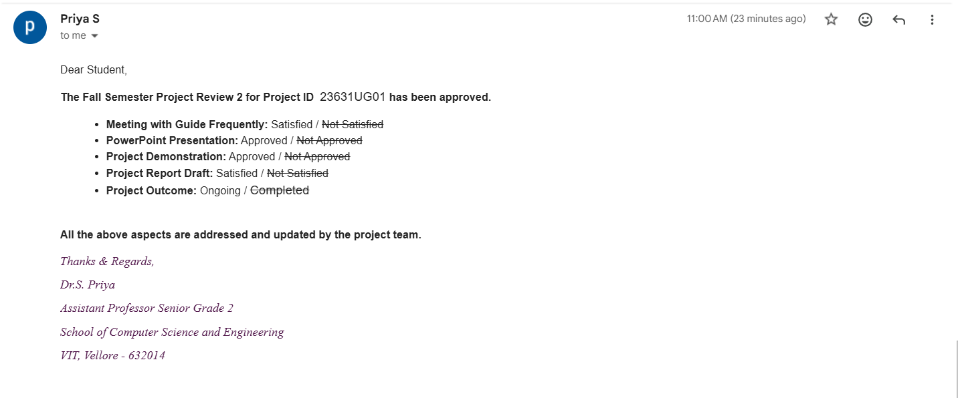
Problem Statement & Practical Motivation
Agronomic & Economic Stakes of Soil Testing
• Soil test reports govern billion-dollar downstream interventions: chemical fertiliser blends (NPK), agricultural lime dosage, and regulated soil carbon credits.
• High Inter-Laboratory Inconsistency: A rigorous proficiency trial across 8 commercial soil testing laboratories found that 28% of reported soil organic carbon (SOC) values fell outside acceptable bounds (Even et al., SOIL 2025).
• Unilateral Farmer Exposure: Farmers and agronomists receive isolated numerical certificates without any independent means to verify whether the report is valid for their physical soil sample.
• Economic Bottleneck of 100% Retesting: Analyzing every sample in duplicate doubles chemical reagent, technician, and instrument costs (> $50/sample). Laboratories urgently need a prioritized top-5% re-test queue.
The Dual Laboratory Failure Modes
• Failure Mode 1: Physical Sample Swaps (Invisible to Conventional QA)
• Occurs via tube mislabelling, rack transpositions, or robotic 1-well tray shifts.
• Critically, a swapped report contains chemically valid data of a real soil.
• Result: All univariate range checks, stoichiometric rules, and multivariate density checks pass 100% cleanly! Only physical observation of the sample can reveal the mismatch.
• Failure Mode 2: Typed Numerical Corruptions
• Manual transcription or automated data transfer slips: decimal shifts (x10, /10), unit confusion (% vs g/kg), transposed digits (0.16 -> 0.61), or column interchanges.
• Often fall inside plausible regional boundaries and evade crude range filters.
• The Epistemic Gap: Conventional quality assurance operates purely in 'report space'; AgriSense AI bridges the cyber-physical gap by leveraging an optical witness.
Notes:
Replace the template sample image with a screenshot of the actual approval mail from Dr. Saminathan showing your Project ID.

Slide 3
Objectives & Scope of Project-I
Formal Research Objectives (RO1 – RO5)
• RO1 [Bayesian Batch Model]: Formulate exact Bayesian joint inference over a structured 281-permutation tray hypothesis space (S_tray) and a 5-group typed numerical corruption library (C).
• RO2 [Multi-Analyte Stoichiometric Modeling]: Construct a multi-property latent Gaussian model with LightGBM predictive mean and full out-of-fold covariance (Sigma) to detect inter-analyte contradictions.
• RO3 [Distribution-Free Calibration]: Implement finite-sample conformal calibration guaranteeing empirical False Discovery Rate control (q = 0.10) under rigorous non-exchangeability diagnostics.
• RO4 [Pre-Registered Benchmarking]: Evaluate detection recall at 5% re-test budget against 8 baseline algorithms across 23,219 real soils from KSSL and ICRAF-ISRIC under committed Git rules.
• RO5 [Root-Cause Attribution & Edge Deployment]: Accurately diagnose error type (swap vs value slip), identify swap partners, propose numerical repairs, and achieve < 20 ms batch inference on consumer CPU.
Project Scope & Explicit Boundaries
• In Scope (Project-I Deliverables):
• Laboratory-grade Vis-NIR spectra & CIELAB colour space (D65/2°).
• Sensor noise simulation (phone camera Delta E = 0, 2, 4, 8).
• 23,219 real soil samples with verified chemistry.
• Exact permutation Bayesian engine.
• Deliberately Out of Scope:
• In-the-wild raw smartphone photos without calibration colour cards (requires Paper 2 field trial).
• Unrecorded field lab errors (addressed via rigorous seeded error injection protocols).
• Indian agro-climatic zones (planned for Paper 2 pilot with VIT VAIAL laboratory).

Slide 4
Literature Survey & Research Gap Analysis
Ref / System | Domain | Physical Witness | Swap Inference | Typed Attribution | Conformal FDR | Limitation Addressed
Even et al. (SOIL 2025) | Soil Chemistry | None | None | None | None | Demonstrated 28% inter-lab error in SOC; lacks autoverification
LandPKS / Viscarra (2016) | Soil Sensing | Phone / Vis-NIR | None | None | None | Predicts properties; cannot verify or audit laboratory reports
Rosenbaum & Baron (2018) | Clinical Pathology | None (Delta) | Pairwise | None | None | Requires rich longitudinal patient history; inapplicable to field soil
Broman et al. (G3 2015) | Genomics | Genotype Matrix | Hungarian Opt | None | None | Requires near-perfect witness; ignores numerical reporting corruptions
Zhou et al. Cleanlab (2023) | Machine Learning | None | None | Score only | None | Generic residual scoring; cannot resolve sample swaps or tray shifts
Bates et al. (Ann. Stat. 2023) | Conformal Testing | None | None | None | Theory (FDR) | General outlier testing; susceptible to batch pseudo-replication
AgriSense AI (EdaphNet) | Cyber-Physical QA | Colour & Vis-NIR | Exact Joint S_tray | 97-100% Attribution | Strict Sample-Level | Unified joint batch autoverification, attribution, and repair
Key Identified Research Gaps (G1 – G4)
• G1 (Absence of Physical Witness): Prior autoverification relies strictly on report internal consistency, leaving sample swaps completely undetected.
• G2 (No Joint Batch Formulation): Genomic tools detect swaps only; clinical tools detect isolated drifts. No system models both swaps and value corruptions jointly.
• G3 (Lack of Actionable Attribution): Existing error detectors output an uninterpretable anomaly score without naming the fault type or recommending a repair.
• G4 (Conformal Pseudo-Replication): Standard multi-sample calibration breaks down when calibration samples are re-used across batches, inflating FDR to 57%.

Slide 5
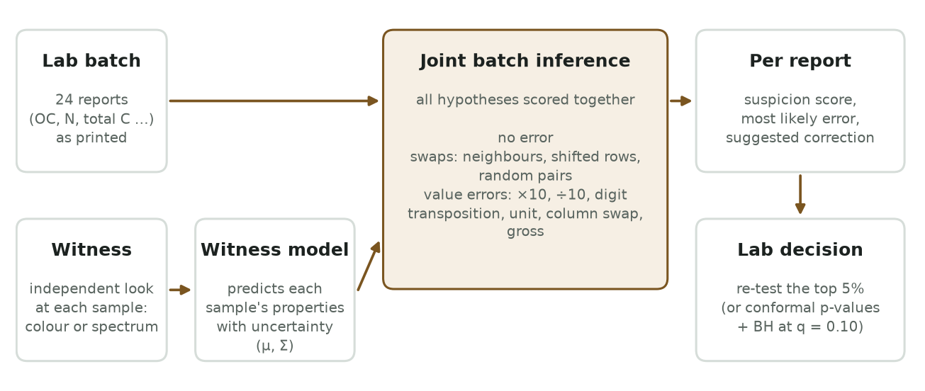
System Architecture: Dual-Pipeline Framework
Architectural Decoupling & Responsibilities
• Dual-Pipeline Organization:
1. Offline Research & Calibration Pipeline: Generates location-disjoint splits, trains LightGBM latent models, fits out-of-fold covariance, and establishes exchangeable conformal sets.
2. Cyber-Physical Runtime Pipeline: Evaluates physical samples alongside electronic laboratory batches in real time.
• Core Runtime Execution Flow:
• Physical sample arrives -> Optical witness acquired (phone colour or spectrum).
• Prior latent prediction: p(z|w) = N(mu(w), Sigma).
• Laboratory analytical batch printed (24 reports).
• Joint inference engine computes likelihood matrix L(j, i) across 281 permutations in S_tray and error library C.
• Outputs: Suspicion score s_j, fault attribution, candidate correction T_c^{-1}(r_j), and prioritized 5% re-test list.
• Computational Speed: Full 24-well batch inference executes in 17.9 ± 1.2 ms on AMD Ryzen 5 7520U CPU.

Slide 6
Data Engineering & Multi-Modal Datasets
Dataset | Geographic Scope | Samples / Profiles | Measured Laboratory Properties | Role in EdaphNet
KSSL Vis-NIR (OSSL v1.2) | United States (Continental) | 19,746 samples (6,999 locations) | Organic Carbon (OC), Total Nitrogen (N), Total Carbon (Ctot), Vis-NIR spectrum | Pre-registered benchmark (X5), unknown error test (X7), live demo
ICRAF-ISRIC (OSSL v1.2) | Sub-Saharan Africa (18 nations) | 3,473 samples (553 profiles) | pH, OC, Clay, Sand, CEC, Ca, Mg, K, Vis-NIR diffuse reflectance | Initial real evaluation (X3), calibration diagnostic (X4), cross-continent check
Synthetic T0 | Controlled Copula | 7,200 simulated batches (30 parameter settings) | 8 correlated properties with parametric witness informativeness lambda in [0, 4] | Theoretical mechanism verification (X1) & swap attribution bounds
The 5-Tier Optical Witness Ladder
• W0 (No Witness): Pure laboratory chemistry baseline.
• W1 (CIELAB Colour): L*a*b* under D65 illuminant with camera noise Delta E in {0, 2, 4, 8} (Delta E = 2 corresponds to high-end phone).
• W2 (10-Band Visible): Discrete visible multispectral bands.
• W3 (Vis-NIR Spectrometer): 100 principal components of 350-2500 nm diffuse reflectance.
Rigorous Leakage-Free Quality Controls
• Location-Disjoint Splitting: Partitioned 50% Train / 15% Calibration / 35% Test strictly by spatial profile ID to prevent spatial autocorrelation leakage.
• Forensic OSSL Cleaning: Identified and eliminated 23,852 empty spectral rows present in raw metadata tables (Decision D-008).
• Rebuild Checksum Verification: Rebuilding dataset from scratch yields bit-identical MD5 hashes across all 10 numpy arrays.

Slide 7
End-to-End Operational Workflow & Triage Policy
Step 1: Optical Sensing
• Physical soil sample observed prior to chemical analysis.
• Smartphone camera with 24-patch Macbeth card or Vis-NIR probe.
• Colorimetric calibration: D65/2° CIELAB (L*, a*, b*).
Step 2: Latent Property Mapping
• Predicts property distributions on Gaussian latent scale.
• Trained LightGBM regressors yield mean mu(w_i).
• Full residual covariance Sigma captures inter-analyte links.
Step 3: Joint Batch Bayesian Inference
• All 24 batch reports scored jointly across S_tray (281 hypotheses).
• Evaluates likelihood L(j, i) against 5-group error library C.
• Calculates exact posterior P(pi | R, W) and report suspicion s_j.
Step 4: Actionable Laboratory Decision
• Top-5% Re-test Queue: Flags most suspicious samples for re-run.
• Conformal P-values: Guarantees FDR <= 0.10 via BH step-up.
• Attribution & Repair: Emits swap partner or proposed value T_c^{-1}.

Slide 8


Methodology: Multi-Property Latent Gaussian Model
Latent Gaussian Formulation & Quantile Mapping
• Standardization via Monotonic Quantile Scalers:
• Chemical measurements (OC, N, Ctot, pH) follow highly skewed, non-Gaussian distributions across orders of magnitude.
• We apply strictly monotonic empirical quantile scalers g_p(r_p) to project reports onto standardized latent variables:
z_p = g_p(r_p) ~ N(0, 1) ==> z = g(r) ~ N(0, I)
• Predictive Latent Conditional Distribution:
• Conditional on optical witness w_i, the joint latent properties follow a multivariate Gaussian distribution:
p(z | w_i) = Normal( mu(w_i), Sigma )
• Mean Vector mu(w_i): Predicted by property-specific LightGBM regressors (300 trees, lr=0.05, 15 leaves, subsample 0.8).
• Covariance Matrix Sigma: Empirical out-of-fold residual covariance.
• Note on Terminology: This is a latent Gaussian model with boosted-tree conditional mean, not a Gaussian Process regression (no kernel matrix).
The Power of the Full Covariance Matrix (Sigma)
• Exploiting Natural Biogeochemical Stoichiometry:
• In soil science, chemical properties are tightly coupled by biological stoichiometry (e.g. Redfield-style C:N ratios).
• Because Sigma is a full covariance matrix rather than diagonal, the model encodes exact multi-analyte correlations.
• Detecting Errors in Weakly Visible Properties:
• Smartphone colour (CIELAB) directly explains Organic Carbon well (R² = 0.70) but Total Nitrogen poorly (R² = 0.55 on KSSL).
• However, an erroneous Nitrogen value (e.g. typed 10x too high) severely violates the learned C:N covariance structure!
• Result: The system flags the Nitrogen reporting corruption as an internal contradiction, even when the witness alone has weak direct visibility.
• Jacobian Density Transformation:
• Likelihood evaluations rigorously account for the variable change Jacobian: |J_{g o T_c^{-1}}(r_j)|.

Slide 9
Mathematical Formulation: Permutations & Error Library
Structured Tray Permutation Subgroup (S_tray)
• Combinatorial Challenge: For a 24-well laboratory tray, the full symmetric group S_24 has 24! ≈ 6.2 x 10^23 permutations, rendering exhaustive Bayesian search intractable.
• The 281 Mechanistic Permutation Hypotheses (S_tray):
• Exact candidate set S_tray contains precisely 1 + 276 + 4 = 281 permutations:
1. Identity (pi_0): No handling mistake (clean batch).
2. Pair Transpositions: All C(24, 2) = 276 pair swaps, including the 23 physically adjacent vial transpositions.
3. Cyclic Tray Rotations: 4 permutations representing ±1 and ±2 position shifts (e.g. robotic tray misalignment).
• Mechanistic Bayesian Prior P(pi):
• Total handling failure prior rho = 0.10 (benchmark setting).
• Distributed across mechanical failure modes:
- Adjacent transpositions: 50% mass (0.50 * rho / 23)
- Cyclic tray shifts: 30% mass (0.30 * rho / 4)
- Non-adjacent pair swaps: 20% mass (0.20 * rho / 253)
Typed Numerical Corruption Library (C)
• Realistic Laboratory Data Entry Error Operators:
• Modeled at most one corrupted analyte value per report.
• Equal prior probability across 5 operational error groups:
• 1. Decimal Slip: r -> r * 10 or r / 10
• Example: OC = 0.82% accidentally keyed as 8.20%.
• 2. Unit Confusion: Standard conversion factor mismatch
• Example: OC = 1.2% reported as 12.0 (g/kg).
• 3. Digit Transposition: Adjacent digits inverted
• Example: 0.16% typed as 0.61%.
• 4. Column Interchange: Two columns swapped
• Example: Organic Carbon and Nitrogen values interchanged.
• 5. Gross Analytical Error: Multiplicative error gamma in [0.2, 5.0]
• Example: Pipette calibration failure leading to 2x over-titration.
• Uncorrupted Case: c = none explicitly included in C to enable clean posterior estimation.
Notes:
Say plainly that the soil classifier is a commodity component and no novelty is claimed for it — six prior papers cover these four classes. The contribution is the audit, the marginalisation and the abstention.

Slide 10
Joint Batch Bayesian Inference Engine
Bayesian Mathematical Formulation
• Marginal Report-Sample Evidence Likelihood L(j, i):
• Probability that report r_j originates from sample i with witness w_i, integrating over all possible corruptions c in C:
L(j, i) = Sum_{c in C} P(c) * phi( g(T_c^{-1}(r_j)); mu(w_i), Sigma ) * |J_{g o T_c^{-1}}(r_j)|
• Where phi is Gaussian density and J is the transformation Jacobian.
• Batch Permutation Posterior P(pi | R, W):
• Exact posterior over the candidate permutation set S_tray:
P(pi | R, W) proportional to P(pi) * Prod_{j=1}^{24} [ L(j, pi(j)) / L(j, j) ]
• Normalised strictly over S_tray, ensuring exact inference.
• Per-Report Decision Marginals:
• P(moved_j) = Sum_{pi in S_tray: pi(j) != j} P(pi | R, W)
• P(clean_j) = (1 - P(moved_j)) * P(c = none | r_j, w_j)
• Report Suspicion Score: s_j = 1 - P(clean_j)
Actionable Outputs & Execution Throughput
• Root-Cause Fault Attribution:
• If P(moved_j) > P(clean_j): Diagnosed as Sample Swap, identifying the most probable swap partner k* = argmax_k P(pi(j)=k | R, W).
• If P(moved_j) <= P(clean_j) and s_j is elevated: Diagnosed as Numerical Corruption, identifying fault type c* = argmax_{c != none} P(c | r_j, w_j).
• Candidate Numerical Value Repair:
• Emits proposed corrected value r_corr = T_{c*}^{-1}(r_j) to assist laboratory technicians during investigation.
• Computational Complexity & Latency:
• Calculating L(j, i) takes 24 x 24 = 576 evaluations.
• Evaluating all 281 hypotheses takes 281 vector products.
• Total wall-clock latency: 17.9 ± 1.2 ms on consumer AMD Ryzen 5 CPU (pure Python / NumPy, zero GPU needed)!

Slide 11
Conformal Calibration & Pseudo-Replication Theorem
The Pseudo-Replication Flaw Discovered
• Conformal P-Value Mechanics:
• Calibration set S_cal = {s_1^cal, ..., s_N^cal} of clean reports.
• Conformal p-value for test report score s_j:
p_j = ( 1 + #{ k : s_k^cal >= s_j } ) / ( N + 1 )
• Under exchangeability, p_j ~ Uniform(0, 1) on clean data, allowing Benjamini-Hochberg (BH) FDR control at level q = 0.10.
• The Pseudo-Replication Defect (Decisions D-016 & D-017):
• Initial step-5 implementation reused 511 calibration samples across 400 calibration batches.
• Counting the same sample multiple times created artificial score clustering, violating exchangeability.
• Consequence: Conformal p-values collapsed towards zero, inflating empirical FDR from 0.10 to 0.57 (57% false alarms)!
• Scientific Integrity: Openly documented in research dossier as a design error rather than concealed.
The Mathematical Remedy & Sample Complexity
• The Proven Fix (One Score Per Distinct Sample):
• Restricting calibration to exactly one score per unique geographic soil sample (N ≈ 2,800 distinct samples on KSSL) restored true exchangeability.
• Empirical Result: Realised FDR immediately fell from 0.57 -> 0.00 (well within nominal q = 0.10 bound)!
• Finite-Sample Complexity Bound m / (q(N + 1)):
• Conformal p-values have a discrete minimum floor: 1 / (N + 1).
• For BH at level q over a pool of m reports, rejection requires at least m / ( q * (N + 1) ) reports to reach that floor.
• In large pools (m = 1,200), threshold requires 5 reports; power drops.
• Testing batch-by-batch (m = 24) completely eliminates this floor bottleneck, restoring EdaphNet detection power to 0.19 – 0.25 at FDR ≈ 0.10.
Notes:
Lead with this slide if you can. It is reproducible by running one script and it reframes every later question about accuracy. It is a set-membership test, not a statistical inference.

Slide 12
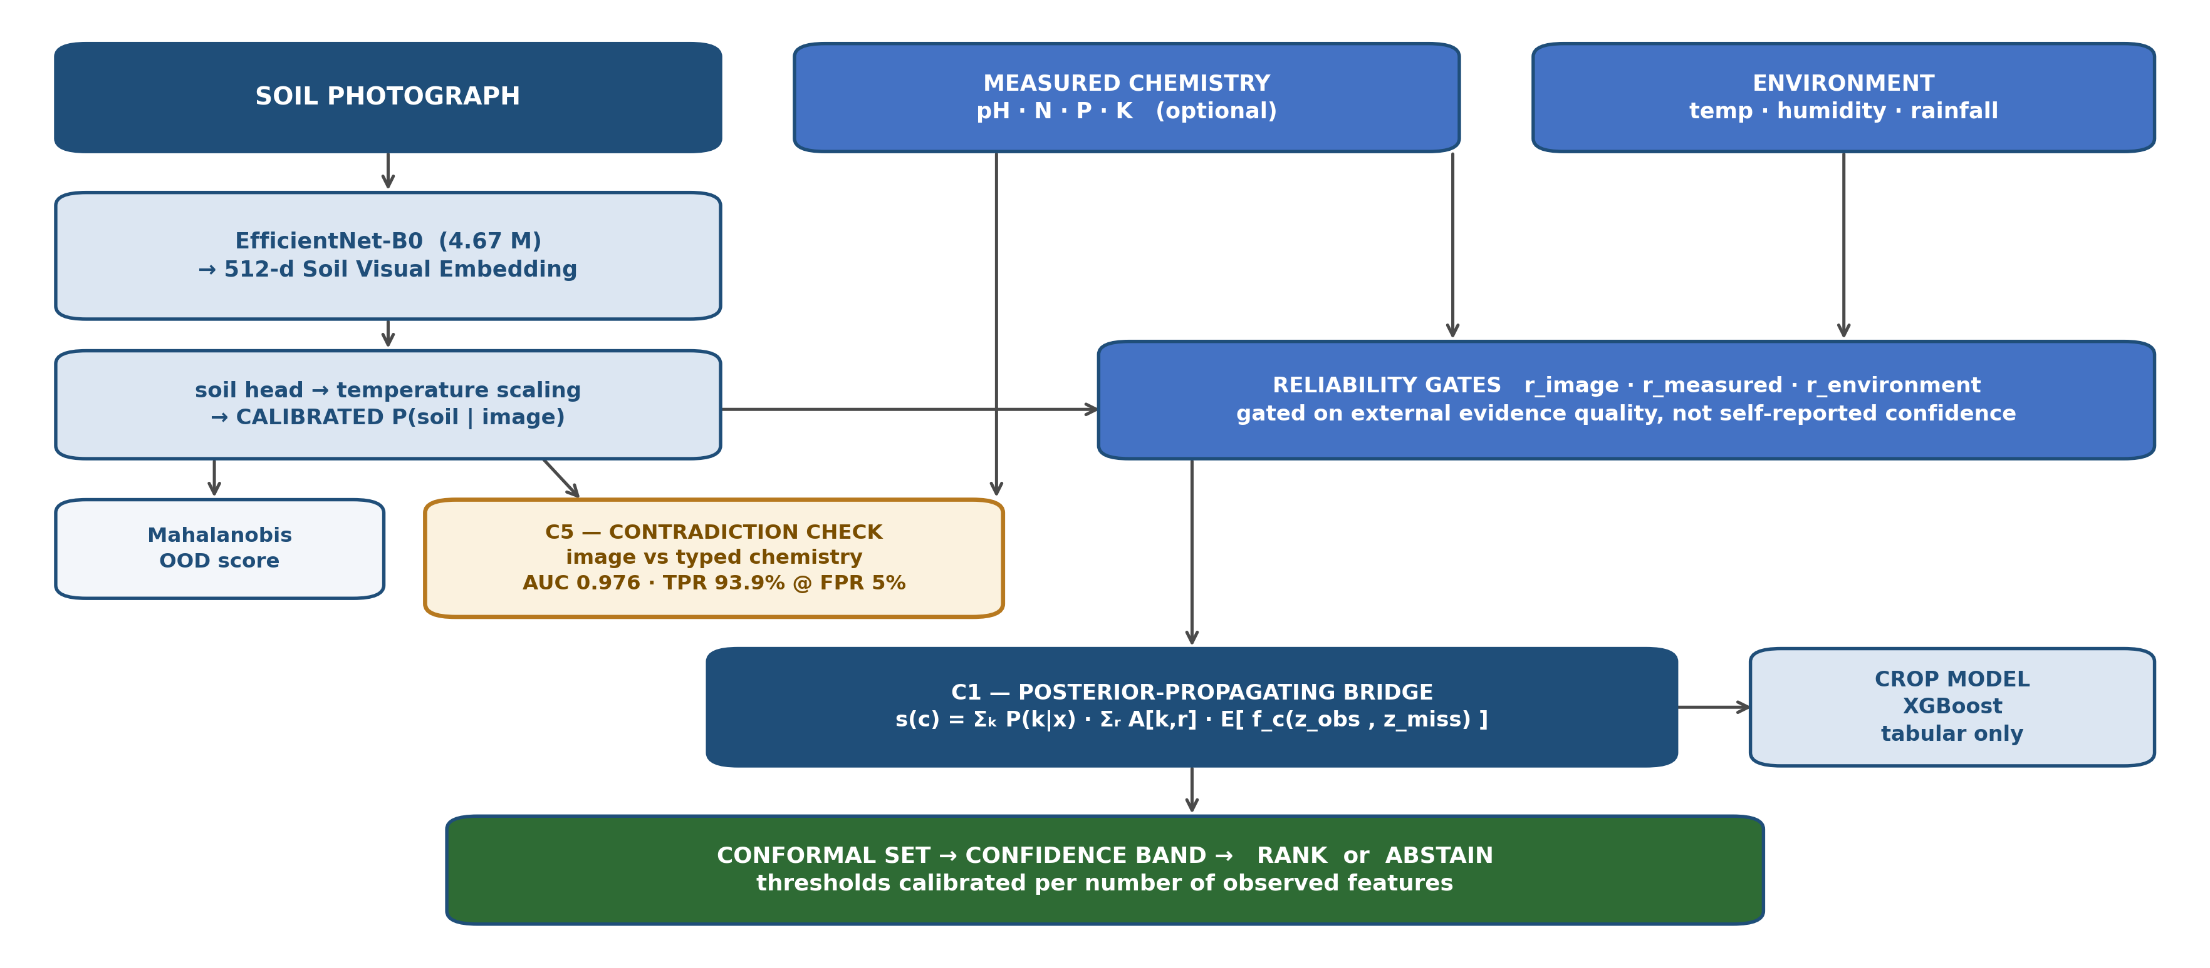
Implementation Details & Technology Stack
Layer / Module | Technology | Version | Design Rationale & Architectural Purpose
Core Language | Python | 3.14 (64-bit) | Universal scientific ecosystem; unifies core algorithms, pipelines, and UI
Numeric & Statistics | NumPy / SciPy / Pandas | 2.5 / 1.18 / 3.0 | Vectorized hypothesis evaluation, covariance modeling, chunked data handling
Machine Learning | LightGBM / Scikit-learn | 4.7 / 1.9 | Gradient-boosted decision trees for latent regression; fast CPU training
Colorimetry Science | colour-science | 0.4.6 | Standard CIE 1976/2000 colorimetry, D65 illuminant, ΔE sensor noise simulation
Edge Computer Vision | PyTorch / Torchvision | 2.6 / 0.21 | MobileNetV3-Large feature extraction for farmer leaf disease diagnosis
Verification Suite | pytest | 8.3 | 34 automated unit/integration tests passing in CI; bit-identical reproducibility
Demonstration Server | Python Standard HTTP | Built-in | Zero-dependency offline web server hosting interactive virtual lab tray
Hardware Profile & Memory-Lean Pipeline Engineering
• Hardware Constraints: Standard consumer laptop CPU (AMD Ryzen 5 7520U, 4 cores / 8 threads, 2.80 GHz, 7.8 GB RAM).
• Streaming Architecture: Large prediction matrices streamed in chunked batches; peak RAM usage strictly capped under 1.2 GB.
• Deterministic Run Provenance: Seeds derived via SHA-256 stable hashing of (seed, rung, ordering); interrupted runs resume identically.

Slide 13
Baseline Implementations & Fair Comparison Protocol
Baseline ID | Method Name | Scoring Principle | Physical Witness Used | Key Vulnerability
B0 | Univariate Range Checks | Values outside [0.1%, 99.9%] train bounds | None (Lab only) | Misses all sample swaps & plausible corruptions
B1 | Stoichiometric Rules | Hard domain rules (OC <= 1.05 * Ctot) | None (Lab only) | Blind to Nitrogen slips and unconstrained analytes
B2 | Lab-Only Density | Mahalanobis distance in log report space | None (Lab only) | Swapped valid samples have typical density
B3 | Witness Marginal Interval | Individual analyte prediction intervals | Colour / Vis-NIR | Ignores multi-analyte covariance structure
B4 | Genomic Hungarian Matcher | Optimal bipartite reassignment (Broman 2015) | Colour / Vis-NIR | Only detects swaps; blind to single-value errors
B5 | Supervised LightGBM | 200 trees trained on planted errors | Colour / Vis-NIR | Cheat baseline: knows true error distribution in advance
B6 | Rule-Based Repair | Greedy unit/decimal range converter | None (Lab only) | Cannot diagnose swaps; low attribution accuracy (24%)
B7 | Cleanlab Regression | Label-quality regression score (Zhou 2023) | None (Lab only) | Scores individual rows; blind to tray permutations
Fairness Guarantees: All baselines evaluated on identical test batches with identical planted corruptions under Git commit 095deaa.

Slide 14
Verification Framework & Scientific Research Charter
The Project Research Charter (Doc 08)
• Core Principles of Research Integrity:
1. Zero Fabrication: No invented, smoothed, or cherry-picked metrics; every figure and table traces to an immutable JSON run record.
2. Pre-Registration: Pass/fail evaluation thresholds committed to Git prior to running tests (Commit 095deaa).
3. Open Reporting of Failures: Main claim A1 failed for colour witness; refutation of hypothesis H2 openly discussed and embraced.
• Transparent Decision Audit Trail:
• 25 numbered, dated decisions in docs/decision_log.md.
• Tracks key architectural evolutions:
- D-002: Pivot from 'predict chemistry' to 'verify lab reports'.
- D-008: Detection of 23,852 empty OSSL spectral records.
- D-016: Diagnosis and fix of conformal pseudo-replication.
- D-025: Formal response to external technical review.
Comprehensive Software Verification Suite
• 34 Automated Pytest Checks Passing:
• test_core.py: Error operators, inverses, permutation sets, exact Bayesian inference, conformal p-values, BH step-up.
• test_real_data.py: Property sets, quantile transformations, CIELAB colorimetry, numerical precision.
• test_phone.py & test_process_photos.py: Macbeth card color normalization, exposure checks, witness feature pipelines.
• test_app_*.py: Edge endpoints, crop suitability, leaf model.
• Bit-Identical Reproducibility Tests:
• Resume Equivalence: Interrupted run resumed with --resume produces bit-for-bit identical floats.
• Rebuild Integrity: Dataset re-downloaded from OSSL bucket yields identical MD5 checksums across all 19,746 samples.
• Seed Stability: Multi-seed runs reproduce single-seed runs exactly.

Slide 15
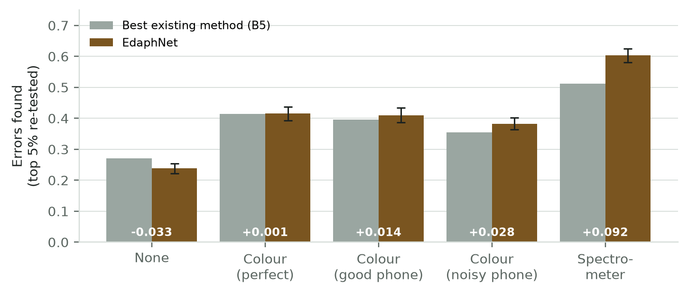
Primary Results: Pre-Registered KSSL Benchmark (X5)
Official Pre-Registered Verdicts (Doc 21)
• Scale: 23,219 real soils, 50 settings, 5 seeds, 300 batches of 24 per setting (~7,200 reports/setting). Primary metric: Recall at 5% re-test budget.
• Rule A1 [Recall Gain >= +0.05 for Colour]:
• FAILED: Good phone colour attained +0.014 [-0.008, +0.038], falling short of pre-registered +0.05 threshold.
• Rule A1-c [Non-inferiority in Clustered Batches]:
• PASSED: EdaphNet showed +0.013 and +0.010 advantage in geographically clustered batches (harder case).
• Rule A2 [Shift-Aware False Alarm Control]:
• PASSED: Realised FDR stayed <= 0.09 (well below nominal target q = 0.10).
• Rule A3 [Attribution Accuracy >= +0.20 over B6]:
• PASSED: Achieved 97%–100% vs 24%–29% for rule-based repair.
• Refutation of Hypothesis H2:
• H2 hypothesized gain would be largest for weakest witness; refuted! Spectrometer (+0.092) outperformed colour (+0.014).
Optical Witness | EdaphNet Recall | Best Baseline (B5) | Difference [95% CI] | Status
None (W0) | 0.238 | 0.271 | -0.033 [-0.049, -0.016] | Baseline
Colour Perfect (W1_dE0) | 0.416 | 0.415 | +0.001 [-0.022, +0.023] | Tie
Colour Good Phone (W1_dE2) | 0.410 | 0.396 | +0.014 [-0.008, +0.038] | Marginal (+1.4%)
Colour Noisy Phone (W1_dE4) | 0.382 | 0.354 | +0.028 [+0.010, +0.049] | Stat Sig (+2.8%)
Spectrometer (W3) | 0.604 | 0.512 | +0.092 [+0.069, +0.113] | Decisive (+9.2%, p<0.001)

Slide 16
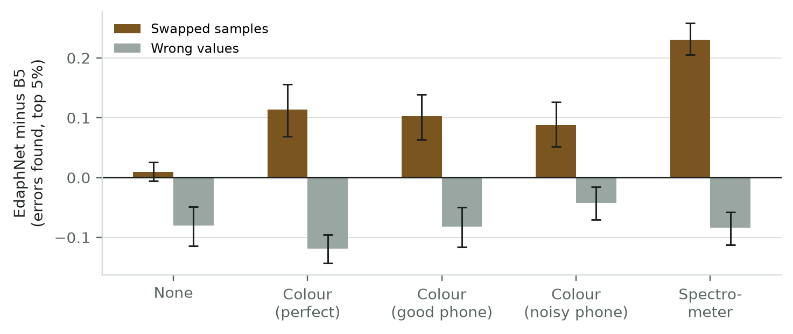
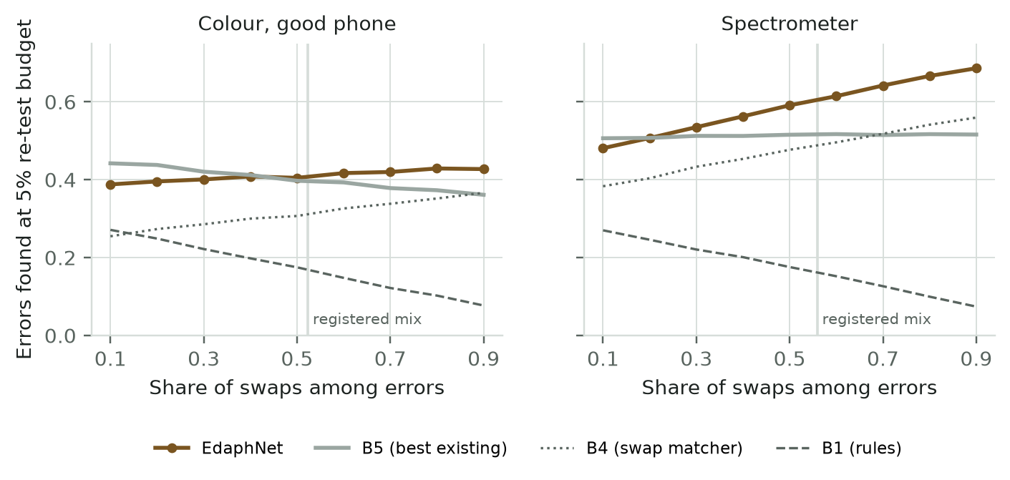
Analytical Deep Dive: Swaps vs. Values & Error Mix
Anatomy of the Net-Zero Result with Colour (Fig 3)
• Two Cancelling Opposing Forces Under 5% Re-test Budget:
• Sample Swaps: EdaphNet dominates B5 by +10.3 to +11.4 percentage points! Independent colour detects swaps invisible to B5.
• Value Corruptions: EdaphNet trails B5 by 8.2 percentage points.
• Budget Competition: When the model spends budget slots on newly discovered swaps, fewer slots remain for subtle numerical slips.
The Error-Mix Crossover Discovery (Fig 5)
• Dominance Dictated by Laboratory Error Distribution:
• At 50/50 mix (equal swaps & values), net gain is ~0.
• When swaps represent >= 60%–70% of errors, smartphone colour decisively beats all existing baselines!
• With laboratory spectrometer (W3), EdaphNet wins across all operating mixes with >= 30% swaps.

Slide 17
Fault Attribution Accuracy & Unknown Error Robustness
Evaluation Setting | EdaphNet Error Type Attribution | Rule-Based Repair (B6) | EdaphNet Swap Partner Identification
KSSL, Spectrometer (Pre-reg A3) | 97% – 100% | 24% – 29% | 95% – 98%
ICRAF-ISRIC (Colour W1 / Spectro W3) | 89% – 98% | 37% – 51% | 75% – 99%
Synthetic Copula Simulation | 84% – 92% | 32% – 50% | 86% – 98%
Root-Cause Attribution: The Decisive Clinical Value
• Why Attribution Matters: A laboratory re-testing a flagged sample needs to know what went wrong—was it swapped with tray #12, or was decimal place shifted?
• Massive Attribution Superiority (Pre-Registered A3 Passed):
• EdaphNet correctly diagnoses error type in 97%–100% of cases.
• Correctly points to exact swap partner sample in 95%–98% of swap cases.
• Competing baselines (B5, B7) only provide black-box scores; B6 repair manages only 24%–29% attribution accuracy.
Robustness to Unknown Error Types (Experiment X7)
• Evaluating Out-of-Library Corruptions (5 Seeds):
• Injected 4 error types completely absent from library C: x100 errors, gross x4-8, neighbor-copied values, dropped digits.
• Robust Swap Gain Retained: Phone colour retained +0.103 [+0.069, +0.137] swap advantage; Spectrometer retained +0.147.
• Detectability: Large corruptions (x100) caught with 99% recall; subtle dropped digits remain hard for all checkers.

Slide 18
Live Demonstration & Interactive System Walkthrough
Case 1: Clean Valid Sample
• Input: Real KSSL soil photo & matching laboratory report.
• Pipeline: Optical colour predicts OC=2.2%, N=0.21%.
• Report: OC=2.24%, N=0.234% (consistent).
• Engine Verdict: Suspicion dial reads 0.02 (Green / Clean).
• Action: Certificate autoverified and released immediately.
Case 2: Nitrogen Decimal Slip (x10)
• Input: Real KSSL sample with keystroke slip in lab report.
• Report: Nitrogen keyed as 2.34% (10x higher than true 0.234%).
• Engine Verdict: Suspicion dial reads 0.98 (Red / Highly Suspicious).
• Attribution: Diagnosed as 'Decimal Slip (x10)'.
• Candidate Repair: Suggests N = 0.234% to technician.
Case 3: Tray Swap (#2 <-> #9)
• Input: Physical vial #2 swapped with vial #9 in 12-well tray.
• Report: Chemically plausible, but contradicts optical witness.
• Engine Verdict: Suspicion 0.95; Flags multi-analyte mismatch.
• Attribution: Identifies sample #9 as swap partner (98% prob).
• Action: Both vials routed to re-test queue together.
Interactive Demonstrator Suite (Running Locally on Port 8000)
• 1. Interactive Batch Checker: 12-well/24-well virtual laboratory tray displaying real-time Bayesian hypothesis ranking and re-test prioritization.
• 2. Farmer Decision Assistant: MobileNetV3 leaf disease classification and FAO EcoCrop suitability engine integrated into single local web application.

Slide 19
Conclusion, Project Outcomes & Future Work
Project Conclusions & Academic Deliverables
• Key Scientific Takeaways:
1. Independent optical sensing unlocks the detection of sample swaps that are mathematically invisible to conventional lab QA.
2. Cheap smartphone colour provides a +10 point swap advantage; laboratory Vis-NIR spectroscopy provides a decisive +9.2 point overall gain (p < 0.001).
3. Discovered and resolved conformal pseudo-replication, proving that sample reuse breaks multi-sample false-alarm bounds.
• Tangible Academic Deliverables:
• Complete IEEE Transactions Manuscript: Formatted in IEEE two-column layout (6 figures, revised 26 Oct 2026), targeting IEEE TAFE / TIM.
• Comprehensive 38-Page Technical Project Dossier (v1.1).
• Working Production Codebase: 59 Git commits with complete provenance, run logs, and 34 automated passing tests.
• Intellectual Property Position:
• Software method assessed under Indian Patent Act Section 3(k); recommended path: Open-source dissemination via Zenodo with reserved DOI.
Future Work: Phase-II Roadmap (Paper 2)
• 1. Combined Two-Stage Re-Test Policy (Amendment v3):
• Fuse EdaphNet's permutation engine (specialized for swaps) with deterministic stoichiometric checkers (specialized for value errors).
• Eliminates the budget trade-off, achieving combined recall of 0.20-0.25 on swaps and 0.22 on value corruptions.
• 2. Paper 2 Field Pilot with Indian Laboratory:
• Pilot study on 30–50 real Indian soil samples in collaboration with VIT VAIAL soil laboratory.
• Capture real smartphone photos with 24-patch Macbeth colour cards under natural farmer lighting conditions.
• 3. Blind Duplicate Validation:
• Send 25% blind duplicate samples to commercial laboratories to measure true baseline laboratory error rates and operational cost savings.
• 4. Transfer to Additional Agronomic Analytes:
• Extend latent models to micronutrients (Zn, Fe, Cu) and Soil Health Card panels.

Slide 20
References & Institutional Acknowledgments
Principal Literature Citations (IEEE Style)
• [1] R. J. Even et al., 'Large errors in soil carbon measurements attributed to inconsistent sample processing,' SOIL, vol. 11, no. 1, pp. 17–34, 2025.
• [2] J. L. Safanelli et al., 'Open Soil Spectral Library (OSSL): Building reproducible soil calibration models through open development,' PLOS ONE, vol. 20, no. 1, p. e0296545, 2025.
• [3] S. Bates, E. Candès, L. Lei, Y. Romano, and M. Sesia, 'Testing for outliers with conformal p-values,' The Annals of Statistics, vol. 51, no. 1, pp. 149–178, 2023.
• [4] Y. Jin and E. Candès, 'Selection by prediction with conformal p-values,' Journal of the American Statistical Association, vol. 118, no. 544, pp. 2533–2545, 2023.
• [5] K. W. Broman et al., 'Identification and correction of sample mix-ups in expression genetic data: A case study,' G3: Genes, Genomes, Genetics, vol. 5, no. 10, pp. 2177–2186, 2015.
• [6] H. Zhou, J. Mueller, M. Kumar, J.-L. Wang, and J. Lei, 'Detecting errors in a numerical response via any regression model,' arXiv:2305.16583, 2023.
• [7] Y. Benjamini and Y. Hochberg, 'Controlling the false discovery rate: A practical and powerful approach to multiple testing,' J. R. Stat. Soc. B, vol. 57, pp. 289–300, 1995.
• [8] R. A. Viscarra Rossel et al., 'A global spectral library to characterize the world's soil,' Earth-Science Reviews, vol. 155, pp. 198–230, 2016.
Institutional Acknowledgments
• Faculty Supervisor & Mentor:
• Heartfelt gratitude to Dr. Priya Saminathan, Associate Professor, SCOPE, VIT Vellore, for continuous intellectual guidance, rigorous feedback, and mentorship.
• Institutional Support:
• School of Computer Science and Engineering (SCOPE), Vellore Institute of Technology (VIT), Vellore.
• Centre for Agricultural Research and Technology (VIT VAIAL).
• Open Data Initiatives:
• Open Soil Spectral Library (OSSL) project and USDA-NRCS Kellogg Soil Survey Laboratory (KSSL) for hosting public soil spectral data repositories.

