Slide 1
Cardiovascular Health Overview
Dashboard Report
Gaining Insights for Stake Holders

Slide 2
Introduction
This report provides an in-depth analysis of cardiovascular health trends using interactive Power BI dashboards.
It aims to identify key risk factors such as cholesterol, triglycerides, hypertension, and lifestyle habits.
Data is segmented by age, gender, and health conditions to uncover patterns and high-risk groups.
The analysis supports healthcare professionals in making data-driven decisions to improve patient outcomes.
It highlights the importance of preventive measures and lifestyle interventions in reducing cardiovascular risks.

Slide 3
Objectives 1 :
How many male and female cardiac patients are recorded in the dataset?
Which age category has the highest total patients?
How does the average total cholesterol differ between males and females across different age categories?
What is the sum of triglycerides across different age categories?
How does hypertension affect the number of male and female patients?
What percentage of heart attacks is linked to smoking?
How does alcohol consumption correlate with the number of total patients?
How many patients are classified as smokers vs. non-smokers?
What is the distribution of patients based on their physical activity levels?
How does physical activity correlate with heart attack occurrences?

Slide 4
Objectives 2:
How does bad cholesterol distribution vary across different age categories?
What is the percentage of heart attacks linked to alcohol for different age categories?
What is the percentage of hypertension cases among different age groups?
Which age group has the highest heart attack percentage due to alcohol consumption?

Slide 5
Key Performance Indicators (KPIs)
Average Total Cholesterol: 201.09
Sum of LDL_HDL Ratio: 2.82K
Male Cardiac Patients: 72
Female Cardiac Patients: 32
(Include a Power BI dashboard screenshot)

Slide 6
Cholesterol & Patient Demographics
"Average Total Cholesterol by Age Category and Gender"
"Total Patients by Age Category"
Breakdown of cholesterol levels among seniors, adults, and teens
(Include relevant bar charts and Power BI visuals)

Slide 7
Triglycerides & Hypertension Analysis
"Sum of Triglycerides by Age Category"
"Total Patients by Hypertension and Sex"
Visualization of how triglyceride levels and hypertension affect different age groups
(Include pie charts and bar charts from Power BI dashboard)

Slide 8
Lifestyle & Risk Factors Dashboard
Overview of lifestyle influences on cardiovascular health
Key indicators:
Diabetes cases: 90
Heart Attack % by Smoking: 47%
Heart Attack % by Alcohol: 34%
Hypertension % by Age Category: 52%

Slide 9
Smoking, Alcohol, & Physical Activity Impact
"Total Patients by Smoking Status"
"Total Patients by Alcohol Consumption"
"Total Patients by Physical Activity Level"
Breakdown of how smoking, alcohol, and physical activity correlate with cardiac health

Slide 10
Age-Based Health Risk Analysis
"Heart Attack % by Alcohol"
"Heart Attack % by Smoking"
"Bad Cholesterol by Age Category"
Age group risk comparison and impact on cardiovascular health
(Include Power BI visualizations)

Slide 11
Key Findings & Recommendations
Key insights from the analysis:
High cholesterol levels in seniors and adults
Smoking and alcohol significantly impact heart attack risk
Hypertension is prevalent among all age groups
Recommendations:
Targeted health interventions for high-risk groups
Promoting awareness of lifestyle risk factors
Encouraging physical activity and balanced diets

Slide 12
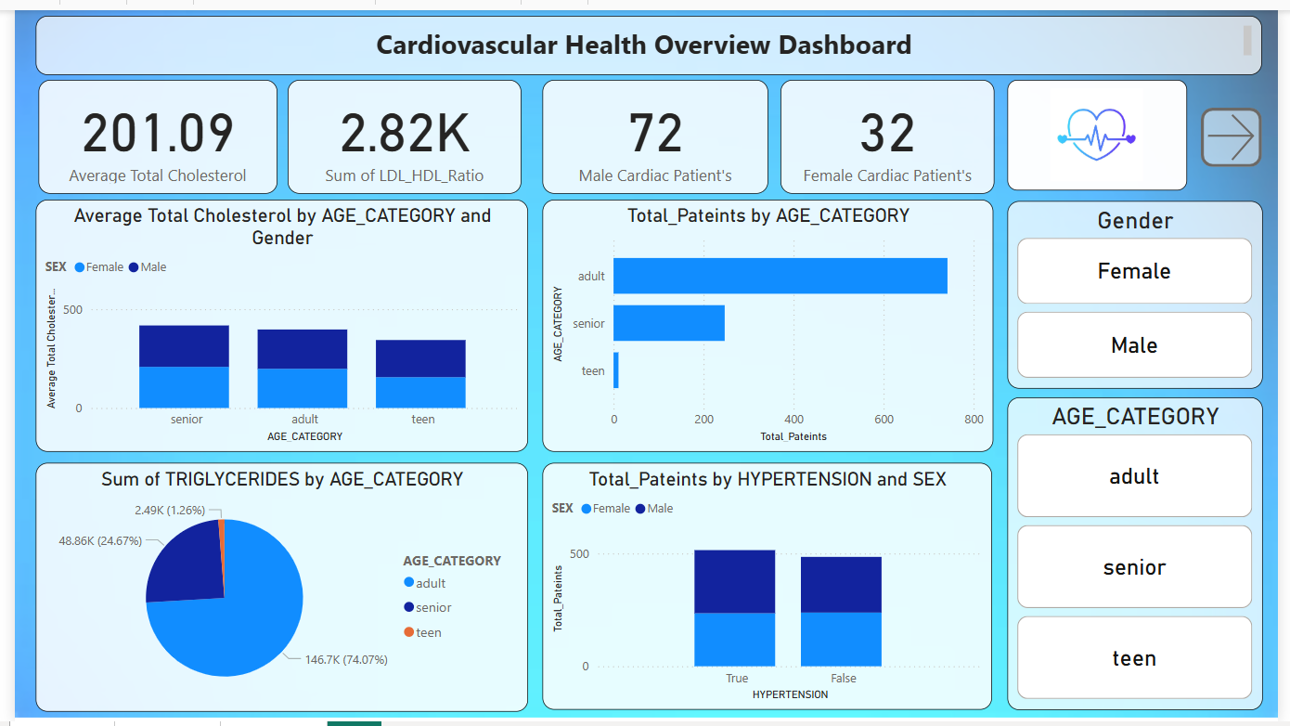
1. Cardiovascular Health Overview Dashboard

Slide 13
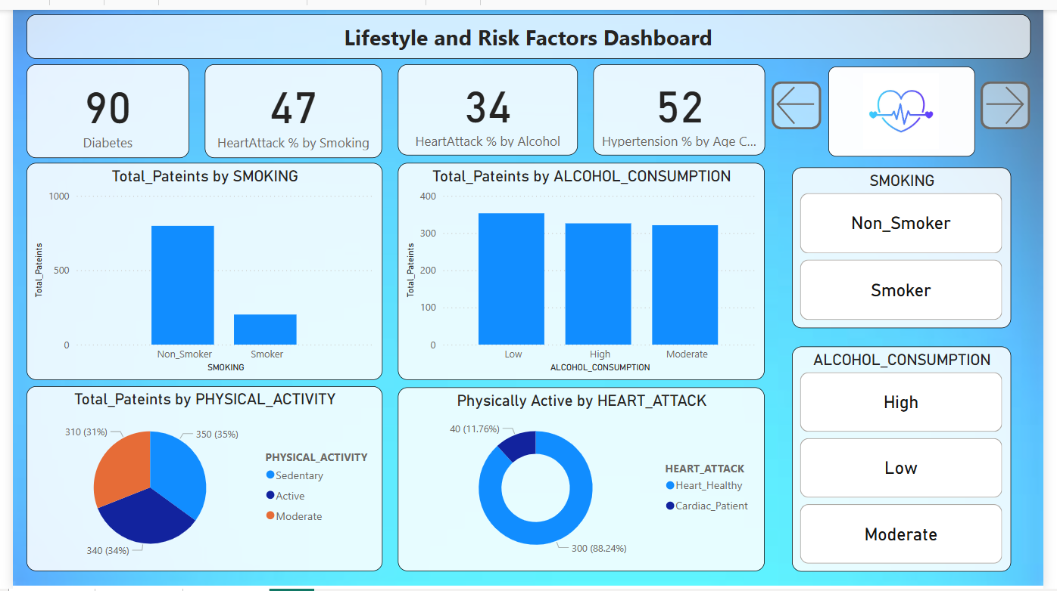
2. Lifestyle & Risk Factors Dashboard

Slide 14
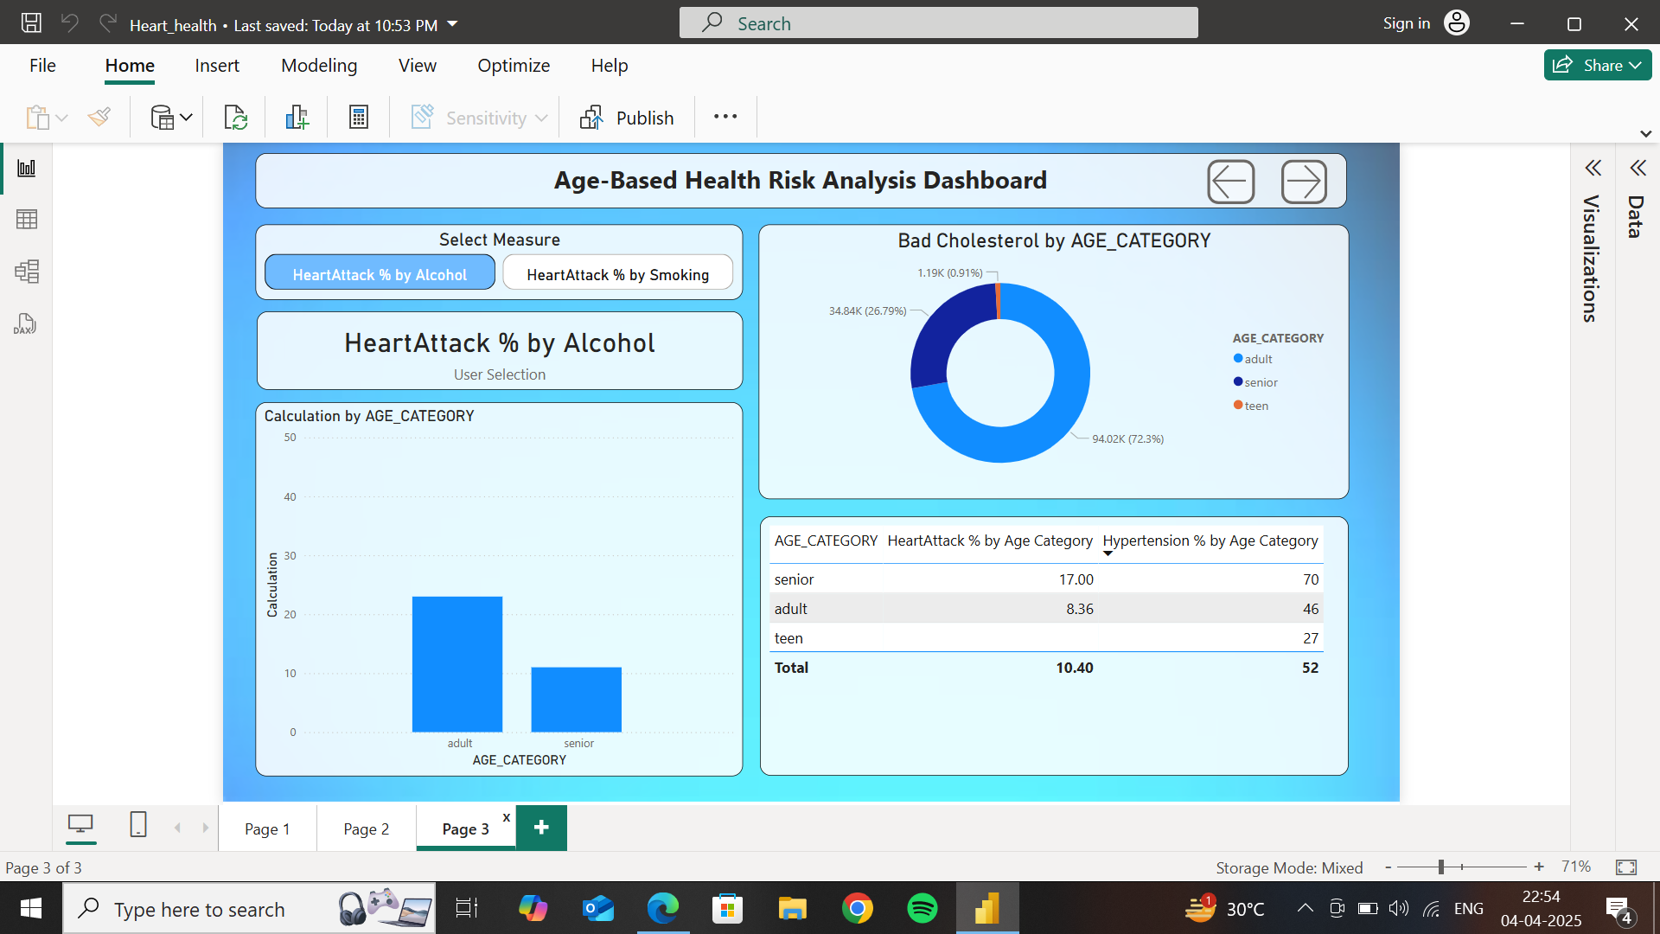
3. Age-Based Health Risk Analysis

Slide 15
Conclusion & Next Steps
Summary of insights
Future improvements in data analysis
Encouraging proactive health monitoring
Q&A session

Slide 16
Tools and Technologies Used
Snowflake for fetching data dynamically and processing real time.
SQL for storing , organizing and cleaning data.
Power Bi for Transformation, data modeling and data visualization.

