Slide 1
Sales & Profit Analysis
Dashboard Report
Gaining Insights for Stake Holders

Slide 2
Introduction
Sales performance by product: This helps us understand which products are driving the most revenue and how their current performance compares to the previous year.
Monthly sales trends: This visualization reveals our sales patterns throughout the year, highlighting peak seasons and potential areas for improvement.
Geographic sales distribution: The dashboard illustrates how our sales are distributed across different cities, allowing us to identify key markets and potential for expansion.
Sales performance by channel: We can analyze the profitability and sales volume generated through different sales channels, enabling us to optimize our channel strategy.
Customer-specific sales: This provides insights into our top-performing customers and their contribution to our overall revenue.

Slide 3
Objectives 1 :
Which product has the highest total sales in the current year?
Which product shows the largest difference in sales compared to the previous year?
Are there any products with lower sales in the current year compared to the previous year?
How do the sales trends compare across different months?
Are there any noticeable seasonal patterns in the sales data?
Which city contributes the largest share to the total sales?
What percentage of total sales comes from the top two cities?
How is the sales distribution across different cities?
Which sales channel had the highest profit in the previous year?

Slide 4
Objectives 2:
Which customer generated the highest total sales?
Which customers show a significant increase or decrease in sales compared to the previous year?
How is the sales performance distributed across different customers?

Slide 5
Key Performance Indicators (KPIs)
Revenue Generation: Total Sales
Profitability: Sum of Profit, Profit Margin
Sales Volume: Total Product Sold
Performance Trends: Comparisons to the previous year (by product, month, customer)
Distribution: Sales by City
Channel Effectiveness: Profit and Sales by Sales Channel
Customer Contribution: Sales by Customer

Slide 6
Key Findings & Recommendations
Strong Overall Sales: The initial dashboard shows a total sales of 2.59M, indicating a significant sales volume.
Healthy Profitability: A profit margin of 29.90% suggests a reasonably healthy profitability for the business.
Significant Profit: The sum of profit at 0.77M aligns with the total sales and profit margin.
Substantial Product Volume: 5.09K total products sold reflects a considerable level of sales activity.
Long-Term Total Sales Trend : The "Calculation by Year and Month" chart on Page 3 shows a historical trend of total sales.
There appears to be a general upward trend in total sales from 2022 into early 2024.
There are noticeable seasonal dips and peaks within each year.
The forecast (shaded green area) suggests a continued upward trend into late 2025 and early 2026, with similar seasonal patterns.

Slide 7
Recommendations
Capitalize on High-Performing Products.
Optimize for Peak Sales Months.
Focus on Key Geographic Markets.
Refine Channel Strategies.
Monitor and Analyze Long-Term Trends.

Slide 8
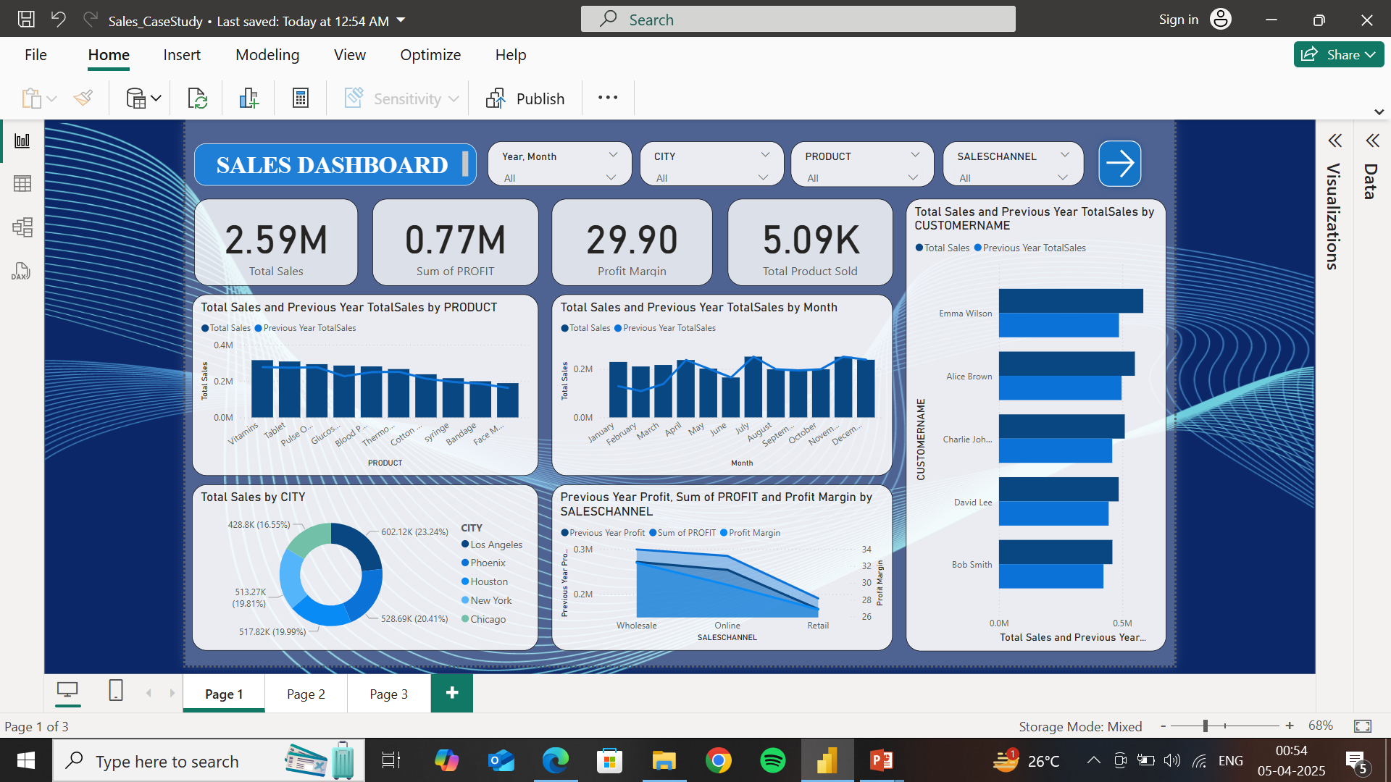
1. Sales Dashboard

Slide 9
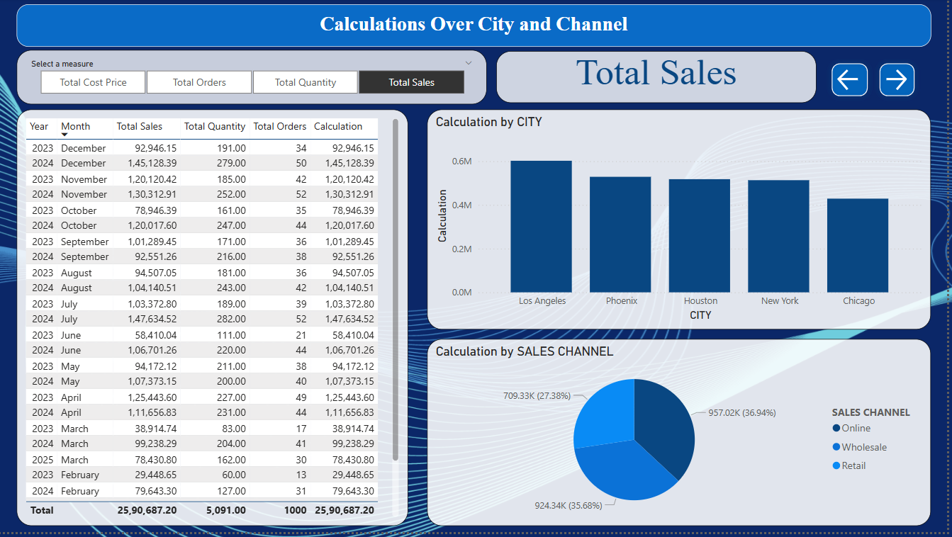
2. Calculations Over City and Channel dashboard

Slide 10
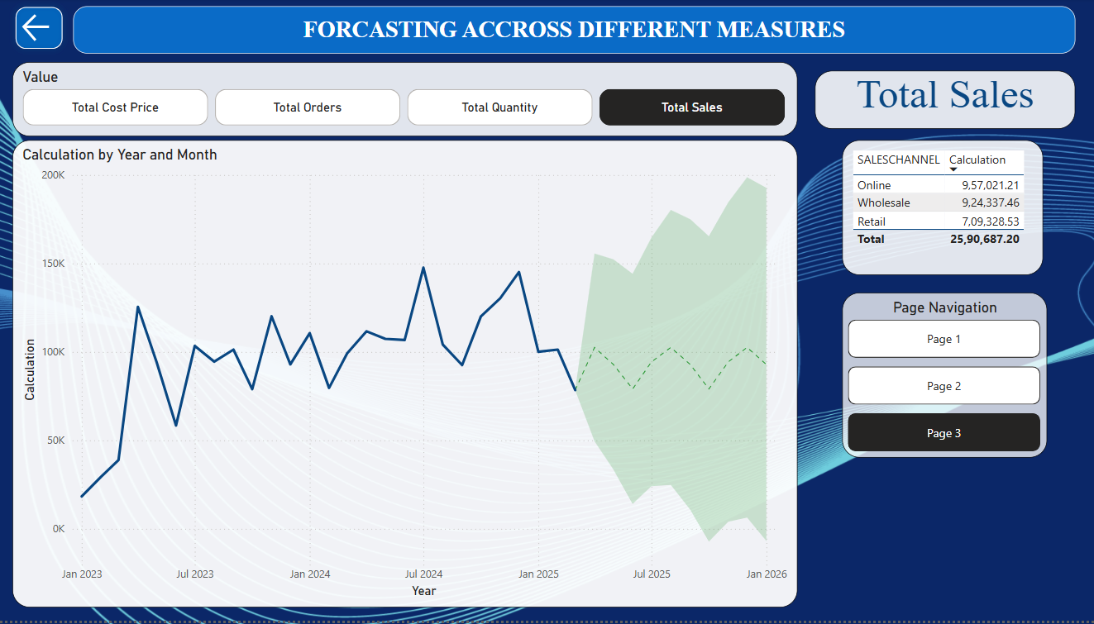
3. FORCASTING ACCROSS DIFFERENT MEASURES

Slide 11
Conclusion & Next Steps
Summary of insights
Future improvements in data analysis
Encouraging proactive health monitoring
Q&A session

Slide 12
Tools and Technologies Used
Snowflake for fetching data dynamically and processing real time.
SQL for storing , organizing and cleaning data.
Power Bi for Transformation, data modeling and data visualization.

