Slide 1
Learning Big Tables
Mentor:- Praseeda
Start Date:- 04/08/18

Slide 2
Learning Vector
Learner vector consists of following dimensions :-
Progress :- It has two parts skyline and status. Skyline contains all the highest competencies of every unit which is completed by the user in a subject. While status maintain record of badge, start time, end time, current_status etc for all the competencies.
Proficiency :-The proficiency score of a learner is the expected value of the badge that the learner is likely to obtain, if the learner takes an arbitrary signature assessment at an arbitrary competency node (after completing its corresponding learning activity). The expected value is calculated by computing the average percentile score across all badges earned by the learner, compared to others who have completed the corresponding signature assessment.
Authority & Citizenship :- Authority and citizenship are considered duals of one another and are defined as follows: A good authority is one who is recognized by a good citizen, and a good citizen is one who recognizes good authorities.

Slide 3
Getting familiar with Gooru server space.
Got access to all the needed remote servers.
Added in the Gooru organization on Github.
Gained familiarity with Nucleus and datascope databases.

Slide 4
Understanding Previous work.
Read the research paper “Designing a Social Machine for Mediated Learning Environments”.
Talked with the senior who was previously working on the same project who explained me the algorithms he implemented and all the previous work he did.
Gave a talk on Gooru projects which was based on my understanding of the same.

Slide 5
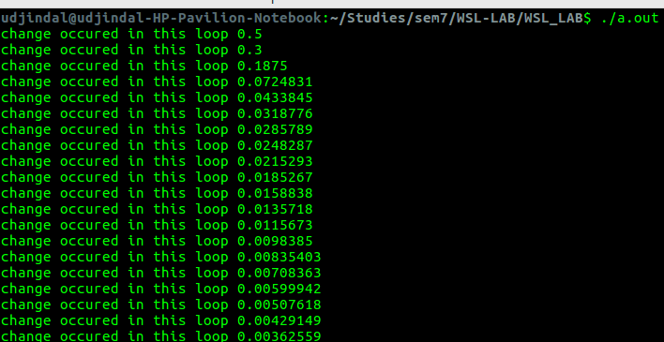
Working on pseudo algorithm for authority and citizenship.
Proposed few changes in the pseudo algorithm and confirmed them with the professor in the talk on Gooru project.
Implemented a sample code based on the finalized algorithm for the proof of concept. Used manually created test data.
Sample code:- https://github.com/udjindal/WSL_LAB/blob/master/wsl.cpp

Slide 6
Implementing Algorithm for citizenship and Authority.
Implemented code based on finalized algorithm for the real data.
Put placeholders for the data which is not available.
Code:- https://github.com/udjindal/WSL_LAB/blob/master/wsl.py
Output:- https://github.com/udjindal/WSL_LAB/blob/master/auth_citi_score.csv

Slide 7
Changing Authority and Citizenship.
As decided in the last meeting with Gooru team, authority and citizenship scores is needed to be calculated on grade and domain level which was previously on subject level. The implemented algorithm is currently calculating on subject level.
For calculating authority and citizenship score on grade and domain level proficiency score will also be needed on grade and domain level which is also currently on subject level.

Slide 8
Understanding previous code for proficiency.
Understood the flow of previous code.
Proposed few possible approaches to find proficiency on grade domain level.
Finalized an approach and discussed it with the mentor.

Slide 9
Modifying Proficiency code.
Started implementing the modifications.
Trying to figure out an efficient way to find all competencies in each grade domain and the competencies for user has given some assessment.
As there is no space on server so facing difficulty in running the test code.
Facing difficulty in modifying the previously written functions with new requirements.
Code :- https://github.com/udjindal/WSL_LAB/blob/master/proficiency.java

Slide 10
Future Work
Will modify Authority and citizenship for grade domain level which will use the new calculated proficiencies.

