Slide 1

SEMINAR PRESENTATION ON Creating a Chatbot for the Department of CSE
Presented By:
Udit Joshi
B.TECH (CSE) – 2nd year
(Roll No. 2219841)
DEPARTMENT OF COMPUTER SCIENCE AND ENGINEERING
GRAPHIC ERA HILL UNIVERSITY, DEHRADUN

Slide 2
Contents:
Objective
Tech Stack
Libraries Used
Defined Dataset
Essential Code Snippets
Sample Test Cases
Conclusion

Slide 3
Objective…
The objective of this project is to assist users with various queries they may have regarding the department of CSE. It handles everything from courses offered to admission procedure to infrastructural facilities, also hovering around the scholarship provisions, curriculum related queries, research opportunities related doubts etc. thrown from the user side.
This project also makes it seamless to switch between the erp portal of the university, the department website and the university website.
It also aims to make user experience improved largely by providing quick and informative responses.

Slide 4



Tech Stack…
FRONT-END:
HTML and CSS have been used for basic structure creation and styling of the webpage
BACK-END:
Python programming language has been used as a backend support due to its highly versatile libraries.

Slide 5



Libraries/ Modules Used…
flask
fuzzywuzzy
spacy

Slide 6
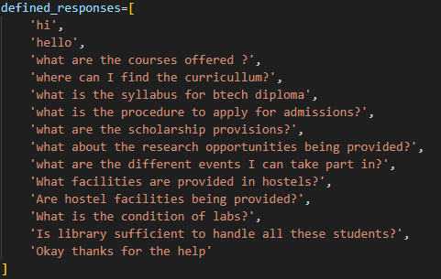
Defined Dataset…
The dataset for the chatbot is in the form of a python list that contains all the relevant questions that a user may ask. Snippet for the same has been attached below:

Slide 7
Essential Code Snippets…
A process manager that returns a list comprising of a match and the score representing the percentage match…
This is done using “process” instance of the fuzzywuzzy module.

Slide 8

Taking input from user…
This is accomplished by creating a form in HTML sheet and then carrying the input to the python file.
(Form creation in HTML)
(Taking the user input in python file)

Slide 9
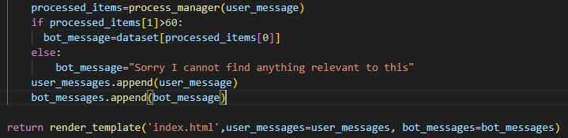
Processing of the user input and rendering the template…
We can simply compare the score returned by the process manager as per the parameter we set to work accordingly

Slide 10
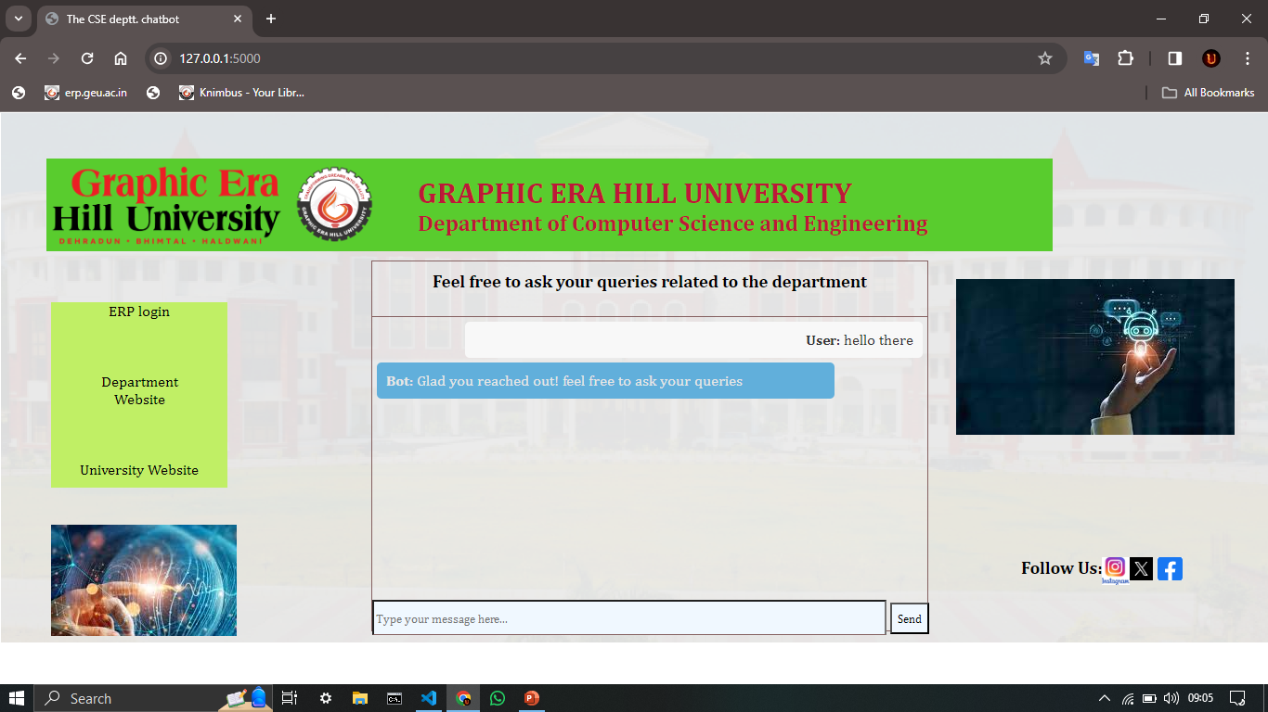
Sample Test Cases…

Slide 11
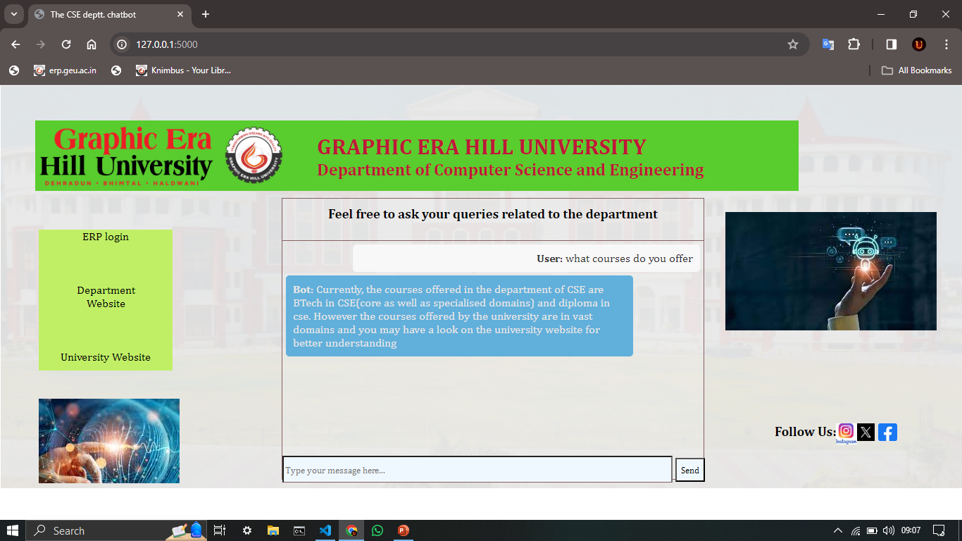

Slide 12


Slide 13


Slide 14


Slide 15
Conclusion…
The chatbot development for the department of CSE has been done taking into consideration various queries of the students related to the department. It aims to make the information gathering process easier and fun to do task. The interactive nature and appealing user interface of this chatbot will surely attract lot of attentions from the audience being targeted.

