Slide 1
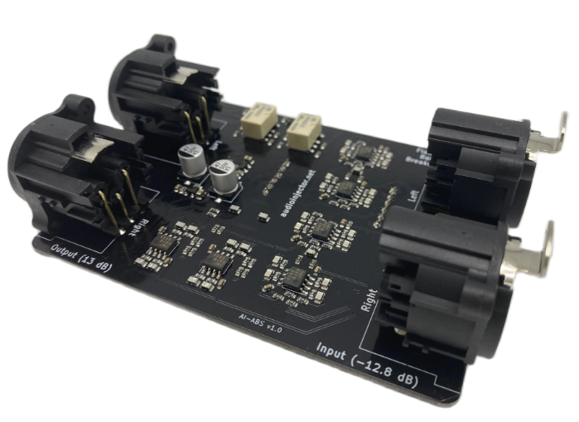

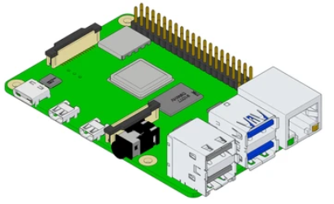
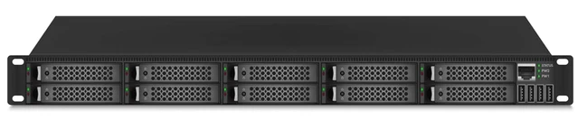
Audio Encoder
Audio Decoder
Audio Source (Radio Studio)
Audio Out (To Tx.)
SRT Relay Server
HW : Raspberry Pi + Audio Injector
HW : Raspberry Pi + Audio Injector
SW : ffmpeg with srt support
SW : ffplay / vlc

