Slide 1
How Agile Development Practices apply to DevOps

Slide 2
Revisiting the Agile Manifesto
We are uncovering better ways of developing software by doing it and helping others do it. Through this work we have come to value:
Individuals and interactions over processes and tools
Working software over comprehensive documentation
Customer collaboration over contract negotiation
Responding to change over following a plan
That is, while there is value in the items on the right, we value the items on the left more.

Slide 3
Principles behind the Agile Manifesto
We follow these principles:
Our highest priority is to satisfy the customer through early and continuous delivery of valuable software.
Welcome changing requirements, even late in development. Agile processes harness change for the customer's competitive advantage.
Deliver working software frequently, from a couple of weeks to a couple of months, with a preference to the shorter timescale.
Business people and developers must work together daily throughout the project.
Build projects around motivated individuals.
Give them the environment and support they need,
and trust them to get the job done.
The most efficient and effective method of
conveying information to and within a development
team is face-to-face conversation.
Working software is the primary measure of progress.
Agile processes promote sustainable development.
The sponsors, developers, and users should be able
to maintain a constant pace indefinitely.
Continuous attention to technical excellence
and good design enhances agility.
Simplicity--the art of maximizing the amount
of work not done--is essential.
The best architectures, requirements, and designs
emerge from self-organizing teams.
At regular intervals, the team reflects on how
to become more effective, then tunes and adjusts
its behavior accordingly.

Slide 4
Principles behind the Agile Manifesto
We follow these principles:
Our highest priority is to satisfy the customer through early and continuous delivery of valuable software.
Welcome changing requirements, even late in development. Agile processes harness change for the customer's competitive advantage.
Deliver working software frequently, from a couple of weeks to a couple of months, with a preference to the shorter timescale.
Business people and developers must work together daily throughout the project.
Build projects around motivated individuals.
Give them the environment and support they need,
and trust them to get the job done.
The most efficient and effective method of
conveying information to and within a development
team is face-to-face conversation.
Working software is the primary measure of progress.
Agile processes promote sustainable development.
The sponsors, developers, and users should be able
to maintain a constant pace indefinitely.
Continuous attention to technical excellence
and good design enhances agility.
Simplicity--the art of maximizing the amount
of work not done--is essential.
The best architectures, requirements, and designs
emerge from self-organizing teams.
At regular intervals, the team reflects on how
to become more effective, then tunes and adjusts
its behavior accordingly.

Slide 5
Principles behind the Agile Manifesto
Our highest priority is to satisfy the customer through early and continuous delivery of valuable software.
Deliver working software frequently, from a couple of weeks to a couple of months, with a preference to the shorter timescale.
Business people and developers must work together daily throughout the project.
Working software is the primary
measure of progress.

Slide 6
Agile Operations
Source Control
Small, frequent releases
Automated testing
Continuous Integration
Continuous Deployment
Peer Review
Immutable Infrastructure
Notes:
Phoenix Project – Gene Kim
<number>

Slide 7
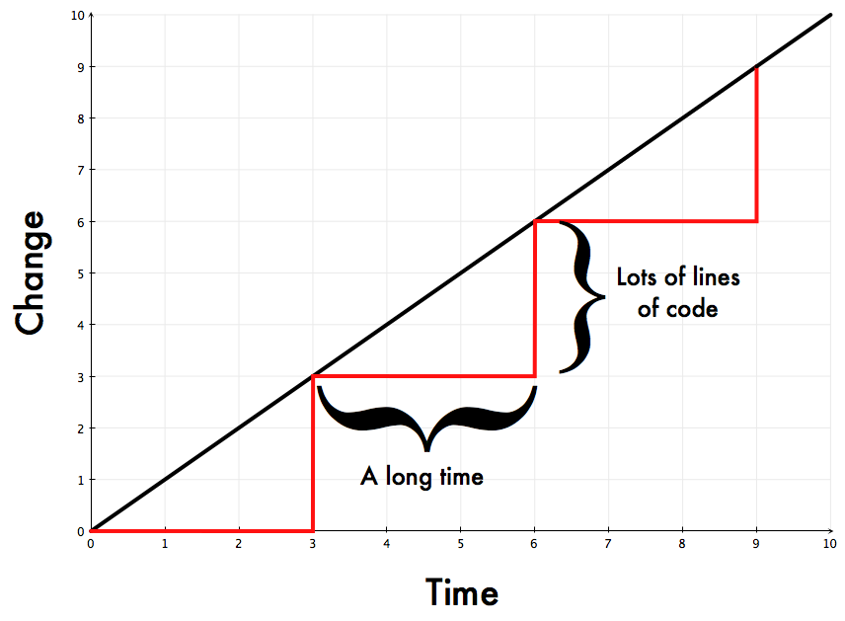
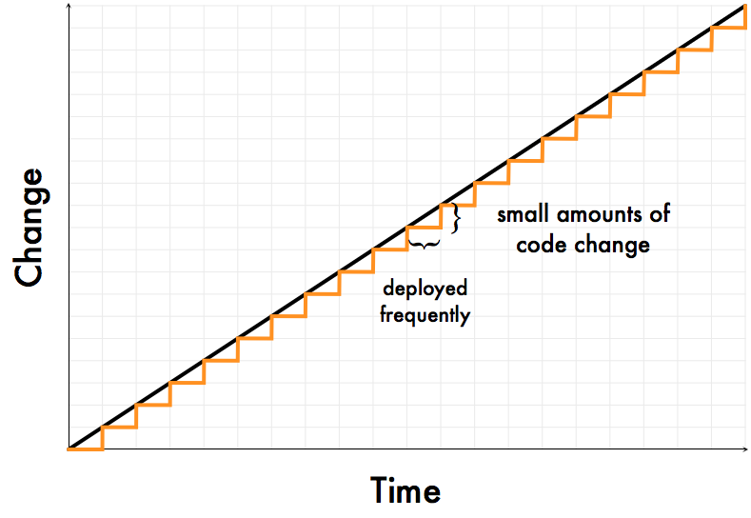


Benefits of Small Releases
Lower risk
Faster feedback
More Confidence
John Allspaw’s visualization of slow and fast delivery cycles
Notes:
<number>

