Slide 1
CSE440: Natural Language Processing II
Farig Sadeque
Assistant Professor
Department of Computer Science and Engineering
BRAC University

Slide 2
Lecture 8: Parsing

Slide 3
Outline
Constituency parsing (SLP 17)
Cocke-Kasami-Younger algorithm (SLP 17)
Probabilistic parsing (Lecture)
Dependency parsing (SLP 18)

Slide 4
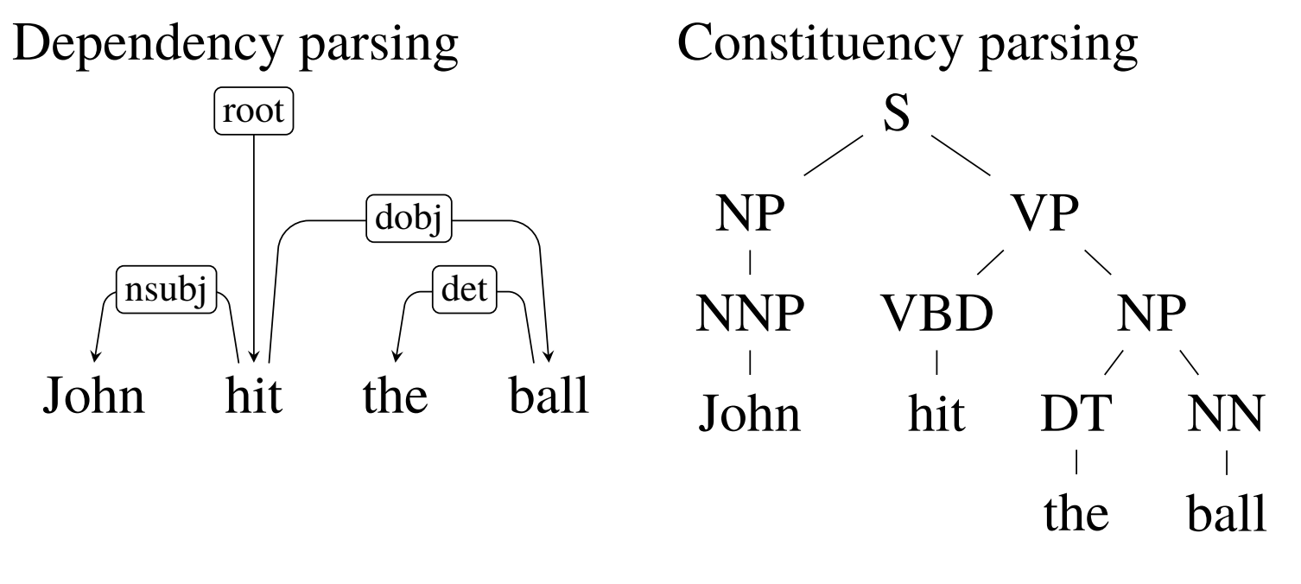
Structured prediction
A structured prediction problem cannot easily be decomposed into simple text or word classification.

Slide 5
Constituency parsing
What is a constituent?
A constituent is a group of words behaving as a single unit.
I’m flying from Tucson to Minneapolis [next week].
I’m flying [next week] from Tucson to Minneapolis.
[Next week] I’m flying from Tucson to Minneapolis.
*[Next] I’m flying [week] from Tucson to Minneapolis.
*I’m flying [next] from Tucson to Minneapolis [week].

Slide 6
Constituency parsing
Gives us a parse tree with indicates which constituents should connect to which one to create a meaningful sentence
To understand how constituency parsing works, we first need to understand Context free grammar

Slide 7
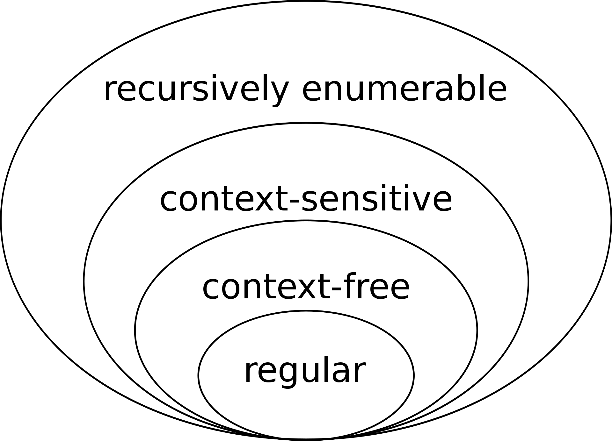
Chomsky hierarchy of languages

Slide 8
Context free grammar
Also known as phrase-structure grammar
They can describe sentence structure of natural language easily
Was formalized by Noam Chomsky in 1956, but idea of this grammar dates back to early 1900s

Slide 9
Context free grammar
A context-free grammar consists of:
N, a set of non-terminal symbols
Σ, a set of terminal symbols (disjoint from N)
R, a set of productions of the form A → β, where
A is a non-terminal,
β is a string of symbols from (Σ ∪ N)∗
S, a designated start symbol from N

Slide 10
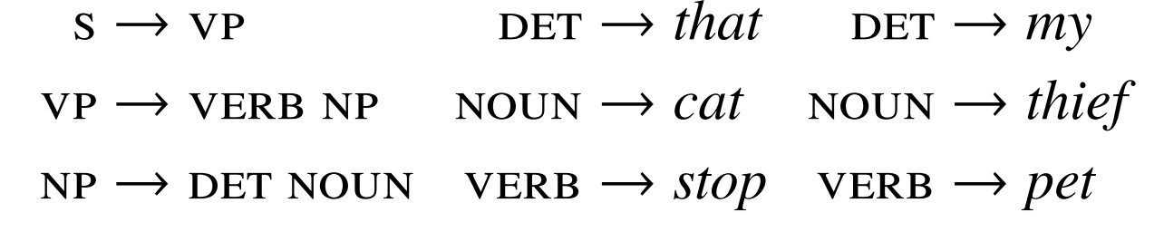
Examples for production rules
In natural language processing, our units are words, and all words are terminals. Terms that are written in lowercase are terminals, whereas terms written in uppercase are non-terminals.

Slide 11
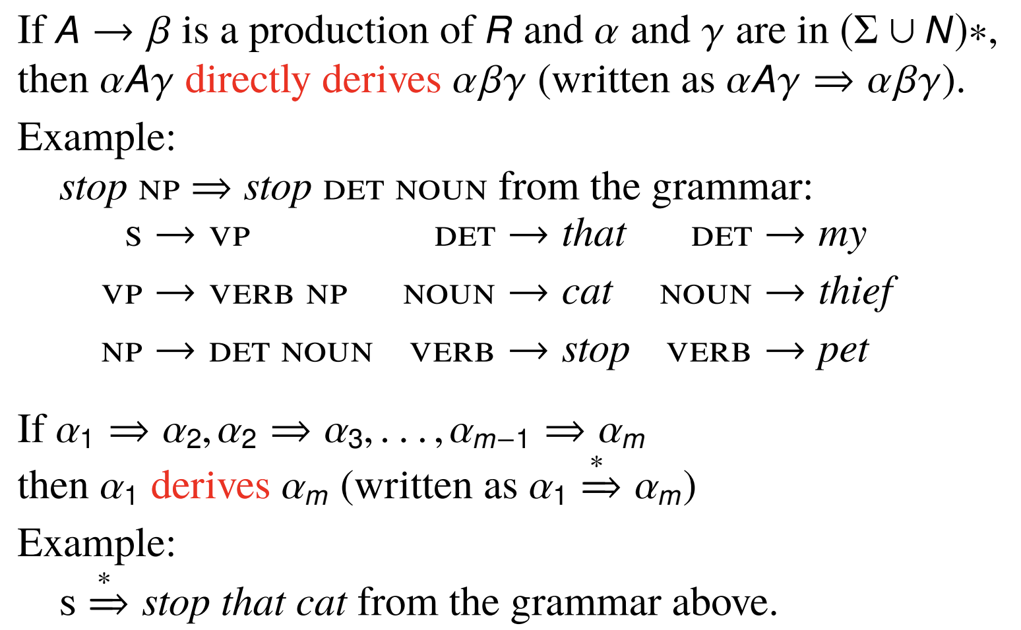
Derivation

Slide 12
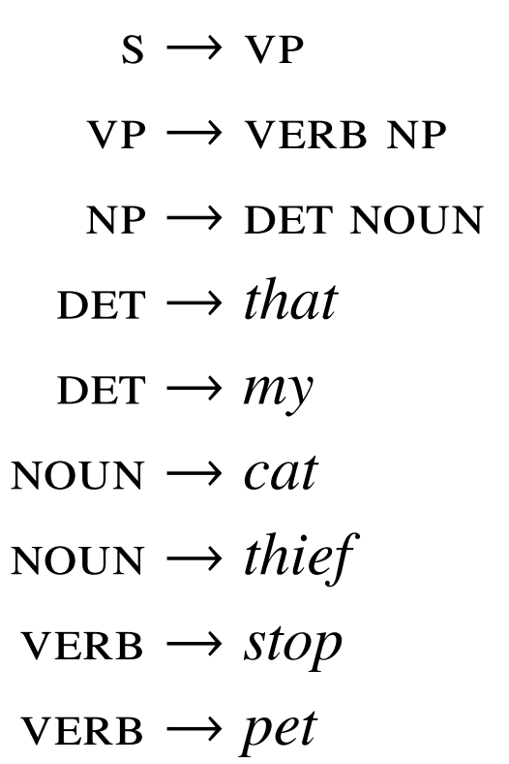
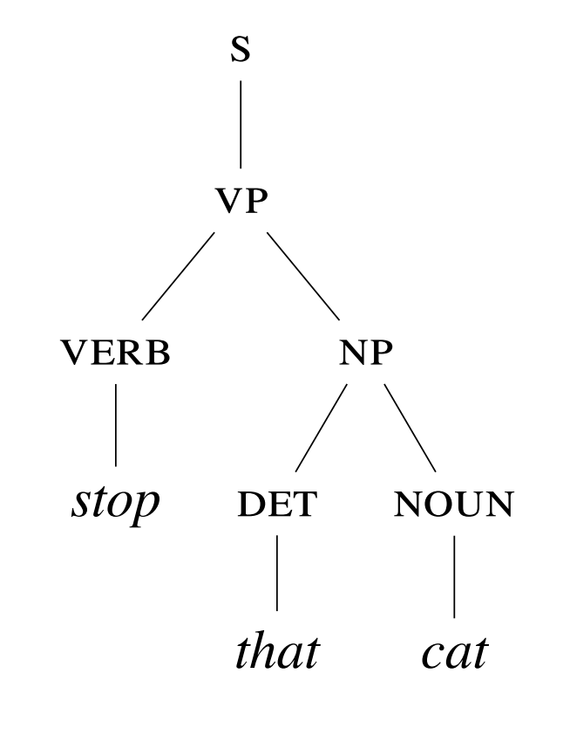
Derivation tree
This derivation tree is popularly known as a constituency tree

Slide 13
Constituency parsing
Ambiguity in phrase-structure grammars
Chomsky normal form
Cocke-Kasami-Younger (CKY) algorithm

Slide 14
Parsing is difficult
Why?
Ambiguity
I shot an elephant in my pajamas
We have two common types of structural ambiguity:
Attachment ambiguity
Coordination ambiguity

Slide 15
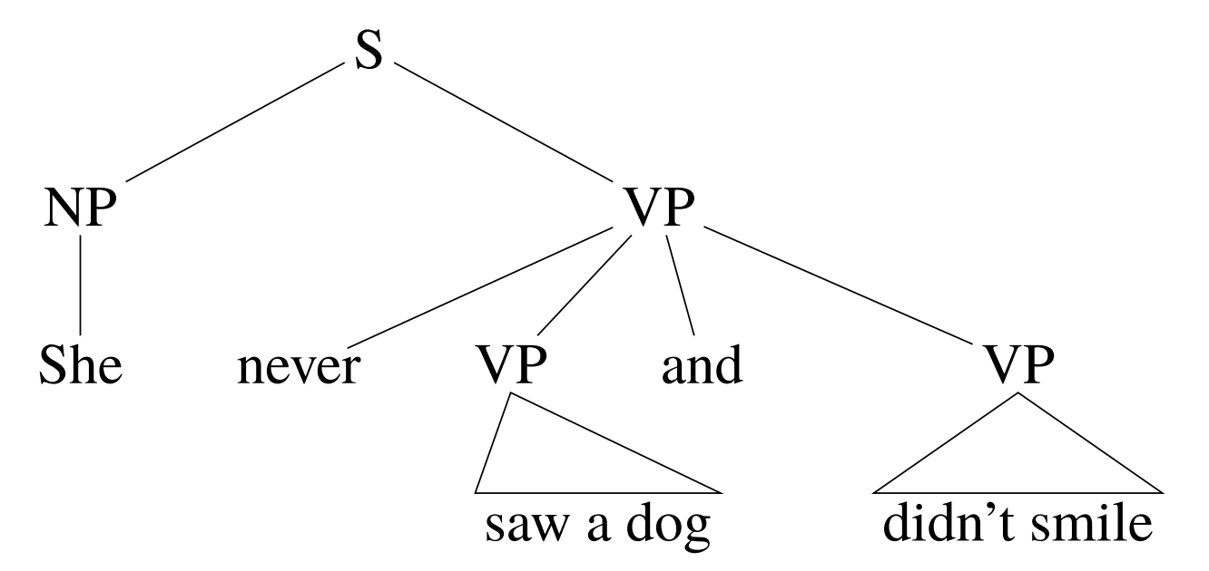
Attachment ambiguity

Slide 16
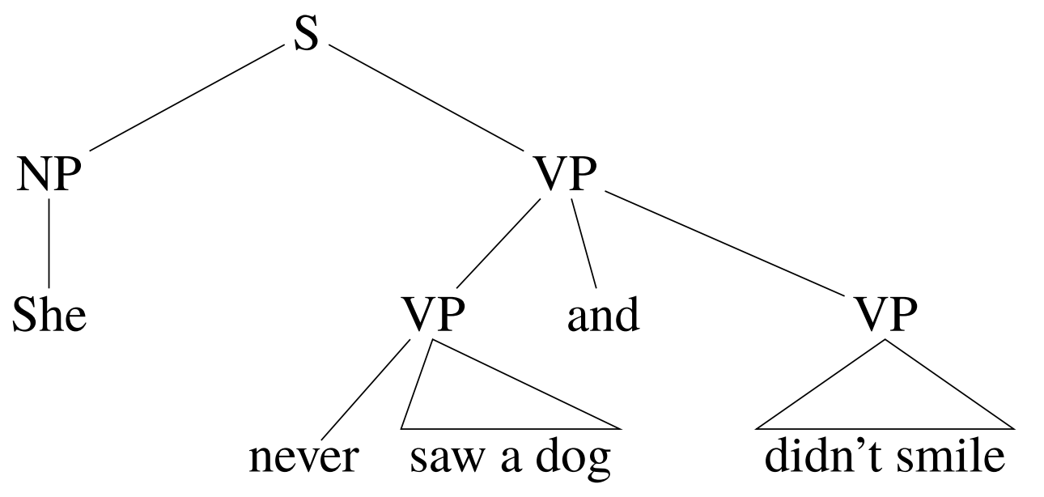
Attachment ambiguity

Slide 17
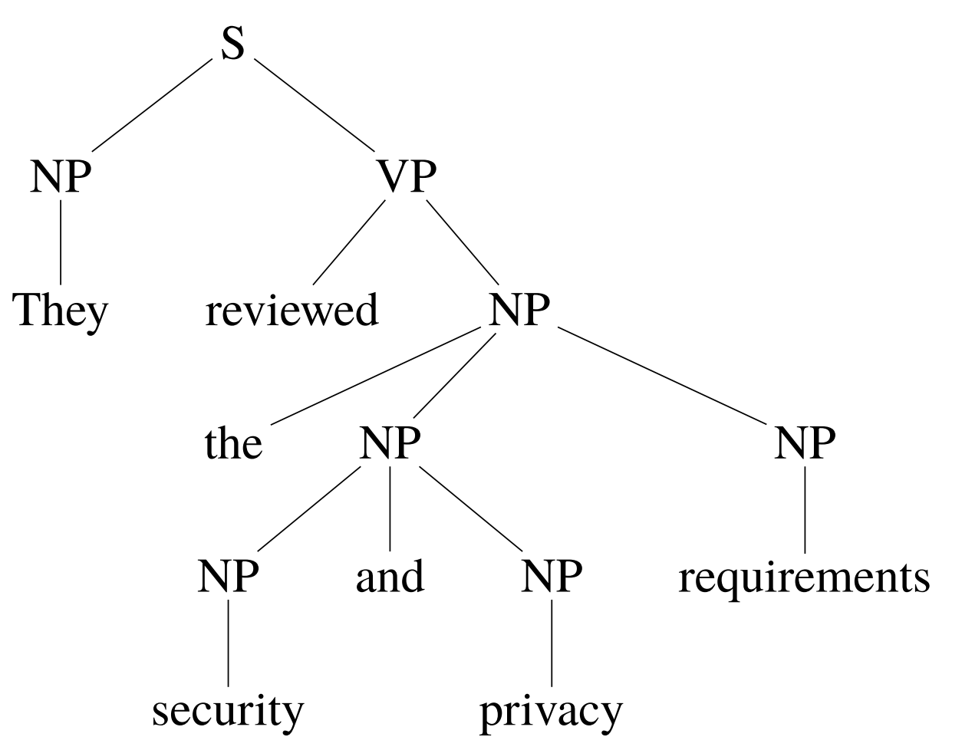
Coordination ambiguity

Slide 18
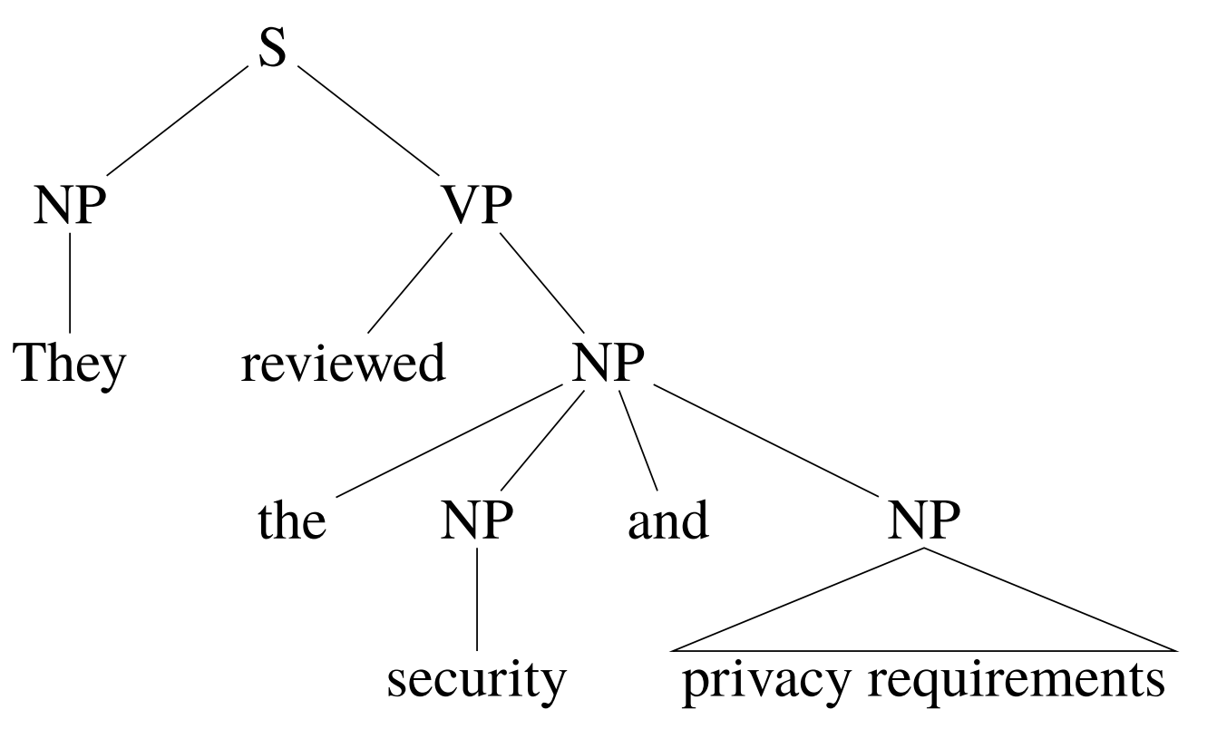
Coordination ambiguity

Slide 19
Practice
The following news headline is syntactically ambiguous. Identify two different possible parses of the sentence.
Lawmen From Mexico Barbecue Guests

Slide 20
Chomsky Normal Form (CNF)
Productions in context free grammars can have:
Exactly one nonterminal on their left-hand side
Any number of terminals or nonterminals on the right
This variability is not ideal for parsing.
A grammar in Chomsky normal form (CNF) allows only two types of right-hand sides:
a single terminal
two non-terminals
Examples:
NN → pizza
NP → DET NN
VP → to VP

Slide 21
Conversion to CNF
For any terminal that is not alone on the right-hand side, introduce a dummy non-terminal
For any non-terminal that is alone on the right-hand side, substitute it everywhere
For any right-hand side with >2 non-terminals, split it
VP → to VP | VP → TO VP TO → to
S→ VP VP → VERB NP VP → VERB PP | S→ VERB NP S → VERB PP VP → VERB NP VP → VERB PP
VP → VERB NP PP | VP → VERB TEMP TEMP → NP PP

Slide 22
Cocke-Kasami-Younger (CKY) algorithm
Intuition:
Consider all word spans as possible constituents
word 1
words 2 to 4
etc.
To see if a span could be a constituent, look for pairs of smaller constituents. E.g., for words 5 to 9, check:
5 to 6 and 6 to 9
5 to 7 and 7 to 9
etc.
If you find a pair of constituents, see if there’s a grammar rule that allows them to be combined

Slide 23
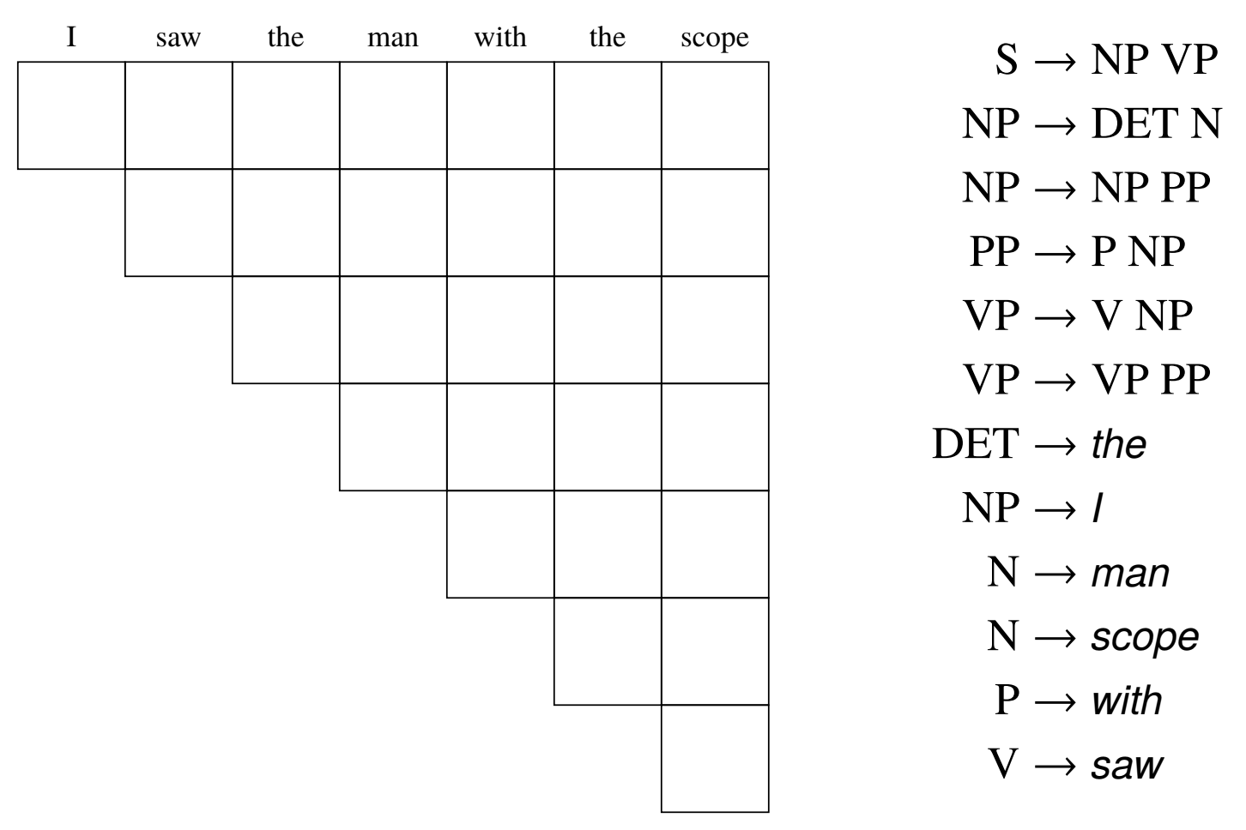
CKY bottom up parsing

Slide 24
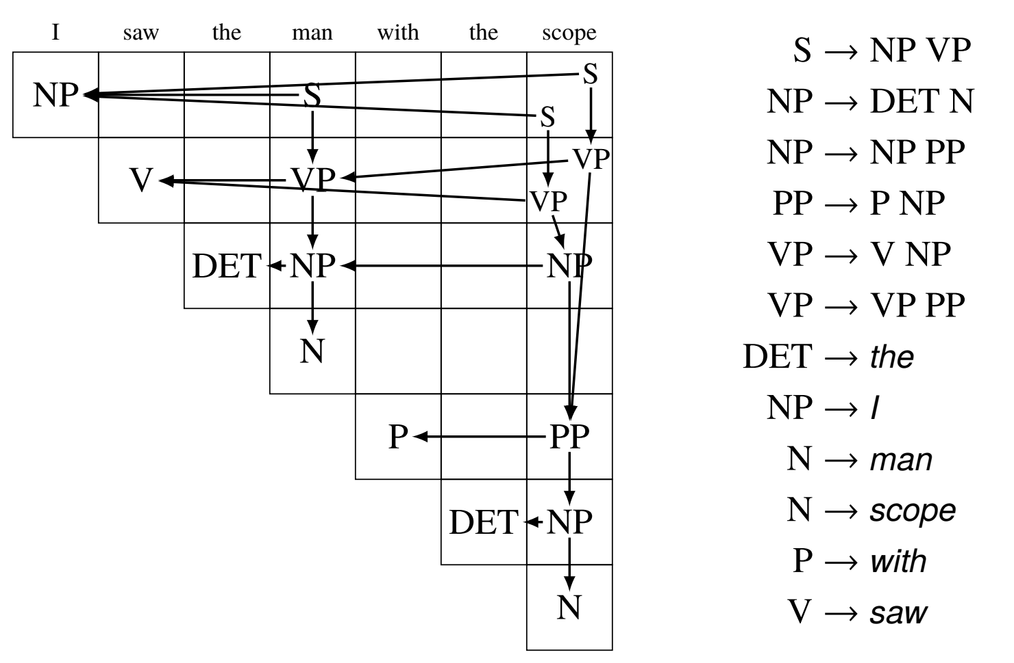
CKY bottom up parsing

Slide 25
Ambiguity kicks in
How can we resolve this ambiguity?
Solution: Probabilistic context free grammar

Slide 26
Context free grammar
A context-free grammar consists of:
N, a set of non-terminal symbols
Σ, a set of terminal symbols (disjoint from N)
R, a set of productions of the form A → β, where
A is a non-terminal,
β is a string of symbols from (Σ ∪ N)∗
S, a designated start symbol from N

Slide 27
Probabilistic context free grammar
A probabilistic context-free grammar consists of:
N, a set of non-terminal symbols
Σ, a set of terminal symbols (disjoint from N)
R, a set of productions of the form A → β [p], where
A is a non-terminal,
β is a string of symbols from (Σ ∪ N)∗
p is the probability P(β|A), also written P(A → β)
- S, a designated start symbol from N

Slide 28
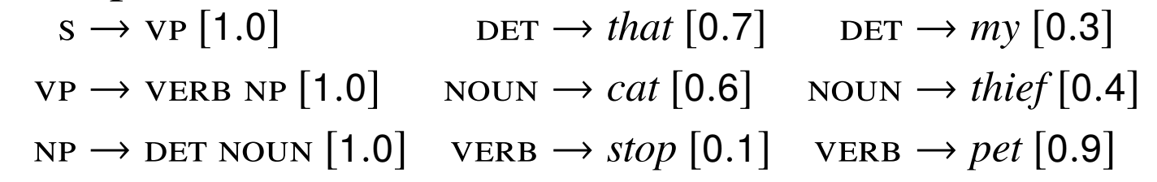
Example

Slide 29
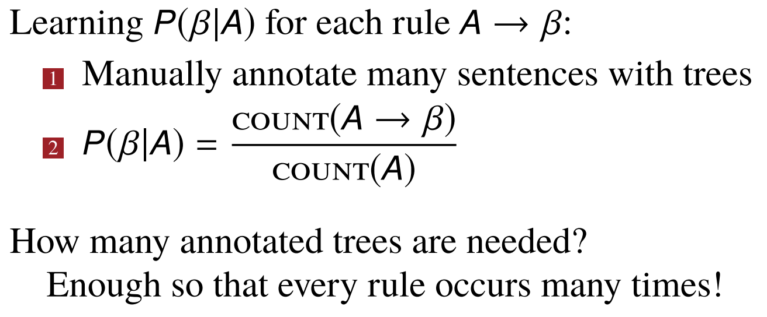
Learning production probabilities

Slide 30
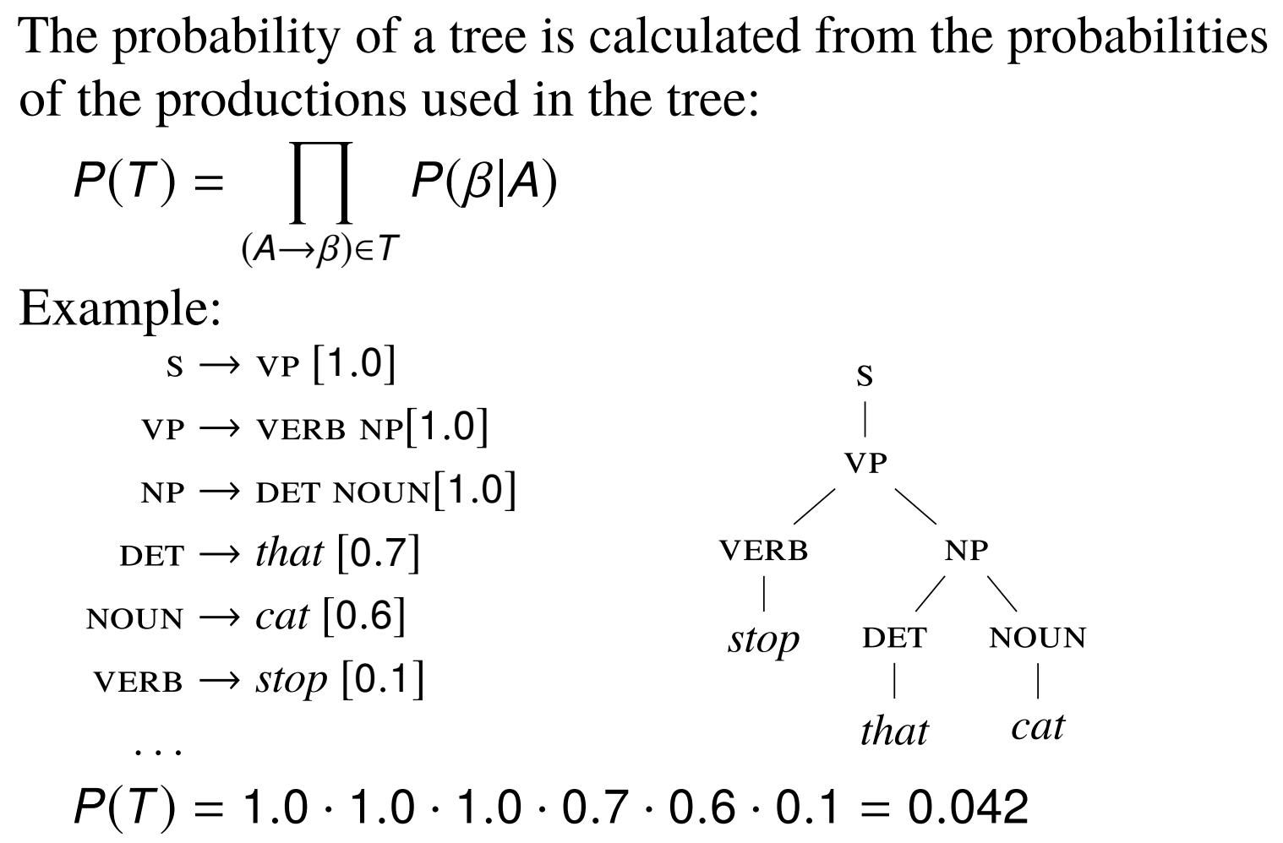
Probability of a tree

Slide 31
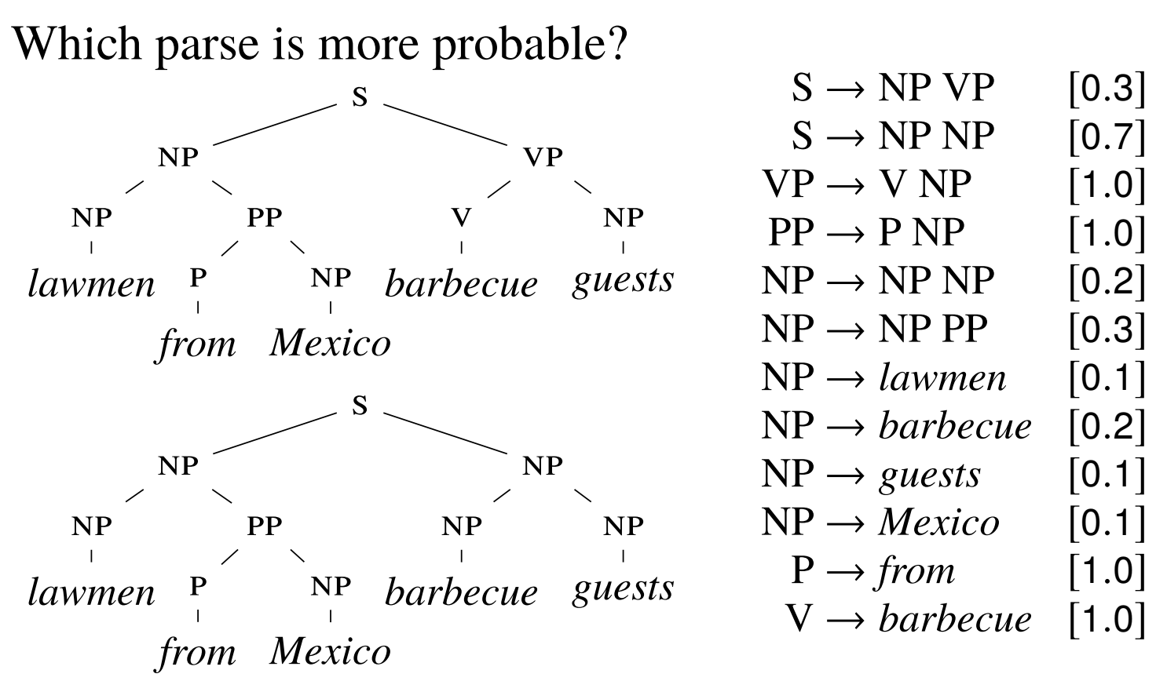
Classwork

Slide 32
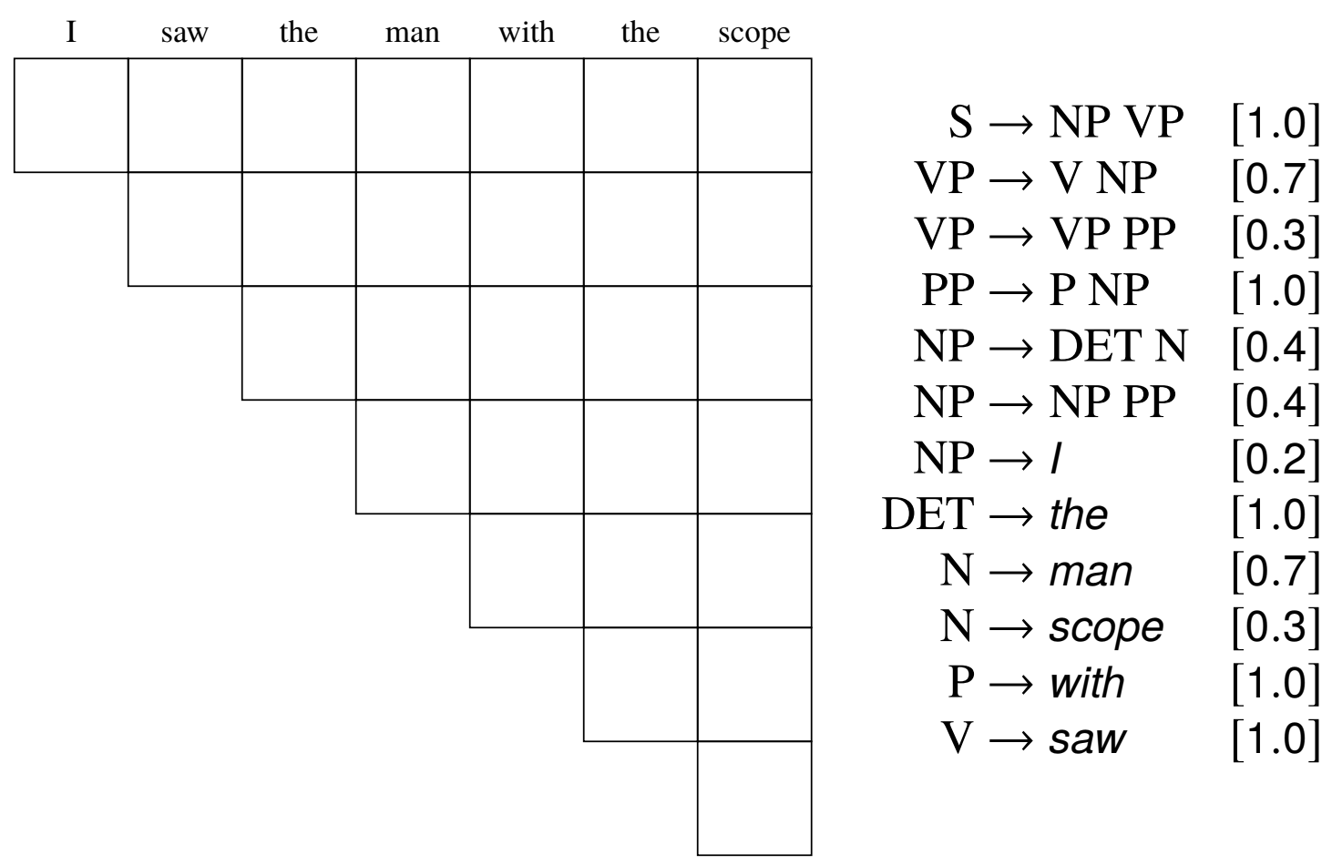
Probabilistic CKY parsing

Slide 33
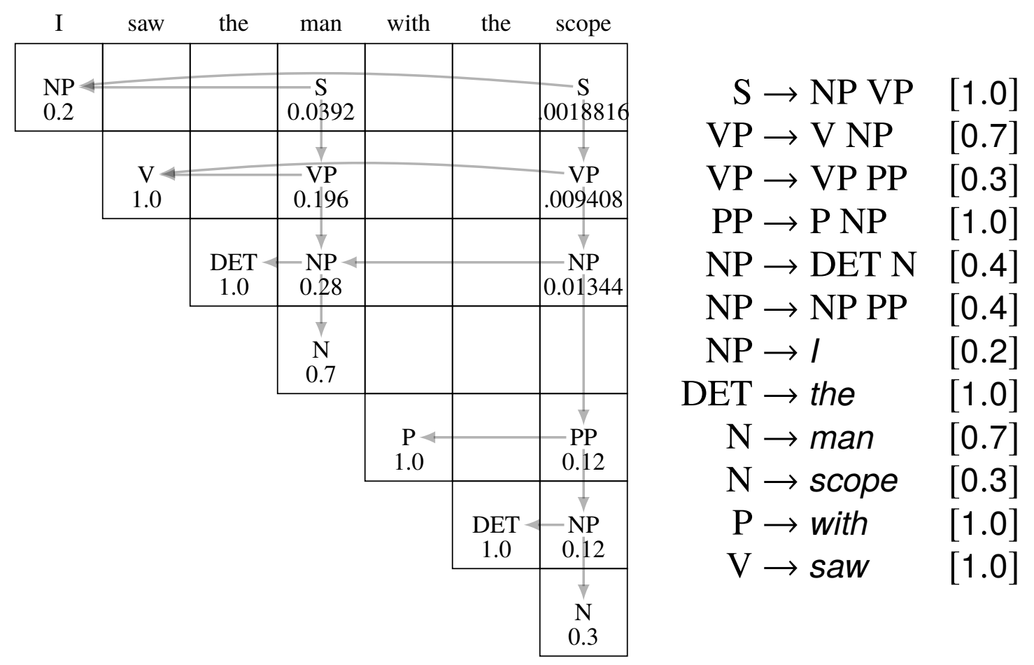
Probabilistic CKY parsing

Slide 34
Dependency parsing
SLP chapter 18

Slide 35
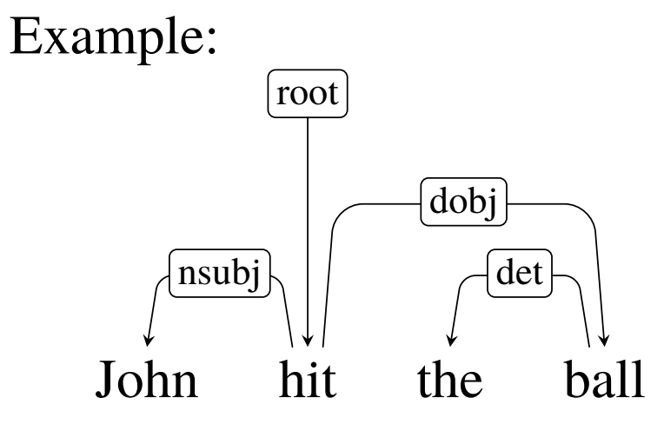
Dependency trees
A dependency tree is a directed graph, where the nodes are words, the edges are syntactic relations, and
There is 1 root node with no incoming arcs
All other nodes have exactly 1 incoming arc
There is a unique path from the root to each node
Intuition:
The head plays the primary role, the dependent modifies that role

Slide 36
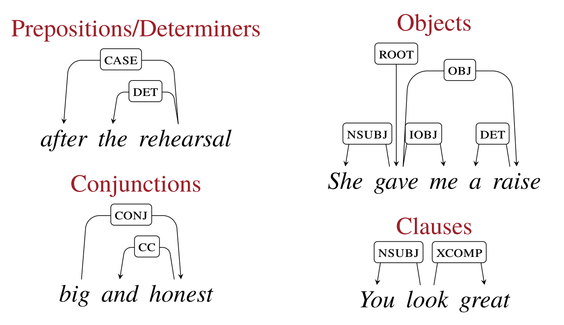
Dependency relations
Some examples from https://universaldependencies.org/

Slide 37
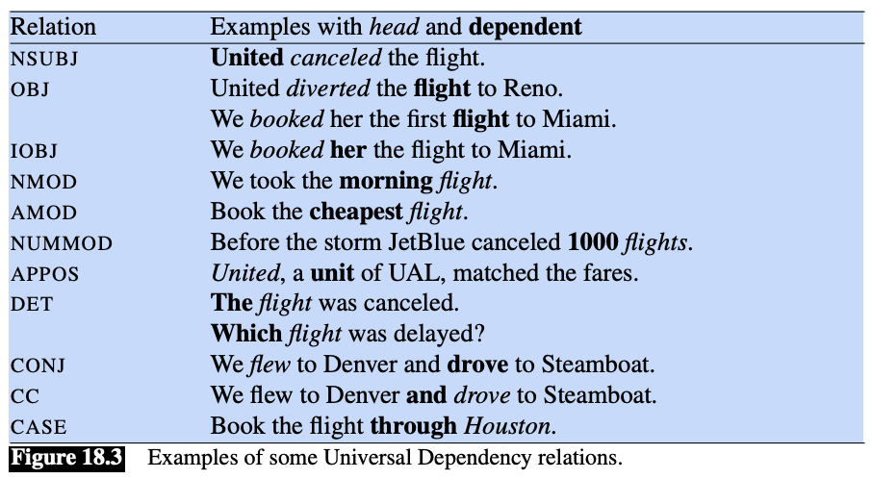
Example dependency relations from SLP

Slide 38
Dependency treebank
A treebank is a parsed text corpus that annotates syntactic or semantic sentence structure
Every sentence in a treebank is annotated with a parse tree
Dependency treebanks are created by
having human annotators directly generate dependency structures for a given corpus, or
by hand-correcting the output of an automatic parser.
The most popular dependency treebank is the universal dependency treebank
Open community project
200 treebanks for more than 100 languages
https://universaldependencies.org/u/dep/

Slide 39
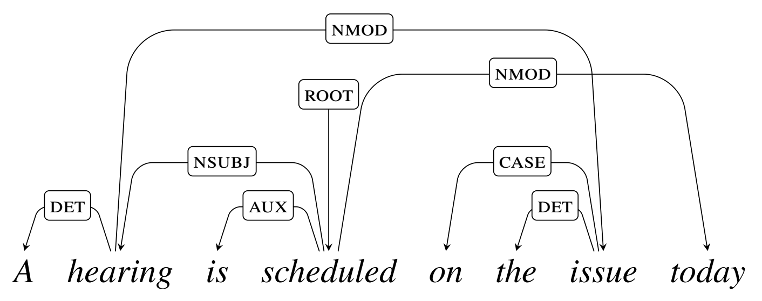
Projectivity
An arc x → y is projective if there is a path from x to every word between x and y in the text. A tree is projective if all arcs in the tree are projective.

Slide 40
Issues with projectivity
From SLP:
The most widely used English dependency treebanks were automatically derived from phrase structure treebanks through the use of head-finding rules. The trees generated in such a fashion will always be projective, and hence will be incorrect when non-projective examples like this one are encountered
There are computational limitations to the most widely used families of parsing algorithms

