Slide 1
CSE440: Natural Language Processing II
Dr. Farig Sadeque
Associate Professor
Department of Computer Science and Engineering
BRAC University

Slide 2
Lecture 7: Translation

Slide 3
Outline
Probabilistic Translation (Lecture)
Seq2seq model (Book chapter 13)
Attention mechanism (Book chapter 13)
Translation issues (Book chapter 13)

Slide 4
Probabilistic Translation
Goal:
Get the most probable English sentence given a French sentence
argmax P(e|f)
Using Bayes Theorem:
argmax P(e|f) = argmax (P(e)*P(f|e))
Notation:
P(e): probability of English sentence e (Do the words follow English order?)
P(f|e): probability that, given an English sentence e, a translator produces French sentence f (Are the words good translations?)

Slide 5
How to get P(e): Language Modeling
A language model estimates P(e), the probability that a sentence e is an English sentence.
Many language modeling techniques exist:
n-gram language models (e.g., SRILM, KenLM)
Assumption: a sentence is a bag of overlapping n-grams
Neural language models (RNNs, etc.)
Assumption: a sentence is a sequence of words
All such models are trained on huge, unlabeled data

Slide 6
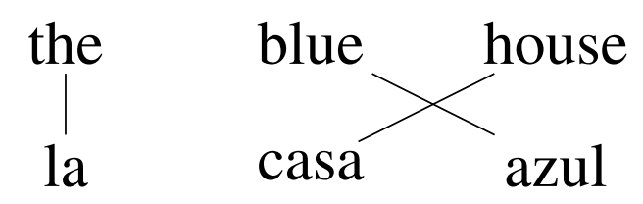
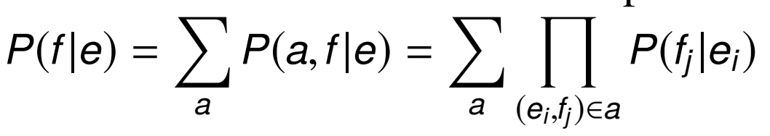
How to get P(f|e): Translation Modeling
Many translation models incorporate some form of alignment indicating which words were translated as which. We will follow IBM Model 1.
An example alignment:
IBM Model 1 calculates translation probability as:

Slide 7
IBM Model 1
Intuition:
Consider all possible word alignments
Combine the word-translation probabilities
We need to estimate P(f_{j}|e_{i}): For each English word ei, the probability of it being translated as French word fj
If we had a corpus of word-level alignments, we could just count and divide.
We typically have only sentence translations. How do we get the word translations?
The expectation maximization (EM) algorithm

Slide 8
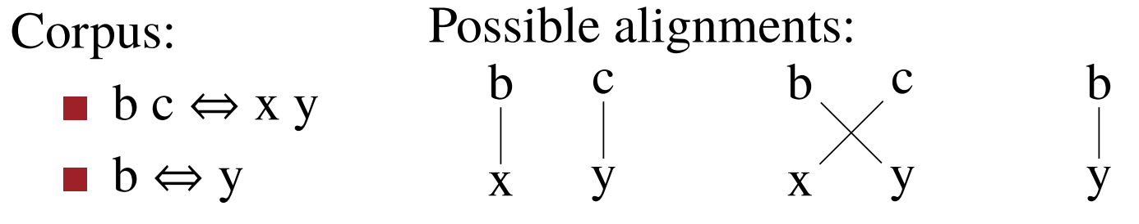
Expectation-maximization algorithm
Expectation maximization:
Start with uniform estimates of word-word translations
Use word-word translation probabilities to estimate alignment probabilities
Use alignment probabilities to estimate word-word translation probabilities
Go to 2

Slide 9
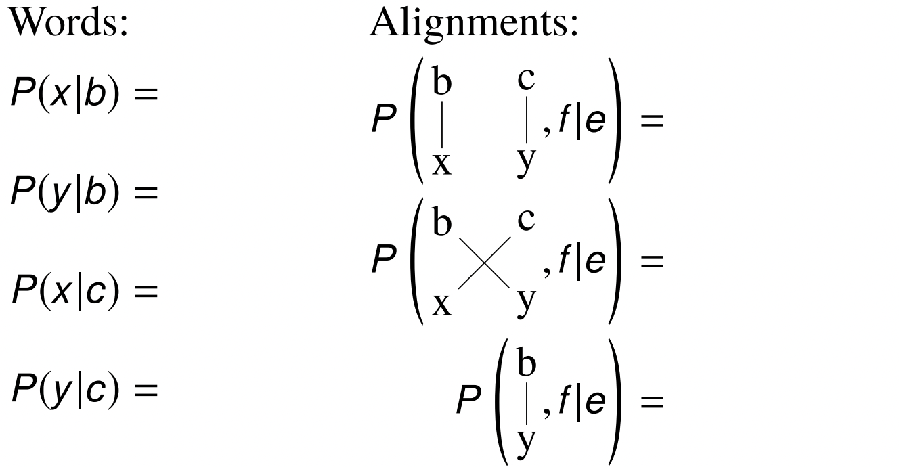
EM Walkthrough
Start with uniform estimates of word-word translations

Slide 10
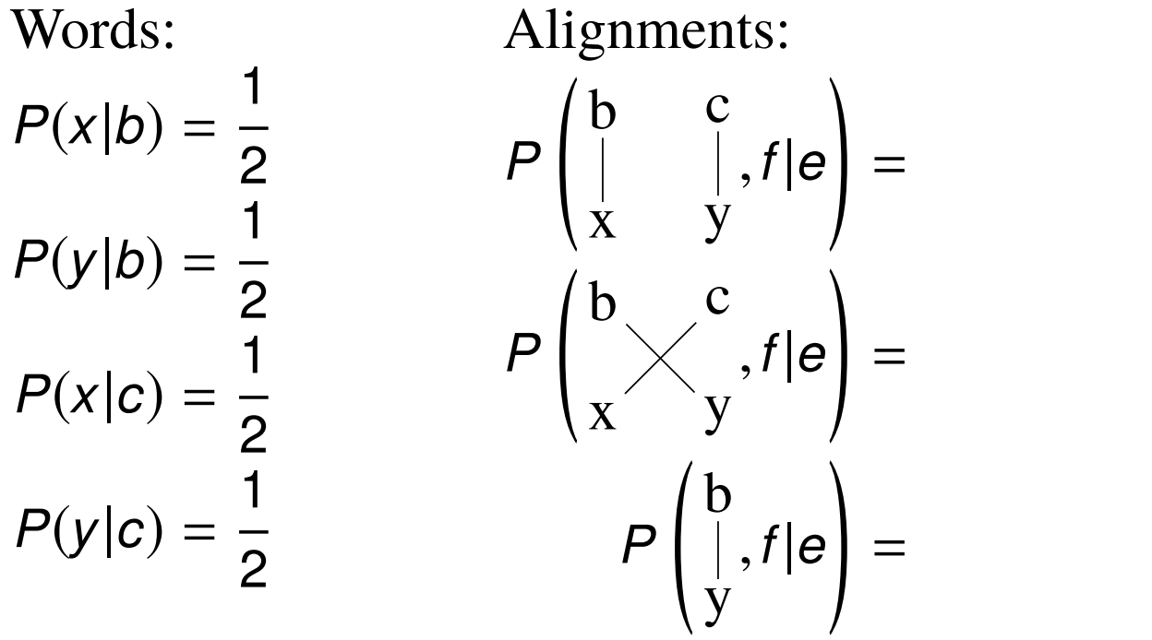
EM Walkthrough
Start with uniform estimates of word-word translations

Slide 11
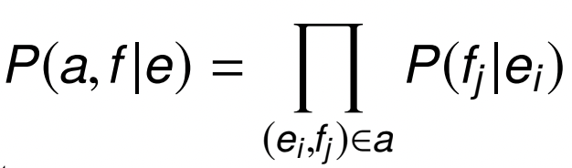
EM Walkthrough
2. For each alignment, compute

Slide 12
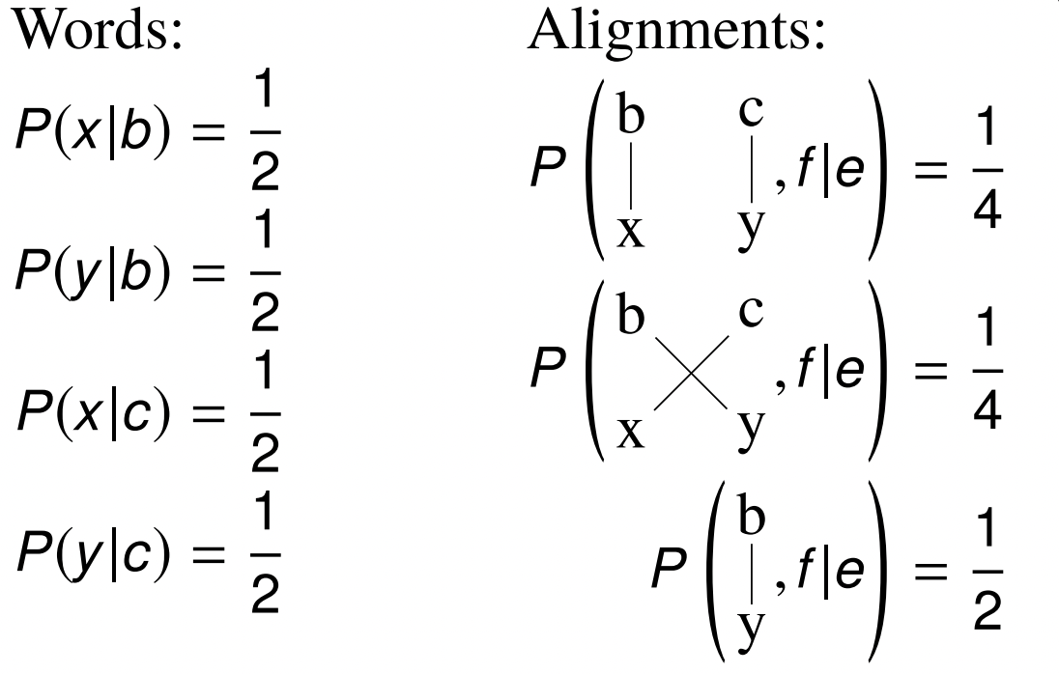
EM Walkthrough
2. For each alignment, compute

Slide 13
EM Walkthrough
3. Normalize so that each sentence sums to 1.

Slide 14

EM Walkthrough
2.1. Normalize so that each sentence sums to 1.

Slide 15
EM Walkthrough
3. Collect fractional counts for word-word translations

Slide 16
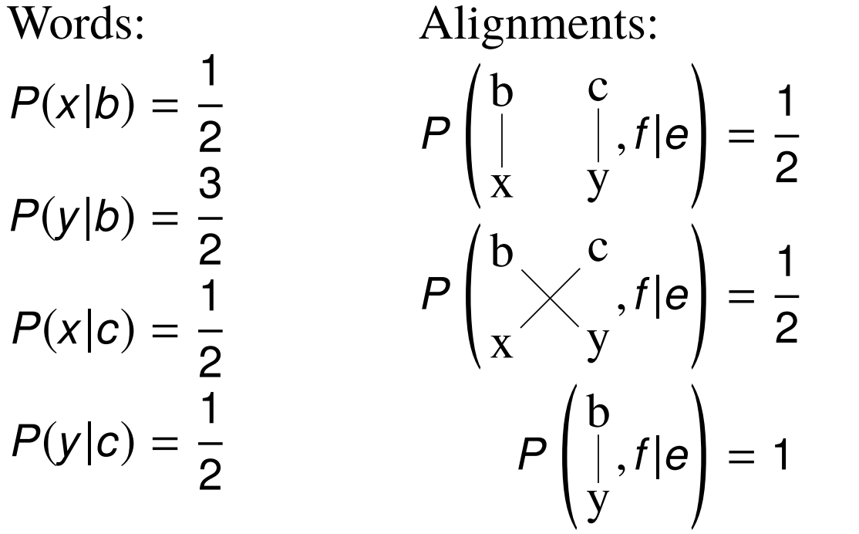
EM Walkthrough
3. Collect fractional counts for word-word translations

Slide 17
EM Walkthrough
3.1. Normalize so that each word sums to 1

Slide 18
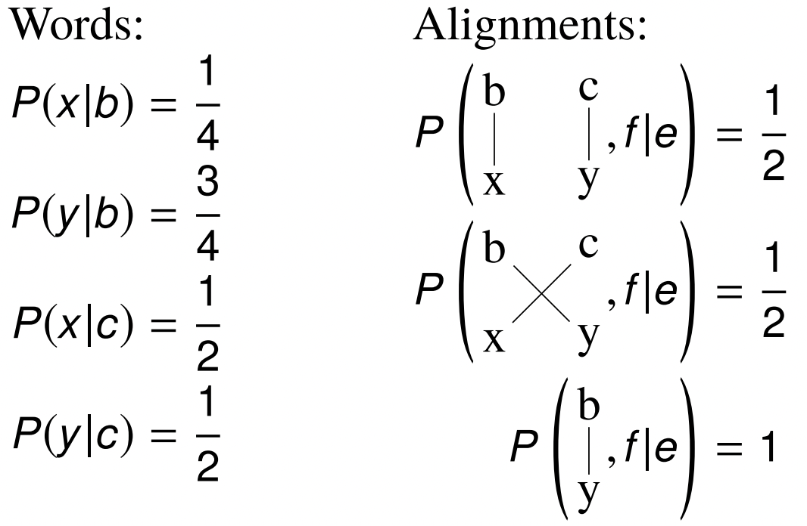
EM Walkthrough
3.1. Normalize so that each word sums to 1

Slide 19
EM Walkthrough
Continue
What will happen if we keep repeating this process?

Slide 20
Class participation
Perform EM on this scenario for two epochs:
b c → x y
b → y
c → x
What trend can you see?

Slide 21
Decoding/prediction
How do we generate e sentences for the argmax?
Build translation left to right:
Randomly select foreign word to be translated
Find possible English word translation
Add English word to end of partial translation
Mark foreign word as translated
Both steps 1 and 2 have many possibilities: use AI search techniques to explore the space

Slide 22
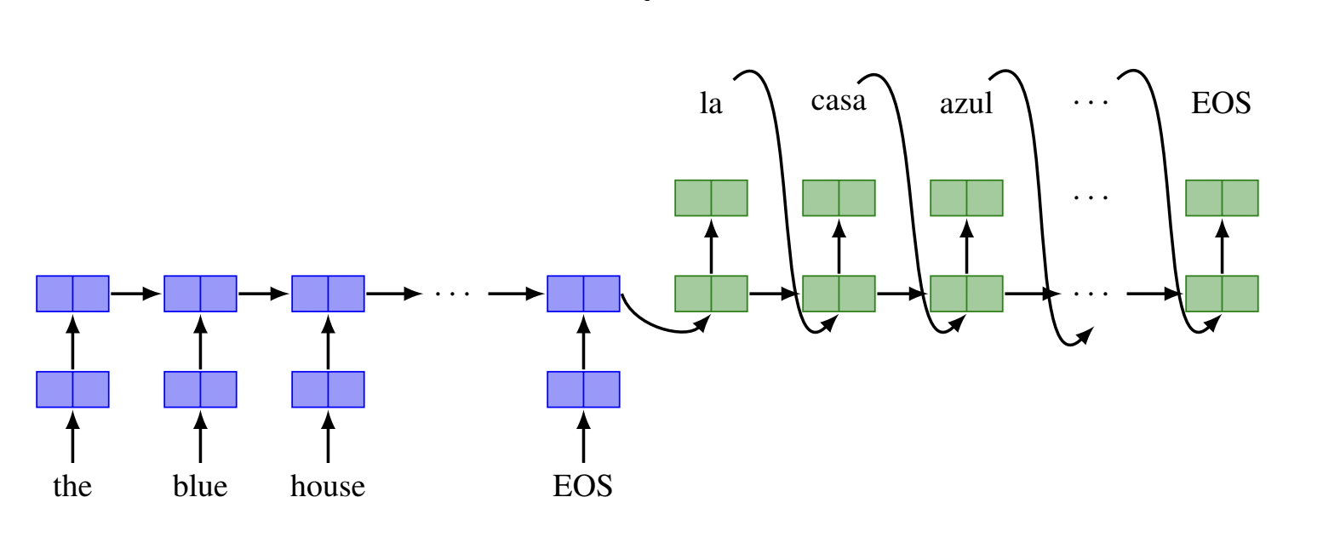
Neural Machine Translation: Seq2Seq Model
MT model using RNN

Slide 23
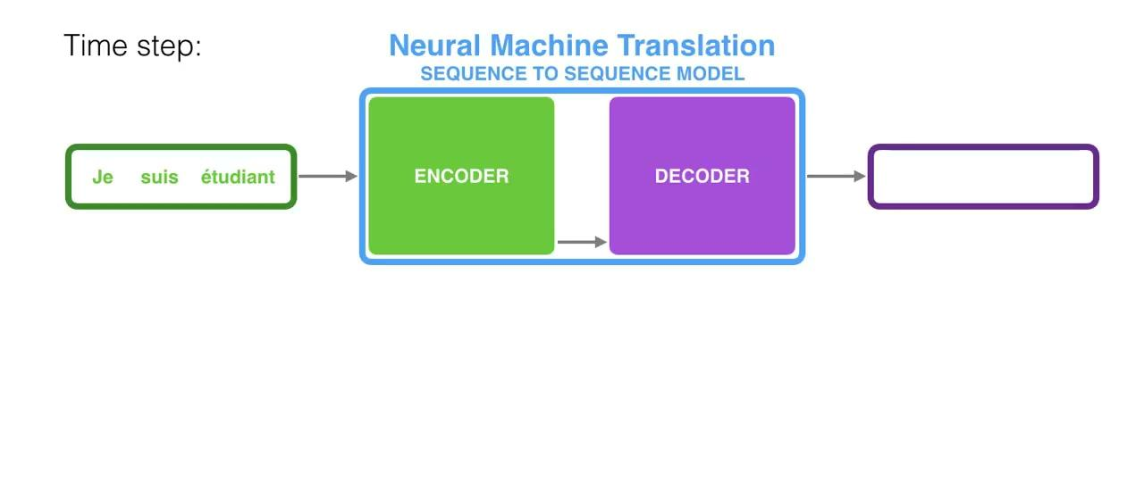
MT model using encoder-decoder
Video Courtesy: Jay Alammar

Slide 24
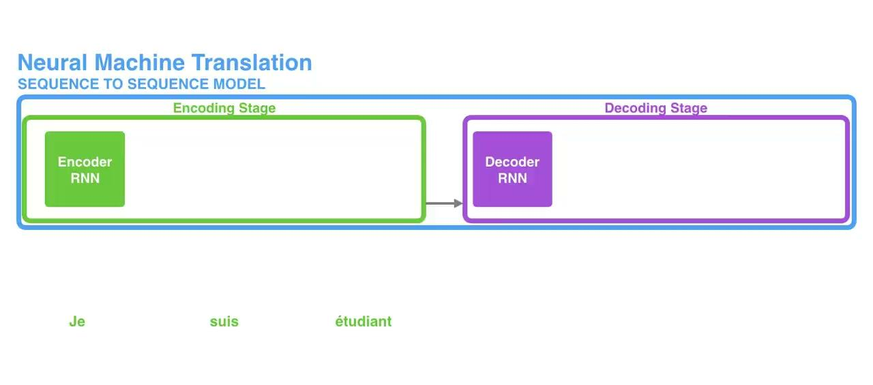
MT model using encoder-decoder
Video Courtesy: Jay Alammar

Slide 25
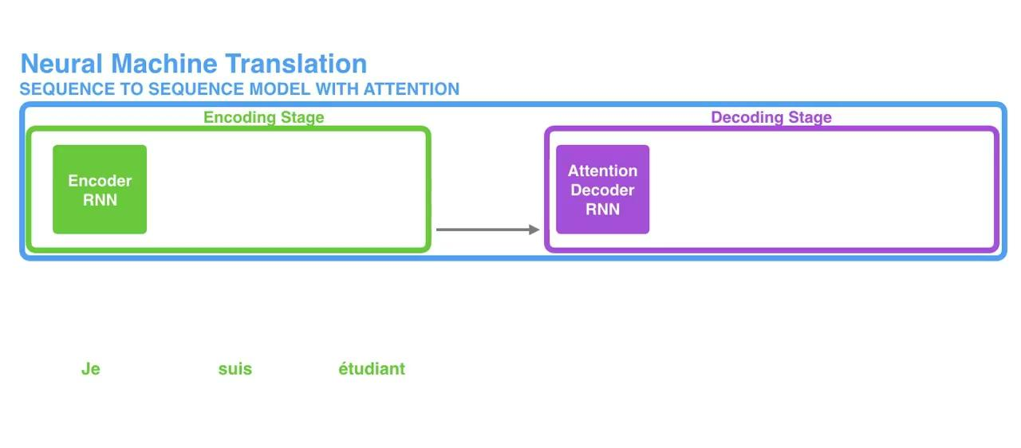
MT model using encoder-decoder
Video Courtesy: Jay Alammar

Slide 26
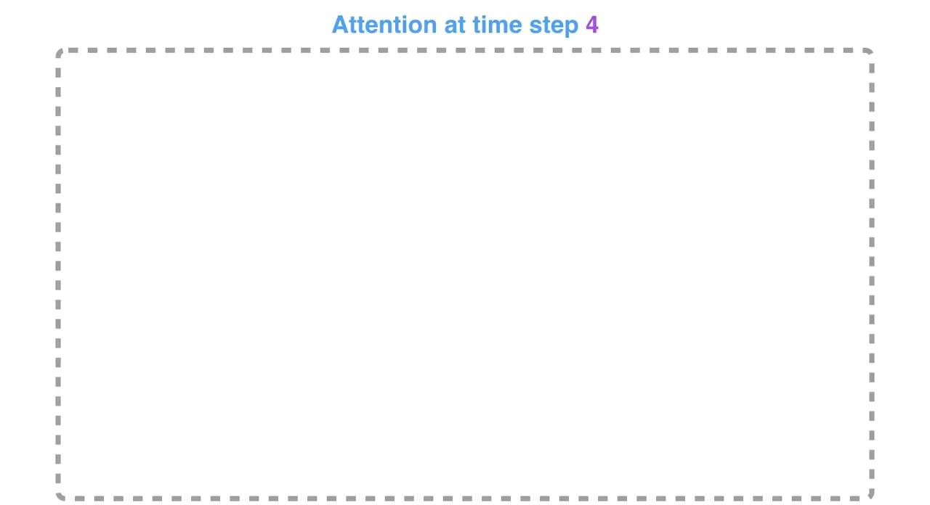
MT model using encoder-decoder
Video Courtesy: Jay Alammar

Slide 27
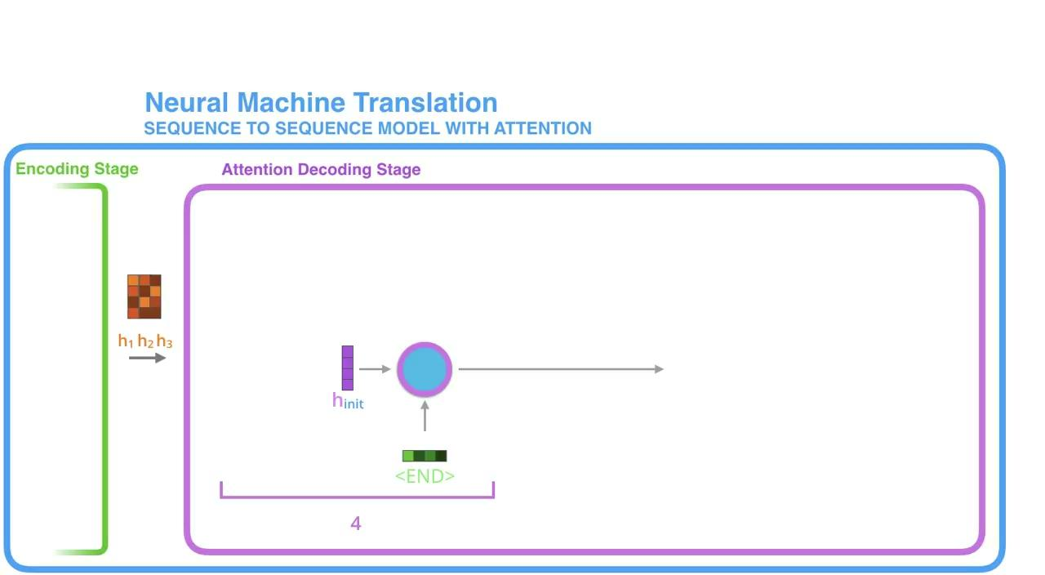
MT model using encoder-decoder
Video Courtesy: Jay Alammar

Slide 28
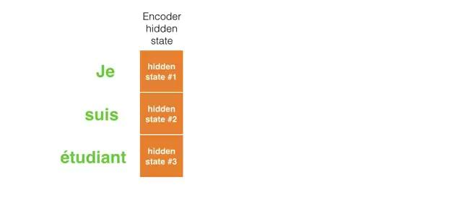
MT model using encoder-decoder
Video Courtesy: Jay Alammar

Slide 29
But…
RNN-based encoder decoder works well, but:
Backpropagation through time and infinite memory is still an issue, even with gated RNNs
RNNs work sequentially, so parallelization is a challenge

Slide 30
Why do we need GPUs?
CPUs are latency-optimized, GPUs are bandwidth-optimized
The more memory your computational operations require, the more significant the advantage of GPUs over CPUs: matrix multiplication requires more computational operations
More computing units: better thread parallelism, can hide latency issues
Faster access to RAMs (VRAMs)
DNN computations just fit well with GPU architecture
Many identical neurons, doing the same computation

Slide 31
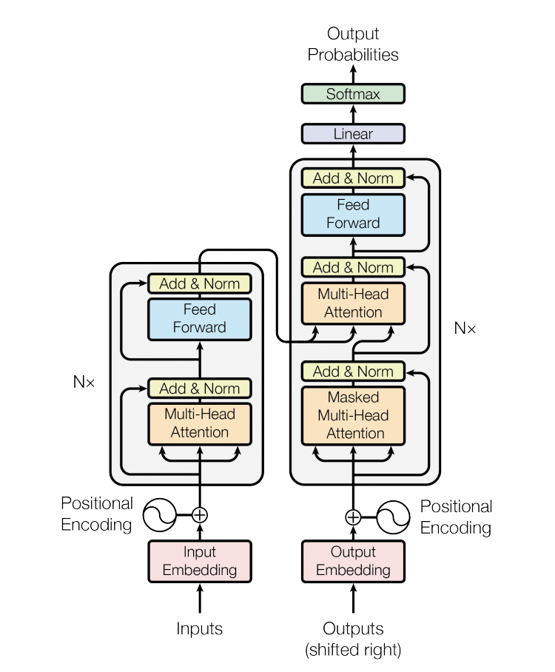
Transformer
We will see:
Self-attention
Multi-head attention
Positional encoding
Byte-pair encoding
Image Courtesy: Attention is all you need

Slide 32
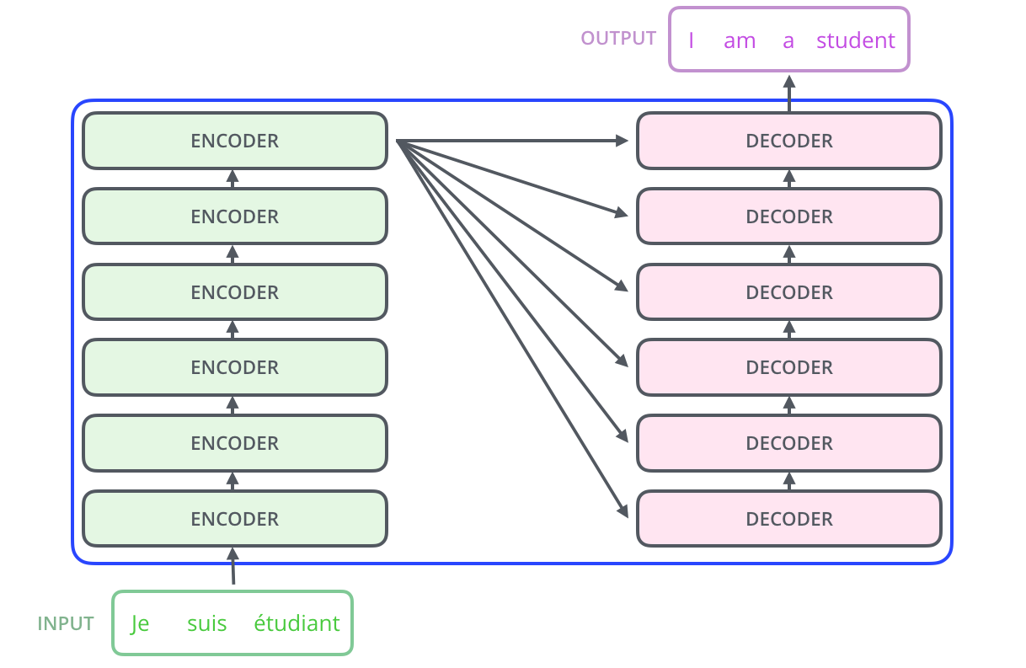
High level view of a transformer
Image Courtesy: Jay Alammar

Slide 33
Training a transformer
Training a transformer is exceptionally difficult
Not enough hardware, not enough time
What to do?

Slide 34
Pretraining
Transformers can be trained to learn through language representations
Someone with enough hardware and time can (pre)train a transformer that can learn that language representation, and then we can use that representation for our NLP task

Slide 35
BERT
BERT = Bidirectional Encoder Representations from Transformers
Designed to pretrain deep bidirectional representations from unlabeled text by jointly conditioning on both left and right context in all layers
Pre-trained BERT model can be fine-tuned with just one additional output layer to create state-of-the-art models
Achieved state-of-the-art performance in almost all tasks when it came out
Uses WordPiece tokenization
Are massive
Base model has 12 encoders, 12 attention heads, 768 hidden units, large model has 24 encoders, 16 heads and 1024 hidden units
Base models counts up to 110 million parameters, large has 340 mils.

Slide 36
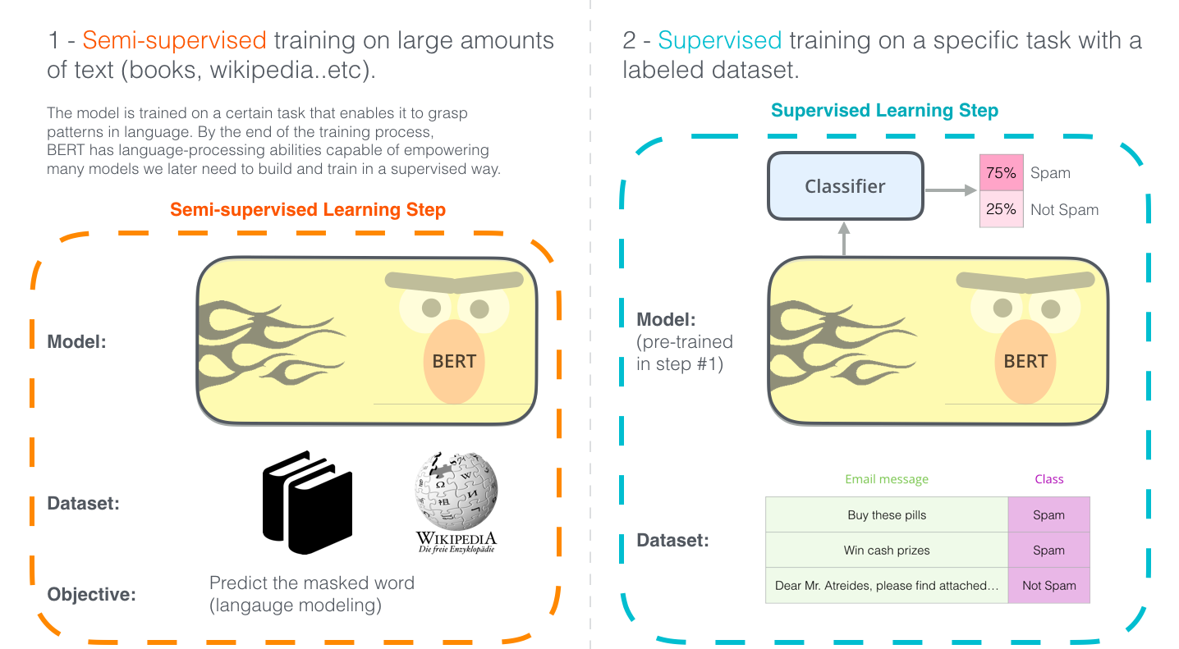
BERT
Image Courtesy: Jay Alammar

Slide 37
BERT
Pretrained on two unsupervised task
Masked language modeling
Next sentence prediction
Masked LM
Chooses 15% of tokens at random
Replaces a token with a [MASK] 80% of the time, with a random token 10% of the time and does not replace 10% of the time
Next sentence prediction
Can model tasks that are not covered by language modeling (QA, inference)
Training data includes: 50% of the time B is the actual next sentence that follows A and 50% of the time it is a random sentence from the corpus

Slide 38
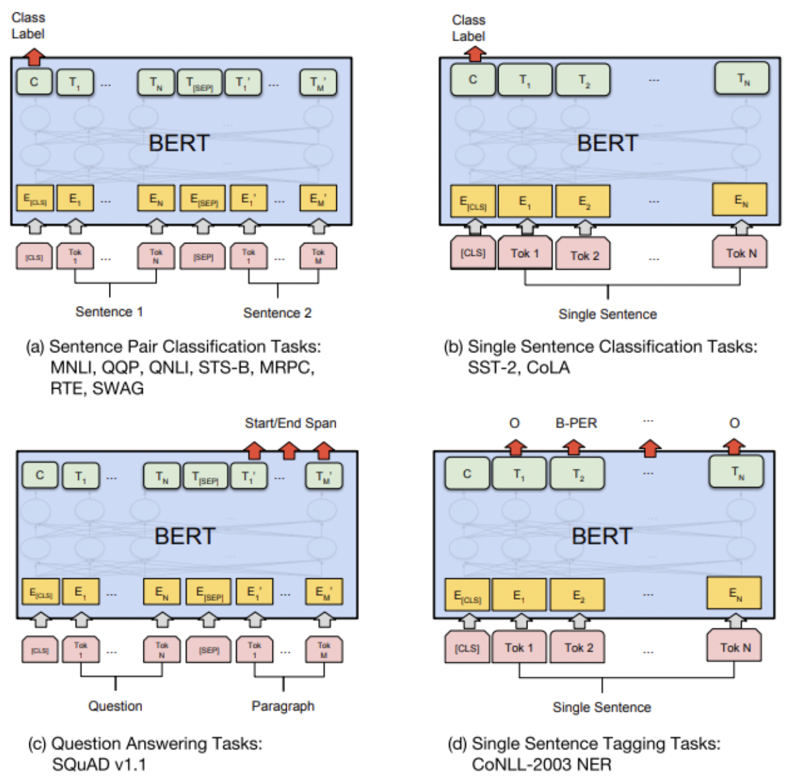
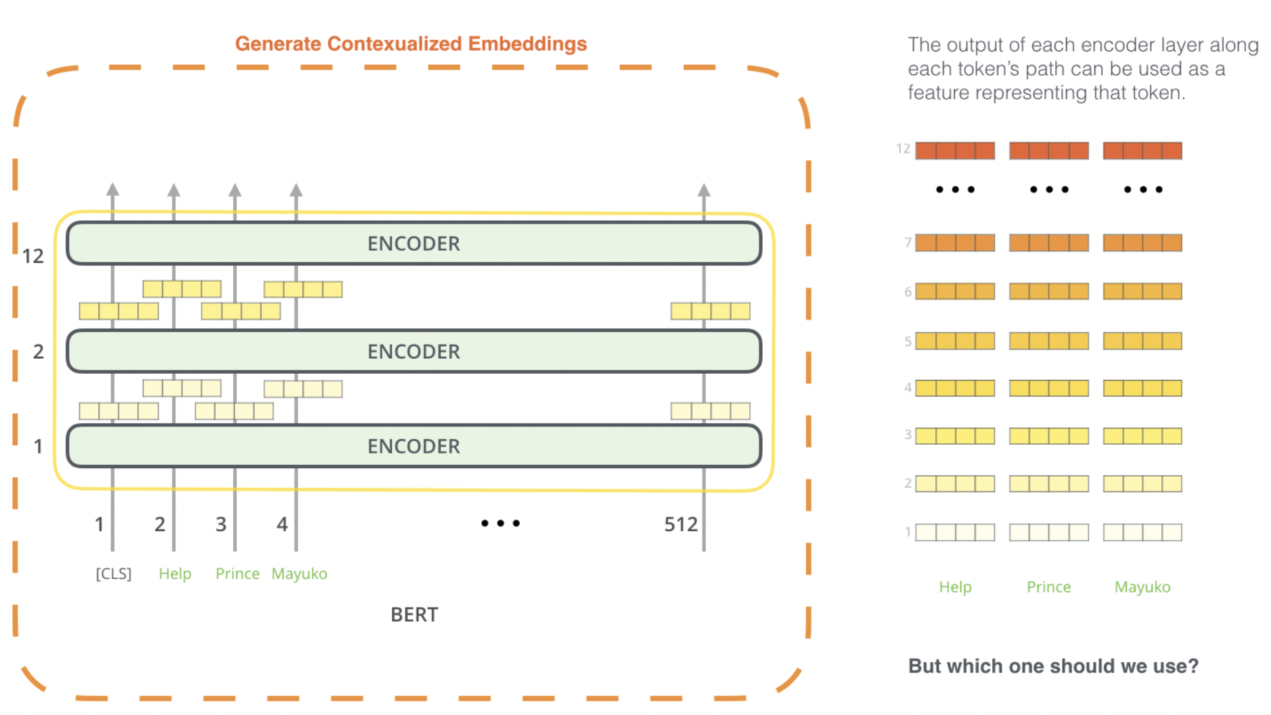
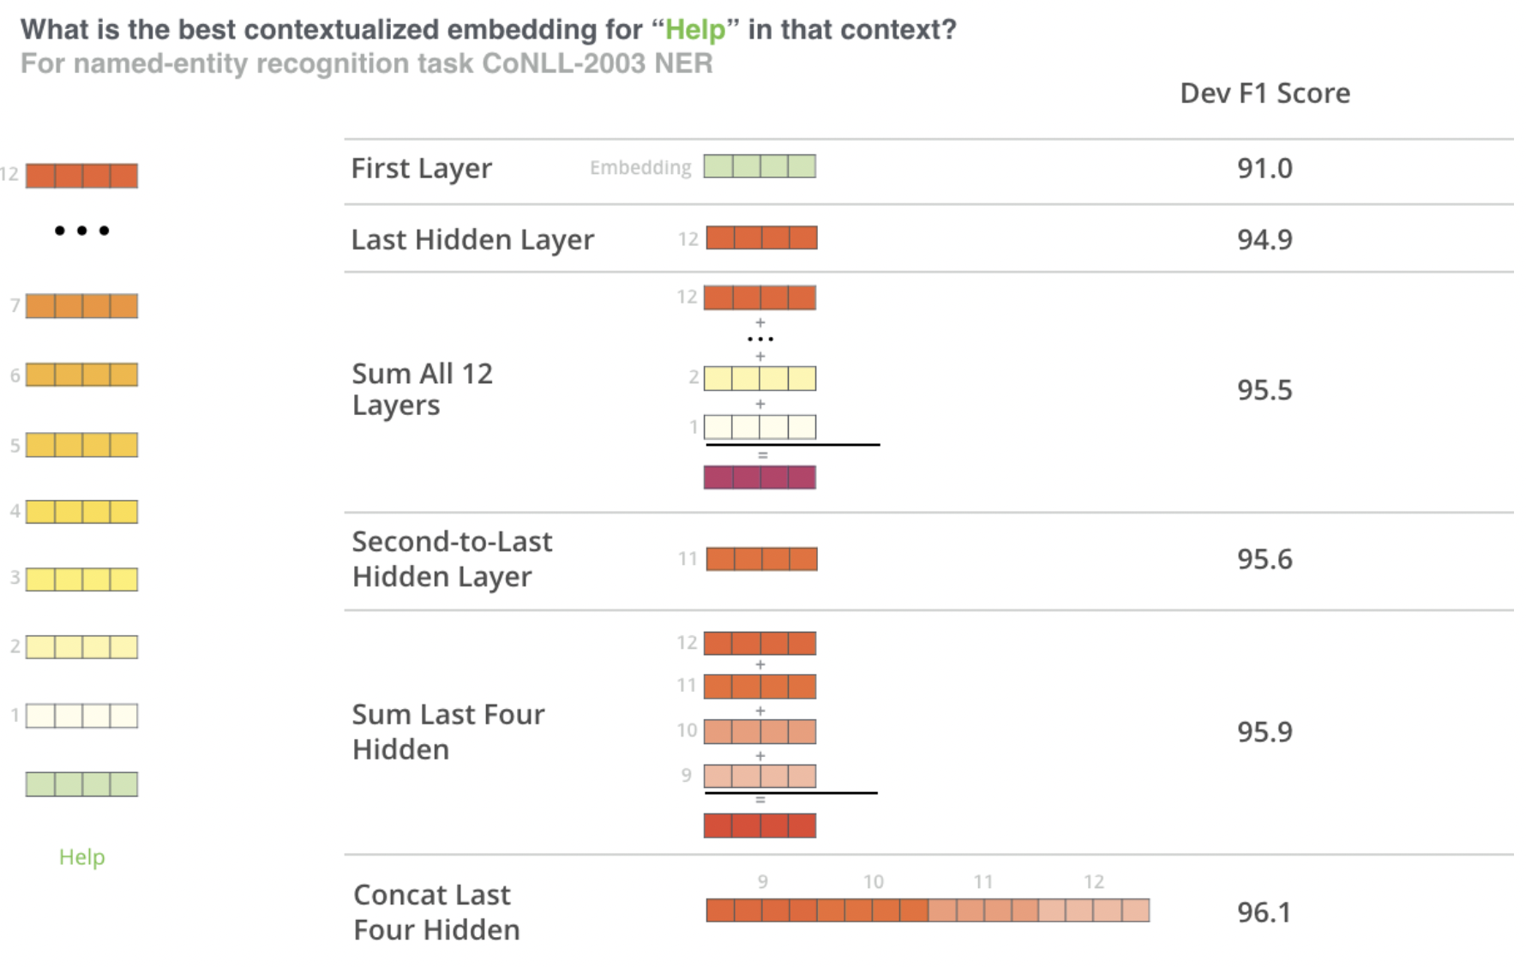
How to use BERT
Task specific-Models (fine-tuning)
Feature extraction
But which one should we use?
Image Courtesy: Jay Alammar

Slide 39
Translation Issues

