Slide 1

Chapter 10
Error Detection and Correction
Presented by NTR
10.1
Copyright © The McGraw-Hill Companies, Inc. Permission required for reproduction or display.
Notes:
1

Slide 2

Note
Data can be corrupted during transmission.
Some applications require that errors be detected and corrected.
10.2
Notes:
2

Slide 3
10-1 INTRODUCTION
Let us first discuss some issues related, directly or indirectly, to error detection and correction.
Topics discussed in this section:
Types of Errors Redundancy Detection Versus Correction Forward Error Correction Versus Retransmission Coding
Modular Arithmetic
10.3
Notes:
3

Slide 4
Note
In a single-bit error, only 1 bit in the data unit has changed.
10.4
Notes:
4

Slide 5
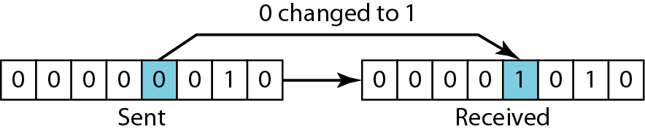
Figure 10.1 Single-bit error
10.5
Notes:
5

Slide 6
Note
A burst error means that 2 or more bits in the data unit have changed.
10.6
Notes:
6

Slide 7
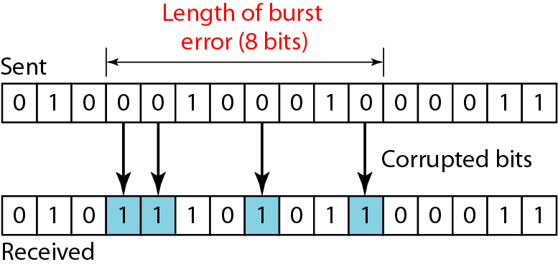
Figure 10.2 Burst error of length 8
10.7
Notes:
7

Slide 8
How to detect the errors
Error detection means to decide whether the received data is correct or not without having a copy of the original message.
To detect or correct errors, we need to send some extra bits with the data.
The extra bits are called as redundant bits.

Slide 9
Redundancy
The central concept in error detection and correction
The redundant bits are added by the sender and removed by the receiver
Their presence helps the receiver to detect and correct corrupted bits
10.9

Slide 10
Redundancy
Note
To detect or correct errors, we need to send extra (redundant) bits with data.
10.10
Notes:
10

Slide 11
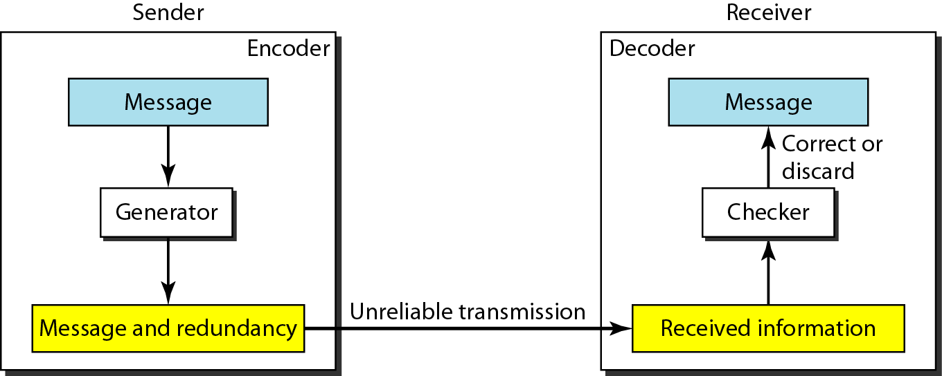
Figure 10.3 The structure of encoder and decoder
10.11
Notes:
11

Slide 12
Coding
Redundancy is achieved through various coding schemes
The coding schemes are divided into two broad categories
Block coding
Convolution coding
10.12

Slide 13
Note
In this book, we concentrate on block codes; we leave convolution codes to advanced texts.
10.13
Notes:
13

Slide 14
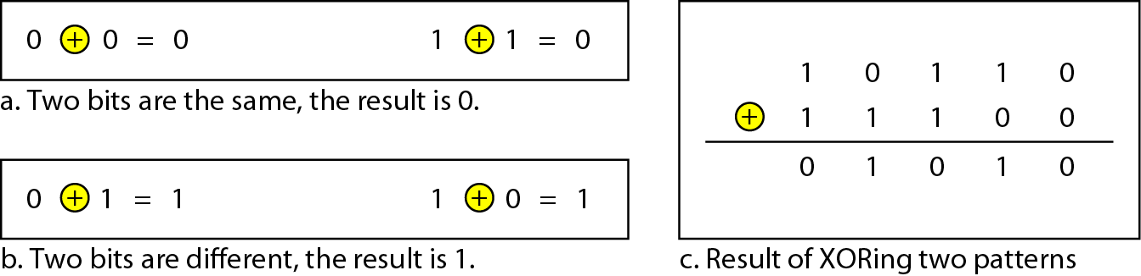
Figure 10.4 XORing of two single bits or two words
10.14
Notes:
14

Slide 15
10-2 BLOCK CODING
In block coding, we divide our message into blocks, each of k bits, called datawords. We add r redundant bits to each block to make the length n = k + r. The resulting n-bit blocks are called codewords.
Topics discussed in this section:
Error Detection Error Correction Hamming Distance
Minimum Hamming Distance
10.15
Notes:
15

Slide 16
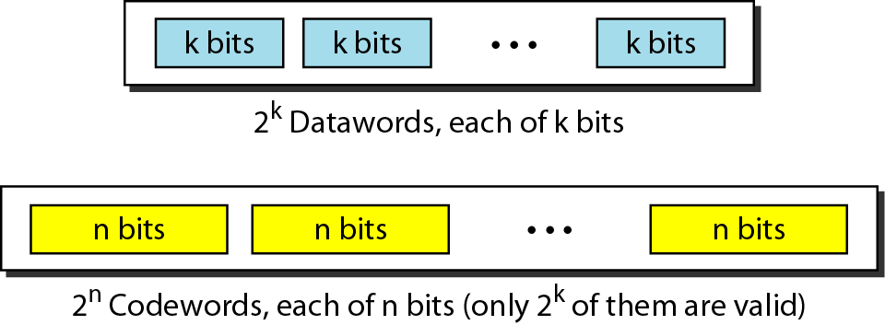
Figure 10.5 Datawords and codewords in block coding
10.16
Notes:
16

Slide 17
Example 10.1
The 4B/5B block coding discussed in Chapter 4 is a good example of this type of coding. In this coding scheme, k = 4 and n = 5. As we saw, we have 2^{k} = 16 datawords and 2^{n} = 32 codewords. We saw that 16 out of 32 codewords are used for message transfer and the rest are either used for other purposes or unused.
10.17
Notes:
17

Slide 18
Error detection in block-coding
If the following two conditions are met, the receiver can detect a change in the original codeword.
1. The receiver has (or can find) a list of valid codewords.
2. The original codeword has changed to an invalid one.
if the codeword is corrupted during transmission but the received word still matches a valid codeword, the error remains undetected.
This type of coding can detect only single error. Two or more errors may remain undetected.

Slide 19
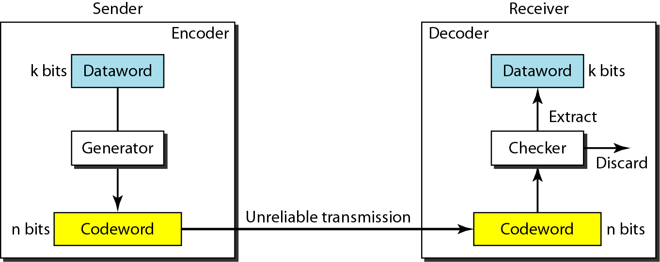
Figure 10.6 Process of error detection in block coding
10.19
Notes:
19

Slide 20
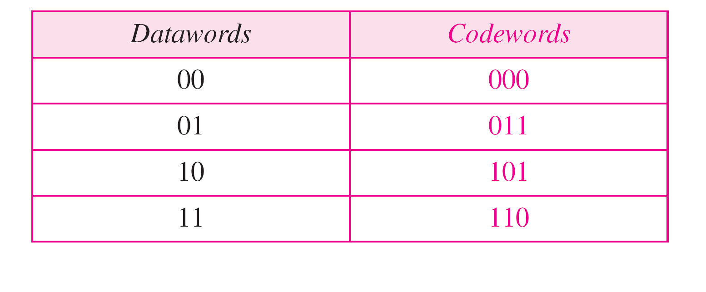
Table 10.1 A code for error detection (Example 10.2)
10.20
Notes:
20

Slide 21
Example 10.2
Let us assume that k = 2 and n = 3. Table 10.1 shows the list of datawords and codewords. Later, we will see how to derive a codeword from a dataword.
Assume the sender encodes the dataword 01 as 011 and
sends it to the receiver. Consider the following cases:
1. The receiver receives 011. It is a valid codeword. The receiver extracts the dataword 01 from it.
10.21
Notes:
21

Slide 22
Example 10.2 (continued)
2. The codeword is corrupted during transmission, and 111 is received. This is not a valid codeword and is discarded.
3. The codeword is corrupted during transmission, and 000 is received. This is a valid codeword. The receiver incorrectly extracts the dataword 00.
Thus two corrupted bits have made the error undetectable.
10.22
Notes:
22

Slide 23
Note
An error-detecting code can detect only the types of errors for which it is designed; other types of errors may remain undetected.
10.23
Notes:
23

Slide 24
Error correction in block-coding
IT can be handled in two ways:
Receiver can have the sender retransmit the entire data unit.
The receiver can use an error-correcting code, which automatically corrects certain errors.

Slide 25
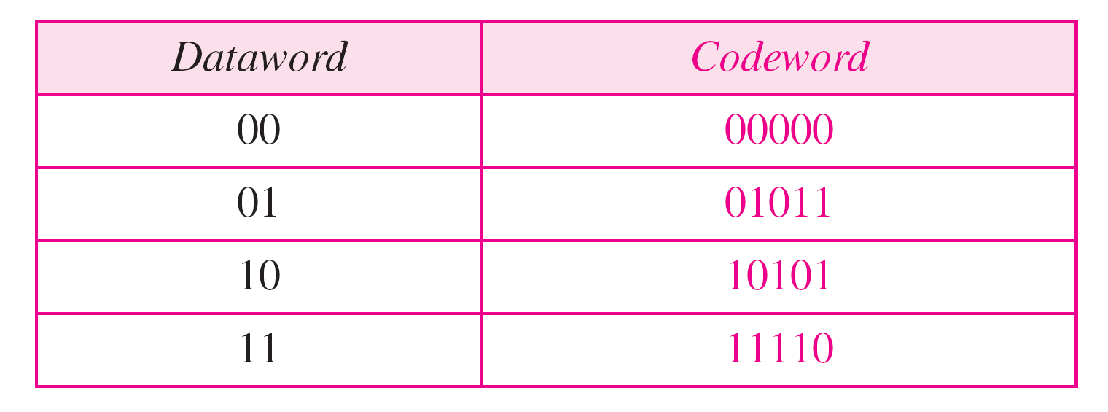
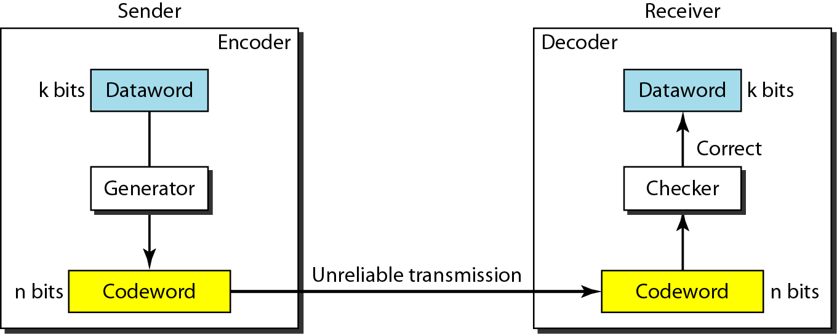
Figure 10.7 Structure of error correction in Block Coding
10.25
Notes:
25

Slide 26
Note
The Hamming distance between two words is the number of differences between corresponding bits.
10.26
Notes:
26

Slide 27
Hamming distance
The Hamming distance between two strings, a and b is denoted as d(a,b). It is used for error detection or error correction when data is transmitted over computer networks.
In order to calculate the Hamming distance between two strings, a and b, we perform their XOR operation, (a⊕ b), and then count the total number of 1s in the resultant string.

Slide 28

Example 10.4
Let us find the Hamming distance between two pairs of words.
1. The Hamming distance d(000, 011) is 2 because
2. The Hamming distance d(10101, 11110) is 3 because
10.28
Notes:
28

Slide 29
Minimum Hamming Distance
In a set of strings of equal lengths, the minimum Hamming distance is the smallest Hamming distance between all possible pairs of strings in that set.
The number of error bits a coding scheme can detect with a minimum hamming distance of d is d-1.

Slide 30
Note
The minimum Hamming distance is the smallest Hamming distance between all possible pairs in a set of words.
10.30
Notes:
30

Slide 31
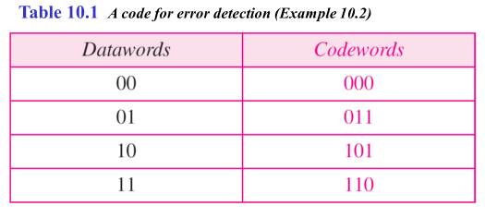
There are four different codewords which can have 6 possible pairs
(000, 011)
(000, 101)
(000, 110)
(011, 101)
(011, 110)
(101.110)
10.31

Slide 32
Example 10.6
Find the minimum Hamming distance of the coding scheme in Table 10.2.
Solution
We first find all the Hamming distances.
The d_{min} in this case is 3.
10.32
Notes:
32

Slide 33
10-4 CYCLIC CODES
Cyclic codes are special linear block codes with one extra property. In a cyclic code, if a codeword is cyclically shifted (rotated), the result is another codeword.
Topics discussed in this section:
Cyclic Redundancy Check Hardware Implementation Polynomials Cyclic Code Analysis
Advantages of Cyclic Codes Other Cyclic Codes
10.33
Notes:
33

Slide 34
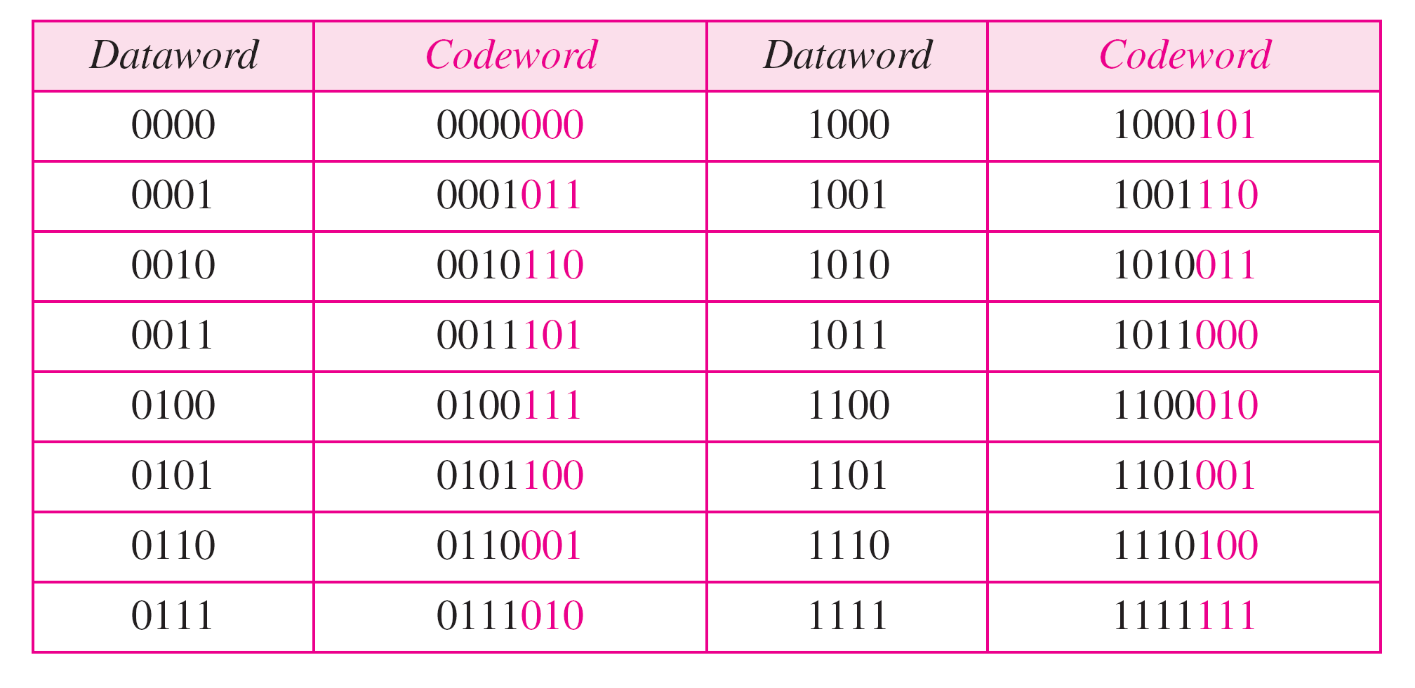
Table 10.6 A CRC code with C(7, 4)
10.34
Notes:
34

Slide 35
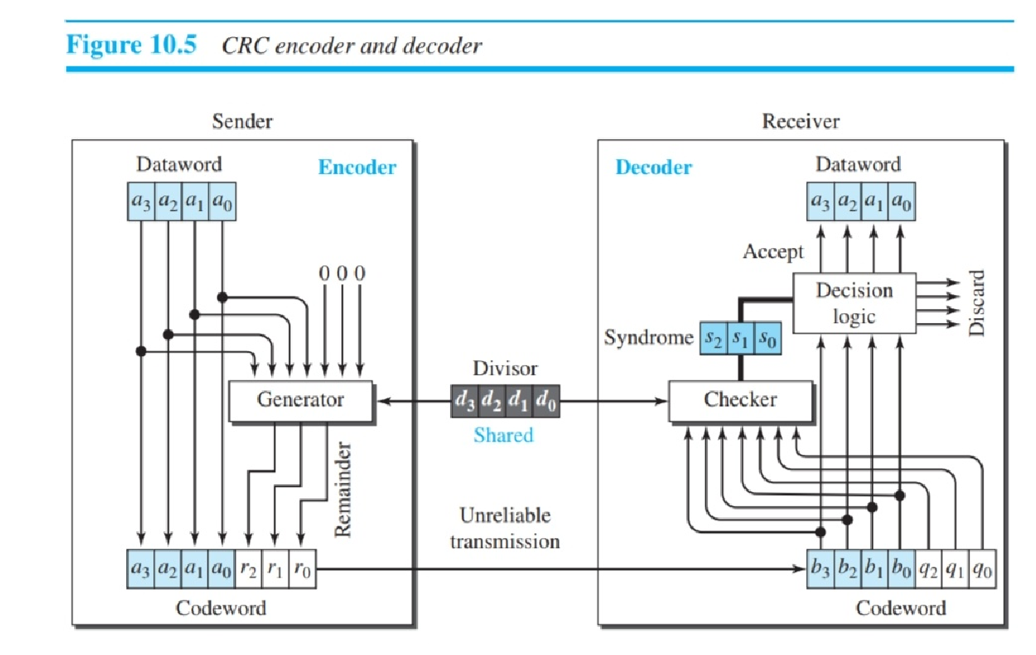
10.35

Slide 36
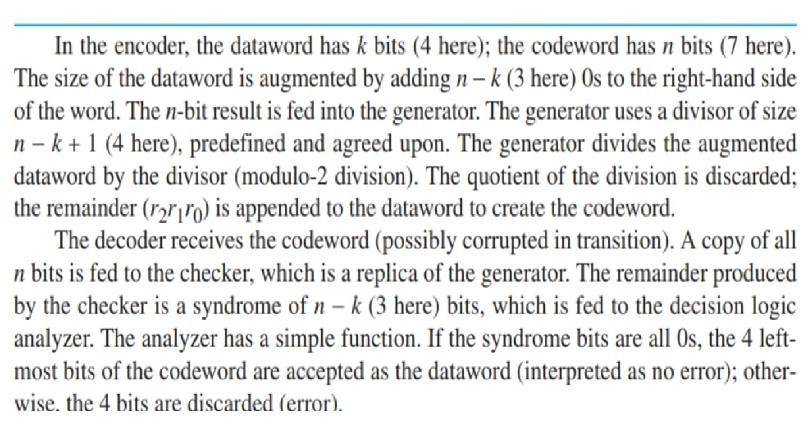
10.36

Slide 37
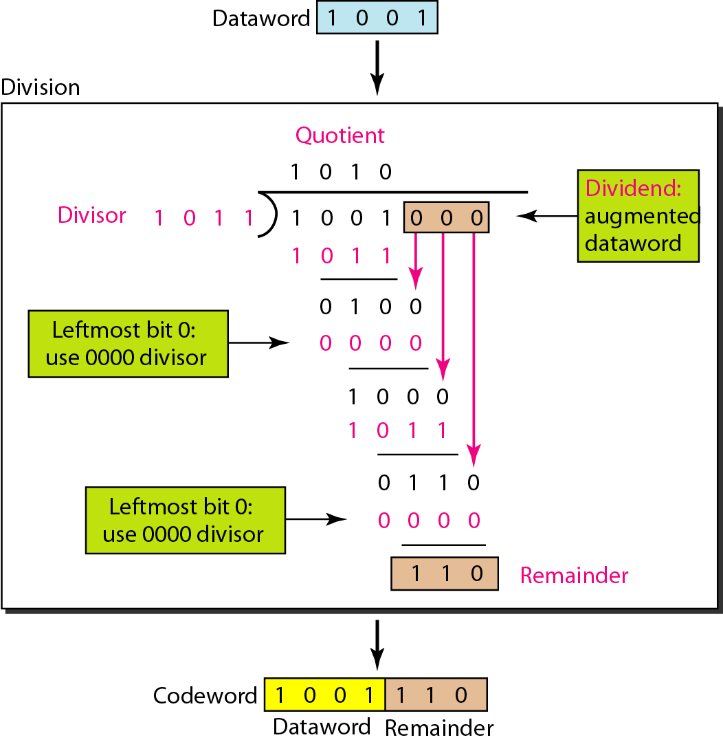
Figure 10.15 Division in CRC encoder
10.37
Notes:
37

Slide 38
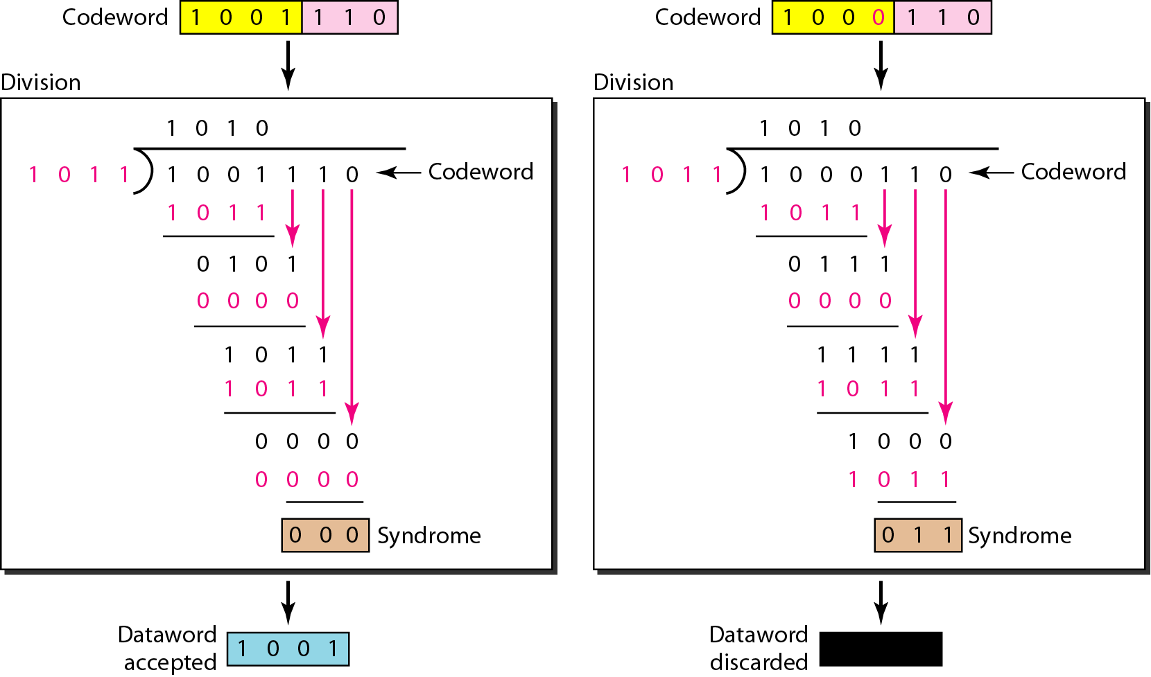
Figure 10.16 Division in the CRC decoder for two cases
10.38
Notes:
38

Slide 39
Cyclic Redundancy Check
We can create cyclic codes to correct errors. We discuss a subset of cyclic codes called the cyclic redundancy check (CRC), which is used in networks such as LANs and WANs.
Can detect all odd errors single bit and burst error of length equal to polynomial degree.

Slide 40
CRC generation at sender side
Find the length of the divisor ‘L’.
Append’L-1’ bits to the original message.
Perform binary division operation.
Remainder of the division =CRC.
Message to be transmitted=Message+CRC

Slide 41
CRC generation at Receiver side
1.Receive the transmitted →Message+CRC.
2. Divide it by divisor.
3. If we found remainder→ error occur.
4 If there is no remainder→ no error in data.

Slide 42
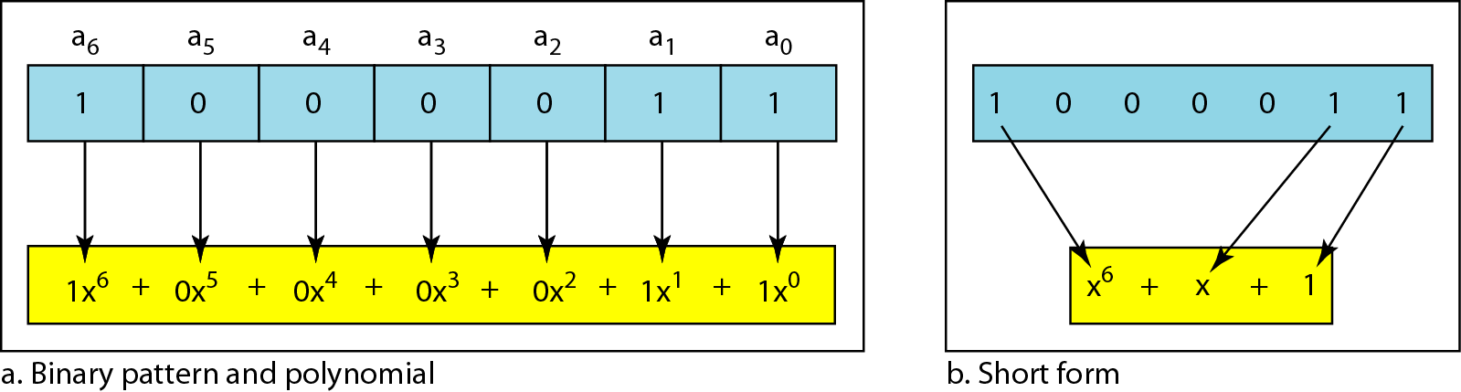
Figure 10.21 A polynomial to represent a binary word
10.42
Notes:
42

Slide 43
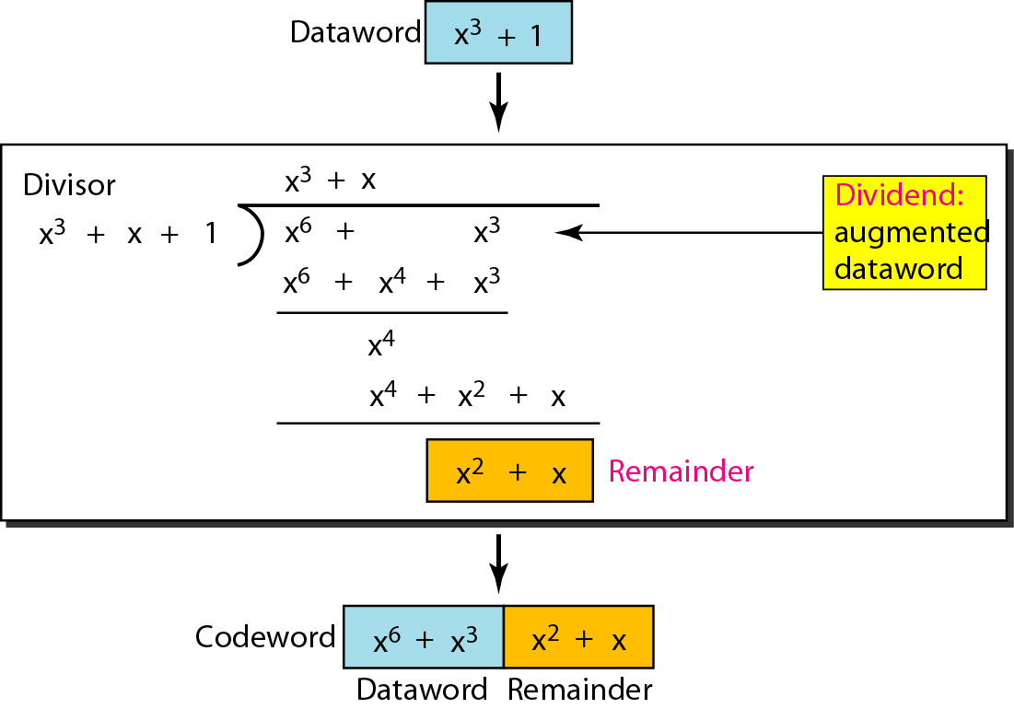
Figure 10.22 CRC division using polynomials
10.43
Notes:
43

Slide 44
Note
The divisor in a cyclic code is normally called the generator polynomial
or simply the generator.
10.44
Notes:
44

Slide 45
Dataword: d(x)
Syndrome: s(x)
Codeword: c(x)
Error: e(x)
Generator: g(x)
10.45

Slide 46
Note
In a cyclic code,
If s(x) ≠ 0, one or more bits is corrupted.
If s(x) = 0, either
a. No bit is corrupted. or
b. Some bits are corrupted, but the decoder failed to detect them.
10.46
Notes:
46

Slide 47
Note
In a cyclic code, those e(x) errors that are divisible by g(x) are not caught.
10.47
Notes:
47

Slide 48
Note
If the generator has more than one term and the coefficient of x⁰ is 1, all single errors can be caught.
10.48
Notes:
48

Slide 49
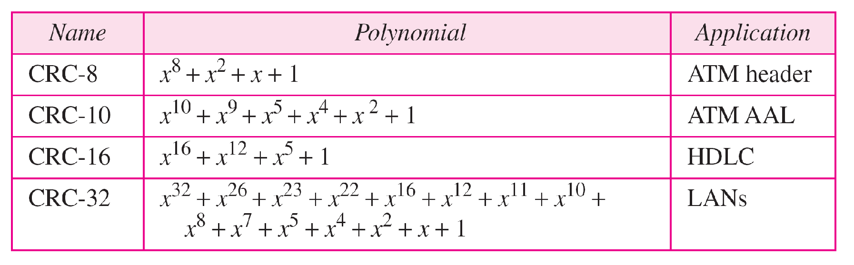
Table 10.7 Standard polynomials
10.49
Notes:
49

Slide 50
10-5 CHECKSUM
The last error detection method we discuss here is called the checksum. The checksum is used in the Internet by several protocols although not at the data link layer. However, we briefly discuss it here to complete our discussion on error checking
Topics discussed in this section:
Idea One’s Complement Internet Checksum
10.50
Notes:
50

Slide 51
Checksum
Checksum= Check+sum
Sender side- Checksum Creation
Receiver side- Checksum Validation

Slide 52
Checksum operation at Sender Side
Block of the original message in to “k” number of blocks with “n” bits in each block
Sum all the “k” data blocks.
Add the carry to the sum, if any.
Do 1’s complement to the sum=Checksum

Slide 53
Checksum operation at Receiver Side
Collect all the data blocks incuding the Checksum
Sum all the data blocks and checksum
If the result is all 1’s, ACCEPT; Else, REJECT

Slide 54
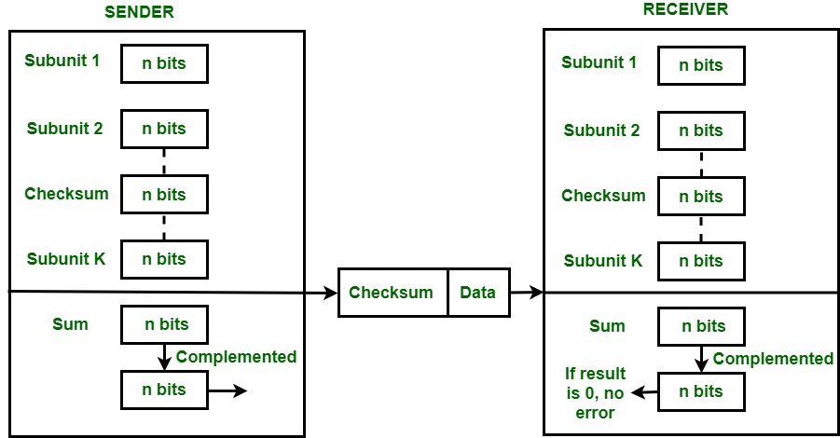

Slide 55
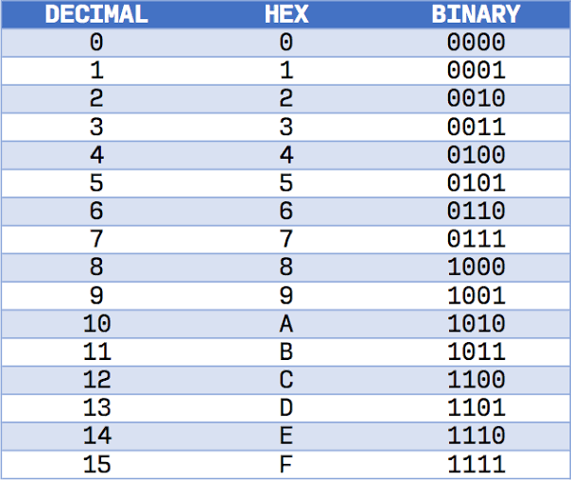

Slide 56


Slide 57
Example 10.18
Suppose our data is a list of five 4-bit numbers that we want to send to a destination. In addition to sending these numbers, we send the sum of the numbers. For example, if the set of numbers is (7, 11, 12, 0, 6), we send (7, 11, 12, 0, 6, 36), where 36 is the sum of the original numbers. The receiver adds the five numbers and compares the result with the sum. If the two are the same, the receiver assumes no error, accepts the five numbers, and discards the sum. Otherwise, there is an error somewhere and the data are not accepted.
10.57
Notes:
57

Slide 58
Example 10.19
We can make the job of the receiver easier if we send the negative (complement) of the sum, called the checksum. In this case, we send (7, 11, 12, 0, 6, −36). The receiver can add all the numbers received (including the checksum). If the result is 0, it assumes no error; otherwise, there is an error.
10.58
Notes:
58

Slide 59
Example 10.20
How can we represent the number 21 in one’s complement arithmetic using only four bits?
Solution
The number 21 in binary is 10101 (it needs five bits). We can wrap the leftmost bit and add it to the four rightmost bits. We have (0101 + 1) = 0110 or 6.
10.59
Notes:
59

Slide 60
Example 10.21
How can we represent the number −6 in one’s complement arithmetic using only four bits?
Solution
In one’s complement arithmetic, the negative or complement of a number is found by inverting all bits. Positive 6 is 0110; negative 6 is 1001. If we consider only unsigned numbers, this is 9. In other words, the complement of 6 is 9. Another way to find the complement of a number in one’s complement arithmetic is to subtract the number from 2^{n} − 1 (16 − 1 in this case).
10.60
Notes:
60

Slide 61
Example 10.22
Let us redo Exercise 10.19 using one’s complement arithmetic. Figure 10.24 shows the process at the sender and at the receiver. The sender initializes the checksum to 0 and adds all data items and the checksum (the checksum is considered as one data item and is shown in color). The result is 36. However, 36 cannot be expressed in 4 bits. The extra two bits are wrapped and added with the sum to create the wrapped sum value 6. In the figure, we have shown the details in binary. The sum is then complemented, resulting in the checksum value 9 (15 − 6 = 9). The sender now sends six data items to the receiver including the checksum 9.
10.61
Notes:
61

Slide 62
Example 10.22 (continued)
The receiver follows the same procedure as the sender. It adds all data items (including the checksum); the result is 45. The sum is wrapped and becomes 15. The wrapped sum is complemented and becomes 0. Since the value of the checksum is 0, this means that the data is not corrupted. The receiver drops the checksum and keeps the other data items. If the checksum is not zero, the entire packet is dropped.
10.62
Notes:
62

Slide 63
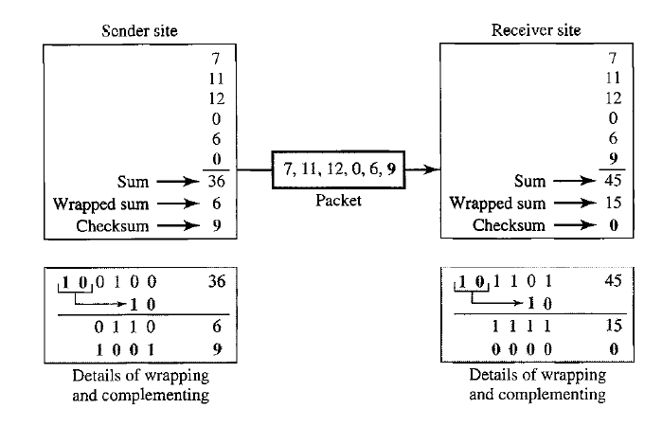
Figure 10.24 Example 10.22
10.63

Slide 64
Internet Checksum
Note
Sender site:
1. The message is divided into 16-bit words.
2. The value of the checksum word is set to 0.
3. All words including the checksum are added using one’s complement addition.
4. The sum is complemented and becomes the checksum.
5. The checksum is sent with the data.
10.64
Notes:
64

Slide 65
Internet Checksum
Note
Receiver site:
1. The message (including checksum) is divided into 16-bit words.
2. All words are added using one’s complement addition.
3. The sum is complemented and becomes the new checksum.
4. If the value of checksum is 0, the message is accepted; otherwise, it is rejected.
10.65
Notes:
65

Slide 66
Example 10.23
Let us calculate the checksum for a text of 8 characters (“Forouzan”). The text needs to be divided into 2-byte (16-bit) words. We use ASCII (see Appendix A) to change each byte to a 2-digit hexadecimal number. For example, F is represented as 0x46 and o is represented as 0x6F. Figure 10.25 shows how the checksum is calculated at the sender and receiver sites. In part a of the figure, the value of partial sum for the first column is 0x36. We keep the rightmost digit (6) and insert the leftmost digit (3) as the carry in the second column. The process is repeated for each column. Note that if there is any corruption, the checksum recalculated by the receiver is not all 0s. We leave this an exercise.
10.66
Notes:
66

Slide 67
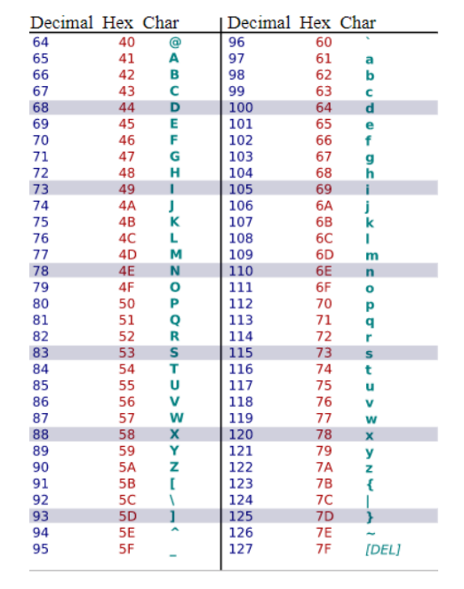
Appendix A

Slide 68
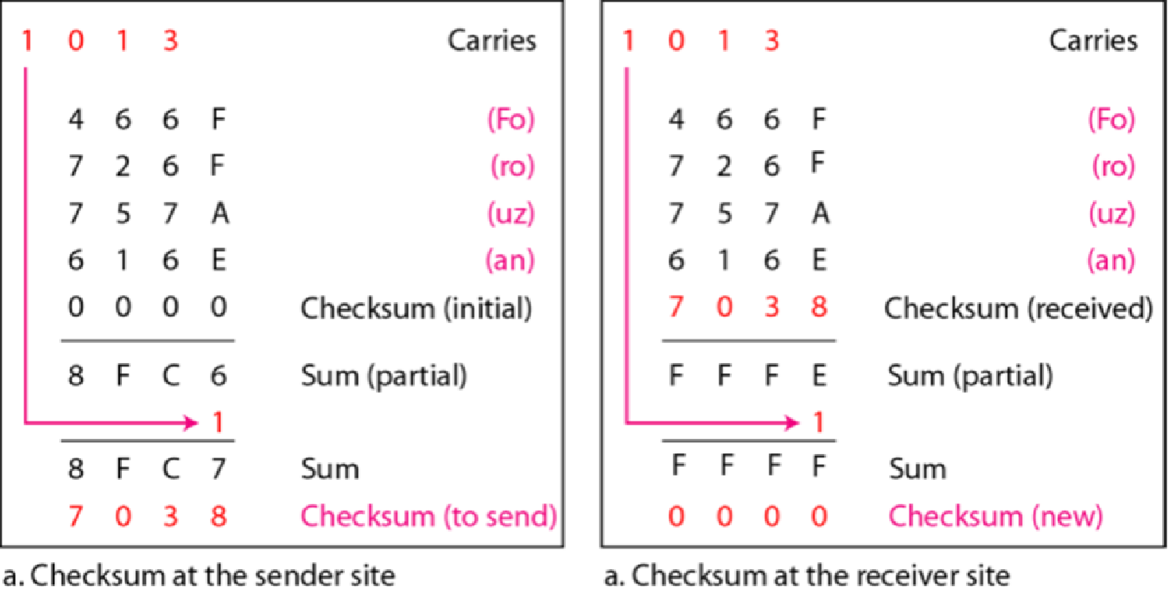
Figure 10.25 Example 10.23
10.68
Notes:
68

