Slide 1

Chapter 12
Multiple Access
Presented By NTR
Copyright © The McGraw-Hill Companies, Inc. Permission required for reproduction or display.

Slide 2
Data Link Layer
Physical Addressing
Access control
Framing
Flow control
Error control

Slide 3
Link Layer Terminology
Nodes : hosts and routers
Links:
wired links
wireless links
Frame : layer-2 packet
data-link layer has responsibility of
transferring datagram from one node
to physically adjacent node over a link

Slide 4
Link layer services
Framing
encapsulate datagram into frame, adding header, trailer
“MAC” addresses used in frame headers to identify source, destination
different from IP address!
Link access:
channel access if shared medium
Reliable delivery between adjacent nodes
we learned how to do this already (Transport Layer)
seldom used on low bit-error link (fiber, some twisted pair)
wireless links: high error rates

Slide 5
Link layer services (more)
error detection:
errors caused by signal attenuation, noise.
receiver detects presence of errors:
signals sender for retransmission or drops frame
error correction:
receiver identifies and corrects bit error(s) without resorting to retransmission
flow control:
pacing between adjacent sending and receiving nodes
half-duplex and full-duplex
with half duplex, nodes at both ends of link can transmit, but not at same time

Slide 6
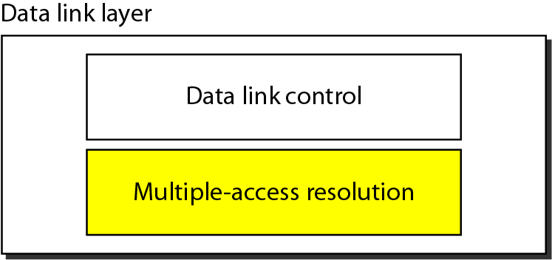
Figure 12.1 Data link layer divided into two functionality-oriented sublayers
IEEE has actually made this division for Lans. The upper sublayer is responsible for flow
control and error control. The lower sublayer is mostly responsible for multiple access resolution is called the
Media Access control Layer (MAC).

Slide 7
Media Access Control
When nodes or stations are connected and use a common link, called a multipoint or broadcast link, we need a multiple-access protocol to coordinate access to the link.
Many protocols have been devised to handle access to a shared
link. All of these protocols belong to a sublayer in the data-link layer called media access control (MAC).
We categorize them into three groups, as shown in next figure

Slide 8
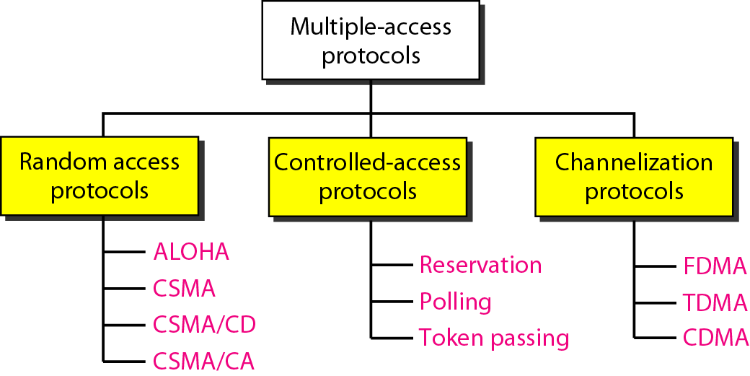
Figure 12.2 Taxonomy of multiple-access protocols discussed in this chapter

Slide 9
12-1 RANDOM ACCESS PROTOCOLS
In random access or contention methods, no station is superior to another station and none is assigned the control over another. No station permits, or does not permit, another station to send. At each instance, a station that has data to send uses a procedure defined by the protocol to make a decision on whether or not to send.
Two features give this method its name. First, there is no scheduled time for a
station to transmit. Transmission is random among the stations. That is why these
methods are called random access. Second, no rules specify which station should send
next. Stations compete with one another to access the medium.
Topics discussed in this section:
ALOHA Carrier Sense Multiple Access
Carrier Sense Multiple Access with Collision Detection
Carrier Sense Multiple Access with Collision Avoidance

Slide 10
RANDOM ACCESS
If more than one station tries to send, there is an access conflict—collision—and the frames will be either destroyed or modified. To avoid access conflict or to resolve it when it happens, each station follows a procedure that answers the following questions:
When can the station access the medium?
What can the station do if the medium is busy?
How can the station determine the success or failure of the transmission?
What can the station do if there is an access conflict?

Slide 11
RANDOM ACCESS
In random-access, we study in this chapter have evolved from a very interesting protocol known as ALOHA, The method was improved with the addition of a procedure that forces the station to sense the medium before transmitting. This was called carrier sense multiple access (CSMA). This method later evolved into two parallel methods: carrier sense multiple access with collision detection (CSMA/CD), which tells the station
what to do when a collision is detected, and carrier sense multiple access with collision avoidance (CSMA/CA), which tries to avoid the collision.

Slide 12
Pure ALOHA
The original ALOHA protocol is called pure ALOHA.
The pure ALOHA protocol relies on acknowledgments from the receiver. If the acknowledgment does not arrive after a time-out period, the station assumes that the frame (or the acknowledgment) has been destroyed and resends the frame.
A collision involves two or more stations. If all these stations try to resend their frames after the time-out, the frames will collide again.
Pure ALOHA dictates that when the time-out period passes, each station waits a random amount of time before resending its frame. The randomness will help avoid more collisions. We call this time the backoff time T_{B}.

Slide 13
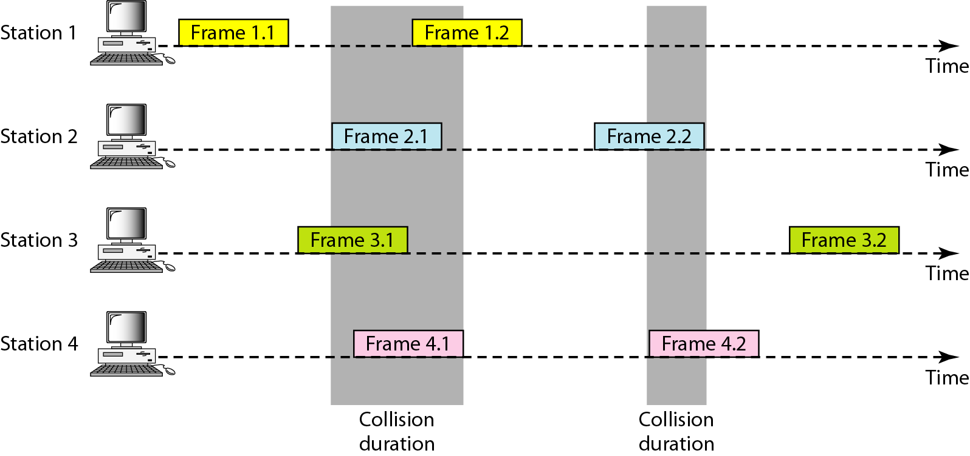
Figure 12.3 Frames in a pure ALOHA network

Slide 14
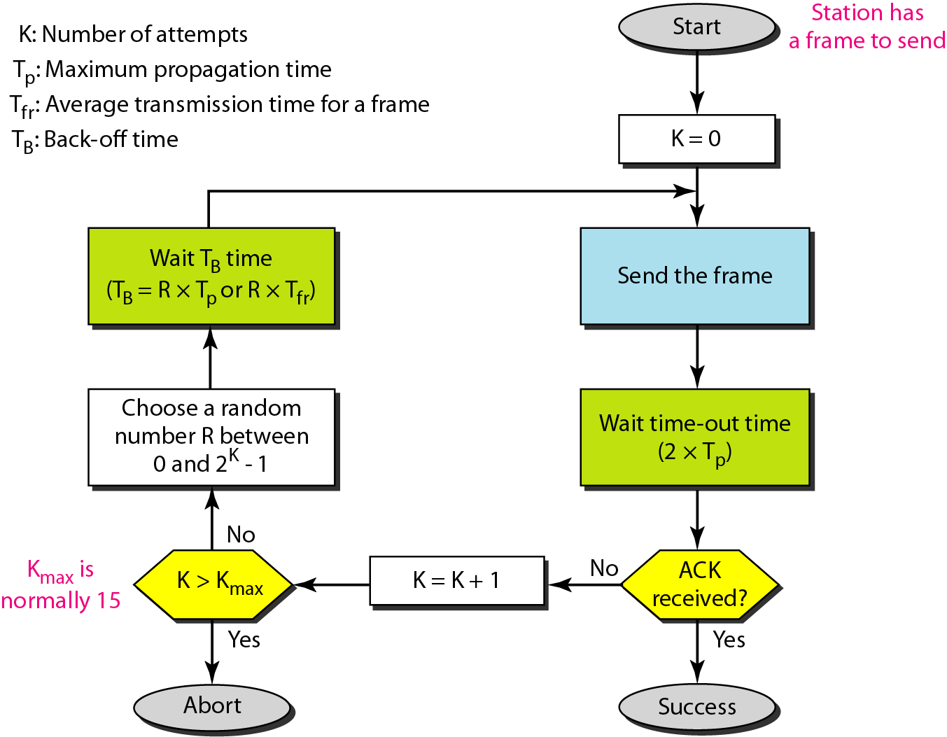
Figure 12.4 Procedure for pure ALOHA protocol

Slide 15
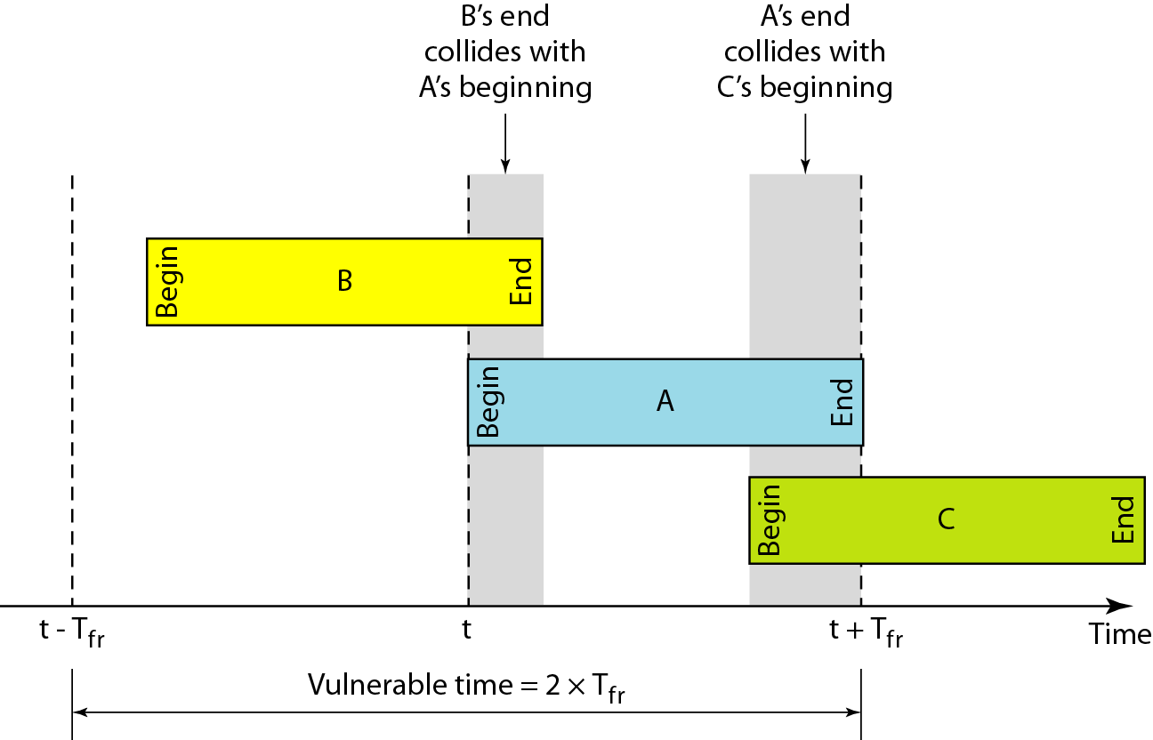
Figure 12.5 Vulnerable time for pure ALOHA protocol
Let’s find the vulnerable time, the length of time in which there is a possibility of collision.
We assume that the stations send fixed-length frames with each frame taking T_{fr} seconds
to send. Below figure shows the vulnerable time for station B.
Pure ALOHA vulnerable time = 2 x T_{fr}

Slide 16
Slotted ALOHA
Slotted ALOHA was invented to improve the efficiency of pure ALOHA.
In slotted ALOHA we divide the time into slots of T_{fr} seconds and force the station to send only at the beginning of the time slot.
A station is allowed to send only at the beginning of the synchronized time slot, if a station misses this moment, it must wait until the beginning of the next time slot.
Of course, there is still the possibility of collision if two stations try to send at the beginning of the same time slot. However, the vulnerable time is now reduced to one-half, equal to Tf_{r}.

Slide 17
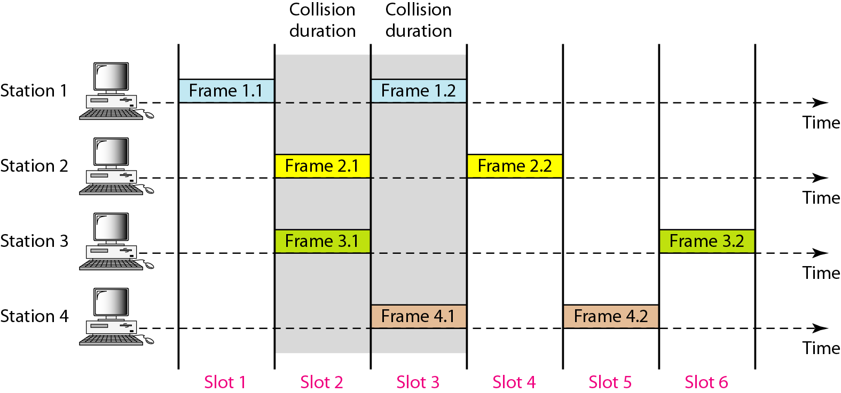
Figure 12.6 Frames in a slotted ALOHA network

Slide 18
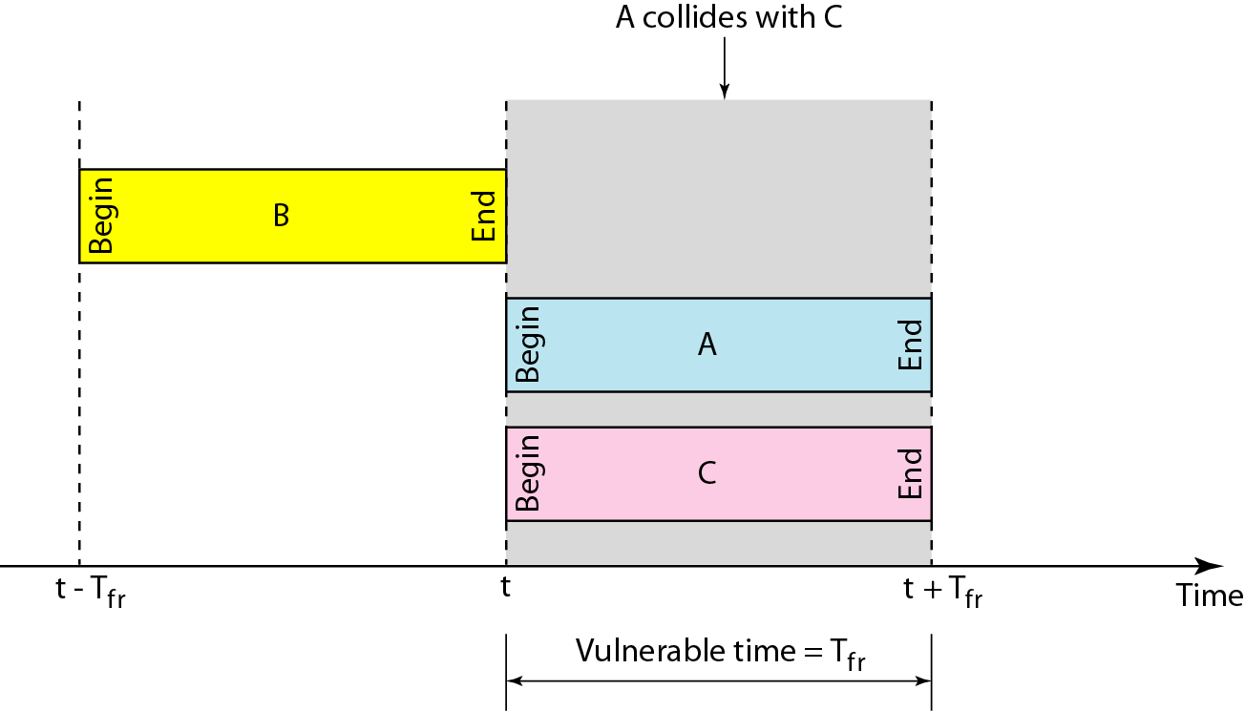
Figure 12.7 Vulnerable time for slotted ALOHA protocol

Slide 19
PURE ALOHA VS SLOTTED ALOHA
Pure Aloha | Slotted Aloha
Any station can transmit the data at any time. | Any station can transmit the data at the beginning of any time slot.
The time is continuous and not globally synchronized. | The time is discrete and globally synchronized.
Vulnerable time in which collision may occur = 2 x T _{Fr} | Vulnerable time in which collision may occur =T _{Fr}
Probability of successful transmission of data packet= G x e^{-2G} | Probability of successful transmission of data , packet= G x e^{-G}
Maximum efficiency = 18.4% (Occurs at G =1/2) | Maximum efficiency = 36.8% ( Occurs at G =1)
Main advantage: Simplicity in implementation. | Main advantage: It reduces the number of collisions to half and doubles the efficiency of pure aloha.

Slide 20
CSMA
To minimize the chance of collision and, therefore, increase the performance, the CSMA method was developed. The chance of collision can be reduced if a station senses the medium before trying to use it.
Carrier sense multiple access (CSMA) is based on the principle “sense before transmit” or “listen before talk.”
CSMA can reduce the possibility of collision, but it cannot eliminate it.
The possibility of collision still exists because of propagation delay;
When a station sends a frame, it still takes time for the first bit to reach every station and for every station to sense it. In other words, a station may sense the medium and find it idle, only because the first bit sent by another station has not yet been received.

Slide 21
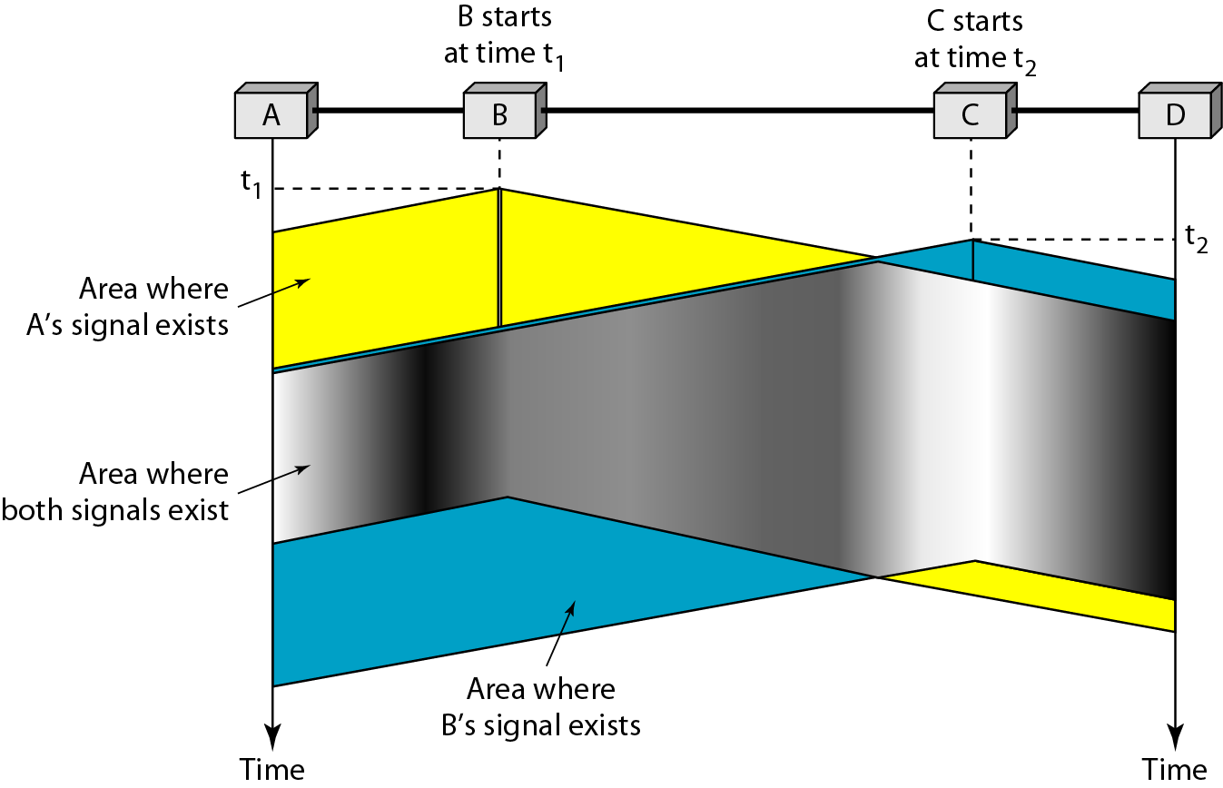
Figure 12.8 Space/time model of the collision in CSMA

Slide 22
Vulnerable Time of CSMA
The vulnerable time for CSMA is the propagation time Tp.
This is the time needed for a signal to propagate from one end of the medium to the other. When a station sends a frame and any other station tries to send a frame during this time, a collision will result.
But if the first bit of the frame reaches the end of the medium, every station will already have heard the bit and will refrain from sending. Figure 12.8 shows the worst case. The leftmost station, A, sends a frame at time t1, which reaches the rightmost station, D, at time t1 + Tp. The gray area shows the vulnerable area in time and space.

Slide 23
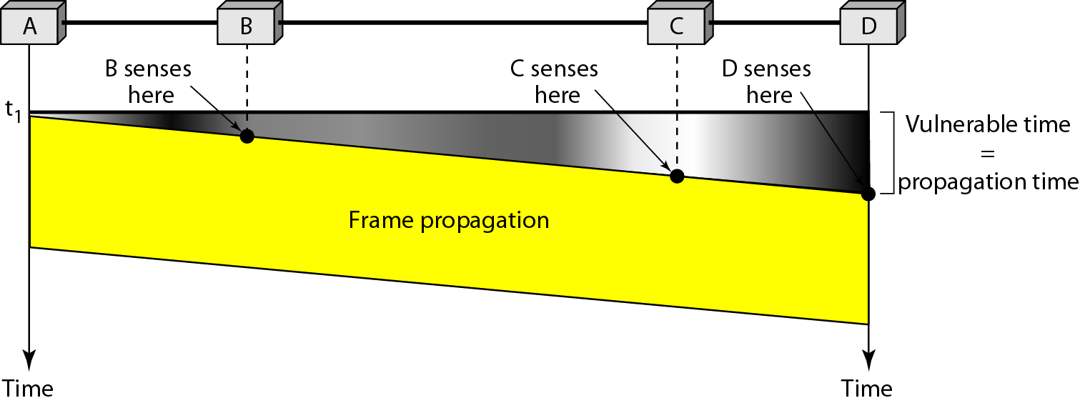
Figure 12.9 Vulnerable time in CSMA

Slide 24
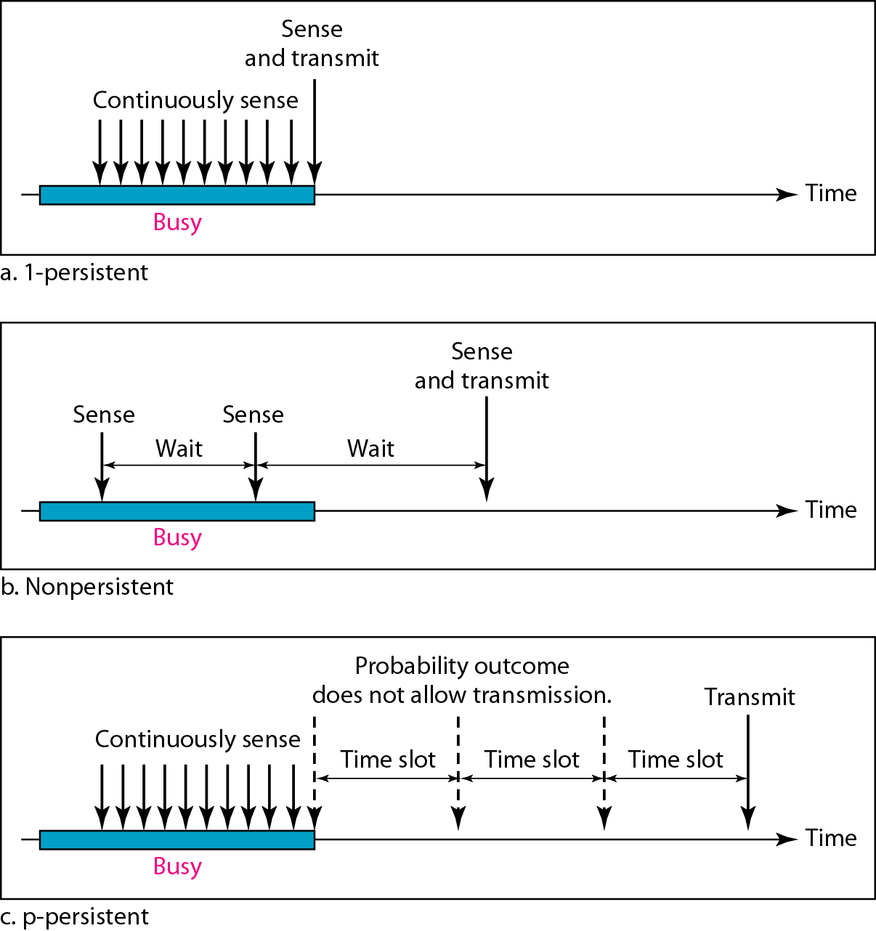
Persistence Methods
What should a station do if the channel is busy? What should a station do if the channel is idle? Three methods have been devised to answer these questions: the 1-persistent method, the nonpersistent method, and the p-persistent method.
Figure shows the behavior of three persistence methods when a station finds a channel busy.

Slide 25
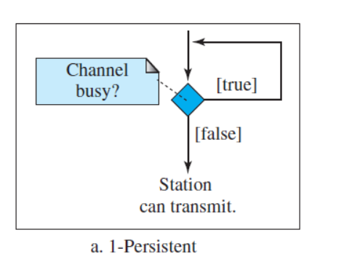
1-Persistent
In this method, after the station finds the line idle, it sends its frame immediately (with probability 1). This method has the highest chance of collision because two or more stations may find the line idle and send their frames immediately.

Slide 26
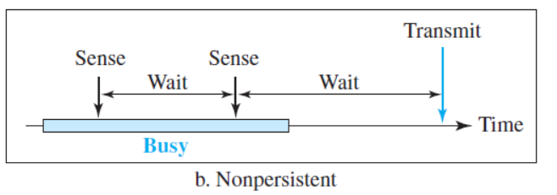
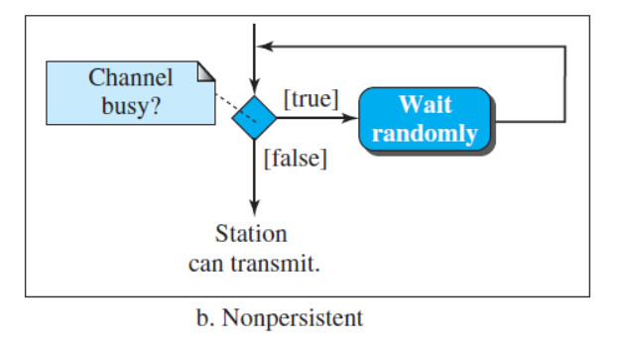
Nonpersistent
In the nonpersistent method, a station that has a frame to send senses the line. If the line is idle, it sends immediately. If the line is not idle, it waits a random amount of time and then senses the line again. The nonpersistent approach reduces the chance of collision because it is unlikely that two or more stations will wait the same amount of time and retry to send simultaneously. However, this method reduces the efficiency of the network because the medium remains idle when there may be stations with frames to send.

Slide 27
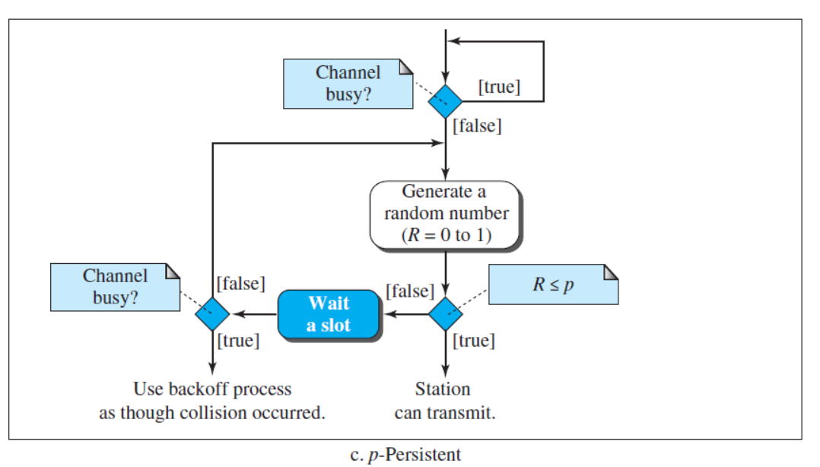
p-Persistent
The p-persistent method is used if the channel has time slots with a slot duration equal to or greater than the maximum propagation time. The p-persistent approach combines the advantages of the other two strategies. It reduces the chance of collision and improves efficiency.

Slide 28
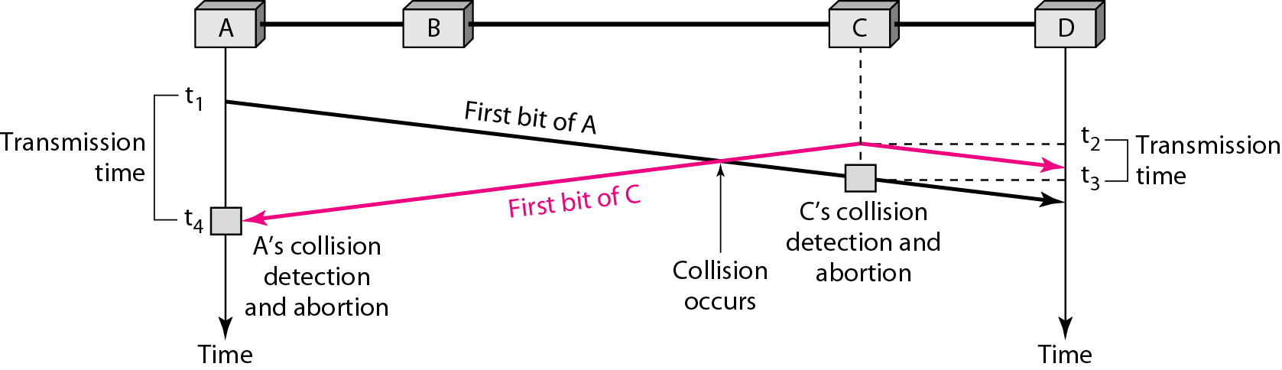
CSMA/CD
Carrier sense multiple access with collision detection (CSMA/CD) augments the algorithm to handle the collision.
In this method, a station monitors the medium after it sends a frame to see if the transmission was successful. If so, the station is finished. If, however, there is a collision, the frame is sent again.
Figure 12.12 Collision of the first bit in CSMA/CD

Slide 29
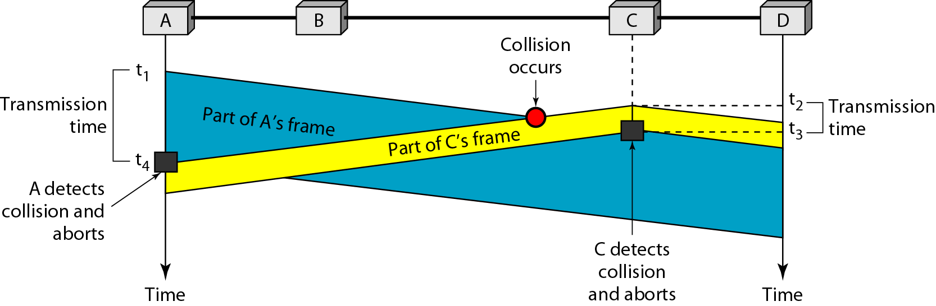
For CSMA/CD to work, we need a restriction on the frame size. Before sending the last bit of the frame, the sending station must detect a collision, if any, and abort the transmission.
This is so because the station, once the entire frame is sent, does not keep a copy of the frame and does not monitor the line for collision detection. Therefore, the frame transmission time T_{fr} must be at least two times the maximum propagation time Tp.
To understand the reason, let us think about the worst-case scenario. If the two stations involved in a collision are the maximum distance apart, the signal from the first takes time Tp to reach the second, and the effect of the collision takes another time T_{P} to reach the first. So the requirement is that the first station must still be transmitting after 2Tp.
Figure 12.13 Collision and abortion in CSMA/CD

Slide 30
Example 12.5
A network using CSMA/CD has a bandwidth of 10 Mbps. If the maximum propagation time (including the delays in the devices and ignoring the time needed to send a jamming signal, as we see later) is 25.6 μs, what is the minimum size of the frame?
Solution
The frame transmission time is T_{fr} = 2 × T_{p} = 51.2 μs. This means, in the worst case, a station needs to transmit for a period of 51.2 μs to detect the collision. The minimum size of the frame is 10 Mbps × 51.2 μs = 512 bits or 64 bytes. This is actually the minimum size of the frame for Standard Ethernet.

Slide 31
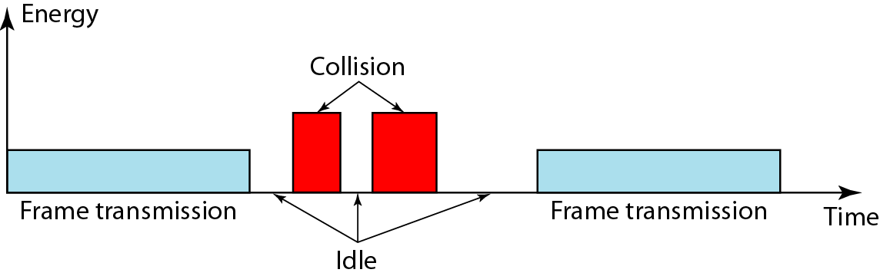
Figure 12.15 Energy level during transmission, idleness, or collision
We can say that the level of energy in a channel can have three values: zero, normal,
and abnormal. At the zero level, the channel is idle. At the normal level, a station has
successfully captured the channel and is sending its frame. At the abnormal level, there
is a collision and the level of the energy is twice the normal level.

Slide 32
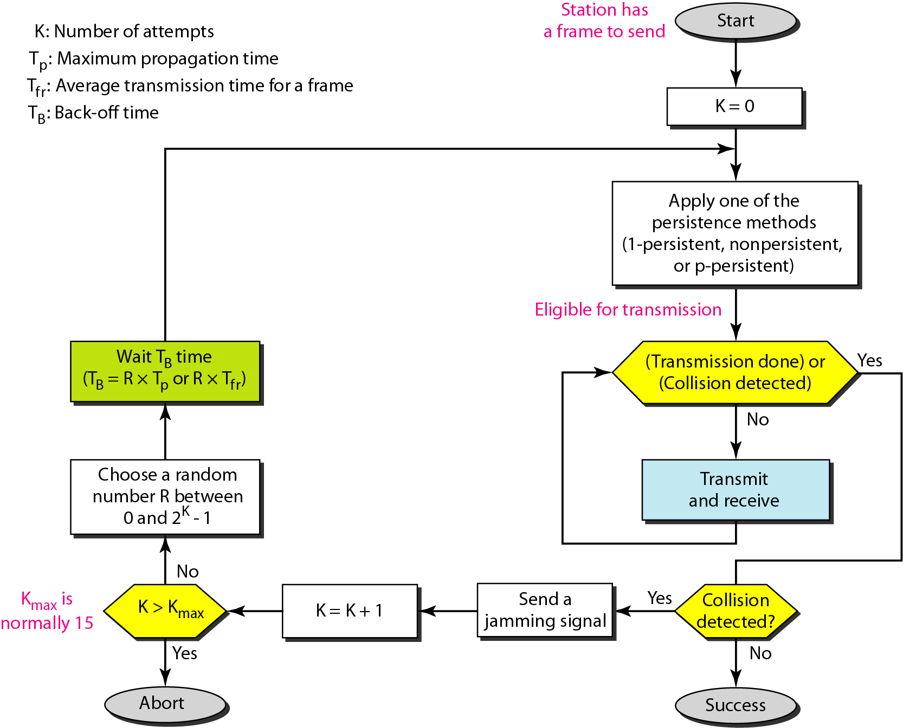
Figure 12.14 Flow diagram for the CSMA/CD

Slide 33
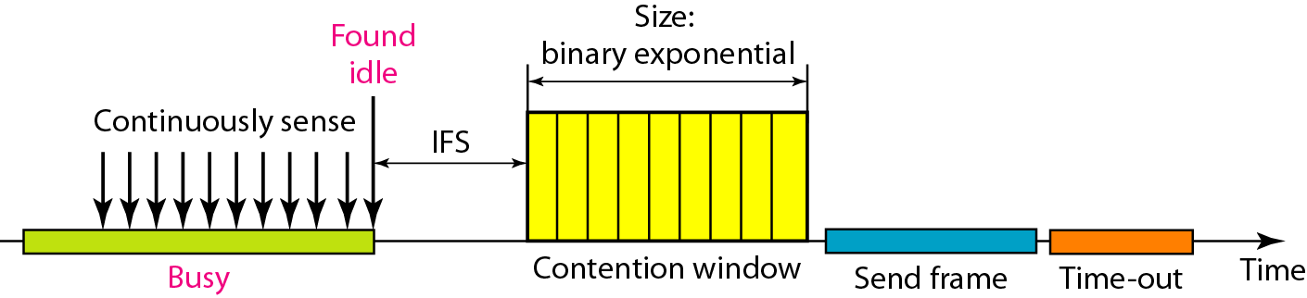
Figure 12.16 Timing in CSMA/CA
Carrier sense multiple access with collision avoidance (CSMA/CA) was invented
for wireless networks. Collisions are avoided through the use of CSMA/CA’s three
strategies: the inter frame space, the contention window, and acknowledgments, as
shown in Figure

Slide 34

Note
In CSMA/CA, the IFS can also be used to define the priority of a station or a frame.
In CSMA/CA, if the station finds the channel busy, it does not restart the timer of the contention window;
it stops the timer and restarts it when the channel becomes idle.

Slide 35
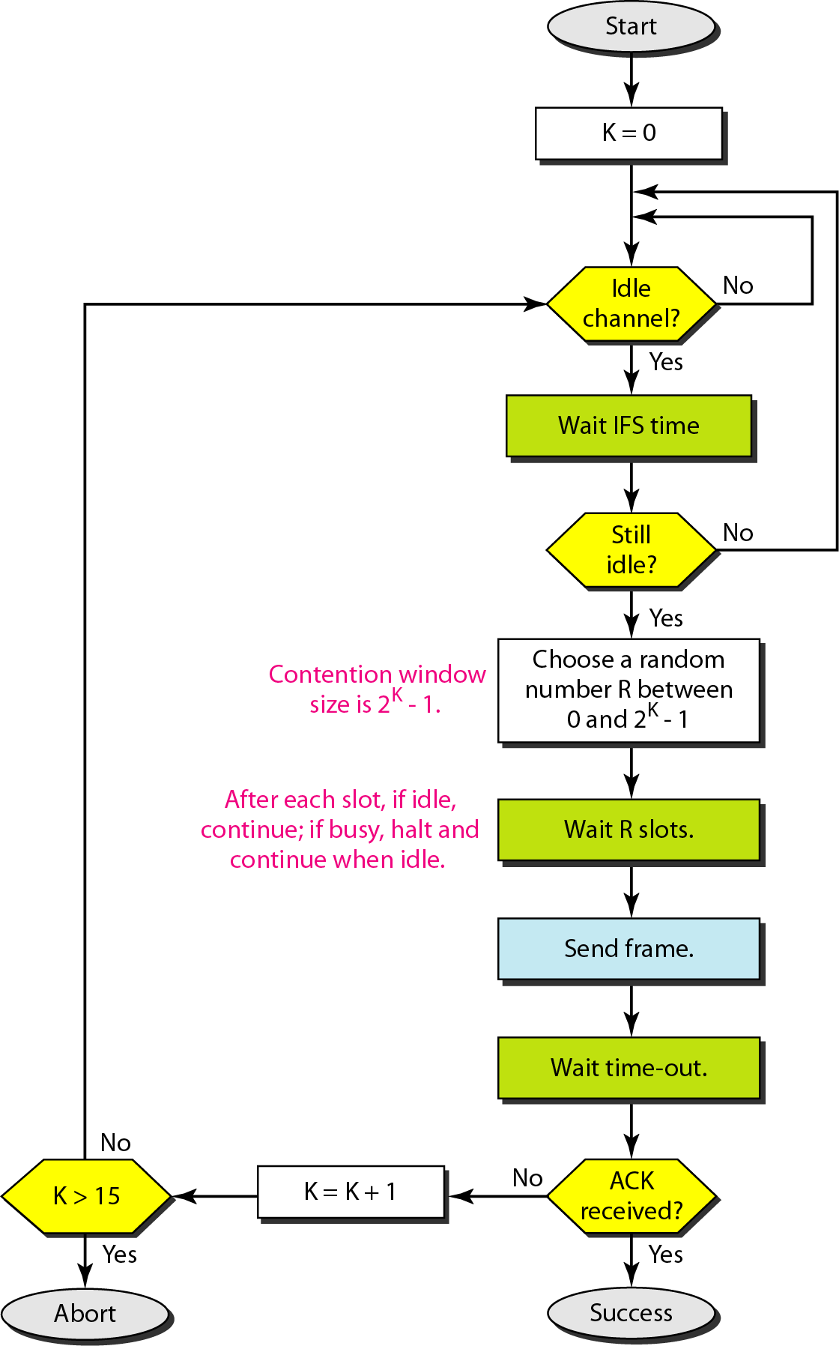
Figure 12.17 Flow diagram for CSMA/CA

Slide 36
Channel Partitioning MAC Protocols
Channelization is a multiple-access mechanism in which the link's available bandwidth is shared among several stations as per time, frequency, or code.
Time Division Multiple Access
Frequency Division Multiple Access
Code Division Multiple Access

Slide 37
TDMA: Time Division Multiple Access
TDMA divides divides the time frames into time slots.
Each slot is assigned to one of the nodes.
Slots sizes are usually the same as the packet (frame) size of node.
Advantages
Eliminates collision
Each node gets dedicated R/N bps during frame time.
Frequency

Slide 38
Channel partitioning MAC protocols: TDMA
Disadvantages:
Unused slots go idle
Example: 6-station LAN, 1,3,4 have packets to send, slots 2,5,6 idle
When there is only one node to transmit
Then the node is limited to an average rate of R/N bps
The node must wait for it’s turn to transmit
6-slot
frame
6-slot
frame
1
3
4
1
3
4

Slide 39
FDMA: Frequency Division Multiple Access
channel spectrum divided into frequency bands
each station assigned fixed frequency band
Disadvantage
unused transmission time in frequency bands go idle
example: only band 1 have packet to send, frequency bands 2 & 3 remains idle
Limited bandwidth of R/N for each node
Frequency
f3
f2
f1
Time

Slide 40
CDMA: Code Division Multiple Access
Assigns a different code to each node.
Each node then uses its unique code to encode the data bits it sends.
Disadvantage
Total frequency band is used inefficiently.

Slide 41
MAC protocols
MAC Protocols
Channel Partitioning
Random Access
Taking Turns/ Control access
Efficient and fair at High load
Inefficient at low load
Efficient at Low Load
Inefficient at high load
Best of both worlds?

Slide 42
In the controlled access approach, all the stations communicate with each other to determine which station has the authority to send data in order to avoid collision.

Slide 43
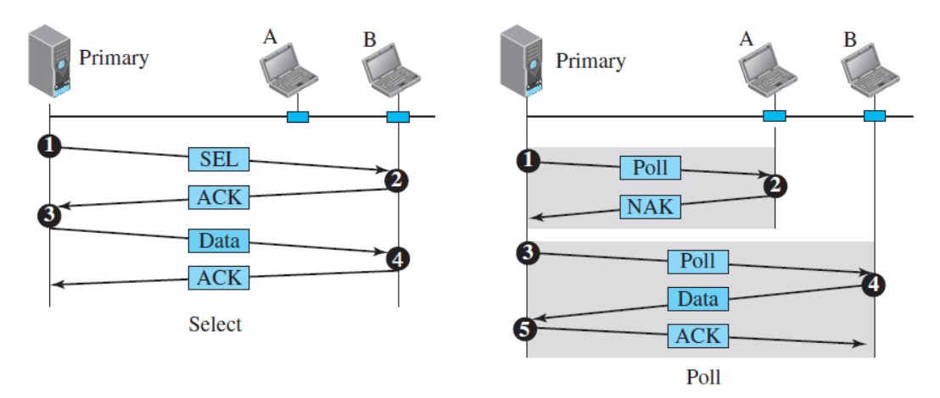
“Taking turns/ Control access ” MAC protocols
Polling
Polling works with topologies in which one device is designated as a primary station and the other devices are secondary stations. All data exchanges must be made through the primary device even when the ultimate destination is a secondary device. The primary device controls the link; the secondary devices follow its instructions.
The select function is used whenever the primary device has something to send.
The poll function is used by the primary device to solicit transmissions from the secondary devices.

Slide 44
“Taking turns/ Control access ” MAC protocols
Token Passing
In the token-passing method, the stations in a network are organized in a logical ring.
In this method, a special packet called a token circulates through the ring. The possession
of the token gives the station the right to access the channel and send its data. When a
station has some data to send, it waits until it receives the token from its predecessor. It
then holds the token and sends its data. When the station has no more data to send, it
releases the token, passing it to the next logical station in the ring. The station cannot
send data until it receives the token again in the next round.
control token passed from one node to next sequentially.
Concerns:
latency
single point of failure (token)

Slide 45
Summary of MAC protocols
random access (dynamic),
ALOHA, S-ALOHA, CSMA, CSMA/CD
carrier sensing: use in some technologies (wire), others (wireless)
CSMA/CD used in Ethernet LAN
CSMA/CA used in 802.11/ in wireless technology.
taking turns/ Control access
polling from central site, token passing
Bluetooth, FDDI, token ring
channel partitioning, by time, frequency or code
Time Division, Frequency Division

Slide 46
THE END!

