Slide 1
Data Communications Chapter 1: Introduction
NARZU TARANNUM (NTR) DEPT. OF CSE, BRAC UNIVERSITY

Slide 2
Information of Course Teachers
Narzu Tarannum (NTR) <narzu.tarannum@bracu.ac.bd
UB80609

Slide 3
Recommended Text book
1. Data Communications and Networking, 5th edition – By Behrouz A. Forouzan, ISBN
10: 1259064751 McGraw Hill
2. Data and Computer Communications, 10th edition – By William Stallings, ISBN-10:0133506487 Pearson

Slide 4
Topic covered in the semester
Topic 1: Introduction to elements of data communication, Network topology, Protocols and standards, Network models: OSI and TCP/IP model, Physical and logical addressing.
Topic 2: Basics concepts of signal: Analog and digital signal and their properties, Transmission impairment, Data rate limit calculation.
Topic 3: Digital to Digital conversion- Line coding, Block coding and Scrambling techniques.
Topic 4: Analog to Digital conversion techniques- PCM, DM.
Topic 5: Bandwidth utilization: Multiplexing and spreading, FDM, WDM, Synchronous Time-Division Multiplexing, FHSS and Direct sequence spread spectrum.
Topic 6: Major components of telephone network, Dial-Up modems and modem standards, Brief idea of DSL, Cable TV network for data transfer- Downstream and Upstream data band, Downstream and Upstream sharing, Guided and Unguided Medium- Twisted-Pair, Coaxial and fiber optic cable, radio and microwaves, wireless media.
Topic 7: Data link layer concepts, services and multi-access protocols: Channel Partitioning, Random Access and Taking Turns protocols.
Topic 8: Different types of error detection and correction mechanisms in the Data Link layer: Block coding, Hamming distance, CRC, Checksum.

Slide 5
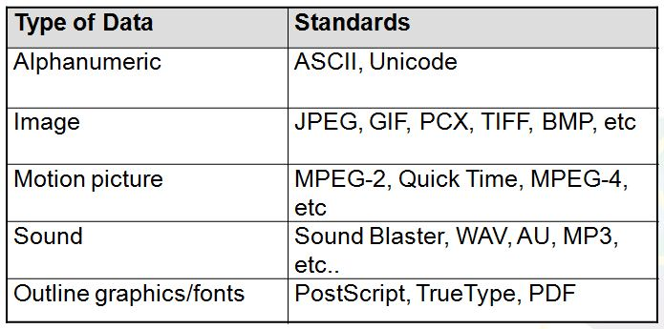
What is Data Communications
When we communicate we are sharing information- information is classified or organized data, which has some meaningful values for receiver.
Data can be a form of- text( in data communications, text is represented as a bit pattern, sequence of 0’s and 1’s), numbers, images(e.g-RGB, CMY), audio, video

Slide 6
What is Data Communications
Data communications- Data communications are exchange of data between two devices( usually sender and receiver) via some form of transmission medium
Transmission medium can be wired or wireless
Communication system- Hardware(physical equipment) and software(program)

Slide 7



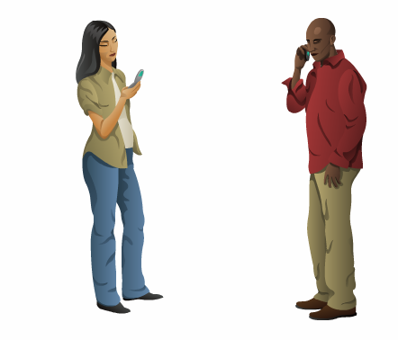
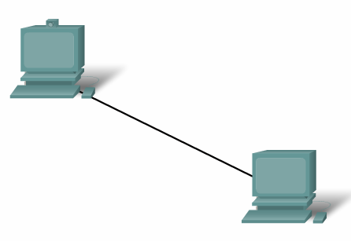

Elements of Communication
7

Slide 8
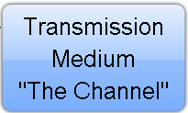




Elements of Communication
8

Slide 9
Elements of Communication over Networks
Devices (Sender/Receiver)
These are used to communicate with one another
Medium
This is how the devices are connected together
Messages
Information that travels over the medium
Rules/Protocols
Governs how messages flow across network

Slide 10
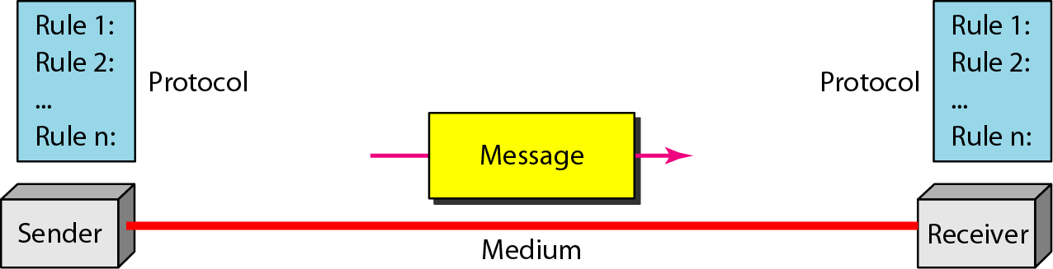
Five elements/components of data communication

Slide 11
DATA COMMUNICATIONs
The term telecommunication means communication at a distance. The word data refers to information presented in whatever form is agreed upon by the parties creating and using the data. Data communications are the exchange of data between two devices via some form of transmission medium such as a wire cable.

Slide 12
Characteristics of effective data communication
Delivery - The system must deliver data to the correct destination.
Accuracy - The system must deliver the data accurately.
Timeliness - The system must deliver data in a timely manner. In the case of video and audio, timely delivery means delivering data as they are produced, in the same order that they are produced, and without significant delay.
Jitter - Jitter refers to the variation in the packet arrival time. It is the uneven delay in the delivery of audio or video packets.

Slide 13
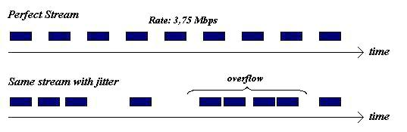

Slide 14
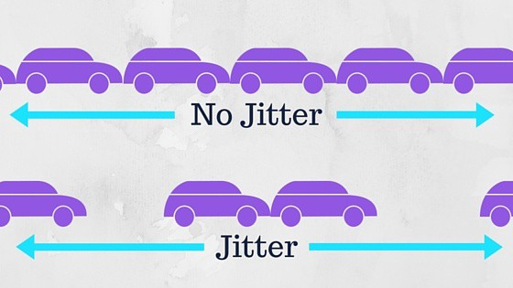

Slide 15
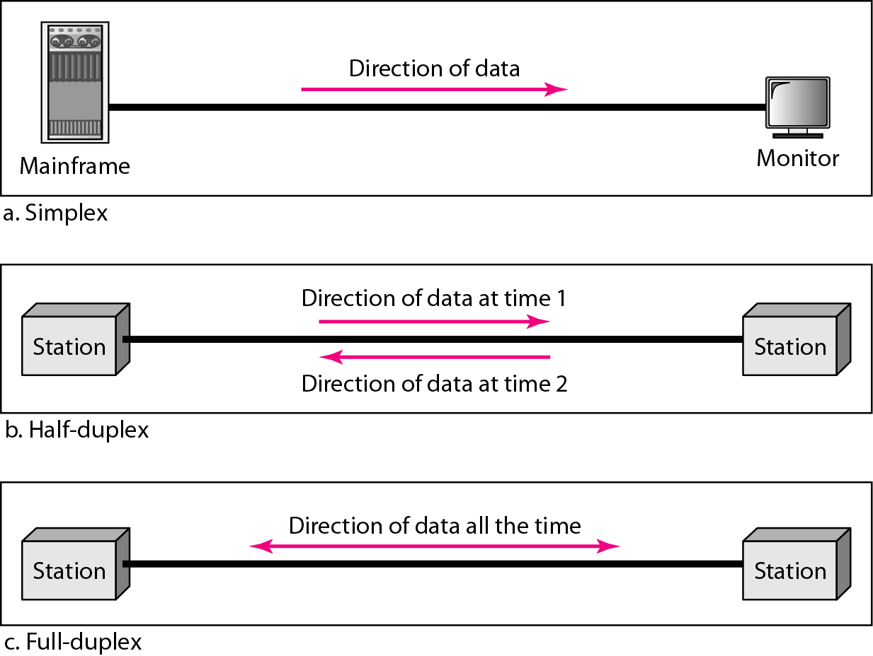
Data flow (simplex, half-duplex, and full-duplex)

Slide 16
NETWORKS
A network is a set of devices (often referred to as nodes) connected by communication links. A node can be a computer, printer, or any other device capable of sending and/or receiving data generated by other nodes on the network. A link can be a cable, air, optical fiber, or any medium which can transport a signal carrying information.
Topics discussed in this section:
Network Criteria
Physical Structures
Categories of Networks

Slide 17
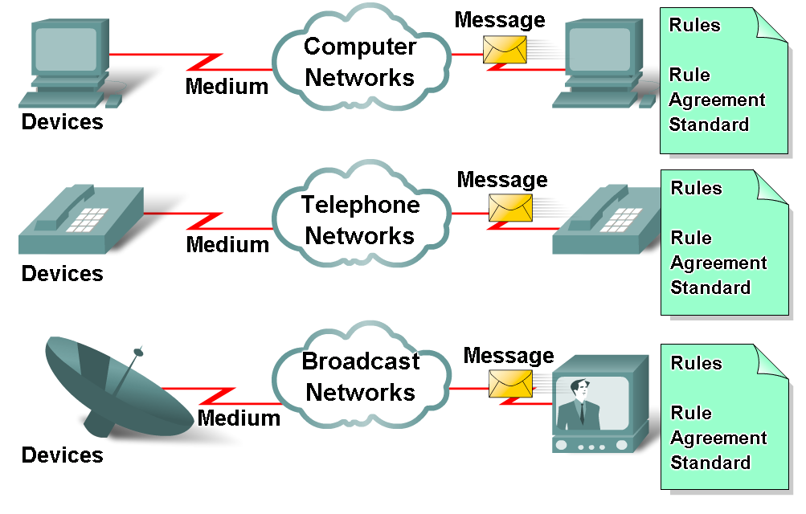
Elements of Communication over Networks
17

Slide 18
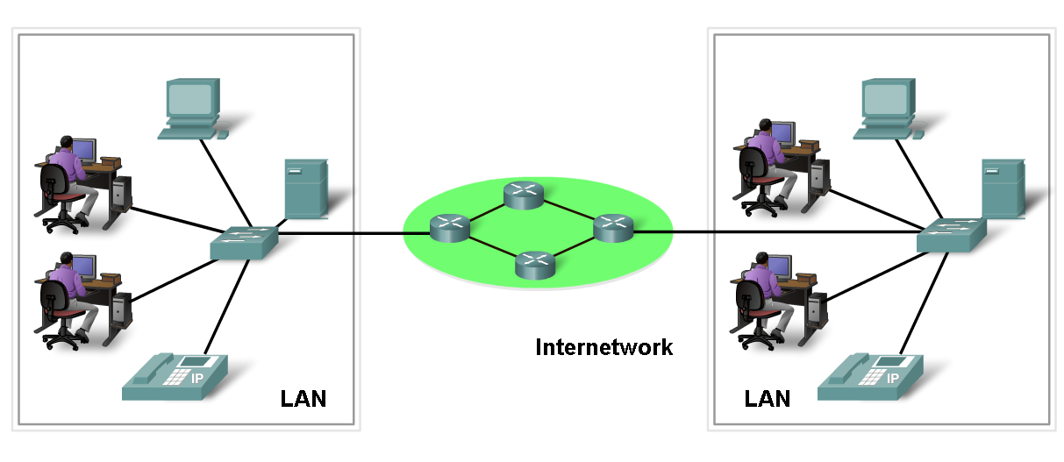
Network Elements/Components
Network Devices
Hardware (Devices and Media)
Software (Services and Processes)
18

Slide 19
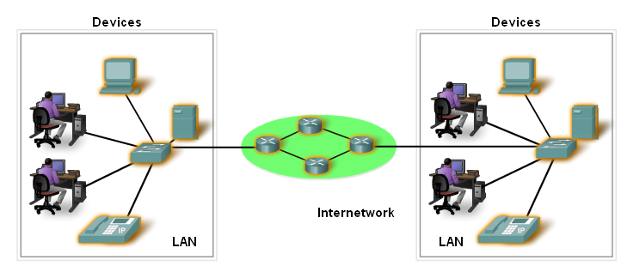
Devices
Two Types:
End Devices
Intermediary Devices
19

Slide 20
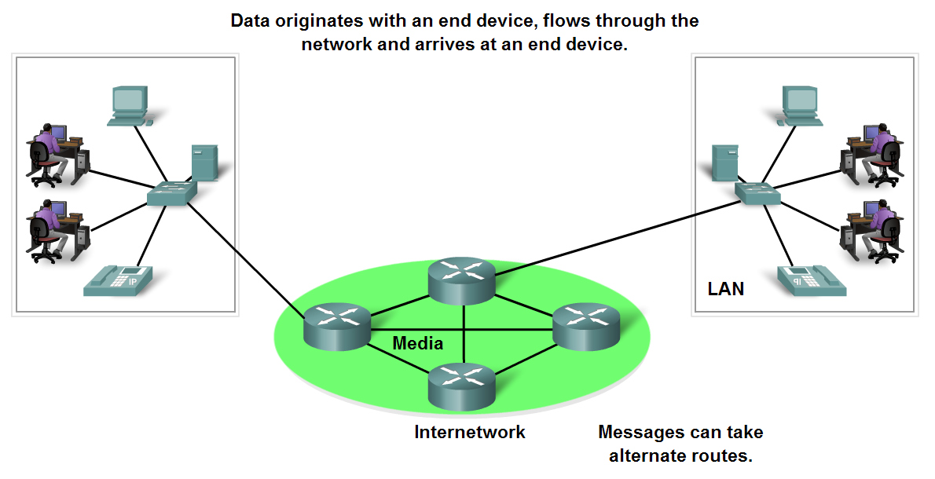
End Devices and their Role
End devices form interface with human network & communications network
20

Slide 21
Intermediary devices
Provides connectivity between end devices.
Manages data as it flows through the network.
Examples?
Routers
Switches
21

Slide 22
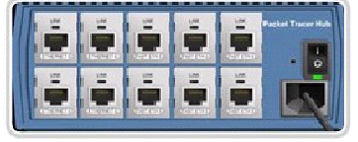
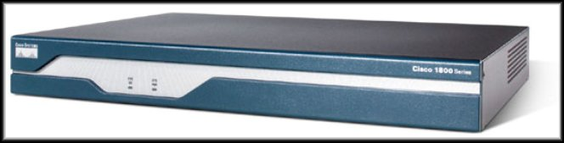
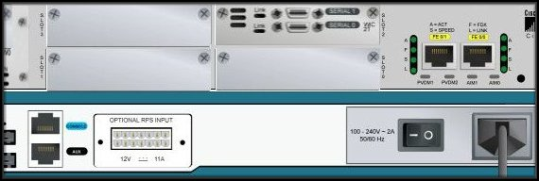
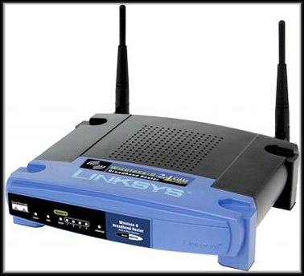

Intermediary devices
Hub
Router
Wireless Router
Switch
22

Slide 23
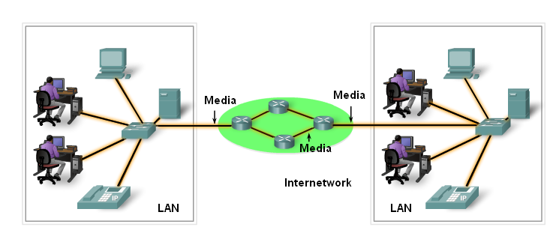
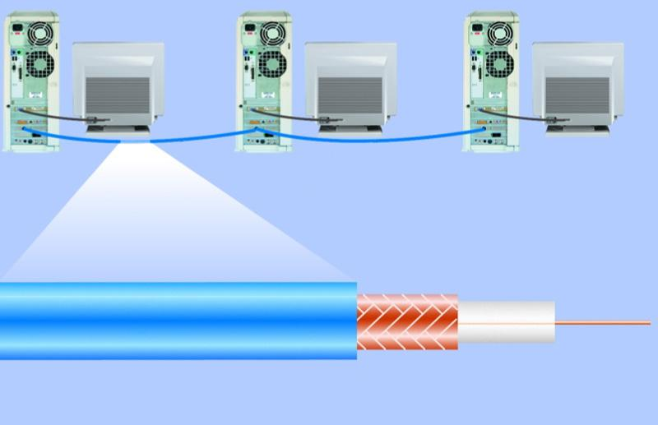
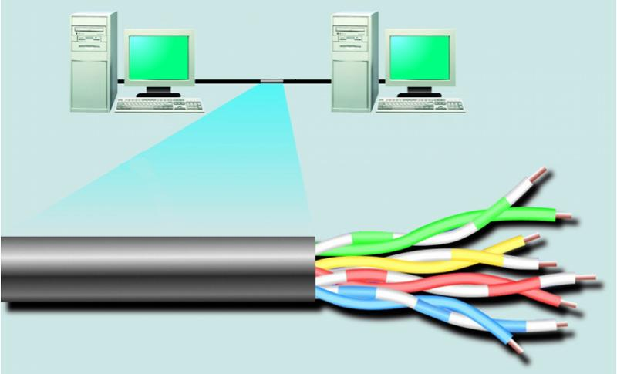
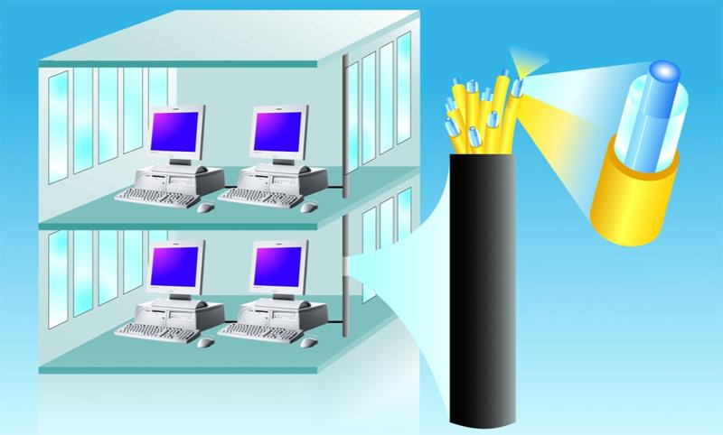
Media
optical fiber core
woven or braided metal
twisted-pair cable
twisted-pair wire
copper wire
glass cladding
plastic outer coating
insulating material
protective coating
23

Slide 24
Software
Services :
provides information in response to a request.
For example e-mail hosting services and web hosting services.
Processes :
Provide the functionality that directs and moves the messages through the network.
Processes are less obvious to us but are critical to the operation of networks.
24

Slide 25
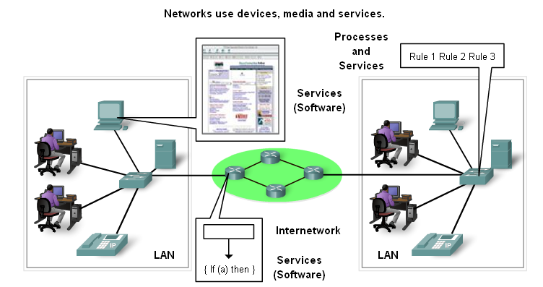
Processes and Services
25

Slide 26
Network Criteria
Performance
Depends on Network Elements
Measured in terms of Delay and Throughput
Reliability
Failure rate of network components
Measured in terms of availability/robustness
Security
Data protection against corruption/loss of data due to:
Errors
Malicious users

Slide 27
Physical Structures
Type of Connection
Point to Point - single transmitter and receiver
Multipoint - multiple recipients of single transmission
Physical Topology
Connection of devices
Type of transmission - unicast, multicast, broadcast

Slide 28
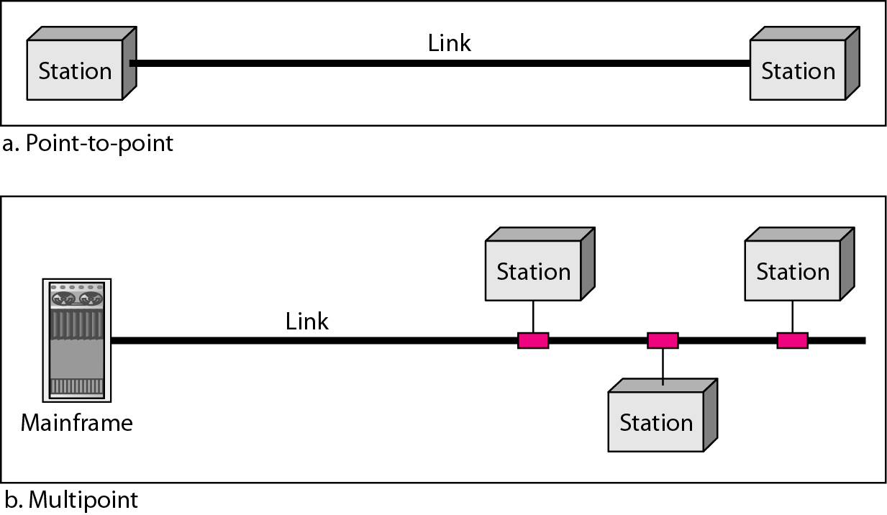
Types of connections: point-to-point and multipoint

Slide 29
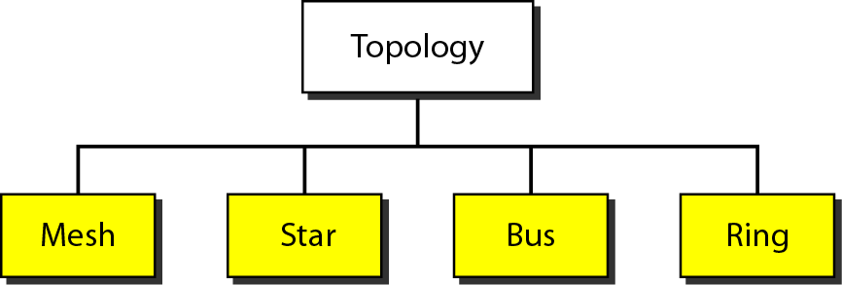
Categories of topology
Network Topology is the schematic description of a network arrangement, connecting various nodes(sender and receiver) through lines of connection.

Slide 30
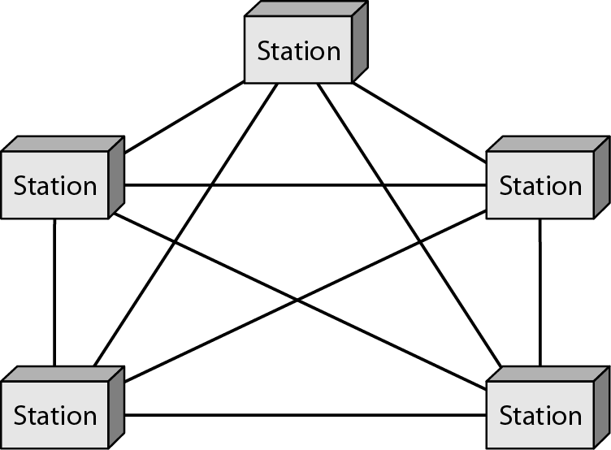
A fully connected mesh topology (five devices)
It is a point-to-point connection to other nodes or devices. All the network nodes are connected to each other. Mesh has n(n1)/2 physical channels to link n devices.

Slide 31
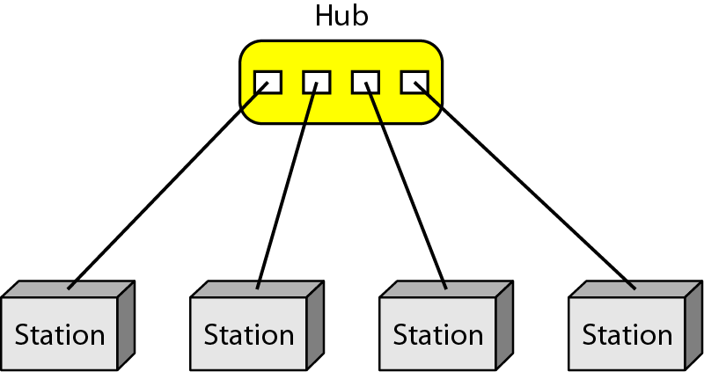
A star topology connecting four stations
In this type of topology all the computers are connected to a single hub through a cable. This hub is the central node and all others nodes are connected to the central node. Hub acts as a repeater for data flow. Can be used with twisted pair, Optical Fiber or coaxial cable.

Slide 32
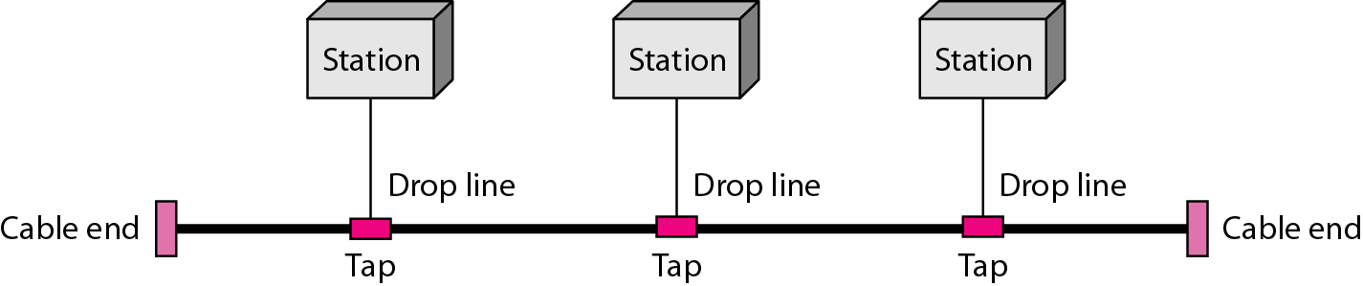
A bus topology connecting three stations
Bus topology is a network type in which every computer and network device is connected to single cable. When it has exactly two endpoints, then it is called Linear Bus topology.

Slide 33
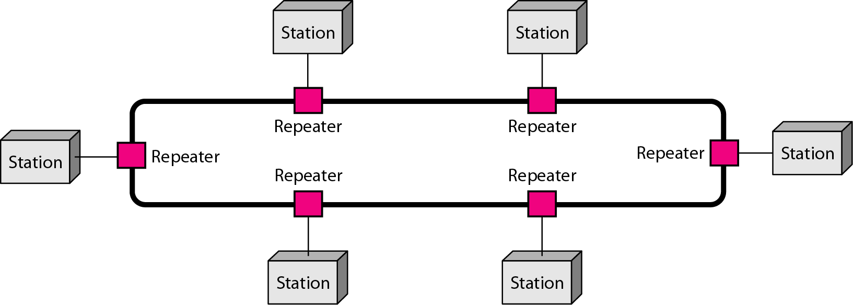
A ring topology connecting six stations
Ring topology is a type of network topology in which each device is connected to two other devices on either side via an RJ-45 cable or coaxial cable. This forms a circular ring of connected devices which gives it its name. Data is commonly transferred in one direction along the ring. The transmission is unidirectional, but it can be made bidirectional by having 2 connections between each Network Node, it is called Dual Ring Topology. In Dual Ring Topology, two ring networks are formed, and data flow is in opposite direction in them. Also, if one ring fails, the second ring can act as a backup, to keep the network up.

Slide 34
Categories of Networks
Local Area Networks (LANs)
Short distances
Designed to provide local interconnectivity
Wide Area Networks (WANs)
Long distances
Provide connectivity over large areas
Metropolitan Area Networks (MANs)
Provide connectivity over areas such as a city, a campus
Personal Area Networks (PAN)

Slide 35
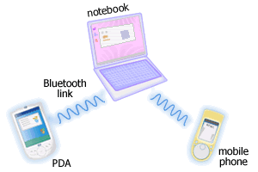
Personal Area Networks (PAN)
A network that connects computers, peripherals and other devices within a personal operating space.
Eg. Bluetooth
35
http://www.conniq.com

Slide 36
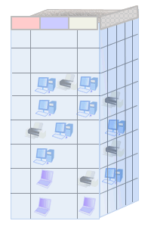
Local Area Networks (LAN)
Connects computers, peripherals and other devices within a building (e.g. office, home) or in a limited area.
Typical coverage 50 to 300 meters.
Ex. Ethernet, Wireless LANs
Through this type of network, users can easily communicate with each other by sending and receiving messages.
LAN is generally used for connecting two or more personal computers through some medium such as twisted pair, coaxial cable etc.
Through the number of computers connected in a LAN is limited
The data is transferred at an extremely faster rate.
36
http://www.conniq.com

Slide 37
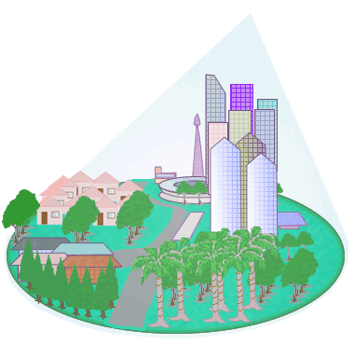
Metropolitan Area Network (MAN)
MAN is a network of computers that covers a large area like city.
The size of the MAN generally lies between LAN and WAN, typically covering a distance of 5 km to 50 km.
The geographical area covered by MAN is comparatively larger than LAN but smaller than WAN.
MAN is generally owned by private organizations.
MAN is generally connected with the help of optical fibers, copper wires etc.
37

Slide 38
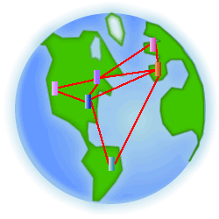
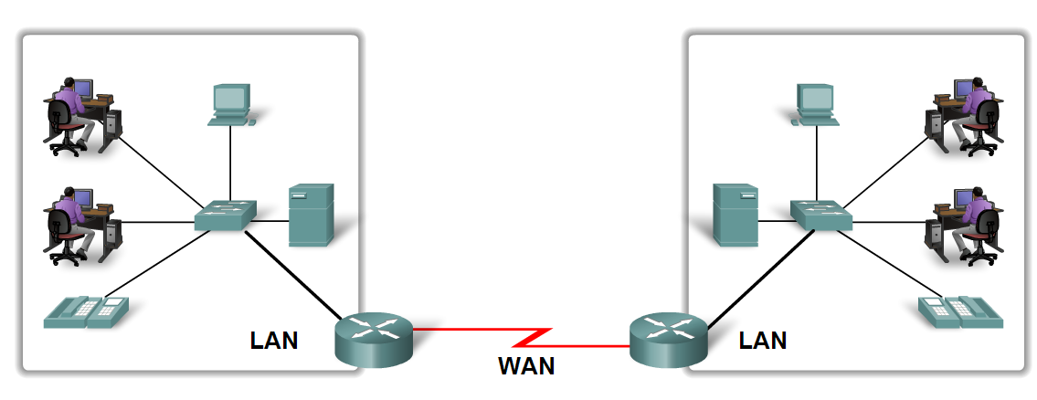
Wide Area Networks (WANs)
A network that spans larger geographical area.
WAN is a group of computers that are connected in a large area such as continent, country, etc.
WAN is generally used for connecting two or more LANs through some medium such as leased telephone lines, microwaves, etc.
38

Slide 39
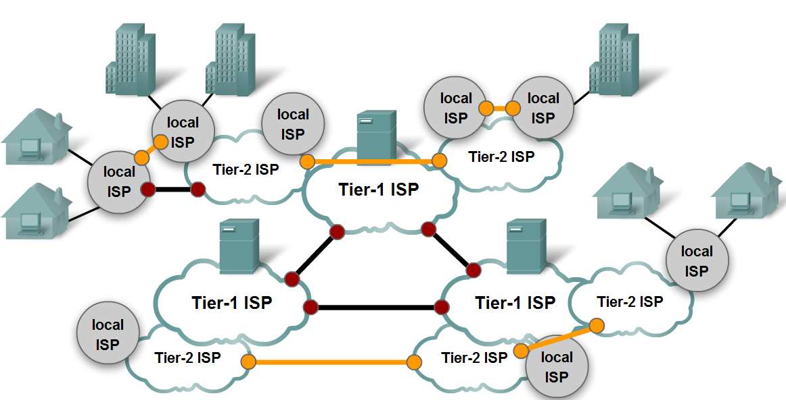
Internet
The Internet (or internet),or simply the Net (or net), is a global system of interconnected computer networks that uses the Internet protocol suite (TCP/IP)to communicate between networks and devices.
It is a network of networks that consists of private, public, academic, business, and government networks of local to global scope, linked by a broad array of electronic, wireless, and optical networking technologies.
The Internet carries a vast range of information resources and services, such as the interlinked hypertext documents and applications of the World Wide Web (WWW), electronic mail, telephony, and file sharing.
39

