Slide 1
Data communications
Chapter 2
Network Models
by NTR
2.<number>

Slide 2
LAYERED TASKS
We use the concept of layers in our daily life. As an example, let us consider two friends who communicate through postal mail. The process of sending a letter to a friend would be complex if there were no services available from the post office.
Topics discussed in this section:
Sender, Receiver, and Carrier
Hierarchy
2.<number>

Slide 3

Tasks involved in sending a letter
2.<number>

Slide 4
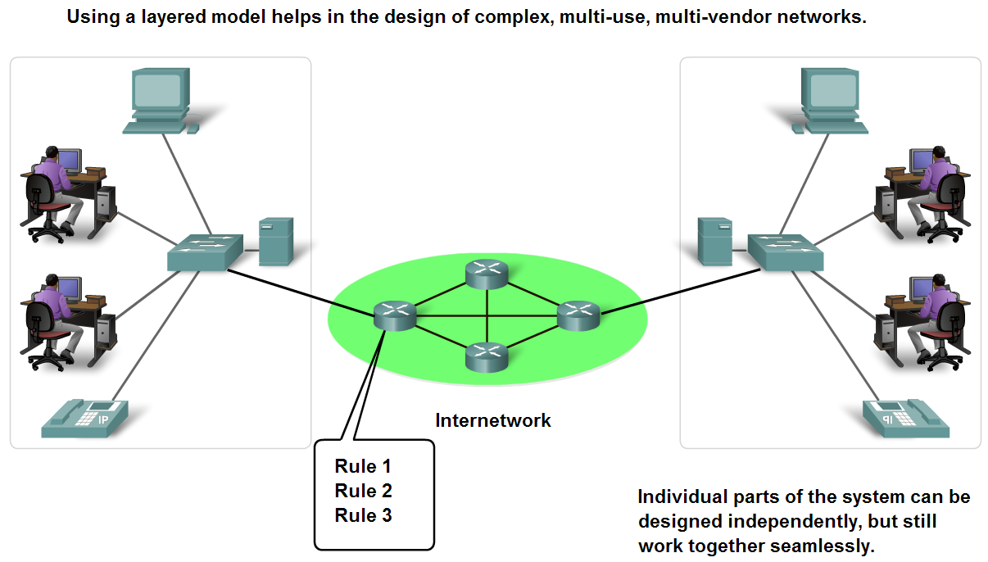
Benefits of using a layered model
To find out the fault easily.
Changes in one layer do not affect other layers.
Have defined information that they act upon.

Slide 5
Protocols and Standards
Protocols
Standards
Standards Organizations
Internet Standards

Slide 6
Standards
Endorsed by the networking industry and approved by a standards organization.
Benefits:
  Create and maintain an open and competitive market.
  Ensured greater compatibility and interoperability.
Categories
De facto: Standards that have not been approved by an organized body but have been adopted as standards through widespread use
De jure: Those standards that have been legislated by an officially recognized body

Slide 7
Standard Organizations
International Organization for Standardization (ISO)
Institute of Electrical and Electronic Engineers (IEEE)
American National Standards Institute (ANSI)
Telecommunications Industry Association (TIA)
The Internet Engineering Task Force (IETF)
International Telecommunications Union – Telecommunication Standards Sector (ITU-T)

Slide 8
Communication Process
Layered standards:
OSI Reference model
  De Jure Standard
TCP/IP Protocol suite
  Open De Facto Standard
  Governed by IETF Working
  Groups

Slide 9
THE OSI MODEL
Established in 1947, the International Standards Organization (ISO) is a multinational body dedicated to worldwide agreement on international standards. An ISO standard that covers all aspects of network communications is the Open Systems Interconnection (OSI) model. It was first introduced in the late 1970s.
An open system is a set of protocols that allows any two different systems to communicate regardless to their underlying architecture.
Topics discussed in this section:
Layered Architecture
Peer-to-Peer Processes
Encapsulation
2.<number>

Slide 10

Note
ISO is the organization.
OSI is the model.
2.<number>

Slide 11
THE OSI MODEL
The OSI model is not a protocol, it is a model for understanding and designing a network architecture that is flexible, robust, and interoperable.
2.<number>

Slide 12

Layered Architecture: Seven layers of the OSI model
In layered Architecture, a particular layer uses the services provided by its lower layer and provides services for its upper layer
2.<number>

Slide 13

The interaction between layers in the OSI model
The processes on each machine that communicate at a given layer are called peer-to-peer processes. Each layer communicates only with its peer layer on the receiving device.
2.<number>

Slide 14

Encapsulation: An exchange using the OSI model
The data portion of a packet at level n-1 carries the whole packet (data and header and maybe trailer) from level n. The concept is called encapsulation.
2.<number>

Slide 15
LAYERS IN THE OSI MODEL
In this section we briefly describe the functions of each layer in the OSI model.
Topics discussed in this section:
Physical Layer
Data Link Layer
Network Layer
Transport Layer
Session Layer
Presentation Layer
Application Layer
2.<number>

Slide 16

Summary of layers
2.<number>

Slide 17
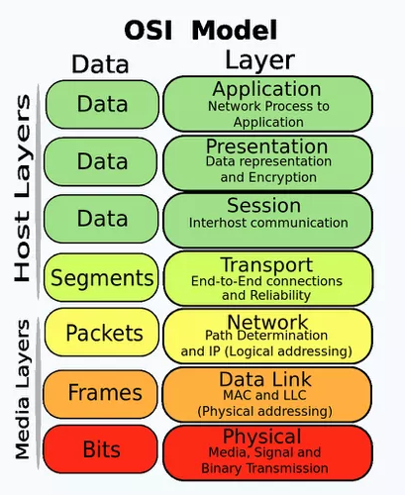
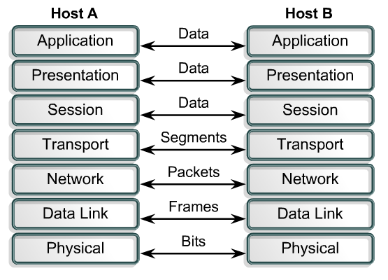
LAYERS IN THE OSI MODEL
2.<number>

Slide 18
OSI Model- 7 Layers
Layers |  | CISCO
7 | Application | All
6 | Presentation | People
5 | Session | Seem
4 | Transport | To
3 | Network | Need
2 | Data Link | Data
1 | Physical | Processing

Slide 19
Physical Layer
Note
The physical layer is responsible for movements of
individual bits from one hop (node) to the next.
2.<number>

Slide 20

Physical layer
2.<number>

Slide 21
Physical layer
Coordinates the functions required to carry a bit stream over a physical medium.
It deals with the mechanical and electrical specifications of the interface and transmission medium.
It also defines the procedures and functions that physical devices and interfaces have to perform for transmission.
2.<number>

Slide 22
Physical layer- Responsibilities:
Physical characteristics of Interfaces and medium
Representation of bits (Encoded into signals- electrical or optical)
Data transfer rate (bits per second and duration)
Synchronization of bits (clock sync of Sender and receiver)
Line Configuration (point to point multipoint)
Physical topology (Bus, Ring, Star, Mesh)
Transmission Mode (simplex, Half and full duplex))
2.<number>

Slide 23
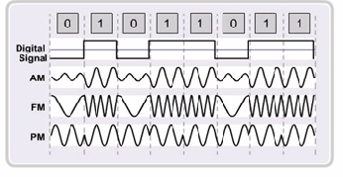
Physical layer- Representation of bits
Amplitude modulation (AM)
Frequency modulation (FM)
Phase modulation (PM)
2.<number>

Slide 24
Data link Layer
Note
The data link layer is responsible for moving
frames from one hop (node) to the next.
2.<number>

Slide 25

Data link layer
2.<number>

Slide 26
Data Link layer
It makes the physical layer appear error free to upper layer (Network layer)
The data link layer overseas the delivery of the frames between two systems on the same network
Responsibilities:
  Framing
  Physical Addressing
  Flow Control (maintain data transfer rate)
  Error Control (detect and re-transmit the lost frame)
  Access Control (who will get access in a given time)
2.<number>

Slide 27

Hop-to-hop delivery
2.<number>

Slide 28
Physical Address : MAC Address
MAC (Media Access Control) address for a device or port of a router is an unique identification number given by manufacturer.
48 bits long, represented by 12 hexadecimal digits.
07:01:02:01:2C:4B
2.<number>

Slide 29
Network Layer
Note
The network layer is responsible for the
delivery of individual packets from
the source host to the destination host.
2.<number>

Slide 30
Network layer
It does not recognize any relationship between packets. It treats each packet independently as though each piece belonged to a separate message.
Responsibilities:
  Logical Addressing(unique for a device)
  Routing(which path to take)
2.<number>

Slide 31

Network layer
2.<number>

Slide 32
Logical Addresses :: IP Address
Universal address, each host uniquely defined.
32-bit address also known as IP Address.
Independent of underlying physical networks.
Common Network layer Protocol is called Internet Protocol (IP)
Network Layer PDU is called Packets.
192.168.10.1
32 bits written in dotted decimal notation. Each decimal represented by 8 bits.
2.<number>

Slide 33

Source-to-destination delivery
2.<number>

Slide 34

Physical and Logical Addressing
Suppose A is source and P is destination IP address
And MAC Addresses are represented by Numbers
2.<number>

Slide 35
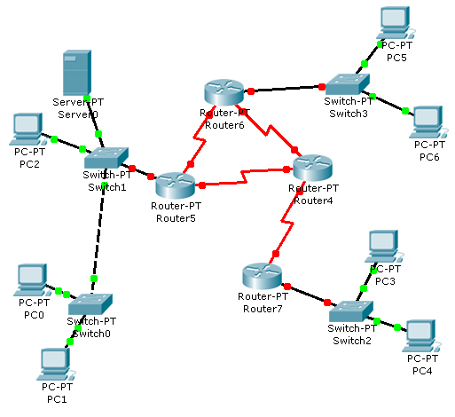

Physical and Logical Addressing (in different network)
Assume:
IP Addresses – Alphabets
MAC Addresses - Numbers
22
21
M
A
F/22
D/13
G/31
32
31
M
A
E/21
H/32
B/12
42
M
A
41
IP address
MAC address
IP address
N/41
MAC address
M/42
A/11
13
11
M
A
Receiver
Sender
D S D S

Slide 36
Physical and Logical Addressing (in same network)
Assume:
IP Addresses – Alphabets
MAC Addresses - Numbers
E/15
D/14
C/13
Receiver
B/12
A/11
14
11
D
A
Sender

Slide 37
Transport Layer
Note
The transport layer is responsible for the delivery
of a message from one process to another.
2.<number>

Slide 38
Transport layer
The transport layer is responsible for process to process delivery of the entire message
The transport layer ensures that the whole message arrives intact and in order
Responsibilities:
  Service point addressing
  Segmentation and reassembly
  Connection control
  Flow control
  Error control
2.<number>

Slide 39

Transport layer
2.<number>

Slide 40

Reliable process-to-process delivery of a message
2.<number>

Slide 41
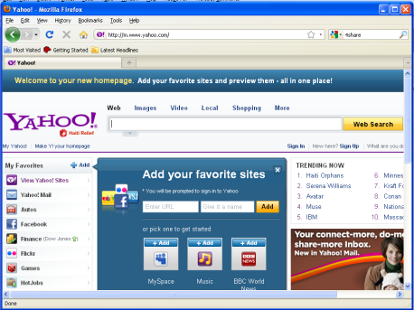
Segmentation
A1
Data from Application layer
1
Segments into small parts
Received by Transport Layer
2
Add a number to identify the application.
1
2
3
3
A1
A1
A1
Add a number sequence the segmented parts.

Slide 42
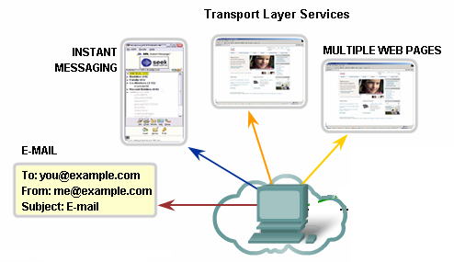
Identifying Different Applications
Port Numbers

Slide 43
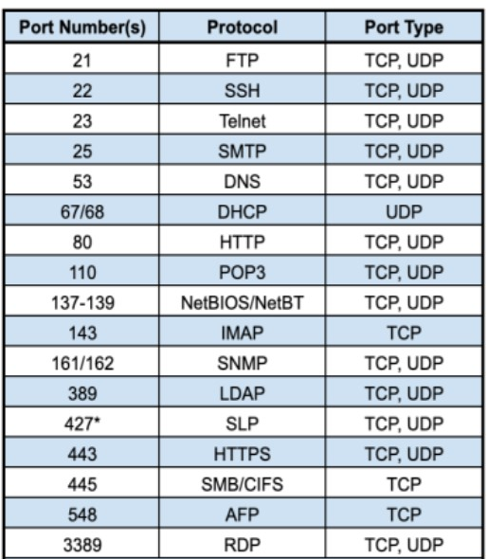
Port Address
To define multiple processes running in a computer.
16-bit in length
A 16-bit port address represented
as one single number.

Slide 44
Connection Control
Are you up?
Yes
Data

Slide 45
Flow Control
Host B has too many packets to process.
Buffer to store incoming packets overflows
Data
Please send less packets.
Host A
Host B

Slide 46
Error Control
1
I have 1&3, where is 2?
3
Data
Please send packet 2.
2
X
Lost in transition
Host A
Host B

Slide 47
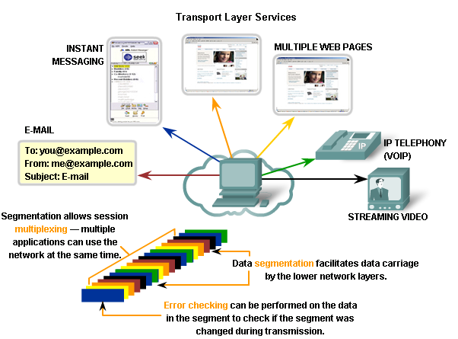
Multiplexing

Slide 48
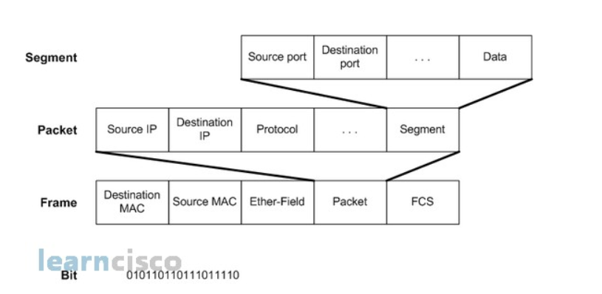
Protocol data units(PDU) and layer addressing
Transport Layer PDU is called Segments.
Common Protocol used in Transport Layer is TCP
2.<number>

Slide 49

Addressing Review
Although physical addresses change from hop to hop, logical and port addresses remain the same from the source to destination.
2.<number>

Slide 50
Session Layer
Note
The session layer is responsible for dialog
control and synchronization.
2.<number>

Slide 51
Session layer
It establishes, maintains and synchronizes the interaction among communicating systems
Responsibilities:
  Dialog control(half duplex/ full-duplex)
  Synchronization(check points/ synchronization point)
2.<number>

Slide 52

Session layer
2.<number>

Slide 53
Presentation Layer
Note
The presentation layer is responsible for translation, compression, and encryption.
2.<number>

Slide 54
Presentation layer
It is concern with the syntax and semantics of that information exchange between two systems
Responsibilities:
  Translation(sender format-common format/ common format-receiver format)
  Compression(reduce the number of bits)
  Encryption(for ensuring privacy)
2.<number>

Slide 55

Presentation layer
2.<number>

Slide 56
Application Layer
Note
The application layer is responsible for
providing user interfaces and services to the user, such as electronic mail, remote file access and transfer, shared database management and other types of distributed information services.
.
2.<number>

Slide 57
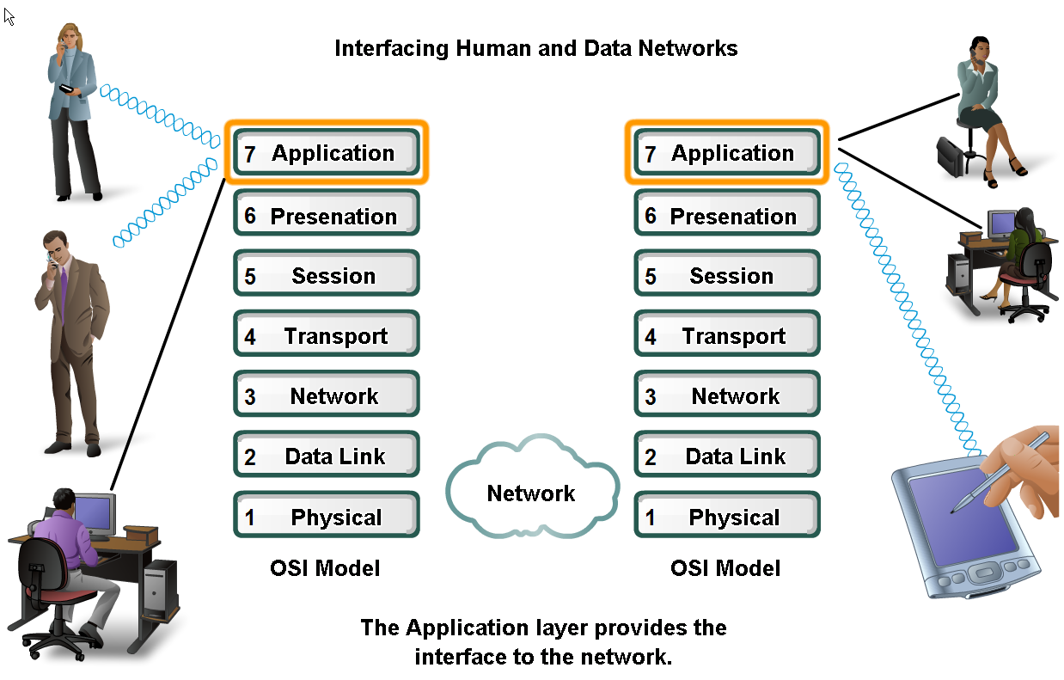
Applications
The Interface Between Human and Data Networks
Responsible for providing services to the user.

Slide 58

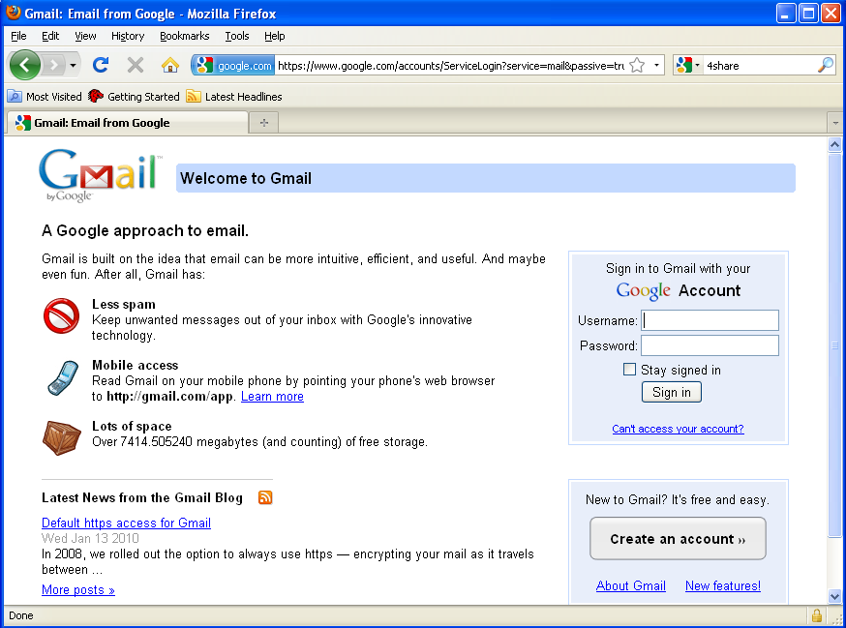
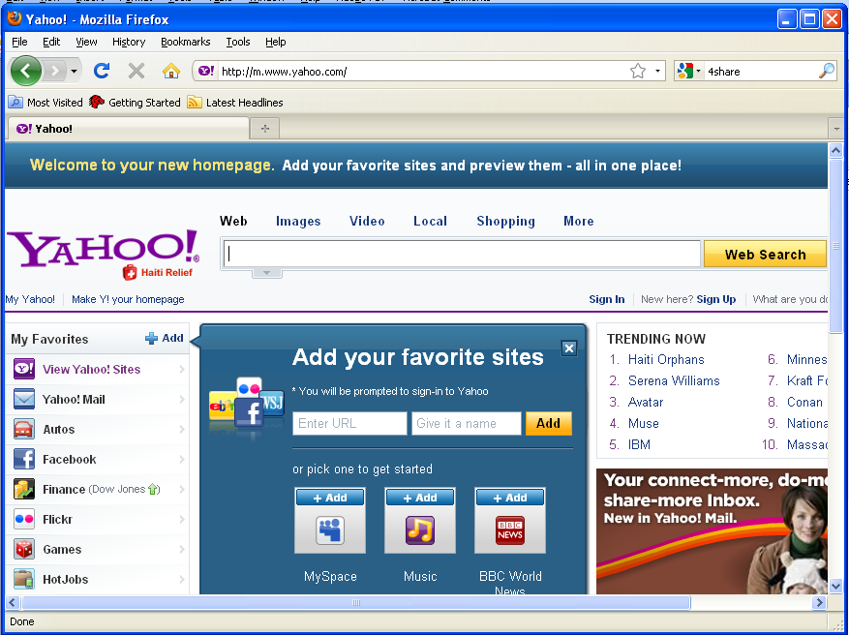
Applications and responsibilities in Application layer
Email
Web Page
Responsibilities:
Network virtual terminal
File transfer, access and management
Mail service
Directory service
Instant messaging

Slide 59

Application layer
2.<number>

Slide 60
TCP/IP PROTOCOL SUITE
The layers in the TCP/IP protocol suite do not exactly match those in the OSI model. The original TCP/IP protocol suite was defined as having four layers: host-to-network, internet, transport, and application. However, when TCP/IP is compared to OSI, we can say that the TCP/IP protocol suite is made of five layers: physical, data link, network, transport, and application.
Topics discussed in this section:
Physical and Data Link Layers
Network Layer
Transport Layer
Application Layer
2.<number>

Slide 61
TCP/IP PROTOCOL SUITE
TCP/IP stands for Transmission Control Protocol/Internet Protocol and is a suite of communication protocols used to interconnect network devices on the internet.
It describes a set of general design guidelines and implementations of specific networking protocols to enable computers to communicate over a network. It provides end to end connectivity specifying how data should be formatted, addresser, transmitted, routed and received at the destination.
Developed by the US Defense Advanced Research Project Agency (DARPA) for its packet switched network (ARPANET)
Used by the global Internet.
2.<number>

Slide 62

TCP/IP and OSI model
2.<number>

Slide 63
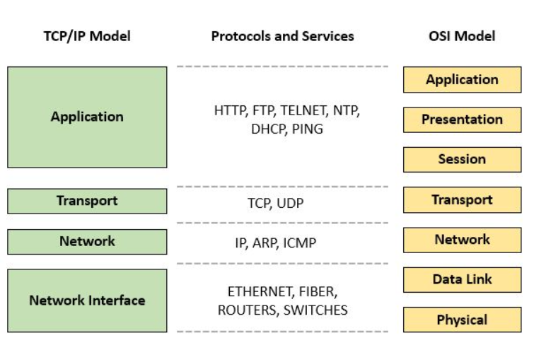
TCP/IP PROTOCOL SUITE
2.<number>

Slide 64
Some of the protocols included in the TCP/IP suite are:
ARP (Address Resolution Protocol) – used to associate an IP address with a MAC address. Used to find the PA. of the node when its Internet address is known.
IP (Internet Protocol) – used to deliver packets from the source host to the destination host based on the IP addresses.
ICMP (Internet Control Message Protocol) – used to detects and reports network error conditions. Used in ping.
TCP (Transmission Control Protocol) – a connection-oriented protocol that enables reliable data transfer between two computers.
UDP (User Datagram Protocol) – a connectionless protocol for data transfer. Since a session is not created before the data transfer, there is no guarantee of data delivery.
FTP (File Transfer Protocol) – used for file transfers from one host to another.
Telnet (Telecommunications Network) – used to connect and issue commands on a remote computer.
DNS (Domain Name System) – used for host names to the IP address resolution.
HTTP (Hypertext Transfer Protocol) – used to transfer files (text, graphic images, sound, video, and other multimedia files) on the World Wide Web.
2.<number>

Slide 65
ADDRESSING
Four levels of addresses are used in an internet employing the TCP/IP protocols: physical, logical, port, and specific.
Topics discussed in this section:
Physical Addresses
Logical Addresses
Port Addresses
Specific Addresses
2.<number>

Slide 66

Addresses in TCP/IP
2.<number>

Slide 67

Relationship of layers and addresses in TCP/IP
2.<number>

Slide 68
Example 2.1
In Figure of next slide a node with physical address 10 sends a frame to a node with physical address 87. The two nodes are connected by a link (bus topology LAN). As the figure shows, the computer with physical address 10 is the sender, and the computer with physical address 87 is the receiver.
2.<number>

Slide 69

Physical addresses
2.<number>

Slide 70
Example 2.2
Most local-area networks use a 48-bit (6-byte) physical address written as 12 hexadecimal digits; every byte (2 hexadecimal digits) is separated by a colon, as shown below:
07:01:02:01:2C:4B
A 6-byte (12 hexadecimal digits) physical address.
2.<number>

Slide 71
Example 2.3
Figure of next slide shows a part of an internet with two routers connecting three LANs. Each device (computer or router) has a pair of addresses (logical and physical) for each connection. In this case, each computer is connected to only one link and therefore has only one pair of addresses. Each router, however, is connected to three networks (only two are shown in the figure). So each router has three pairs of addresses, one for each connection.
2.<number>

Slide 72
IP addresses
2.<number>

Slide 73
Example 2.4
Figure of next slideshows two computers communicating via the Internet. The sending computer is running three processes at this time with port addresses a, b, and c. The receiving computer is running two processes at this time with port addresses j and k. Process a in the sending computer needs to communicate with process j in the receiving computer. Note that although physical addresses change from hop to hop, logical and port addresses remain the same from the source to destination.
2.<number>

Slide 74
Port addresses
2.<number>

Slide 75
Specific Address
Designed by users for access web resources through different application on network.
Two types of specific address: URL, E-mail address
URL(Uniform Resource Locator)
  Address of resources on Internet, web sites, wed document
  https://www.prothomalo.com/sports/football/98rpu81sf0
E-mail(electronic mail):
  It is message contains text, file, images, videos etc.
  heroalom@ gmail.com
These are converted into corresponding port and logical addresses by the sending computer.
2.<number>

Slide 76
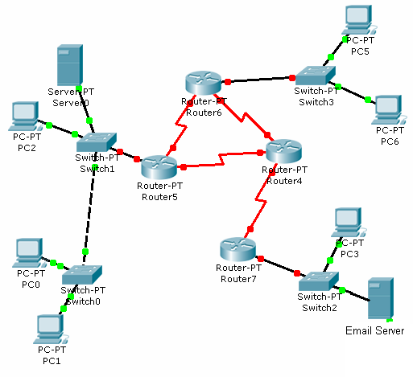

Addressing Review
13
11
M
A
k
a
Assume:
IP Addresses – Capital Alphabets
MAC Addresses – Numbers
Port Numbers- Small Alphabets
D S D S D S
F/22
D/13
G/31
E/21
B/12
H/32
IP address
N/41
Email
k
MAC address
A/11
Email
a
Web
c
M/42
Receiver
Sender

Slide 77
END
2.<number>

