Slide 1
Data Communications Chapter 3: Data and Signals
NARZU TARANNUM (NTR) DEPT. OF CSE, BRAC UNIVERSITY

Slide 2

Note
Data must be transformed to electromagnetic signals, To be transmitted
3.2

Slide 3
3-1 ANALOG AND DIGITAL
Data can be analog or digital. The term analog data refers to information that is continuous; digital data refers to information that has discrete states. Analog data take on continuous values. Digital data take on discrete values.
Topics discussed in this section:
Analog and Digital Data Analog and Digital Signals Periodic and Nonperiodic Signals
3.3

Slide 4
ANALOG AND DIGITAL DATA
Note
Data can be analog or digital.
Analog data are continuous and take continuous values.
Digital data have discrete states and take discrete values.
3.4

Slide 5
ANALOG AND DIGITAL SIGNALS
Note
Signals can be analog or digital.
Analog signals can have an infinite number of values in a range;
Digital signals can have only a limited number of values. It is often as simple as 1 and 0.
3.5

Slide 6
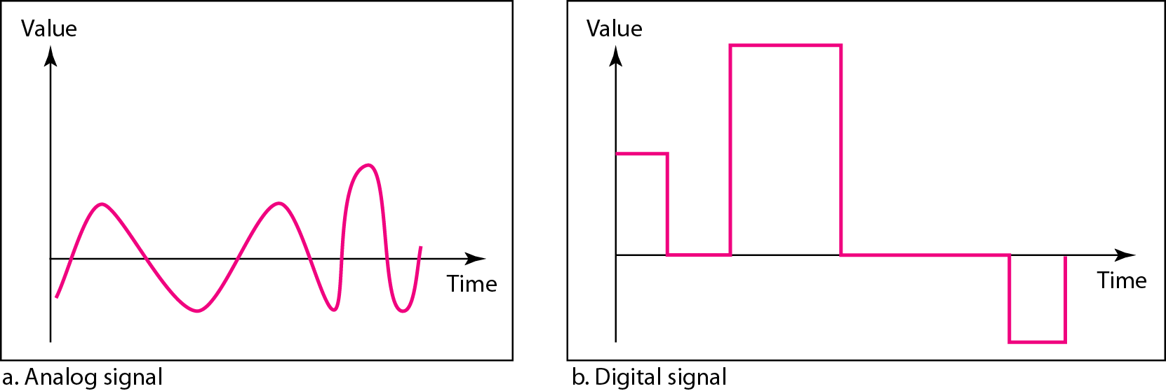
Figure: Comparison of analog and digital signals
3.6

Slide 7
Periodic and Non-periodic signals
Both analog and digital signals can take one of two terms: Periodic or non periodic.
A periodic signal completes a pattern within a measurable time frame, called a period, and repeats that pattern over subsequent identical periods.
The completion of one full pattern is called a cycle.
A non-periodic signal changes without exhibiting a pattern or cycle that repeats over time.
3.7

Slide 8
Note
In data communications, we commonly use periodic analog signals and non-periodic digital signals.
3.8

Slide 9
3-2 PERIODIC ANALOG SIGNALS
Periodic analog signals can be classified as simple or composite.
A simple periodic analog signal, a sine wave, cannot be decomposed into simpler signals.
A composite periodic analog signal is composed of multiple sine waves.
Topics discussed in this section:
Sine Wave Wavelength Time and Frequency Domain Composite Signals
Bandwidth
3.9

Slide 10
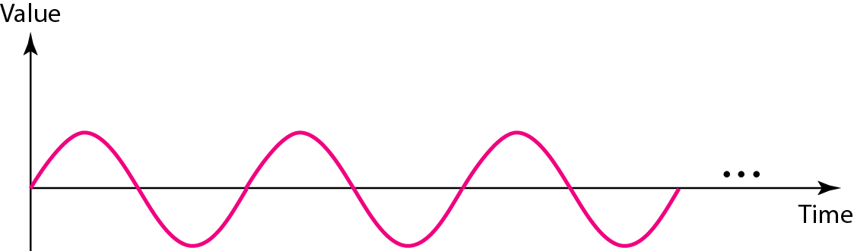
A sine wave
A sine wave can be represented by three parameters: the peak amplitude, the frequency and the phase. These three parameters fully describe a sine wave.
3.10

Slide 11
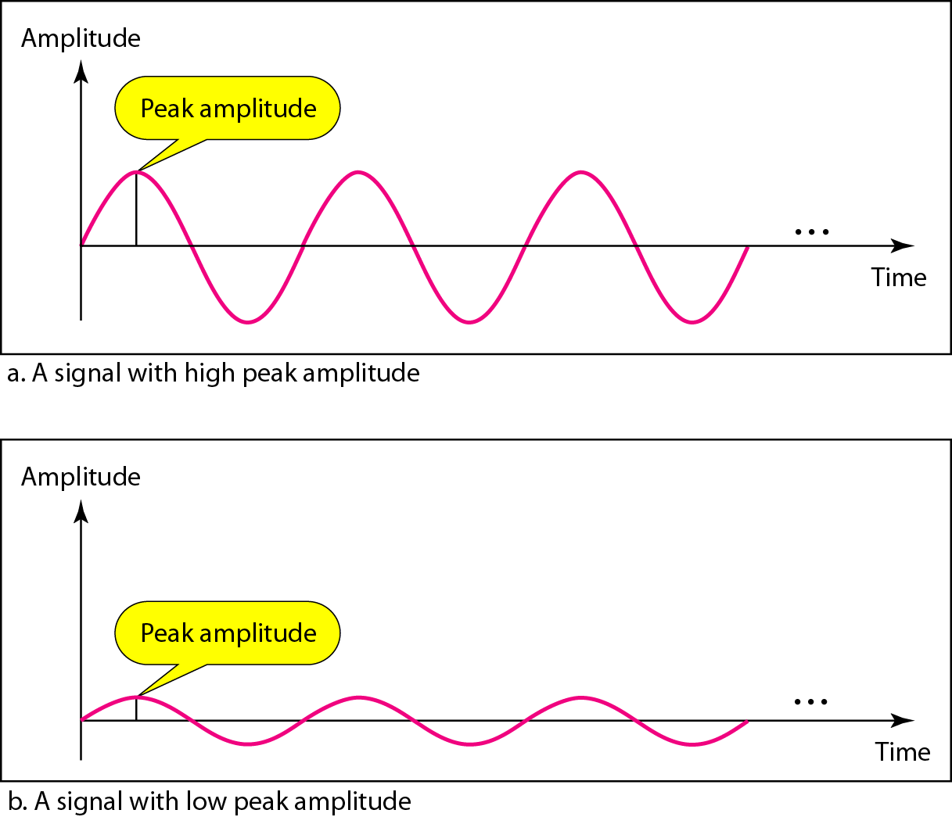
Figure: Two signals with the same phase and frequency, but different amplitudes
The peak amplitude of a signal is the absolute value of its highest intensity, proportional to the energy it carries.
For electric signals, peak amplitude is normally measured in volts.
3.11

Slide 12

Period and Frequency
Period refers to the amount of time, in seconds, a signal needs to complete 1 cycle.
Frequency refers to the number of periods in 1 s.
Frequency and period are the inverse of each other.
Frequency is the rate of change with respect to time.
Change in a short span of time means high frequency.
Change over a long span of time means low frequency.
If a signal does not change at all, its frequency is zero.
If a signal changes instantaneously, its frequency is infinite.
3.12

Slide 13
Note
Frequency and period are the inverse of each other.
3.13

Slide 14
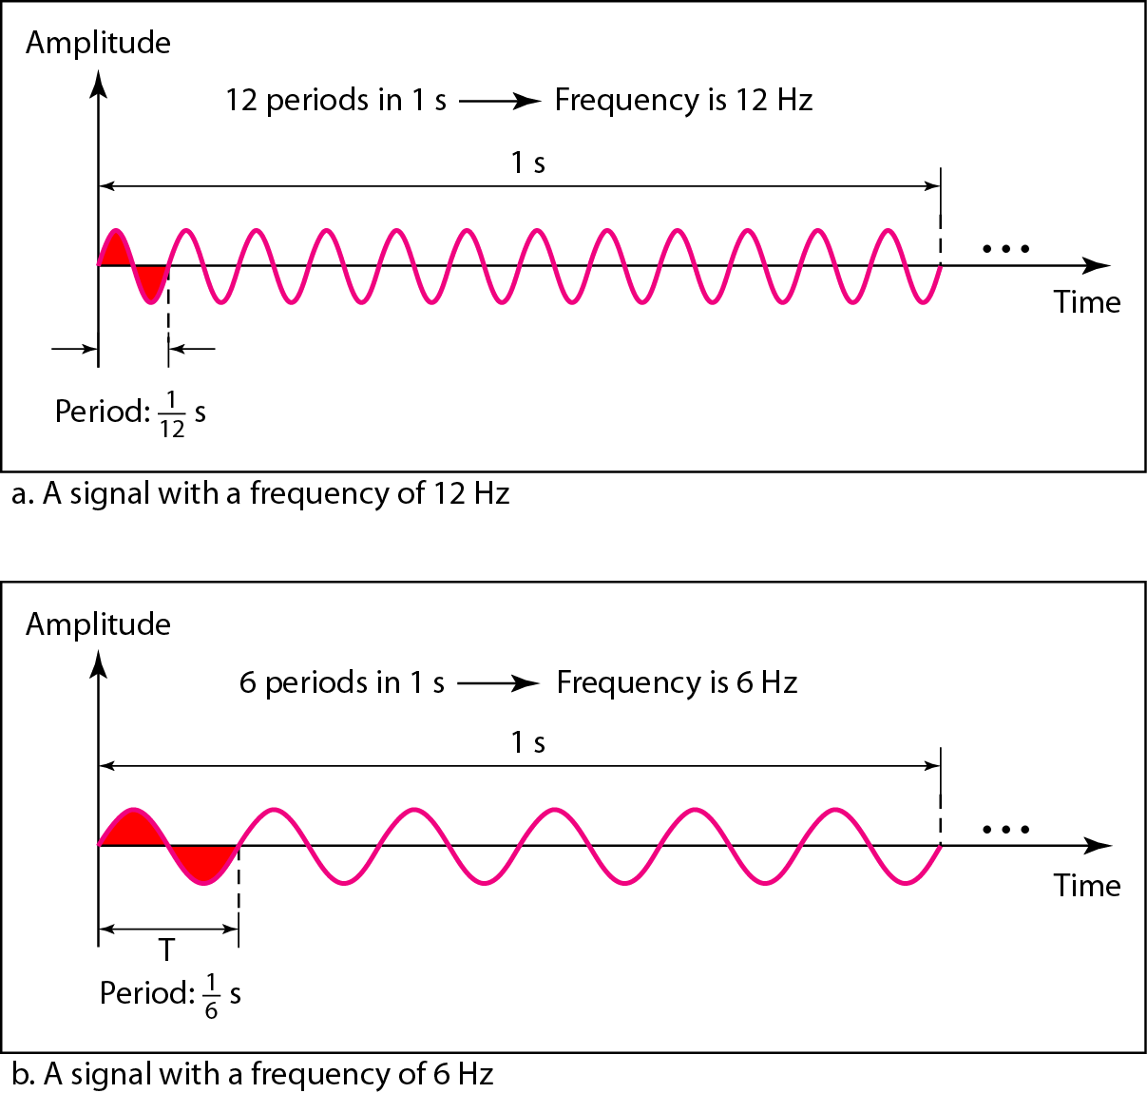
Figure: Two signals with the same amplitude and phase, but different frequencies
3.14

Slide 15
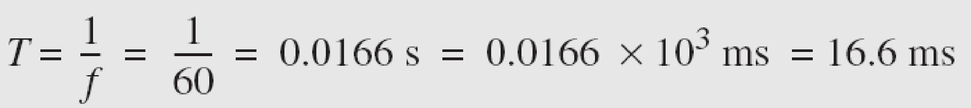
Example 3.3
The power we use at home has a frequency of 60 Hz. The period of this sine wave can be determined as follows:
3.15

Slide 16
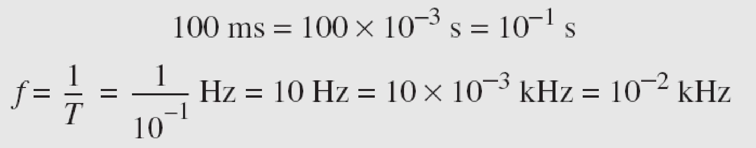
Example 3.5
The period of a signal is 100 ms. What is its frequency in kilohertz?
Solution
First we change 100 ms to seconds, and then we calculate the frequency from the period (1 Hz = 10⁻³ kHz).
3.16

Slide 17
Phase
Note
Phase describes the position of the waveform relative to time 0.
3.17

Slide 18
Phase
The term phase or phase shift, describe the position of the waveform relative to time 0.
Phase is measured in degrees or radians.
360° is 2π rad; 1° = 2π/360 rad, and 1 rad =360/2π °.
A phase shift of 360° corresponds to a shift of a complete period;
A phase shift of 180° corresponds to a shift of one-half of a period;
A phase shift of 90° corresponds to a shift of one-quarter of a period
3.18

Slide 19
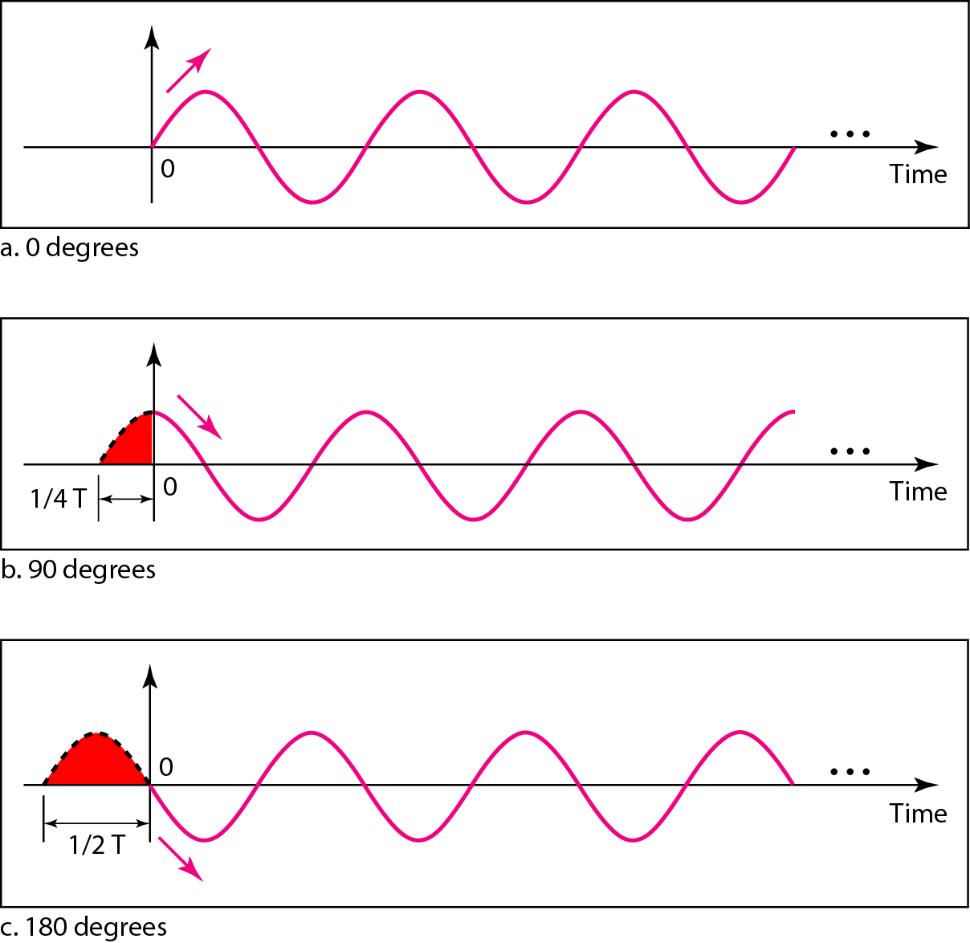
Figure: Three sine waves with the same amplitude and frequency, but different phases
3.19

Slide 20
0 degree Phase
A sine wave with a phase of 0° starts at time 0 with a zero amplitude. The amplitude is increasing.
A sine wave with a phase of 0° is not shifted.
3.20

Slide 21
90 degree Phase
A sine wave with a phase of 90° starts at time 0 with a peak amplitude. The amplitude is decreasing.
A sine wave with a phase of 90° is shifted to the left by ¼ cycle.
However, note that the signal does not really exist before time 0.
3.21

Slide 22
180 degree Phase
A sine wave with a phase of 180° starts at time 0 with a zero amplitude. The amplitude is decreasing.
A sine wave with a phase of 180° is shifted to the left by ½ cycle.
However, note that the signal does not really exist before time 0.
3.22

Slide 23
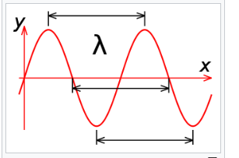
Wavelength
The wavelength of a wave describes how long the wave is. The distance from the "crest" (top) of one wave to the crest of the next wave is the wavelength. Alternately, we can measure from the "trough" (bottom) of one wave to the trough of the next wave and get the same value for the wavelength.
3.23

Slide 24
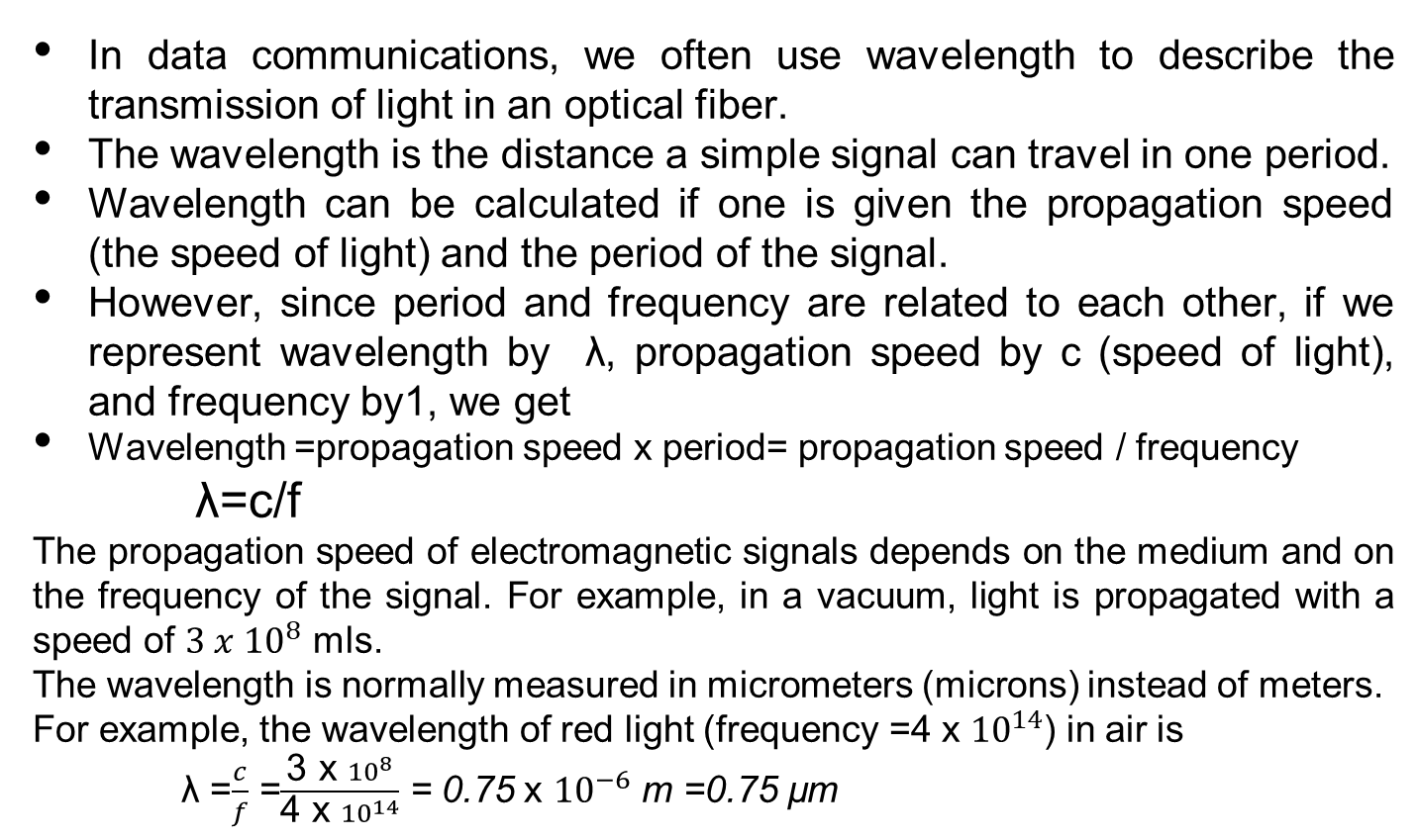
Wavelength
In data communications, we often use wavelength to describe the transmission of light in an optical fiber.
The wavelength is the distance a simple signal can travel in one period.
Wavelength can be calculated if one is given the propagation speed (the speed of light) and the period of the signal.
However, since period and frequency are related to each other, if we represent wavelength by λ, propagation speed by c (speed of light), and frequency by1, we get
Wavelength =propagation speed x period= propagation speed / frequency
λ=c/f
The propagation speed of electromagnetic signals depends on the medium and on the frequency of the signal. For example, in a vacuum, light is propagated with a speed of $3 x {10}^{8}$ mls.
The wavelength is normally measured in micrometers (microns) instead of meters.
For example, the wavelength of red light (frequency =4 x ${10}^{14}$) in air is
λ =$\frac{c}{f}$ =$\frac{\text{3 }\text{x} {10}^{8}}{\text{4 }\text{x} {10}^{14}}$ = 0.75 x ${10}^{−6}$ m =0.75 µm
3.24

Slide 25
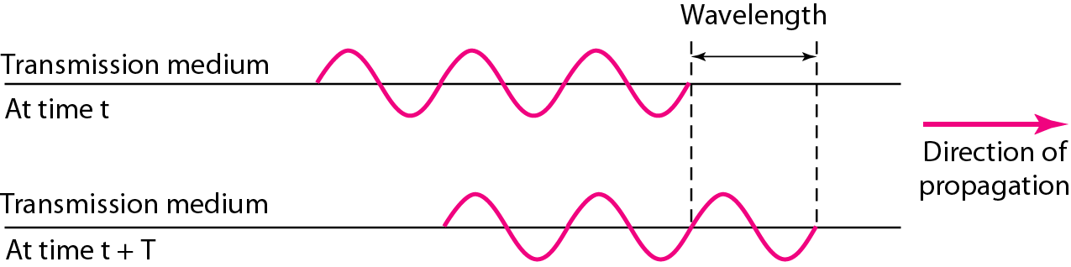
Figure: Wavelength and period
3.25

Slide 26
The time-domain and frequency-domain plots of a sine wave
The time-domain plot shows changes in signal amplitude with respect to time (it is an amplitude-versus-time plot). Phase is not explicitly shown on a time-domain plot.
The frequency-domain plot show the relationship between amplitude and frequency. A frequency-domain plot is concerned with only the peak value and the frequency. Changes of amplitude during one period are not shown.
The advantage of the frequency domain is that we can immediately see the values of the frequency and peak amplitude. The position of the spike shows the frequency; its height shows the peak amplitude.
A complete sine wave in the time domain can be represented by one single spike in the frequency domain.
3.26

Slide 27
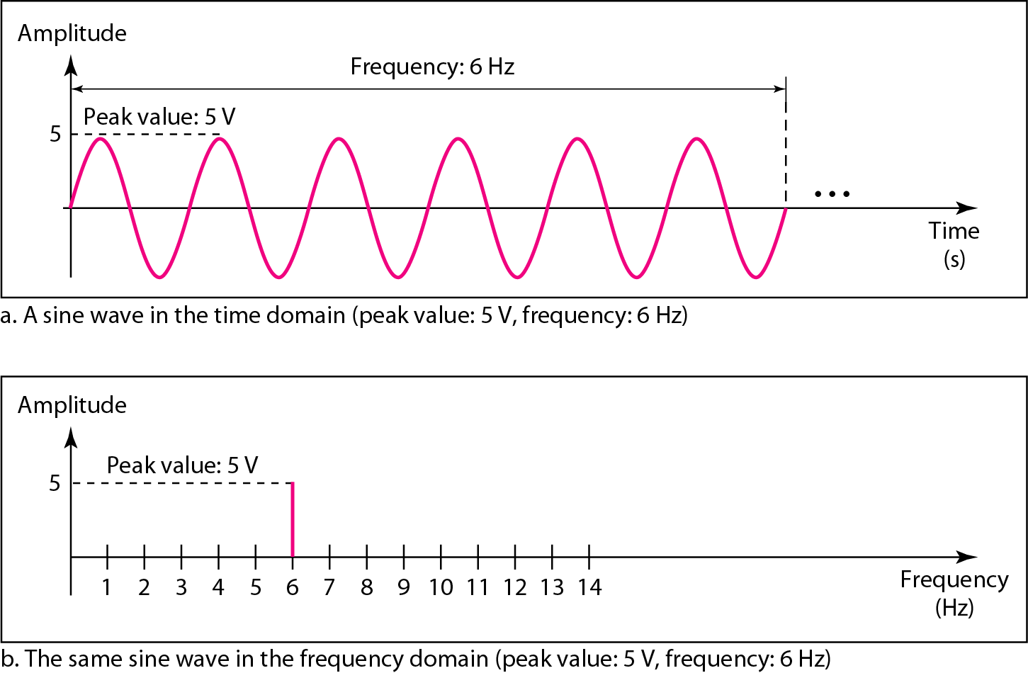
Figure: The time-domain and frequency-domain plots of a sine wave
3.27

Slide 28
Composite Signals
Note
A single-frequency sine wave is not useful in data communications;
we need to send a composite signal, a signal made of many simple sine waves.
3.28

Slide 29
Example 3.7
The frequency domain is more compact and useful when we are dealing with more than one sine wave. For example, Figure of next slide shows three sine waves, each with different amplitude and frequency. All can be represented by three spikes in the frequency domain.
3.29

Slide 30
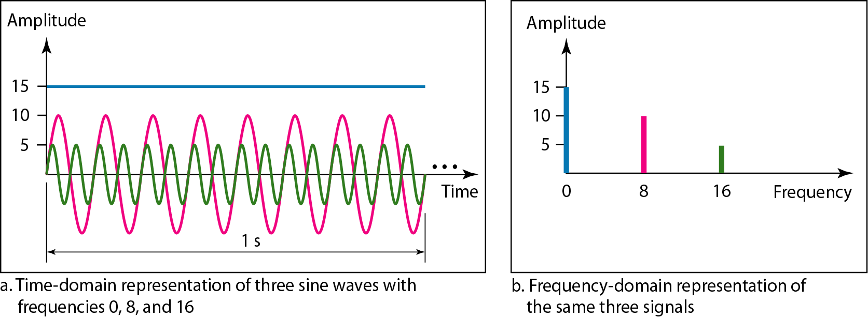
Figure: The time domain and frequency domain of three sine waves
3.30

Slide 31
Composite Signals
Any composite signal is a combination of simple sine waves with different frequencies, amplitudes, and phases.
A composite signal can be periodic or non-periodic.
If the composite signal is periodic, the decomposition gives a series of signals with discrete frequencies;
If the composite signal is non-periodic, the decomposition gives a combination of sine waves with continuous frequencies.
3.31

Slide 32
Example 3.8
Figure of next slide shows a periodic composite signal with frequency f. This type of signal is not typical of those found in data communications. We can consider it to be three alarm systems, each with a different frequency. The analysis of this signal can give us a good understanding of how to decompose signals.
3.32

Slide 33
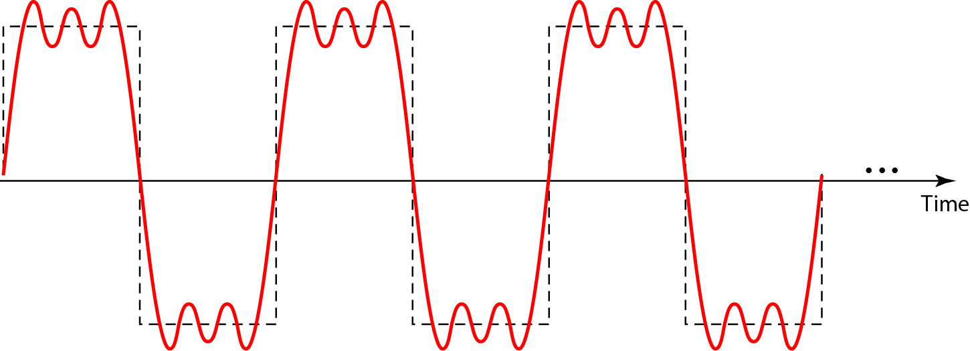
Figure: A composite periodic signal
3.33

Slide 34
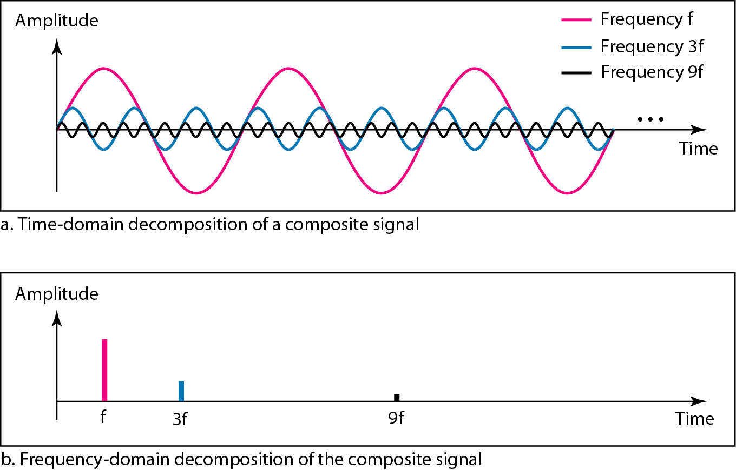
Figure: Decomposition of a composite periodic signal in the time and frequency domains

Slide 35
Decomposition of a composite periodic signal in the time and frequency domains
It is very difficult to manually decompose this signal into a series of simple sine waves.
Figure of last slide shows the result of decomposing the above signal in both the time and frequency domains.
The amplitude of the sine wave with frequency f is almost the same as the peak amplitude of the composite signal. The amplitude of the sine wave with frequency 3f is one-third of that of the first, and the amplitude of the sine wave with frequency 9f is one-ninth of the first.
Note that the frequency decomposition of the signal is discrete; it has frequencies f, 3f, and 9f. Because f is an integral number, 3f and 9f are also integral numbers. There are no frequencies such as 1.2f or 2.6f. The frequency domain of a periodic composite signal is always made of discrete spikes.

Slide 36
Example 3.9
Figure of next slide shows a non-periodic composite signal. It can be the signal created by a microphone or a telephone set when a word or two is pronounced. In this case, the composite signal cannot be periodic, because that implies that we are repeating the same word or words with exactly the same tone.

Slide 37
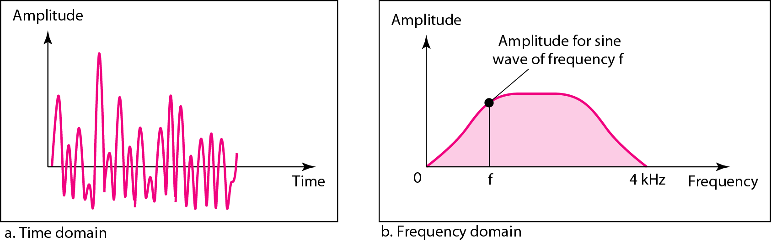
Figure: The time and frequency domains of a non-periodic signal
In a time-domain representation of this composite signal, there are an infinite number of simple sine frequencies.
Although the number of frequencies in a human voice is infinite, the range is limited.
A normal human being can create a continuous range of frequencies between 0 and 4 kHz.

Slide 38
Bandwidth
The bandwidth of a composite signal is the difference between the highest and the lowest frequencies contained in that signal.
The range of frequencies contained in a composite signal is its bandwidth.
The bandwidth is normally a difference between two numbers. For example, if a composite signal contains frequencies between 1000 and 5000, its bandwidth is 5000 − 1000, or 4000.
3.38

Slide 39
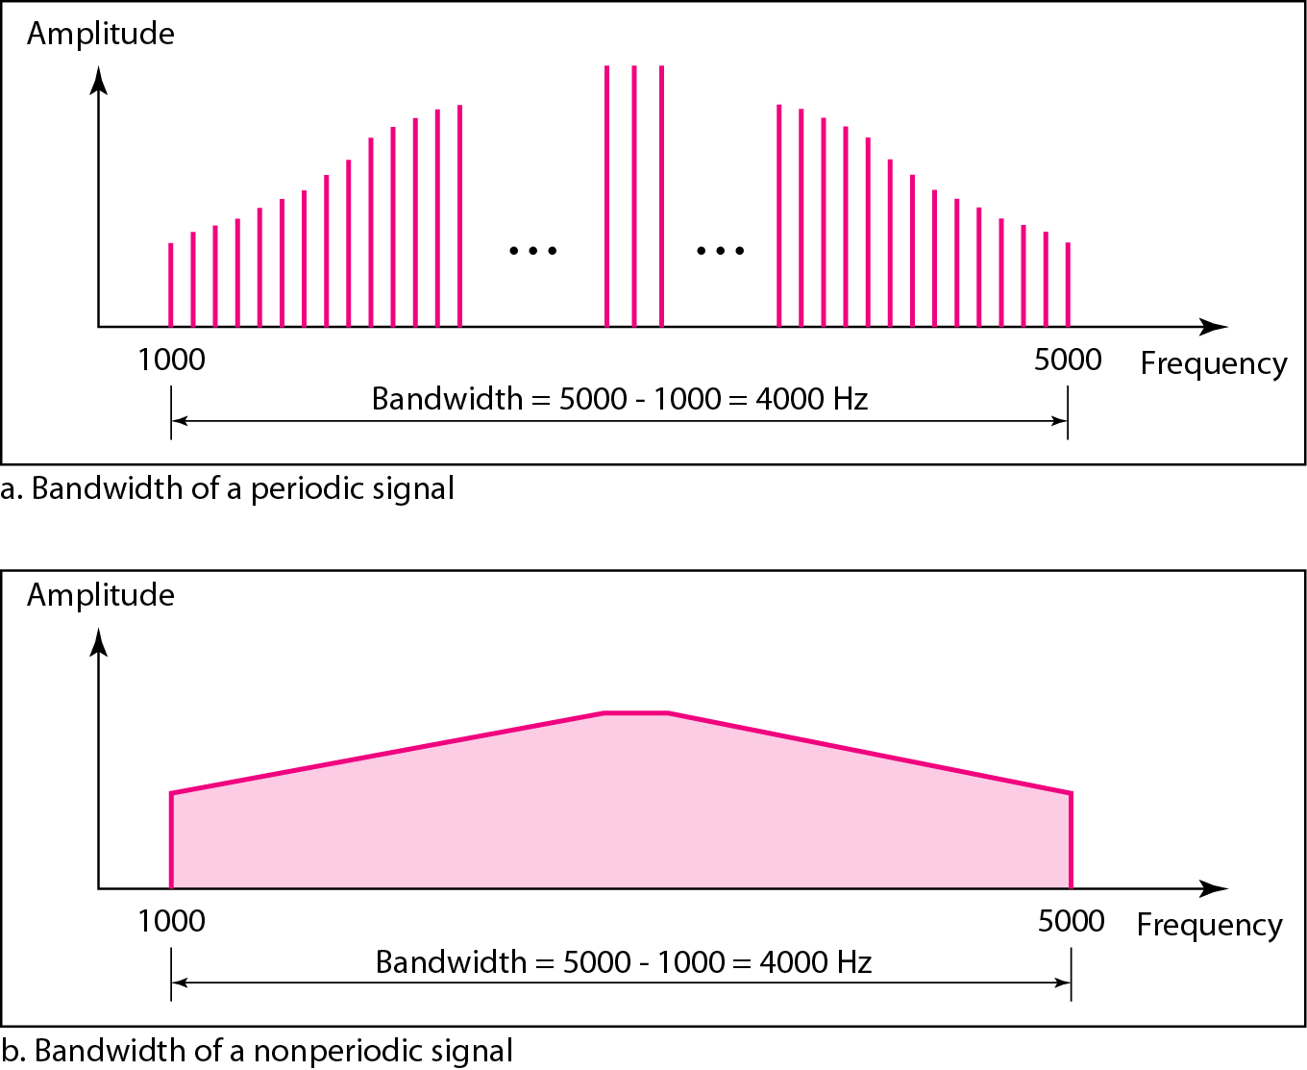
Figure: The bandwidth of periodic and nonperiodic composite signals
3.39

Slide 40

Example 3.10
If a periodic signal is decomposed into five sine waves with frequencies of 100, 300, 500, 700, and 900 Hz, what is its bandwidth? Draw the spectrum, assuming all components have a maximum amplitude of 10 V.
Solution
Let f_{h} be the highest frequency, f_{l} the lowest frequency, and B the bandwidth. Then
The spectrum has only five spikes, at 100, 300, 500, 700, and 900 Hz (see Figure 3.13).
3.40

Slide 41
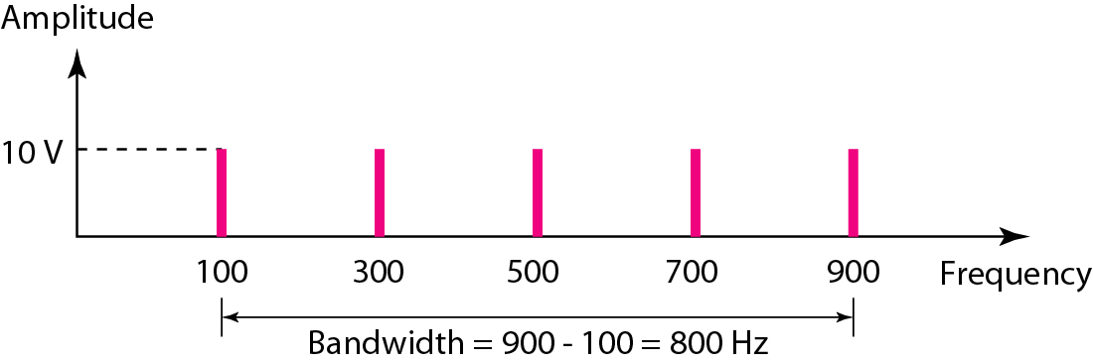
Figure: The bandwidth for Example 3.10
3.41

Slide 42
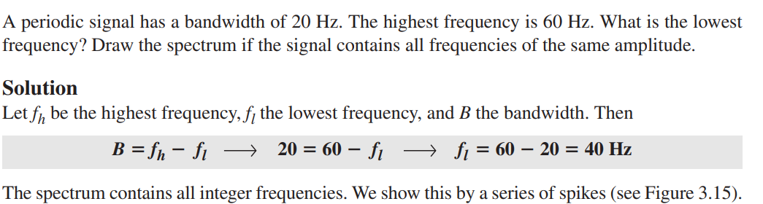
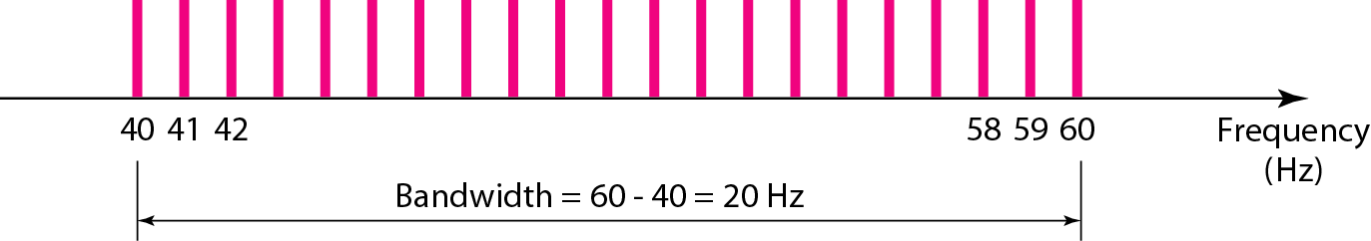
The bandwidth for Example 3.11

Slide 43
Example 3.8
A nonperiodic composite signal has a bandwidth of 200 kHz, with a middle frequency of 140 kHz and peak amplitude of 20 V. The two extreme frequencies have an amplitude of 0. Draw the frequency domain of the signal.
Solution
The lowest frequency must be at 40 kHz and the highest at 240 kHz. Figure 3.15 shows the frequency domain and the bandwidth.

Slide 44
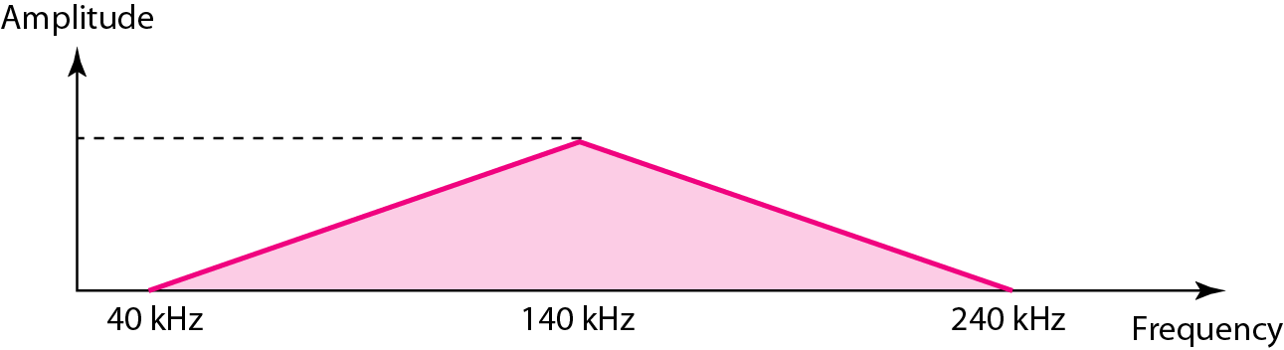
Figure: The bandwidth for Example 3.8
The lowest frequency must 40 kHz and the highest at 240 kHz. Figure shows the frequency domain and bandwidth.

Slide 45
3-3 DIGITAL SIGNALS
In addition to being represented by an analog signal, information can also be represented by a digital signal. For example, a 1 can be encoded as a positive voltage and a 0 as zero voltage. A digital signal can have more than two levels. In this case, we can send more than 1 bit for each level.
Topics discussed in this section:
Bit Rate Bit Length Digital Signal as a Composite Analog Signal
Application Layer
3.45

Slide 46
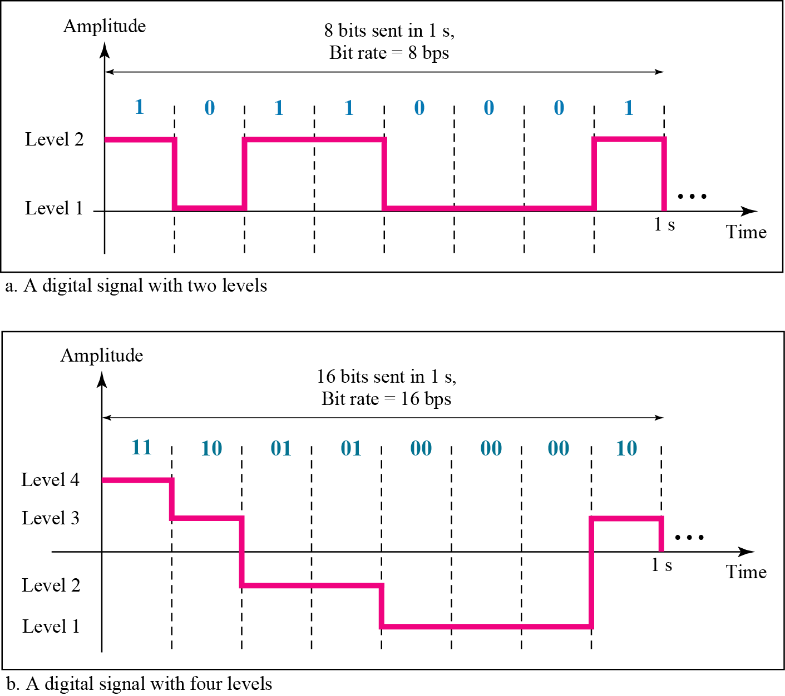
Figure: Two digital signals: one with two signal levels and the other with four signal levels
Figure shows two signals, one with two levels and the other with four. We send 1 bit per level in part a of the figure and 2 bits per level in part b of the figure.
In general, if a signal has L levels, each level needs log2 L bits. For this reason, we can send log2 4 = 2 bits in part b.
3.46

Slide 47
Example 3.16
A digital signal has eight levels. How many bits are needed per level? We calculate the number of bits from the formula
Each signal level is represented by 3 bits.
3.47

Slide 48
Example 3.17
A digital signal has nine levels. How many bits are needed per level? We calculate the number of bits by using the formula. Each signal level is represented by 3.17 bits. However, this answer is not realistic. The number of bits sent per level needs to be an integer as well as a power of 2. For this example, 4 bits can represent one level.
3.48

Slide 49
Bit Rate & Bit length
Bit rate (instead of frequency)—is used to describe digital signals. The bit rate is the number of bits sent in 1s, expressed in bits per second (bps).
The bit length is the distance one bit occupies on the transmission medium.
3.49

Slide 50
Example 3.18
Assume we need to download text documents at the rate of 100 pages per second. What is the required bit rate of the channel?
Solution
A page is an average of 24 lines with 80 characters in each line. If we assume that one character requires 8 bits, the bit rate is
3.50

Slide 51
Example 3.19
A digitized voice channel, as we will see in Chapter 4, is made by digitizing a 4-kHz bandwidth analog voice signal. We need to sample the signal at twice the highest frequency (two samples per hertz). We assume that each sample requires 8 bits. What is the required bit rate?
Solution
The bit rate can be calculated as
3.51

Slide 52
Digital Signal as a Composite Analog Signal
A digital signal is a composite analog signal.
3.52

Slide 53
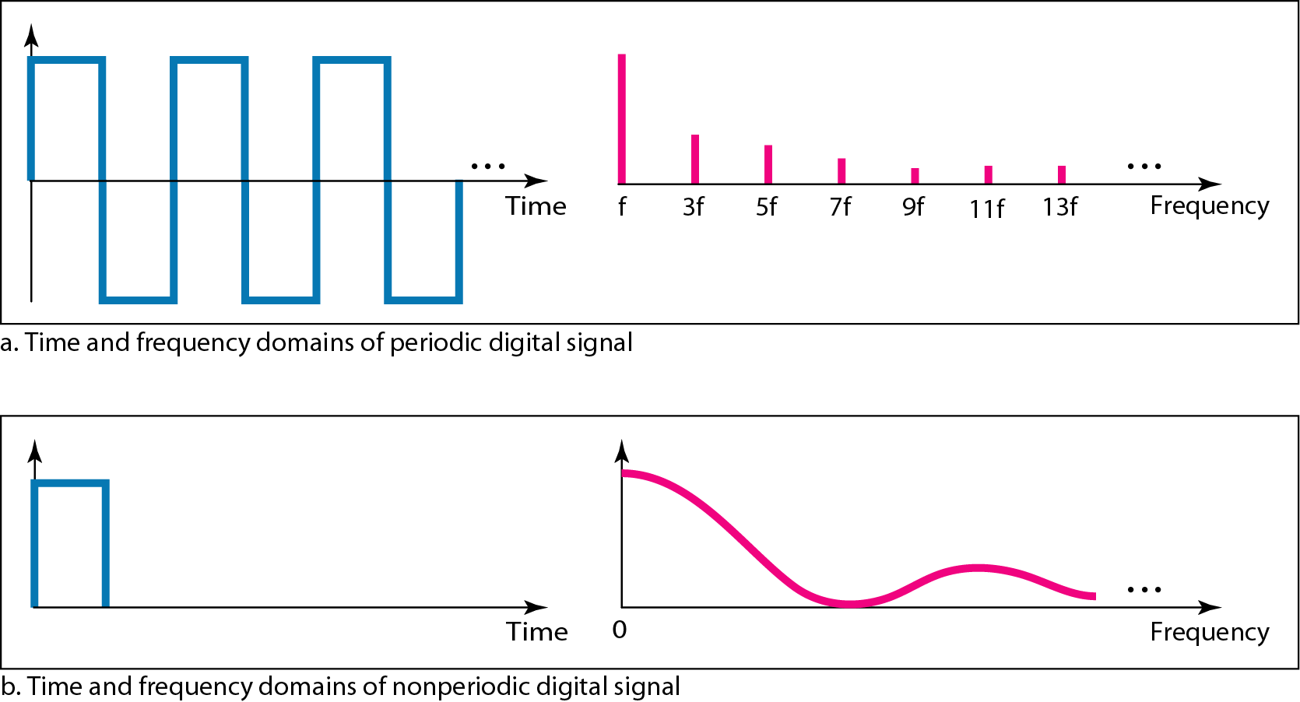
Figure 3.17 The time and frequency domains of periodic and nonperiodic digital signals
If the digital signal is periodic, which is rare in data communications, the decomposed signal has a frequency domain representation with an infinite bandwidth and discrete frequencies.
3.53

Slide 54
Figure 3.17 The time and frequency domains of periodic and nonperiodic digital signals
If the digital signal is non-periodic, the decomposed signal still has an infinite bandwidth, but the frequencies are continuous.
3.54

Slide 55
Figure 3.17 The time and frequency domains of periodic and nonperiodic digital signals
Note that both bandwidths are infinite, but the periodic signal has discrete frequencies while the non-periodic signal has continuous frequencies.
3.55

Slide 56
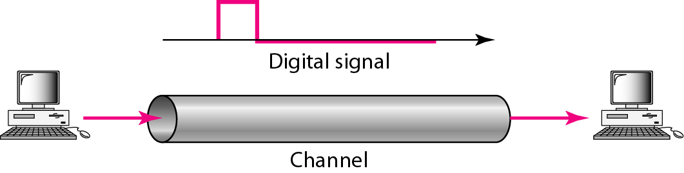
Transmission of digital signals
We can transmit a digital signal by one of two different approaches:
Baseband Transmission
Broadband Transmission(using modulation)
Baseband transmission means sending a digital signal over a channel without changing the digital signal to an analog signal.
Baseband transmission requires a low-pass channel, a channel with a bandwidth that starts from zero.

Slide 57
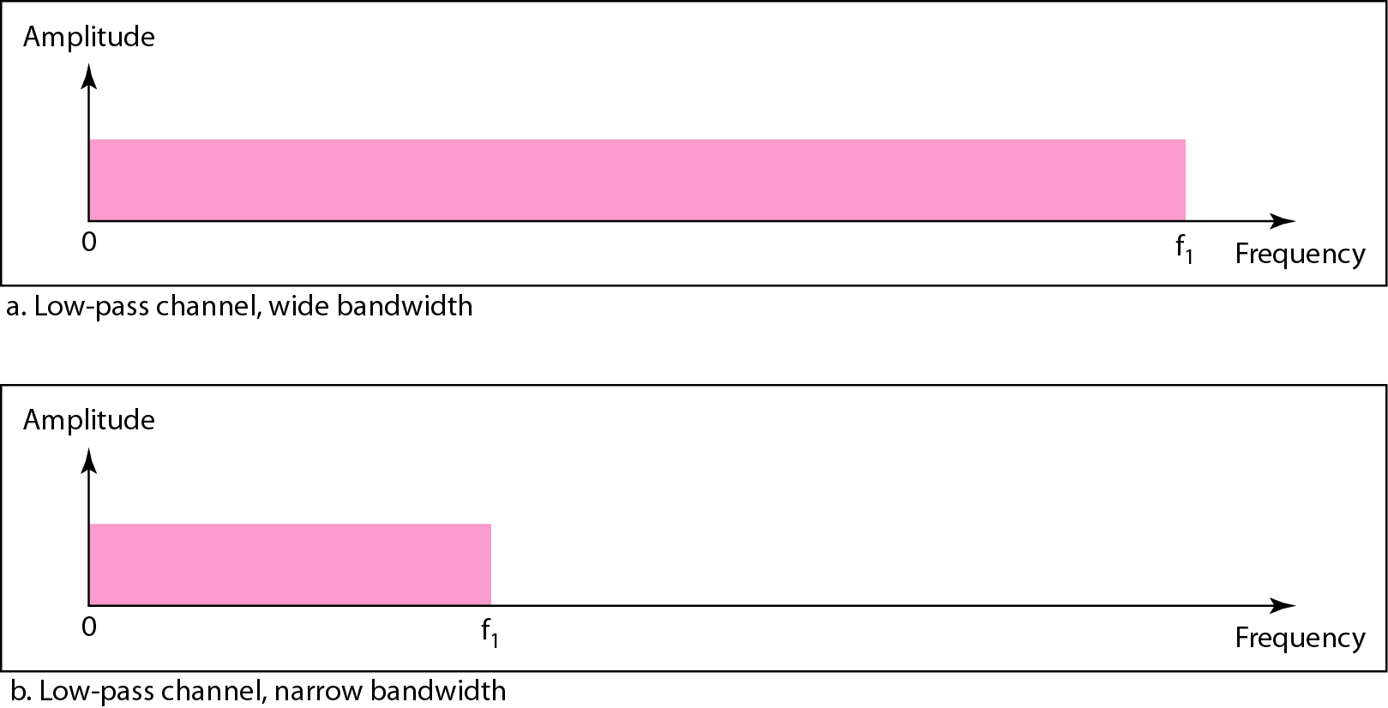
Figure: Bandwidths of two low-pass channels

Slide 58
Broadband Transmission
Broadband transmission or modulation means changing the digital signal to an analog signal for transmission.
Modulation allows us to use a bandpass cannel– a channel with a bandwidth that does not start from zero.
This type of channel is more available than a low-pass channel.
If the available channel is a bandpass channel, we cannot send the digital signal directly to the channel; we need to convert the digital signal to an analog signal before transmission.

Slide 59
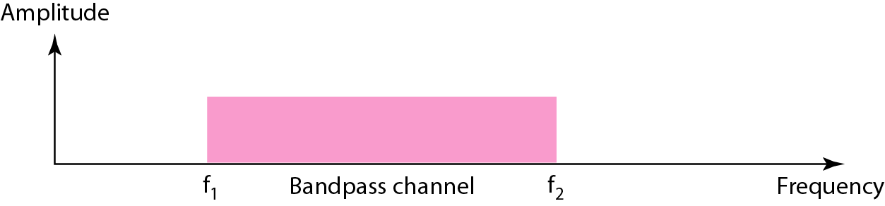
Figure: Bandwidth of a bandpass channel

Slide 60
3-4 TRANSMISSION IMPAIRMENT
Signals travel through transmission media, which are not perfect. The imperfection causes signal impairment. This means that the signal at the beginning of the medium is not the same as the signal at the end of the medium. What is sent is not what is received. Three causes of impairment are attenuation, distortion, and noise.
Topics discussed in this section:
Attenuation Distortion Noise
3.60

Slide 61
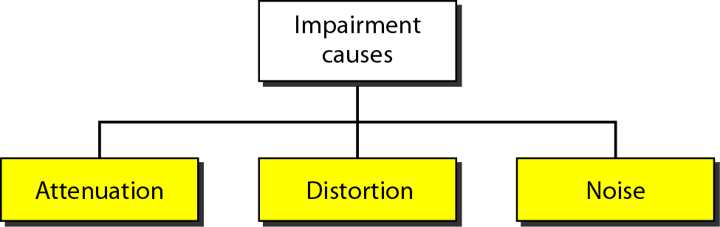
Figure: Causes of impairment
3.61

Slide 62
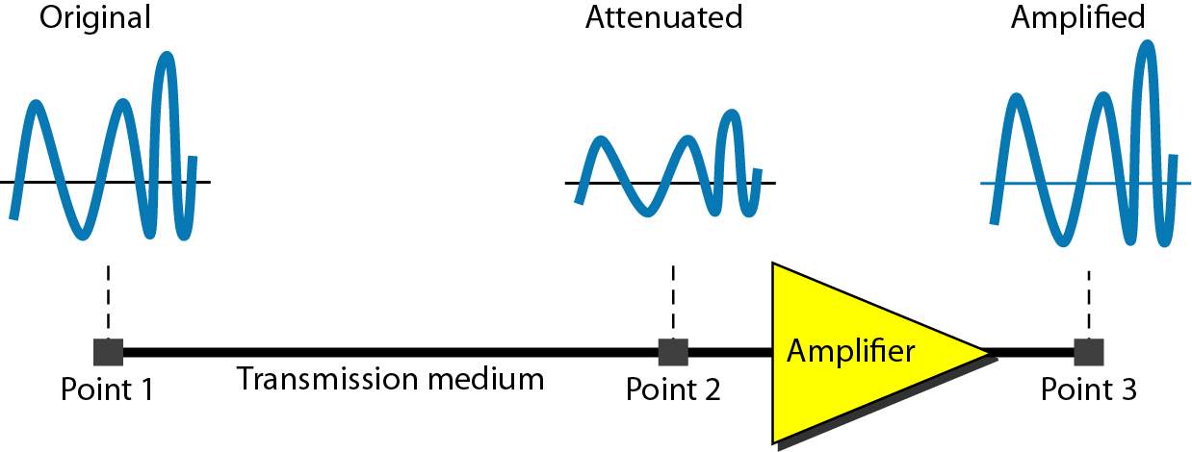
Attenuation
It means loss of energy -> weaker signal
When a signal travels through a medium it loses energy overcoming the resistance of the medium.
This is also known as attenuated signal.
Amplifiers are used to amplify the attenuated signal which gives the original signal back.
Loss of energy
3.62

Slide 63
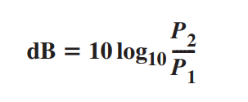
Measurement of Attenuation
Attenuation is measured in decibels (dB).
It measures the relative strengths of two signals or one signal at two different points.
Variables P1 and P2 are the powers of a signal at points 1 and 2, respectively and
positive sign means amplification.
3.63

Slide 64

Example 3.26
Suppose a signal travels through a transmission medium and its power is reduced to one-half. This means that P₂ is (1/2)P₁. In this case, the attenuation (loss of power) can be calculated as
A loss of 3 dB (–3 dB) is equivalent to losing one-half the power.
3.64

Slide 65

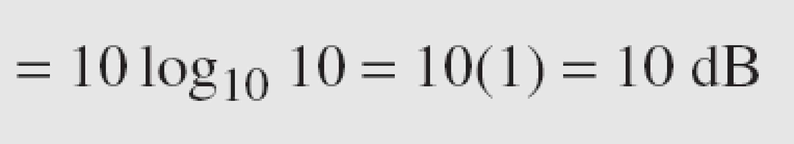
Example 3.27
A signal travels through an amplifier, and its power is increased 10 times. This means that P₂ = 10P₁ . In this case, the amplification (gain of power) can be calculated as
3.65

Slide 66

Example 3.28
One reason that engineers use the decibel to measure the changes in the strength of a signal is that decibel numbers can be added (or subtracted) when we are measuring several points (cascading) instead of just two. In Figure 3.27 a signal travels from point 1 to point 4. In this case, the decibel value can be calculated as

Slide 67
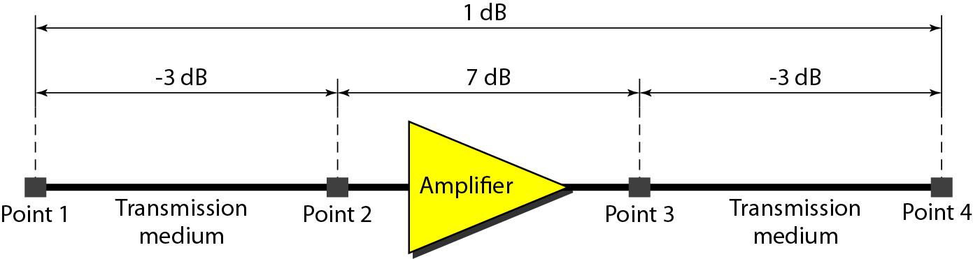
Figure 3.27 Decibels for Example 3.28

Slide 68
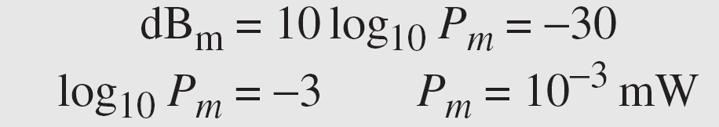
Example 3.29
Sometimes the decibel is used to measure signal power in milliwatts. In this case, it is referred to as dB_{m} and is calculated as dB_{m} = 10 log10 P_{m} , where P_{m} is the power in milliwatts. Calculate the power of a signal with dB_{m} = −30.
Solution
We can calculate the power in the signal as

Slide 69
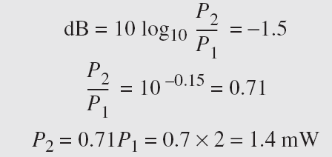
Example 3.30
The loss in a cable is usually defined in decibels per kilometer (dB/km). If the signal at the beginning of a cable with −0.3 dB/km has a power of 2 mW, what is the power of the signal at 5 km?
Solution
The loss in the cable in decibels is 5 × (−0.3) = −1.5 dB. We can calculate the power as

Slide 70
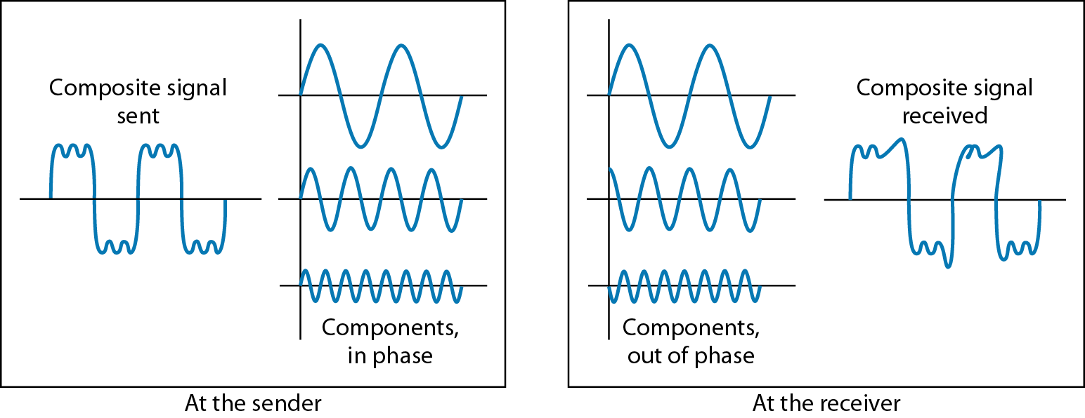
Figure: Distortion
It means change in the shape of signal.
Distortion occurs in composite signals with different frequencies.
Each frequency component has its own propagation speed traveling through a medium.
The different components therefore arrive with different delays at the receiver.
That means that the signals have different phases at the receiver end from what they had at senders end.
changes in the form or shape of the signal
3.70

Slide 71
Noise
The random or unwanted signal that mixes up with the original signal is called noise.
There are different types of noise
Thermal - noise random movement of electrons in the wire creates an extra signal
Induced – comes from sources such as motors and appliances. These devices act as sending antenna and transmission medium act as receiving antenna.
Crosstalk – when one wire affects the other wire.
Impulse - Spikes that result from power lines, lightning, or comes from high energy etc.
3.71

Slide 72
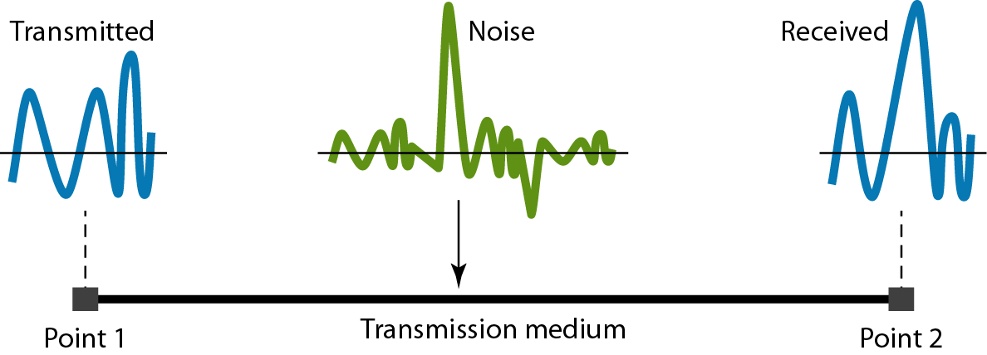
Figure: Noise
unwanted signal that mixes up with the original signal
3.72

Slide 73
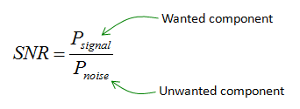


Signal to Noise Ratio (SNR)
To measure the quality of a system the SNR is often used. It indicates the strength of the signal with the noise power in the system.
SNR is actually the ratio of what is wanted (signal) to what is not wanted (noise).
A high SNR means the signal is less corrupted by noise; a low SNR means the signal is more corrupted by noise.
It is the ratio between two powers.
It is usually described in dB unit and referred to as SNR_{dB.}

Slide 74
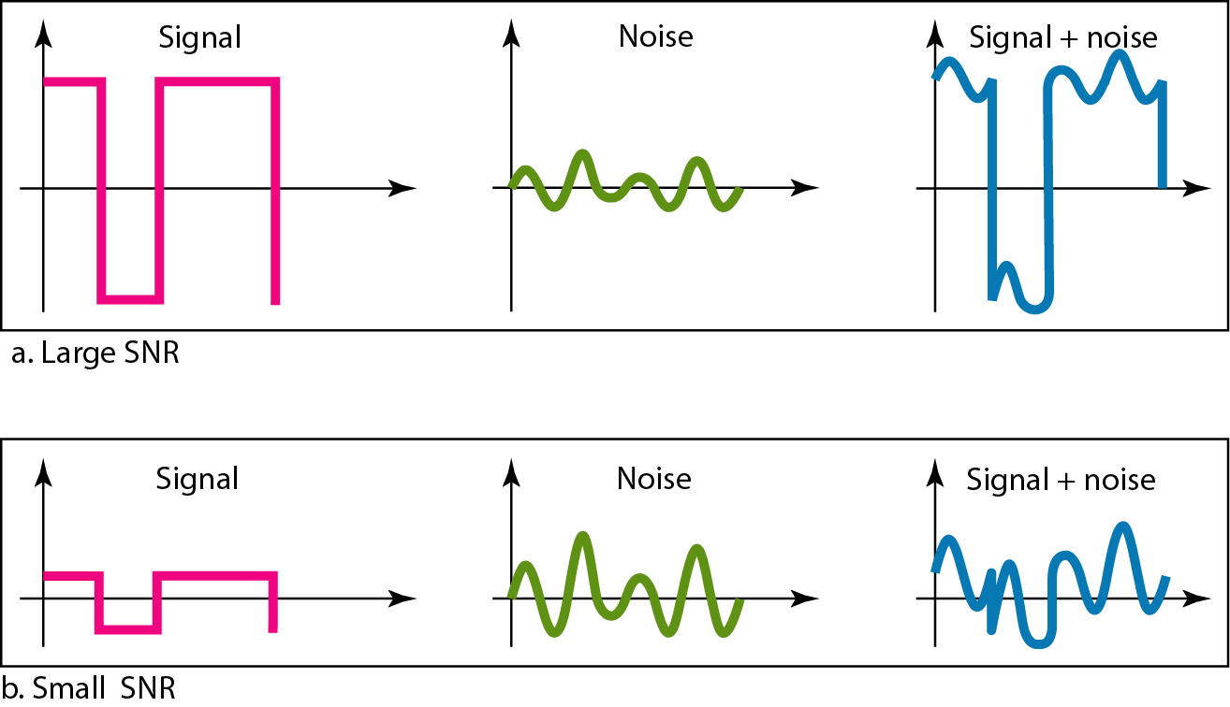
Figure: Two cases of SNR: a high SNR and a low SNR
3.74

Slide 75
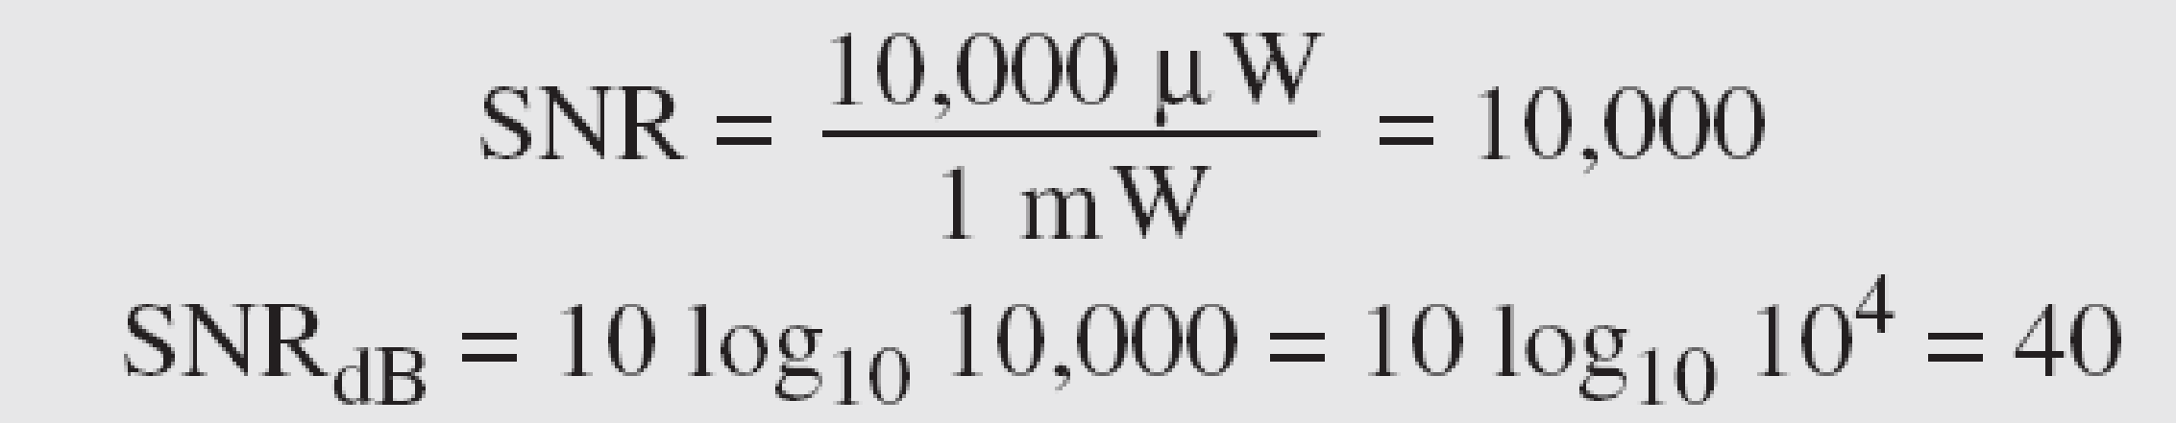
Example 3.31
The power of a signal is 10 mW and the power of the noise is 1 μW; what are the values of SNR and SNR_{dB} ?
Solution
The values of SNR and SNR_{dB} can be calculated as follows:
3.75

Slide 76
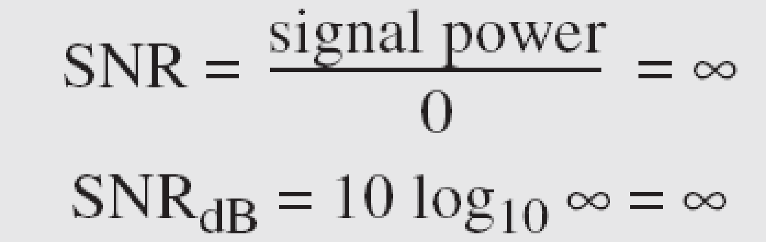
Example 3.32
The values of SNR and SNR_{dB} for a noiseless channel are
We can never achieve this ratio in real life; it is an ideal.
3.76

Slide 77
3-5 DATA RATE LIMITS
A very important consideration in data communications is how fast we can send data, in bits per second, over a channel. Data rate depends on three factors:
1. The bandwidth available
2. The level of the signals we use
3. The quality of the channel (the level of noise)
Two theoretical formulas were developed to calculate the data rate: one by Nyquist for
a noiseless channel, another by Shannon for a noisy channel.
Topics discussed in this section:
Noiseless Channel: Nyquist Bit Rate Noisy Channel: Shannon Capacity Using Both Limits
3.77

Slide 78
Noiseless Channel: Nyquist Bit Rate
For a noiseless channel, the Nyquist bit rate formula defines the theoretical maximum bit rate
In this formula, bandwidth is the bandwidth of the channel, L is the number of signal levels used to represent data, and BitRate is the bit rate in bits per second.
According to the formula, we might think that, given a specific bandwidth, we can have any bit rate we want by increasing the number of signal levels. Although the idea is theoretically correct, practically there is a limit. When we increase the number of signal levels, we impose a burden on the receiver.
Increasing the levels of a signal may reduce the reliability of the system.
3.78

Slide 79
Example 3.34
Consider a noiseless channel with a bandwidth of 3000 Hz transmitting a signal with two signal levels. The maximum bit rate can be calculated as
3.79

Slide 80
Example 3.35
Consider the same noiseless channel transmitting a signal with four signal levels (for each level, we send 2 bits). The maximum bit rate can be calculated as
3.80

Slide 81

Example 3.36
We need to send 265 kbps over a noiseless channel with a bandwidth of 20 kHz. How many signal levels do we need?
Solution
We can use the Nyquist formula as shown:
Since this result is not a power of 2, we need to either increase the number of levels or reduce the bit rate. If we have 128 levels, the bit rate is 280 kbps. If we have 64 levels, the bit rate is 240 kbps.
3.81

Slide 82
Noisy Channel: Shannon Capacity
In 1944, Claude Shannon introduced a formula, called the Shannon capacity, to determine the theoretical highest data rate for a noisy channel:
n this formula, bandwidth is the bandwidth of the channel, SNR is the signal-to-noise ratio, and capacity is the capacity of the channel in bits per second. Note that in the Shannon formula there is no indication of the signal level, which means that no matter how many levels we have, we cannot achieve a data rate higher than the capacity of the channel.
In other words, the formula defines a characteristic of the channel, not the method of transmission.
3.82

Slide 83
Example 3.37
Consider an extremely noisy channel in which the value of the signal-to-noise ratio is almost zero. In other words, the noise is so strong that the signal is faint. For this channel the capacity C is calculated as
This means that the capacity of this channel is zero regardless of the bandwidth. In other words, we cannot receive any data through this channel.
3.83

Slide 84
Example 3.38
We can calculate the theoretical highest bit rate of a regular telephone line. A telephone line normally has a bandwidth of 3000. The signal-to-noise ratio is usually 3162. For this channel the capacity is calculated as
This means that the highest bit rate for a telephone line is 34.860 kbps. If we want to send data faster than this, we can either increase the bandwidth of the line or improve the signal-to-noise ratio.
3.84

Slide 85
Example 3.39
The signal-to-noise ratio is often given in decibels. Assume that SNR_{dB} = 36 and the channel bandwidth is 2 MHz. The theoretical channel capacity can be calculated as
3.85

Slide 86


Example 3.40
For practical purposes, when the SNR is very high, we can assume that SNR + 1 is almost the same as SNR. In these cases, the theoretical channel capacity can be simplified to
For example, we can calculate the theoretical capacity of the previous example as
3.86

Slide 87
Example 3.41
We have a channel with a 1-MHz bandwidth. The SNR for this channel is 63. What are the appropriate bit rate and signal level?
Solution
First, we use the Shannon formula to find the upper limit.
3.87

Slide 88
Using Both Limits
In practice, we need to use both methods to find the limits and signal levels. Let us show this with an example.
Example 3.41 (continued)
The Shannon formula gives us 6 Mbps, the upper limit. For better performance we choose something lower, 4 Mbps, for example. Then we use the Nyquist formula to find the number of signal levels.
3.88

Slide 89
Note
The Shannon capacity gives us the upper limit; the Nyquist formula tells us how many signal levels we need.
3.89

Slide 90
3-6 PERFORMANCE
One important issue in networking is the performance of the network—how good is it? We discuss quality of service, an overall measurement of network performance, in greater detail in Chapter 24. In this section, we introduce terms that we need for future chapters.
Topics discussed in this section:
Bandwidth Throughput Latency (Delay)
3.90

Slide 91
Note
In networking, we use the term bandwidth in two contexts.
❏ The first, bandwidth in hertz, refers to the range of frequencies in a composite signal or the range of frequencies that a channel can pass.
❏ The second, bandwidth in bits per second, refers to the speed of bit transmission in a channel or link.
3.91

Slide 92
Example 3.42
The bandwidth of a subscriber line is 4 kHz for voice or data. The bandwidth of this line for data transmission
can be up to 56,000 bps using a sophisticated modem to change the digital signal to analog.
3.92

Slide 93
Throughput
The throughput is a measure of how fast we can actually send data through a network.
A link may have a bandwidth of B bps, but we can only send T bps through this link with T always less than B. In other words, the bandwidth is a potential measurement of a link; the throughput is an actual measurement of how fast we can send data. For example, we may have a link with a bandwidth of 1 Mbps, but the devices connected to the end of the link may handle only 200 kbps. This means that we cannot send more than 200 kbps through this link.
3.93

Slide 94

Example 3.44
A network with bandwidth of 10 Mbps can pass only an average of 12,000 frames per minute with each frame carrying an average of 10,000 bits. What is the throughput of this network?
Solution
We can calculate the throughput as
The throughput is almost one-fifth of the bandwidth in this case.
3.94

Slide 95
Latency (Delay)
The latency or delay defines how long it takes for an entire message to completely arrive at the destination from the time the first bit is sent out from the source. We can say that latency is made of four components: propagation time, transmission time, queuing time and processing delay.
Propagation Time
Propagation time measures the time required for a bit to travel from the source to the destination. The propagation time is calculated by dividing the distance by the propagation speed.
The propagation speed of electromagnetic signals depends on the medium and on the frequency of the signal.
3.95

Slide 96
Latency (Delay)
Transmission Time
There is a time between the first bit leaving the sender and the last bit arriving at the receiver. The first bit leaves earlier and arrives earlier; the last bit leaves later and arrives later. The transmission time of a message depends on the size of the message and the bandwidth of the channel.
3.96

Slide 97
Example 3.46
What are the propagation time and the transmission time for a 2.5-kbyte message (an e-mail) if the bandwidth of the network is 1 Gbps? Assume that the distance between the sender and the receiver is 12,000 km and that light travels at 2.4 × 108 m/s.
Solution
We can calculate the propagation and transmission time as shown on the next slide:
3.97

Slide 98
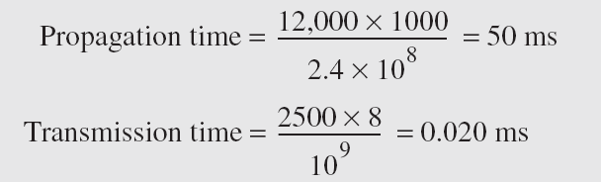
Example 3.46 (continued)
Note that in this case, because the message is short and the bandwidth is high, the dominant factor is the propagation time, not the transmission time. The transmission time can be ignored.
3.98

Slide 99
Latency (Delay)
Queuing Time
The third component in latency is the queuing time, the time needed for each intermediate or end device to hold the message before it can be processed. The queuing time is not a fixed factor; it changes with the load imposed on the network.
Processing Delay
Delay of processing in router or intermediate device
3.99

Slide 100

3.100

