Slide 1
CSE 320 Data Communications
Digital Transmission
Chapter 4
Presented by
NTR

Slide 2
Recap Previous Lecture
Digital data
Analog data
Digital Signal
Analog Signal
Digital Signal
Analog Signal

Slide 3
Encoding Techniques
Digital Data, Digital Signal
Less expensive and less complex than digital to analog modulation.
Digital Data, Analog Signals
Some transmission media, such as optical fiber and unguided media , will only propagate analog signals.

Slide 4
Digital Data--Digital Signal
Signal Encoding Techniques:
Line Coding
- Diffrent Line Coding Schemes
Block Coding
Scrambling
Line coding is always needed; block coding and scrambling may or may not be needed.

Slide 5
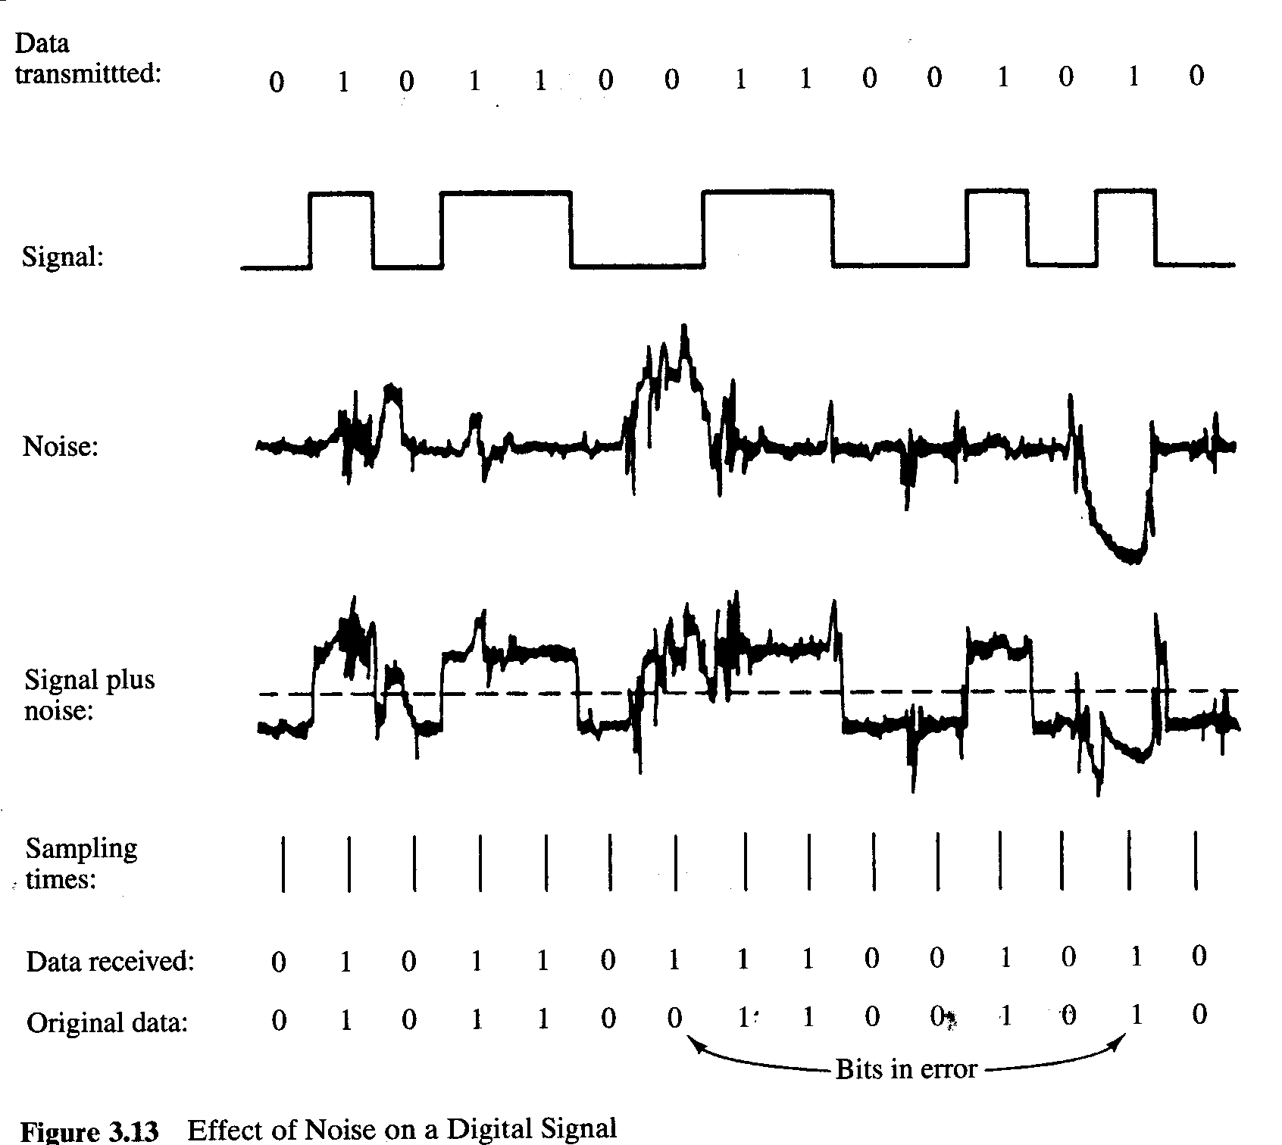
Digital Data, Digital Signal
Digital signal
Discrete, discontinuous voltage pulses
Each pulse is a signal element
Binary data encoded into signal elements

Slide 6
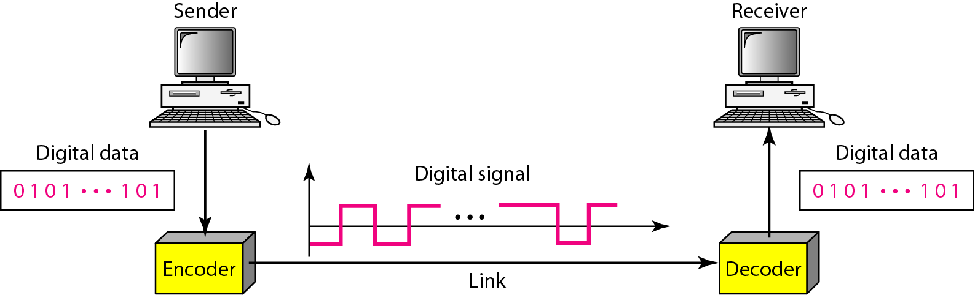
Line Coding
Line coding is the process of converting binary data, a sequence of bits, to a digital signal.

Slide 7
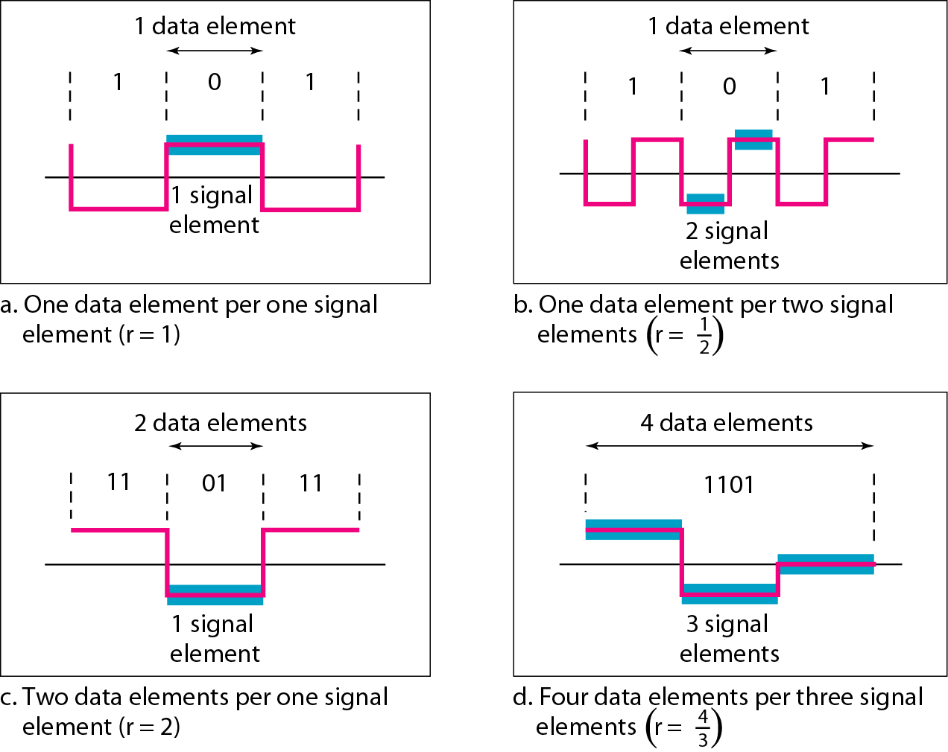
Signal Vs Data Element
A signal element is the shortest unit (time wise) of a digital signal. In other words, data elements are what we need to send; signal elements are what we can send. Data elements are being carried; signal elements are the carriers.
We define a ratio r which is the number of data elements carried by each signal element.

Slide 8

Data Rate Versus Signal Rate
The data rate defines the number of data elements (bits) sent in 1s. The unit is bits per second (bps). The signal rate is the number of signal elements sent in 1s. The unit is the baud.
The data rate is sometimes called the bit rate;
the signal rate is sometimes called the pulse rate, the modulation rate, or the baud rate.
We can formulate the relationship between data rate and signal rate as:
where N is the data rate (bps); c is the case factor, which varies for each case; S is the number of signal elements; and r is the previously defined factor.

Slide 9
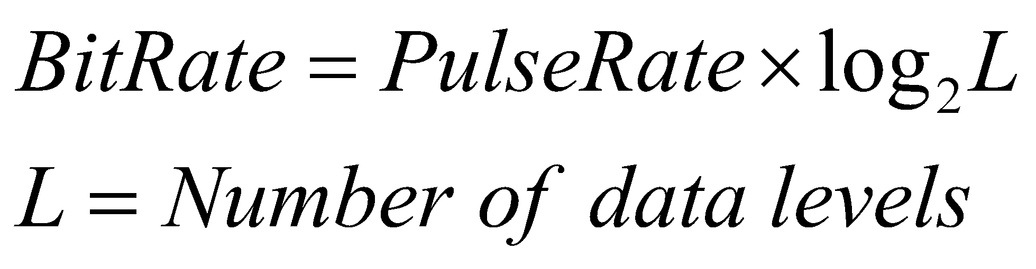
Pulse /Modulation /Signal/ Baud Rate versus Bit Rate
The pulse rate defines the number of pulses/signals sent in one second. Also known as Baud Rate.
The bit rate defines the number of bits per second.

Slide 10
Digital Data-- Digital Signal
Receiver needs to know
Timing of bits
Signal levels
Factors affecting successful interpretation of signals
Baseline Wandering
DC Components
Self-synchronization
Built in Error Detection
Immunity to Noise and Interference
Complexity

Slide 11
BaseLine Wandering
Receiver calculates the running average of received signal power.
Average = baseline
A log strings of 0’s and 1’s can cause a drift in the baseline making it difficult for the receiver to decode properly.

Slide 12
DC Components
When the voltage level in a digital signal is constant for a while, the spectrum creates very low frequencies (results of Fourier analysis).
If the signal is to pass through a system (such as a transformer) that does not allow the passage of a dc component, the signal is distorted and may create errors in the output.
This component is extra energy residing on the line and is useless.

Slide 13
Self-Synchronization
The receiver’s bit intervals must correspond exactly to the senders bit intervals.
If the receiver clock is faster or slower, the bit intervals are not matched and the receiver might misinterpret the signals.

Slide 14
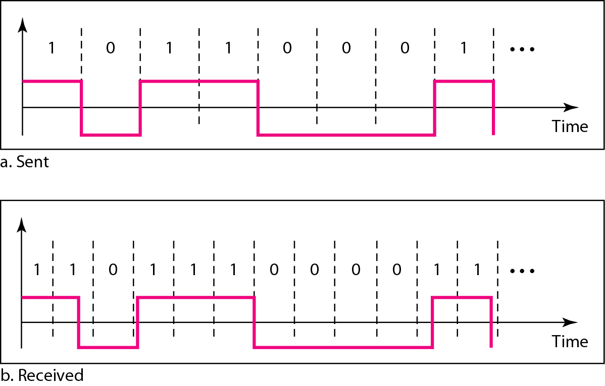
Figure 4.3 Effect of lack of synchronization

Slide 15
Self-Synchronization
A self-synchronizing digital signal includes timing information in the data being transmitted.
This can be achieved if there are transitions in the signal that alert the receiver to the beginning, middle, or end of the pulse.
If the receiver’s clock is out of synchronization, these points can reset the clock.

Slide 16
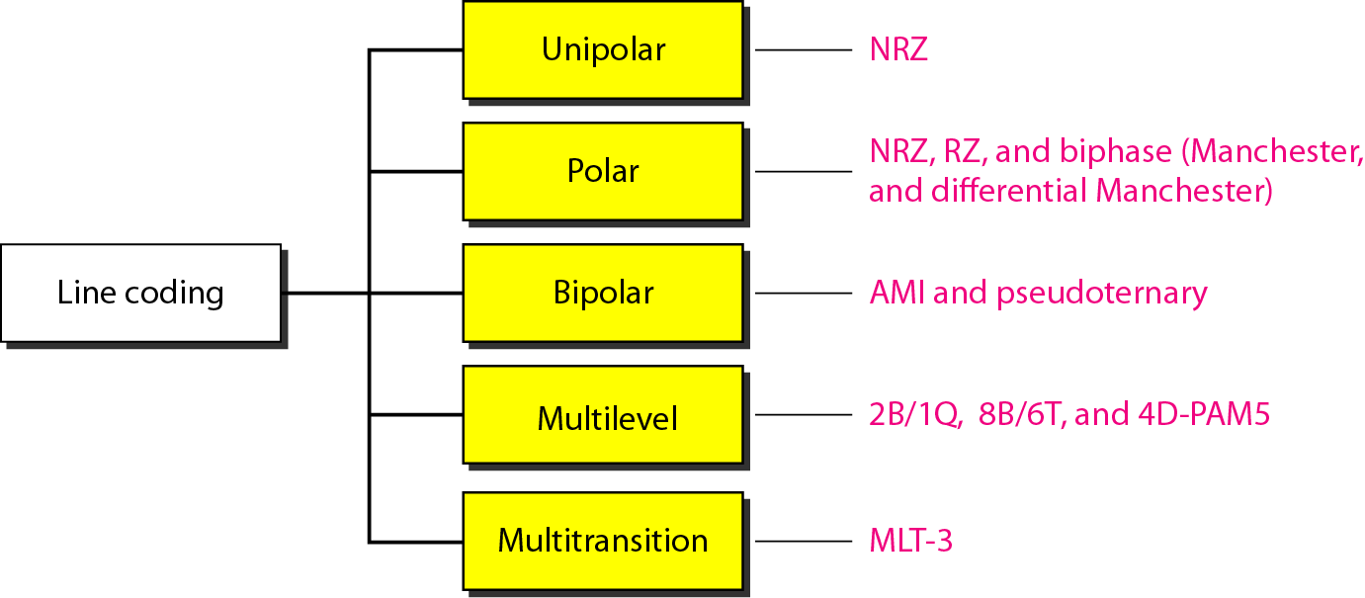
Different Line Encoding Schemes

Slide 17
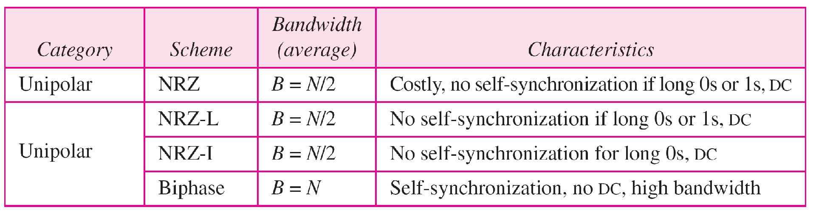
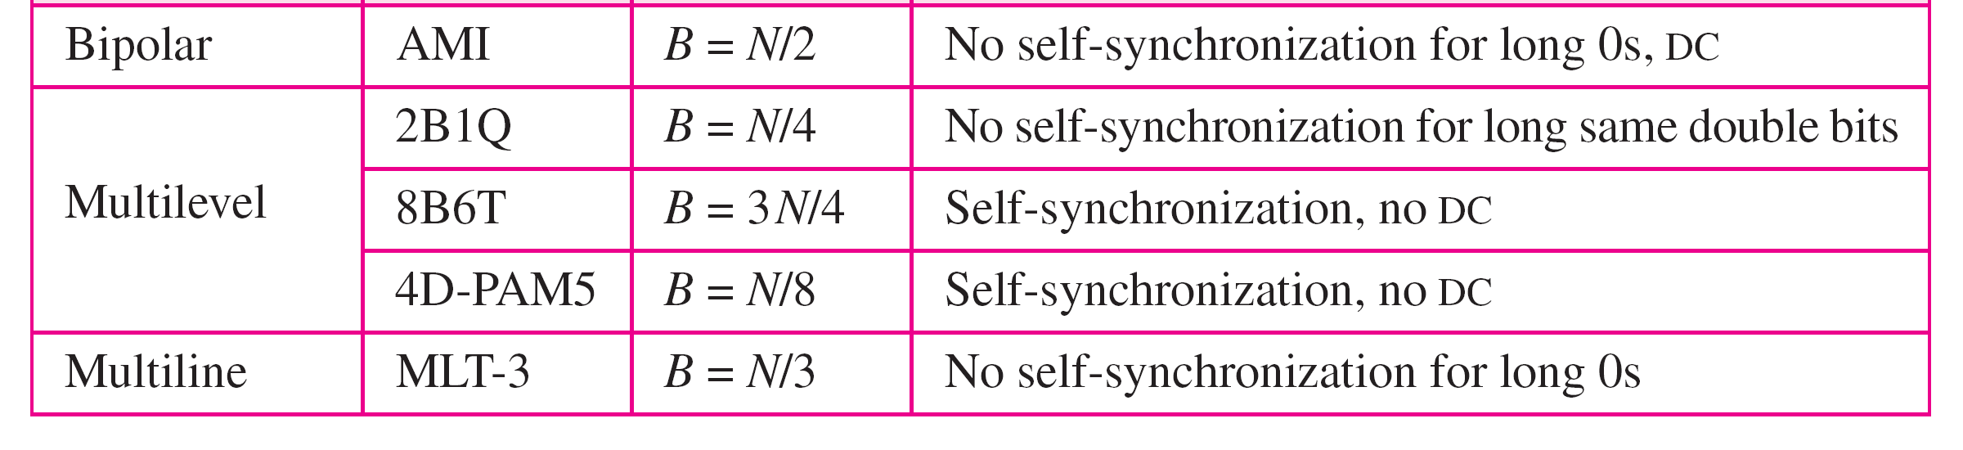
Table 4.1 Summary of line coding schemes

Slide 18
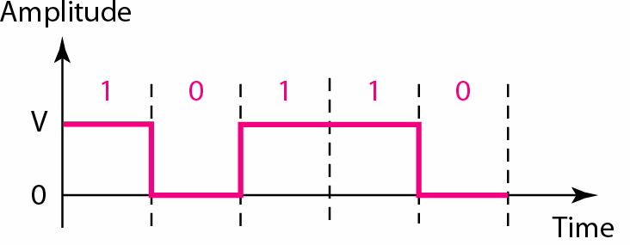
Unipolar
The positive voltage defines bit 1 and the zero voltage defines bit 0.
It is called NRZ because the signal does not return to zero at the middle of the bit.

Slide 19
Notes:
Manchester
Transition in middle of each bit period
Transition serves as clock and data
Low to high represents 1
High to low represents 0
Used by IEEE 802.3 (Ethernet LAN)
Differential Manchester
Mid-bit transition is clocking only
Transition at start of a bit period represents 0
No transition at start of a bit period represents 1
This is a differential encoding scheme
Used by IEEE 802.5 (Token Ring LAN)

Slide 20
Polar Schemes →NRZ-L & NRZ-I
Non-Return-to-Zero (NRZ) In polar NRZ encoding, we use two levels of voltage amplitude.
We can have two versions of polar NRZ: NRZ-L and NRZ-I.

Slide 21
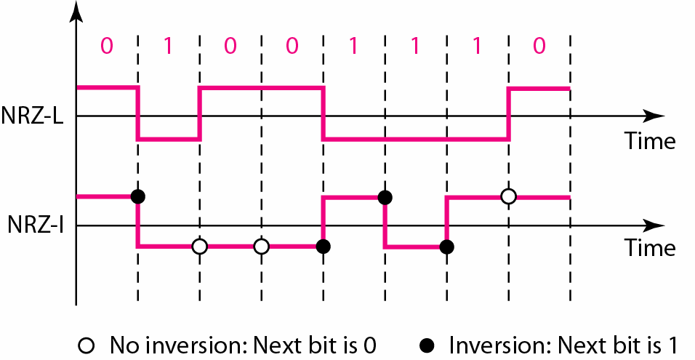
Polar Schemes →NRZ-L & NRZ-I

Slide 22
Non return to Zero (NRZ)
NRZ-L NRZ-I
1→ negative voltage 1→transition
0→ positive voltage 0→notransition
0 1 0 0 1 1 0 0 0 1 1
NRZ-L
NRZI
Notes:
NRZ
Two different voltages for 0 and 1 bits
Voltage constant during bit interval
No transition (i.e. no return to zero voltage)
Options:
1. Absence of voltage for zero, constant positive voltage for one
2. More often, negative voltage for one value and positive for the other
NRZI
Inverted on ones
Constant voltage pulse for duration of bit
Data encoded as presence or absence of signal transition at beginning of bit time
Transition (low to high or high to low) denotes a binary 1
No transition denotes binary 0
An example of differential encoding

Slide 23
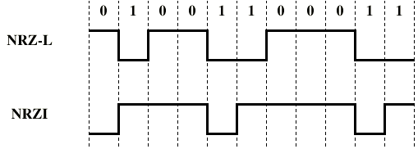
NRZ

Slide 24
NRZ – Pros and Cons
Pros
Easy to engineer
Make good use of bandwidth
Cons
DC component
Lack of synchronization capability
Used for magnetic recording
Not often used for signal transmission
NRZ-L and NRZ-I both have an average signal rate of N/2 Bd.

Slide 25


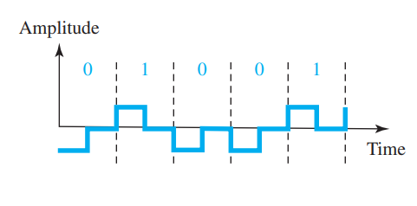
Return-to-Zero (RZ)
In RZ, the signal changes not between bits but during the bit.
The main disadvantage of RZ encoding is that it requires two signal changes to encode a bit and therefore occupies greater bandwidth.
1→ positive to zero
0→ negative to zero
Figure: Polar RZ scheme

Slide 26
Notes:
Manchester
Transition in middle of each bit period
Transition serves as clock and data
Low to high represents 1
High to low represents 0
Used by IEEE 802.3 (Ethernet LAN)
Differential Manchester
Mid-bit transition is clocking only
Transition at start of a bit period represents 0
No transition at start of a bit period represents 1
This is a differential encoding scheme
Used by IEEE 802.5 (Token Ring LAN)

Slide 27
Biphase: Manchester and Differential Manchester
The idea of RZ (transition at the middle of the bit) and the idea of NRZ-L are combined into the Manchester scheme.
In Manchester encoding, the duration of the bit is divided into two halves. The voltage remains at one level during the first half and moves to the other level in the second half.
The transition at the middle of the bit provides synchronization.
Differential Manchester, combines the ideas of RZ and NRZ-I. There is always a transition at the middle of the bit, but the bit values are determined at the beginning of the bit. If the next bit is 0, there is a transition; if the next bit is 1, there is none

Slide 28
Differential Manchester Encoding
In complex transmission layouts, it is easy to lose sense of polarity
Therefore
Data represented by changes (i.e., transitions) rather than levels
More reliable detection of transition rather than level

Slide 29
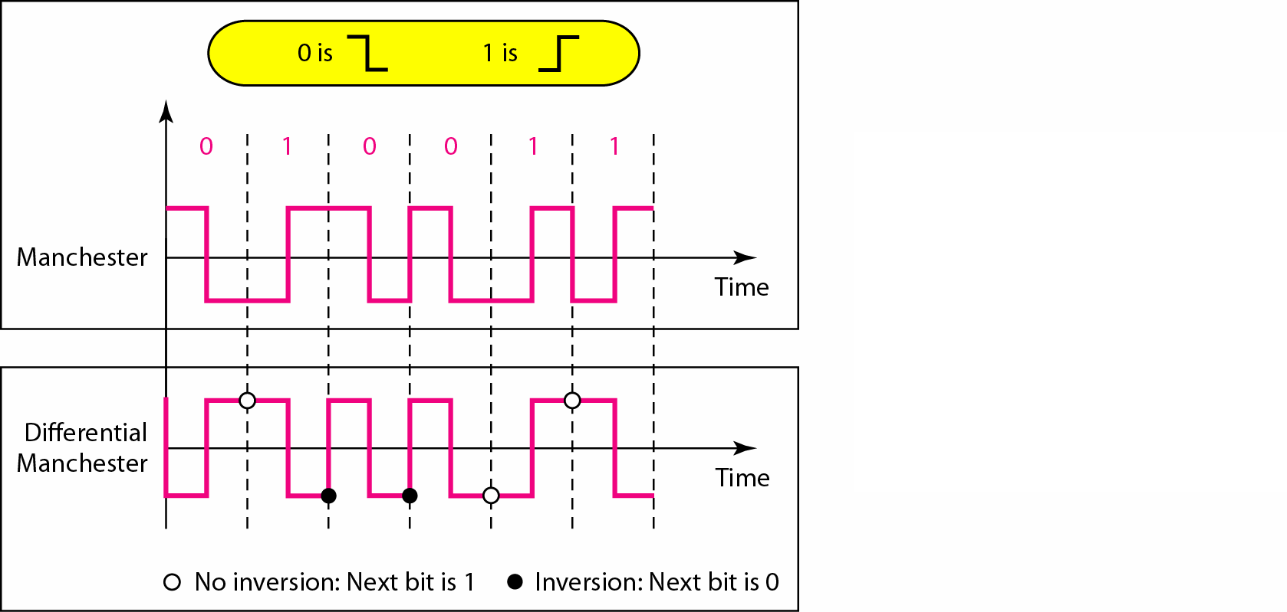
Manchester & Differential Manchester Encoding
0→ transition
1→ no transition

Slide 30
Biphase (Manchester and D-Manchester)
0 1 0 0 1 1 0 0 0 1 1
Man
D-Man
Notes:
Manchester
Transition in middle of each bit period
Transition serves as clock and data
Low to high represents 1
High to low represents 0
Used by IEEE 802.3 (Ethernet LAN)
Differential Manchester
Mid-bit transition is clocking only
Transition at start of a bit period represents 0
No transition at start of a bit period represents 1
This is a differential encoding scheme
Used by IEEE 802.5 (Token Ring LAN)

Slide 31
Notes:
Manchester
Transition in middle of each bit period
Transition serves as clock and data
Low to high represents 1
High to low represents 0
Used by IEEE 802.3 (Ethernet LAN)
Differential Manchester
Mid-bit transition is clocking only
Transition at start of a bit period represents 0
No transition at start of a bit period represents 1
This is a differential encoding scheme
Used by IEEE 802.5 (Token Ring LAN)

Slide 32
Biphase -- Pros and Cons
Pros
Synchronization on mid bit transition (self clocking)
No dc component
Error detection
Cons
At least one transition per bit time and possibly two
Maximum modulation rate is twice NRZ
Requires more bandwidth
The minimum bandwidth of Manchester and differential Manchester is 2 times that of NRZ.

Slide 33
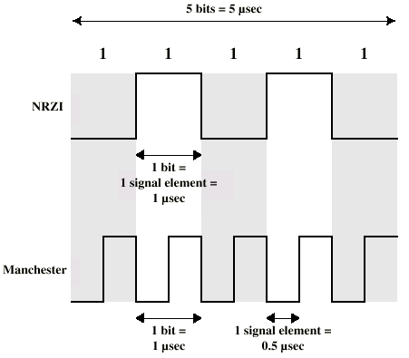
Modulation Rate

Slide 34
Bipolar Schemes
In bipolar encoding sometimes called multilevel binary.
Two variations of bipolar encoding: AMI and pseudoternary.
A common bipolar encoding scheme is called bipolar alternate mark inversion (AMI).
A variation of AMI encoding is called pseudoternary in which the 1 bit is encoded as a zero voltage and the 0 bit is encoded as alternating positive and negative voltages

Slide 35
Bipolar- AMI Schemes
More than two levels
There are three voltage levels: positive, negative, and zero.
The voltage level for one data element is at zero, while the voltage level for the other element alternates between positive and negative.
0→represented by no line signal / zero voltage level.
1→ represented by positive or negative pulse / alternative.
No loss of sync if a long string of ones (zeros still a problem)
Lower bandwidth

Slide 36
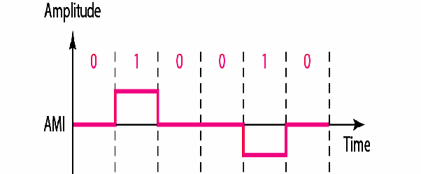
Bipolar-AMI

Slide 37
0→ zero voltage level.
1→ alternative.
Notes:
Manchester
Transition in middle of each bit period
Transition serves as clock and data
Low to high represents 1
High to low represents 0
Used by IEEE 802.3 (Ethernet LAN)
Differential Manchester
Mid-bit transition is clocking only
Transition at start of a bit period represents 0
No transition at start of a bit period represents 1
This is a differential encoding scheme
Used by IEEE 802.5 (Token Ring LAN)

Slide 38
Multilevel Transition- MLT-3
The multiline transmission, three-level (MLT-3) scheme uses three levels (+V, 0, and −V) and three transition rules to move between the levels.
1. If the next bit is 0, there is no transition.
2. If the next bit is 1 and the current level is not 0, the next level is 0.
3. If the next bit is 1 and the current level is 0, the next level is the opposite of the last nonzero level.
If first bit is zero let us assume that, the last level was at zero voltage.
If first bit is one let us assume that, last non zero pulse was negative.

Slide 39
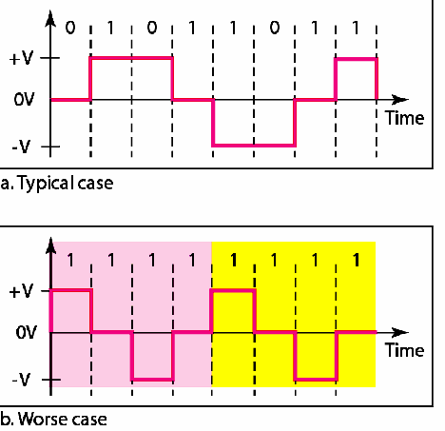
MLT-3

Slide 40
Biploar AMI and MLT-3 Example
0 1 0 0 1 1 1 0 0 1 1
Biploar
AMI
MLT-3
Notes:
Manchester
Transition in middle of each bit period
Transition serves as clock and data
Low to high represents 1
High to low represents 0
Used by IEEE 802.3 (Ethernet LAN)
Differential Manchester
Mid-bit transition is clocking only
Transition at start of a bit period represents 0
No transition at start of a bit period represents 1
This is a differential encoding scheme
Used by IEEE 802.5 (Token Ring LAN)

Slide 41
1.If the next bit is 0, there is no transition.
2. If the next bit is 1 and the current level is not 0, the next level is 0.
3. If the next bit is 1 and the current level is 0, the next level is the opposite of the last nonzero level.
If first bit is zero let us assume that, the last level was at zero voltage.
If first bit is one let us assume that, last non zero pulse was negative.
MLT-3
Notes:
Manchester
Transition in middle of each bit period
Transition serves as clock and data
Low to high represents 1
High to low represents 0
Used by IEEE 802.3 (Ethernet LAN)
Differential Manchester
Mid-bit transition is clocking only
Transition at start of a bit period represents 0
No transition at start of a bit period represents 1
This is a differential encoding scheme
Used by IEEE 802.5 (Token Ring LAN)

Slide 42
Block Coding

Slide 43
Block Coding
NRZ, Bipolar AMI, MLT-3 all has a common problem.
Block coding can give us redundancy and improve the performance of line coding.
Long sequence of 0 can make the receiver lose synchronization.

Slide 44
Solutions: Block Coding
Block coding is referred to as an mB/nB encoding technique.
Changes a block of m bits to a block of n bits. where n is larger than m.
Referred to as mB/nB encoding.

Slide 45
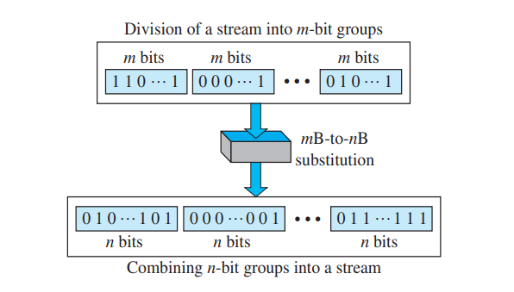
Block Coding
Three Steps Process:
Division
Substitution
Combination

Slide 46
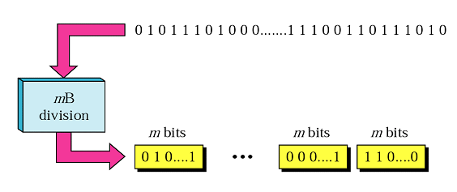
Step 1-Division
The sequence of bits in data in divided into m Bits.
For example in 4B/5B encoding, the original bit sequence is divided into 4-bit codes/sequence.

Slide 47
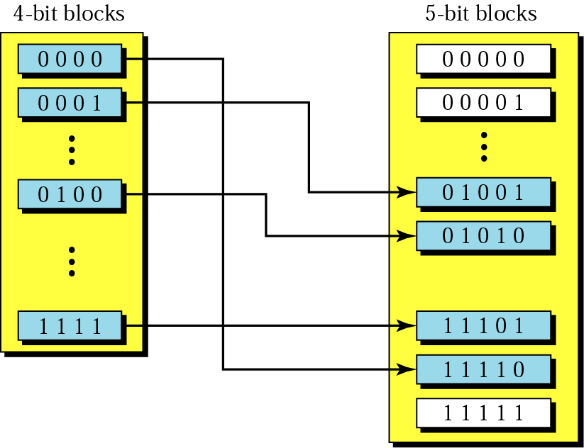
Step 2-Substitution
Each m bits sequence is substituted for a n bit code.

Slide 48
Step 3-Combination
Finally, the n-bit groups are combined to form a stream.
The new stream has more bits than the original bits.

Slide 49
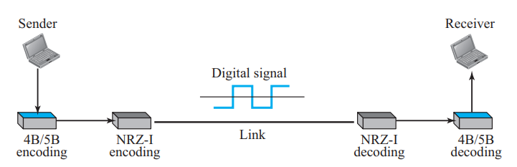
4B/5B Block Coding
The four binary/five binary (4B/5B) coding scheme was designed to be used in combination with NRZ-I.
it has a synchronization problem. A long sequence of 0s can make the receiver clock lose synchronization.
One solution is to change the bit stream, prior to encoding with NRZ-I, so that it does not have a long stream of 0s.
The 4B/5B scheme achieves this goal. The block-coded stream does not have more that three consecutive 0s. At the receiver, the NRZ-I encoded digital signal is first decoded into a stream of bits and then decoded to remove the redundancy.

Slide 50
4B/5B Block Coding
4-bit code ==16 different combinations
5-bit code== 32 possible combinations.
So total of 16-bit codes are unused.
“one leading 0 and no more than two trailing 0s.” (3 consecutive 0s)

Slide 51
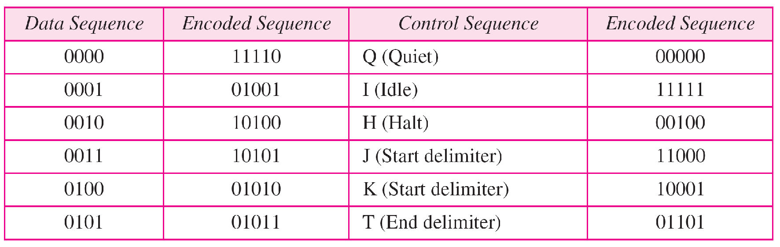
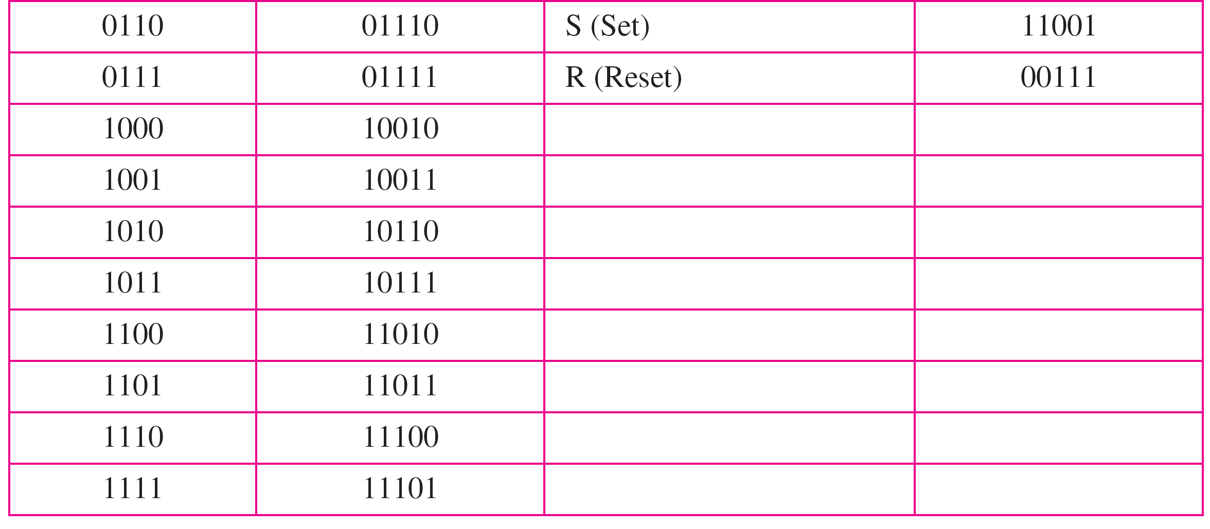
Table : 4B/5B encoding

Slide 52
Block Coding-Pros/Cons
Solves the synchronization problem but not the DC component problem.
If DC is unacceptable, use bipolar or biphase encoding.
Increases the baud rate by 20%, still better than Manchester schemes.

Slide 53
An example of 4B/5B Line coding

Slide 54
Scrambling

Slide 55
Scrambling
In Bipolar AMI encoding, has a narrow bandwidth and does not create a DC component that’s why not suitable for long distance.
However, a long sequence of 0s upsets the synchronization.
If we can find a way to avoid a long sequence of 0s in the original stream, we can use bipolar AMI for long distances.
We are looking for a technique that does not increase the number of bits and does provide synchronization.
One solution is called scrambling.
Scrambling, as opposed to block coding, is done at the same time as encoding.
Two common scrambling techniques are B8ZS and HDB3

Slide 56
Types of Scarmbling:
B8ZS
Bipolar With 8 Zeros Substitution
Commonly used US.
HDB3
High Density Bipolar 3 Zeros
Based on Bipolar AMI
Commonly used Europe and Japan.

Slide 57
B8ZS
Based on bipolar-AMI
In this technique, eight consecutive zero-level voltages are replaced by the sequence 000VB0VB.
The V in the sequence denotes violation → same as last non zero level
The B in the sequence denotes bipolar → opposite to last non zero level.
And for AMI
0→represented by no line signal / zero voltage level.
1→ represented by positive or negative pulse / alternative.

Slide 58
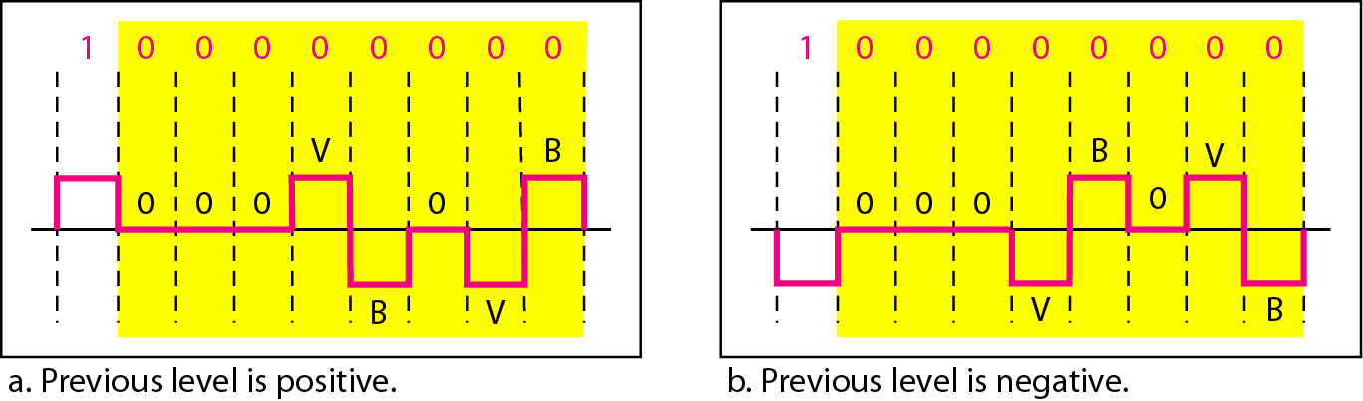
B8ZS
V (violation) → same as last non zero level
B ( bipolar ) → opposite to last non zero level.
And for AMI
0→represented by no line signal / zero voltage level.
1→ represented by positive or negative pulse / alternative.

Slide 59
V (violation) → same as last non zero level
B (bipolar) → opposite to last non zero level.
And for AMI
0→represented by no line signal / zero voltage level.
1→ represented by positive or negative pulse / alternative.
Notes:
Manchester
Transition in middle of each bit period
Transition serves as clock and data
Low to high represents 1
High to low represents 0
Used by IEEE 802.3 (Ethernet LAN)
Differential Manchester
Mid-bit transition is clocking only
Transition at start of a bit period represents 0
No transition at start of a bit period represents 1
This is a differential encoding scheme
Used by IEEE 802.5 (Token Ring LAN)

Slide 60
HDB3-High Density Bipolar 3 Zeros
Based on bipolar-AMI
In this technique, four consecutive zero-level voltages are replaced with a sequence of 000V or B00V.
The two rules can be stated as follows:
1. If the total number of nonzero pulses is odd, the pattern will be 000V.
2. If the number of nonzero pulses is even, the pattern will be B00V.

Slide 61
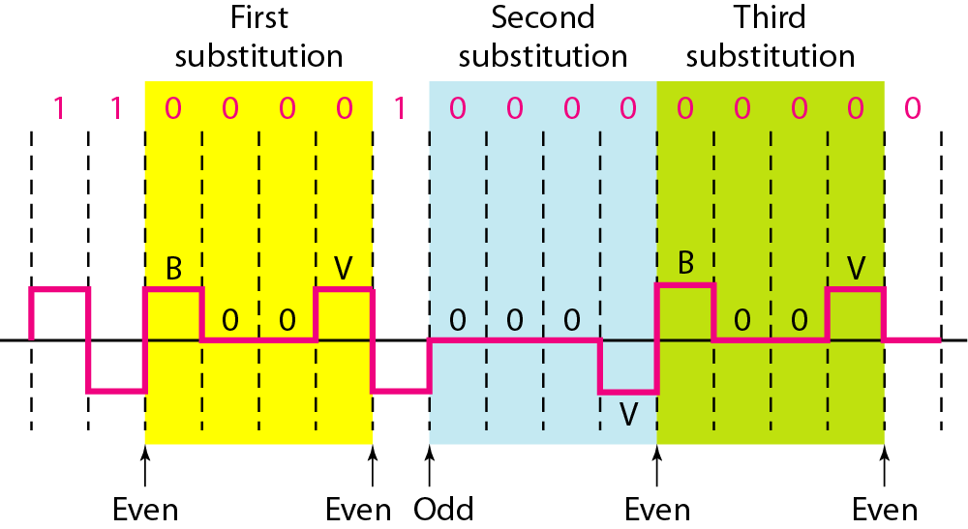
HDB3
1. If the total number of nonzero pulses is odd, the pattern will be 000V.
2. If the number of nonzero pulses is even, the pattern will be B00V.

Slide 62
1. If the total number of nonzero pulses is odd, the pattern will be 000V.
2. If the number of nonzero pulses is even, the pattern will be B00V.
Notes:
Manchester
Transition in middle of each bit period
Transition serves as clock and data
Low to high represents 1
High to low represents 0
Used by IEEE 802.3 (Ethernet LAN)
Differential Manchester
Mid-bit transition is clocking only
Transition at start of a bit period represents 0
No transition at start of a bit period represents 1
This is a differential encoding scheme
Used by IEEE 802.5 (Token Ring LAN)

