Slide 1
CSE 320 Data Communications
Digital Transmission
Chapter 4
By NTR

Slide 2
Analog Signal → Digital Data
Topics discussed in this section:
Pulse Code Modulation (PCM) Delta Modulation (DM)

Slide 3
Delta Modulation
A delta modulation (DM or Δ-modulation) is an analog-to-digital and digital-to-analog signal conversion technique used for transmission of voice information where quality is not of primary importance.

Slide 4
Delta Modulation
To improve the performance of PCM (reduce complexity)
Analog input is approximated by a staircase function
Move up or down one quantization level (δ) at each sample interval
Binary behavior—important characteristic
Function moves up or down at each sample interval

Slide 5
Delta Modulation
This scheme sends only the difference between pulses, if the pulse at time t_{n+1} is higher in amplitude value than the pulse at time t_{n}, then a single bit, say a “1”, is used to indicate the positive value.
If the pulse is lower in value, resulting in a negative value, a “0” is used.
This scheme works well for small changes in signal values between samples.
If changes in amplitude are large, this will result in large errors.

Slide 6
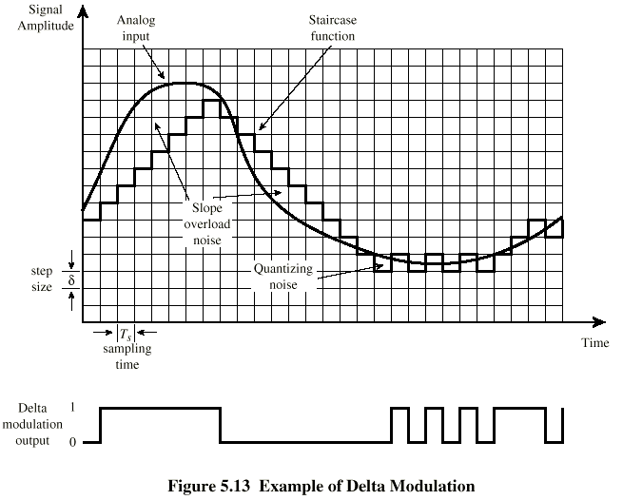
Delta Modulation - example

Slide 7
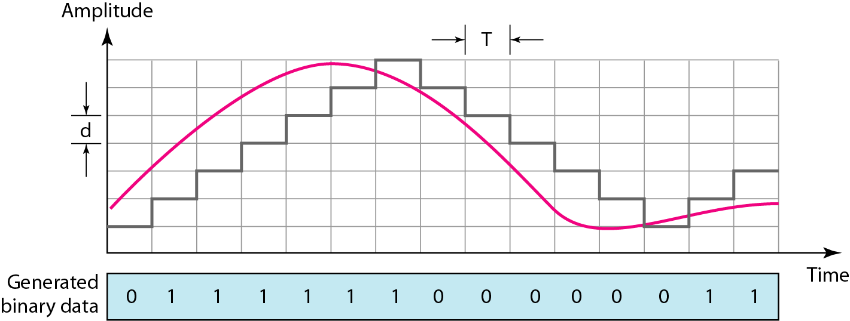
The process of delta modulation

Slide 8


Slide 9
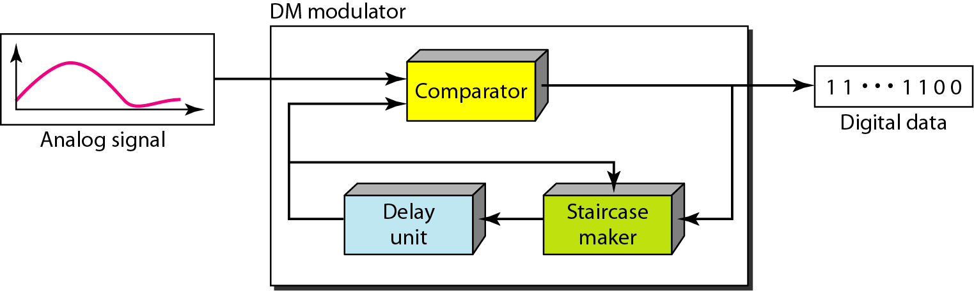
Figure: Delta modulation components

Slide 10
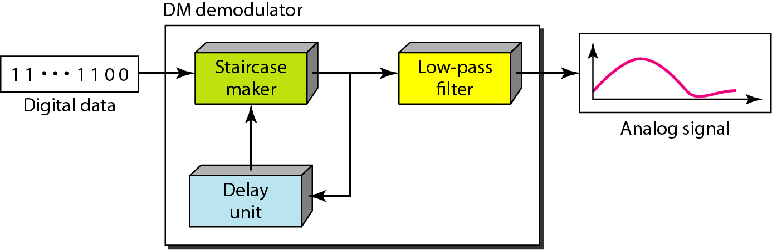
Figure: Delta demodulation components
Demodulator
The demodulator takes the digital data and, using the staircase maker and the delay unit, creates the analog signal. The created analog signal, however, needs to pass through a low-pass filter for smoothing. Figure below shows the schematic diagram.

Slide 11
Delta Modulation
2 important parameters are
size of the step δ
the sampling rate.
Adaptive DM
A better performance can be achieved if the value of δ is not fixed. In adaptive delta modulation, the value of δ changes according to the amplitude of the analog signal.
Quantization Error
It is obvious that DM is not perfect. Quantization error is always introduced in the process. The quantization error of DM, however, is much less than that for PCM

