Slide 1
UML Sequence diagram

Slide 2
Sequence Diagram(make a phone call)
Caller
Phone
Recipient
Picks up
Dial tone
Dial
Ring notification
Ring
Picks up
Hello
Notes:
‹#›

Slide 3
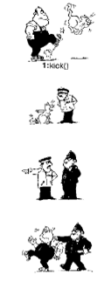
Person kicks the cat
Cat reports to inspector
Inspector reports to Policeman
Policeman arrests person
Slide ‹#›

Slide 4
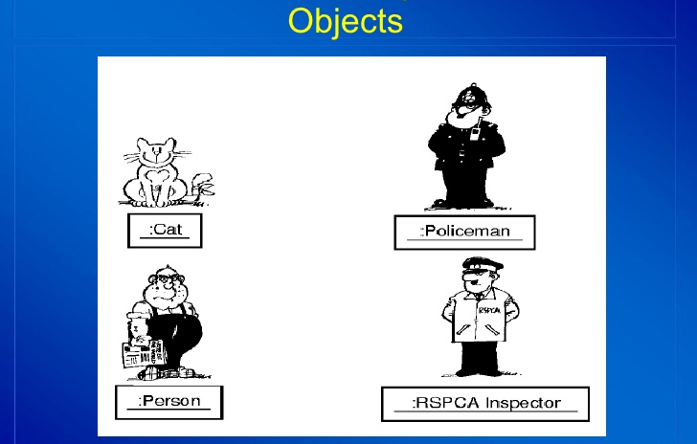
Slide ‹#›

Slide 5
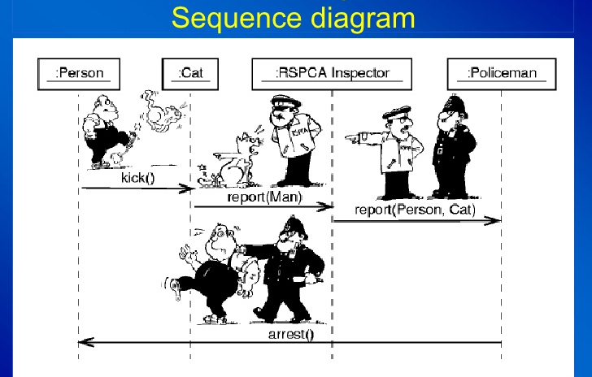
Slide ‹#›

Slide 6
Sequence Diagrams
Dynamic model
Illustrate the objects that participate in a use-case
Show the sequence of messages that pass between objects for a particular use-case over time
Example: order food, change tv channel
It models a single scenario executing in the system
Slide ‹#›

Slide 7
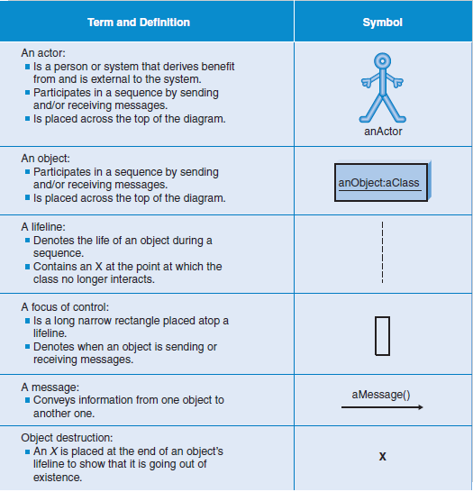

Slide 8
Sequence Diagrams – Object Life Spans
Creation
Create message
Object life starts at that point
Activation
Symbolized by rectangular stripes
Place on the lifeline where object is activated.
Rectangle also denotes when object is deactivated.
Deletion
Placing an ‘X’ on lifeline
Object’s life ends at that point
A
Create
B
Activation bar
X
Return
Deletion
Lifeline
Notes:
‹#›

Slide 9
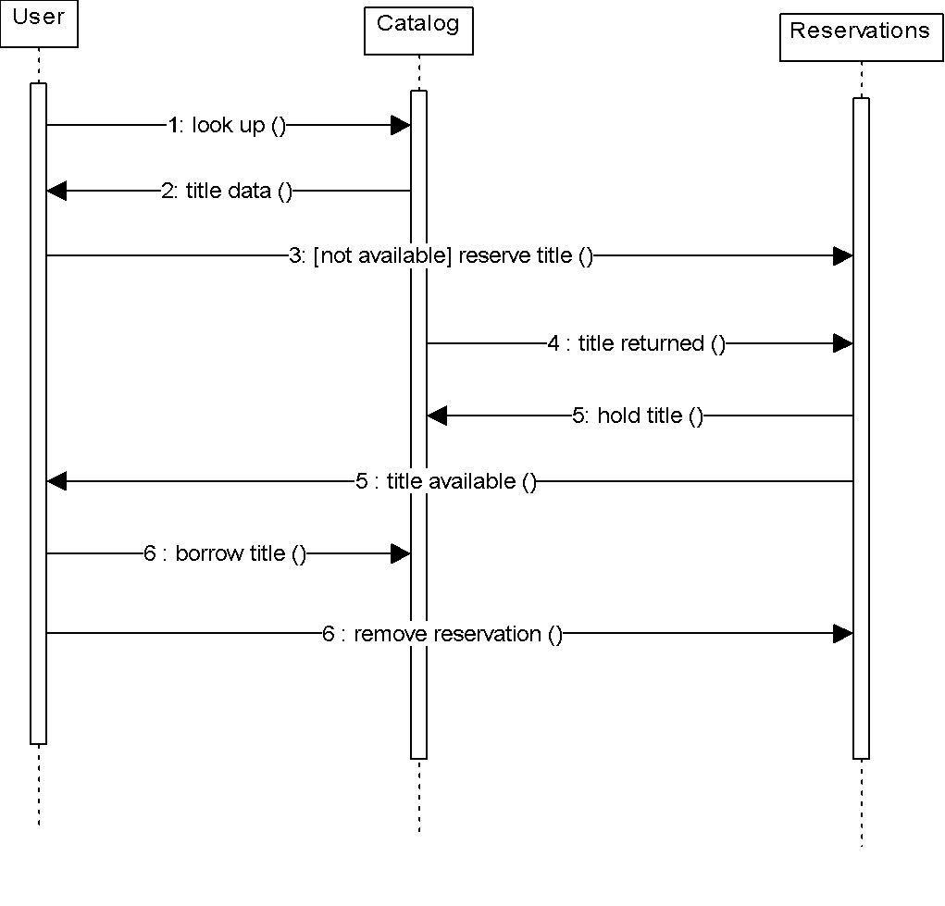
Sequence Diagram
Sequence diagrams demonstrate the behavior of objects in a use case by describing the objects and the messages they pass.
The horizontal dimension shows the objects participating in the interaction.
The vertical arrangement of messages indicates their order.
The labels may contain the seq. # to indicate concurrency.
Message
Notes:
‹#›

Slide 10
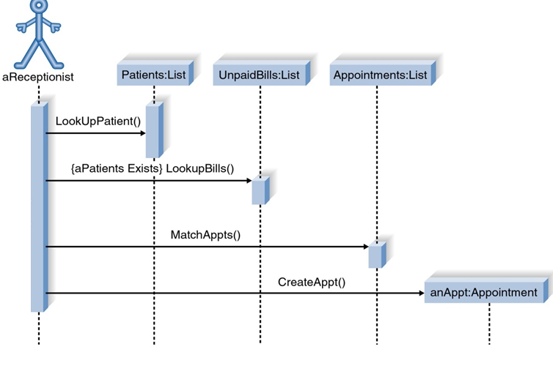
Sequence Diagram for Patient appointment Use Case
Slide ‹#›
Notes:
‹#›

Slide 11
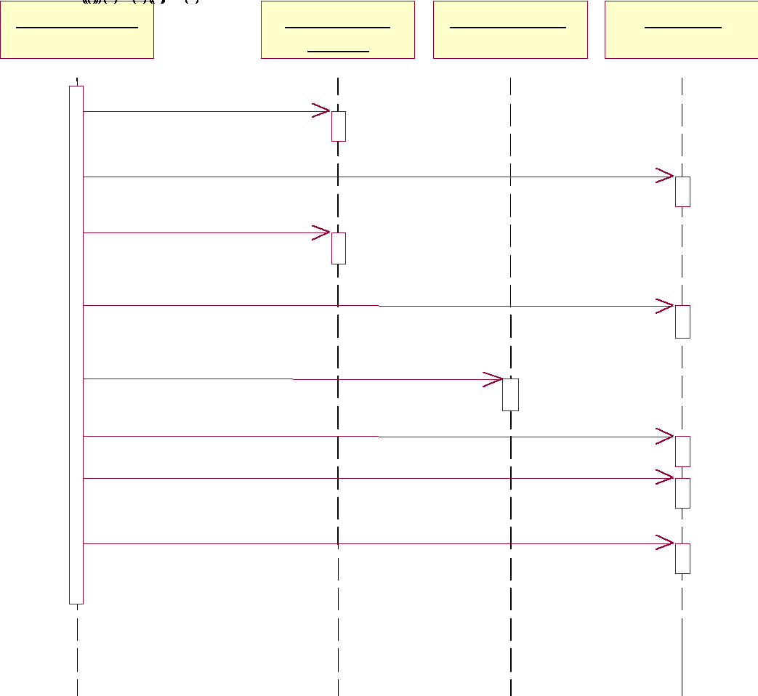
Sequence Diagram for Print Invoice use case

Slide 12
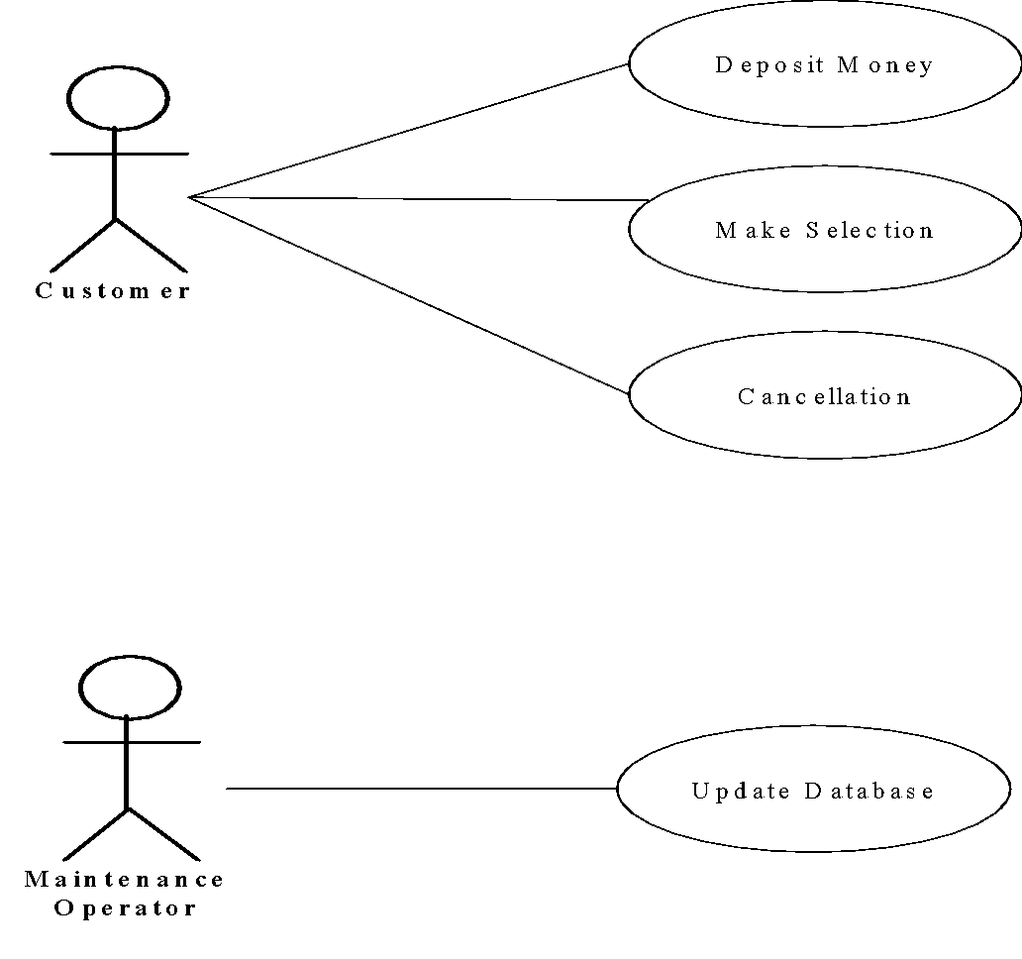
Example: Use Case Diagram of the Vending Machine

Slide 13
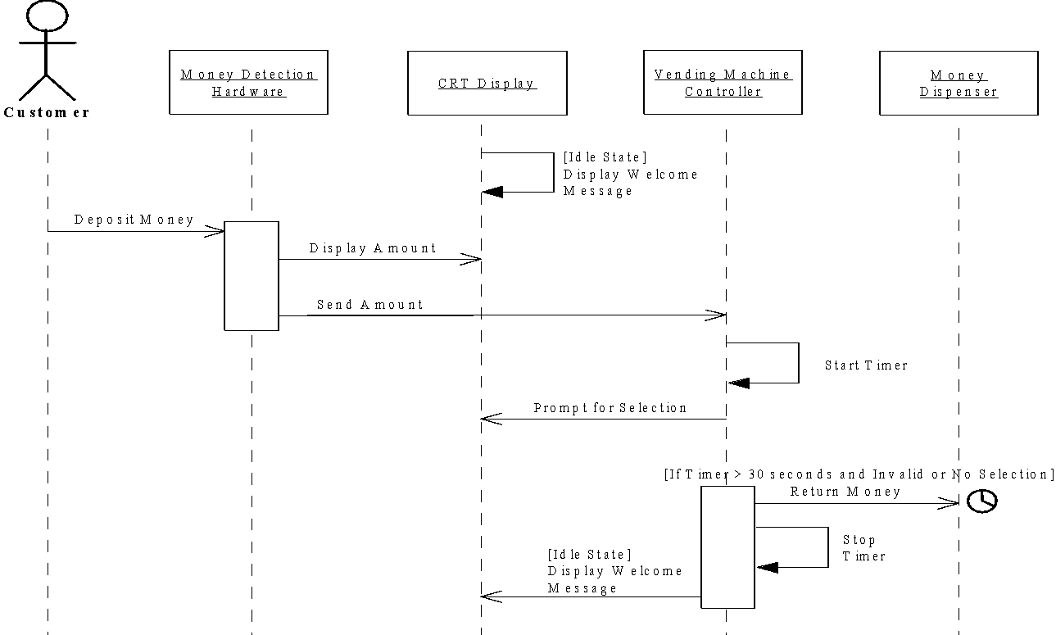
Sequence Diagram for Deposit Money Use Case

Slide 14
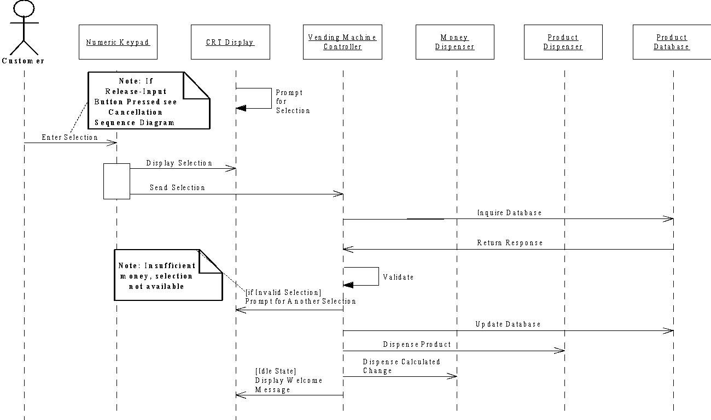
System Sequence Diagram for Make Selection Use Case

Slide 15
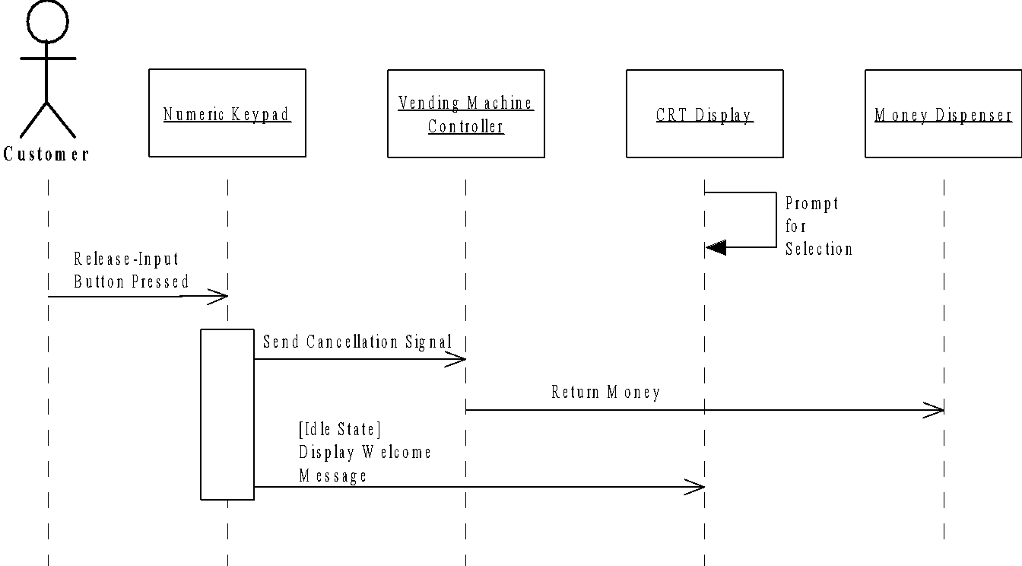
System Sequence Diagram for Cancellation Use Case

Slide 16
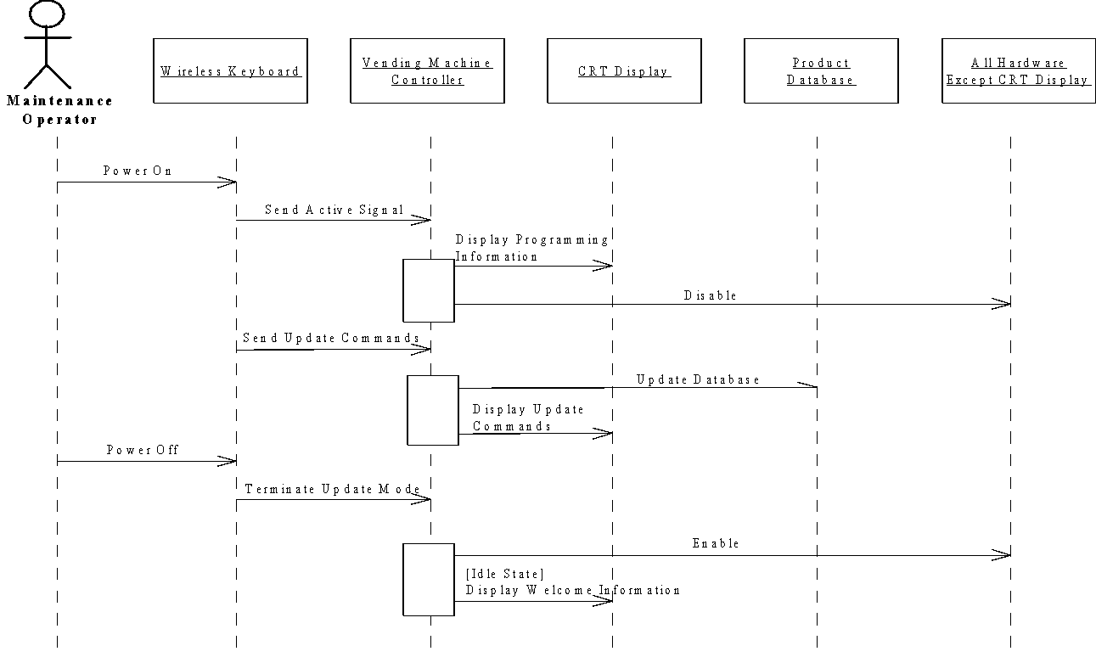
System Sequence Diagram for Update Database Use Case

Slide 17
Building a Sequence Diagram
Determine the context of the sequence diagram
Identify the participating objects
Set the lifeline for each object
Add messages
Add execution occurrence on each object’s lifeline
Validate the sequence diagram
Slide ‹#›

Slide 18
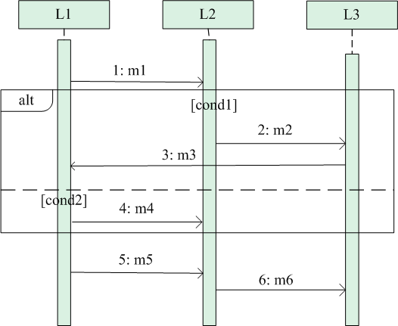
Alternate / if-else scenario in sequence diagram
Upper or lower part will work at a time.
Based on the condition.

Slide 19
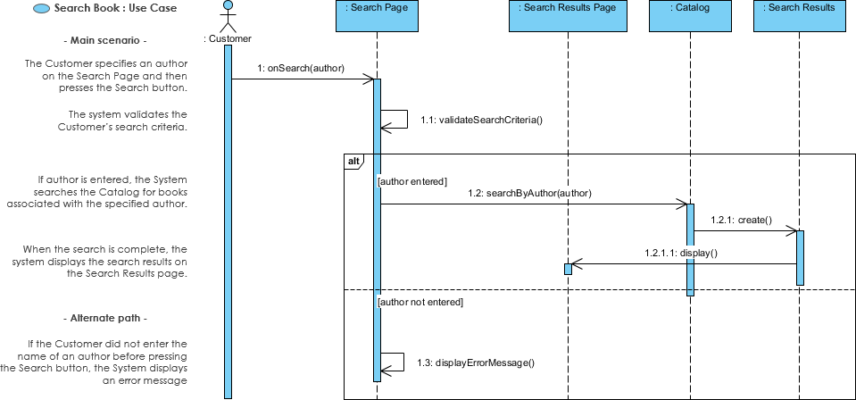
Sequence Diagram for search book Use Case

Slide 20
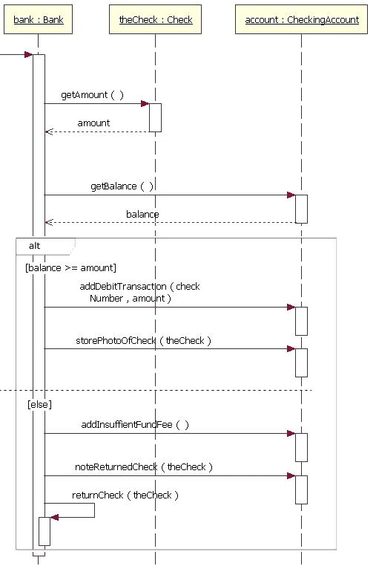

Slide 21
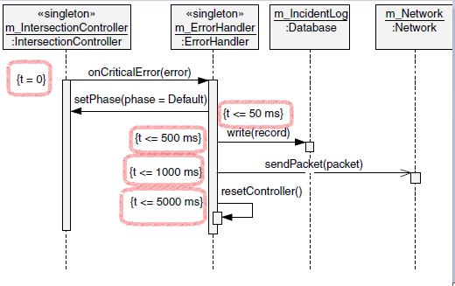
Multiple If-else condition
Slide ‹#›

Slide 22
Thanks
*
‹#›
Notes:
‹#›

