Slide 1
Component Diagram

Slide 2

Component Diagrams
UML component diagrams describe software components and their dependencies to each others
Models the physical implementation of the software (file resources)
Models the high-level software components, and their interfaces
We use component diagrams to model the static implementation view of a software system.
It is a type of structural UML diagram

Slide 3

What is a Component
Modular unit with well-defined interfaces that is replaceable within its environment
Autonomous unit within a system
Has one or more provided and required interfaces
Its internals are encapsulated, hidden and inaccessible
Its dependencies are designed such that it can be treated as independently as possible
The components can be a software component such as a database or user interface; or a hardware component such as a circuit, microchip or device; or a business unit such as supplier, payroll or shipping.

Slide 4
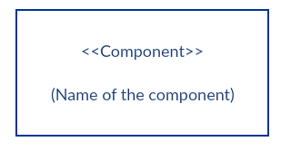
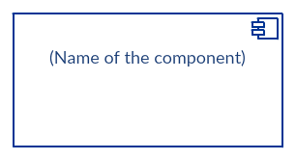
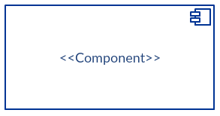
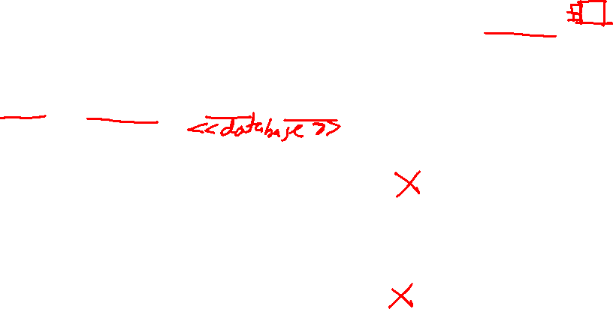
Component Notation
1) Rectangle with the component stereotype (the text <<component>>). The component stereotype is usually used above the component name to avoid confusing the shape with a class icon.Components can be labelled with a number of standard stereotypes
ex: <<entity>>, <<subsystem>>,<<table>>,<<library>>, etc
2) Rectangle with the component icon in the top right corner and the name of the component.
3) Rectangle with the component icon and the component stereotype.

Slide 5
Component Elements
1. Interfaces
An interface represents a declaration of a set of operations and obligations
2. Usage dependencies
A usage dependency is relationship which one element requires another element for its full implementation
3. Ports
Port represents an interaction point between a component and its environment
4. Connectors
Connect two components through interface.

Slide 6

INTERFACE
A component defines its behaviour in terms of provided and required interfaces
An interface
Is the definition of a collection of one or more operations
Provides only the operations but not the implementation
Implementation is normally provided by a class/ component
In complex systems, the physical implementation is provided by a group of classes rather than a single class
2 types
Provided Interface
Required interface

Slide 7
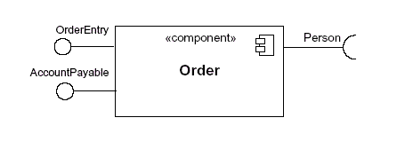
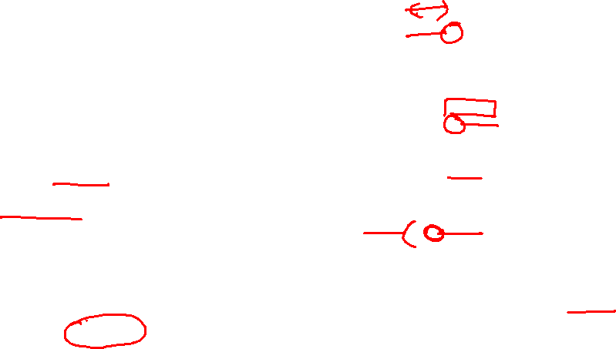
INTERFACE
Provided Interface
A component's provided interface describes the services provided by the component.
Is modeled using a ball, labelled with the name, attached by a solid line to the component
Required Interface
A required interface declares the services a component will need.
Is modeled using a socket, labelled with the name, attached by a solid line to the component

Slide 8

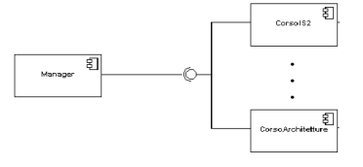
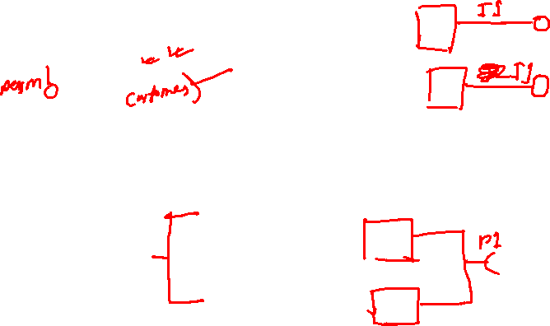
INTERFACE
Where two components/classes provide and require the same interface, these two notations may be combined
In a system context where there are multiple components that require or provide a particular interface, a notation abstraction can be used that combines by joining the interfaces

Slide 9

Usage Dependency
A usage dependency is relationship which one element requires another element for its full implementation
Is a dependency in which the client requires the presence of the supplier
Is shown as dashed arrow with a <> keyword

Slide 10
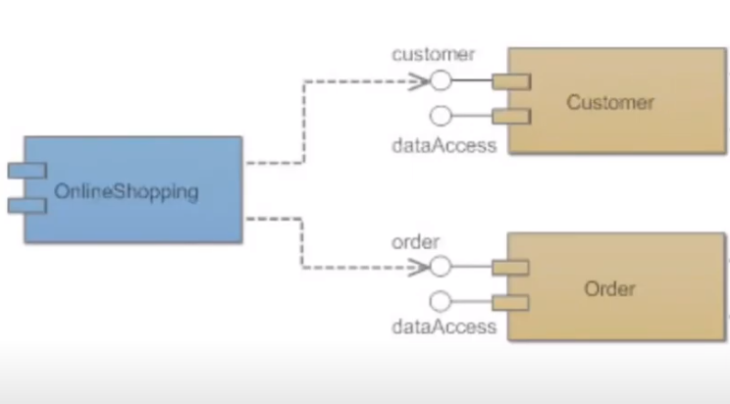

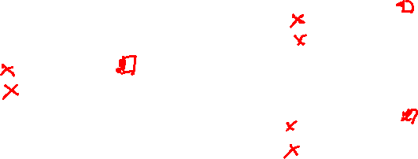
Dependency Relation
One component is dependent on data from another component
<<component>>
<<database>>
<<component>>
Here order and customer component depends on data from online shopping database

Slide 11
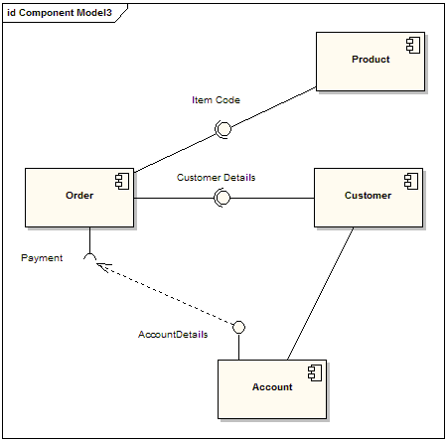

Here the payment interface depends on data from Account Component for it’s full implementation. The dependency maps a customer's associated account details to the required interface "Payment"

Slide 12
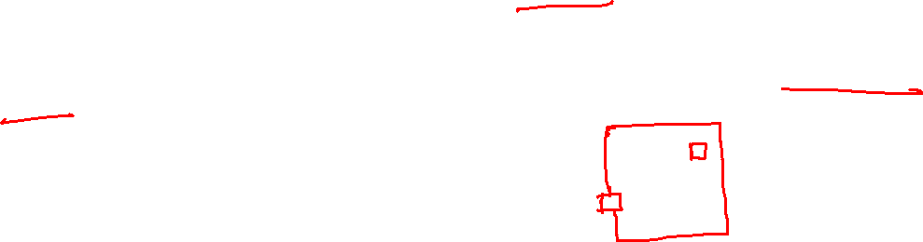
Port
Specifies a distinct interaction point
Between that component and its environment
Between that component and its internal parts
port may have visibility. When a port is drawn over the boundary of a component, then it means that the port is public. It also means that all the interfaces used are made as public.
When a port is drawn inside the component, then it is either protected or private.

Slide 13
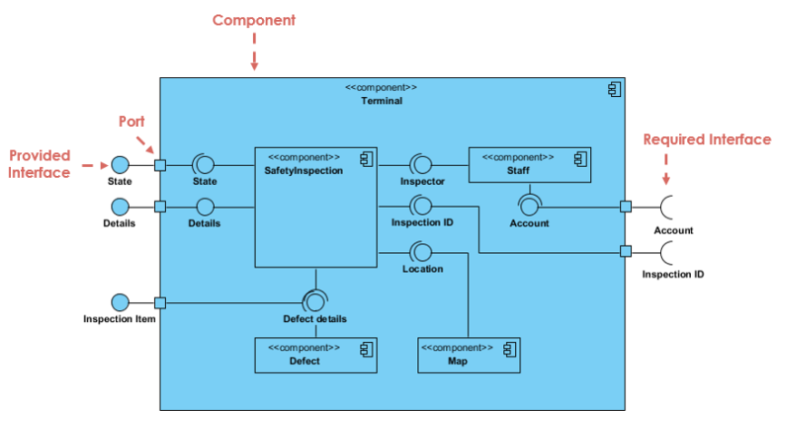
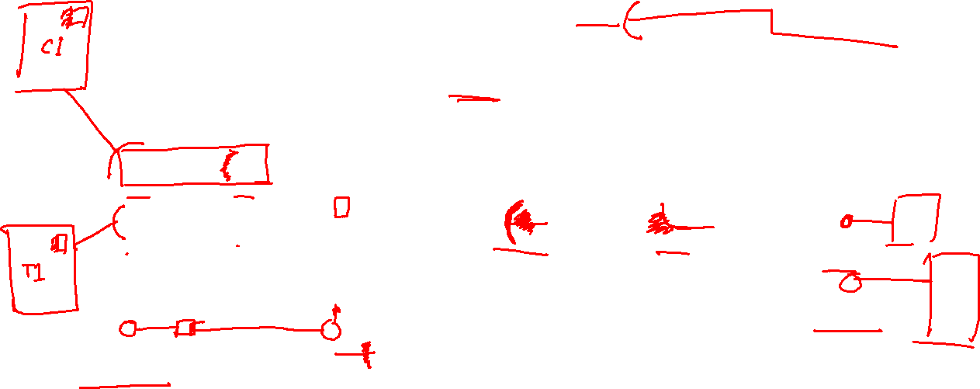

Slide 14
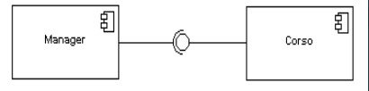
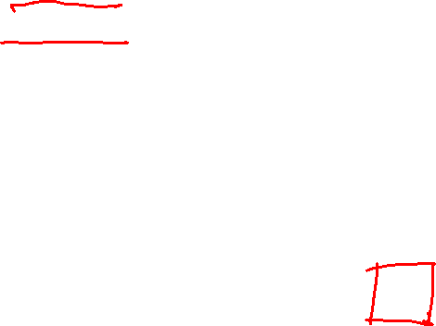
Connector
Two kinds of connectors:
Assembly
Delegation
ASSEMBLY CONNECTOR
A connector between 2 components defines that one component provides the services that another component requires
An assembly connector is notated by a “ball-and-socket” connection

Slide 15
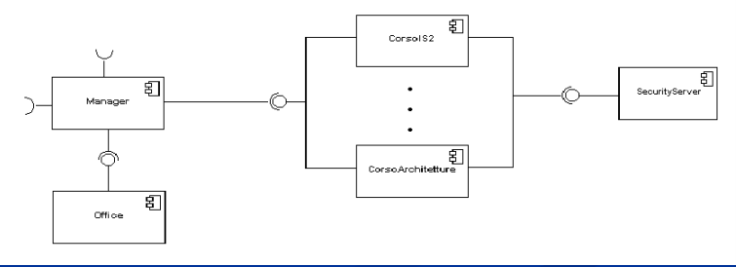
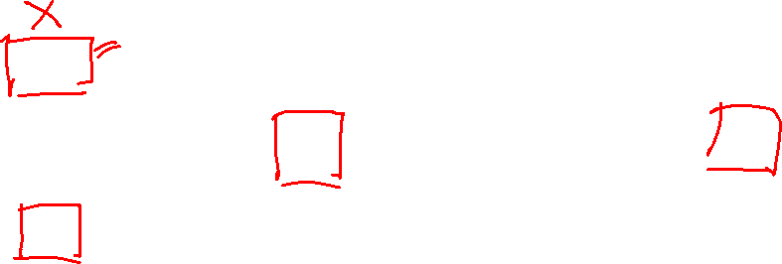
Multiple connections directed from a single required interface to provided interfaces indicates that the instance that will handle the signal will be determined at execution time

Slide 16
DELEGATION CONNECTOR
Links the external contract of a component to the internal component
Represents the forwarding of signals
It must only be defined between used interfaces or ports of the same kind

Slide 17
Where to use
To model the component of the system
To model source code
To model executable releases
To model physical databases
To model adaptable systems

Slide 18
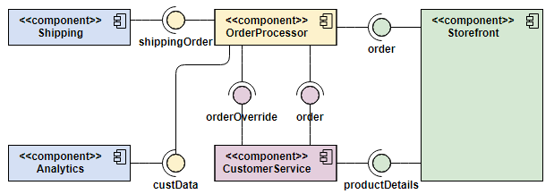
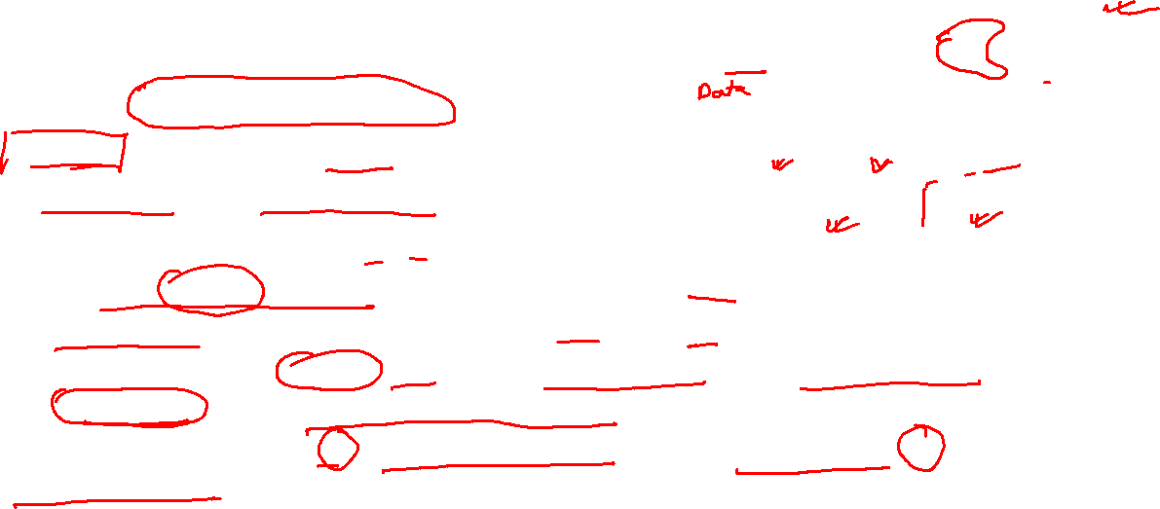
Order Processing System Component diagram example
Here the Storefront component
provides interfaces for Order and
ProductDetails. CustomerService
implements this interface as this
component needs access to
ProductDetails of the products available in storefront. Again CustomerService is able to order and override orders. All these operations are handled by the Orderprocessor component. Then this component provide Customer data to analytics component and shipping data to the shipping component

Slide 19
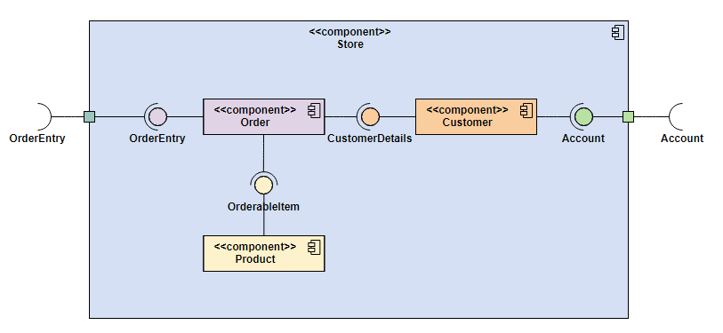
Nested Component Structure
Here the Store component has
some components inside it. In
such cases delegation connector
and port is used to pass signal
from external component to the
internal ones. Here we see that
Customer component requires the account and and Order component provides order entry related functionalities from an external component.

Slide 20
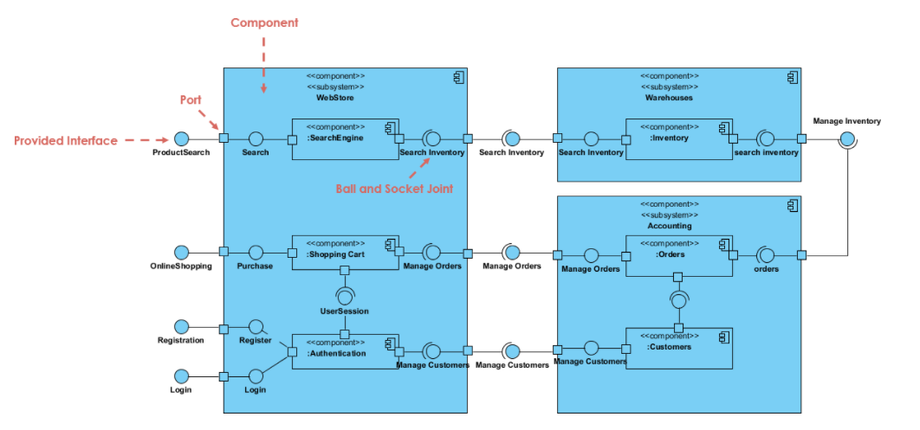
Some more examples

Slide 21
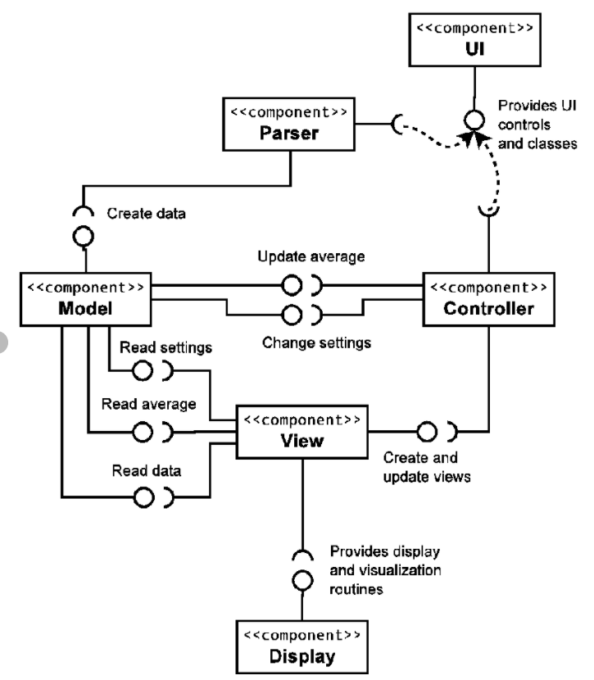

Slide 22
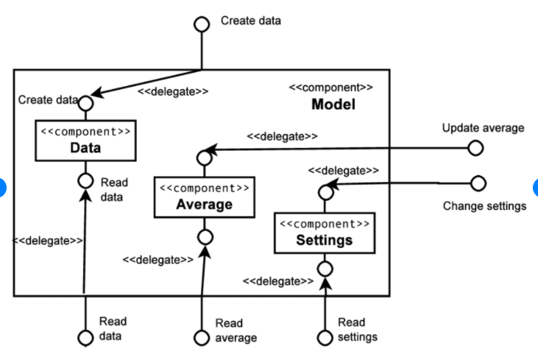

Slide 23
Life Care Hospital is a renowned hospital that uses a simple hospital management system named Life Care hospital management. The XYZ hospital management component is dependent on the access of data from four components: Hospital, Patient, Doctor, and Nurse. These four components provide an interface named readData. There is another component named Appointment which provides two interfaces setAppointment and getAppointmentDetails. The Hospital, Patient and Doctor component implements the getAppointmentDetails interface while the Receptionist component implements the setAppointment interface. There are three more components named Synchronization, Database and Security. The dbConnector interface is provided by and required by Database and Synchronization components respectively. Both Security and Synchronization Components provide three crucial interfaces; accessControl, Encryption, and Decryption which are required by all of the components except XYZ hospital management and the Database component.
Now Design a component diagram based on the above scenario.

Slide 24
WebStore subsystem contains three components related to online shopping - Search Engine, Shopping Cart, and Authentication. Search Engine component allows to search or browse items by exposing provided interface Product Search and uses required interface Search Inventory provided by Inventory component. [Inventory depends on Search engine] Shopping Cart component uses Manage Orders interface provided by Orders component during checkout. [Orders depends on Shopping cart] Authentication component allows customers to create account, login, or logout and binds customer to some account. This component allows Shopping Cart component and other components to have user session data by provided interface User Session.
Accounting subsystem provides two interfaces - Manage Orders and Manage Customers. Delegation connectors link these external contracts of the subsystem to the realization of the contracts by Orders and Customers components.
Warehouses subsystem provides two interfaces Search Inventory and Manage Inventory used by other subsystems and wired through dependencies.

Slide 25
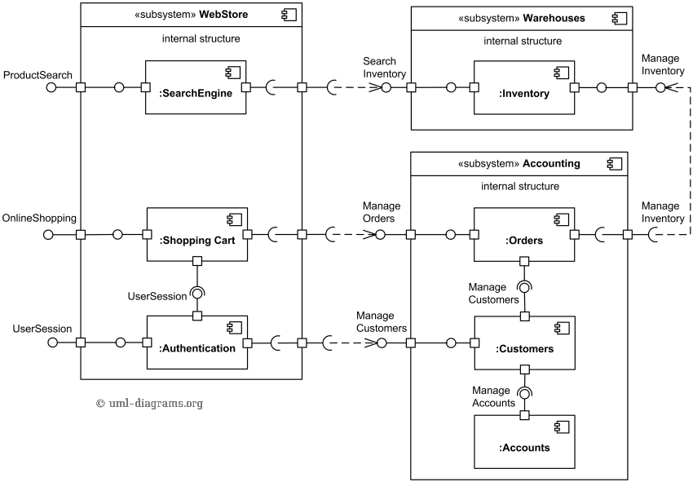

Slide 26
An example of UML component diagram with some simplified view of provided and implemented components utilizing SafeNet Sentinel HASP Software Licensing Security Solution and Licensing API.
On the top of the diagram we have some software implemented using Sentinel HASP - License Status .Net application and License Services Java component. License Status application is intended to show license status and is manifested (implemented) by license_status.exe artifact. License Services Java component implements License Service interface and could be used by other Java applications or services.
License Status application uses License Services Net component through the License Service interface implemented by this component. The License Services Net component uses HASP .Net API provided by HASP .Net Runtime component which is part of Sentinel HASP product.
License Services Java component uses HASP Java Native Interface Proxy to communicate with HASP Java Native Interface component, both components provided by Sentinel. When product is used in Microsoft Windows, the HASP Java Native Interface could be manifested by either HASPJava.dll (32 bit OS), HASPJava_x64.dll, or HASPJava_ia64.dll (64 bit OS).
The SafeNet Sentinel LDK 6.1 Licensing API includes:
structural declarations and information on individual Sentinel Licensing API functions,
description of XML tags that can be used to define scope and output format of various API functions,
description of all API return codes.
Sentinel LDK installation includes API samples for various programming languages including C, C#, Java. For example, HASP Java API includes 4 Java classes: Hasp, HaspApiVersion, HaspTime, and HaspStatus in Aladdin package. Those classes are bundled into HASPJava.jar artifact. The HASP Java API classes load and link native methods from a platform-specific native library using the System.loadLibrary() method. As we said, for Microsoft Windows the DLL library loaded is one of the HASPJava.dll, HASPJava_x64.dll, or HASPJava_ia64.dll.

Slide 27
An example of UML component diagram with some simplified view of provided and implemented components utilizing SafeNet Sentinel HASP Software Licensing Security Solution and Licensing API.
On the top of the diagram we have some software implemented using Sentinel HASP - License Status .Net application and License Services Java component. License Status application is intended to show license status and is manifested (implemented) by license_status.exe artifact. License Services Java component implements License Service interface and could be used by other Java applications or services.
License Status application uses License Services Net component through the License Service interface implemented by this component. The License Services Net component uses HASP .Net API provided by HASP .Net Runtime component which is part of Sentinel HASP product.

Slide 28
License Services Java component uses HASP Java Native Interface Proxy component to communicate with HASP Java Native Interface component, both components provided by Sentinel. When product is used in Microsoft Windows, the HASP Java Native Interface could be manifested by either HASPJava.dll (32 bit OS), HASPJava_x64.dll, or HASPJava_ia64.dll (64 bit OS).
The SafeNet Sentinel LDK 6.1 Licensing API includes:
structural declarations and information on individual Sentinel Licensing API functions,
description of XML tags that can be used to define scope and output format of various API functions,
description of all API return codes.

Slide 29
Sentinel LDK installation includes API samples for various programming languages including C, C#, Java. For example, HASP Java API includes 4 Java classes: Hasp, HaspApiVersion, HaspTime, and HaspStatus in Aladdin package. Those classes are bundled into HASPJava.jar artifact. The HASP Java API classes load and link native methods from a platform-specific native library using the System.loadLibrary() method. As we said, for Microsoft Windows the DLL library loaded is one of the HASPJava.dll, HASPJava_x64.dll, or HASPJava_ia64.dll.

Slide 30
