Slide 1
Chapter 6. Data Modeling Data Flow Diagram

Slide 2

Models: Logical and Physical
Model – a pictorial representation of reality.
Just as a picture is worth a thousand words, most models are pictorial representations of reality.
Logical model – a nontechnical pictorial representation that depicts what a system is or does. Synonyms are essential model, conceptual model, and business model.
Physical model – a technical pictorial representation that depicts what a system is or does and how the system is implemented. Synonyms are implementation model and technical model.
9-1
Notes:
1
Teaching Notes
In some books, the term logical is called a conceptual or essential. The term essential comes from the notion that the model represents the “essence” of the system.
For database-oriented instructors, the term logical in the world of systems analysis is NOT equivalent to the term logical in the world of database. In the database world, a “logical schema” is already constrained by the choice of a database technology, which runs contrary to the systems analysis expectation that a logical model is technology-independent.
In some books, the term physical is called implementation or technical.
Emphasize that there are nearly always multiple technical solutions for any given set of business requirements. In most projects, there is one logical model that represents the mandatory and desirable business requirements, regardless of how those requirements might be implemented. On the other hand, given that one logical model, there are multiple candidate physical models that could represent alternative, technical implementations that could fulfill the business requirements (although analysts rarely draw more than one or two of those physical models).

Slide 3

What is a Data Flow Diagram?
A data flow diagram (DFD) is a graphical representation of the movement of data between external entities, processes and data stores within a system.
Simply put, DFD’s show how data moves through an information system.
9-2
Notes:
2
No additional notes

Slide 4



External Agents
External agent – an outside person, unit, system, or organization that interacts with a system. Also called an external entity.
External agents define the “boundary” or scope of a system being modeled.
As scope changes, external agents can become processes, and vice versa.
Gane and Sarson shape
DeMarco/Yourdon shape
9-3
Notes:
3
Teaching Notes
It is very important to emphasize the external agents on DFDs are not the same as entities on ERDs (from Chapter 7)—especially if the instructor prefers the more traditional term “external entity.”
This is true even though you could have both an entity (on an ERD) with the same name as an external agent/entity on a DFD. Consider the entity CUSTOMER and the external agent CUSTOMER:
The entity CUSTOMER indicates the requirement to store data about customers.
The external agent CUSTOMER indicates the requirement for an interaction (inputs and/or outputs) with customers.
It is very important for students to understand that external agents are “processes” outside of the scope of the system or business. As such, as scope “increases,” external agents can become processes. Conversely, if scope “decreases,” processes can become external agents.

Slide 5


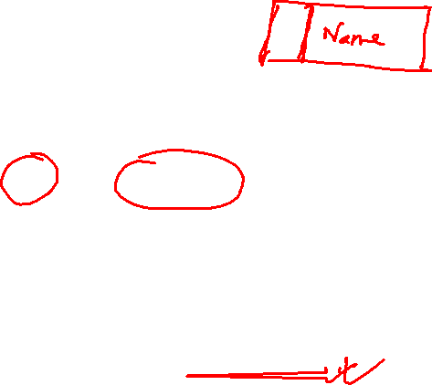
Data Stores
Data store – stored data intended for later use. Synonyms are file and database.
Frequently implemented as a file or database.
A data store is “data at rest” compared to a data flow that is “data in motion.”
Almost always one of the following:
Persons, Places, Objects etc
Data stores depicted on a DFD store all instances of data entities (depicted on an ERD)
Gane and Sarson shape
DeMarco/Yourdon shape
9-4
Notes:
4
Teaching Notes
Emphasize that a data store contains all instances of a data entity (from the data model). That is why data store names are plurals (as contrasted to data entity names that are singular).
Although we don’t prefer it, some analysts designate a data store to contain all instances of several entities and relationships from a data model. For example, an ORDERS data store might include all instances of the data entities ORDER and ORDERED PRODUCT, and all instances of the relationship between ORDER and ORDERED PRODUCT—We prefer the simplicity of representing each data entity from the data model as its own data store on the process models.
Emphasize that because data stores are shared resources available to many processes, it is acceptable to duplicate them on several DFDs—The duplication does NOT indicate redundant storage (on logical DFDs); it merely represents the sharing of the data store by several processes.

Slide 6
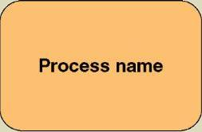

Process
Process – work performed by a system in response to incoming data flows or conditions. A synonym is transform.
All information systems include processes - usually many of them
Processes respond to business events and conditions and transform data into useful information
Modeling processes helps us to understand the interactions with the system's environment, other systems, and other processes.
Named with a strong action verb followed by object clause describing what the work is performed on/for .
Gane and Sarson shape
9-5
Notes:
5
No additional notes.

Slide 7

Data Flows & Control Flows
Data flow – data that is input to or output from a process.
A data flow is data in motion
A data flow may also be used to represent the creation, reading, deletion, or updating of data in a file or database (called a data store).
Composite data flow – a data flow that consists of other data flows.
Control flow – a condition or nondata event that triggers a process.
Used sparingly on DFDs.
Data flow name
Control flow name
9-6
Notes:
6
Teaching Notes
Most books do not teach “control flows.” The were initially proposed by Paul Ward in his books that extended structured analysis techniques to cover real-time systems. They are especially useful in contemporary information systems analysis because they are as close as structured analysis gets to illustrating “messages” in an object-oriented world.
Make sure students do not confuse data flows with flowchart arrows. Flowchart arrows are not named because they merely indicate “the next step.” Data flows pass actual data attributes to and from processes.
CRUD is a useful acronym from the database world to remember the basic data flows as they relate to data stores: Create, Read, Update (or change), and Delete.
One of the most common uses of composite data flows is to combine many reports into a single data flow on a high-level DFD. They can also be used to combine similar transactions on a higher level DFD before differentiating between those flows on lower-level DFDs.
Use case diagrams, an object-oriented analysis tool that also describes interfaces are taught in Chapter 7.

Slide 8
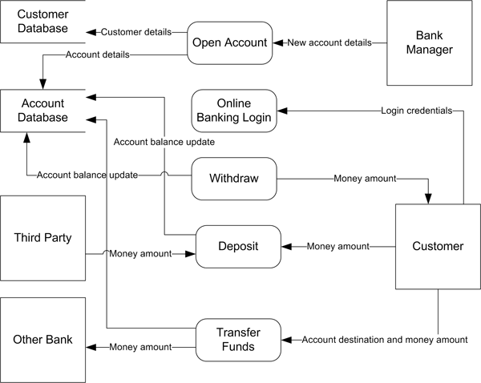
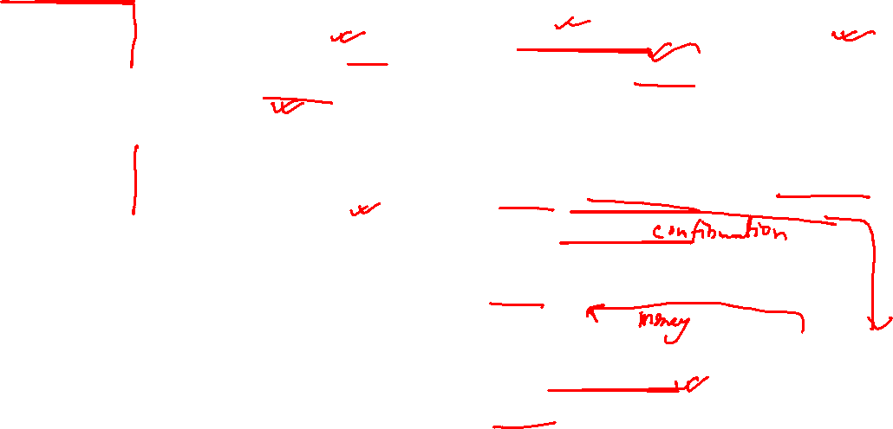
6-7

Slide 9
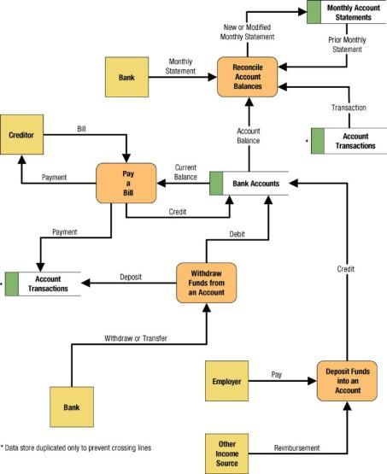

Simple Data Flow Diagram
9-8
Notes:
8
Teaching Notes
We have found it useful to walk through this first DFD. Don’t be alarmed if students take exception to some of the oversimplification of the illustrated problem—it can actually contribute to the learning experience.

Slide 10
Common Process Errors on DFDs
6-9

Slide 11
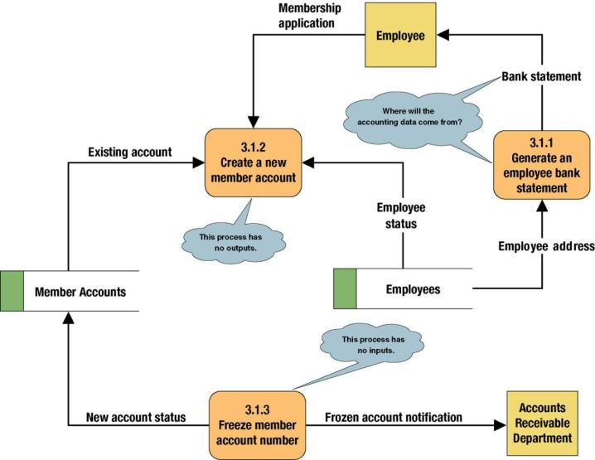
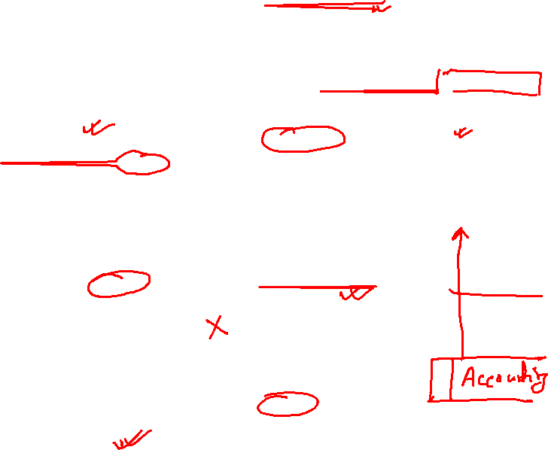
Common Process Errors on DFDs
9-10
Notes:
10
Teaching Notes
Idea: Correct this diagram as an in-class exercise.
3.1.1: To correct the diagram, a data flow, ACCOUNTING DATA, should be added from the data store, MEMBER ACCOUNTS, to process 3.1.1.
3.1.2: To fix the black hole, we might add an output data flow called NEW MEMBER ACCOUNT from process 3.1.2 to the data store MEMBER ACCOUNTS.
3.1.3: To fix the miracle, you would need to at least add a data flow such as ACCOUNTING DATA from the data store, MEMBER ACCOUNTS, to process 3.1.3. In all likelihood, you also need some type of triggering data flow, such as ACCOUNT FREEZE AUTHORIZATION, from a new external agent, such ACCOUNTING DEPARTMENT, to process 3.1 3.

Slide 12
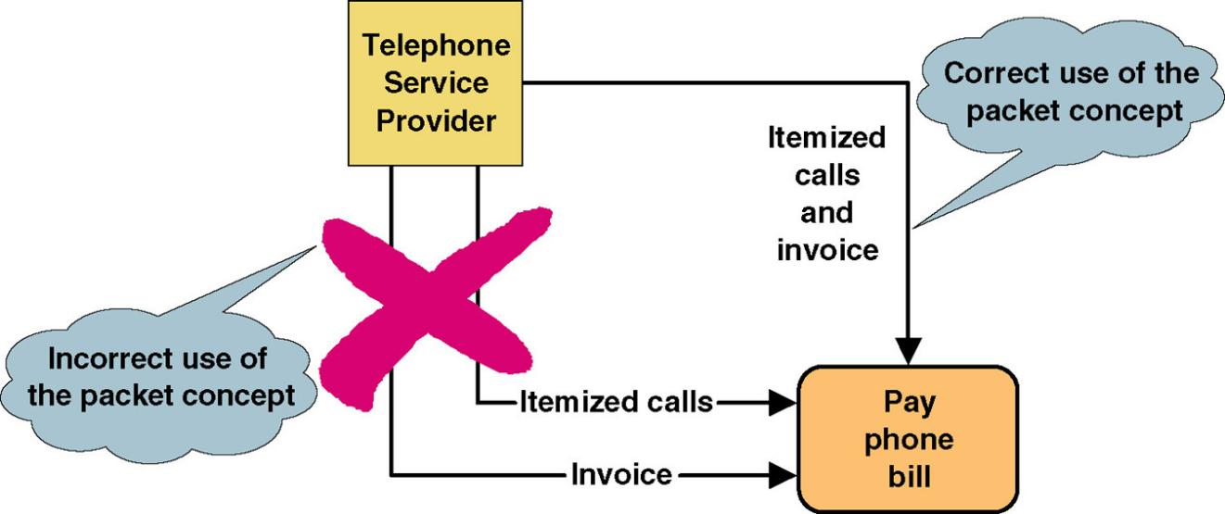
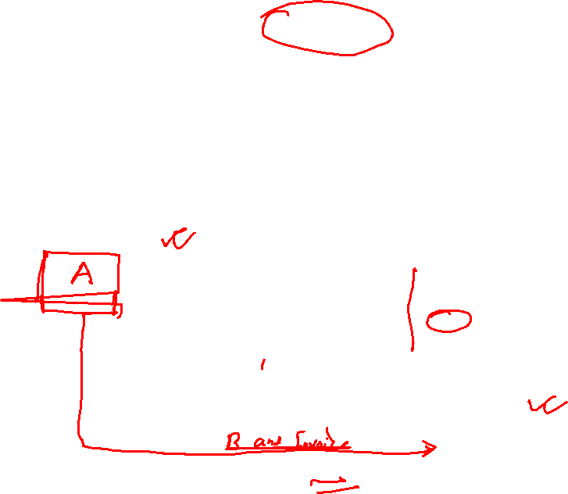
Data Flow Packet Concept
Data that should travel together should be shown as a single data flow, no matter how many physical documents might be included.
9-11

Slide 13
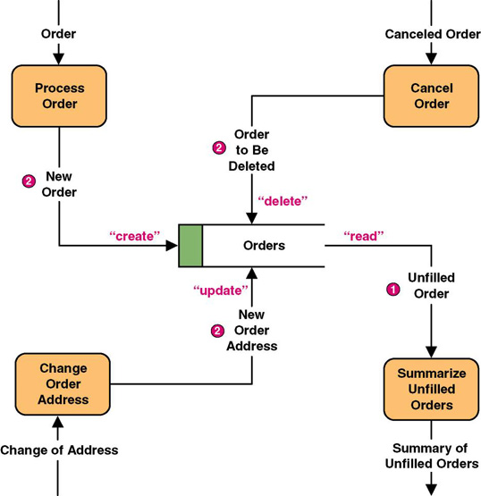
Data Flows to and from Data Stores
9-12
Notes:
12
Teaching Notes
Some DFD methodologies suggest that data flows to and from data stores not be named. We think this confuses the end-users when they try to read the diagrams. Also, we believe that it is easier to have DFD errors of omission if the rules state that some flows are named while others are not.
Some DFD notations actually use the CRUD letters only to name flows to and from data stores. We consider this an acceptable alternative. CRUD is a useful acronym from the database world to remember the basic data flows as they relate to data stores: Create, Read, Update (or change), and Delete.

Slide 14
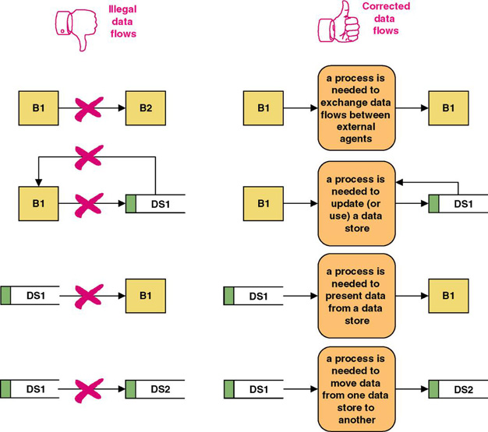

Rules for Data Flows
A data flow should never go unnamed.
In logical modeling, data flow names should describe the data flow without describing the implementation
All data flows must begin and/or end at a process.
9-13
Notes:
13
No additional notes.

Slide 15

Diverging and Converging Data Flows
Diverging data flow – a data flow that splits into multiple data flows.
Indicates data that starts out naturally as one flow, but is routed to different destinations.
Also useful to indicate multiple copies of the same output going to different destinations.
Converging data flow – the merger of multiple data flows into a single packet.
Indicates data from multiple sources that can (must) come together as a single packet for subsequent processing.
9-14
Notes:
14
No additional notes.

Slide 16
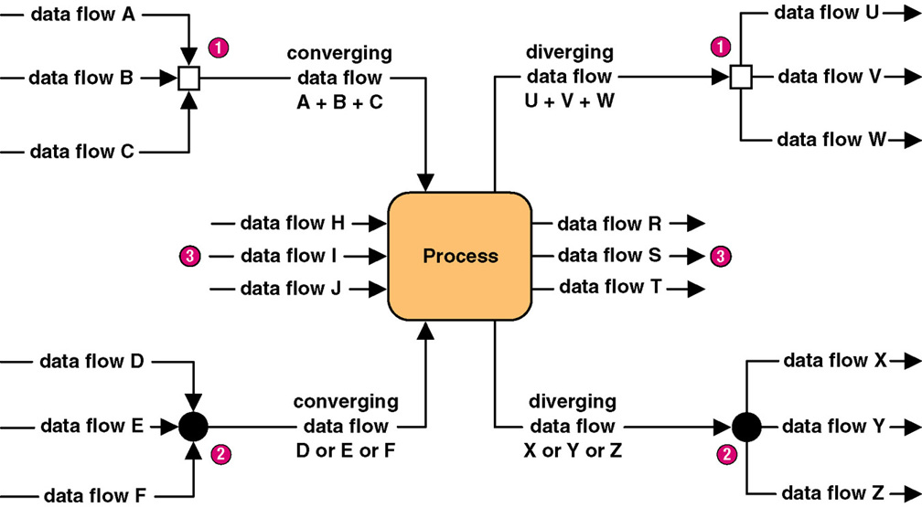

Diverging and Converging Data Flows
9-15
Notes:
15
Teaching Notes
Different CASE tools use different notations to illustrate converging and diverging data flows. In fact, some CASE tools do not even support this concept.

Slide 17
Draw a Data Flow Diagram (DFD) for “Food Ordering System” considering the following scenarios:
Customer place an Order. The Order Food process receives the Order, forwards it to the Kitchen, store it in the Order data store, and store the updated Inventory details in the Inventory data store. The process also delivers a Bill to the Customer. The Bill data will be generated from Order datastore, Manager can receive Reports through the Generate Reports process, which takes Inventory details and Orders as input from the Inventory and Order data store respectively. Manager can also initiate the Order Inventory process by providing Inventory order. The process forwards the Inventory order to the Supplier and stores the updated Inventory details in the Inventory data store.
9-16

Slide 18
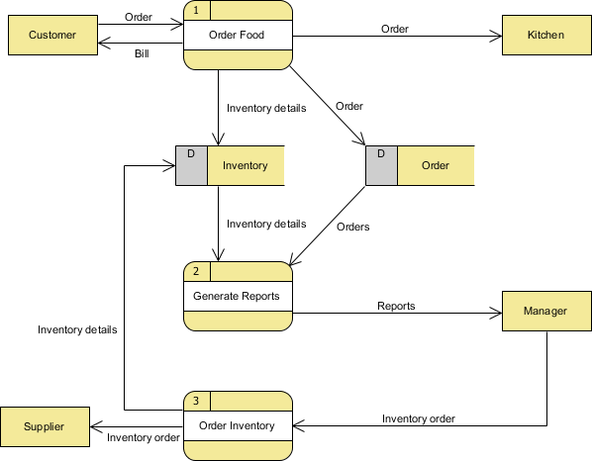
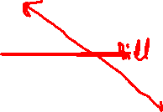
6-17

Slide 19
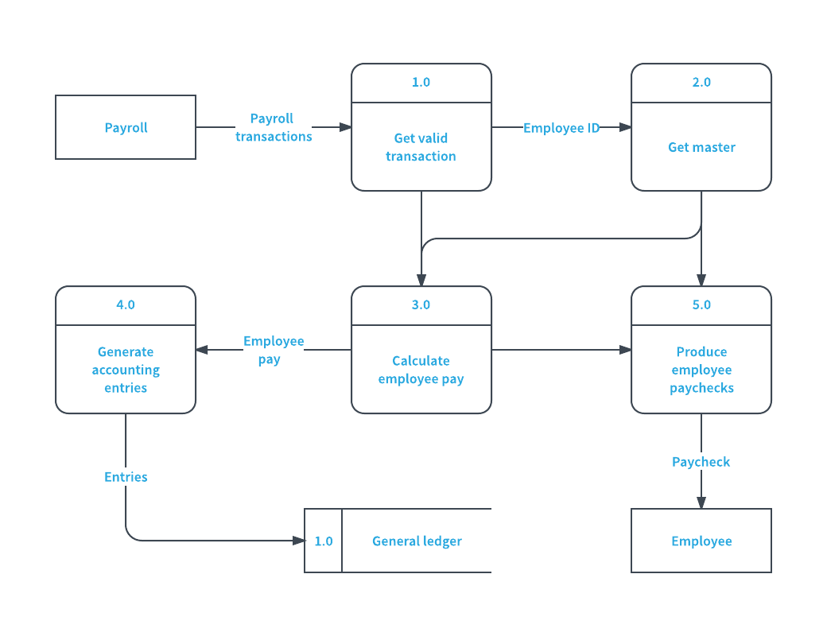
Payroll management system
6-18

Slide 20
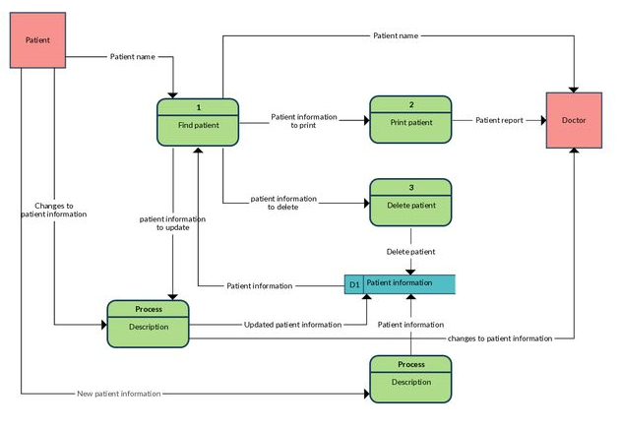
Patient Information system
6-19

Slide 21
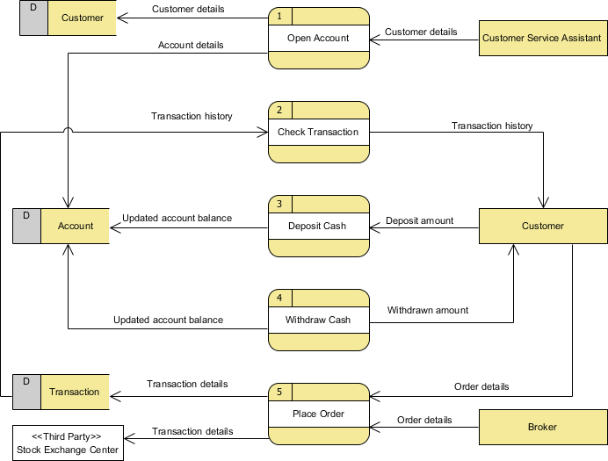
6-20

Slide 22
Process Decomposition
6-21

Slide 23
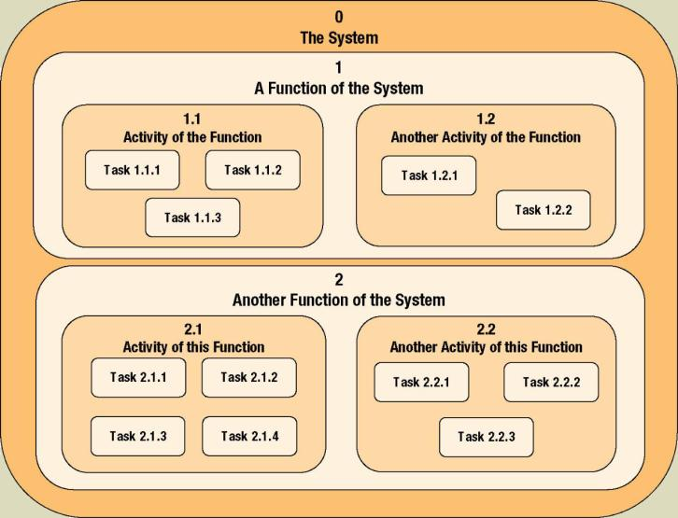

Process Decomposition
Decomposition – the act of breaking a system into sub-components. Each level of abstraction reveals more or less detail.
9-22
Notes:
22
No additional notes

Slide 24
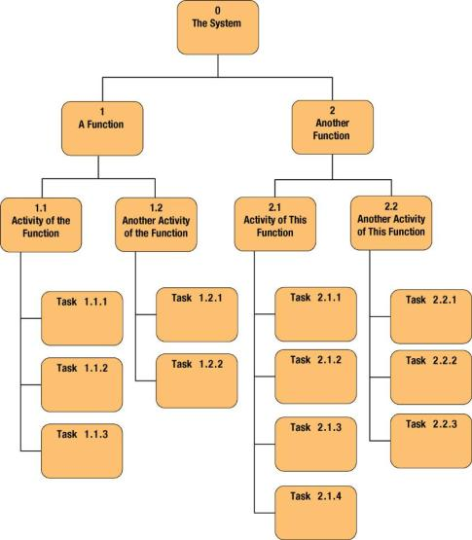
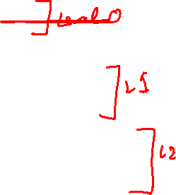
Decomposition Diagrams
Decomposition diagram – a tool used to depict the decomposition of a system. Also called hierarchy chart.
9-23
Notes:
23
Teaching Notes
Decomposition is a top-down problem-solving approach.
It might be useful to point out the numbering scheme. This scheme is common, but we do not like it because if the system is restructured, it forces renumbering all processes.
Some instructors like to do a quick example using a small but realistic problem.

Slide 25
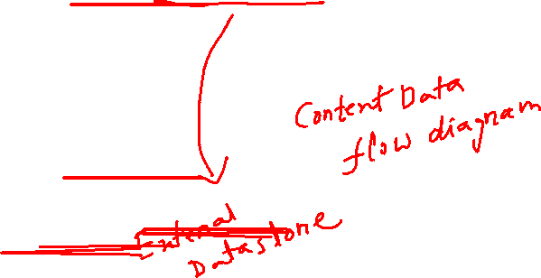
Level 0 Diagram
Shows all the processes that comprise the overall system
Shows how information moves from and to each process
Adds data stores
9-24
Notes:
24
No additional notes

Slide 26
Level 1 Diagrams
Shows all the processes that comprise a single process on the level 0 diagram
Shows how information moves from and to each of these processes
Shows in more detail the content of higher level process
Level 1 diagrams may not be needed for all level 0 processes
9-25
Notes:
25
No additional notes

Slide 27
Level 2 Diagrams
Shows all processes that comprise a single process on the level 1 diagram
Shows how information moves from and to each of these processes
Level 2 diagrams may not be needed for all level 1 processes
Correctly numbering each process helps the user understand where the process fits into the overall system
9-26
Notes:
26
No additional notes

Slide 28
Modern Structured Analysis (More Commonly Practiced)
Draw context DFD to establish initial project scope.
Draw functional decomposition diagram to partition the system into subsystems.
Create event-response or use-case list for the system to define events for which the system must have a response.
Draw an event DFD (or event handler) for each event.
Merge event DFDs into a system diagram (or, for larger systems, subsystem diagrams).
Draw detailed, primitive DFDs for the more complex event handlers.
Document data flows and processes in data dictionary.
9-27
Notes:
27
Teaching Notes
Although this process may not be as familiar to some adopters as the top-down, fully leveled, classical “physical-logical-logical-physical” approach in the 1976 DeMarco methodology, this is the more contemporary approach and is taught in our book. The original approach is rarely, if ever, practiced because it is so labor intensive and time consuming.

Slide 29
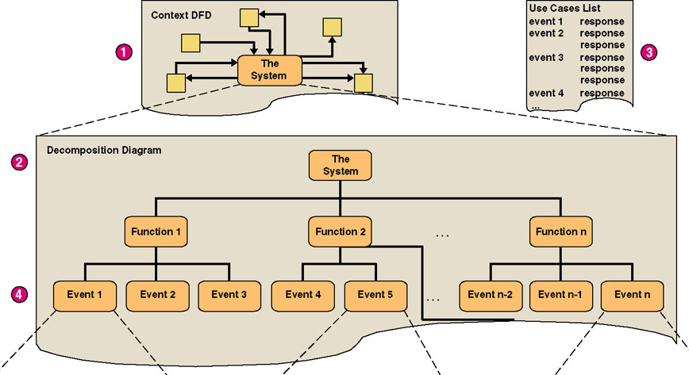
Structured Analysis Diagram Progression (1 of 3)
9-28
Notes:
28
Teaching Notes
The numbers in red correspond to the numbers on the previous slide.

Slide 30
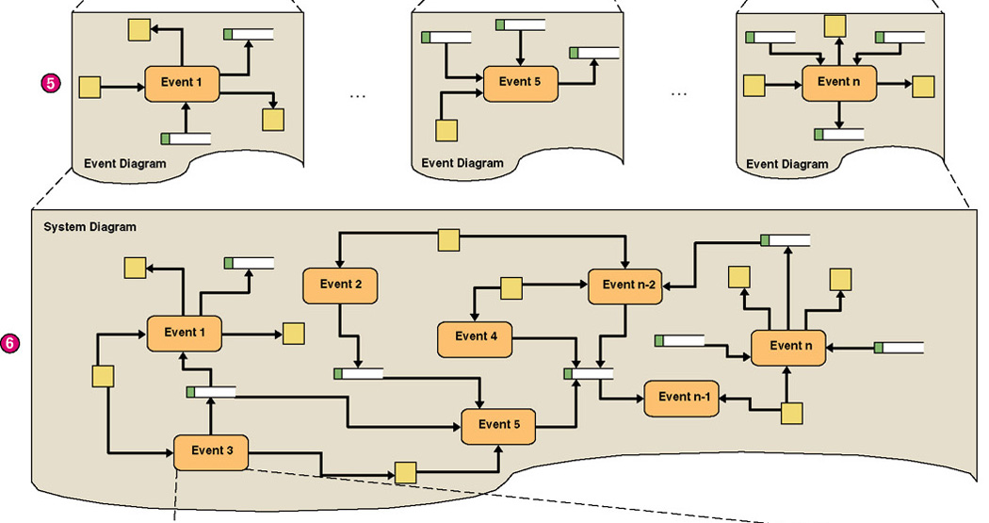
Structured Analysis Diagram Progression (2 of 3)
9-29
Notes:
29
Teaching Notes
The numbers in red correspond to the numbers on the slide 33.

Slide 31
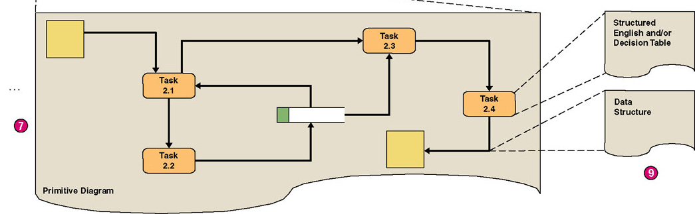
Structured Analysis Diagram Progression (3 of 3)
9-30
Notes:
30
Teaching Notes
The numbers in red correspond to the numbers on the slide 33.

Slide 32
Context Data Flow Diagram
6-31

Slide 33

Context Data Flow Diagram
Context data flow diagram - a process model used to document the scope for a system. Also called the environmental model.
Think of the system as a "black box."
Ask users what business transactions the system must respond to. These are inputs, and the sources are external agents.
Ask users what responses must be produced by the system. These are outputs, and the destinations are external agents.
Identify any external data stores, if any.
Draw a context diagram.
9-32
Notes:
32
Teaching Notes
This may be review from chapter 5.

Slide 34
Balancing
Balancing - a concept that requires that data flow diagrams at different levels of detail reflect consistency and completeness
Quality assurance technique
Requires that if you explode a process to another DFD to reveal more detail, you must include the same dta flows and data stores
9-33
Notes:
33
Teaching Notes
Discuss balancing with the class, the concept that requires that data flow diagrams at different levels of detail reflect consistency and completeness.

Slide 35
Example
Clothes ordering system is decomposed into order cloths, generate reports and order inventory processes. Order clothes process, take customer order and send it to clothes
store and order datastore. This process also sends a bill to the customer and updates the inventory datastore. Generate reports receive orders and inventory details and send the
report to the sales manager. Sales managers place inventory orders into the order inventory process and forward the inventory order to the supplier and update the inventory.
Design level-1 DFD based on above scenario.

Slide 36
Example
Now you need to decompose the Order clothes process only. Forward order takes orders from the customer and sends that information to generate bills and update
inventory process. Generate bill process generates bill based on the order and Inventory is updated by update inventory process. Design level-2 DFD for order cloth process
and make sure it is Balanced. Also mention if you find any error in the scenario.

Slide 37
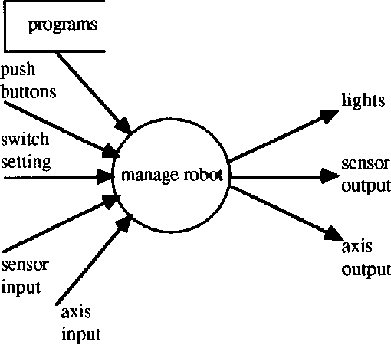
Manage Robot
6-36

Slide 38
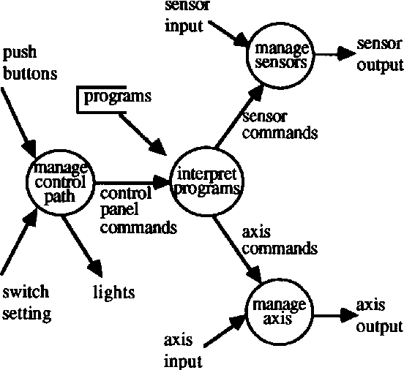
Manage Robot decomposed
6-37

Slide 39
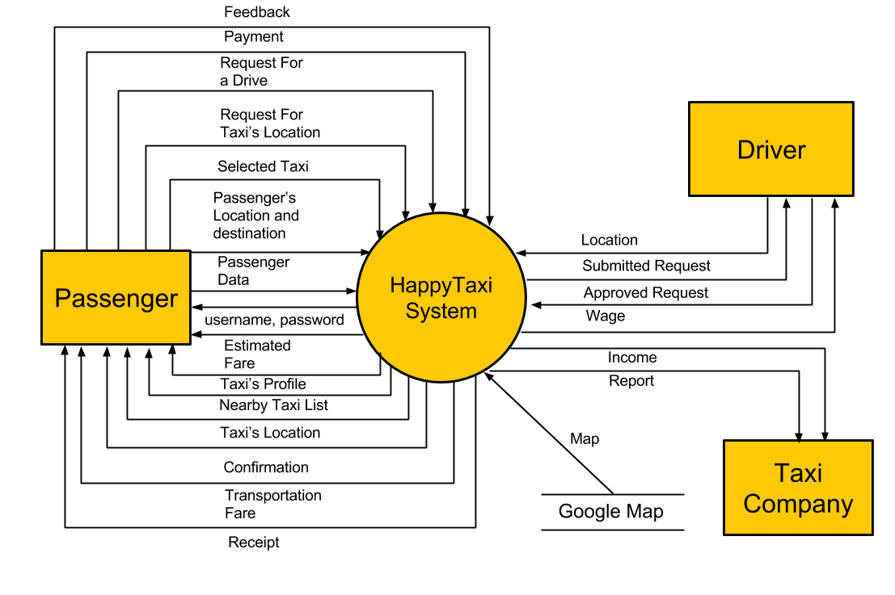
6-38

Slide 40
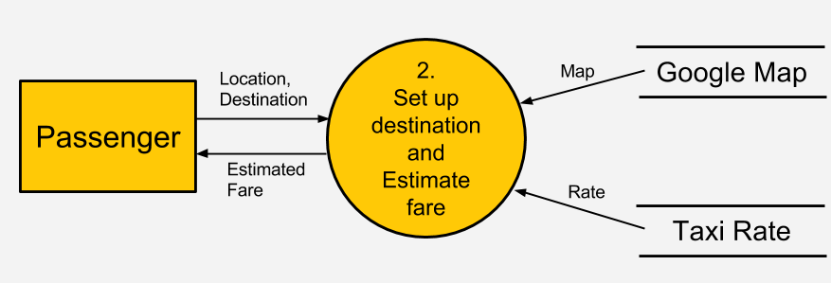
Here passenger input current location and destination address to set up destination and estimate fare process and the process send estimate fare to the passenger. The same process gather map information from Google map and rate from taxi rate data base.
6-39

Slide 41
Class work
Draw level 1 DFD where set up destination and estimate fare process is decomposed into two sub process as get distance and calculate fare. Data of distance will sent from get distance to calculate fare.
Draw Level 2 DFD for get distance sub process. Decompose get distance in two sub process as get route and calculate distance. Data of route will sent from get route to calculate distance.
6-40

Slide 42
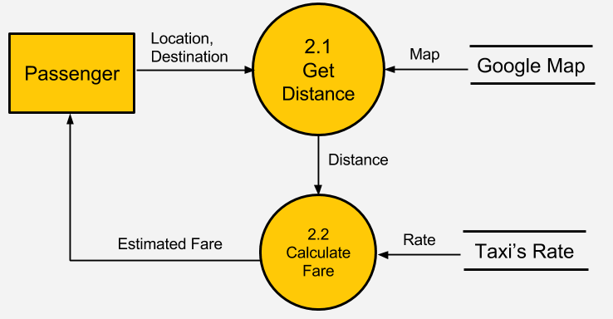
Draw level 1 DFD where set up destination and estimate fare process is decomposed into two sub process as get distance and calculate fare. Data of distance will sent from get distance to calculate fare.
6-41

Slide 43
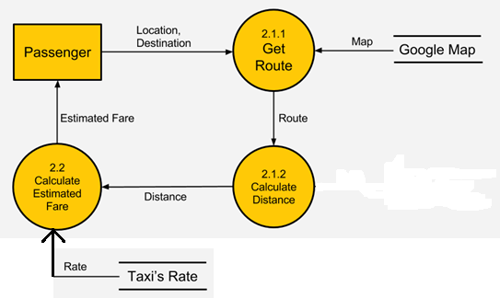
Draw Level 2 DFD for get distance sub process. Decompose get distance in two sub process as get route and calculate distance. Data of route will sent from get route to calculate distance.
6-42

