Slide 1
Systems Analysis and Design 5th Edition Chapter 11. Data Storage Design
Alan Dennis, Barbara Haley Wixom, and Roberta Roth
© Copyright 2011 John Wiley & Sons, Inc.
11-0

Slide 2

Chapter 11 Outline
Data storage formats.
- Files.
- Databases.
Moving from logical to physical data models.
Optimizing data storage.
© Copyright 2011 John Wiley & Sons, Inc.
11-1

Slide 3

INTRODUCTION
The data storage function is concerned with how data is stored and handled by programs that run the system.
Data storage design is to
- select the data storage format;
- convert the logical data model created during analysis into a physical data model to reflect the implementation decision;
- ensure that DFDs and ERDs balance; and
- design the selected data storage format to optimize its processing efficiency.
© Copyright 2011 John Wiley & Sons, Inc.
11-2

Slide 4

Files
A data file contains an electronic list of information that is formatted for a particular transaction.
Typically, files are organized sequentially.
Records can be associated with other records by pointers.
Sometimes files are called linked Lists because of the way the records are linked together using pointers.
© Copyright 2011 John Wiley & Sons, Inc.
11-3

Slide 5


File based DB: appointment record
© Copyright 2011 John Wiley & Sons, Inc.
11-4

Slide 6
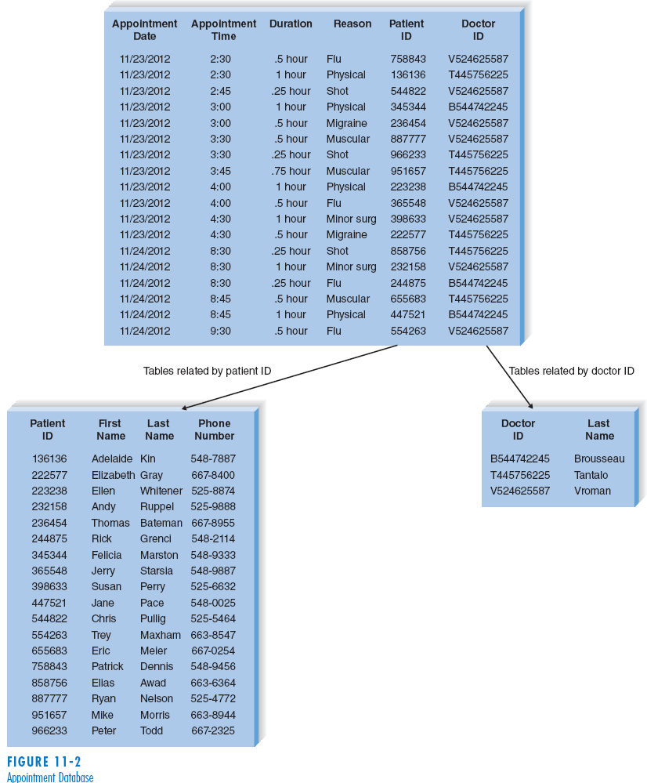

Example of database:
© Copyright 2011 John Wiley & Sons, Inc.
11-5

Slide 7

Databases
There are many types of databases:
- Relational database
- Object database
- Multidimensional database
© Copyright 2011 John Wiley & Sons, Inc.
11-6

Slide 8

Relational Databases
The relational database is the most popular kind of database for application development today.
A relational database is based on collections of tables, each of which has a primary key.
The tables are related to each other by the placement of the primary key from one table into the related table as a foreign key.
Most relational database management systems (RDBMS) support referential integrity, or the idea of ensuring that values linking the tables together are valid and correctly synchronized.
Structured Query Language (SQL) is the standard language for accessing the data in the tables.
© Copyright 2011 John Wiley & Sons, Inc.
11-7

Slide 9
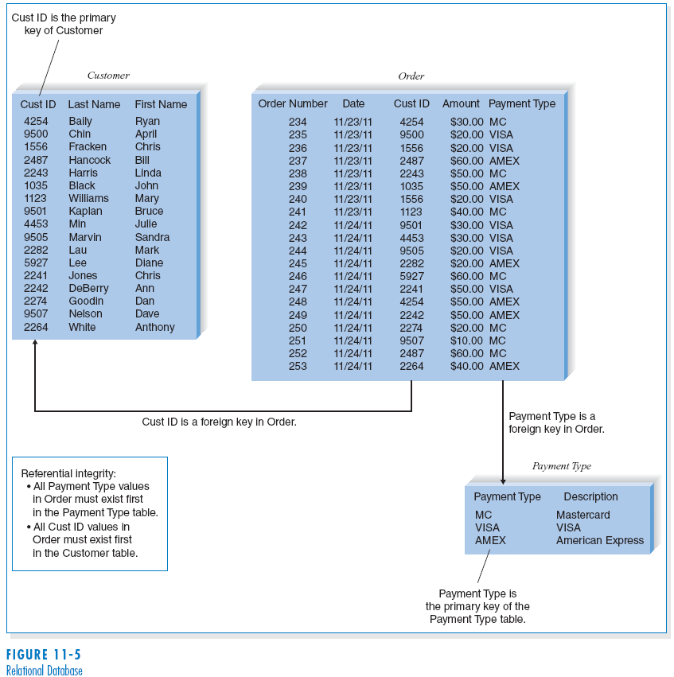

(cont’d)
Relational
database
example
© Copyright 2011 John Wiley & Sons, Inc.
11-8

Slide 10

Object Databases
The object database, or object-oriented database, is based on the premise of object orientation that all things should be treated as objects that have both data (attributes) and processes (behaviors).
Changes to one object have no effect on other objects because the attributes and behaviors self-contained, or encapsulated, within each one.
This encapsulation allows objects to be reused.
© Copyright 2011 John Wiley & Sons, Inc.
11-9

Slide 11
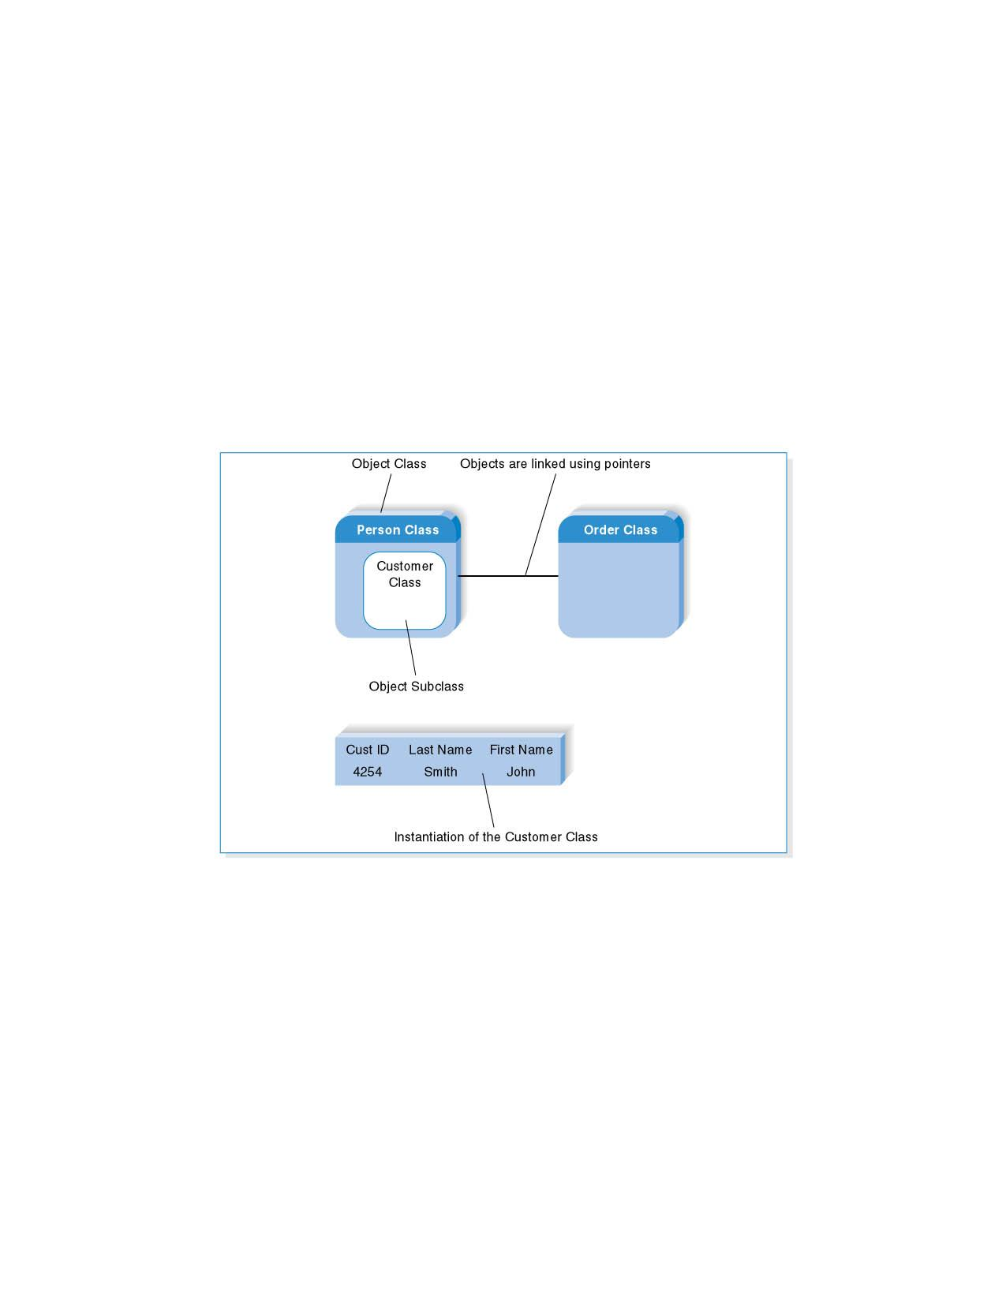

(cont’d)
Object Database Example
© Copyright 2011 John Wiley & Sons, Inc.
11-10

Slide 12

Multidimensional Databases
A multidimensional database is a type of relational database that is used extensively in data warehousing.
Data warehousing is the practice of taking and storing data in a data warehouse (i.e., a large database) that supports decision support systems (DSS).
Data marts are smaller databases based on data warehouse data, and support DSS for specific departments or functional areas of the organization.
© Copyright 2011 John Wiley & Sons, Inc.
11-11

Slide 13
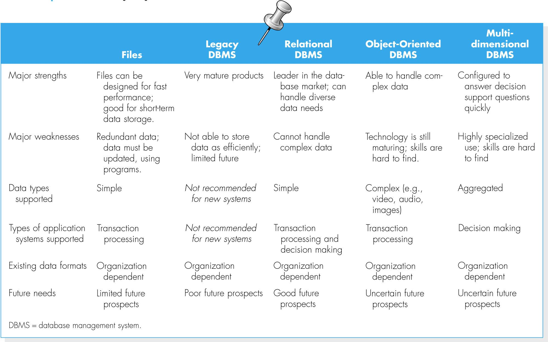

Selecting a Storage Format
Comparing Data Storage Formats
© Copyright 2011 John Wiley & Sons, Inc.
11-12

Slide 14
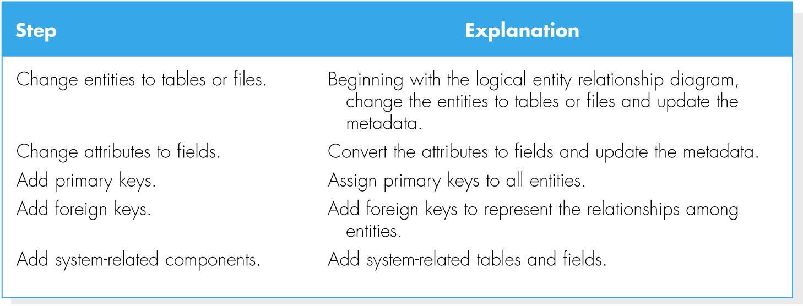

MOVING FROM LOGICAL TO PHYSICAL
© Copyright 2011 John Wiley & Sons, Inc.
11-13

Slide 15

Conceptual, Logical and Physical
Conceptual, logical and physical model or ERD are three different ways of modeling data in a domain.
Business analyst uses conceptual and logical model for modeling the data required and produced by system from a business angle
while database designer refines the early design to produce the physical model for presenting physical database structure ready for database construction.
© Copyright 2011 John Wiley & Sons, Inc.
11-14

Slide 16
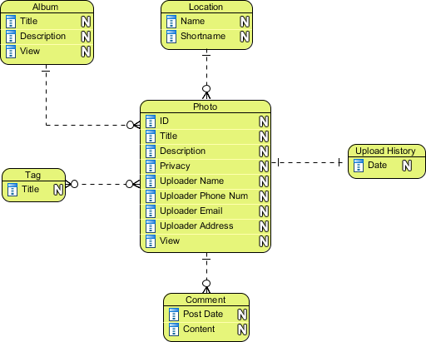

Conceptual Model
Conceptual ERD models information gathered from business requirements.
Entities and relationships modeled in such ERD are defined around the business's need.
The need of satisfying the database design is not considered yet.
© Copyright 2011 John Wiley & Sons, Inc.
11-15

Slide 17
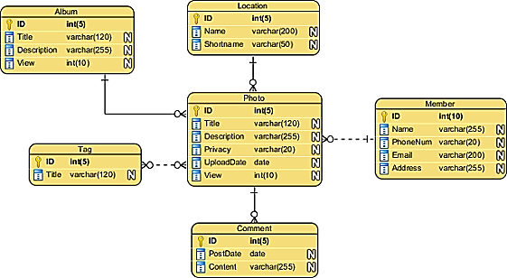

Logical Model
Logical ERD also models information gathered from business requirements. It is more complex than conceptual model in that column types are set. Note that the setting of column types is optional and if you do that, you should be doing that to aid business analysis. It has nothing to do with database creation yet.

Slide 18
Physical Model
Actual design blueprint of a relational database.
It represents how data should be structured and related in a specific DBMS so it is important to consider the convention and restriction of the DBMS you use when you are designing a physical ERD.
This means that an accurate use of data type is needed for entity columns and the use of reserved words has to be avoided in naming entities and columns.
Besides, database designers may also add primary keys, foreign keys and constraints to the design.
© Copyright 2011 John Wiley & Sons, Inc.
11-17

Slide 19
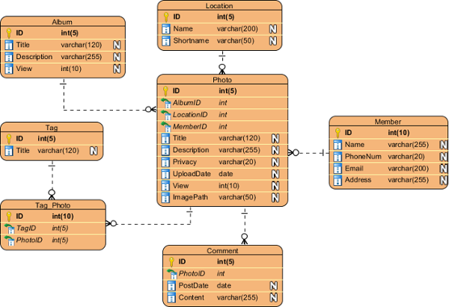

Physical Model
11-18

Slide 20
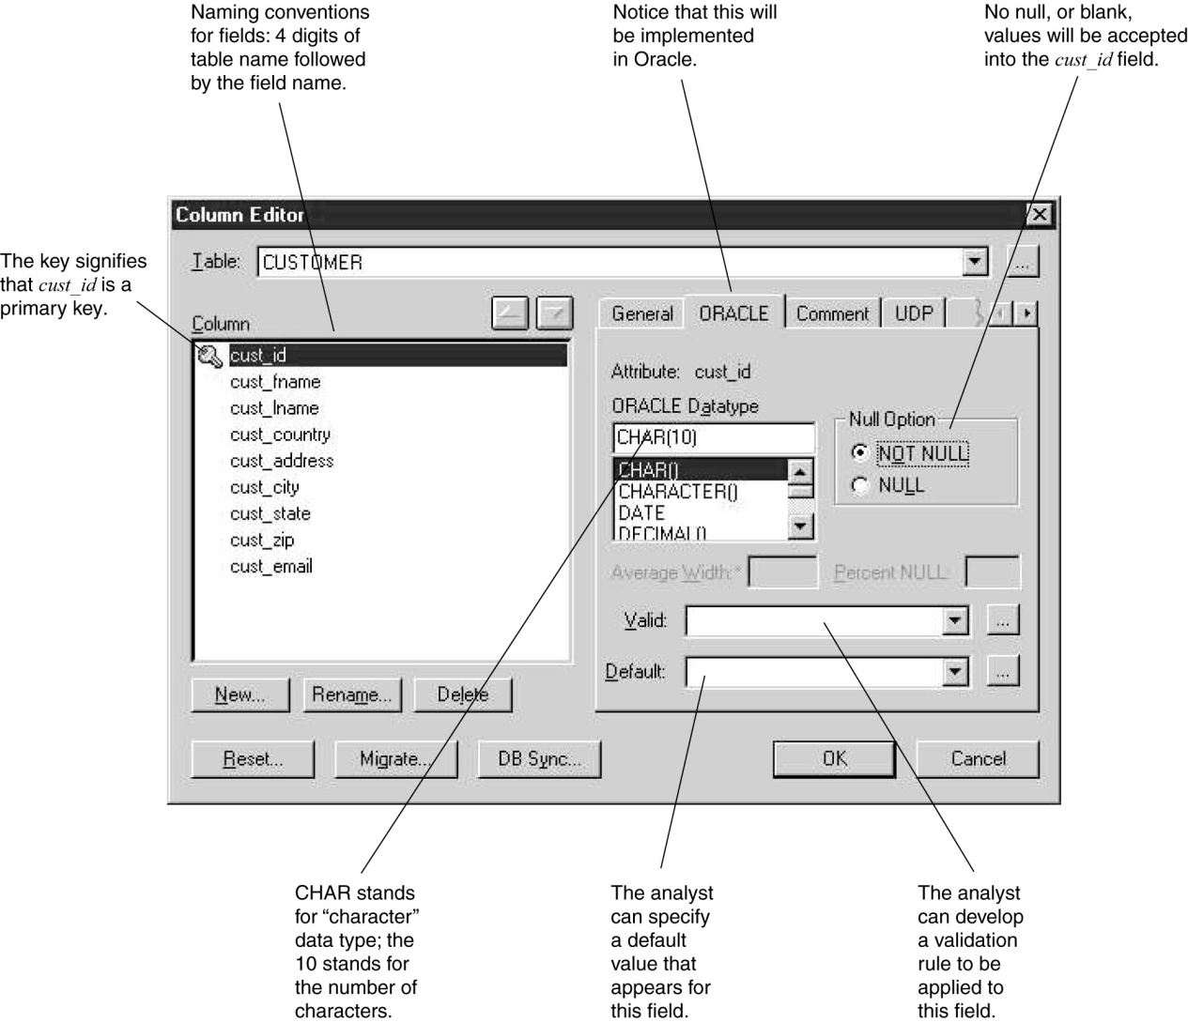

Metadata
© Copyright 2011 John Wiley & Sons, Inc.
11-19

Slide 21

OPTIMIZING DATA STORAGE
The data storage format is now optimized for processing efficiency.
There are two primary dimensions in which to optimize a relational database: for storage efficiency and for speed of access.
© Copyright 2011 John Wiley & Sons, Inc.
11-20

Slide 22

Optimizing Storage Efficiency
The most efficient tables in a relational database in terms of storage space have no redundant data and very few null values.
Normalization is the best way to optimize data storage for efficiency.
© Copyright 2011 John Wiley & Sons, Inc.
11-21

Slide 23
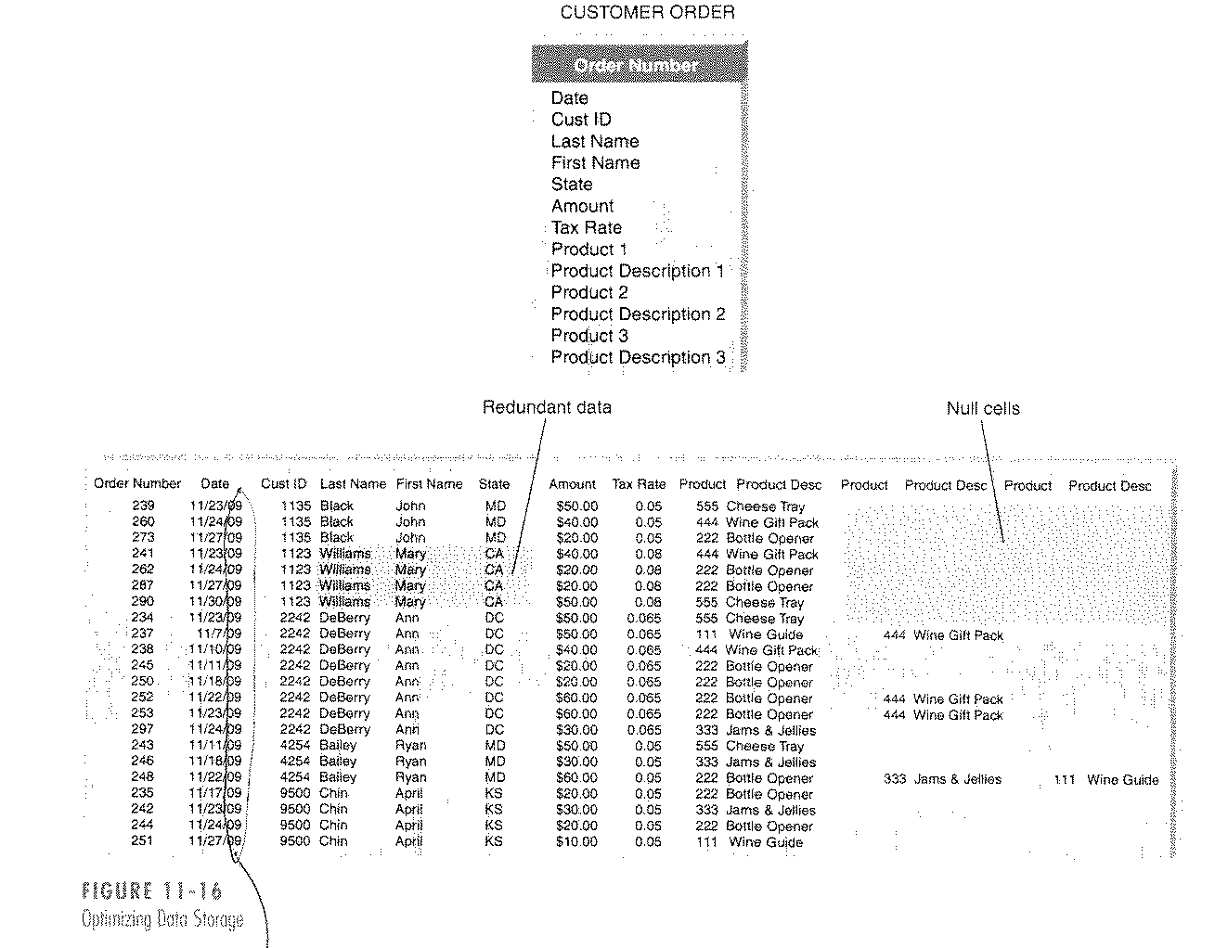
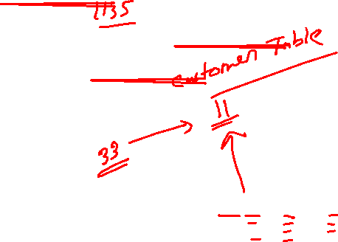
(cont’d)
Optimizing data storage
© Copyright 2011 John Wiley & Sons, Inc.
11-22

Slide 24

Optimizing Access Speed
After having optimized the data model design for data storage efficiency, the end result is that data are spread out across a number of tables.
For a large relational database, it is necessary to optimize access speed.
There are several techniques of optimizing access speed:
Denormalization
Clustering
Indexing
Estimating the size of data for hardware planning
© Copyright 2011 John Wiley & Sons, Inc.
11-23

Slide 25
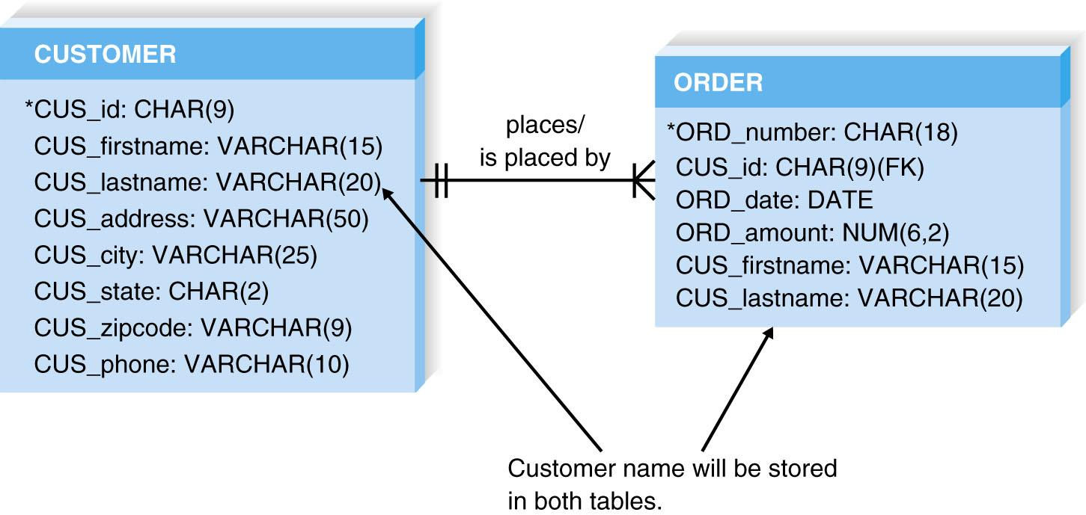

Denormalization
Denormalization – adding redundancy back into the design.
© Copyright 2011 John Wiley & Sons, Inc.
11-24

Slide 26
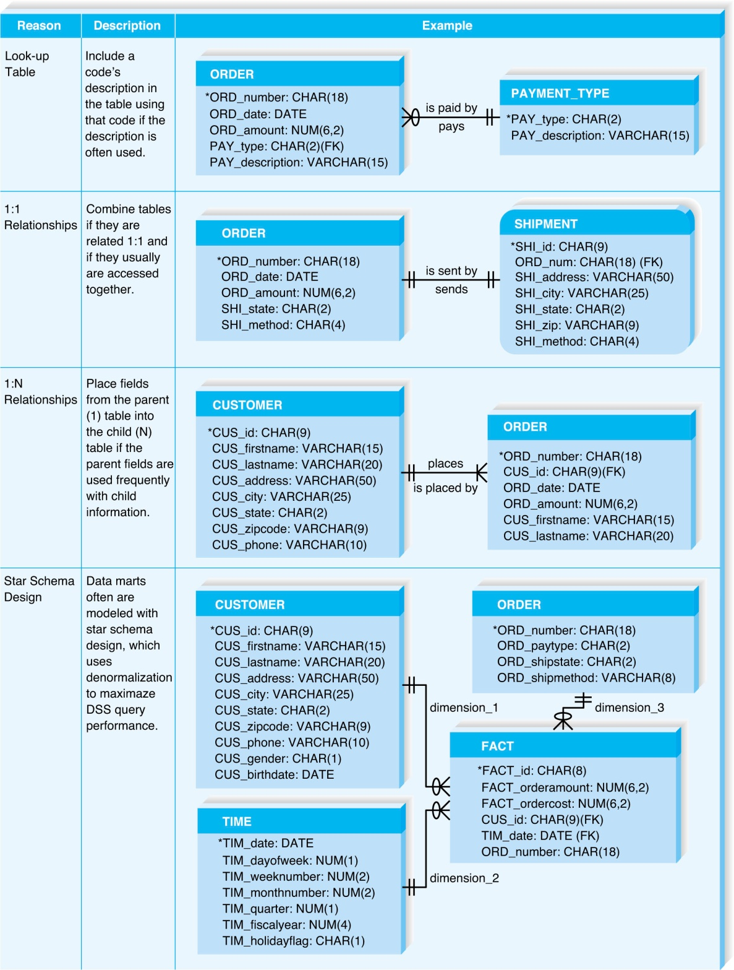
(cont’d)
There are four reasons for de-normalization.
© Copyright 2011 John Wiley & Sons, Inc.
11-25

Slide 27

Clustering
Clustering – placing records together physically so that like records are stored close together.
Intrafile clustering – Similar records in the table are stored together.
Interfile clustering – Combining records from more than one table that typically are retrieved together.
© Copyright 2011 John Wiley & Sons, Inc.
11-26

Slide 28

Indexing
An index in data storage is a minitable (similar to an index of a book) that contains values from one or more columns in a table and the location of the values within the table.
Indexes require overhead in that they take up space on the storage.
© Copyright 2011 John Wiley & Sons, Inc.
11-27

Slide 29
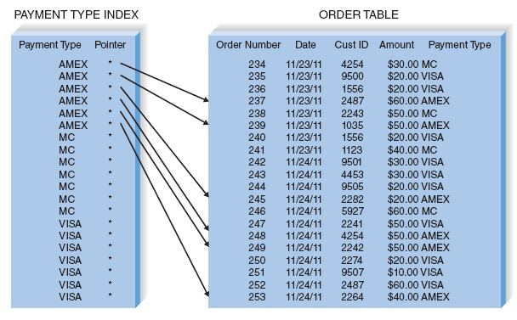

(cont’d)
Example of indexing
© Copyright 2011 John Wiley & Sons, Inc.
11-28

Slide 30
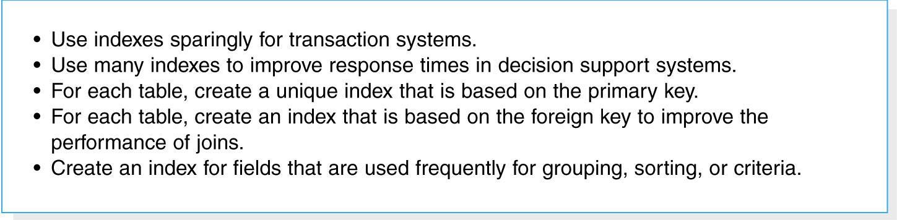
(cont’d)
Guidelines for creating indexes
© Copyright 2011 John Wiley & Sons, Inc.
11-29

Slide 31

Estimating Storage Size
Volumetrics – technique of estimating the amount of data that the hardware will need to support.
1. Calculate the amount of raw data - all the data that are stored within the tables of the database.
2. Calculate the overhead requirements based on the DBMS vendor’s recommendations.
3. Record the number of initial records that will be loaded into the table, as well as the expected growth per month.
© Copyright 2011 John Wiley & Sons, Inc.
11-30

Slide 32
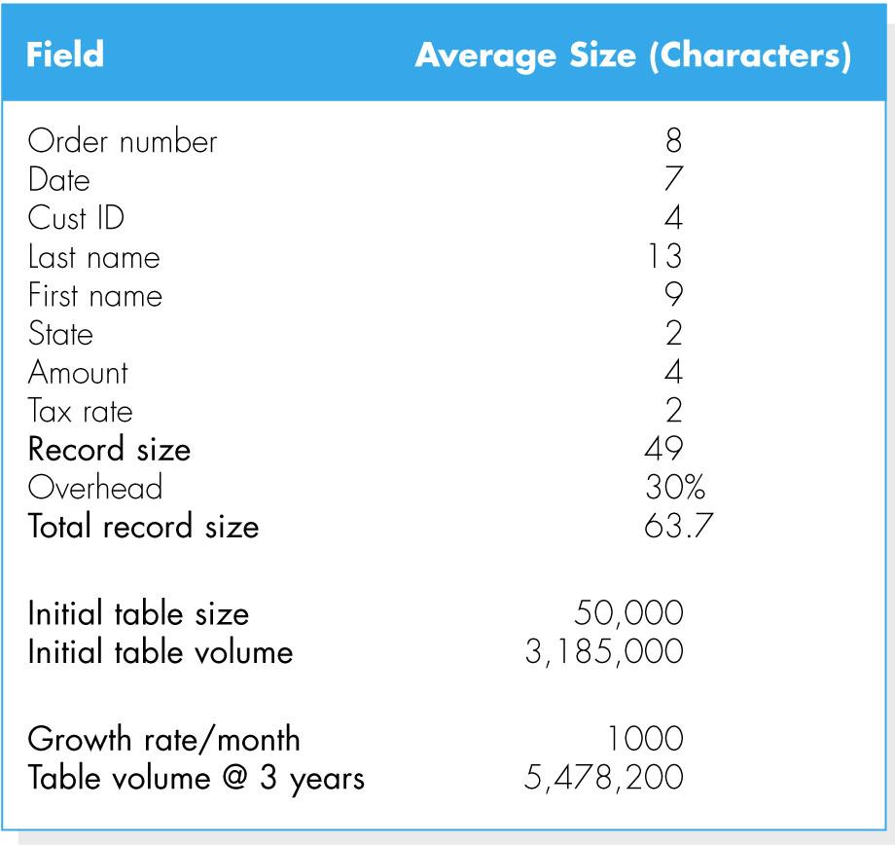
(cont’d)
Example of calculating volumetrics
© Copyright 2011 John Wiley & Sons, Inc.
11-31

Slide 33
SUMMARY
File data storage formats
- Files are electronic lists of data.
- Five types of files: master, look-up, transaction, audit, and history.
Database storage formats
- A database is a collection of groupings of information
- A DBMS is software that creates and manipulates these databases.
Selecting a data storage format
- Relational databases support simple data types very effectively, whereas object databases are best for complex data.
© Copyright 2011 John Wiley & Sons, Inc.
11-32

Slide 34
(cont’d)
Physical entity relationship diagrams
- Physical ERDs contain references to how data will be stored in a file or database table, and metadata are included.
Optimizing data storage
- There are two primary dimensions in which to optimize a relational database: for storage efficiency and for speed of access.
- There are a number of techniques of optimizing data storage.
© Copyright 2011 John Wiley & Sons, Inc.
11-33

