Slide 1
Systems Analysis and Design 5th Edition Program Design
Alan Dennis, Barbara Haley Wixom, and Roberta Roth
© Copyright 2011 John Wiley & Sons, Inc.
10-0

Slide 2
Chapter 10 Outline
Moving from logical to physical process models.
Designing programs.
Structure chart.
Program specification.
© Copyright 2011 John Wiley & Sons, Inc.
10-1

Slide 3
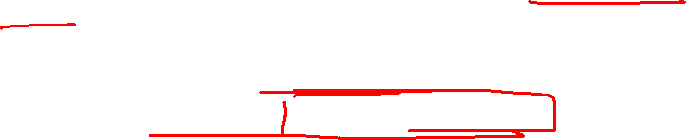
INTRODUCTION
Program design – Analysts determine what programs will be written and create instructions for the programmers.
Various implementation decisions are made about the new system (e.g., what programming language(s) will be used.)
The DFDs created during analysis are modified to show these implementation decisions, resulting in a set of physical data flow diagrams.
The analysts determine how the processes are organized, using a structure chart to depict the decisions.
Detailed instructions called program specifications are developed.
© Copyright 2011 John Wiley & Sons, Inc.
10-2

Slide 4
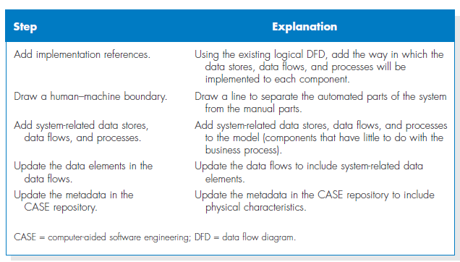
Steps to Create the Physical Data Flow Diagram
© Copyright 2011 John Wiley & Sons, Inc.
10-3

Slide 5
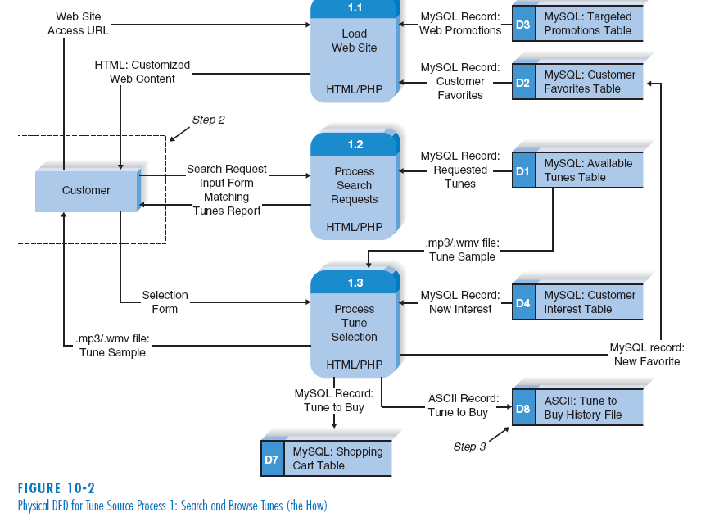
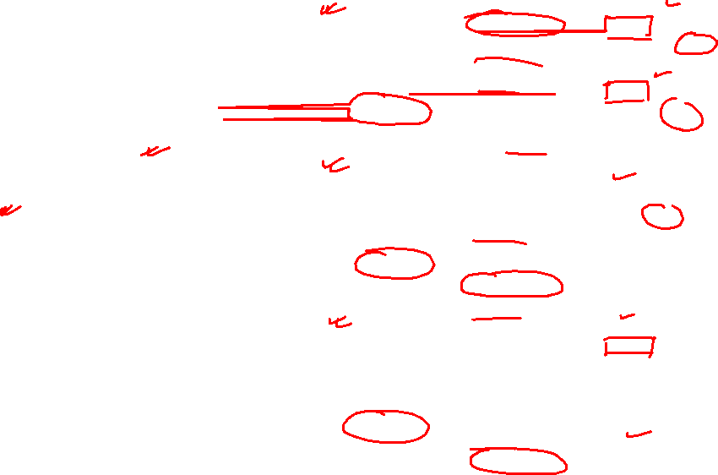
Example of Physical DFD
© Copyright 2011 John Wiley & Sons, Inc.
10-4

Slide 6
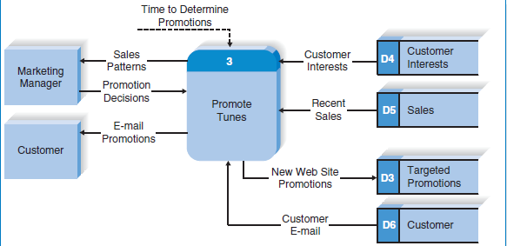
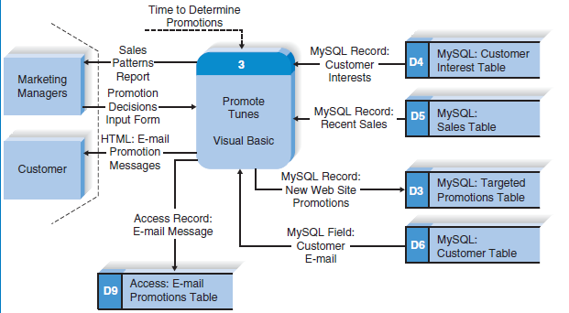

Logical Model of the Promote Tunes Process
Physical Model for Promote Tunes Process

Slide 7

STRUCTURE CHART
The structure chart is an Important program design technique that help the analyst design the program.
It shows all components of code in a hierarchical format that implies
Sequence (in what order components are invoked),
Selection (under what condition a module is invoked),
Iteration (how often a component is repeated)
10-6

Slide 8
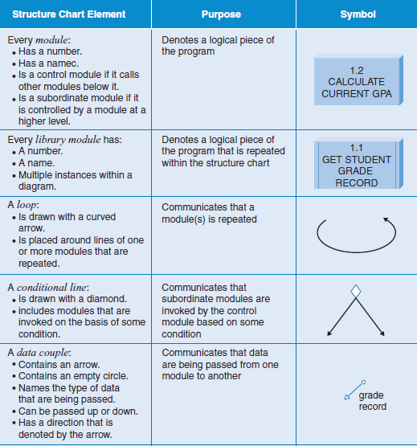

Syntax of Structure Chart
© Copyright 2011 John Wiley & Sons, Inc.
10-7

Slide 9
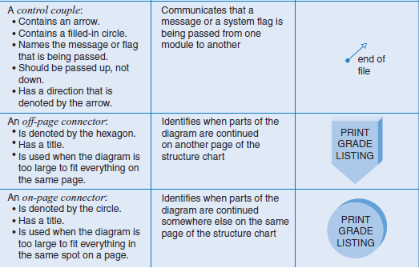

(cont’d)
© Copyright 2011 John Wiley & Sons, Inc.
10-8

Slide 10
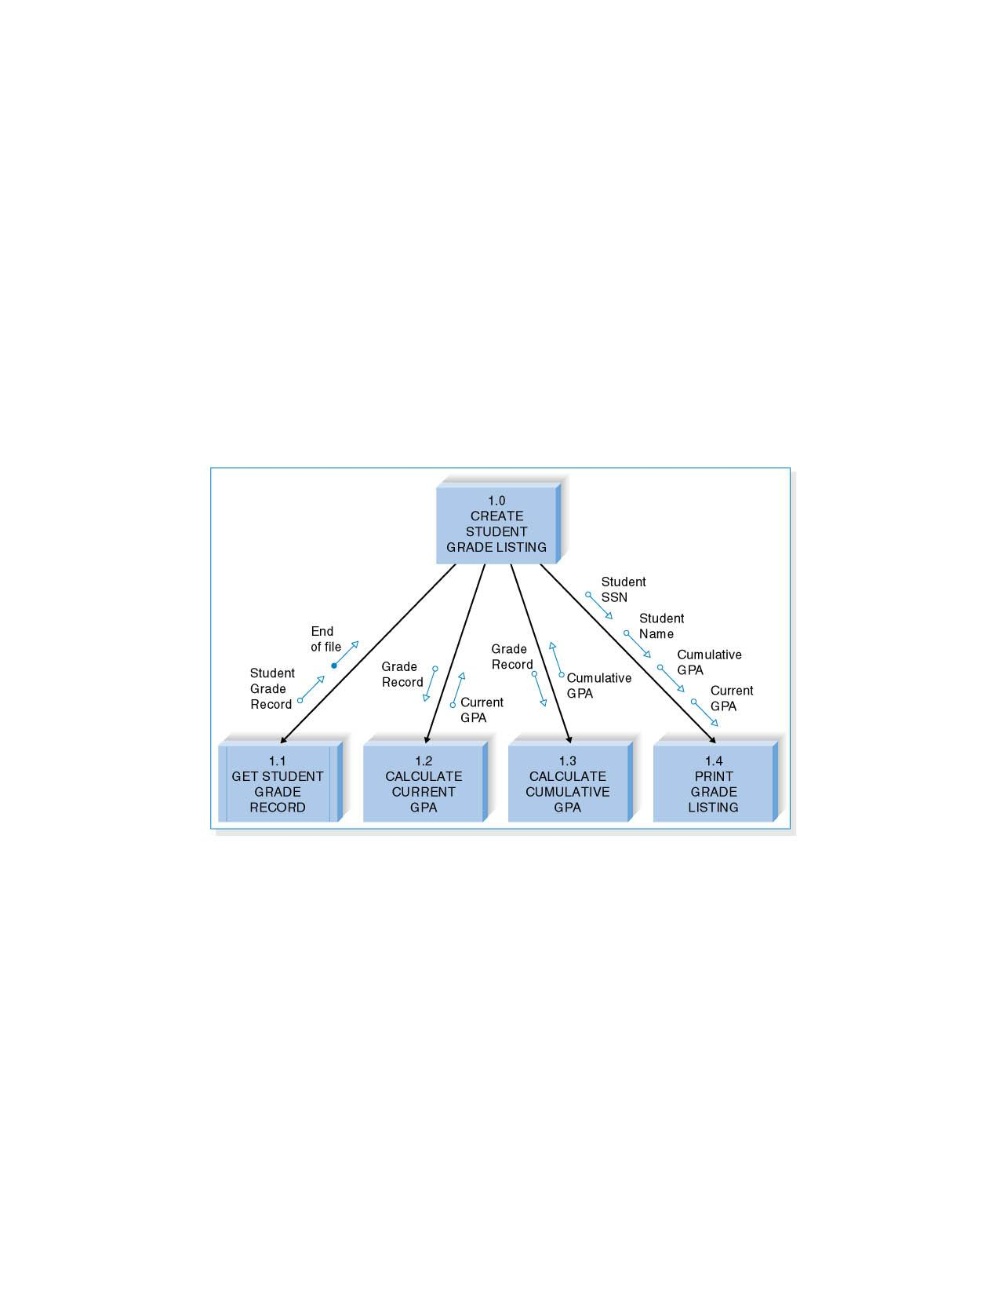
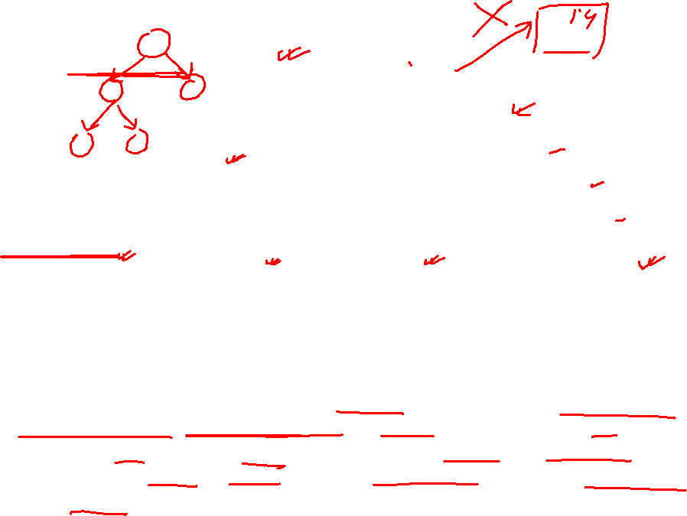
An academic system needs a program that will print a listing of students along with their grade point averages (GPAs), both for the current semester and overall. First, the program must retrieve the student grade records; then it must calculate the current and cumulative GPAs; finally, the grade list can be printed.
© Copyright 2011 John Wiley & Sons, Inc.
10-9
Notes:
a programmer can tell that there are four main
code modules involved in creating a student grade listing: getting the student grade
records, calculating current GPA, calculating cumulative GPA, and printing the listing.
Also, there are various pieces of information that are either required by each
module or created by it (e.g., the grade record, the cumulative GPA).
9

Slide 11
a programmer can tell that there are four main code modules involved in creating a student grade listing: getting the student grade records, calculating current GPA, calculating cumulative GPA, and printing the listing. Also, there are various pieces of information that are either required by each module or created by it (e.g., the grade record, the cumulative GPA).
© Copyright 2011 John Wiley & Sons, Inc.
10-10

Slide 12
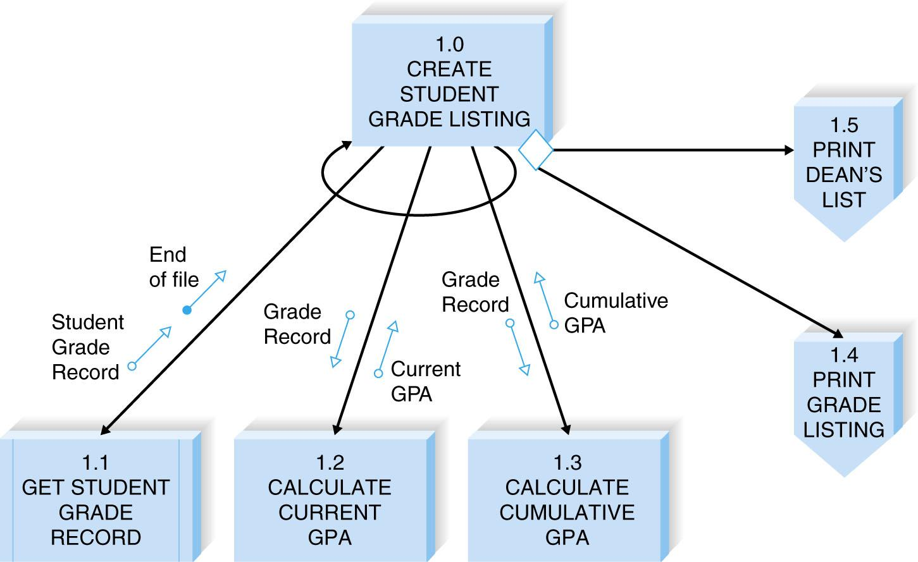
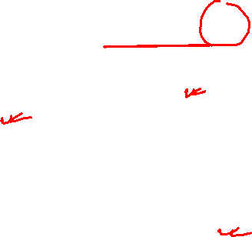
(cont’d)
Revised structure chart example
© Copyright 2011 John Wiley & Sons, Inc.
10-11

Slide 13
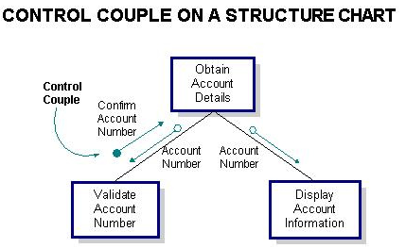
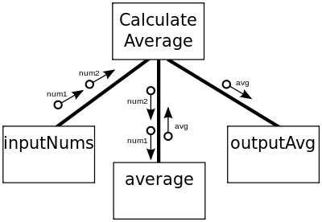
© Copyright 2011 John Wiley & Sons, Inc.
10-12

Slide 14

Design Guidelines
High quality structure charts result in programs that are modular, reusable, and easy to implement.
Measures of good design include
cohesion,
appropriate levels of fan-in and fan-out.
© Copyright 2011 John Wiley & Sons, Inc.
10-13

Slide 15

Build Modules with High Cohesion
Cohesion refers to how well the lines of code within each module relate to each other.
Cohesive modules are easy to understand and build because their code performs one function effectively.
© Copyright 2011 John Wiley & Sons, Inc.
10-14

Slide 16
(cont’d)
There are various types of cohesion.
Functional cohesion – all elements of the modules contribute to performing a single task.
Temporal cohesion – functions are invoked at the same time.
Coincidental cohesion – there is no apparent relationship among a module’s functions.
© Copyright 2011 John Wiley & Sons, Inc.
10-15

Slide 17
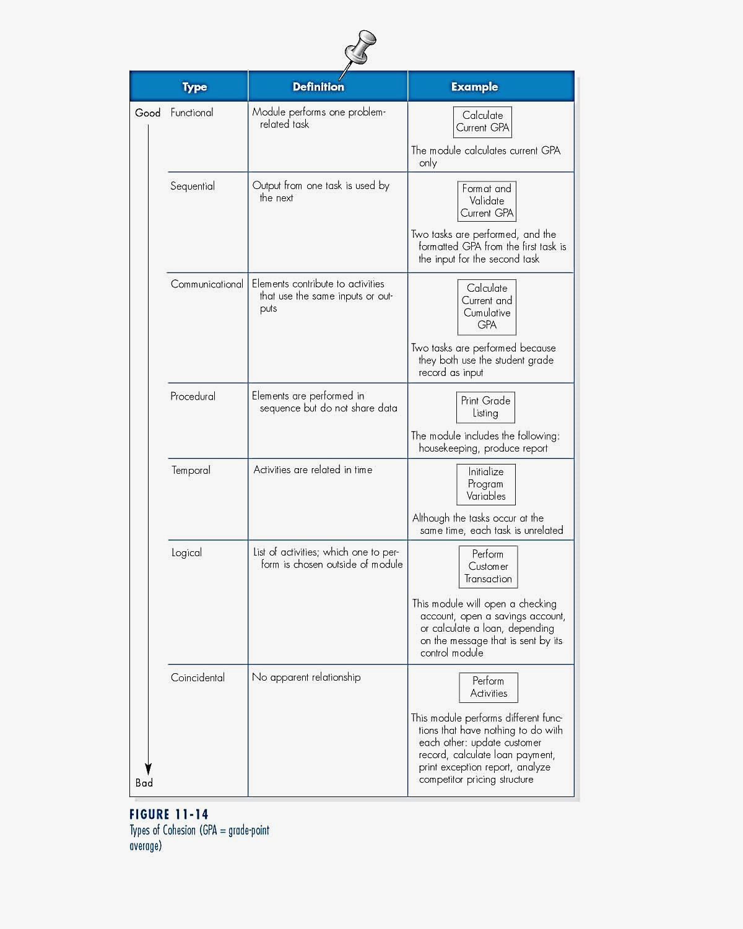
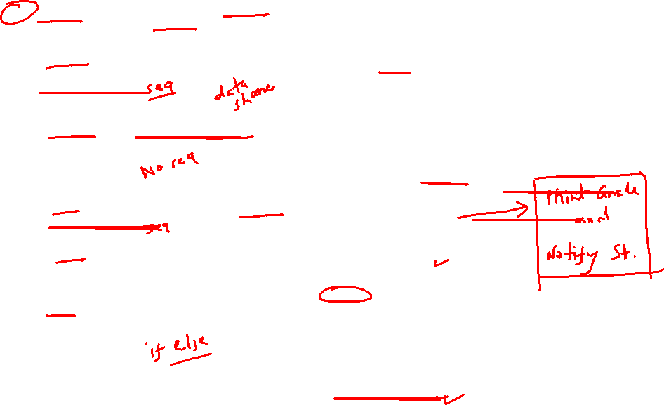
(cont’d)
© Copyright 2011 John Wiley & Sons, Inc.
10-16

Slide 18
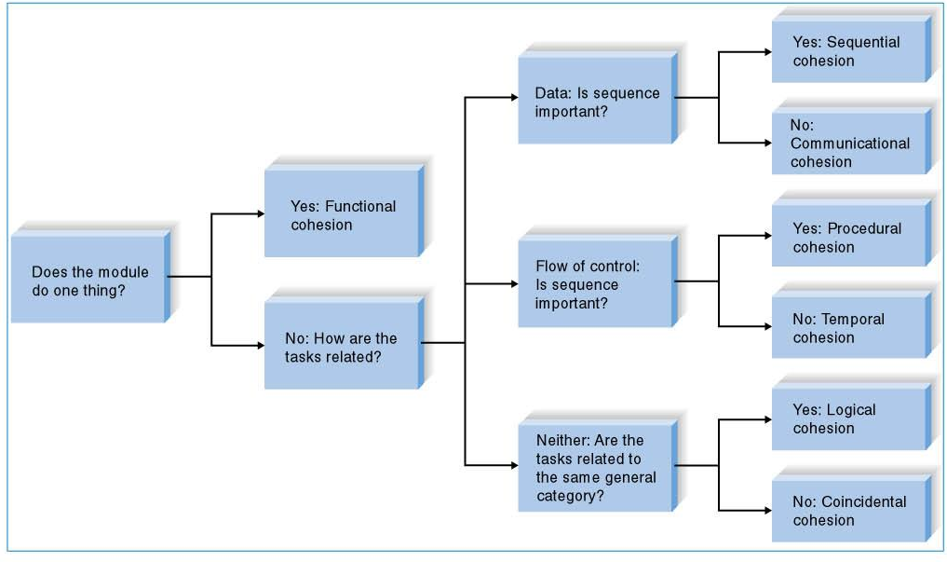
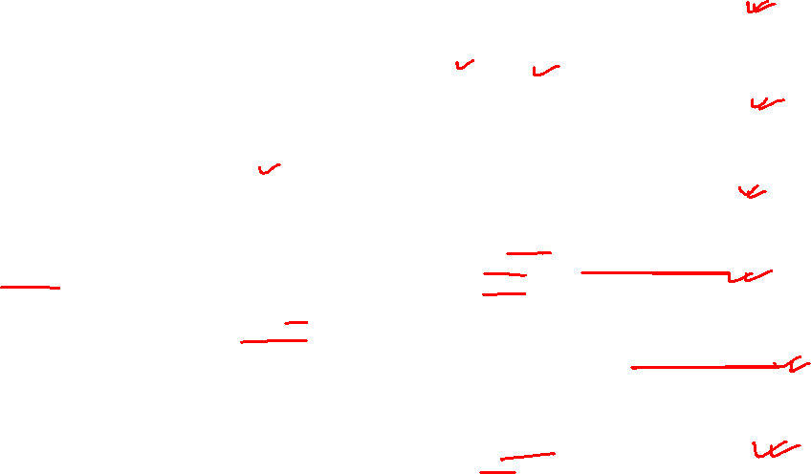
Cohesion Decision Tree
© Copyright 2011 John Wiley & Sons, Inc.
10-17

Slide 19

Fan-In
Fan-in describes the number of control modules that communicate with a subordinate.
A module with high fan-in has many different control modules that call it. This is a good situation because high fan-in indicates that a module is reused in many places on the structure chart.
© Copyright 2011 John Wiley & Sons, Inc.
10-18

Slide 20

Fan-Out
A large number of subordinates associated with a single control should be avoided.
The general rule of thumb is to limit a control module’s subordinates to approximately seven for low fan-out.
fanin is call by other modules.
Create High Fan-In
fanout is call from that module.
Avoid High Fan-Out
© Copyright 2011 John Wiley & Sons, Inc.
10-19

Slide 21
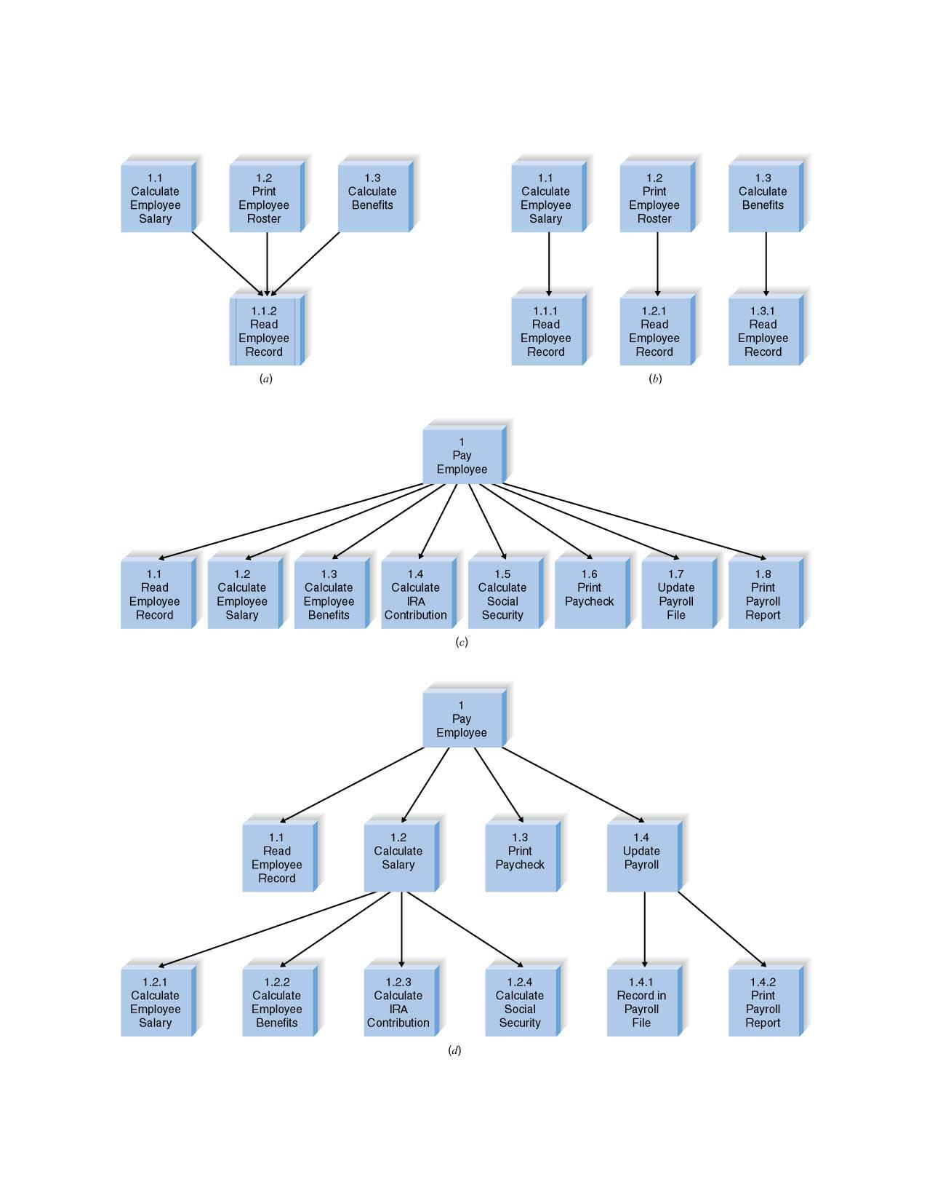
Examples of Fan-in and Fan-out
© Copyright 2011 John Wiley & Sons, Inc.
10-20

Slide 22
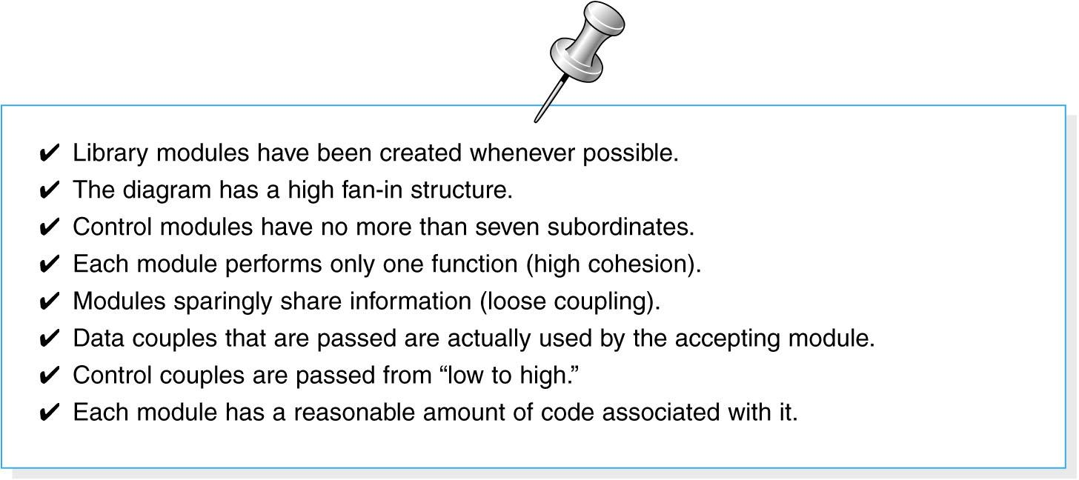

Assess the Chart for Quality
Check list for structure chart quality
© Copyright 2011 John Wiley & Sons, Inc.
10-21

Slide 23

PROGRAM SPECIFICATION
Program Specifications are documents that include explicit instructions on how to program pieces of code.
There is no formal syntax for program specification.
Four components are essential for program specification:
- Program information;
- Events;
- Inputs and outputs; and
- Pseudocode – a detailed outline of lines of code that need to be written.
Additional notes and comments can also be included.
© Copyright 2011 John Wiley & Sons, Inc.
10-22

Slide 24
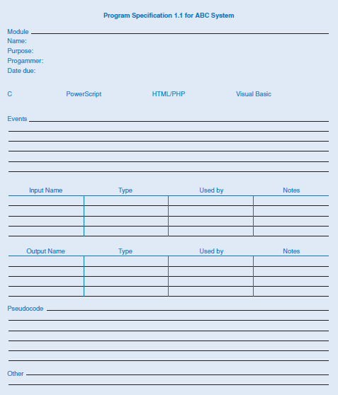

Program specification form
© Copyright 2011 John Wiley & Sons, Inc.
10-23

Slide 25
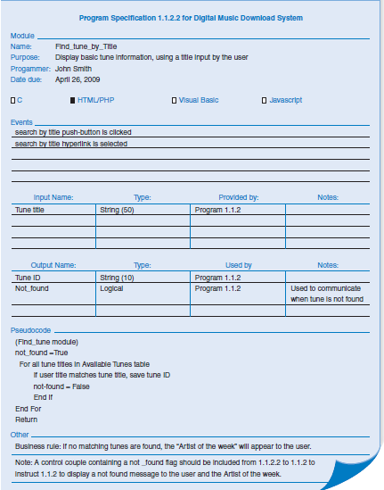

© Copyright 2011 John Wiley & Sons, Inc.
10-24

Slide 26
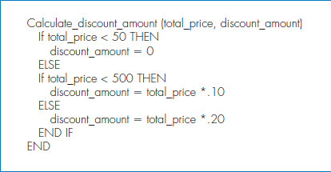

(cont’d)
Pseudocode Example
© Copyright 2011 John Wiley & Sons, Inc.
10-25

Slide 27

SUMMARY
Moving from logical to physical process models.
- Physical DFDs show implementation details.
Structure chart.
- The structure chart shows all of the functional components needed in the program at a high level.
Building structure chart.
- Module, control connection, couples, review.
Structure chart design guidelines.
- Cohesion, coupling, and fan-in/fan-out.
Program specifications.
- Program specifications provide more detailed instructions to the programmers.
© Copyright 2011 John Wiley & Sons, Inc.
10-26

