Slide 1
Systems Analysis and Design 5th Edition Chapter 9. User Interface Design
Alan Dennis, Barbara Haley Wixom, and Roberta Roth
© Copyright 2011 John Wiley & Sons, Inc.
9-0

Slide 2
Chapter 9 Outline
Principles of user interface design.
User interface design process.
Navigation design.
Input design.
Output design.
© Copyright 2011 John Wiley & Sons, Inc.
9-1

Slide 3
INTRODUCTION
Interface design is the process of defining how the system will interact with external entities.
In this chapter, we focus on the design of user interfaces – how the system will interact with the users.
The design of system interfaces defines how the systems exchange information with other systems.
© Copyright 2011 John Wiley & Sons, Inc.
9-2

Slide 4

(cont’d)
The user interface includes three fundamental parts:
- The Navigation mechanism - the way in which the user tells the system what to do.
- The input mechanism – the way in which the system captures information.
- The output mechanism - the way in which the system provides information to the user or to other systems.
Graphical user interfaces (GUI) use windows, menus, icons, etc., and are the most common type of user interfaces.
© Copyright 2011 John Wiley & Sons, Inc.
9-3

Slide 5

PRINCIPLES FOR USER INTERFACE DESIGN
User interface design is an art.
The goal is to make the interface pleasing to the eye and simple to use, while minimizing the user’s effort.
© Copyright 2011 John Wiley & Sons, Inc.
9-4

Slide 6
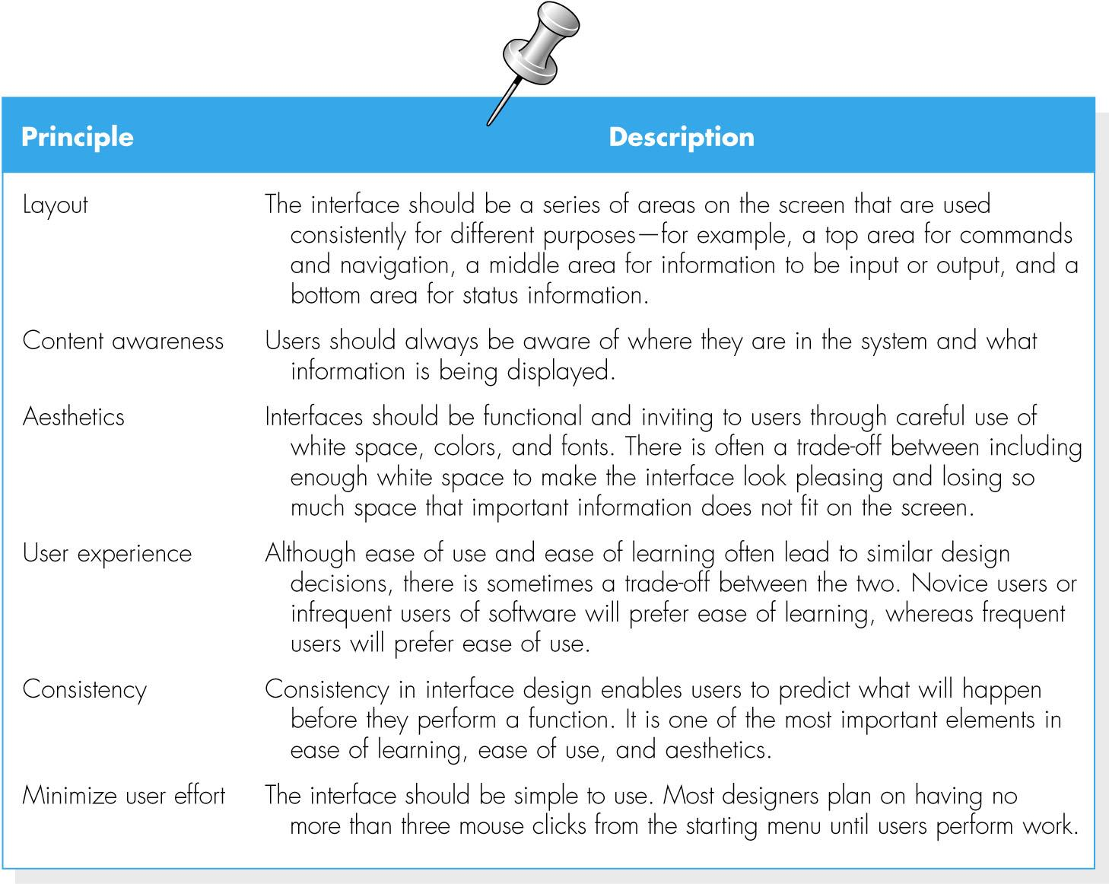

(cont’d)
© Copyright 2011 John Wiley & Sons, Inc.
9-5

Slide 7
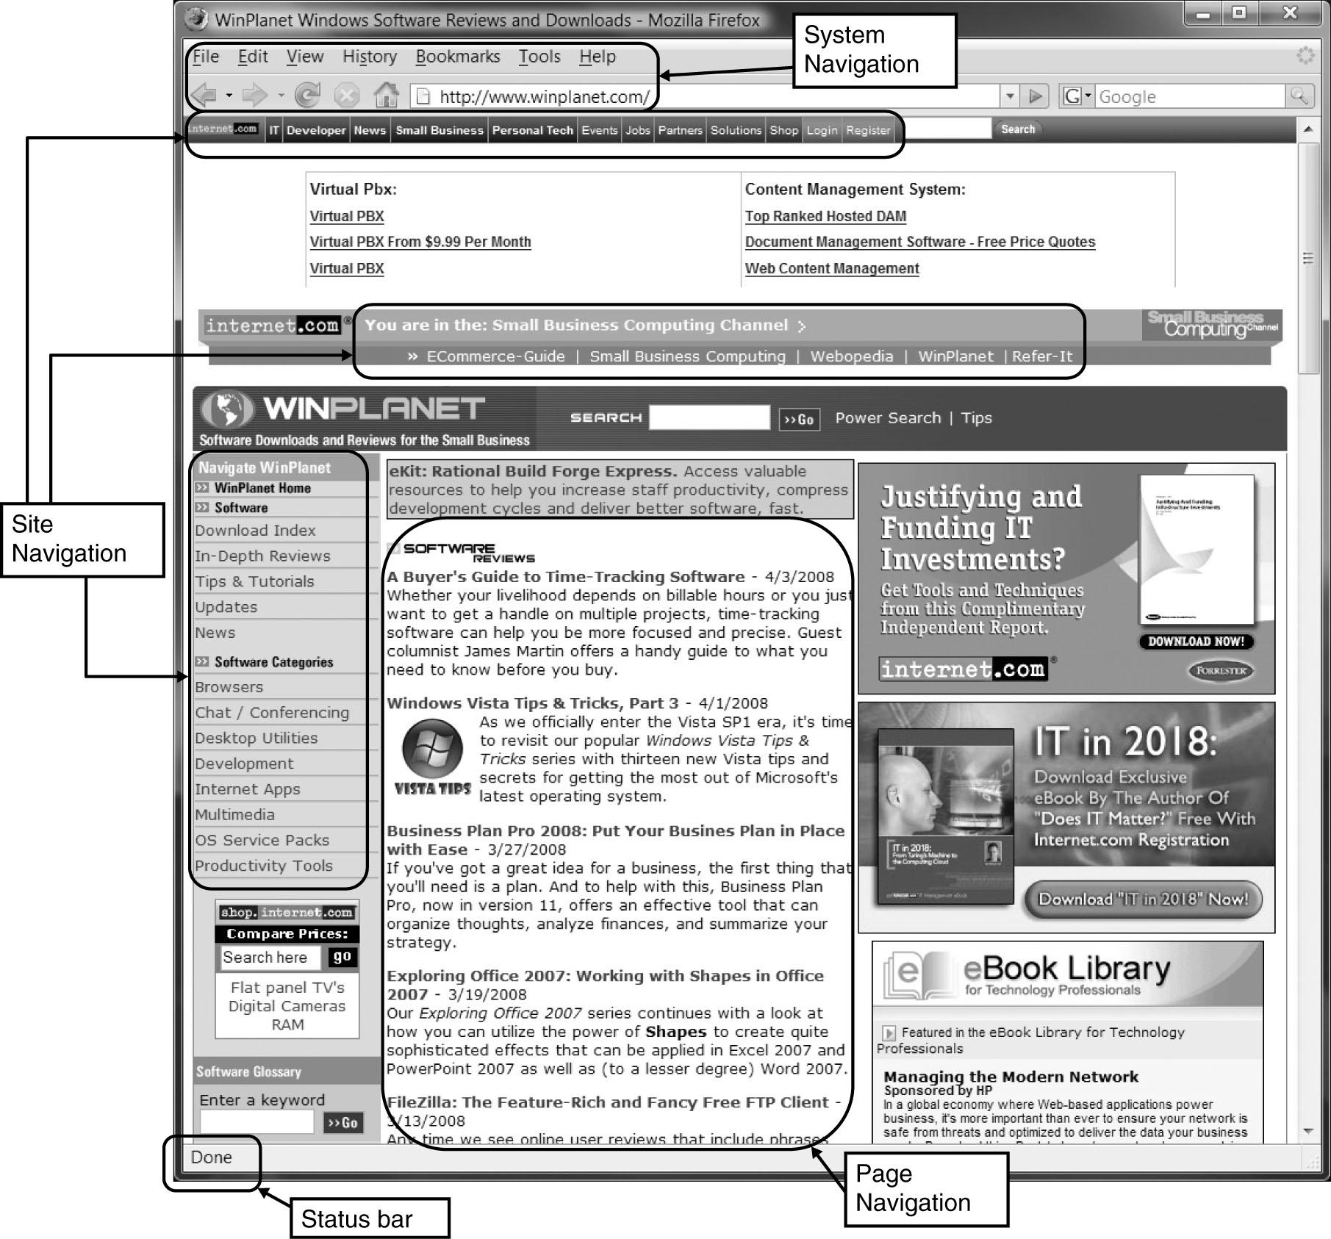

(cont’d)
Web page layout with multiple navigation areas
© Copyright 2011 John Wiley & Sons, Inc.
9-6

Slide 8
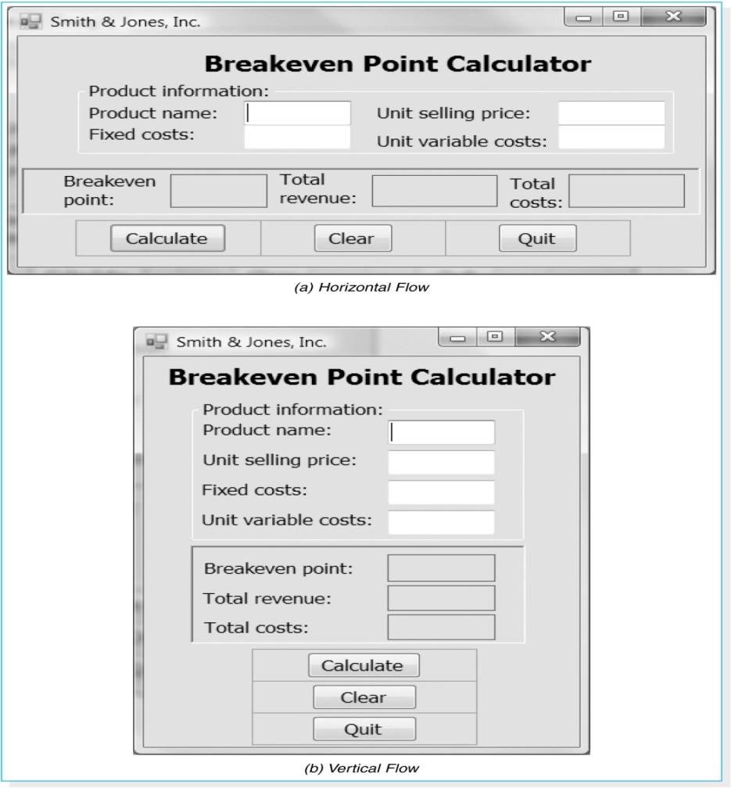

Consistency
The flow between sections should also be consistent.
© Copyright 2011 John Wiley & Sons, Inc.
9-7

Slide 9
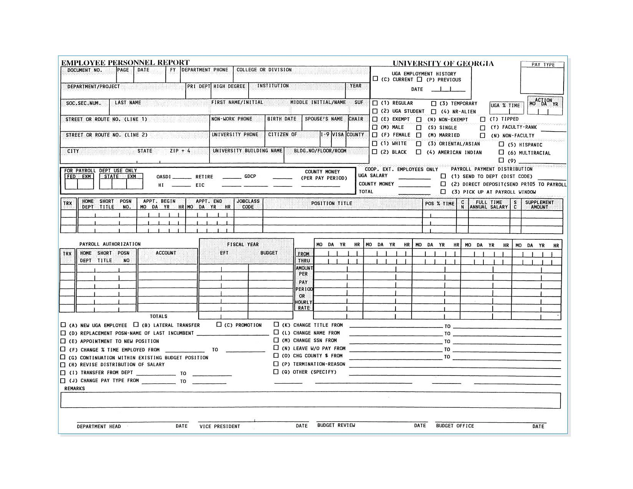
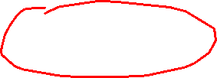
An example of form with high density
© Copyright 2011 John Wiley & Sons, Inc.
9-8

Slide 10
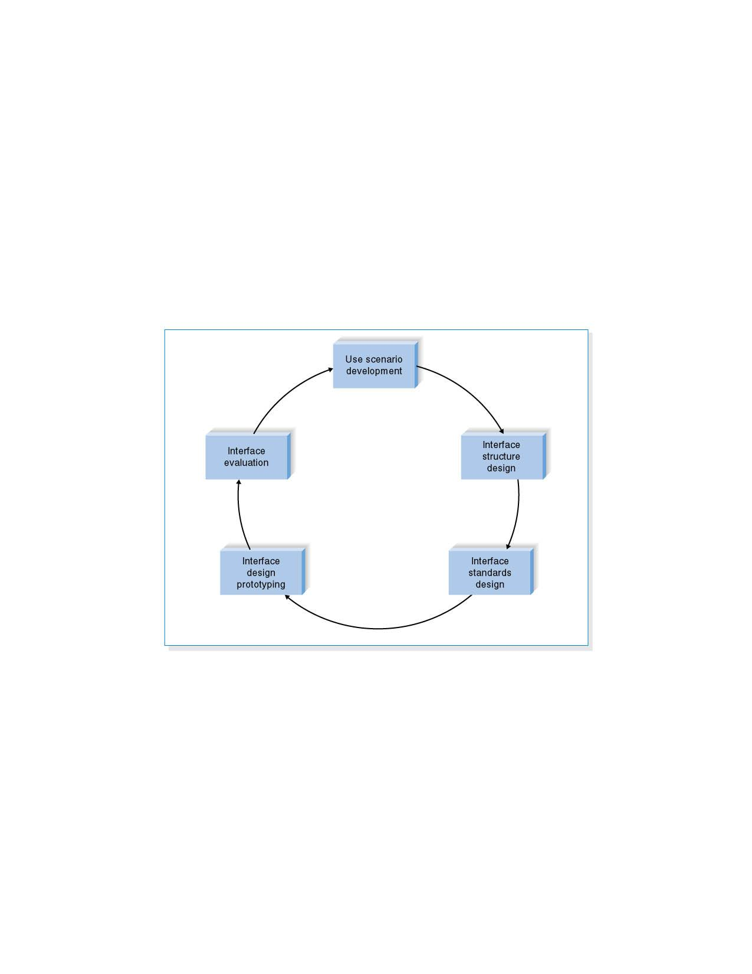

USER INTERFACE DESIGN PROCESS
User interface design is a five-step process that is iterative.
© Copyright 2011 John Wiley & Sons, Inc.
9-9

Slide 11

Use Scenario Development
A use scenario is an outline of steps that users perform to accomplish some part of their work.
Use scenarios are presented in a simple narrative description that is tied to the DFD.
© Copyright 2011 John Wiley & Sons, Inc.
9-10

Slide 12
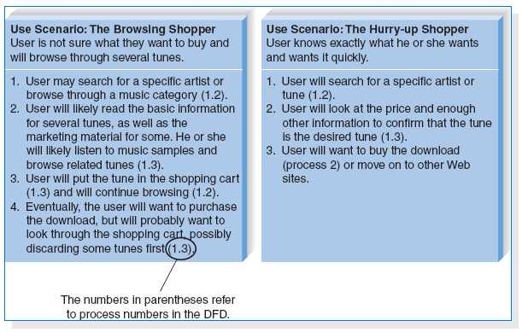
(cont’d)
Examples of use scenarios
© Copyright 2011 John Wiley & Sons, Inc.
9-11

Slide 13

Interface Standards Design
The interface standards are the basic design elements that are common across the individual screens, forms, and reports within the system.
The interface template defines the general appearance of all screens and the paper-based forms and reports.
© Copyright 2011 John Wiley & Sons, Inc.
9-12

Slide 14

(cont’d)
The template specifies the names that the interface will use for the major interface objects, the fundamental building blocks of the system.
The template gives names to the most commonly used interface actions.
The interface objects and actions, and also their status, may be represented by interface icons.
© Copyright 2011 John Wiley & Sons, Inc.
9-13

Slide 15
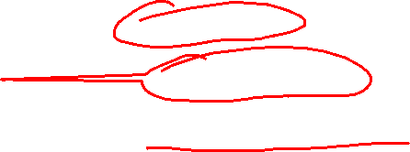
Interface Design Prototyping
An interface design prototype is a mock-up or a simulation of a computer screen, form, or report.
Common approaches to interface design prototyping:
Storyboards
HTML prototypes
Language prototypes.
© Copyright 2011 John Wiley & Sons, Inc.
9-14

Slide 16
(cont’d)
The storyboard shows hand-drawn pictures of screens.
An HTML prototype is built with the use of Web pages created in HTML
A language prototype is an interface design prototype built in the actual language or by the actual that will be used to build the system.
© Copyright 2011 John Wiley & Sons, Inc.
9-15
Notes:
15

Slide 17
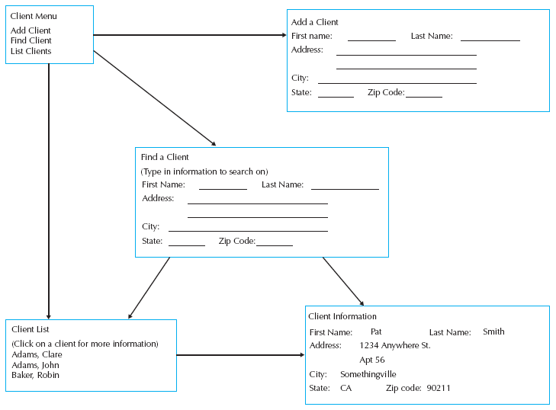

Sample Storyboard
Slide 16

Slide 18

Interface Evaluation
The objective of interface evaluation is to understand how to improve the interface design.
There are four common approaches to interface evaluation.
1. Heuristic evaluation - Compare the interface to a checklist of design principles.
2. Walk-through evaluation - It is a meeting conducted with the users to walk through the interface.
3. Interactive evaluation - Users try out the interface.
4. Formal usability testing - It is a formal testing process to understand how usable the interface is.
© Copyright 2011 John Wiley & Sons, Inc.
9-17

Slide 19

NAVIGATION DESIGN
Basic Principles
- Analysts usually must assume that users have not read the manual, have not attended training, and do not have external help readily at hand.
- All controls should be clear and understandable and placed in an intuitive location on the screen.
© Copyright 2011 John Wiley & Sons, Inc.
9-18

Slide 20
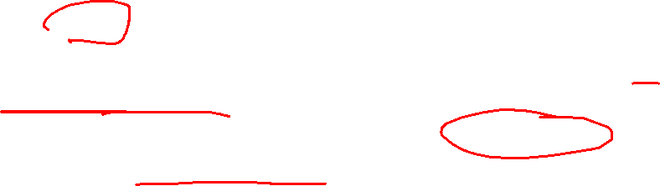
(cont’d)
Prevent Mistakes - The first of principle of designing navigation control is to prevent users from making mistakes.
Labeling commands appropriately and limiting choices.
Confirming with the user that the actions are difficult or impossible to undo.
Simplify Recovery from Mistakes – making “undo” buttons whenever possible.
Use Consistent Grammar Order – Windows application uses an object-action grammar order.
© Copyright 2011 John Wiley & Sons, Inc.
9-19

Slide 21
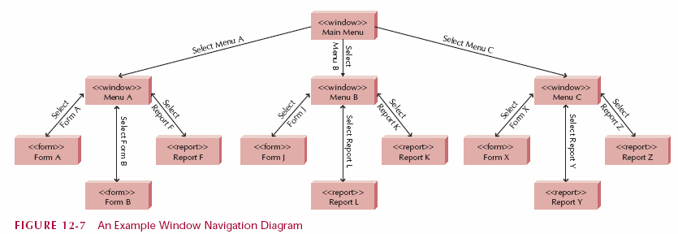
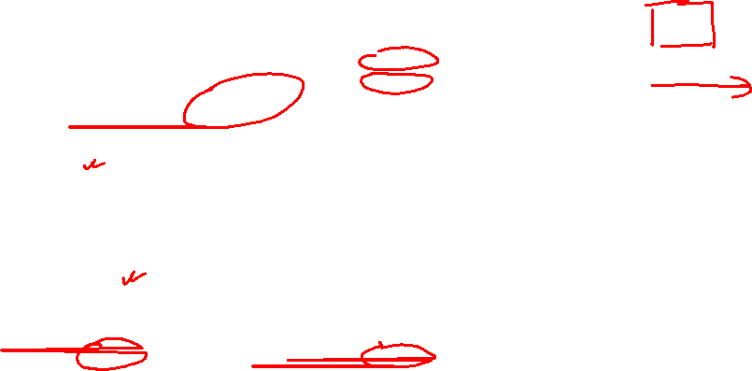
Window Navigation Diagram
Slide 20
Notes:
20
Here is another example of a WND
Can you construct its related UIDM

Slide 22
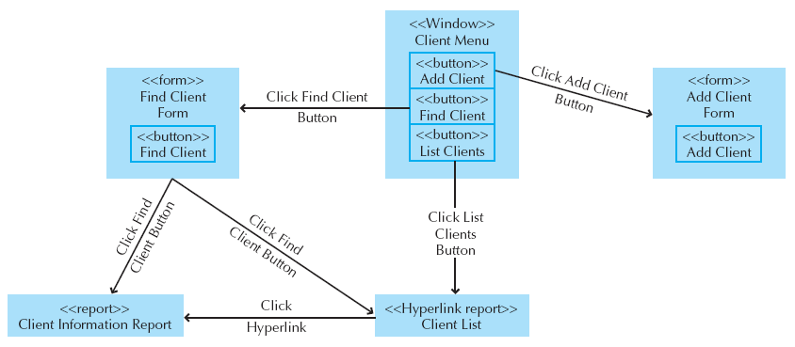

Sample WND
Slide 21

Slide 23
INPUT DESIGN
Input mechanisms facilitate the entry of data into the computer system.
Input design means designing the screen used to enter information and forms on which the users write and type information.
The goal of input design is to capture accurate information for the system simply and easily.
© Copyright 2011 John Wiley & Sons, Inc.
9-22

Slide 24
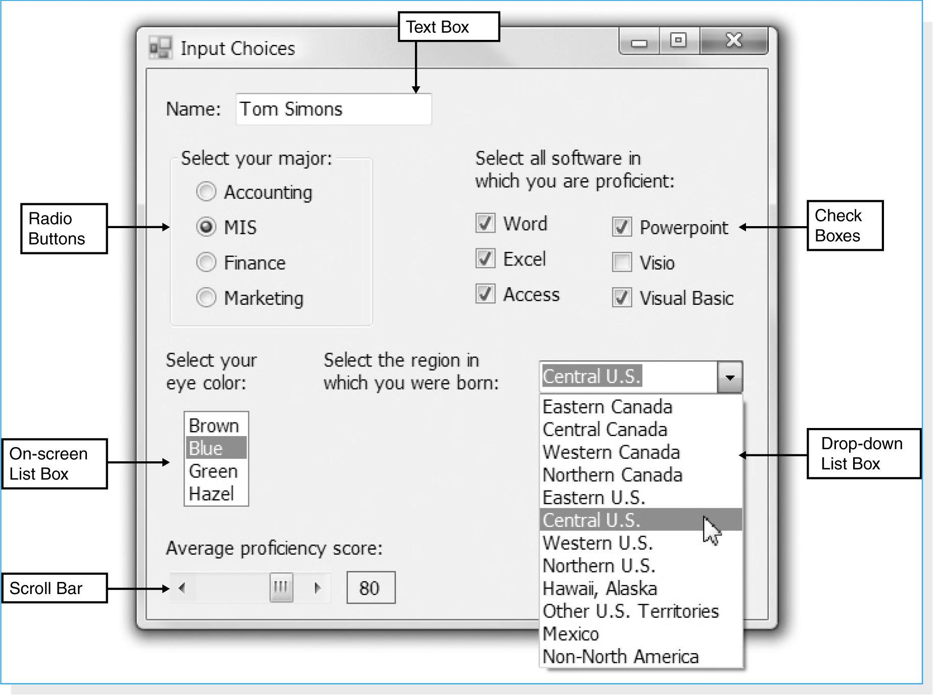

Types of Inputs
There are many different types of inputs, in the same way that there are many different types of fields.
© Copyright 2011 John Wiley & Sons, Inc.
9-23

Slide 25

Minimize Keystrokes
Keystrokes cost time and money.
The system should never ask for information that can be obtained in another way (e.g., by retrieving it from a database).
The system should not require a user to type information that can be selected from a list.
The frequent values should be used as the default value for the data.
© Copyright 2011 John Wiley & Sons, Inc.
9-24

Slide 26
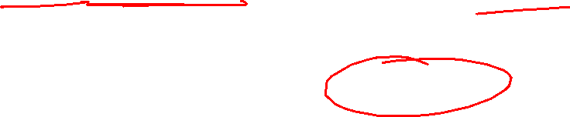
OUTPUT DESIGN
Outputs are the reports that the system produces, whether on the screen, on paper, or in other media, such as the Web.
Outputs are the most visible part of any system.
© Copyright 2011 John Wiley & Sons, Inc.
9-25

Slide 27

Basic Principles
The goal of the output mechanism is to present information to users so that they can accurately understand it with the least effort.
Understand report usage – the first principle in designing reports is to understand how they are used.
Manage information load – the goal of a well-designed report is to provide all needed information without information overload.
Minimize bias – no analyst sets out to design a biased report.
© Copyright 2011 John Wiley & Sons, Inc.
9-26

Slide 28
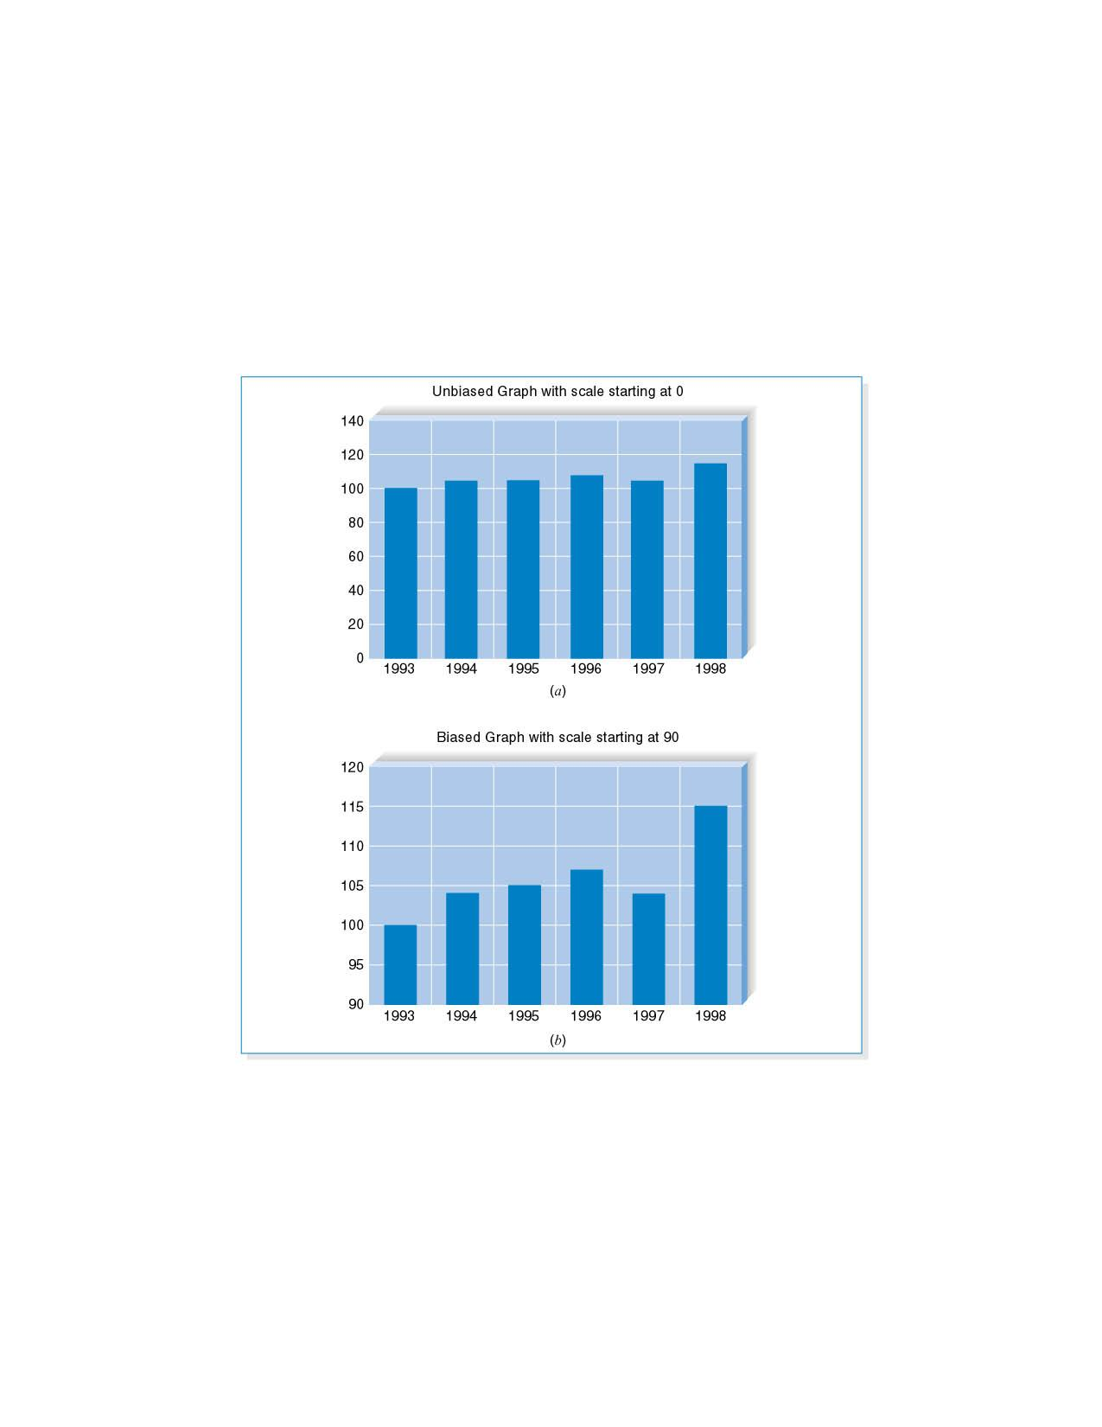
(cont’d)
Example of bias: Bias in graphs.
© Copyright 2011 John Wiley & Sons, Inc.
9-27

Slide 29

SUMMARY
User interface design principles
- Layout, content awareness, aesthetics, user experience, consistency, minimize user effort.
The user interface design process
- Use scenario development, interface structure design, interface standards design, interface design prototyping, and interface evaluation.
© Copyright 2011 John Wiley & Sons, Inc.
9-28

Slide 30

(cont’d)
Navigation design
- The fundamental goal of navigation design is to make the system as simple to use as possible.
Input design
- The goal of input design is to simply and easily capture accurate information for the system.
Output design
- The goal of the output design is to present information to users so that they can accurately understand it with the least effort.
© Copyright 2011 John Wiley & Sons, Inc.
9-29

