Slide 1
Emergence of Bangladesh (EMB101): Lesson 3
British India 1747-1857

Slide 2
Topic Points
British East India Company in India and growth of its power
Battle of Polashi and it’s aftermath
Battle of Buxar 1764
Diwani Rights to the British East India Company and its aftermath
Permanent Settlement Act 1793
Impact of Permanent Settlement
Early Reforms and repercussions
Early Resistance movement
The First Indian War of Independence, 1857

Slide 3

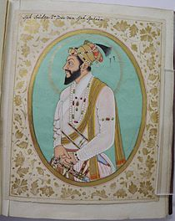
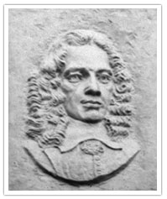
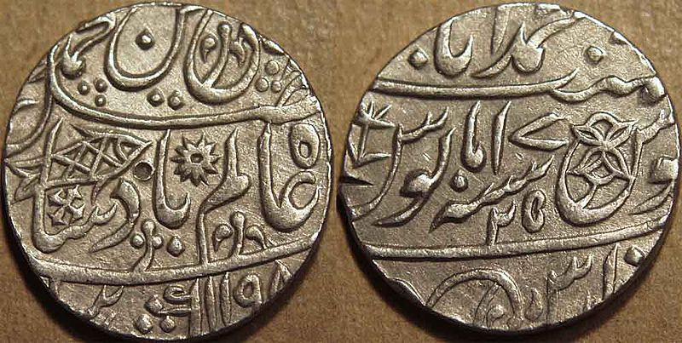
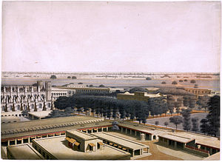
Advent of the BEIC in Bengal
In 1651 Prince Shuja granted trading right to EIC in Bengal
Job Charnock
By 1696 built Fort William in Calcutta
Silver rupee of the Bengal Presidency, issued in the name of the Mughal Emperor Shah Alam II in 1784-85

Slide 4
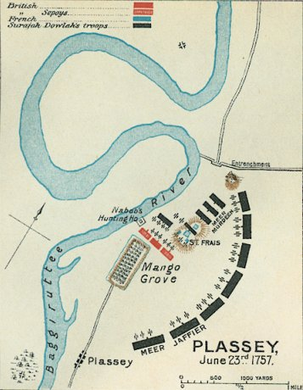
Battle of Polashi

Slide 5
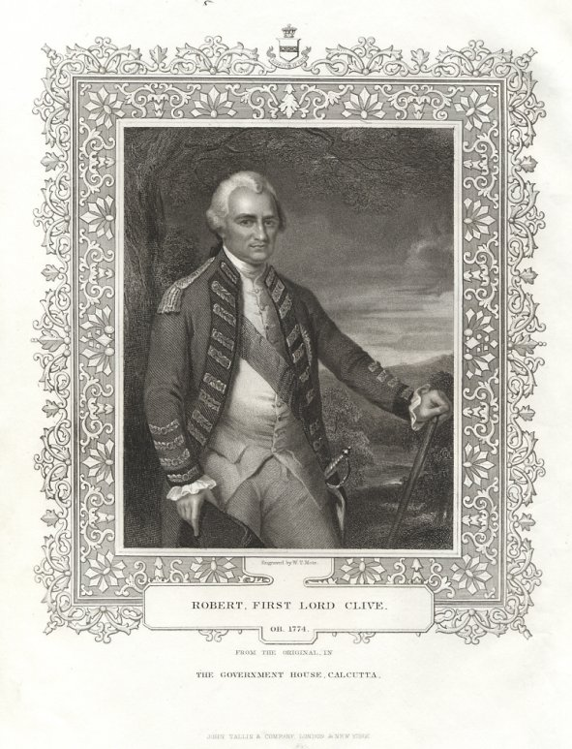
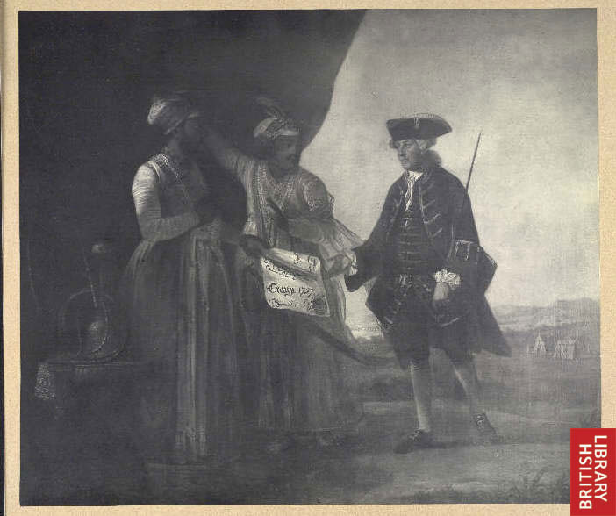
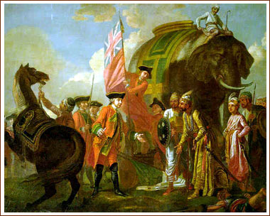
Mir Jafar and his son Miran delivering the Treaty of 1757 to William Watts (chief of the Kasimbazar factory of the British East India Company)
Robert Clive meeting with Mir Jafar after Palashi, by Francis Hayman

Slide 6
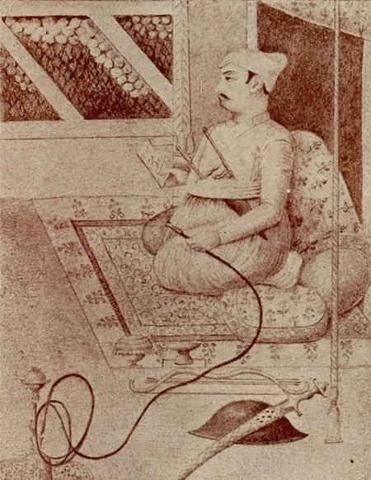
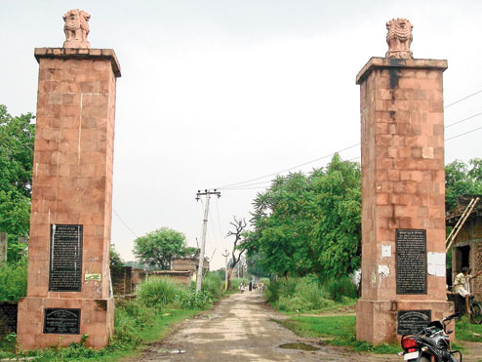
The Battle of Buxar was fought on 23 October 1764 between the forces under the command of the British East India Company and the combined army of Mir Kasim the Nawab of Bengal; Shuja-ud-Daula the Nawab of Awadh and the Mughal Emperor Shah Alam II
Mir Kasim (1760-1764)
The memorial of the Battle of Buxar, constructed by the British

Slide 7
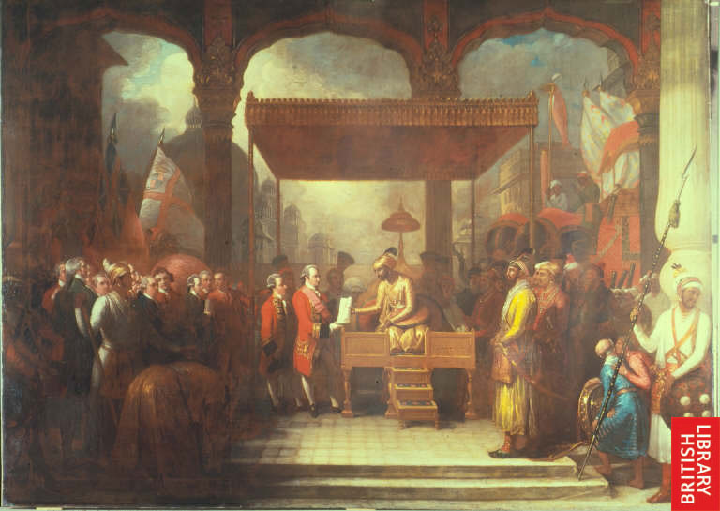
Immediately after the battle, Shah Alam II granted the diwani right over Bengal to the East India Company in 1765, allowing it to collect revenue.

Slide 8
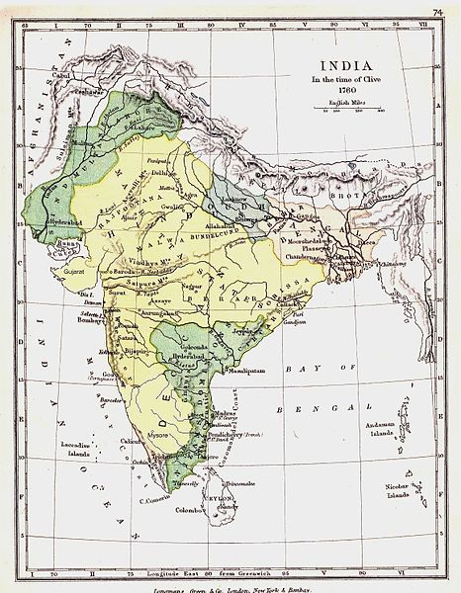
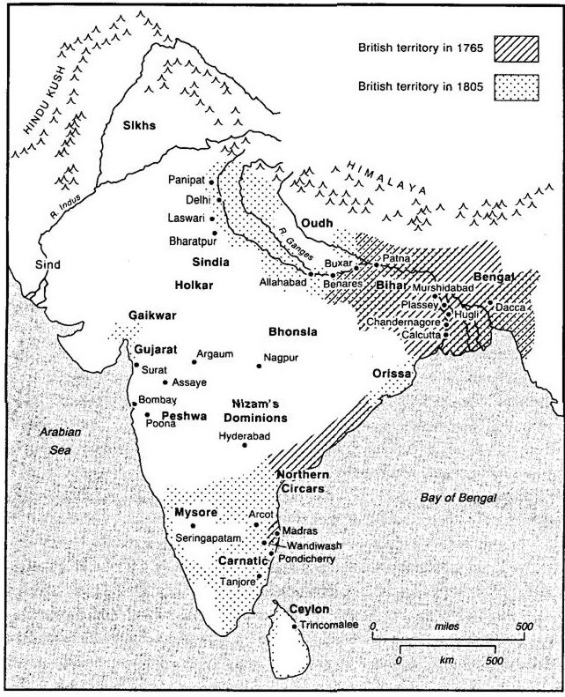
Growing British Empire in India

Slide 9
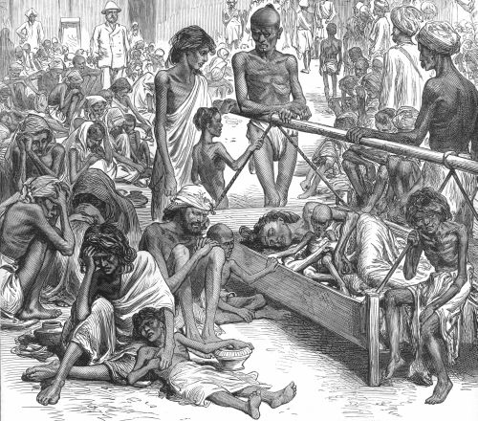
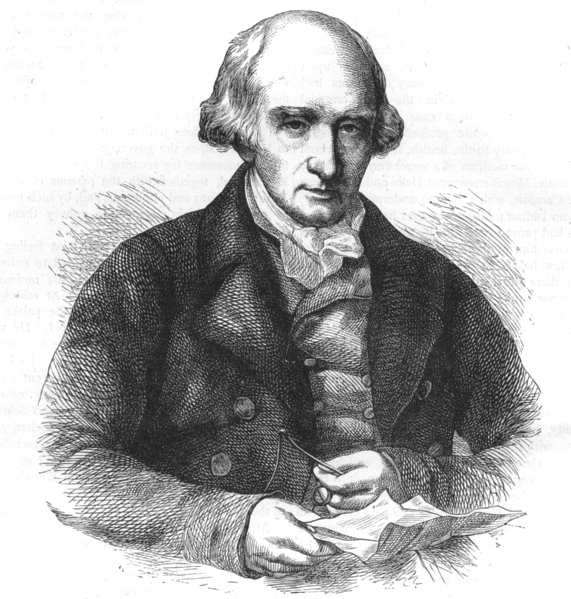
British East India Company continues to experiment with ruling system till 1772
Land tax was increased fivefold
Shortfall in crops in 1769
These resulted a severe famine in 1770
To overhaul the management of the East India Company's rule in India the Parliament of Great Britain passes The Regulating Act of 1773
This law created a new post Governor General
Warren Hastings was the first Governor General

Slide 10
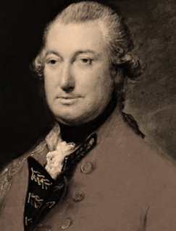
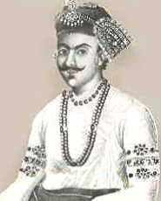
The Permanent Settlement of 1793
Sunset Law
Zamindar Class

Slide 11
Social Reforms and Repercussions
Education Act of 1835
Bengal renaissance
Young Bengal Movement
Raja Ram Mohon Roy
Enacting laws to criminalize different local customs and practices e.g., Sati, widow remarriage, Doctrine of Lapse etc.

Slide 12
Fakir-Sannyasi Resistance
(1760s-1790s)
Fakir Majnu Shah
Bhabani Pathak
Notes:
Fakir Majnu Shah
Bhabani Pathak

Slide 13
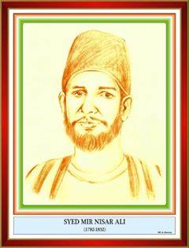
Titu Mir
( 1782-1831)
Notes:
Titu Mir

Slide 14
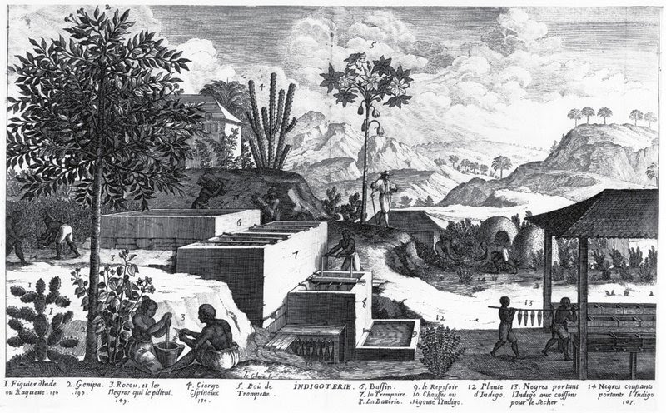
Indigo Resistance Movement
(1859-1862)

Slide 15
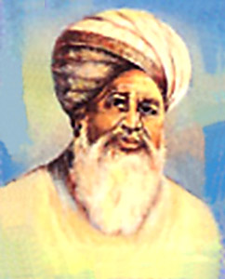
Faraizi Movement
Haji Shariatullah
Dudu Miyan

Slide 16
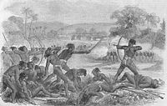
Santhal Rebellion

Slide 17
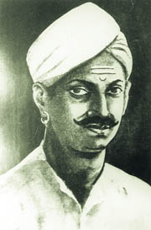
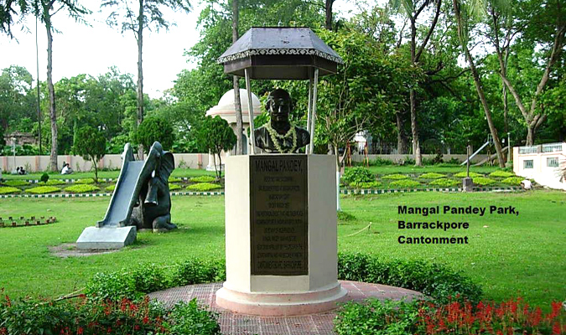

First War of Independence, 1857
Enfield Rifle

Slide 18
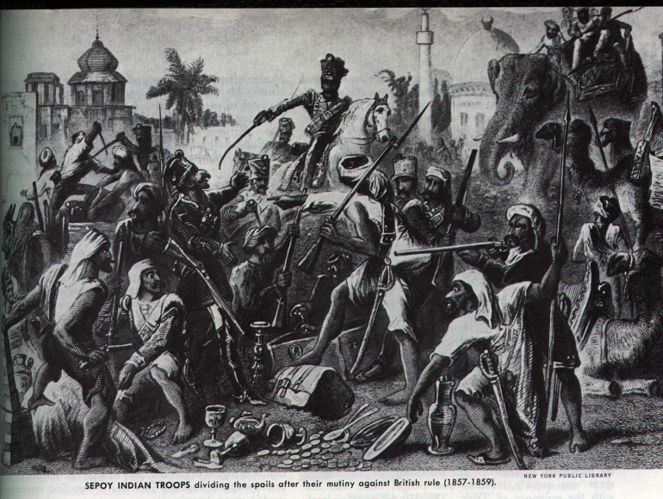
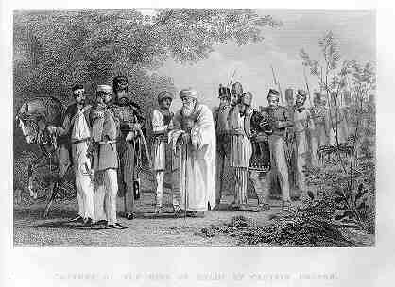
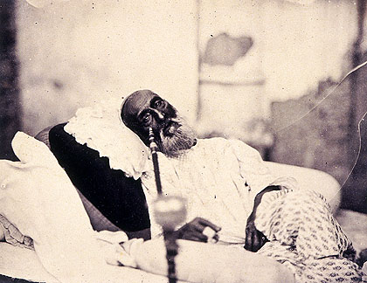
First War of Independence, 1857
Capture of Bahadur Shah Zafar and his sons by William Hodson at Humayun's tomb on 20 September 1857
Bahadur Shah Zafar in 1858, just after his trial in Delhi and before his departure for exile in Rangoon. This is possibly the only photograph ever taken of a Mughal emperor.

Slide 19
Suggested Readings
Bose, Sugata, and Ayesha Jalal, Modern South Asia: History, Culture and Political Economy (New York and London: Routledge, 2004)
Schendel, Willem Van, A History of Bangladesh (New York: Cambridge University Press, 2009)
Sarkar, Sumit, Modern India: 1885-1947 (New Delhi: Pearson, 2014)
Ahmed, A. F. Salahuddin, “Religious and Social Reform Movements in the Nineteenth Century”, in Ahmed, A. F. Salahuddin and Chowdhury, BazlulMobin (Ed.), Bangladesh, National Culture, and Heritage: An Introductory Reader (Dhaka: Independent University Bangladesh, 2004),
Banerjee, Ishita, A History of Modern India ((New York: Cambridge University Press, 2014)
Chopra, P. N.et al., A Comprehensive History of Modern India (New Delhi: Sterling Publishers Private Limited, 2003),
Nitish Sengupta, Land of Two Rivers, (India:Penguin Books, 2011)

Slide 20
Topic for the next class
Class 4
British India 1858- 1911

