Slide 1
Emergence of Bangladesh Course
Lecture 1
BENGAL FROM THE SEVENTH CENTURY TO THE EVE OF PLASSEY
DR. TAHSEEN ALI,PHD
COURSE INSTRUCTOR

Slide 2
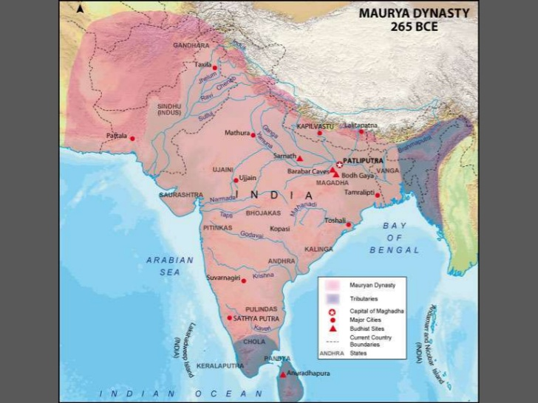

Slide 3
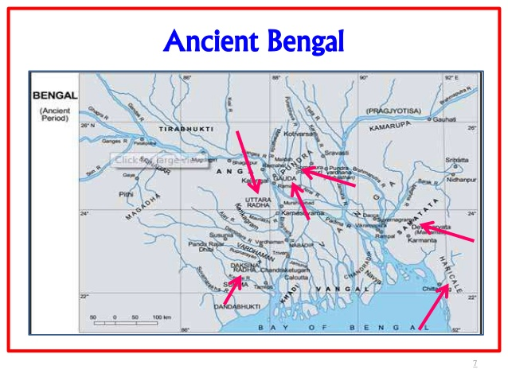

Slide 4
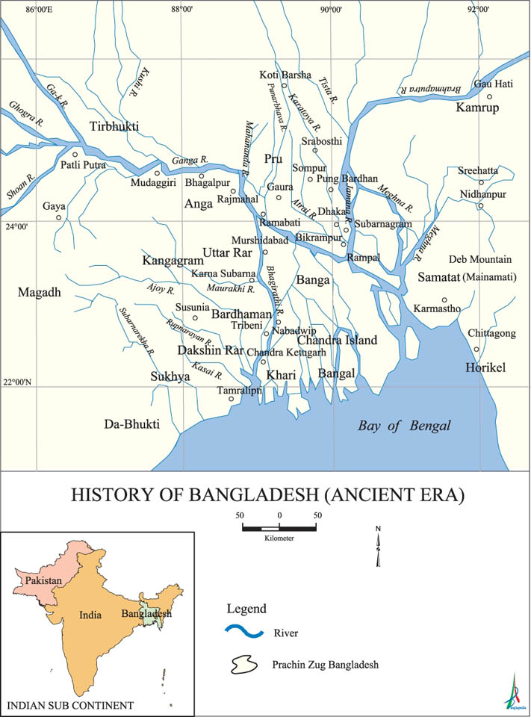

Slide 5
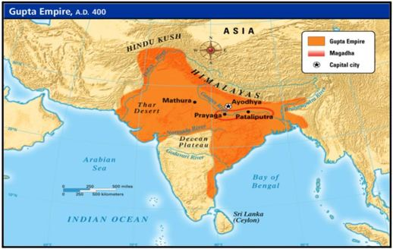

Slide 6
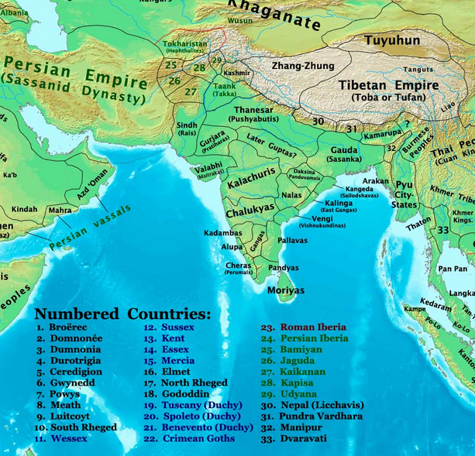

Slide 7
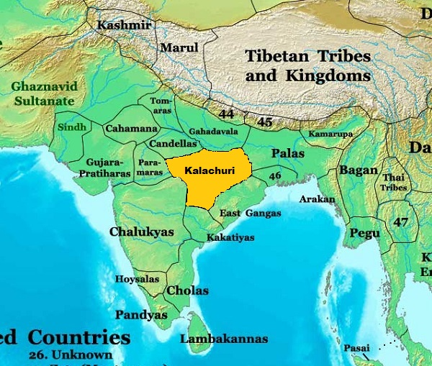

Slide 8
Part I: 606 – 1206 CE
THE SITUATION IN THE SUBCONTINENT AFTER THE COLLAPSE OF THE GUPTA DYNASTY
WHO WAS SHASHANKA?
THE EARLY CONTOURS OF POLITICAL AND GEOGRAPHIC BENGAL
THE AGE OF THE PALA DYNASTY
THE SEN OF BENGAL
THE ESTABLISHMENT OF THE DELHI SULTANATES

Slide 9
Part II: 1206 – 1584/86 CE
THE ARRIVAL OF ISLAM IN BENGAL
QUASI AND INDEPENDENT BENGAL ‘SULTANATES’
SUFIISM AND THE TRANSFORMATION OF THE RELIGIOUS LANDSCAPE IN BENGAL
THE GRADUAL EVOLUTION OF BENGALI FROM ELITE SANSKRIT
THE TRANSLATIONS OF THE GREAT EPICS
THE IMPACT OF VAISHNAVISM ON THE CULTURAL, LINGUISTIC AND RELIGIOUS LANDSCAPE OF BENGAL
THE AGE OF HOSSAIN SHAH

Slide 10
Part II: 1206 – 1584/86 CE
THE DISINTEGRATION OF THE BENGAL SULTANATES AFTER 1538 CE
THE ARRIVAL OF BABUR IN DELHI, THE SHER SHAH MUGHAL INTERREGNUM AND THE SITUATION IN BENGAL
AKBAR AND THE DEFEAT, CONSOLIDATION AND ABSORPTION OF BENGAL INTO MUGHAL INDIA

Slide 11
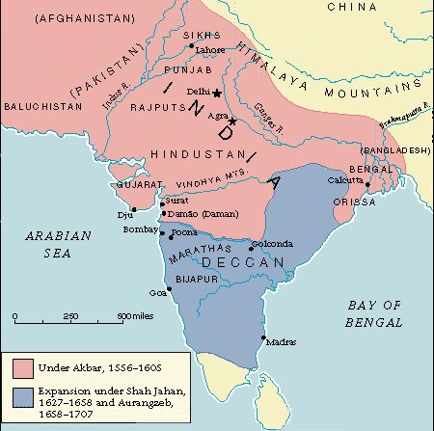

Slide 12
Part III: 1526-1707 CE
BABUR, HEIR TO TAMERLANE
1526 A.D.: DEFEATS THE HOUSE OF LODI, THE LAST OF THE DELHI SULTANATES AT PANIPAT
ESTABLISHES THE MUGHAL DYNASTY IN THE INDIAN SUBCONTINENT
WANTS TO MAKE A HOME IN THE INDIAN SUBCONTINENT
TENSIONS WITH HIS NOBLES (‘AMIRS’) WHO WANT TO RETURN HOME
TURNS TO LOCAL HINDU AND MUSLIM NOBILITY TO RULE

Slide 13
Part III: 1526-1707 CE
EMPEROR AKBAR:
CONSIDERED ONE OF THE TWO GREATEST RULERS IN SOUTH ASIAN HISTORY
TOUCHED ON EVERY ASPECT OF GOVERNANCE
PATRON OF ARTS, CULTURE AND LEARNING
PLURALISM AND SECULARISM
HINDUS, JAINS, SHIA MUSLIMS CHRISTIANS AND OTHER RELIGIOUS GROUPS ARE PROTECTED AND FREELY PARTICIPATE IN MUGHAL LIFE

Slide 14
Part III: 1526-1707 CE
EMPEROR AKBAR:
CONSIDERED ONE OF THE TWO GREATEST RULERS IN SOUTH ASIAN HISTORY
TOUCHED ON EVERY ASPECT OF GOVERNANCE
PATRON OF ARTS, CULTURE AND LEARNING
PLURALISM AND SECULARISM
HINDUS, JAINS, SHIA MUSLIMS CHRISTIANS AND OTHER RELIGIOUS GROUPS ARE PROTECTED AND FREELY PARTICIPATE IN MUGHAL LIFE

Slide 15
Part III: 1526-1707 CE
THE RULERS OF BENGAL REFUSE TO ACCEPT MUGHAL SUPREMACY
BENGALI HINDUS AND BENGALI MUSLIMS JOIN TOGETHER TO RESIST THE MUGHALS
THE ENTIRE REGION OF BENGAL DOES NOT COME UNDER COMPLETE MUGHAL CONTROL UNTIL 1584/86 AD

Slide 16
Part III: 1526-1707 CE
IN TIME, ECONOMIC POLICIES OF MUGHAL EMPIRE TURNS BENGAL INTO ONE OF ITS WEALTHIEST PROVINCES
MUGHAL INDIA IS WEALTHIER AND MORE PROSPEROUS THAN CONTEMPORARY EUROPEAN STATES INCLUDING BOURBON FRANCE
ON PAR OR HIGHER THAN CONTEMPORARY SAFAVID AND OTTOMAN EMPIRES

Slide 17
Part IV: 1710-1757 CE
MUGHAL INDIA IS AT ITS HEIGHT BY 1689 A.D.
YET BY DOING SO AURANGZEB HAS SPENT FAR TOO MUCH STRENGTH AND MONEY
IRONICALLY, HAS WEAKENED THE CENTRAL SYSTEM
DIES AN EXHAUSTED MAN IN 1707 A.D.
HIS HEIRS BEGIN TO FIGHT AMONGST THEMSELVES FOR THE SUCCESSION
AUTHORITY COLLAPSES RAPIDLY

Slide 18
Part IV: 1710-1757 CE
1707 A.D.: EMPEROR AURANGZEB PASSES AWAY IN DELHI
CENTRAL RULE; WHICH HAD NEVER BEEN STRONGER THAN DURING AURANGZEB’S RULE, NOW SUDDENLY COLLAPSES
AURANGZEB’S HEIRS FIGHT FOR THE SUCCESSION
AS SECURITY FOR THE EUROPEAN TRADING COMPANIES FROM THE MUGHAL ARMIES EVAPORATES; THE EUROPEANS TAKE A FATEFUL STEP

Slide 19
Part IV: 1710-1757 CE
“SIPAHI” = “SOLDIER” = “SEPOY”
MERCENARY TROOPS
EUROPEANS CREATE SMALL, TRAINED & PAID CORPS OF SUBCONTINENTAL MERCENARIES TO PROTECT THEIR ECONOMIC ASSETS
HOWEVER, INCREASINGLY THEY USE THESE MERCENARIES TO INTERFERE IN THE INTERNAL AFFAIRS OF THE SUBCONTINENTAL KINGDOMS AND PRINCIPALITIES WHICH EMERGE/REMERGE AFTER THE COLLAPSE OF CENTRAL RULE

Slide 20
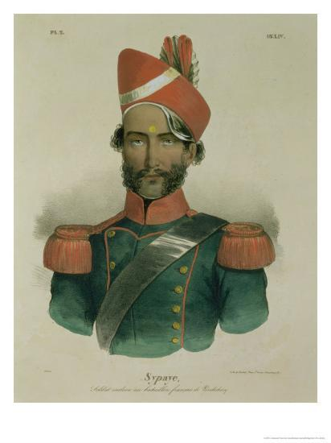

Slide 21
Part IV: 1710-1757 CE
1710 A.D.: MURSHID QULI KHAN BECOMES CHIEF FINANCIAL ADMINISTRATOR OF BENGAL
CAPABLE
COMPLETELY REORGANIZES SYSTEM OF GOVERNANCE
BRINGS IN HINDU MERCHANTS AND OFFICIALS TO RUN THE ADMINISTRATION
FLOURISHING OF TRADE; INCLUDING WITH EUROPEANS

Slide 22
Part IV: 1710-1757 CE
1717 A.D.: QUIETLY BREAKS AWAY FROM MUGHAL RULE, RE-ESTABLISHING AN INDEPENDENT BENGAL
CAPITAL AT MURSHIDABAD
BIHAR AND ODISHA ALSO PART OF KINGDOM
BENGAL IS ONE OF THE RICHEST KINGDOMS IN THE INDIAN SUBCONTINENT
1717 A.D.: EMPEROR FARUKHSIYAR GRANTS A ROYAL FIRMAN OR “LICENSE” TO THE BRITISH TO TRADE WITH BENGAL
PROBLEM: ONLY APPLIES TO COMPANY GOODS AND NOT OF INDIVIDUAL OFFICIALS

Slide 23
Part IV: 1710-1757 CE
BENGAL REVENUE OFFICIALS FREQUENTLY CLASH WITH BRITISH OFFICERS OF THE EAST INDIA COMPANY
AN ISSUE THAT WILL RETURN IN 1756
MURSHID QULI KHAN DIES IN 1727 A.D.
NEXT TWO NAWABS:
1727 A.D. – 1737 A.D.:SHUJA-UD-DIN
1737 A.D. – 1740 A.D..:SARFRAZ KHAN

Slide 24
Part IV: 1710-1757 CE
BENGAL REVENUE OFFICIALS FREQUENTLY CLASH WITH BRITISH OFFICERS OF THE EAST INDIA COMPANY
AN ISSUE THAT WILL RETURN IN 1756
MURSHID QULI KHAN DIES IN 1727 A.D.
NEXT TWO NAWABS:
1727 A.D. – 1737 A.D.:SHUJA-UD-DIN
1737 A.D. – 1740 A.D..:SARFRAZ KHAN

Slide 25
Part IV: 1710-1757 CE
IN 1740 A.D. ALIVARDI KHAN, ADVISER TO SHUJA-UD-DIN, IS FALSELY ACCUSED BY COURT FACTIONS OF TREASON
TAKES TO THE BATTLEFIELD AGAINST SARFRAZ KHAN
SARFRAZ IS KILLED
ALIVARDI KHAN NOW BECOMES NAWAB OF BENGAL
VETERAN ADMINISTRATOR & EXPERIENCED MILITARY COMMANDER

Slide 26
Part IV: 1710-1757 CE
SIXTEEN-YEAR REIGN
MARRED BY ATTACKS FROM NEIGHBORING MARATHA KINGDOMS (E.G. NAGPUR)
MARATHAS CARRY OUT 10-YEAR REIGN OF TERROR AGAINST BENGAL
1742 A.D. & 1745 A.D. MARATHA RAIDING PARTIES REACH MURSHIDABAD
1751 A.D.: BENGAL PAYS HUGE INDEMNITY BUT MARATHA RULER OF POONA RENOUNCES TREATY

Slide 27
Part IV: 1710-1757 CE
DESPITE FINANCIAL LOSSES BENGAL CONTINUES TO THRIVE
EUROPEAN TRADE IS LUCRATIVE
ALIVARDI IS VERY SHREWD DIPLOMAT
DOES NOT WANT TO GET INVOLVED IN EUROPEAN CONFLICTS
HIS ONLY CONDITION IS THAT BRITISH AND FRENCH MUST NOT MILITARILY FORTIFY THEIR TRADING BASES

Slide 28
Part IV: 1710-1757 CE
1756 A.D.: ALIVARDI PASSES AWAY OF NATURAL CAUSES AT EIGHTY-FOUR YEARS OF AGE
HIS FAVOURITE GRANDSON BECOMES NAWAB WITHOUT ANY PROBLEMS; UNUSUAL FOR THIS TIME IN THE SUBCONTINENT
THE SEVEN YEARS’ WAR (1756 – 1763) IS ABOUT TO START IN EUROPE BETWEEN BRITISH AND FRENCH EMPIRES
FIRST ‘WORLDWIDE WAR’ IN WHICH THE BRITISH AND FRENCH FIGHT EACH OTHER IN THE AMERICAS, AFRICA AND ASIA

Slide 29
Part V: 1460 – 1763 CE
THE WORLD BEFORE 1500 CE
A VIBRANT EXCHANGE OF CULTURE, IDEAS AND COMMODITIES BETWEEN INDEPENDENT ‘SUB-SYSTEMS’ RANGING FROM EUROPE, THE MEDITERRANEAN, THE AFRICAN CONTINENT, AND WEST, SOUTH, SOUTHEAST AND EAST ASIA
THE EUROPEAN POWERS AND THE CONQUEST OF THE AMERICAS, WEST AFRICA AND INCURSIONS INTO ASIA AND THE BEGINNING OF THE DESTRUCTION OF THE SUB-SYSTEMS

Slide 30
Part V: 1460 – 1763 CE
AFRICAN AND ASIAN PRODUCTS: GOLD, DIAMONDS, SPICES, PERFUMES, SUGAR ARE IN HIGH DEMAND
EUROPE IS CONCERNED ABOUT ‘DRAIN’ OF GOLD AND SILVER TO AFRICA AND ASIA TO PAY FOR THESE ITEMS
SEEKING WAYS TO REACH ASIA DIRECTLY WITHOUT GOING THROUGH MIDDLEMEN TO TRADE
1492: BEGINNING OF EUROPEAN CONQUEST OF THE AMERICAS

Slide 31
Part V: 1460 – 1763 CE
15TH CENTURY: EUROPEAN POWERS LED BY PORTUGAL BEGIN TO CONQUER AND COLONIZE AFRICA
GENOCIDE AGAINST PEOPLES OF THE AMERICAS LEADS TO DEMAND FOR FORCED LABOR
BEGINNING OF THE SLAVE TRADE
PORTUGUESE ARRIVE IN SUBCONTINENT AFTER DESTROYING EAST AFRICAN PRINCIPALITIES AND CITY-STATES
SUB-SYSTEMS ARE GRADUALLY BEING DESTROYED

Slide 32
Part V: 1460 – 1763 CE
SINCE 1500 WORLD HAS BEEN DIVIDED INTO THREE “SYSTEMS”
THE CAPITALIST WORLD-SYSTEM (WORLD ECONOMY)
EXTERNAL WORLDS (MERCANTILIST EMPIRES)
MINI-SYSTEMS/SUB-SYSTEMS/ SUBSISTENCE COMMUNITIES
SINCE 1500 THE ADVANCE OF THE WORLD ECONOMY HAS BEEN AT THE EXPENSE OF THE OTHER TWO

Slide 33
Part V: 1460 – 1763 CE
BY THE MID-EIGHTEENTH CENTURY, THE FRENCH AND BRITISH EMPIRES ARE FIGHTING FOR SUPREMACY AT THE ‘CENTRE’ OF THE WORLD-SYSTEM
MAY 1756: THE BRITISH EMPIRE DECLARES WAR ON THE FRENCH EMPIRE
THE WAR WILL BE FOUGHT ACROSS THE GLOBE AND TO THE DEATH
IN BENGAL AND THE SUBCONTINENT, BRITISH VIOLATIONS OF STANDING AGREEMENTS WITH BENGAL NOW LEAD TO OPEN CONFLICT WITH THE NAWAB, SIRAJ-UD-DAULAH

