Slide 2
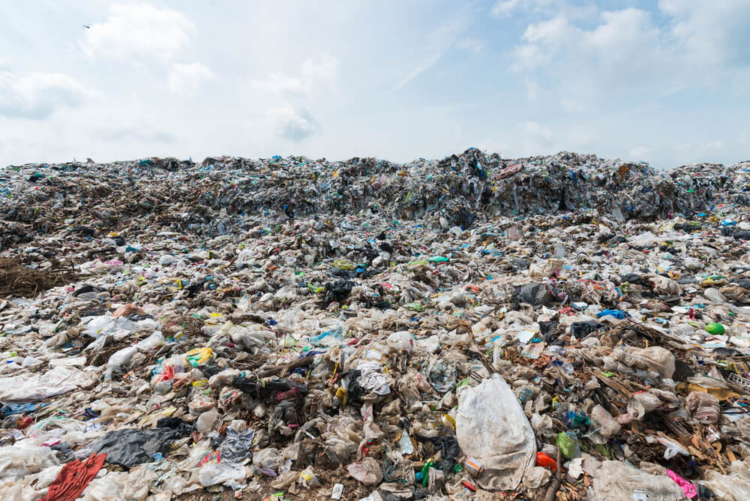
Source: WWF-Australia

Slide 3
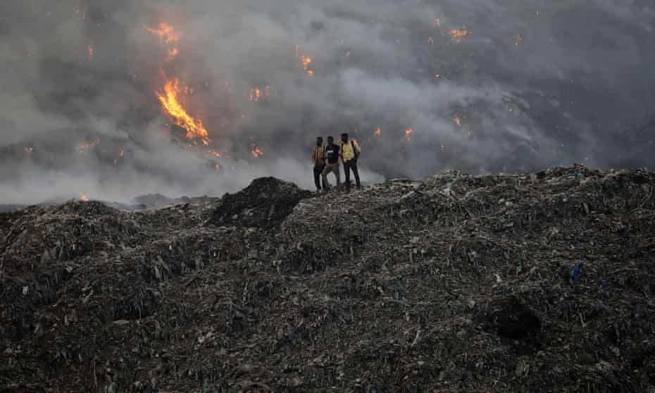
Source: theguardian.com

Slide 4
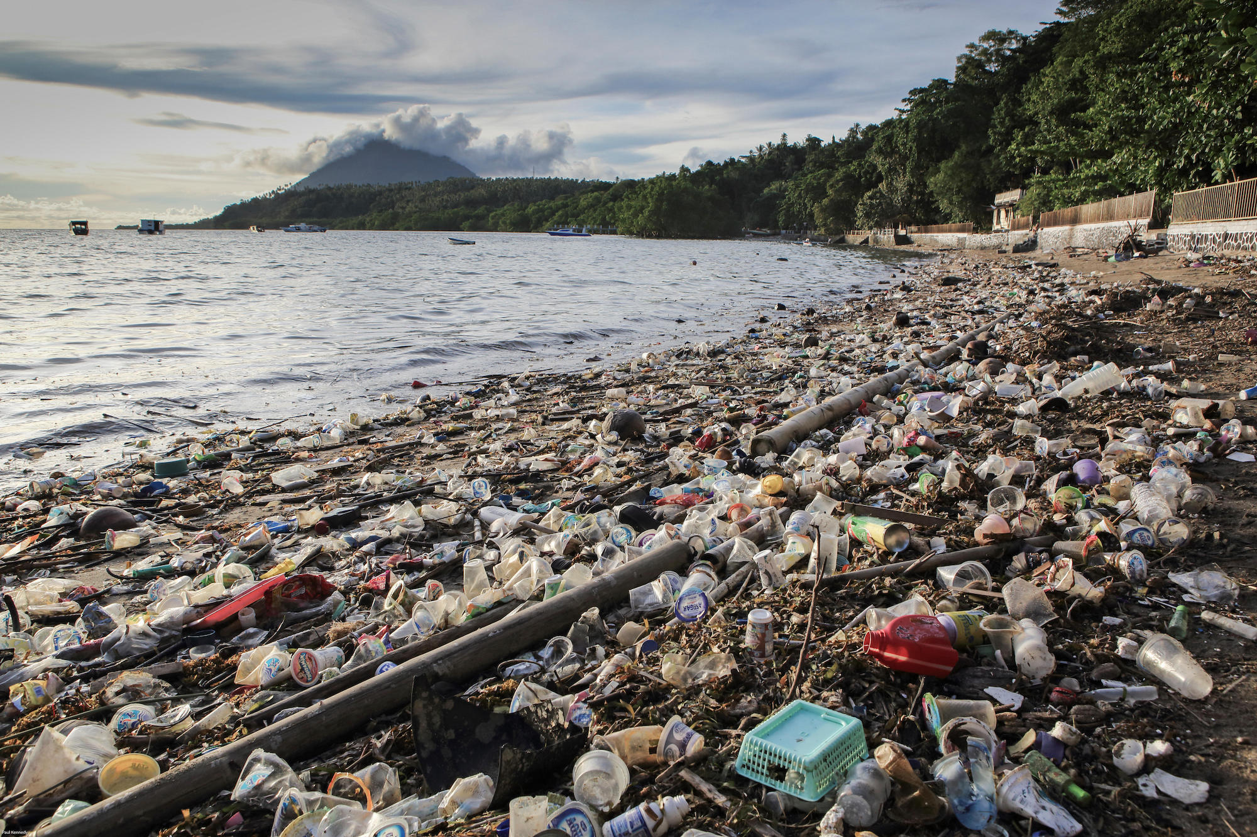
Source: chinadialogueocean.net

Slide 5
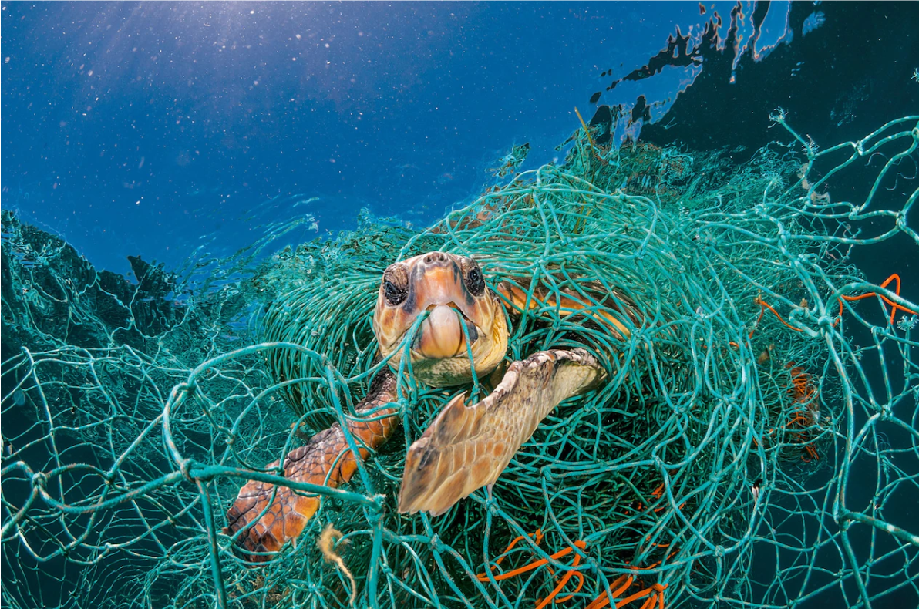
Source: nationalgeographic.com

Slide 6
