Slide 1
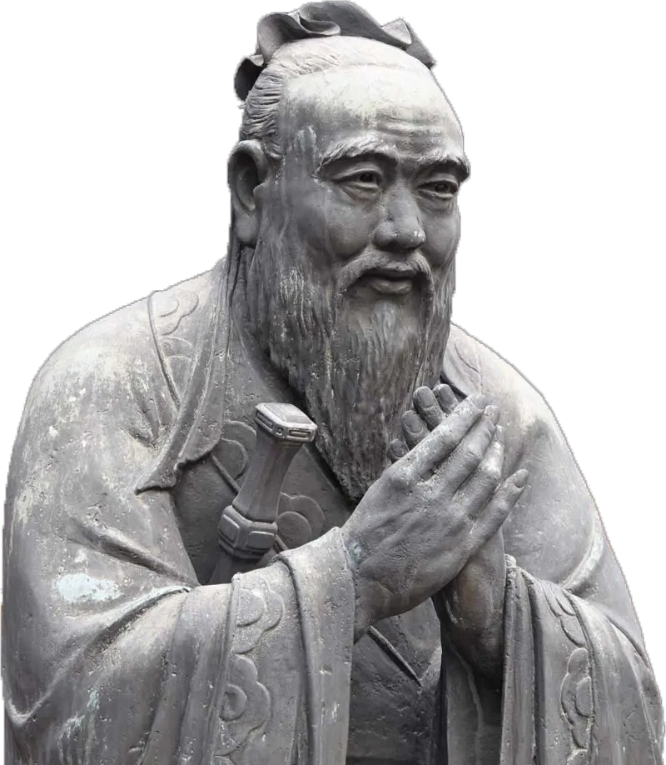
The Teachings of Confucius
HUM103
Instructor: Shaiya Binte Mahbub Nisa
Section-17
Presenters
Al Mahmud
Tasnim Rahman
Udoy Saha
Ulfat Fatema Elma

Slide 2
Confucius (551 479 Bce)
Founder of moral and political philosophy
Also known as master kong or Kong fuzi
Known as ru and student called ruists
Active in politics, music, poetry and most significantly ethics & philosophy
Lived in a time of chaos & corruption & trying to morally transform the rulers of different states
Followed him from state to state of 10 official position

Slide 3
What is Confucianism ?
emphasized personal and governmental morality, social relationship appropriateness
Part of Chinese social fabric & way of life
Religious arena that expanded across asia
Despite the fact that numerous books have been written
Students got together to compile his thoughts into remarkable collection
‘analects’ published in late 140 bce

Slide 4
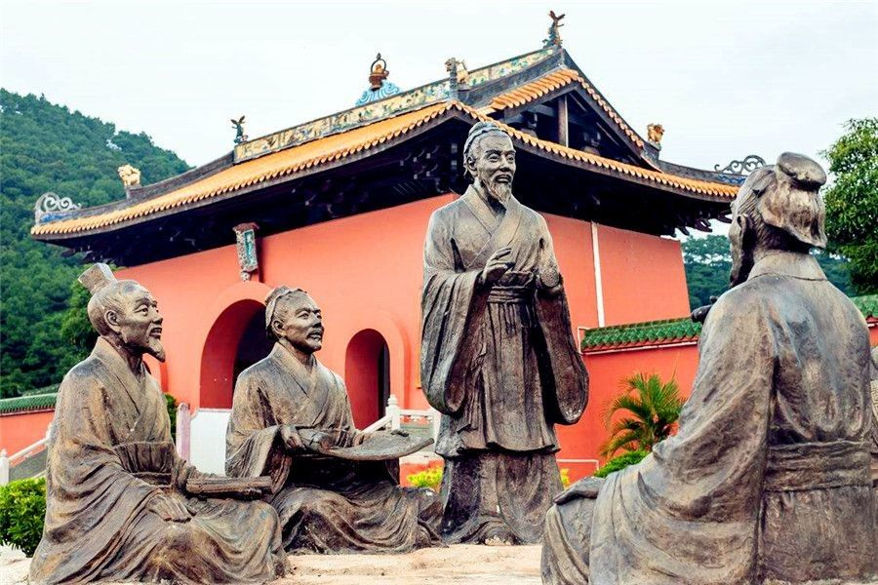
Confucianism
Chinese belief system
Personal ethics and morality
Hundred Schools of thought
Religion or Philosophy
Great impact on East Asian culture

Slide 5
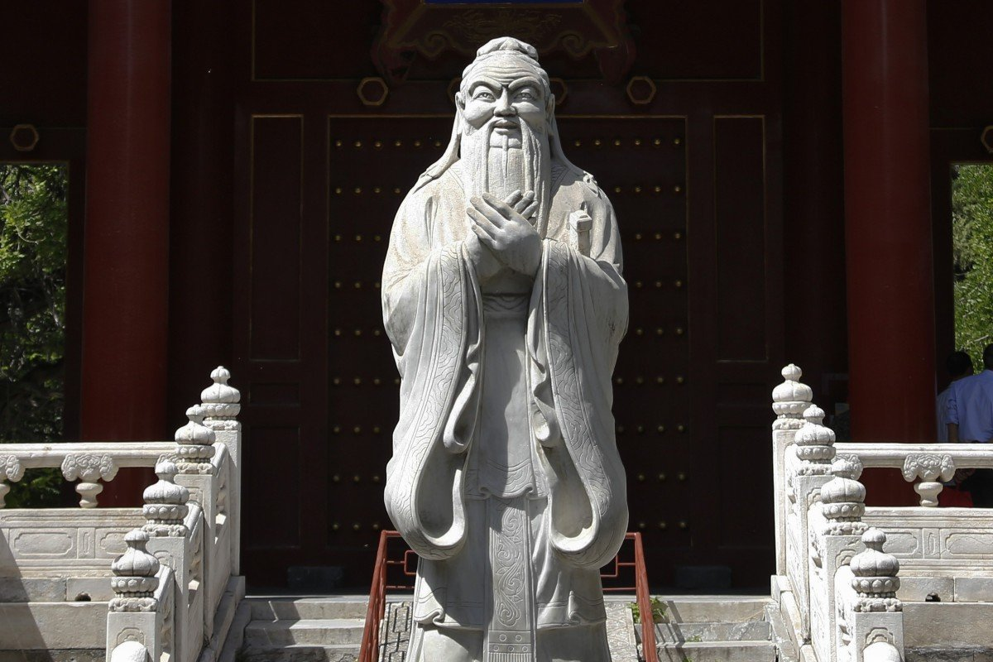
Dimensions of Confucianism
Virtue Ethics
Dao ➝ The way of life → Helping others
De ➝ Virtue ➝ Kindness
5 Ethical Virtues
Yi or Righteousness
Li or Propriety
Ren or Benevolence
Zhi or Wisdom
Xin or Fidelity

Slide 6
The teaching of confucius
Main goal ⇒ “Chun Tzu”
Superior person or ideal person

Slide 7
Junzi ⇒ The exemplary person
Central concept of virtue ethics
Yi ⇒ Decision ➝ Knowledge of right and Wrong
Li ⇒ Good action ➝ Ritual (Tradition / Habit)
Ren ⇒ Humaneness ➝ Social communal-helping
others to be good.
Mutual understanding

Slide 8
The Golden rule of Confucianism
“Do not do unto others
What you do not wish
To be done to yourself”
Confucius

Slide 9
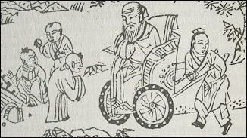
The Confucius ideals
Yi
The knowledge of right and wrong
Li
Ritual of good actions
Ren
A good character
Helping the community

Slide 10

Dao
The way of life
de
good virtue
Junzi
The highest stage
Exemplary person
Confucius ethics
Not only theoretical, but also practical

Slide 11
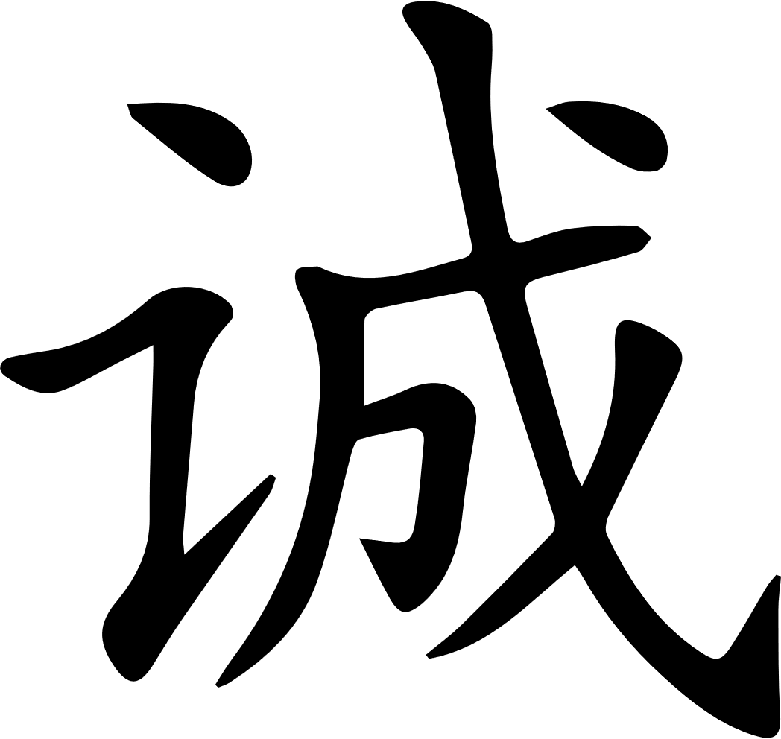

A story from confucius

Slide 12
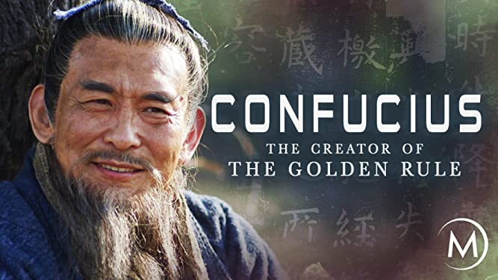
Exploring Confucian culture in the youth life
Dramas and movies
Educational policy

Slide 13
Quotes that still ring true today
The strength of a nation derives from the integrity of the home
It doesn’t matter how slowly you go as long as you do not stop
When anger arises, think about the consequences
We have two lives, and the second begins when we realize we only have one

Slide 14

Thank you

