Slide 1
Balancing a Tree

Slide 2
A Simple Balancing Algorithm
Convert tree to an array (or Vector or List)
Delete tree
Rebuild tree
Insert middle item of array
Rebuild left subtree (recursive call) with left sub array
Rebuild right subtree (recursive call) with right sub array
Delete array (or Vector or List)

Slide 3
balance()
The balance() routine will create a Vector of Cars, delete the tree and then rebuild it.
public void balance()
{
if (root != null)
{
Vector<Car> v_car = toVector();
root = null;
balance(v_car,0,v_car.size()-1);
}
}

Slide 4
toVector()
The toVector() routine will create a new Vector and then parse the tree “In Order” via a recursive routine to add each Car to the Vector.
public Vector<Car> toVector()
{
Vector<Car> vector = new Vector<Car>();
toVector(root,vector);
return vector;
}

Slide 5
toVector(node,vector)
The toVector(node,vector) routine will add the left nodes, current node, and then right nodes.
This will be parsed in the “In Order” methodology.
private void toVector(CarBinaryTreeNode node, Vector<Car> vector)
{
if (node != null)
{
toVector(node.getLeft(),vector);
vector.add(node.getValue());
toVector(node.getRight(),vector);
}
}

Slide 6
balance(vector,start,end)
The balance(vector,start,end) routine will recursively .
In this case, we want to process the middle node, then process the left and right sub-arrays.
public void balance(Vector<Car> vector,int start, int end)
{
int middle = (start + end) / 2;
if (start == end)
{
insertNode(vector.get(middle));
}
else if (start < end)
{
insertNode(vector.get(middle));
balance(vector,start,middle-1);
balance(vector,middle+1,end);
}
}

Slide 7
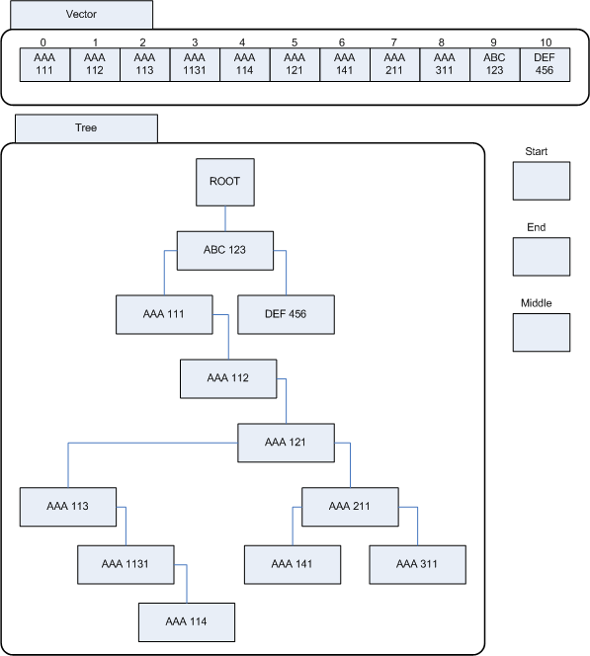
balance()
Step 1 Call toVector to create a list of Cars. This could have been an array or a vector, I chose to use the Vector class.

Slide 8
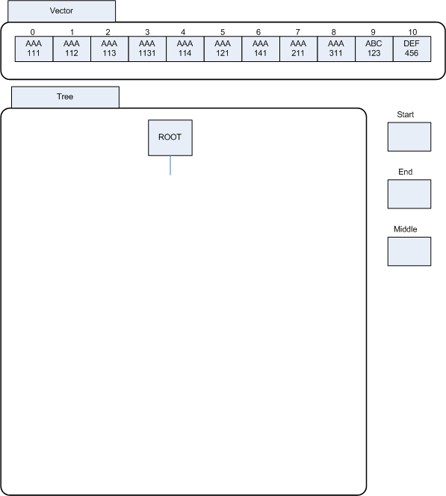
balance()
Step 1 Call toVector to create a list of Cars. This could have been an array or a vector, I chose to use the Vector class.
Step 2 Delete the tree.

Slide 9
balance()
Step 1 Call toVector to create a list of Cars. This could have been an array or a vector, I chose to use the Vector class.
Step 2 Delete the tree.
Step 3 Rebuild the tree.

Slide 10
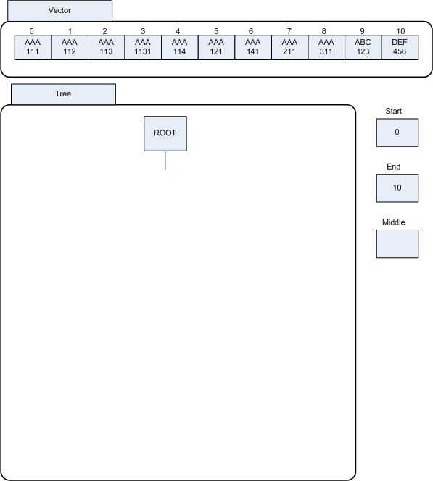
balance()
Step 1 Call toVector to create a list of Cars. This could have been an array or a vector, I chose to use the Vector class.
Step 2 Delete the tree.
Step 3 Rebuild the tree.
balance(vector,0,vector.size()-1)

Slide 11

balance()
Step 1 Call toVector to create a list of Cars. This could have been an array or a vector, I chose to use the Vector class.
Step 2 Delete the tree.
Step 3 Rebuild the tree.
balance(vector,0,vector.size()-1)
Middle=(start+end)/2

Slide 12
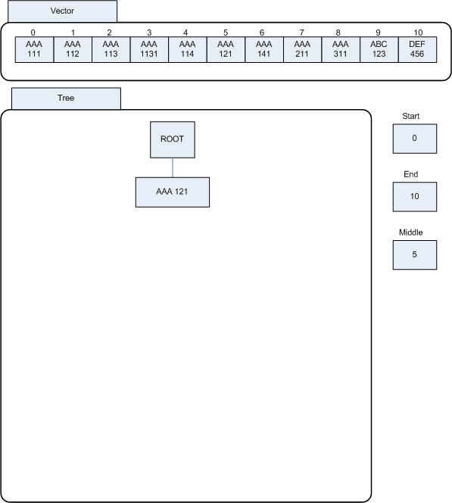
balance()
Step 1 Call toVector to create a list of Cars. This could have been an array or a vector, I chose to use the Vector class.
Step 2 Delete the tree.
Step 3 Rebuild the tree.
balance(vector,0,vector.size()-1)
middle=(start+end)/2
insertNode(vector.get(middle)

Slide 13
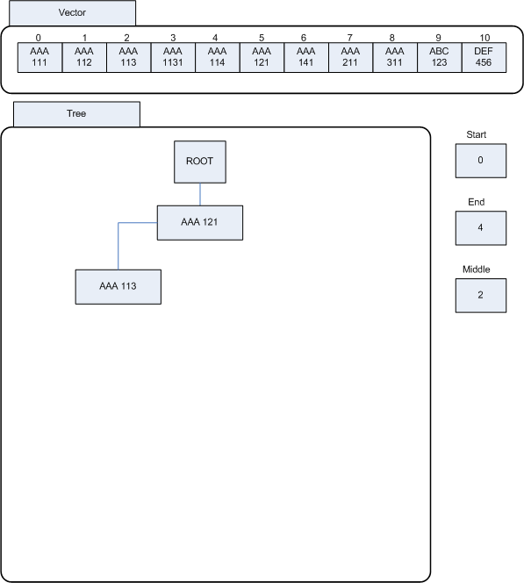
balance()
Step 1 Call toVector to create a list of Cars. This could have been an array or a vector, I chose to use the Vector class.
Step 2 Delete the tree.
Step 3 Rebuild the tree.
balance(vector,0,vector.size()-1)
middle=(start+end)/2
insertNode(vector.get(middle)
balance(vector,start,middle-1)
middle=(start+end)/2
insertNode(vector.get(middle)
balance(vector,start,middle-1)

Slide 14
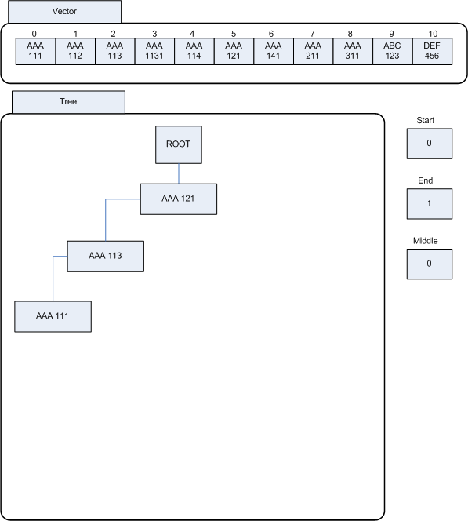
balance()
Step 1 Call toVector to create a list of Cars. This could have been an array or a vector, I chose to use the Vector class.
Step 2 Delete the tree.
Step 3 Rebuild the tree.
balance(vector,0,vector.size()-1)
middle=(start+end)/2
insertNode(vector.get(middle)
balance(vector,start,middle-1)
middle=(start+end)/2
insertNode(vector.get(middle)
balance(vector,start,middle-1)
middle=(start+end)/2
insertNode(vector.get(middle))
balance(vector,start,middle-1)

Slide 15
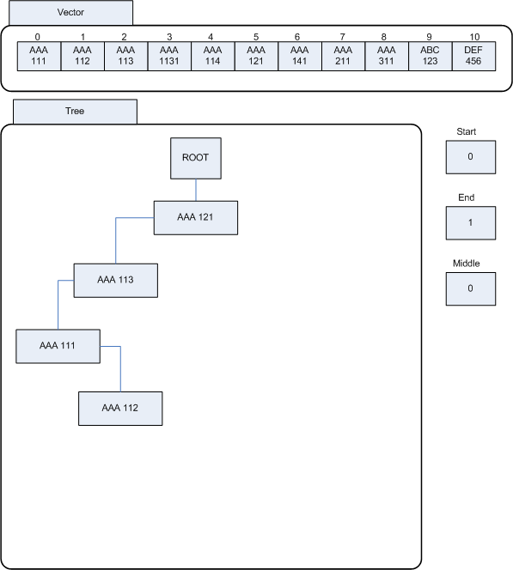
balance()
Step 1 Call toVector to create a list of Cars. This could have been an array or a vector, I chose to use the Vector class.
Step 2 Delete the tree.
Step 3 Rebuild the tree.
balance(vector,0,vector.size()-1)
middle=(start+end)/2
insertNode(vector.get(middle)
balance(vector,start,middle-1)
middle=(start+end)/2
insertNode(vector.get(middle)
balance(vector,start,middle-1)
middle=(start+end)/2
insertNode(vector.get(middle))
balance(vector,start,middle-1)

Slide 16
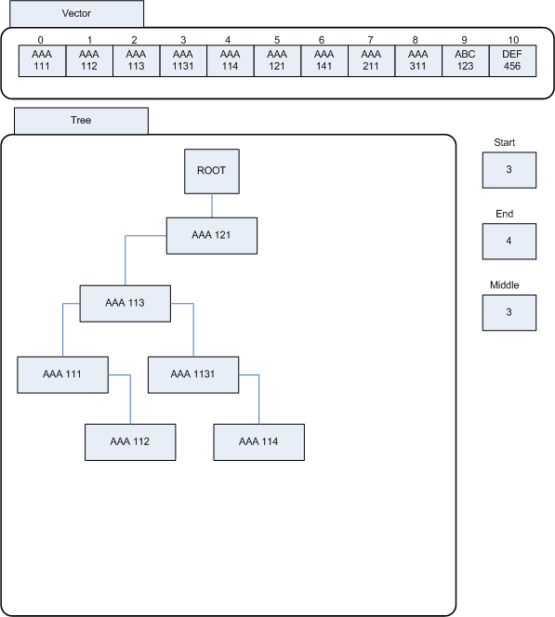
balance()
Step 1 Call toVector to create a list of Cars. This could have been an array or a vector, I chose to use the Vector class.
Step 2 Delete the tree.
Step 3 Rebuild the tree.
balance(vector,0,vector.size()-1)
middle=(start+end)/2
insertNode(vector.get(middle)
balance(vector,start,middle-1)
middle=(start+end)/2
insertNode(vector.get(middle)
balance(vector,start,middle-1)
middle=(start+end)/2
insertNode(vector.get(middle))
balance(vector,start,middle-1)
balance(vector,middle+1,end)
…

Slide 17
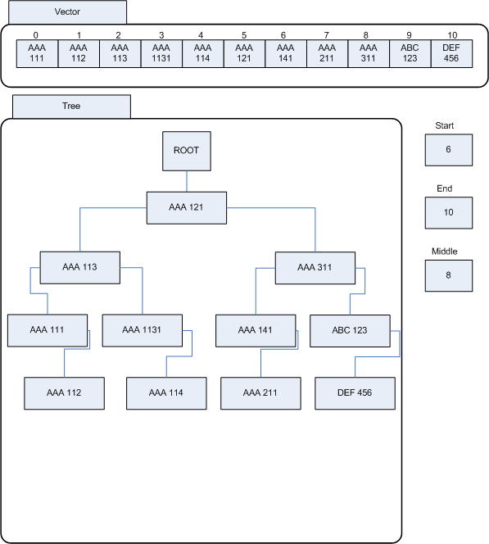
balance()
Step 1 Call toVector to create a list of Cars. This could have been an array or a vector, I chose to use the Vector class.
Step 2 Delete the tree.
Step 3 Rebuild the tree.
balance(vector,0,vector.size()-1)
middle=(start+end)/2
insertNode(vector.get(middle)
balance(vector,start,middle-1)
middle=(start+end)/2
insertNode(vector.get(middle)
balance(vector,start,middle-1)
middle=(start+end)/2
insertNode(vector.get(middle))
balance(vector,start,middle-1)
balance(vector,middle+1,end)
…
balance(vector,middle+1,end)
…

