Slide 1
Deleting a Tree Node

Slide 2
Defining Our Tree
Our tree consists of the following Cars inserted into the tree in order:
Car car1 = new Car("ABC 123","Geo","Metro",1997);
Car car2 = new Car("DEF 456","Chevy","Cruze",2011);
Car car3 = new Car("AAA 111","Ford","Mustang",1963);
Car car4 = new Car("AAA 112","Ford","Mustang",1963);
Car car5 = new Car("AAA 121","Ford","Mustang",1963);
Car car6 = new Car("AAA 211","Ford","Mustang",1963);
Car car7 = new Car("AAA 113","Ford","Mustang",1963);
Car car8 = new Car("AAA 1131","Ford","Mustang",1963);
Car car9 = new Car("AAA 311","Ford","Mustang",1963);
Car car10 = new Car("AAA 114","Ford","Mustang",1963);
Car car11 = new Car("AAA 141","Ford","Mustang",1963);

Slide 3
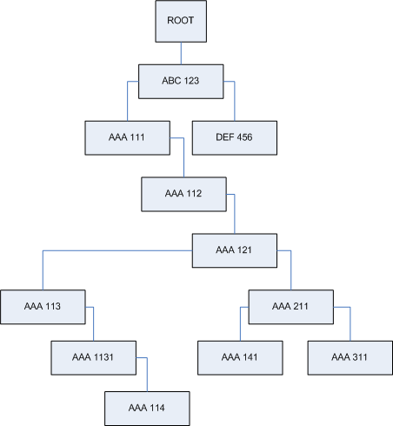
Parking Lot Tree
This is our tree

Slide 4
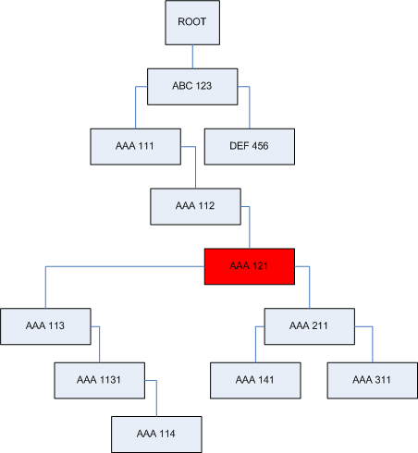
Parking Lot Tree
This is our tree
Choose a car to delete

Slide 5
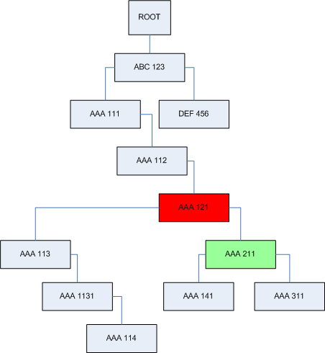
Parking Lot Tree
This is our tree
Choose a car to delete
Since we will advance the right subtree (no other reason than we needed to pick either the right or left)
On the right subtree, find the left most node.

Slide 6
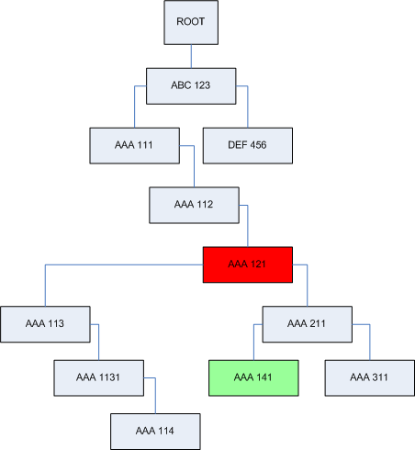
Parking Lot Tree
This is our tree
Choose a car to delete
On the right subtree, find the left most node.

Slide 7

Parking Lot Tree
This is our tree
Choose a car to delete
On the right subtree, find the left most node.
Point the right subtree’s left most node’s left pointer to the deleteNode’s left node.

Slide 8

Parking Lot Tree
This is our tree
Choose a car to delete
On the right subtree, find the left most node.
Point the right subtree’s left most node’s left pointer to the deleteNode’s left node.
Point the deleteNode’s Parent to the deleteNode’s right subtree.
At this point, remove the deleteNode.

Slide 9
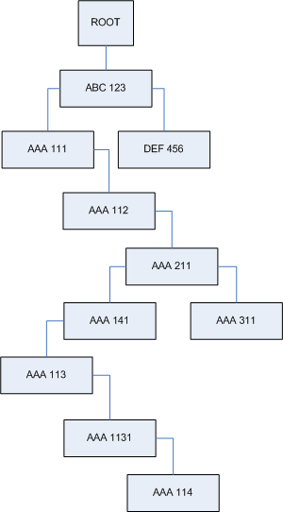
Parking Lot Tree
This is our tree
Choose a car to delete
On the right subtree, find the left most node.
Point the right subtree’s left most node’s left pointer to the deleteNode’s left node.
Point the deleteNode’s Parent to the deleteNode’s right subtree.
At this point, remove the deleteNode.
Final Tree

