Slide 1



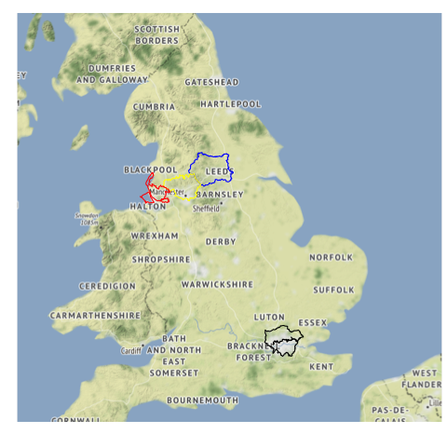




OpenInfra
Urban Analytics
Intern: Greta Timaite
Supervisors: Dr Robin Lovelace, Dr Victoria Houlden, Prof Ed Manley
Notes:
Hi everyone.
For the last 6 months I’ve been working OpenInfra project aims to explore how OpenStreetMap (OSM) can be used to understand, prioritise, and design active travel infrastructure. A particular focus is also paid to accessibility and accessible pedestrian infrastructure. Up to know I’ve focused on 4 metropolitan areas: West Yorkshire, Greater Manchester, Merseyside, and Greater London. The main takeaway or insight is that OSM can provide a comprehensive overview of active travel network but if you want to dive deeper and find out about the infrastructure at a more granular level, the data becomes more and more sparse. In other words, a more specific an attribute is, the less data there is. This gets problematic for planning accessible infrastructure because there every detail matters.
As part of the project I’ve developed skills in geocomputation with R and RStudio, GitHub workflow, also teeny-tiny bit of SQL querying. Besides that I’d say that I improved my communication skills, both oral and written, which helped me to improve my collaboration skills with both research and policy communities.

