Slide 1
FAST MOVEMENT

Slide 2
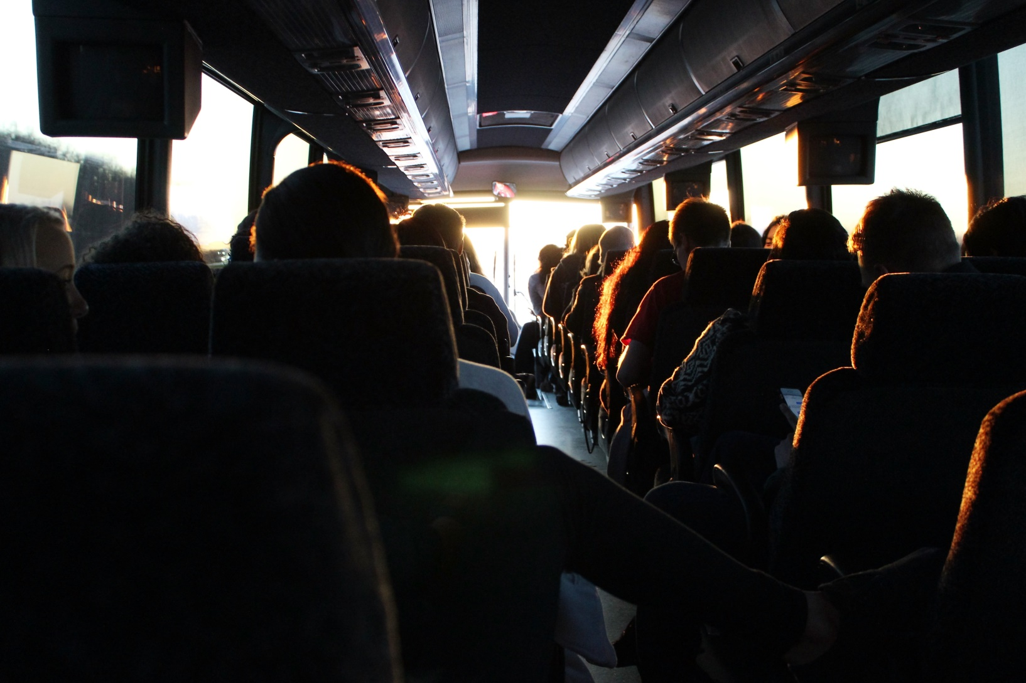
Transport of your choice

Slide 3
Your choice is all that matters
Fast movement simplifies your journeys by providing you with different buses going to different regions at any day and time.
All you need to do is register, make your choices and enjoy your journeys.

Slide 4
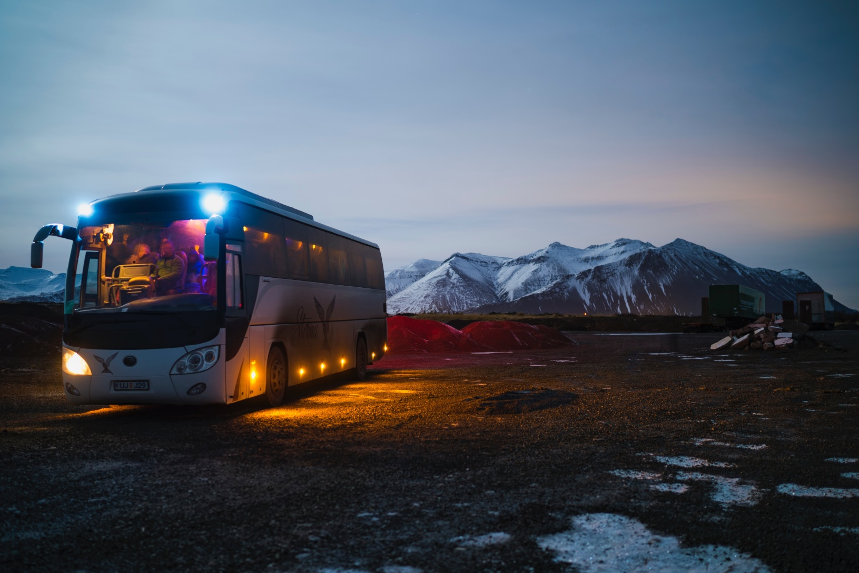
Enjoy your ride

