Slide 1
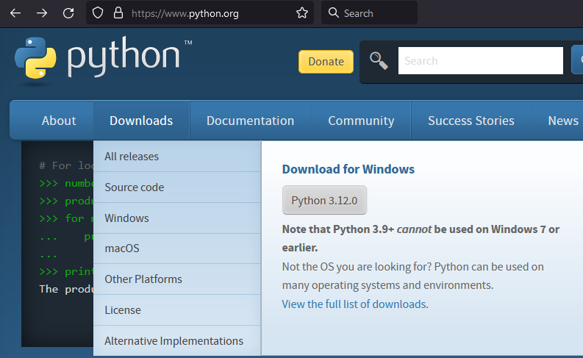
check url
download

Slide 2
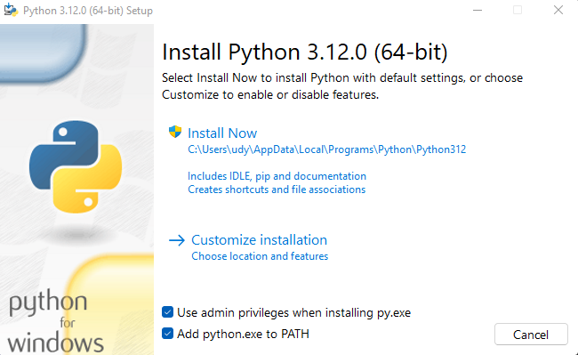
install
keep checked

Slide 3
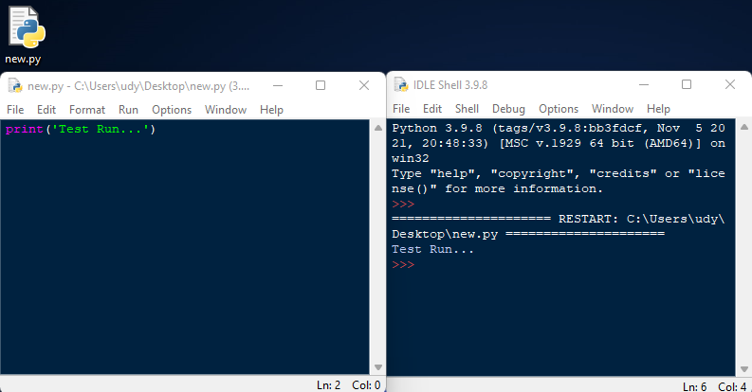
.py code file
type your code here,
press F5 to run
after running the code,
results are displayed here

Slide 4
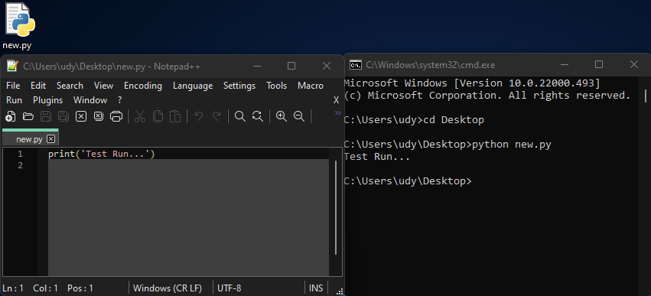
.py code file
type your code here,
save before running
after saving the code,
run the code here

Slide 5
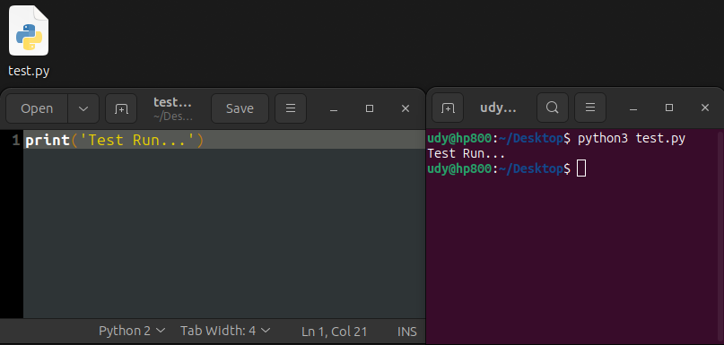
.py code file
type your code here,
save before running
after saving the code,
run the code here

Slide 6
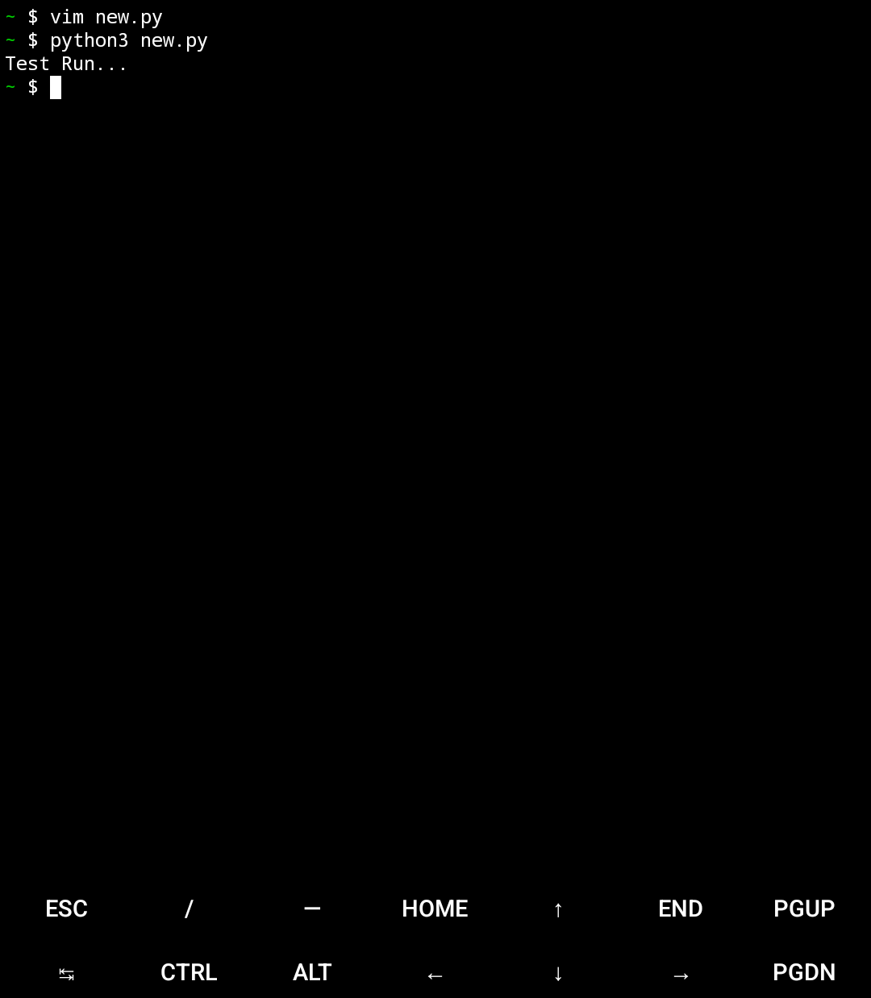
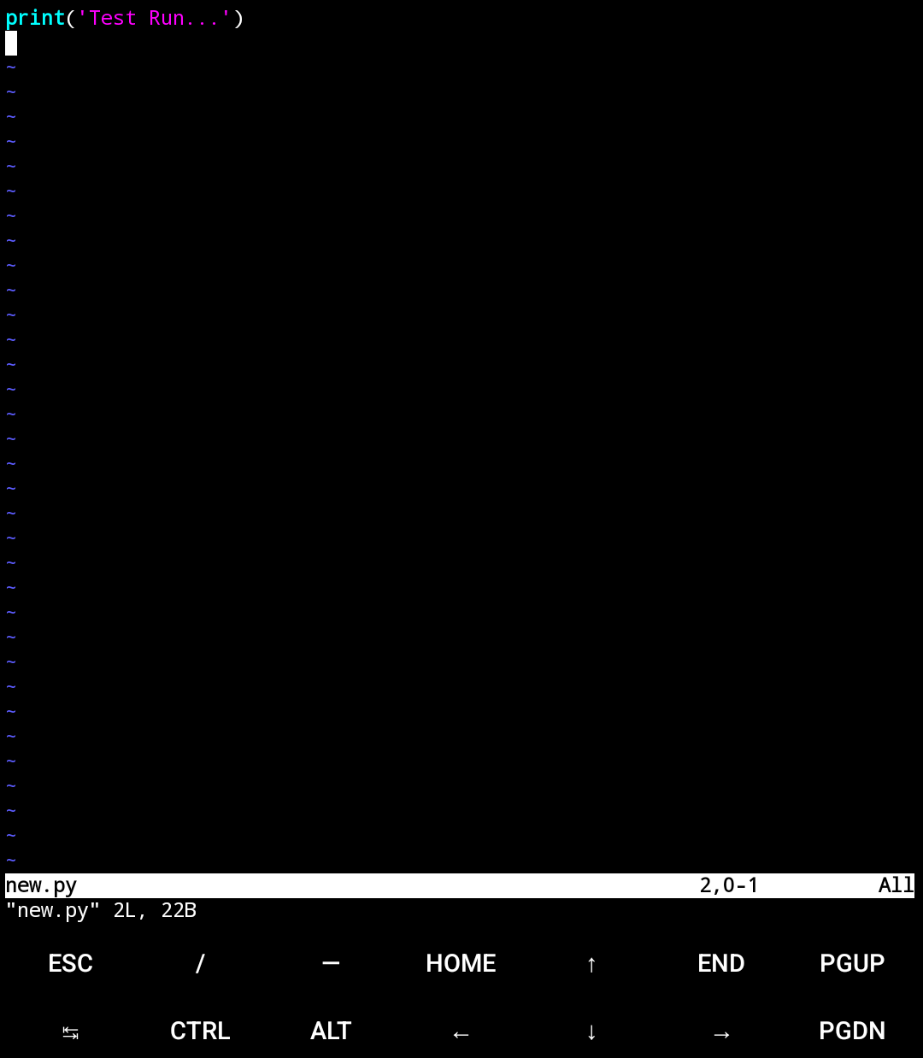
vim will open
this window
this is vim editor.
type your code here,
save before exiting
after saving the code,
run the code here

Slide 7
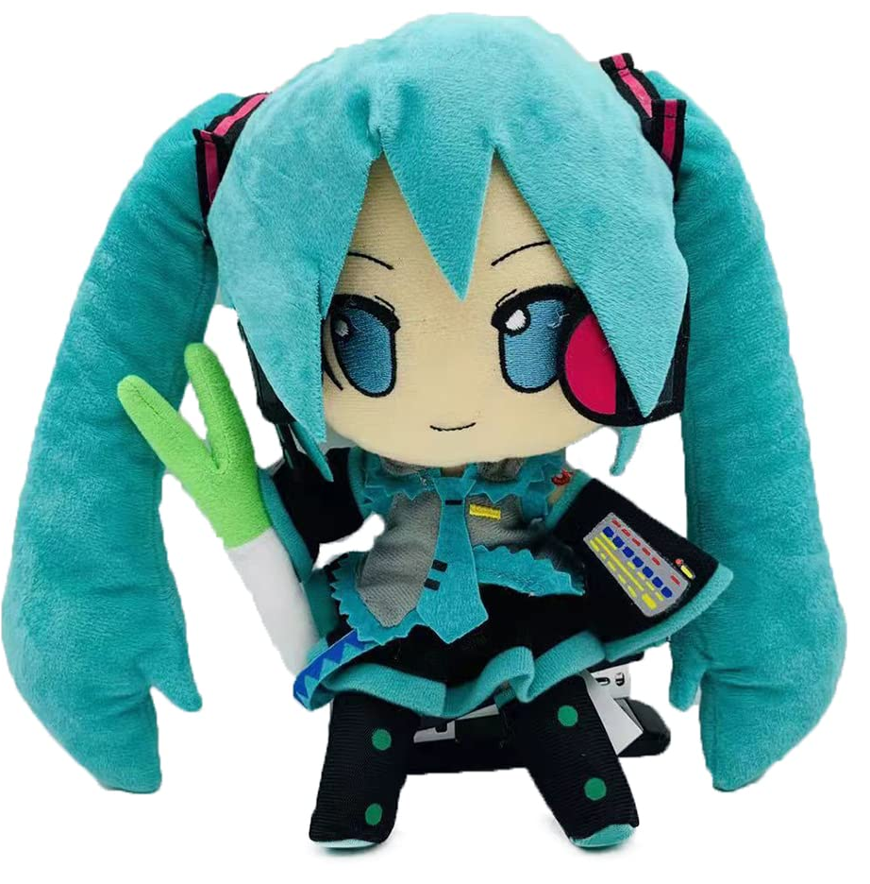
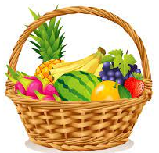
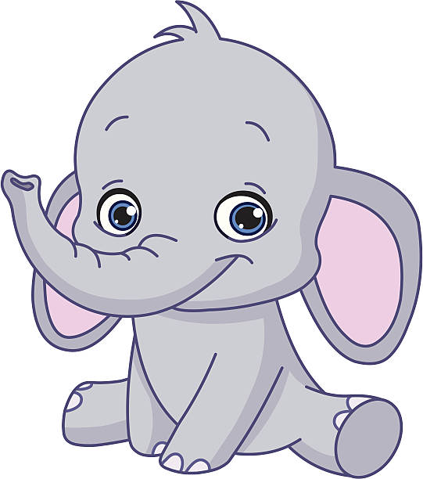







$$myDoll=$$
$$fruits_7=$$
$$c3=$$
3
$$NewStuff=$$

Slide 8
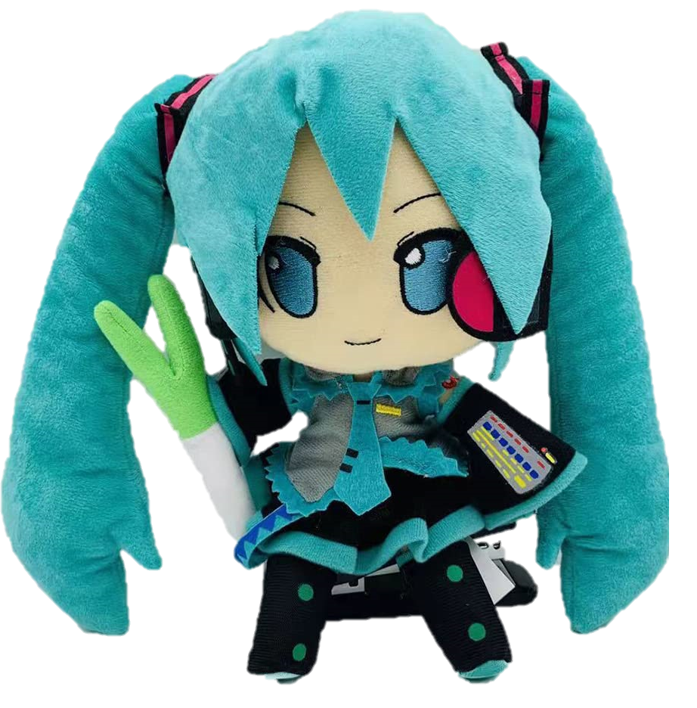



multiplication operation
assign operation
$$myDolls=$$
3
$$NewStuffs=$$
addition operation

Slide 9
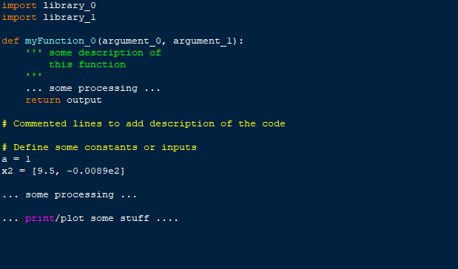
additional libraries are
loaded like this
using strings as comments
commented lines
start with #

Slide 10
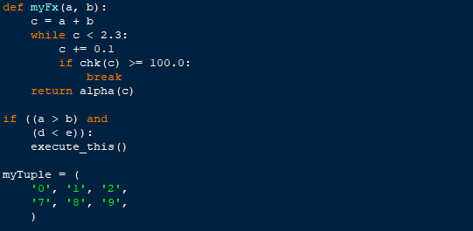



$4$ spaces
$8$ spaces
indentations used in
functions and loops
$12$ spaces
(optional) indentation to
avoid long lines

Slide 11

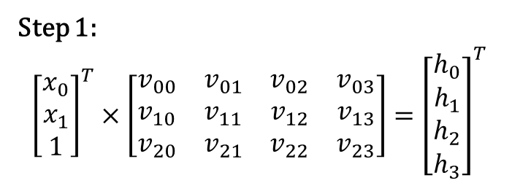
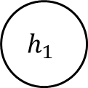



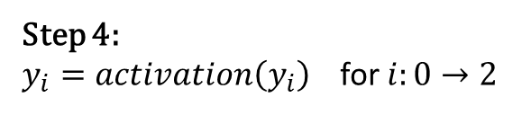



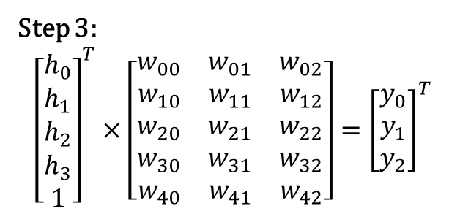

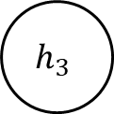

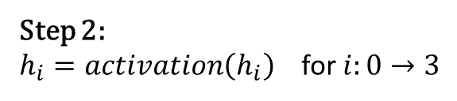
Hidden Layer
$$h_{0}$$
Step 1:
$${\left[\begin{matrix}x_{0} \\ x_{1} \\ 1\end{matrix}\right]}^{T}×\left[\begin{matrix}v_{00} & v_{01} & v_{02} & v_{03} \\ v_{10} & v_{11} & v_{12} & v_{13} \\ v_{20} & v_{21} & v_{22} & v_{23}\end{matrix}\right]={\left[\begin{matrix}h_{0} \\ h_{1} \\ h_{2} \\ h_{3}\end{matrix}\right]}^{T}$$
Outputs
Inputs
$$y_{0}$$
$$x_{0}$$
$$h_{1}$$
Step 2:
$h_{i}=activation\left(h_{i}\right)$ for $i:0→3$
$$y_{1}$$
$$h_{2}$$
Step 3:
$${\left[\begin{matrix}h_{0} \\ h_{1} \\ h_{2} \\ h_{3} \\ 1\end{matrix}\right]}^{T}×\left[\begin{matrix}w_{00} & w_{01} & w_{02} \\ w_{10} & w_{11} & w_{12} \\ w_{20} & w_{21} & w_{22} \\ w_{30} & w_{31} & w_{32} \\ w_{40} & w_{41} & w_{42}\end{matrix}\right]={\left[\begin{matrix}y_{0} \\ y_{1} \\ y_{2}\end{matrix}\right]}^{T}$$
$$x_{1}$$
$$y_{2}$$
$$h_{3}$$
1
weights matrix W of shape $(4+1,3)$
Step 4:
$y_{i}=activation\left(y_{i}\right)$ for $i:0→2$
weights matrix V of shape $(2+1,4)$
1

