Slide 1

UnderwAIse
Automating Underwriting with AI

Slide 2
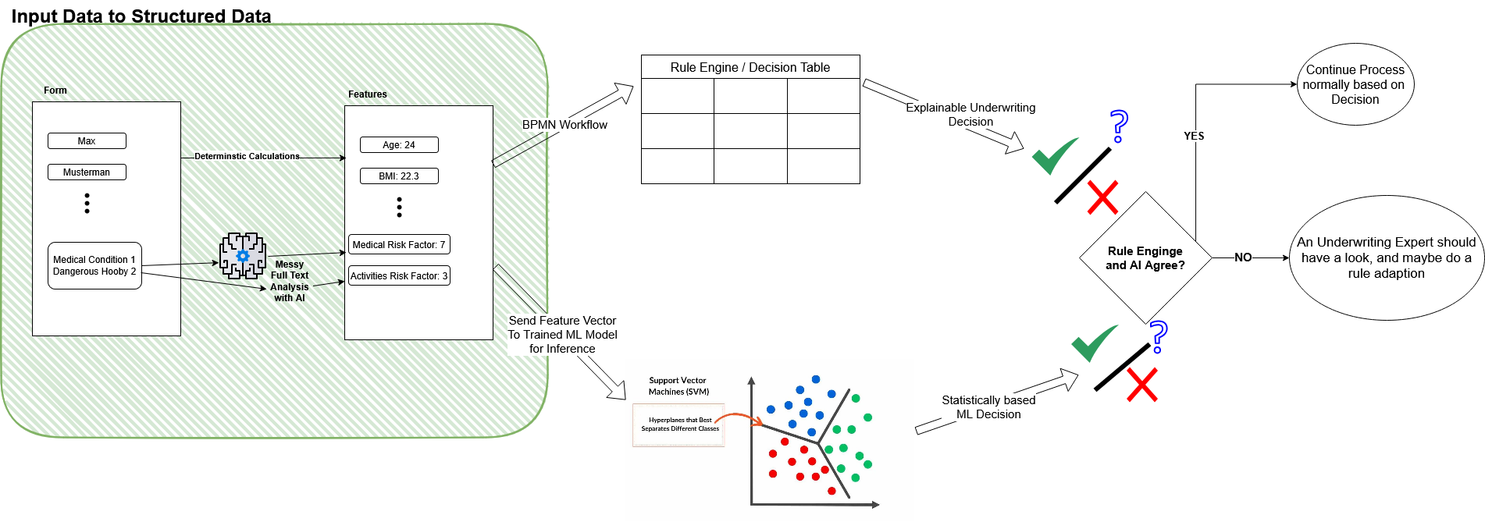
High Level Process Flow

Slide 3
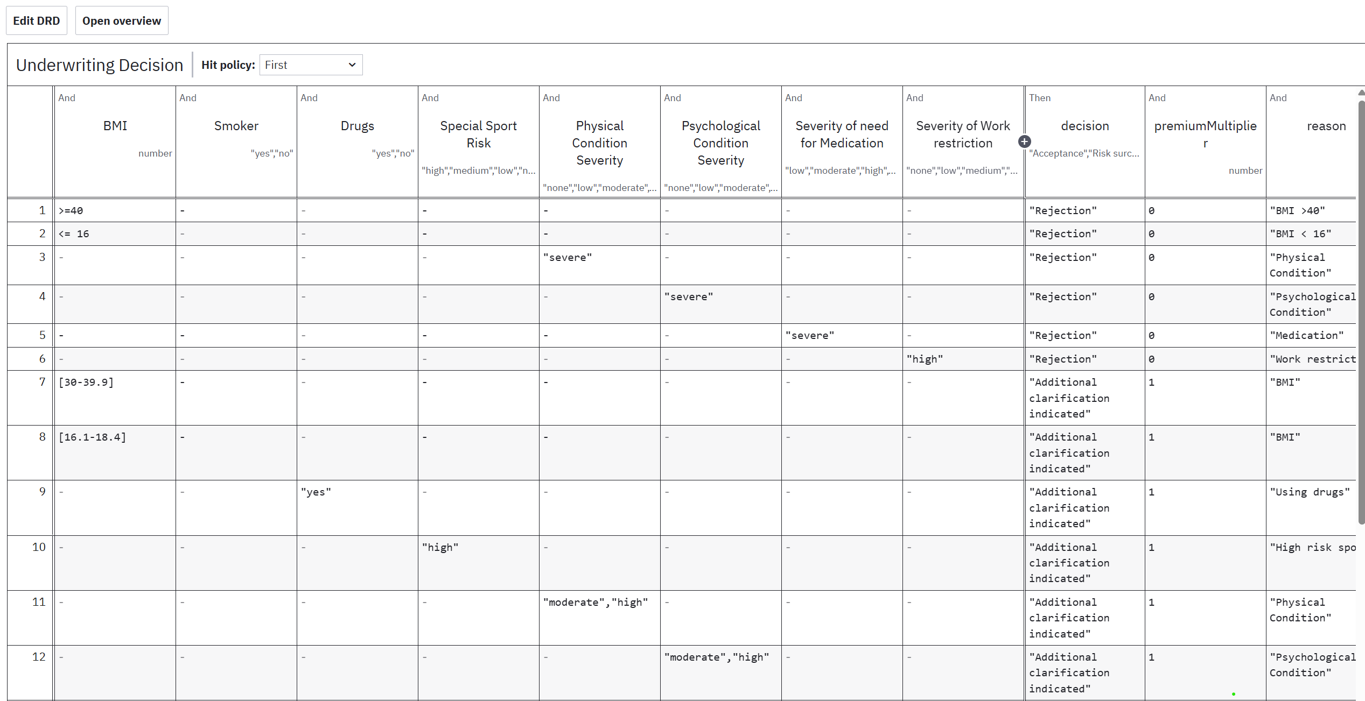
Wettbewerbsumfeld
Customizable Business Rule Engine

