Slide 1









Reproducible Research Using RMarkdown
Basic Statistics with R for Biomedical Research
UEB – VHIR
Miriam Mota-Foix
Miriam.mota@vhir.org

Slide 2
Why Rmarkdown?
Reproducbility (With one click, literally)
Organization
Share-ability (easily share or publish knitted files to HTML/RPubs)
Annotate-ability (now I’m just making these up… Markdown makes it easy to annotate your code)
Insert chunks of Python, Bash, SQL code
Notes:
https://rpubs.com/lgcarlson/tidyramen#:~:text=%22R%20Markdown%20allows%20you%20to,you%20analysed%20your%20data%20properly.

Slide 3
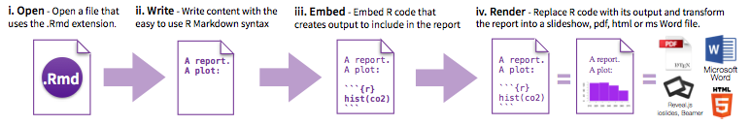
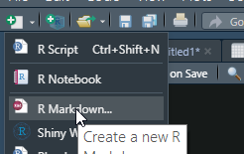
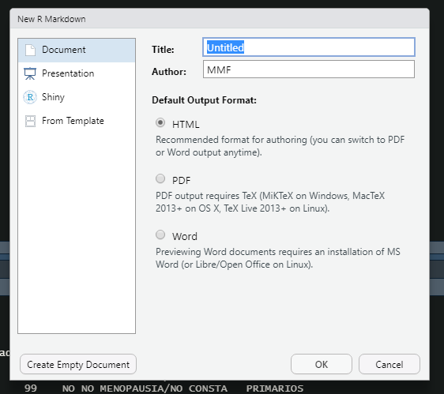
Workflow
Open an Rmd File Choose output

Slide 4
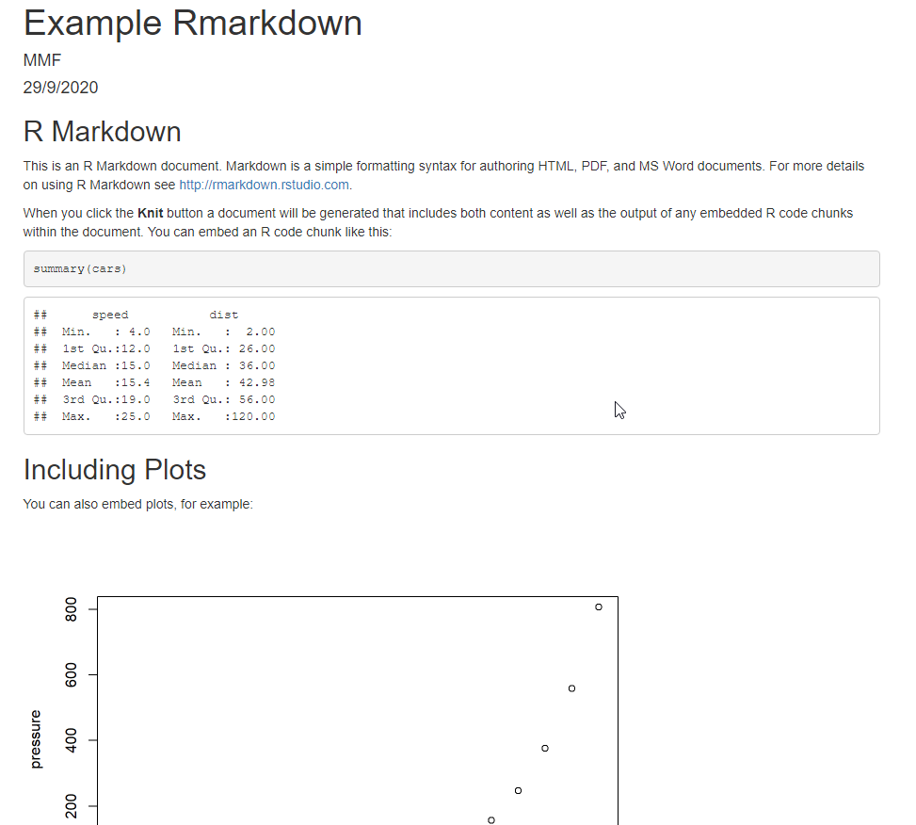
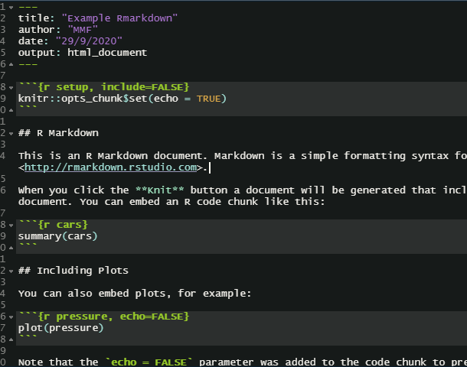
Rmarkdown Example

Slide 5
Descriptive Statistics: Summaries and Graphs
Basic Statistics with R for Biomedical Research
UEB – VHIR
Miriam Mota-Foix and Santiago Pérez-Hoyos
Miriam.mota@vhir.org santi.perezhoyos@vhir.org

Slide 6
Index
INTRODUCTION. ANALYSIS STRATEGY
VARIABLES CLASSIFICATION
SUMMARY MEASURES
  Measures of location/central tendency
  Measures of variability/dispersion
SUMMARY OF VARIABLES
  Contingency Tables
  Graphs
Examples & exercises
3
5

Slide 7
Index
INTRODUCTION. ANALYSIS STRATEGY
VARIABLES CLASSIFICATION
SUMMARY MEASURES
  Measures of location/central tendency
  Measures of variability/dispersion
SUMMARY OF VARIABLES
  Contingency Tables
  Graphs
Examples & exercises
3
5

Slide 8
GENERAL CONCEPTS
Population: It represents the largest group of individuals who want to study and generally usually inaccessible.
Sample: Subset of the population in which measurements are done. This sample should be representative of the original population (any individual has equal opportunity to be selected).
Variable: Feature measurable and observable that represents a concept of study
Measure: Procedure for assign quantitative or qualitative values ​​ to the characteristics of objects, people or events. If these procedures are not well measured the validity of the results is not guaranteed.

Slide 9
STEPS IN A STATISTICAL STUDY ANALSYIS
Make hypothesis about a population
Decide which data collect (Experimental design)
  Which individuals will be part of the study (samples)
  Which data must be collected for each individual (variables)
Collect Data
Describe (summarize) collected data
  Summary measures and graphs
  Point estimations and confidence intervals
Establish relations between two variables
  Set up Statistical Hypothesis test
  Check application conditions
  Calculate intensity relationship measures
Multivariable analysis . Modelling
  Consider effects of several variables on an outcome
  Regression models
  More complex models

Slide 10
Index
INTRODUCTION. ANALYSIS STRATEGY
VARIABLES CLASSIFICATION
SUMMARY MEASURES
  Measures of location/central tendency
  Measures of variability/dispersion
SUMMARY OF VARIABLES
  Contingency Tables
  Graphs
Examples & exercicis
3
5

Slide 11
TYPES OF VARIABLES
Event of
interest
Conceptual
definition
Operational
Definition
QUALITATIVE
NOMINAL
Measure qualities of an individual
Examples: Sex, Treatment, Disease
ORDINAL
Measure qualities but they are ordered
Examples: Educational level, Stage, Severity
QUANTITATIVE
DISCRETE
Take only a finite possible values
Examples: Nº of admissions, Nº of programmed visits
CONTINOUS
Can take an infinite number of values. Between two measures always can be another
Example: Stay time, Age, Cholesterol level

Slide 12
Variable classification in a Study
Response, dependent or outcome variable
  One that answer the research question
Explain, independent or exposure variables
  They are those that are related to the causes of the events we want to study
Confounding or effect modifier variables
  Are those that can affect the relation between exposure and outcome variables
Universal variables
  Are those that can be exposures or confounders that always have to be considered. For example: sex, age, residence location, ethnic, etc.

Slide 13
Descriptive analysis
Data have to be organized to be useful (frequency or contingency tables)
Graph data before calculating summary measures
This actions can help to:
  Select the best summary measure
  Transform variables
  Detect outliers

Slide 14
Index
INTRODUCTION. ANALYSIS STRATEGY
VARIABLES CLASSIFICATION
SUMMARY MEASURES
  Measures of location/central tendency
  Measures of variability/dispersion
SUMMARY OF VARIABLES
  Contingency Tables
  Graphs
Examples & exercises
3
5

Slide 15
Quantitative Variables
We have a new variable (i.e. a biomarker and we want to summarize information)
  Around which values is the variable ?
  Values vary greatly between different individuals
  Data are grouped or not

Slide 16
Summary Measures
Location
  Mean
  Median
  Mode
Dispersion
  Range (Maximum-Minimum)
  Variance
  Standard Deviation
  Variation Coefficient
  Percentile
  Interquartile range (IQR) or Interquartile interval
Shape
  Asymmetry
  Kurtosis

Slide 17
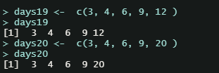
Data
  days19 <- c(3, 4, 6, 9, 12 )
  days19
  days20 <- c(3, 4, 6, 9, 20 )
  days20

Slide 18

Location measures
  Mean
  Median
  Mode

Slide 19

Mean
μ
Useful to locate data .
Is the sum of observed values over sample size
Can be altered by extreme values
Example Stay days
3, 4, 6, 9, 12 Mean=6,8
3, 4, 6, 9, 20 Mean=8,4

Slide 20
Median
Is the point that divied in two parts the observations
Observations are ordered from lowest to highest and median is the central point
It is not altered by extreme observations
Obsv. 1
Obsv. 2
median
Obsv. n-1
Obsv. n
Example Stay days
3, 4, 6, 9, 12 Median=6
3, 4, 6, 9, 20 Median=6

Slide 21
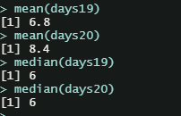
Example: Location measures
  CODE:
  mean(days19)
  mean(days20)
  median(days19)
  median(days20)
  RESULT:

Slide 22
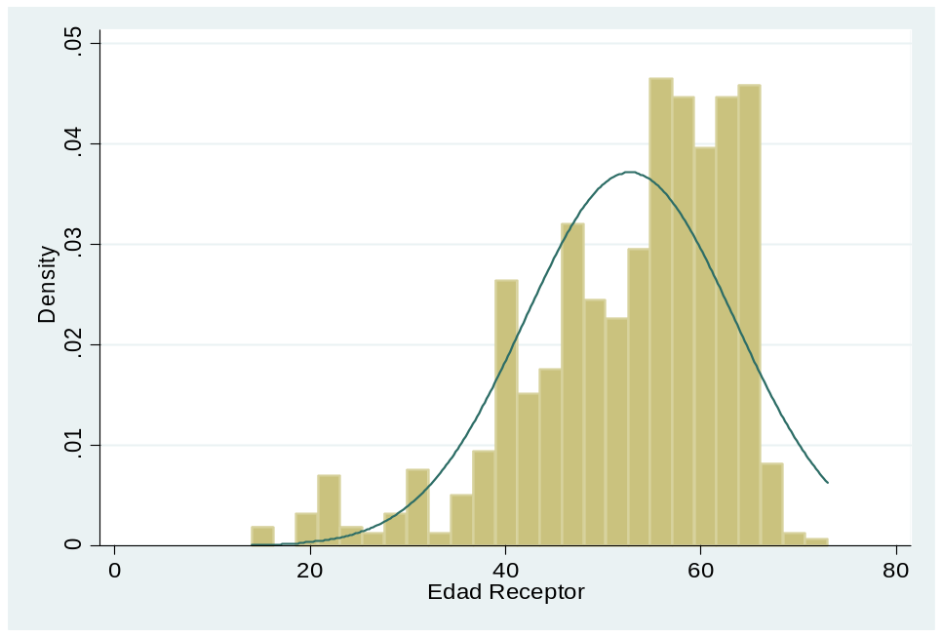
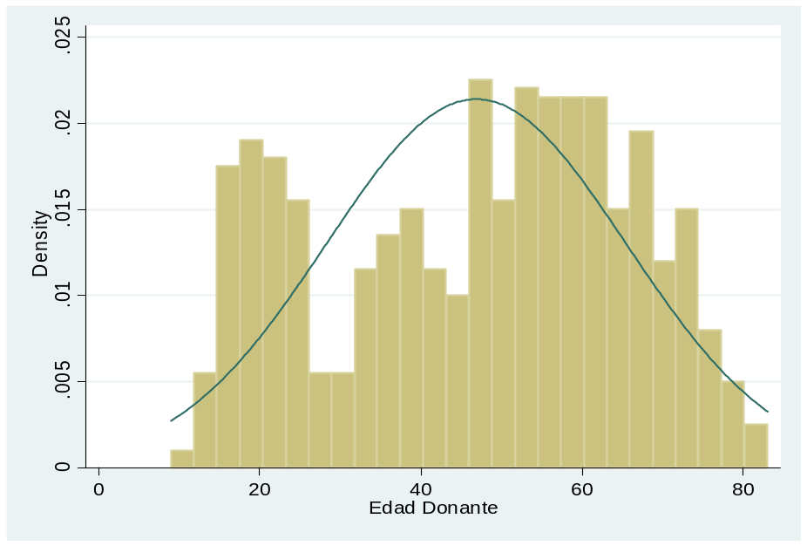
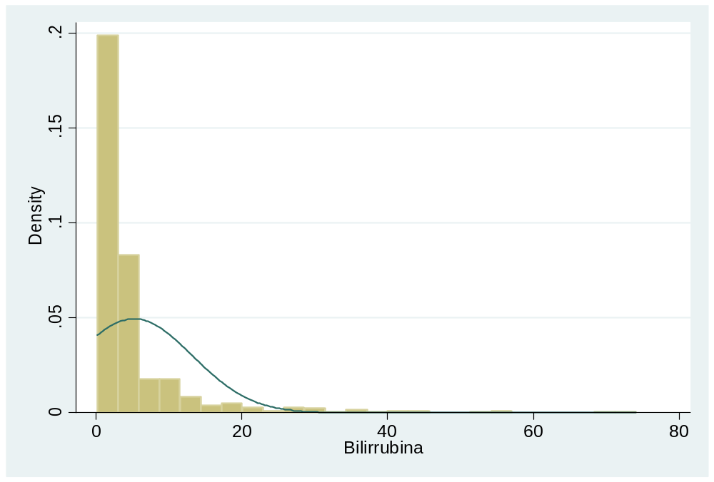
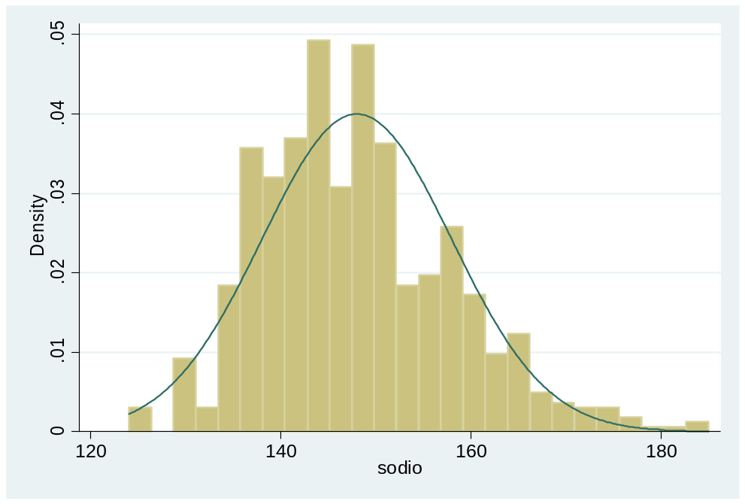
Transplant study: Mean or Median

Slide 23
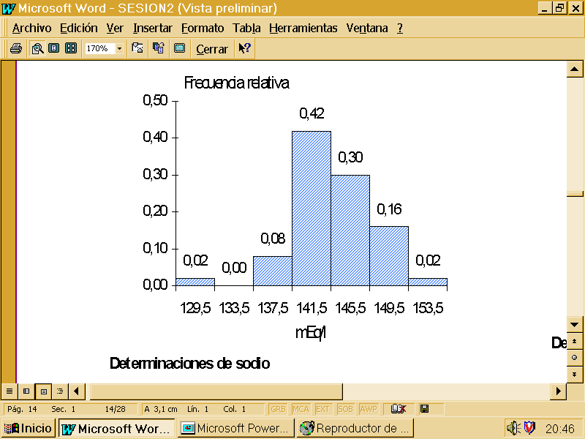
Mode
The most frequent value
May be not unique
In a quantitative variable is the maximum values of an histogram

Slide 24

Dispersion or variability measures
  Range ( Maximum-Minimum)
  Variance
  Standard Deviation
  Variation Coefficient
  Percentile
  Interquartile Range (IQR)

Slide 25
Range
Simplest measure of dispersion
Is the difference between maximum and minimum value of the observations
Range
μ
Minimum
Maximum
Example Stay days
3, 4, 6, 9, 12 Range=12-3=9
3, 4, 6, 9, 20 Range=20-3=17

Slide 26
Variance
Mean difference of observations from mean in squared scale
μ
Obsv. n-1
Obsv. n
Obsv. 1
Obsv. 2
d
d-mean
(d-mean)^2
d
d-mean
(d-mean)^2
Si se suman las desviaciones con respecto a la media, éstas se anulan
Por ello para evitar los signos se elevan las desviaciones al cuadrado, se suman y se dividen por el número de datos
3
-3,8
14,44
3
-5,4
29,16
4
-2,8
7,84
4
-4,4
19,36
6
-0,8
0,64
6
-2,4
5,76
9
2,2
4,84
9
0,6
0,36
12
5,2
27,04
20
11,6
134,56
Sum
σ²= suma(observación-media)²/nº observaciones
0
54,8
0
189,2
Sum/5
6,8
0
10,96
8,4
0
37,84

Slide 27
Standard Deviation
Squared root of the variance
It is measured in the same units than the variable
Example Stay days
3, 4, 6, 9, 12 Variance =10.96
Std. Dev.=3.31
3, 4, 6, 9, 20 Variance= 37.84
Std. Dev.= 6.15

Slide 28
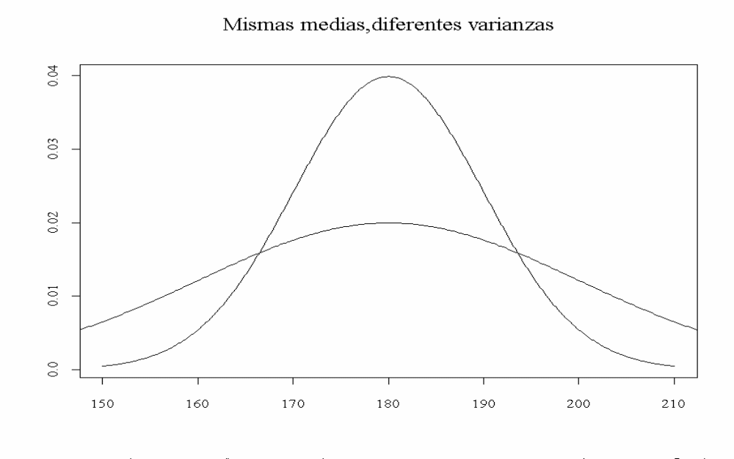
Same mean , different variances

Slide 29
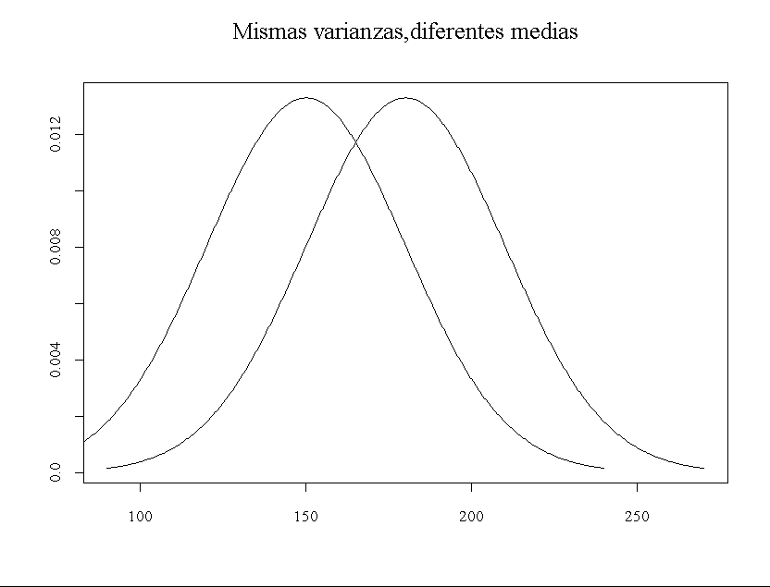
Same variances, different means

Slide 30
Coefficient of Variation (CV)
It is the ratio between standard deviation and mean
Allows to compare the variability of variables measured in different scales
Example Stay Days
3, 4, 6, 9, 12 Std. Dev.= 3.31 Mean = 6.8 Variation Coef.= 0.49
3, 4, 6, 9, 20 Std. Dev. = 6.15 Mean = 8.4 Variation Coef.= 0.73

Slide 31
Percentiles
Observations are ranked from minimum to maximum and the point that leaves below p% of observations is selected
There are some special percentiles
  Deciles are percentiles 10, 20, 30, 40, 50, 60, 70, 80, 90
  Quartiles are percentiles 25, 50, 75
  Quintiles are percentiles 20,40, 60,80
  They are not affected by extreme observations
  Interquartile range is difference between 25 and 75 percentile
Percentile
Obsv. 1
Obsv. 2
Obsv. n-1
Obsv. n

Slide 32
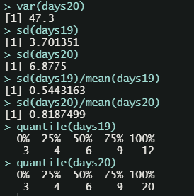
Example: Variability measures
  CODE:
  var(days19)
  var(days20)
  sd(days19)
  sd(days20)
  sd(days19)/mean(days19)
  sd(days20)/mean(days20)
  quantile(days19)
  quantile(days20)
  RESULT:

Slide 33
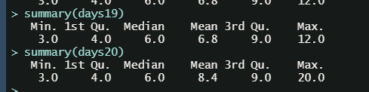
Summary measures in R
  RESULT:
  CODE:
  summary(days19)
  summary(days20)

Slide 34
Syllabus
INTRODUCTION. ANALYSIS STRATEGY
VARIABLES CLASSIFICATION
SUMMARY MEASURES
  Measures of location/central tendency
  Measures of variability/dispersion
SUMMARY OF VARIABLES
  Contingency Tables
  Graphs
Examples & exercises
3
5

Slide 35

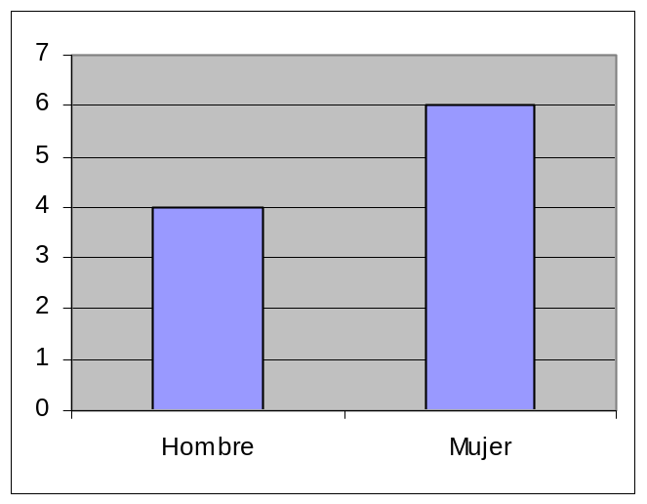
Summary of variables
Frequency tables and graphs are two equivalent ways to present information. Both expose in an ordered way the collected data.a.
Género | Frec.
Hombre | 4
Mujer | 6

Slide 36
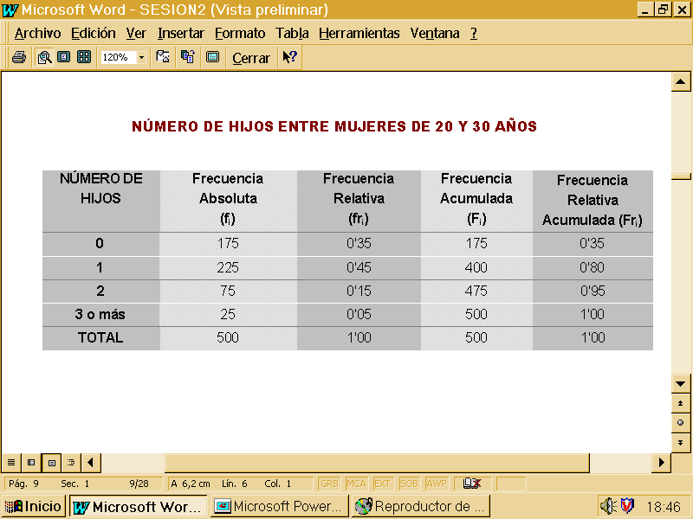
Frequency table

Slide 37
Frequency table
Catego ries

Slide 38
Taula de Freqüencia
Nº of subjects by category
Catego ries

Slide 39
Frequency table
Percentage of subjects
Freq /Total
Nº of subjects by category
Catego ries

Slide 40
Frequency table
Percentage of subjects
Freq /Total
Nº of subjects by category
Catego ries
Nº accumulated subects up to category
(Only ordinal or discrete variables)

Slide 41
Frequency table
Percentage of subjects
Freq /Total
Nº of subjects by category
Catego ries
Nº accumulated subects up to category
(Only ordinal or discrete variables)
Accumulated Frequency up to category
Freq Abs/Total

Slide 42
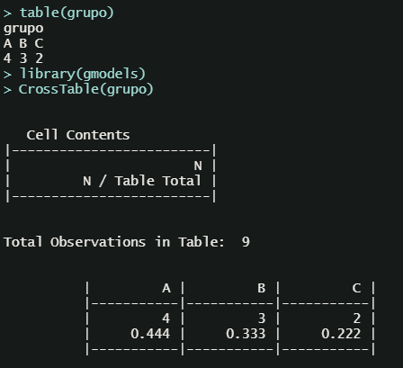
Example: Frequency table
  RESULT:
  CODE:
  grupo <- factor(c("A", "A","B","B","A","C","C", "A", "B"))
  table(grupo)
  library(gmodels)
  CrossTable(grupo)

Slide 43
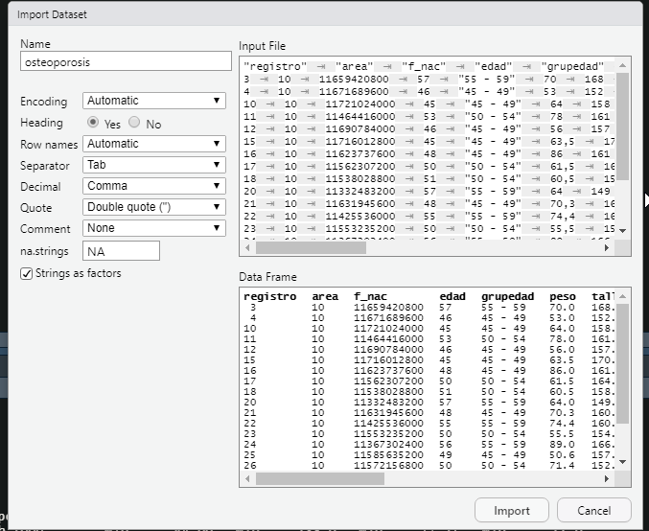
Dataset osteoporosis
  osteo <- read.delim2(“/osteoporosis.csv")
#All dataset
summary(osteo)
# quantitative variable
mean(osteo$edad)
sd(osteo$edad)
median(osteo$edad)
IQR(osteo$edad)
# qualitative variable
library(gmodels)
CrossTable(osteo$grupedad)

Slide 44
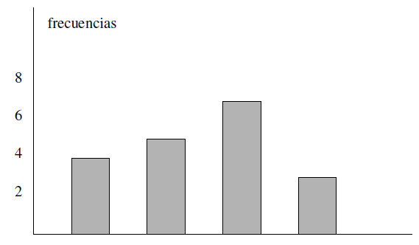
Bar Graph
Categorys are representened in X axis and frequencies in Y axis
- For comparing two population better use relative frequencies
freqüències
A B C D

Slide 45
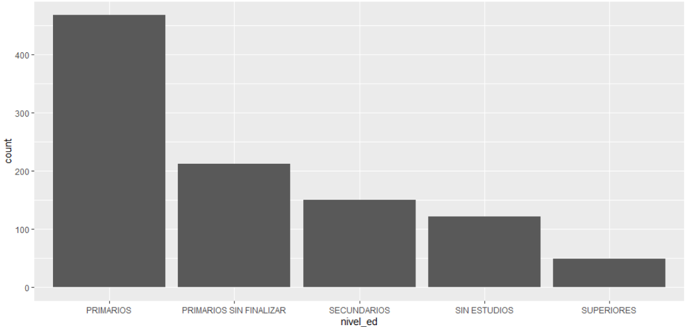
Example. Bar Graph
  CODE:
  require(ggplot2)
  ggplot(data = osteo) +
  geom_bar(mapping = aes(x = nivel_ed))
  RESULT:

Slide 46
Histogram
Relative Frequency
Frequency poligon
Mid point interval
Interval

Slide 47
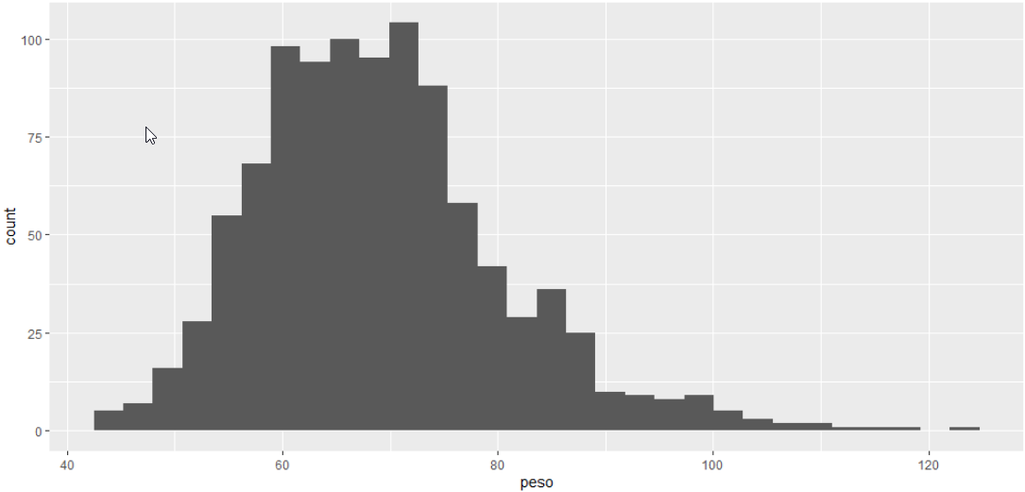
  CODE:
  ggplot(data = osteo) +
  geom_histogram(mapping = aes(x = peso))
  RESULT:

Slide 48
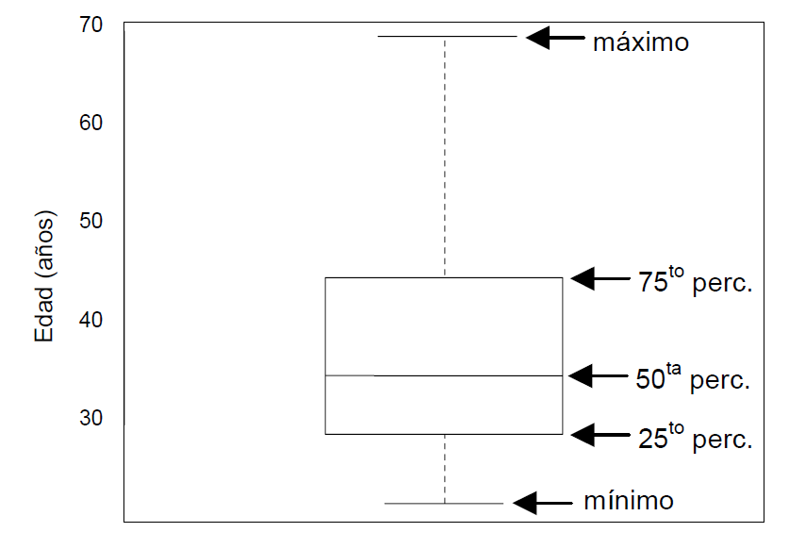
Boxplot
It is graphically represented the “five numbers": box are 25th and 75th percentiles, the middle line is the median (50th percentile) and the ends are the minimum and maximum values.
màxim
Edat (anys)
percentil 75
mediana
percentil 25
mínim

Slide 49
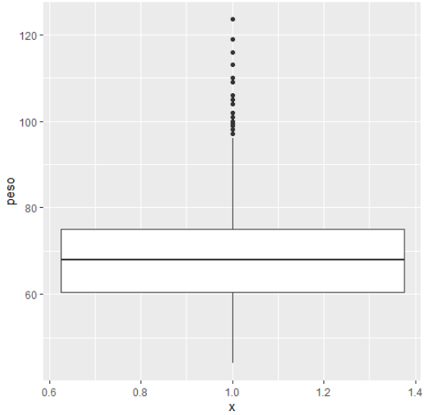
  CODE:
  ggplot(osteo,aes(y=peso,x=1))+
  geom_boxplot()
  RESULT:

Slide 50
Index
INTRODUCTION. ANALYSIS STRATEGY
VARIABLES CLASSIFICATION
SUMMARY MEASURES
  Measures of location/central tendency
  Measures of variability/dispersion
SUMMARY OF VARIABLES
  Contingency Tables
  Graphs
Examples & exercises
3
5

Slide 51
Exercise
- Import diabetes.sav
MEAN_{BMI} =
SD_{BMI} =
BMI (Body mass index) of 149 patients →
MEAN_{SPB} =
SD_{SPB} =
SPB(Diastolic Pression Blood) of 149 patients →
Which variable have more variation? BMI or SPB
CV_{BMI} = %
CV_{SPB} = %
Calculate CV
- Create a boxplot with BMI
- Resume “MORT” variable. Create a frequency table and a barplot.

