Slide 1
Statistics with R: Exploratory Data Analysis II and Plots with R
Statistics with R - VHIO 2020
Ricardo Gonzalo Sanz Miriam Mota Foix
ricardo.gonzalo@vhir.org miriam.mota@vhir.org
06/10/2020

Slide 2
TABLE OF CONTENTS
Elegant graphics for data analysis
From univariate to bivariate analysis
Bivariate analysis
Qualitative vs Qualitative
Qualitative vs Quantitative
Quantitative vs Quantitative
Correlation
Definition
Types of correlation (Pearson, Spearman)

Slide 3
TABLE OF CONTENTS
Elegant graphics for data analysis
From univariate to bivariate analysis
Bivariate analysis
Qualitative vs Qualitative
Qualitative vs Quantitative
Quantitative vs Quantitative
Correlation
Definition
Types of correlation (Pearson, Spearman)

Slide 4
Elegant graphics for data analysis
R is a powerful tool to plot your data
Hadley Wickam (2009) introduced a modern (and perhaps easier) way to plot your data
Extensions to ggplot2
GGally, ggrepel, …
Hadley Wickam book
http://moderngraphics11.pbworks.com/f/ggplot2-Book09hWickham.pdf
https://ggplot2-book.org/
STHDA (Statistical tools for high-throughput data analysis)
http://www.sthda.com/english/wiki/ggplot2-essentials
R Colors
http://www.stat.columbia.edu/~tzheng/files/Rcolor.pdf

Slide 5
Elegant graphics for data analysis
How ggplot2 works?
It is based on the Grammar of Graphics (Wilkinson 2005)
Grammar tells us that a graphic maps the data to the aesthetic attributes (colour, shape, size) of geometric objects (points, lines, bars).
Plot may also include statistical transformations of the data and information about plot’s coordinate system

Slide 6
Elegant graphics for data analysis
Mapping components:
Layer: Geoms (what you actually see in the plot: points, lines,…), stats (summarise the data)
Scales: how we want to see the data (aesthetic). Color, shapes, legend, axes….
Coord: axes, gridlines
Facet: if you want to divide your data in different plots
Theme: Font size, background colors, …

Slide 7
Elegant graphics for data analysis
How to install: install.packages("ggplot2")
First steps. Three key components:
Data
Aesthetic mappings between variables
A least one layer. Usually created with a geom function

Slide 8
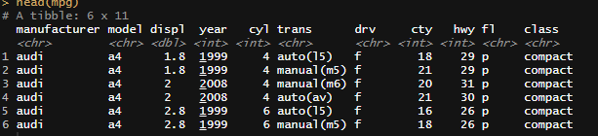
Elegant graphics for data analysis
The data: (https://ggplot2.tidyverse.org/reference/mpg.html)
head(mpg)
A data frame with 234 rows and 11 variables:
manufacturer: manufacturer name
model: model name
displ: engine displacement, in litres
year: year of manufacture
"type" of car
cyl: number of cylinders
trans: type of transmission
drv: the type of drive train, where f = front-wheel drive, r = rear wheel drive, 4 = 4wd
cty: city miles per gallon
hwy: highway miles per gallon
fl: fuel type
class

Slide 9
Elegant graphics for data analysis
The plot:
ggplot(mpg, aes(x = displ, y = hwy)) +
geom_point()

Slide 10
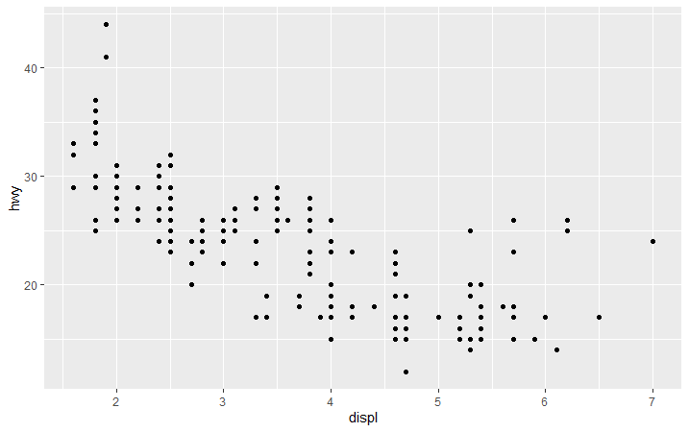
Elegant graphics for data analysis
ggplot(mpg, aes(x = displ, y = hwy)) +
geom_point()

Slide 11
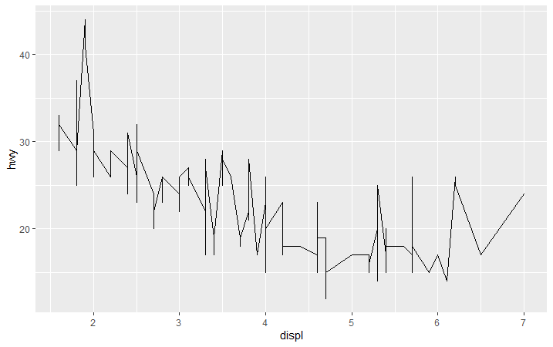
Elegant graphics for data analysis
ggplot(mpg, aes(x = displ, y = hwy)) +
geom_line()

Slide 12
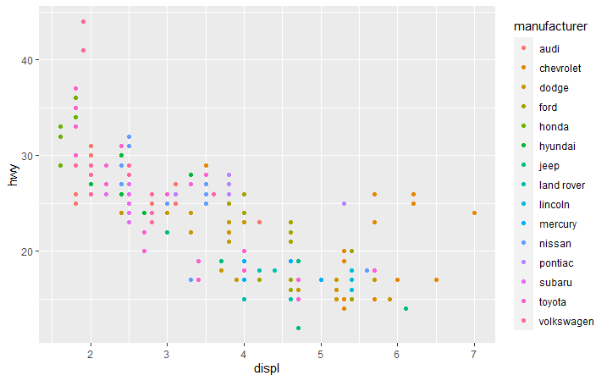
Elegant graphics for data analysis
ggplot(mpg, aes(x = displ, y = hwy, color = manufacturer)) +
geom_point()

Slide 13
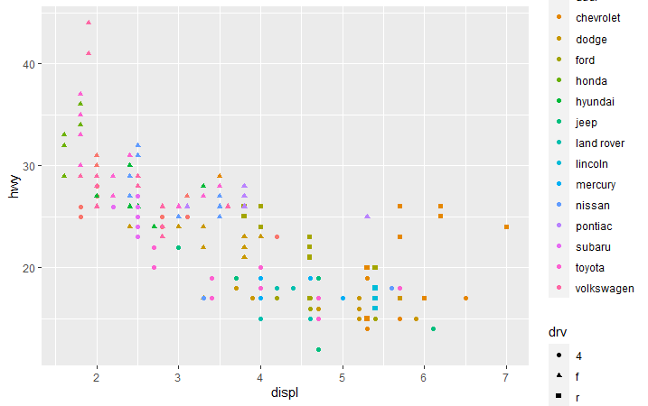
Elegant graphics for data analysis
ggplot(mpg, aes(x = displ, y = hwy, color = manufacturer, shape = drv)) +
geom_point()

Slide 14
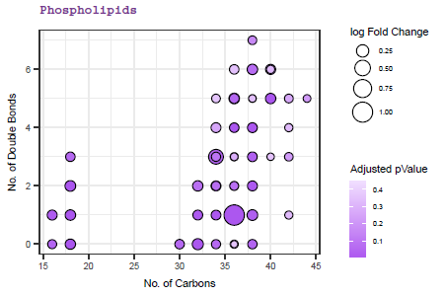
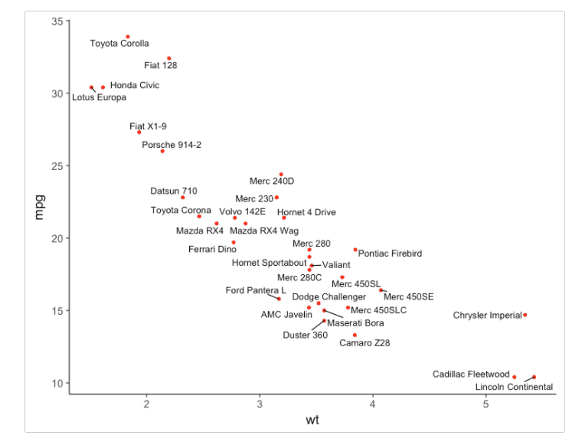
Elegant graphics for data analysis

Slide 15
TABLE OF CONTENTS
Elegant graphics for data analysis
From univariate to bivariate analysis
Bivariate analysis
Qualitative vs Qualitative
Qualitative vs Quantitative
Quantitative vs Quantitative
Correlation
Definition
Types of correlation (Pearson, Spearman)

Slide 16
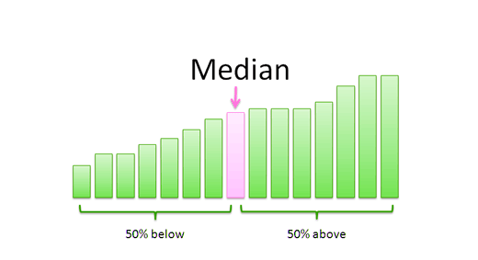
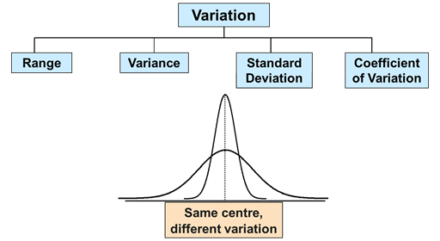
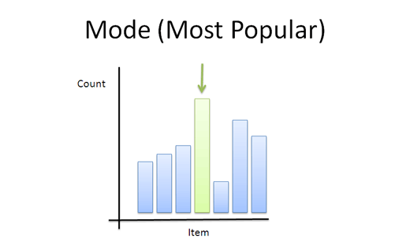
From univariate to Bivariate analysis
Last week we learned…
We can analyse and describe each variable one by one:
With some measures:
Measures of central tendency Measures of dispersion

Slide 17
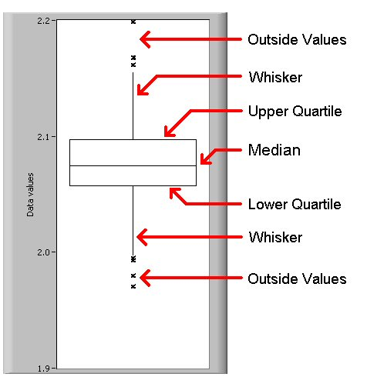
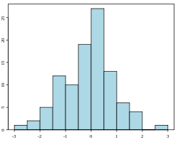
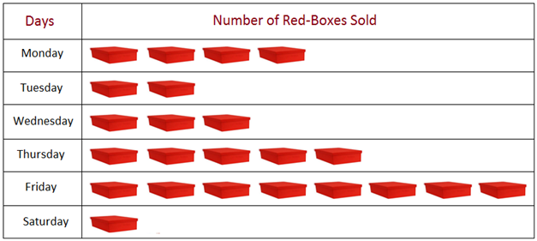
From univariate to Bivariate analysis
Some graphics

Slide 18
From univariate to Bivariate analysis
In univariate analysis only one variable is analyzed each time
the purpose of the analysis is descriptive
If there are more than one variable in the dataset it could be interesting to guess if:
Does exist a relation between the two variables?
How important is this relation?
Which is the direction of the relation?

Slide 19
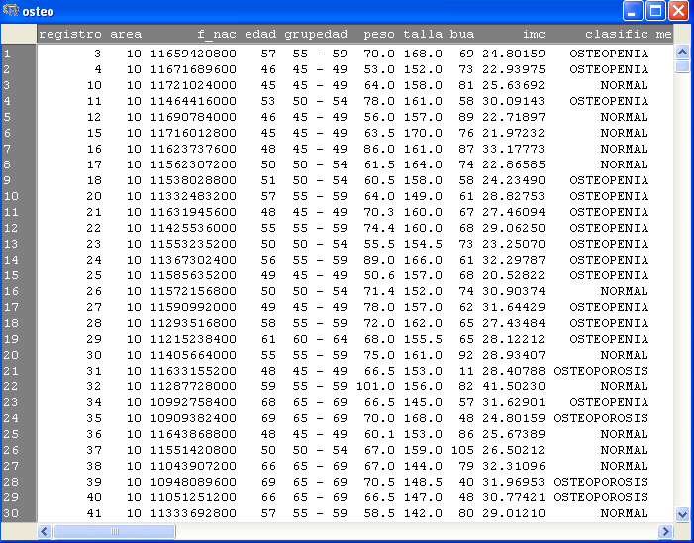
From univariate to Bivariate analysis

Slide 20
From univariate to Bivariate analysis

Slide 21
From univariate to Bivariate analysis

Slide 22
TABLE OF CONTENTS
Elegant graphics for data analysis
From univariate to bivariate analysis
Bivariate analysis
Qualitative vs Qualitative
Qualitative vs Quantitative
Quantitative vs Quantitative
Correlation
Definition
Types of correlation (Pearson, Spearman)

Slide 23
3. Bivariate analysis
Bivariate analysis
Involves the analysis of two variables for the purpose of determining the empirical relationship between them.
easiest way is to measure how those two variables simultaneously change together

Slide 24
3. Bivariate analysis
Bivariate analysis
Involves the analysis of two variables for the purpose of determining the empirical relationship between them.
easiest way is to measure how those two variables simultaneously change together
Major differentiating point between univariate and bivariate analysis (a part from the number of variables implicated) is that bivariate analysis goes beyond simply descriptive, since it study the relationship between the two variables.

Slide 25

3. Bivariate analysis
Why bivariate analysis?
Let’s begin by asking if:
Our experience tells us “yes”, but how good is the correspondence?
People tend to marry other people of about the same age?
Sample of spousal ages of 10 White American Couples
Onlinestatbook (Authors: Rudy Guerra and David M. Lane)

Slide 26
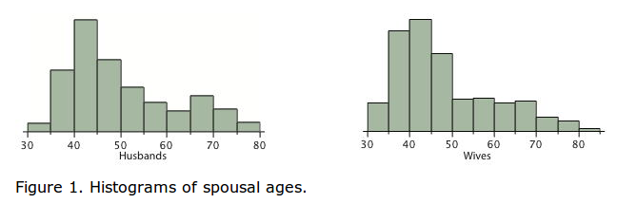
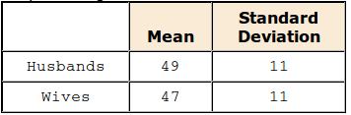
3. Bivariate analysis
Why bivariate analysis?
Onlinestatbook (Authors: Rudy Guerra and David M. Lane)

Slide 27
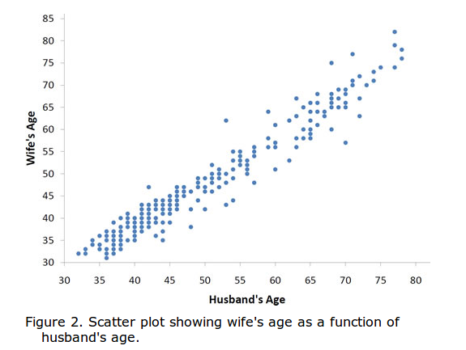
3. Bivariate analysis
Why bivariate analysis?
The older the husband the older the wife.
It is possible to know age of wives for an husband age.
Onlinestatbook (Authors: Rudy Guerra and David M. Lane)

Slide 28







3. Bivariate analysis
Some plots to study the relationship between two variables...
Quantitative

Slide 29
3. Bivariate analysis 3.1 Qualitative versus qualitative

Slide 30
3. Bivariate analysis 3.1 Qualitative versus qualitative
The way to study the relation will depend on the variable types:
Two qualitative variables: contingency table
Used for organizing categorical variables and testing hypothesis with the chi-squared test for independence

Slide 31
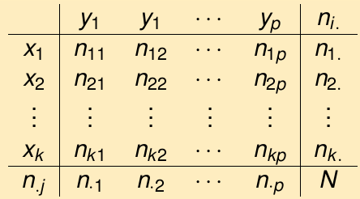

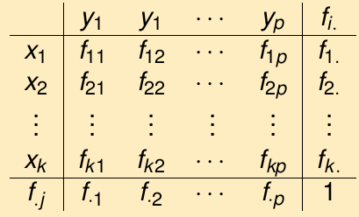
3. Bivariate analysis 3.1 Qualitative versus qualitative
The way to study the relation will depend on the variable types:
Two qualitative variables: contingency table
Used for organizing categorical variables and testing hypothesis with the chi-squared test for independence
Count of individuals that simultaneously presents variable 1 (x) and variable 2 (y)
Absolute
relative

Slide 32
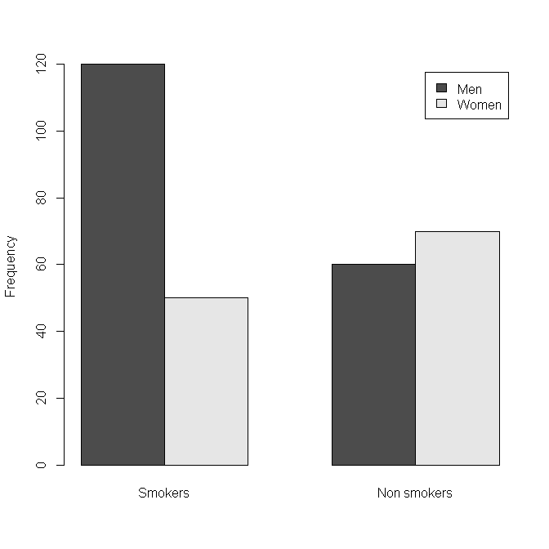
3. Bivariate analysis 3.1 Qualitative versus qualitative
An study wants to know if there are differences about smoking habits in men and women.
Gender | Smoking habits
1 | 1
2 | 1
1 | 0
1 | 0
1 | 0
1 | 1
2 | 1
... | ...
 | Smokers | Non Smoking | Total
Men | 120 | 60 | 180
Women | 50 | 70 | 120
Total | 170 | 130 | 300

Slide 33
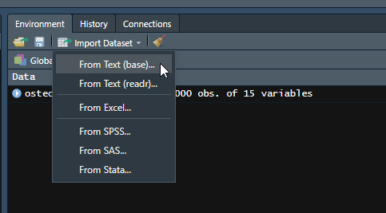
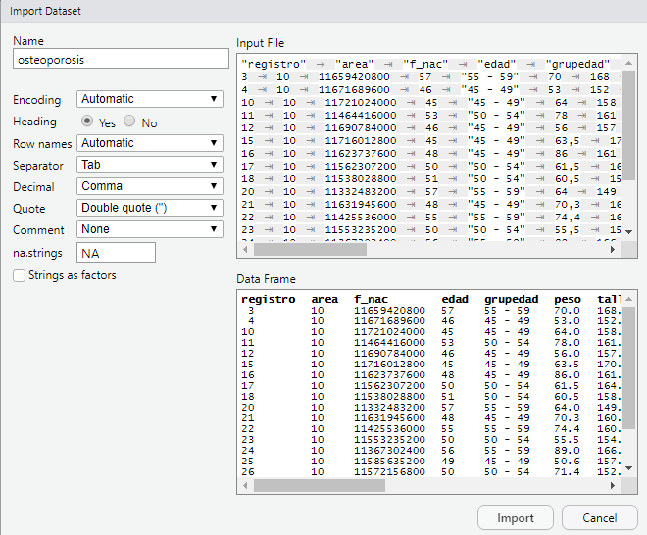
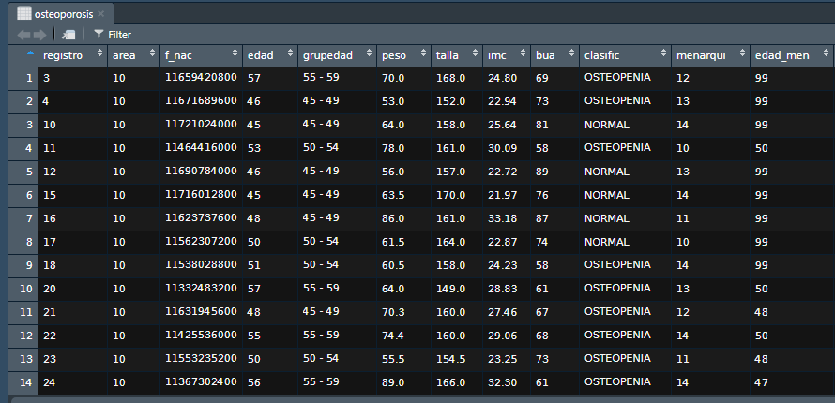
3. Bivariate analysis 3.1 Qualitative versus qualitative
Let´s do in R :
Osteoporosis dataset (osteoporosis.txt)
Study if the group age (grupedad) of patients, influence in the illness type (classific):

Slide 34
3. Bivariate analysis 3.1 Qualitative versus qualitative
table(osteoporosis$grupedad, osteoporosis$clasific)
prop.table(table(osteoporosis$grupedad, osteoporosis$clasific))
NORMAL OSTEOPENIA OSTEOPOROSIS
45 - 49 233 138 7
50 - 54 113 113 7
55 - 59 67 100 9
60 - 64 38 74 17
65 - 69 18 42 24
NORMAL OSTEOPENIA OSTEOPOROSIS
45 - 49 0.233 0.138 0.007
50 - 54 0.113 0.113 0.007
55 - 59 0.067 0.100 0.009
60 - 64 0.038 0.074 0.017
65 - 69 0.018 0.042 0.024

Slide 35
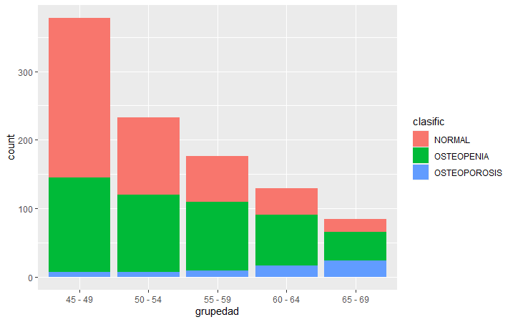
3. Bivariate analysis 3.1 Qualitative versus qualitative
Barplot with R
ggplot(data = osteoporosis, aes(x = grupedad)) +
geom_bar(aes(fill = clasific))

Slide 36
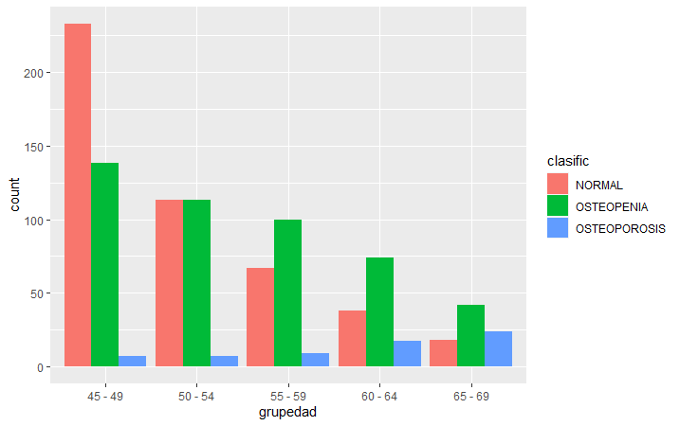
3. Bivariate analysis 3.1 Qualitative versus qualitative
ggplot(data = osteoporosis, aes(x = grupedad)) +
geom_bar(aes(fill = clasific), position = "dodge")

Slide 37
3. Bivariate analysis 3.1 Qualitative versus qualitative
Improving barplot
http://www.sthda.com/english/wiki/ggplot2-barplots-quick-start-guide-r-software-and-data-visualization
Change colors, legend position, labels and finally save it!
p + scale_fill_manual(values=c("#8618b1", "blanchedalmond", "red"))
p + theme(legend.position="bottom")
p + labs(x = "Age group", y = "Women", title = "Osteo disease classified by age group")
pdf("clasific_grupedad.pdf")
p + labs(x = "Age group", y = "Women", title = "Osteo disease classified by age group")
dev.off()

Slide 38
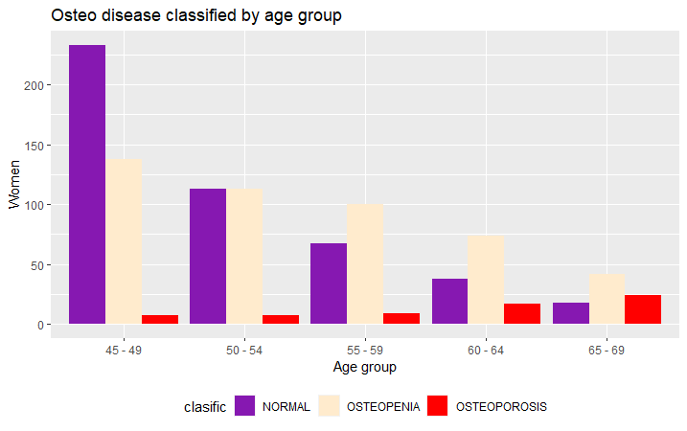
3. Bivariate analysis 3.1 Qualitative versus qualitative
Improving barplot

Slide 39
3. Bivariate analysis 3.1 Qualitative versus qualitative
Another way to introduce the data:
 | Smokers | Non Smoking | Total
Men | 120 | 60 | 180
Women | 50 | 70 | 120
Total | 170 | 130 | 300
tab <- matrix(data = c(120, 60, 50, 70), nrow = 2, ncol = 2, byrow = TRUE)
tab
colnames(tab) <- c("Smokers", "Nonsmokers")
rownames(tab) <- c("Men", "Women")
tab
Smokers Nonsmokers
Men 120 60
Women 50 70
[,1] [,2]
[1,] 120 60
[2,] 50 70

Slide 40
3. Bivariate analysis 3.1 Qualitative versus qualitative
Another way to introduce the data:
 | Smokers | Non Smoking | Total
Men | 120 | 60 | 180
Women | 50 | 70 | 120
Total | 170 | 130 | 300
prop.table(tab)
Smokers Nonsmokers
Men 0.4000000 0.2000000
Women 0.1666667 0.2333333

Slide 41
3. Bivariate analysis 3.2 Qualitative versus quantitative

Slide 42
3. Bivariate analysis 3.2 Qualitative versus quantitative
The way to study the relation will depend on the variable types:
One qualitative variable and one quantitative variable: Table of statistics
Mean value of the variable in each category for each individual

Slide 43
3. Bivariate analysis 3.2 Qualitative versus quantitative
Let´s do it in R:
Osteoporosis dataset
Study if bone density (bua) changes depending the age group
library(dplyr)
osteoporosis %>%
group_by(grupedad) %>%
summarize(mean(edad))
45-49 50-54 55-59 60-64 65-69
78.75926 75.05150 71.43182 64.89147 60.66667

Slide 44
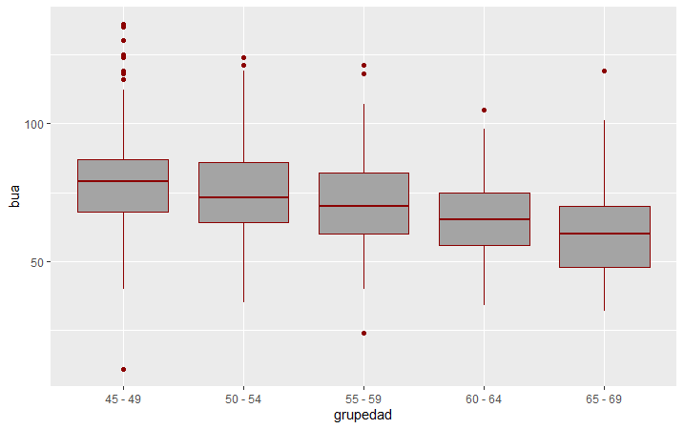
3. Bivariate analysis 3.2 Qualitative versus quantitative
Study if bone density (bua) is related with the age group
bp <- ggplot(osteoporosis, aes(x = grupedad, y = bua)) +
geom_boxplot(fill='#A4A4A4', color="darkred")
bp

Slide 45
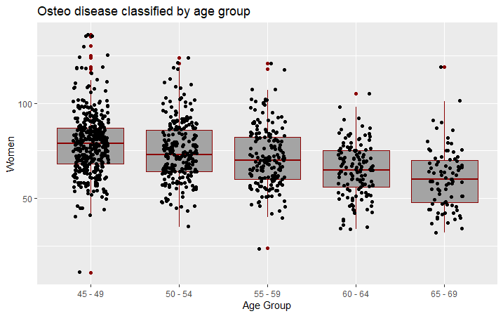
3. Bivariate analysis 3.2 Qualitative versus quantitative
Study if bone density (bua) is related with the age group
# Box plot with points
# 0.2 : degree of jitter in x direction
bp + geom_jitter(shape = 16, position = position_jitter(0.2)) +
labs(x = "Age Group", y = "Women", title = "Osteo disease classified by age group")

Slide 46
3. Bivariate analysis
Exercise
Study the relationship between menop and group of illness (classific)
Study the relationship between peso iand group of illness (classific).

Slide 47
3. Bivariate analysis 3.3 Quantitative versus Quantitative
The way to study the relation will depend on the variable types:
Two quantitatives variables:

Slide 48
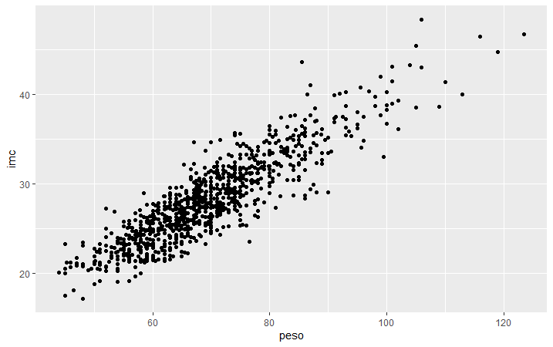
3. Bivariate analysis 3.3 Quantitative versus Quantitative
# Basic scatter plot
ggplot(osteoporosis, aes(x = peso, y = imc)) +
geom_point()
http://www.sthda.com/english/wiki/ggplot2-scatter-plots-quick-start-guide-r-software-and-data-visualization

Slide 49
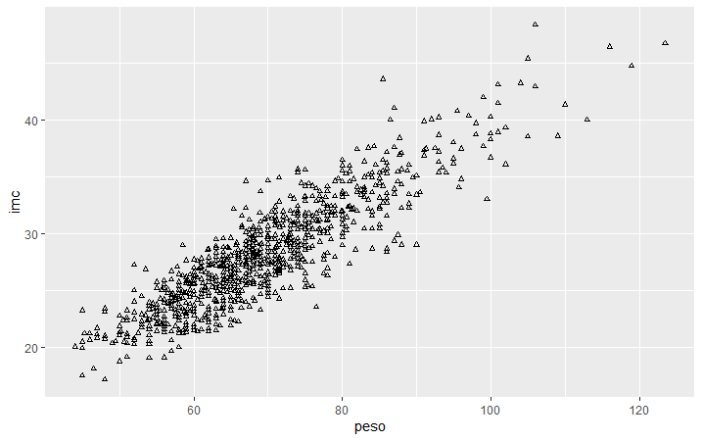
3. Bivariate analysis 3.3 Quantitative versus Quantitative
# Change the point size, and shape
ggplot(osteoporosis, aes(x = peso, y = imc)) +
geom_point(size = 1, shape = 1)

Slide 50
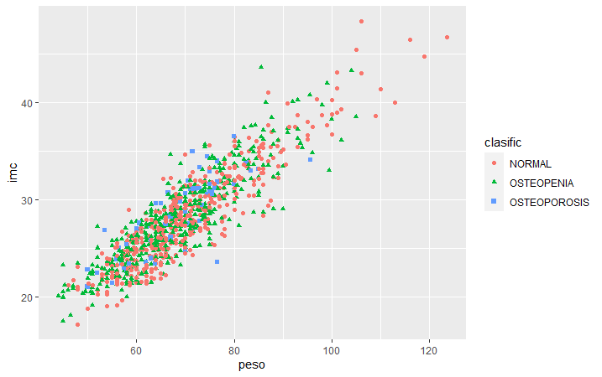
3. Bivariate analysis 3.3 Quantitative versus Quantitative
# Color the points depending of another variable
ggplot(osteoporosis, aes(x = peso, y = imc, color = clasific, shape = clasific)) +
geom_point()

Slide 51
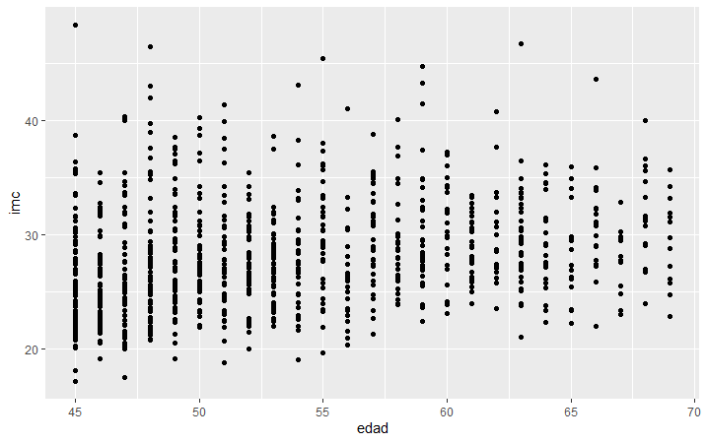
3. Bivariate analysis 3.3 Quantitative versus Quantitative
But not always the correlation is good!
ggplot(osteoporosis, aes(x = edad, y = imc)) +
geom_point()
Whatever you compute Always look at the data!

Slide 52
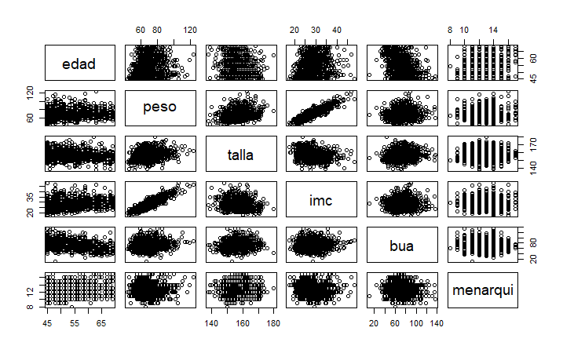
3. Bivariate analysis 3.3 Quantitative versus Quantitative
pairs(osteoporosis[, c("edad", "peso", "talla", "imc", "bua", "menarqui")])

Slide 53
3. Bivariate analysis 3.3 Quantitative versus Quantitative
library(GGally)
ggpairs(osteoporosis, columns = c("edad", "peso", "talla", "imc", "bua", "menarqui"), ggplot2::aes(colour = clasific))

Slide 54
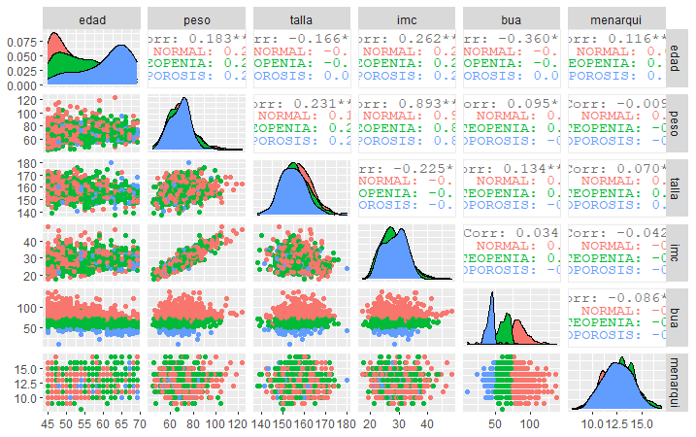
3. Bivariate analysis 3.3 Quantitative versus Quantitative
library(GGally)
ggpairs(osteoporosis, columns = c("edad", "peso", "talla", "imc", "bua", "menarqui"), ggplot2::aes(colour = clasific))

Slide 55
TABLE OF CONTENTS
Elegant graphics for data analysis
From univariate to bivariate analysis
Bivariate analysis
Qualitative vs Qualitative
Qualitative vs Quantitative
Quantitative vs Quantitative
Correlation
Definition
Types of correlation (Pearson, Spearman)

Slide 56
Correlation 1. Definition
Main characteristics of correlation analysis:
Correlation analysis allows
To study the way of relation between the two variables
To quantify the intensity of relation
Correlation is not causation one thing does not causes the other
In the correlation analysis, the two variables have the same weight
The correlation coefficient measures the strength of a linear relation

Slide 57
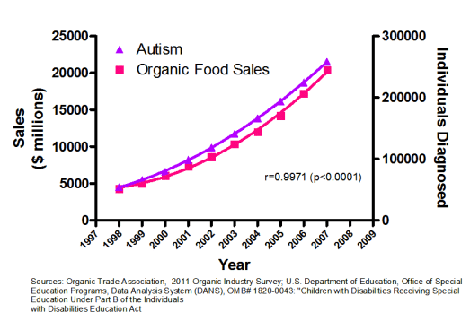
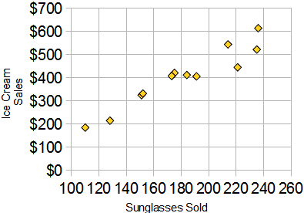
Correlation 1. Definition
Main characteristics of correlation analysis:
Correlation is not causation

Slide 58
Correlation 2. Types of correlation
Pearson correlation coefficient
Measures linear correlation between two variables
It is represented by letter r. It has no dimensions (no units)
Values go from -1 to +1
r=0 indicates no linear relation between the variables
r>0 indicates direct relation between the variables
r<0 indicates indirect relation between the variables
r=1/-1 indicates a perfect relation between the variables

Slide 59
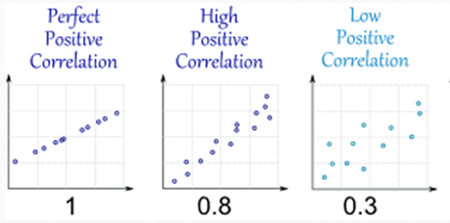
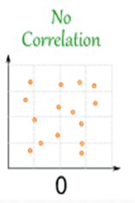
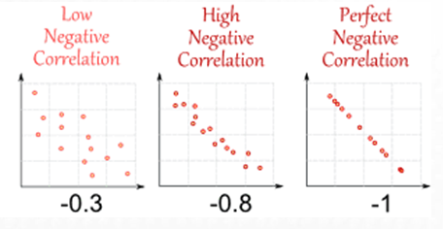
Correlation 2. Types of correlation
Pearson correlation coefficient. Examples

Slide 60
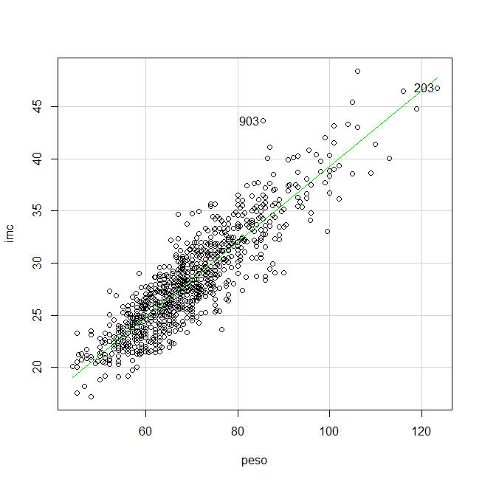
Correlation 2. Types of correlation
Study the relationship between peso and body mass index (imc):
imc peso
imc 1.0000000 0.8927967
peso 0.8927967 1.0000000

Slide 61
Correlation 2. Types of correlation
Pearson correlation coefficient. How to in R?
Bone density and age are correlated?
cor(osteoporosis$bua, osteoporosis$edad, method = "pearson")
[1] -0.3601883
Don’t forget to look the graphic!!

Slide 62
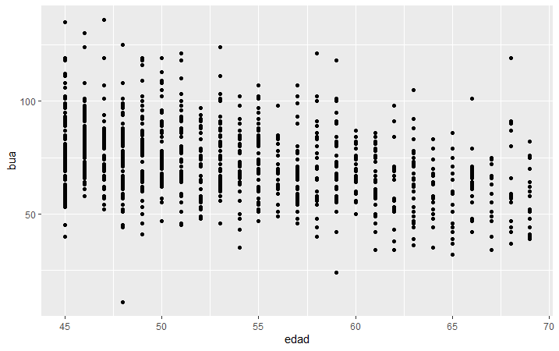
Correlation 2. Types of correlation
Pearson correlation coefficient. How to in R-commander?
ggplot(osteoporosis, aes(x = edad, y = bua)) +
geom_point()

Slide 63
Correlation 2. Types of correlation
Pearson correlation coefficient. How to in R?
Exercise 1. Do you think that exists a relationship between peso and talla? What type of relationship? Show a scatterplot of the values.

Slide 64
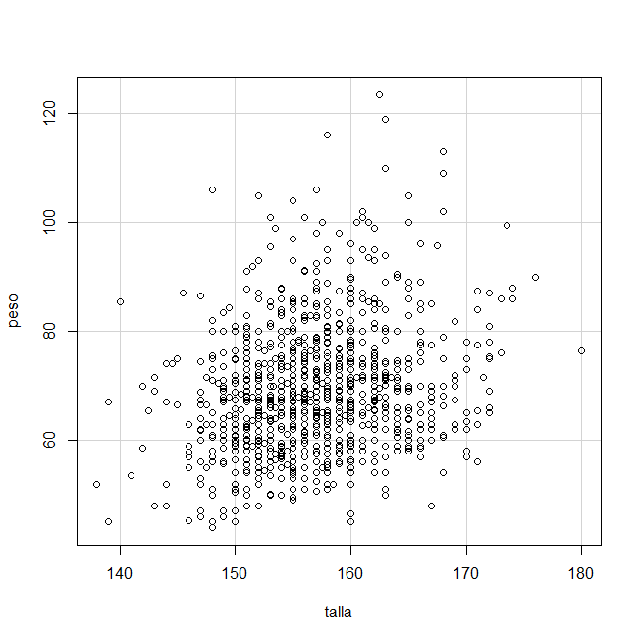
Correlation. Exercises
Exercise 1. peso~talla
peso talla
peso 1.0000000 0.2311058
talla 0.2311058 1.0000000

Slide 65
Correlation 2. Types of correlation
Non Parametric correlation: Spearman correlation coefficient
Pearson correlation coefficient is severely affected by outliers and if the relation is not linear
Better to use Spearman correlation coefficient (use the ranks between the numbers instead the values) to calculate the correlation coefficient
Evaluates the monotonic relationship between the variables (not the linear relationship as Pearson does).
The variables tend to change together but not necessarily at a constant rate

Slide 66
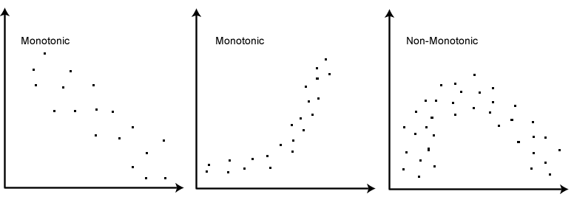
Correlation 2. Types of correlation
Non Parametric correlation: Spearman correlation coefficient

Slide 67
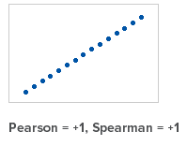
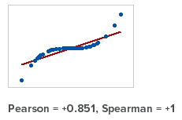
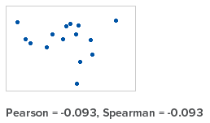
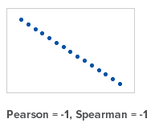
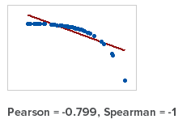
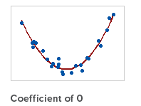
Correlation 2. Types of correlation
Comparison of Pearson and Spearman coefficients.
Always examine a scatterplot to determine the form of the relationship

Slide 68
Correlation 2. Types of correlation
Spearman correlation coefficient. How to in R?
cor(osteoporosis$bua, osteoporosis$edad, method = "spearman")
[1] -0.3540295

Slide 69
Correlation 2. Types of correlation
Correlation matrix
cor(osteoporosis[, c("edad", "peso", "talla", "imc", "bua", "menarqui")])
edad peso talla imc bua menarqui
edad 1.0000000 0.182629245 -0.16635268 0.26173285 -0.36018834 0.115901253
peso 0.1826292 1.000000000 0.23110585 0.89278635 0.09467837 -0.008526465
talla -0.1663527 0.231105848 1.00000000 -0.22546438 0.13350207 0.070002843
imc 0.2617329 0.892786346 -0.22546438 1.00000000 0.03415938 -0.041607661
bua -0.3601883 0.094678365 0.13350207 0.03415938 1.00000000 -0.085935539
menarqui 0.1159013 -0.008526465 0.07000284 -0.04160766 -0.08593554 1.000000000

Slide 70
Correlation. Exercises
Exercise 2. An hypothetic study, published last year that exists a relation between age and systolic blood pressure (sbp)? Do you think is it true? Show a scatterplot of the values? If not, find another variable in the dataset that has a good correlation with systolic blood pressure.
Use dataset Framingham250.csv

