Slide 1








Hypothesis Testing. Quantitative Variables
Basic Statistics with R
UEB-VHIR
Mireia Ferrer, Miriam Mota, Alex Sanchez and Santiago Perez-Hoyos
10/05/2021

Slide 2
Syllabus
INTRODUCTION
TYPE OF TEST
NORMALITY TEST
ONE GROUP COMPARISON
TWO GROUPS COMPARISON IN INDEPENDENT SAMPLES
TWO GROUPS COMPARISON IN DEPENDENT SAMPLES
MORE THAN TWO GROUPS COMPARISON IN INDEPENDENT SAMPLES
Multiple comparisons and mUltiple testing
3
5

Slide 3
Introduction
Once the concept of hypothesis testing is established,
Researchers face the problem of _which test should be applied at every possible situation_.
Best (ideal) solution:
  understand the problem and the questions addressed
  know available tests for each problem
  be aware of applicability assumptions of each test and how to check them.
Easier to say than to do.
  Sometimes cheatsheets may be helpful,
  but be warned against a blind use,
  that is understand and be critic with the steps.

Slide 4
How to choose the right statistical test

Slide 5
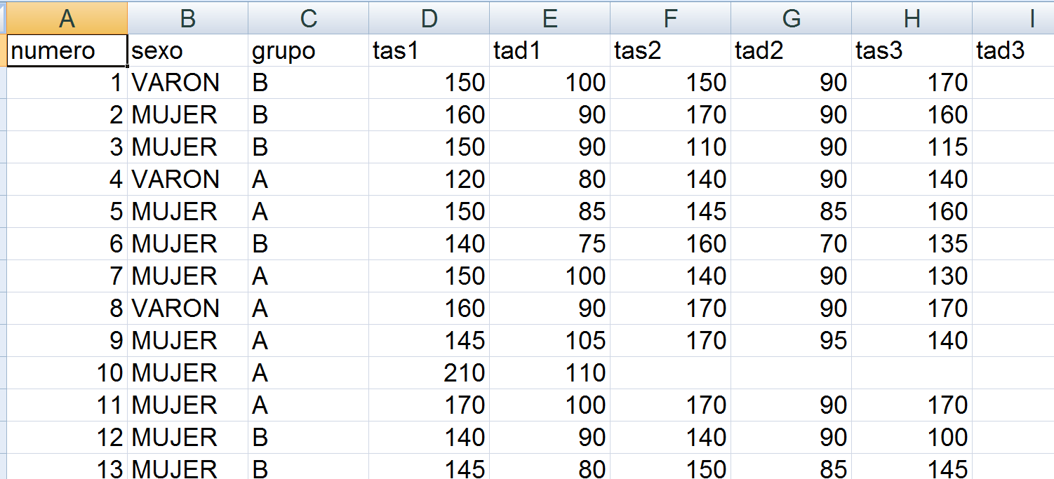
Example Data/Problem
A study was designed to compare two distinct hypertension control programs.
60 individuals with HTA were randomly assigned to either one or the other group (30 per group)
Blood pressure was measured each month during a year

Slide 6
Questions to answer
Is diastolic (min) tension above 90, “on average”, at the beginning of the study.
Are samples “comparable” at baseline?
  In Age? Sex%? Sist? Diast?
Has there been a change in BP between month 1 (first measure) and month 12?
Has this change been different between tretament groups?

Slide 7
Let’s think about it
Is diastolic (min) tension above 90, “on average”, at the beginning of the study.
  One variable. Test about the mean
Are samples “comparable” at baseline?
  Comparison between distinct individuals in two groups (A/B, Male/Fem)
Has there been a change in BP between month 1 (first measure) and month 12?
  Comparison between same individuals

Slide 8
Our goal
Lear how to do tests about characteristics of one variable.
Distinct scenarios
  One group, Two groups, Paired data
  Normally or non normally distributed data
We start checking normality
  Depending on what we obtain →
  Use parametric or non-parametric test
Be flexible and comprehensive!

Slide 9
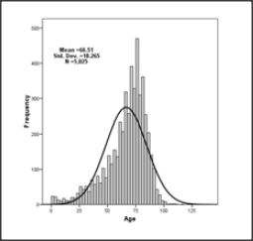
Normality test
Some parametrical test assume data come from a normal population
How can we check this assumption?
What can we do if assumption is false?

Slide 10
Testing normality
We can use graphical methods or hypothesis tests
Graphs
  Check if it is a symmetric distribution
  Probability graphs (QQ-plots)
Hypothesis test (Normality)
  Kolmogorov‐Smirnov test
  Kolmogorov-Liliefors test
  Shapiro-Wilks test

Slide 11
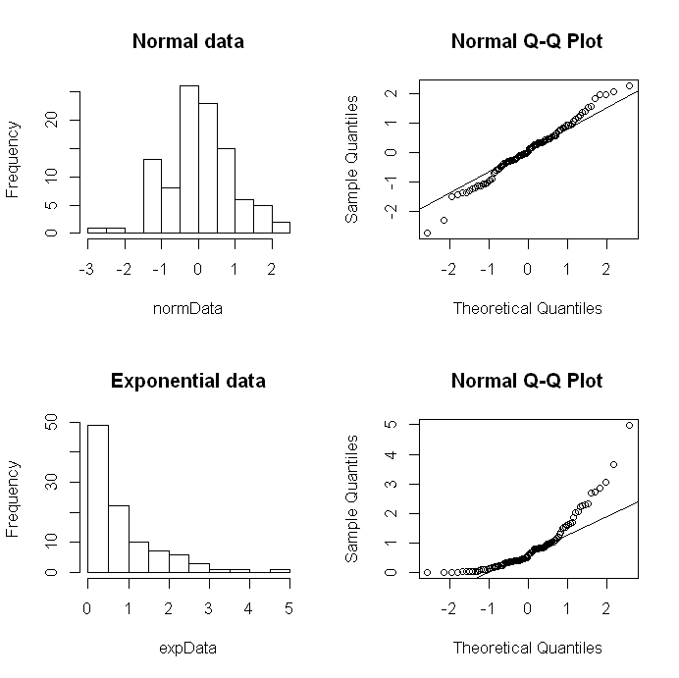
Histograms and QQ-plots
Histogram
  It should be symmetric with gaussian shape.
QQ-plot
  Dots should be over the diagonal line
Non normal data deviate from normal patterns.
Difficult to quantify if there are few data

Slide 12
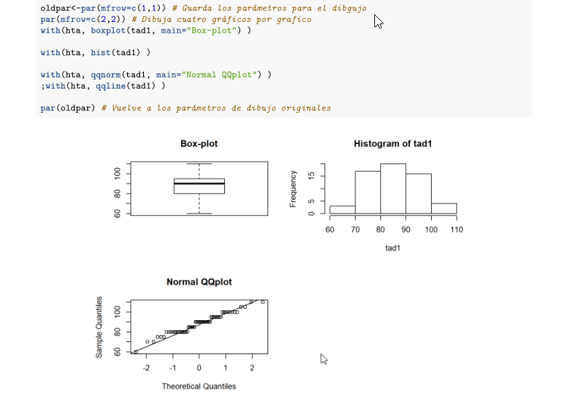

Slide 13
Normality tests
Statistical normality test are more precise than graphs. It is possible to calculate a p-value.
The most used tests are Kolmogorov-Smirnov and Shapiro-Wilks test.
The hypothesis to test are:
  H₀: Data follow a normal distribution
  H₁ : Data do not follow a normal distribution

Slide 14
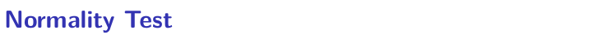
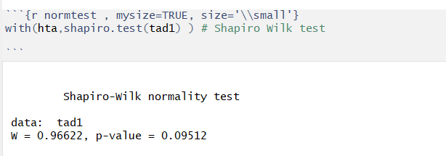

Slide 15
Syllabus
INTRODUCTION
NORMALITY TEST
ONE GROUP COMPARISON
TWO GROUPS COMPARISON IN INDEPENDENT SAMPLES
TWO GROUPS COMPARISON IN DEPENDENT SAMPLES
MORE THAN TWO GROUPS COMPARISON IN INDEPENDENT SAMPLES
MULTIPLE COMPARISONS AND MULTIPLE TESTING
3
5

Slide 16
One sample t-test
We do not use it very often.
Very similar to estimation questions. It can be solved calculating a confidence interval
Idea: We want to verify from a sample a previous hypothesis about the mean in a population
Can it be accepted that the initial TAD is 90 or greater in Hipertensive patients?

Slide 17
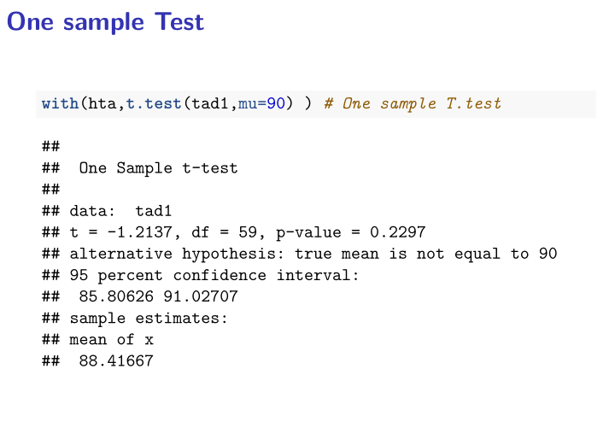

Slide 18
Exercise 1
Check the normality of tas1 variable in hta dataset
Can it be accepted that the initial TAS is 120 in Hipertensive patients?
Find the 95% confidence interval for the mean of tas1 variable
Extra: Can it be accepted that the initial TAS is higher than 120 in Hipertensive women?

Slide 19
Syllabus
INTRODUCTION
NORMALITY TEST
TWO GROUPS COMPARISON IN INDEPENDENT SAMPLES
TWO GROUPS COMPARISON IN DEPENDENT SAMPLES
MORE THAN TWO GROUPS COMPARISON IN INDEPENDENT SAMPLES
MULTIPLE COMPARISONS AND MULTIPLE TESTING
3
5

Slide 20
Questions to answer
Are samples comparable at baseline time
Is blood pressure comparable between first and 12th measures

Slide 21
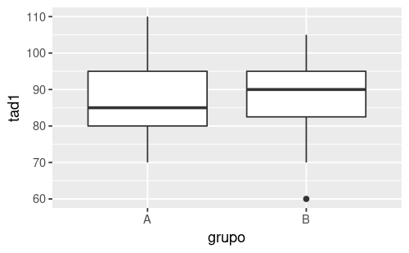
Boxplot tad1, by group

Slide 22
Compare a Quantitative variable in two groups
Null Hypothesis: There is not difference of the variable in two population or groups
Samples have been generated
INDEPENDENT
Selected individuals in a group have nothing to do with selected individuals in the other group.
DEPENDENT
Each individual in a group has a correspondent in other group.
These are paired data.

Slide 23
Two sample tests
EQUAL VARIANCES T-TEST
Yes
P>,05 Levene test for Homogeneity of Variances
Yes
UNEQUAL VARIANCES T--TEST(WELCH)
Normality
or n>30
No
no
Yes
NON-PARAMETRIC TESt : MANN-WHITNEY’S U or WILCOXON RANK-SUMS
Independent Groups
Yes
PAIRED T-TEST
No
Normality
ó n>30
No
NON-PARAMETRIC TEST: WILCOXON SIGNED-RANK

Slide 24
Two sample tests (1)
EQUAL VARIANCES T-TEST
Yes
P>,05 Levene test for Homogeneity of Variances
Yes
UNEQUAL VARIANCES T--TEST(WELCH)
Normality
or n>30
No
no
Yes
NON-PARAMETRIC TEST : U DE MANN-WHITNEY O SUM-RANK OF WILCOXON
Independent Groups
Data is normal (normality test) or sample size > 30.
Mean is a good summary statistic for this problem.
Test homogeneity of variances

Slide 25
Test of homogeneity of variances
> library(car)
> hta%>%
+ group_by(grupo) %>%
+ summarise(var = sd(tad1))
# A tibble: 2 × 2
grupo var
<chr> <dbl>
1 A 10.6
2 B 9.79
> with(hta,leveneTest(tad1~factor(sexo),center="median"))
Levene's Test for Homogeneity of Variance (center = "median")
Df F value Pr(>F)
group 1 1.3506 0.2499
58
We cannot reject H0: Variances cannot be considered to be distinct

Slide 26
t-Test if variances are equal
> with(hta,t.test(tad1~factor(grupo),var.equal=TRUE ))
Two Sample t-test
data: tad1 by factor(grupo)
t = 0.15001, df = 58, p-value = 0.8813
alternative hypothesis: true difference in means between group A and group B is not equal to 0
95 percent confidence interval:
-4.874549 5.664316
sample estimates:
mean in group A mean in group B
88.62069 88.22581
We cannot reject H0: Mean values are the same in group A and B (cannot be considered to be distinct)

Slide 27
Comparison between two groups, data non normal
Normality
or n>30
no
Yes
NON-PARAMETRIC TEST: MANN-WHITNEY’S U O WILCOXON SUM-RANK
Independent Groups

Slide 28
Non parametric tests
If data distribution is unknown or mean is not the best way to summarize data …
  Non parametric test are not based on the usual parameters from a distribution, such as μ or σ^{2.}
  Instead they may be based …
    On order statistics, such as median or percentiles
  They take into account the whole distribution.

Slide 29
Test based on ranks (Wilcoxon)
Based on susbtituting original values by “ranks” in a joint sample
  12, 5, 14, 16, 3 → ranks are: 3, 2, 4, 5, 1
Ranks only depend on the position of each value in the ordered sample.
  120, 95, 121, 130, 3 have the same ranks as values in the first sample
☺ NP test are more robust than parametrics ones
☹ In the ideal situation where parametric tests are valid they are considered to be preferable.

Slide 30
Wilcoxon rank sums test
> hta%>%
+ group_by(sexo) %>%
+ summarise(median = median(tad1))
# A tibble: 2 × 2
sexo median
<chr> <dbl>
1 MUJER 90
2 VARON 90
> with(hta,wilcox.test(tad1~factor(grupo),
+ alternative='two.sided',
+ exact=TRUE, correct=FALSE))
Wilcoxon rank sum test
data: tad1 by factor(grupo)
W = 432, p-value = 0.7926
alternative hypothesis: true location shift is not equal to 0
Warning message:
In wilcox.test.default(x = c(80, 85, 100, 90, 105, 110, 100, 100, :
cannot compute exact p-value with ties

Slide 31
Exercise 2
Is TAD comparable at baseline time between Men and women?
  What is the Hypothesis that we want to test? Describe the null hypothesis and the alternative hypothesis.
  What test would be appropiate to answer the question?
  Compute and decide
  Apply a non-parametric test and compare the results

Slide 32
Questions to answer
Are samples comparable at baseline time?
Is blood pressure comparable between first and 12th measures?

Slide 33
Example Data
A study was designed to compare two distinct hypertension control programs.
60 individuals with HTA were randomly assigned to either one or the other group (30 per group)
Blood pressure was measured each month during a year

Slide 34
Syllabus
INTRODUCTION
NORMALITY TESTS
ONE GROUP COMPARISON
TWO GROUPS COMPARISON IN INDEPENDENT SAMPLES
TWO GROUPS COMPARISON IN DEPENDENT SAMPLES
MORE THAN TWO GROUPS COMPARISON IN INDEPENDENT SAMPLES
MULTIPLE COMPARISONS AND MULTIPLE TESTING
3
5

Slide 35
Two dependent groups
Independent Groups
Yes
PAIRED T-TEST
No
Normality
ó n>30
No
NON-PARAMETRIC TEST: WILCOXON SIGNED RANK

Slide 36
Questions to answer
Are samples comparable at baseline time?
Is blood pressure comparable between first and 12th measures?

Slide 37
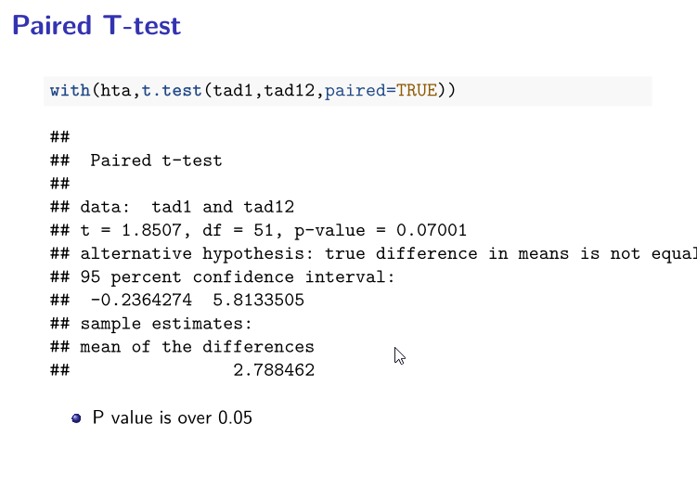

Slide 38
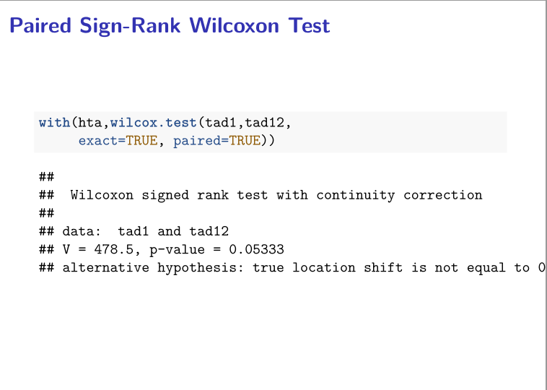

Slide 39
Exercise 3
Is sistolic blood pressure (TAS) comparable between first and 12th measures?

Slide 40
Syllabus
INTRODUCTION
NORMALITY TEST
ONE GROUP COMPARISON
TWO GROUPS COMPARISON IN INDEPENDENT SAMPLES
TWO GROUPS COMPARISON IN DEPENDENT SAMPLES
MORE THAN TWO GROUPS COMPARISON IN INDEPENDENT SAMPLES
MULTIPLE COMPARISONS AND MULTIPLE TESTING
3
5

Slide 41



Question to answer
A pharmaceutical laboratory wants to test which of three drugs are better:
drug 1 drug 2 drug 3

Slide 42
Question to answer
Could we use Student's t test? We will see with and example:
A pharmaceutical laboratory wants to test which of three drugs are better:
To know which of the drugs is the best one, one could think to perform the following comparison using a t test:
drug 1 drug 2 drug 3

Slide 43
Question to answer
Could we use Student's t test? We will see with and example:
Comparisons with separate t test would be:
Chance of Type I error
Chance of Accept H0
vs
vs
vs
α = 5%
1−α =95%
α = 5%
1−α =95%
α = 5%
1−α =95%

Slide 44
Question to answer
Could we use Student's t test? We will see with and example:
Comparisons with t test would be:
Chance of Type I error
Chance of Accept H0
vs
vs
vs
α = 5%
1−α = 95%
α ≈ 10%
1−α = 95%*95%
α ≈ 15%
1−α = 95%*95%*95%

Slide 45
Question to answer
Could we use Student's t test? We will see with and example:
Comparisons with t test would be:
Chance of Type I error
Chance of Accept H0
vs
vs
vs
α = 5%
1−α = 95%
α ≈ 10%
1−α = 95%*95%
α ≈ 15%
1−α = 95%*95%*95%
Would be easier not reject the null hypothesis when it was wrong (more false positives)

Slide 46
Analysis of the variance
Null Hypothesis
The means of all population are equal
H₀ μ₁ =μ₂ =.... =μ_{k}
Alternative Hypothesis
Not all the means are equal. At least there are two different means
H_{a} ∃ i,j μ_{i} ≠μ_{j}

Slide 47
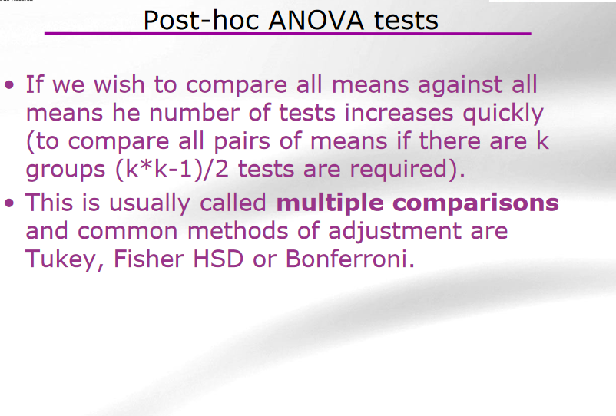

Slide 48
Three or more groups
ANOVA
Yes
Normality
Homocedasticity
No
Yes
KRUSKAL- WALLIS TEST
Independent Groups
REPEATED MEASURES ANOVA
No
Yes
Normality Homocedasticity
No
FRIEDMAN TEST

Slide 49
Three or more groups
ANOVA
Yes
Normality
Homocedasticity
No
Yes
KRUSKAL- WALLIS TEST
Independent Groups

Slide 50
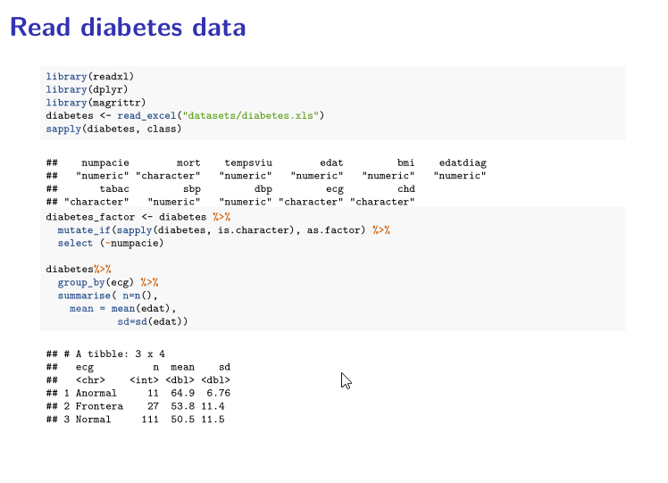

Slide 51
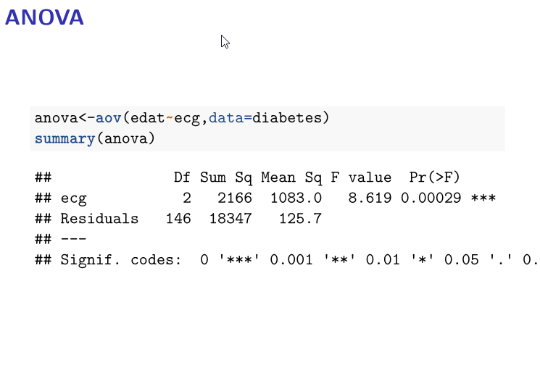

Slide 52
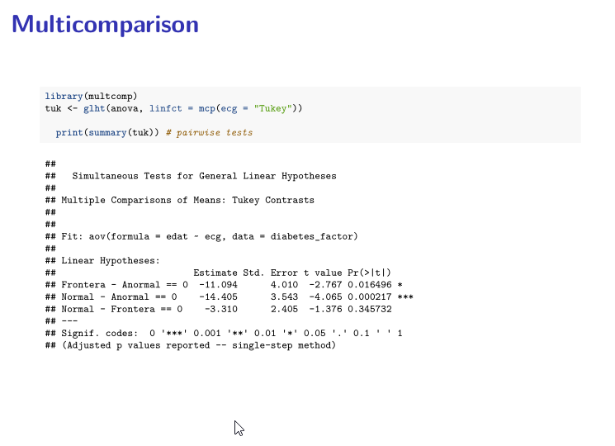

Slide 53
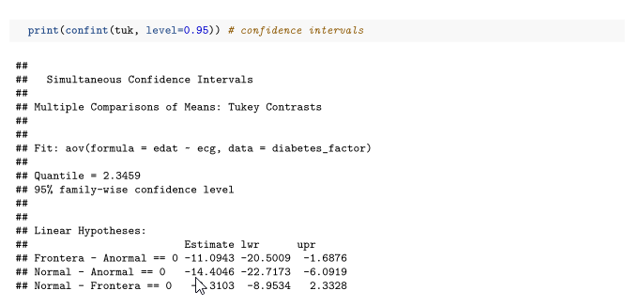

Slide 54
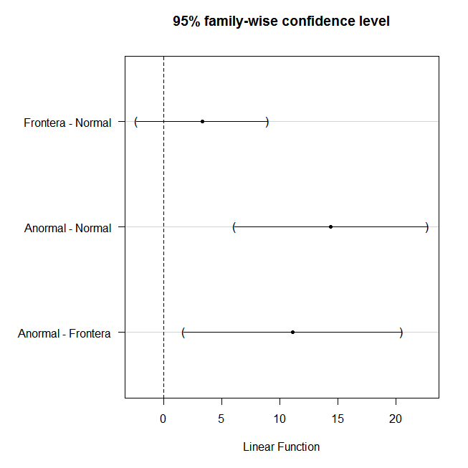
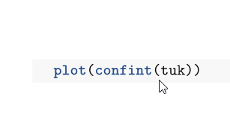
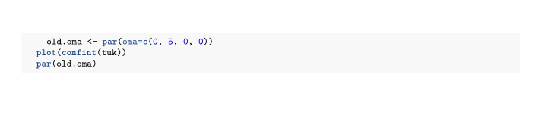

Slide 55
Three or more groups
ANOVA
Yes
Normality
Homocedasticity
No
Yes
KRUSKAL- WALLIS TEST
Independent Groups

Slide 56
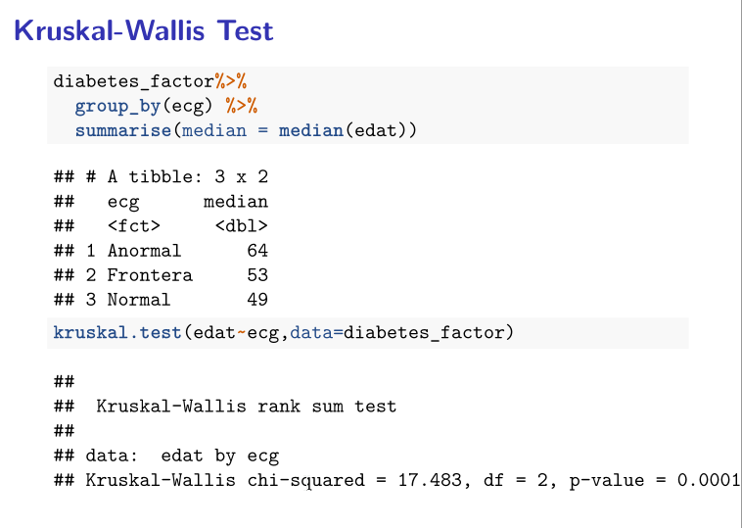

Slide 57
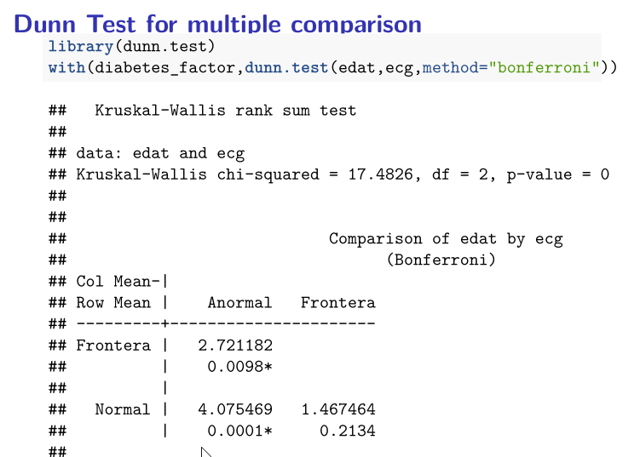

Slide 58
Exercise 5
Are there differences between systolic pressure (sbp) and ECG in diabetic patients?
  For each variable, perform some descriptives and check normality assumptions
  Set the hypothesis contrast and perform the test
  If needed, apply a post-hoc test for multiple comparisons to test which groups are different.
  Extra: Analyze the relation between the follow-up time (tempsviu) and the ECG.

Slide 59
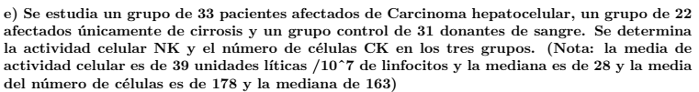
Exercise 6

Slide 60
Questions to answer
Is diastolic (min) tension above 90, “on average”, at the beginning of the study.
Are samples “comparable” at baseline?
  In Age? Sex%? Sist? Diast?
Has there been a change in BP between month 1 (first measure) and month 12?

