Slide 1
Master in Translational Biomedical Research
Module II: Advanced Methodologies and Tools for Research
Section II: Biostatistics
Lesson 1.2 Principles of
statistical inference.
Alex Sánchez)
Alex.sanchez@vhir.org
09/10/2015

Slide 2
Table of contents
Case study problem
Dependent/independent variables
The objective of statistical inference
Sampling issues
Estimators
Hypothesis testing
Significance level
Bilateral/unilateral tests
Errors and statistical power
Interpreting p-values

Slide 3
Case study problem: osteoporosis
Our data set: osteoporosis.csv
Bone density (''bua'') is a key variable to determine if a person is suffering osteoporosis.
But, how do other variables affect or determine the level of bone density?
Have these other variables differences regarding their distribution and properties?
In our case study, we may want, for instance, to...
Explore the distribution of the bone density variable.
Estimate the % of women with an unusually low bone density
Compare it between menopausic and non-menopausic women.

Slide 4


Slide 6
Dependent / Independent variables
Independent variable: a variable that stands alone and isn't changed by the other variables you are trying to measure.a variable that stands alone and isn't changed by the other variables you are trying to measure.
Dependent variable: a variable that is affected by the value of other variables, and that would probably change if these are modified.

Slide 7
Dependent / Independent variables
Independent variable: a variable that stands alone and isn't changed by the other variables you are trying to measure.a variable that stands alone and isn't changed by the other variables you are trying to measure.
Dependent variable: a variable that is affected by the value of other variables, and that would probably change if these are modified.
* Anyway, the dependency or not of a variable is determined by the context of the experiment, the role of the other variables and the relationships between them.
In our case study: edad, peso, talla, menop*, nivel_ed ...
In our case study: bua, imc*, clasific*, grupedad* ...

Slide 8





























The objective of statistical inference
Taking the observed (measured)
values of a group of samples...
... determine the properties of the entire population.

Slide 9






















The objective of statistical inference
Hypothesis
Population
Samples
(sampling techniques)
Conclusions based
on the observed data
(Statistical inference)
(Parameters estimation)
(Hypothesis testing)
Generalization to
the population

Slide 10
Sampling issues
Sample(s) should be representative of the population where they come from.
Sample size and sampling methods must follow the statistical criteria depending on the the experiment.
It is very common to have sampling limitations (samples not randomly obtained, desired sample size unaffordable...)
Much better to know our limitations than the sampling techniques!

Slide 11
Two types of statistical inference problems
We are usually faced with either one or both of the following types of questions
ESTIMATION
  When we wish to learn some characteristics of our population, such as, but not limited to, the mean or the proportion
    The percentage of non osteopenic or menopausic women
    The mean bone density in each of these groups
HYPOTHESIS TESING
    When we wish to check about some statement on some characteristic of the population or we wish to make some comparisons
      Is it true that the mean bone density is smaller than 75 in menopausic
      Can we state that non menopausic women have a higher bone density than menopausic?

Slide 12
Estimators: Approximating the value of poulation parameters
Numeric value calculated on a sample that we hope to be a good approximation of a certain real value (parameter) in the population.
Intuitively, we work with many estimators, such as the mean or a computed percentage of a given sample, that we assume that are somehow characterizing a population.
It is not allways obvious to decide which is the best estimator for each parameter.
There are methods to define the precision of the estimators and quantify the underlying error(s).

Slide 13
Precison of an Estimator
An obvious question when we choose an estimator is how precise is it to approximeate the value of the population parameter.
This can be answered using the standard error of the estimator
The standard error is a great quantity :
  Informs about the precision of our estimates
  Helps build another type of estimators: confidence intervals
  Helps find formulae to compute sample size for estimation

Slide 14
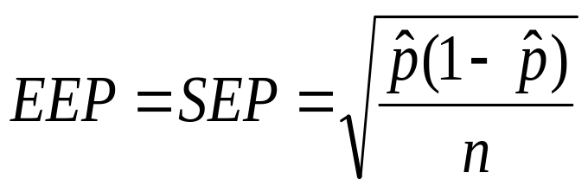
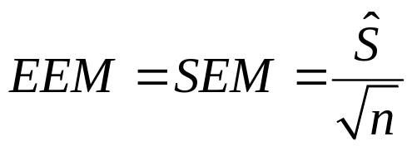
The standard error
Standard error of the mean
Standard error of the proportion

Slide 15
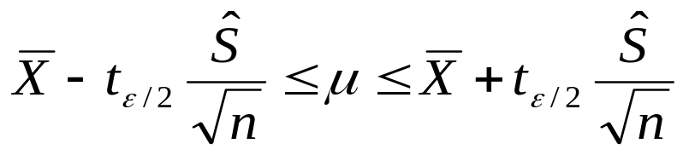
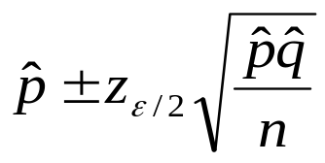
Confidence intervals are based on standard errors
Confidence interval for the mean of a normal population
Confidence interval for the proportion

Slide 16
Confidence intervals with R
In general R does not compute (has no functions) for the direct calculation of confidence intervals
This can be done by calling the corresponding tests functions such as t.test or prop.test
Some R commander plugins such as EZR allow this computations directly

Slide 17
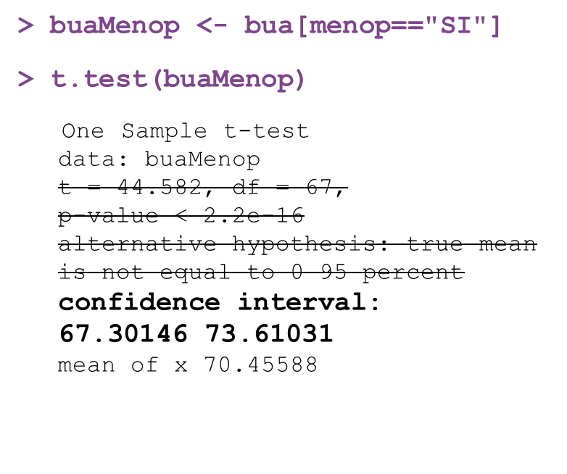
Examples – CI for the mean using R or Rcmdr
In RCmdr the menu options below will yield the same result as in the left pannel
Estadísticos
→ Medias
→ Test-t para la media
In EZR this can be done by simply providing the mean the standard deviation and the sample size

Slide 18
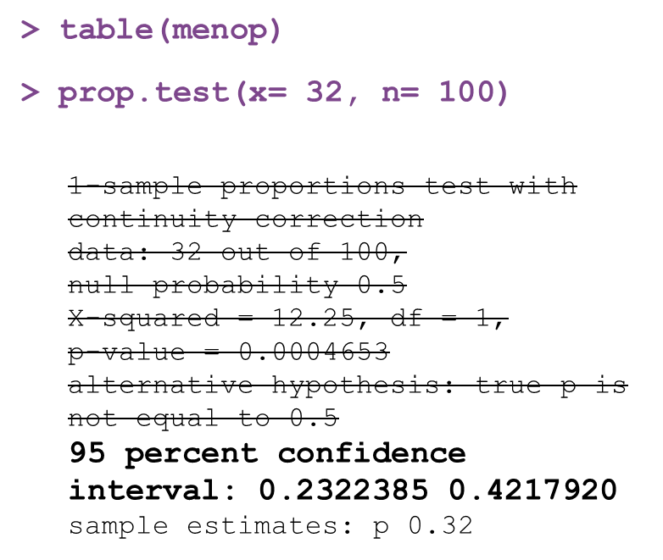
Examples – CI for the proportion
In RCmdr the menu options below will yield the same result as in the left pannel
Estadísticos
→ Medias
→ Test-t para la media
In EZR this can be done by simply providing the mean the standard deviation and the sample size

Slide 19
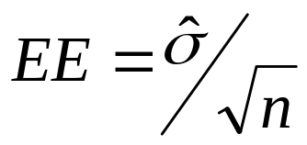
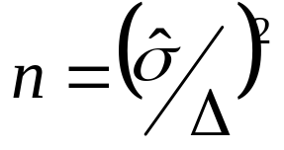
Sample size for estimation
The standard error informs of how precise an estimation is if one knows the variability and the sample size
We can proceed in the opposite sense: assuming we know the variability (e.g. from a pilot study) and the highest precision we wish to attain ("arm length" of a confidence interval: Δ=z_{α/2}·EE)
The sample size needed to attain this precision can be isolated from the formula

Slide 20
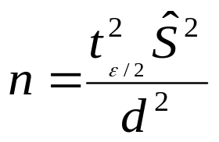
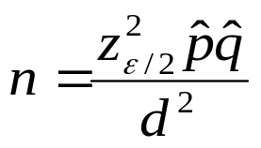
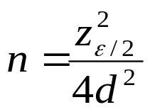
Sample size example formulae
Sample size needed to estimate the mean of a normal population with a given precision d
Sample size formula to estimate a proportion
Left: assuming p is known from a pilot study
Right: assuming p=q=0.5

Slide 21
Sample size calculations with R
In general R does not compute (has no functions) for sample size calculations for estimation purposes.
One can use web sites such as:
http://www.imim.cat/ofertadeserveis/software-public/granmo/index.html
If the goal is to do a hypothesis test this can be done using the power package
Some R commander plugins such as EZR allow this computations directly

Slide 22

Hypothesis testing: Making decisions about poulations
Guess that average bone density in women is
70...
But... why not to check median,
mode or other estimators?

Slide 23
Case study problem
Our assumptions:
The average ''bua'' value in our population is 70
The ''bua'' mean value in menopausic and non-menopausic women is not the same.
.
Exercise 1):
- Explore osteoporosis data in order to get an idea about our first assumption
- What other things you can figure out about the bone density in our population?

Slide 24
Hypothesis testing
Guess that average bone density in women is
70...
But... why not to check median,
mode or other estimators?
Our assumptions:
The average ''bua'' value in our population is 70.
The ''bua'' mean value in menopausic and non-menopausic women is not the same.
We can use hypothesis testing to verify these assumptions, by checking if our samples are compatible with these statements.

Slide 25
Hypothesis testing: elements
Null hypothesis (H₀): depends on the question we want to answer
- Is the mean of the bua values equal to 70.0? H_{0:} The mean of the bua values is 70.0
- Is the mean bua of the menop. and non-menop groups equal? H_{0:} Both means are equal

Slide 26
Hypothesis testing: elements
Null hypothesis (H₀): depends on the question we want to answer
Alternative hypothesis (H_{α} =H_{a} =H₁): the opposite idea
- Is the mean of the bua values equal to 70.0? H_{0:} The mean of the bua values is 70.0
- Is the mean bua of the menop. and non-menop groups equal? H_{0:} Both means are equal
- H_{1:} The mean of the bua values is not equal to 70.0
- H_{1:} Both means are different
H₁ only accepted if clear evidence
that H₀ is not true

Slide 27
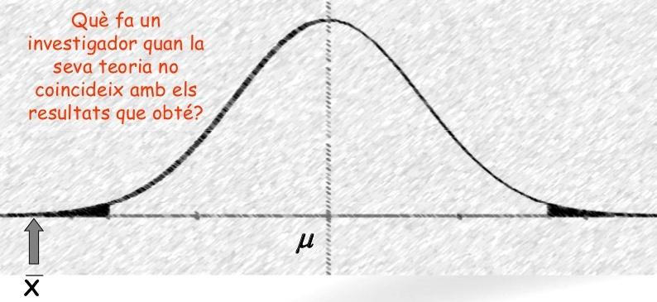
Hypothesis testing: elements
Null hypothesis (H₀): depends on the question we want to answer
Alternative hypothesis (H_{α} =H_{a} =H₁): the opposite idea
- Is the mean of the bua values equal to 70.0? H_{0:} The mean of the bua values is 70.0
- Is the mean bua of the menop. and non-menop groups equal? H_{0:} Both means are equal
- H_{1:} The mean of the bua values is not equal to 70.0
- H_{1:} Both means are different
H₁ only accepted if clear evidence
that H₀ is not true
If observed mean = 18 H₀ is rejected
= 70
= 18

Slide 28
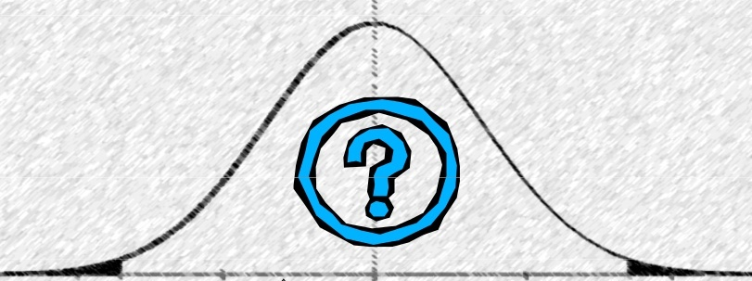
Hypothesis testing: elements
Null hypothesis (H₀): depends on the question we want to answer
Alternative hypothesis (H_{α} =H_{a} =H₁): the opposite idea
- Is the mean of the bua values equal to 70.0? H_{0:} The mean of the bua values is 70.0
- Is the mean bua of the menop. and non-menop groups equal? H_{0:} Both means are equal
- H_{1:} The mean of the bua values is not equal to 70.0
- H_{1:} Both means are different
H₁ only accepted if clear evidence
that H₀ is not true
If observed mean = 18 H₀ is rejected
If observed mean = 58 H₀ can not be rejected
(it not means H₀
can be accepted!!)
μ = 70
x = 58

Slide 29
Hypothesis testing: elements
Null hypothesis (H₀): depends on the question we want to answer
Alternative hypothesis (H_{α} =H_{a} =H₁): the opposite idea
Test: Depends on the sample data (sample size, distribution of the variable of interest...). It is a measure of discrepancy between H₀ and the observed data.
- Is the mean of the bua values equal to 70.0? H_{0:} The mean of the bua values is 70.0
- Is the mean bua of the menop. and non-menop groups equal? H_{0:} Both means are equal
- H_{1:} The mean of the bua values is not equal to 70.0
- H_{1:} Both means are different
Only accepted if claer evidence
that H₀ is not true

Slide 30
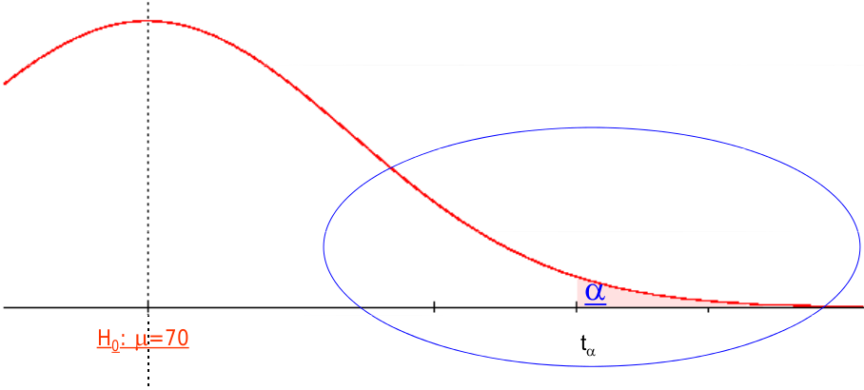
Hypothesis testing: elements
Null hypothesis (H₀): depends on the question we want to answer
Alternative hypothesis (H_{α} =H_{a} =H₁): the opposite idea
Test: Depends on the sample data (sample size, distribution of the variable of interest...). It is a measure of discrepancy between H₀ and the observed data.
Rejection value (critical value, T_{α}): Value obtained by the statistics test from which we reject H₀
- Is the mean of the bua values equal to 70.0? H_{0:} The mean of the bua values is 70.0
- Is the mean bua of the menop. and non-menop groups equal? H_{0:} Both means are equal
- H_{1:} The mean of the bua values is not equal to 70.0
- H_{1:} Both means are different
Only accepted if claer evidence
that H₀ is not true

Slide 31
Significance level
Significance level (α): Arbitrary level (that should be established a priori) to compare the obtained p-values in order to reject or not H₀
Is the probability of the critical region (the region left at one or two sides by the critical value)
Commonly set at (but not necessarily always) 0.05 (5%) or 0.01 (1%)

Slide 32
Significance level
Significance level (α): Arbitrary level (that should be established a priori) to compare the obtained p-values in order to reject or not H₀
Is the probability of the critical region (the region left at one or two sides by the critical value)
Commonly set at (but not necessarily always) 0.05 (5%) or 0.01 (1%)

Slide 33
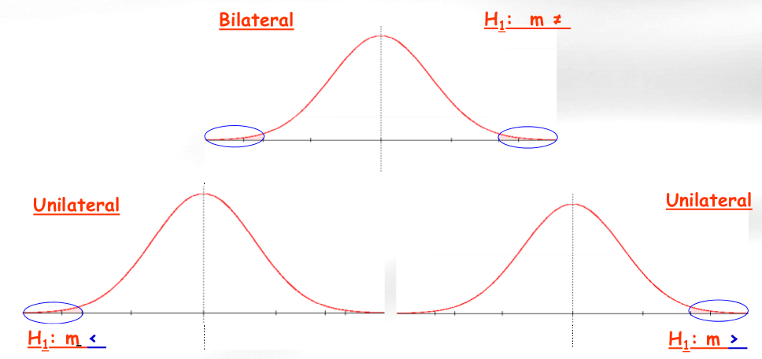
Bilateral / Unilateral tests

Slide 34
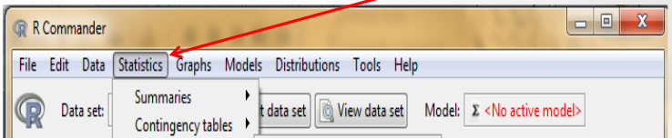
Case study problem
Our assumptions:
The average ''bua'' value in our population is 70.
The ''bua'' mean value in menopausic and non-menopausic women is not the same.
Hint: look at this menu
Exercise 2):
- Test if the mean bone density value is 70.0 or not
- Test if the mean bone density is equal or not between groups
if we separate our observations by ''menop'' category

Slide 35
Exercise 2 – Solution (1)
t.test(bua, mu=75)
One Sample t-test
data: bua t = -0.22669, df = 99,
p-value = 0.8211
alternative hypothesis: true mean is not equal to 75
95 percent confidence interval: 71.68398 77.63602 sample estimates: mean of x 74.66
In RCmdr the menu options below will yield the same result as in the left pannel
Estadísticos
→ Medias
→ Test-t para la media

Slide 36
Exercise 2 – Solution (2)
> t.test (bua~menop)
Welch Two Sample t-test
data: bua by menop
t = 4.2203, df = 53.292,
p-value = 9.536e-05
alternative hypothesis: true difference in means is not equal to 0
95 percent confidence interval: 6.894761 19.380975 sample estimates:
mean in group NO mean in group SI 83.59375 70.45588
In RCmdr the menu options below will yield the same result as in the left pannel
Estadísticos
→ Medias
→ Test-t para la media

Slide 37
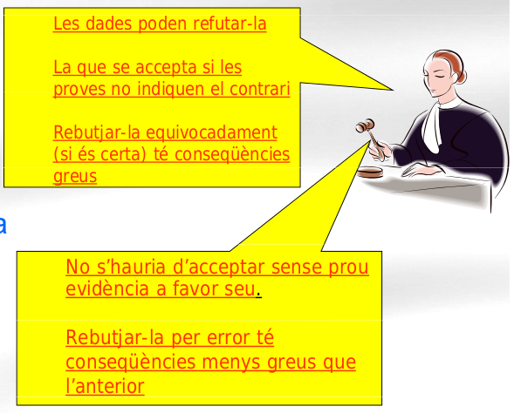
Errors and power (in hypothesis testing)
Data can lead to reject it
Accepted if data don't
show the contrary
Reject it by mistake (if it is true) has severe consequences
H₀
(innocent)
(not speculative)
Should not be accepted without enough evidence
Reject it erroneously has less dramatic consequences
H₁
(guilty)
(speculative)

Slide 38

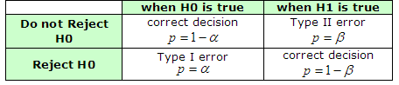
Errors and power (in hypothesis testing)
Real population
Experiment
conclusions
Type I error = False positives
Type II error = False negatives
α = Prob [refusing H₀ | H₀ is true] = Proportion of false positives = Significance level
β = Prob [not refusing H₀ | H₀ is false] = Proportion of false negatives
1 – α = confidence level (95 - 99%)= Prob [refusing H₀ | H₀ is false]
1 – β = statistical power = Prob [refusing H₀ | H₀ is false]

Slide 39
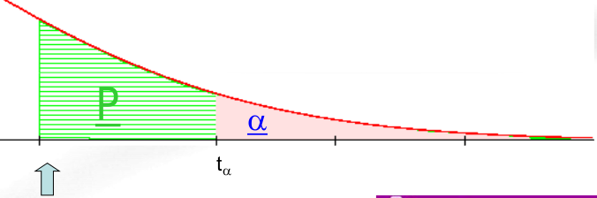
Interpreting p-values
What does the obtained p-value mean?
· The probability that would correspond with the critical region starting exactly at the test value that we have obtained from our data, and
· the probability of having a new sample that differs more than our sample in comparison with H0, and
· the probability of finding, just by chance, a sample more rare that the one that we have used for the test.

