Slide 1








Principles of Statistical Inference
Curs d'Estadística Bàsica per a la Recerca Biomèdica
UEB – VHIR
Santiago Pérez-Hoyos i Alex Sánchez-Pla
santi.perezhoyos@vhir.org
alex.sanchez@vhir.org

Slide 2





























The objective of statistical inference
Taking the observed (measured)
values of one (or more) of samples...
... Determine (“infer”) the properties of the entire population.

Slide 3





















The objective of statistical inference
Hypothesis
Population
Samples
(sampling techniques)
Conclusions based
on the observed data
(Statistical inference)
(Parameters estimation)
(Hypothesis testing)
Generalization to
the population

Slide 4
Estimation
The aim of estimation is to infer properties (parameters) of the distribution of population data from sample data
Some key concepts
Point estimate: Give a numerical value to the parameter of interest.
Estimator: Mathematical function to obtain the estimate
Interval Estimation: Give two values ​​between which is the value of the population parameter with a preset confidence level (or probability)
Random error: Difference between estimation and real value if the sample is random

Slide 5
Point estimation (1)
Data from qualitative variables
Parameter: Probability to observe a certain category
Estimate: Sample proportion: % of that category in the sample
Example: In the Osteoporosis dataset, what is the probability of observing a woman without ostheoporosis

Slide 6
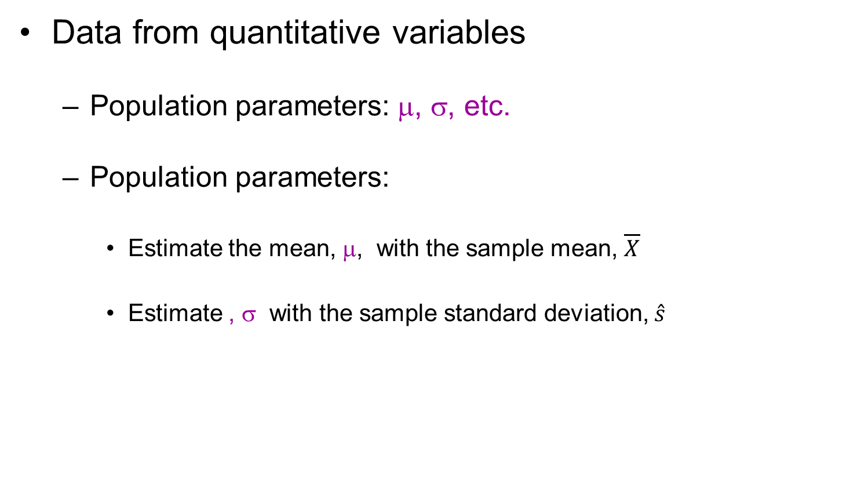
Point estimation (II)
Data from quantitative variables
Population parameters: μ, σ, etc.
Population parameters:
Estimate the mean, μ, with the sample mean, $\overline{X}$
Estimate , σ with the sample standard deviation, $\hat{s}$

Slide 7
Exercise
In the osteoporosis dataset (osteo100) estimate the mean bone density (BUA)
for all the population indistinctly
depending on the CLASSIFIC variable

Slide 8









Biological variability. Sampling
Sample 1
=1/8
Sample 2
=3/8
Sample 3
Population
=0/8
=1/8

Slide 9
Sampling distribution
Population is 5 Children with age
x₁=6, x₂=8, x₃=10, x₄=12, x₅=14
Mean μ=10
Variance σ² =8
Extract all possible samples with replacement and compute the mean in each sample
In this problem we can compute the population parameters because we know all the population values!!!

Slide 10
25 Samples n=2
Second Data
6
8
10
12
14
6
6,6
6,8
6,10
6,12
6,14
(6)
(7)
(8)
(9)
(10)
Fist Data
8
8,6
8,8
8,10
8,12
8,14
(7)
(8)
(9)
(10)
(11)
10
10,6
10,8
10,10
10,12
10,14
(8)
(9)
(10)
(11)
(12)
12
12,6
12,8
12,10
12,12
12,14
(9)
(10)
(11)
(12)
(13)
14
14,6
14,8
14,10
14,12
14,14
(10)
(11)
(12)
(
13)
(14)

Slide 11
Frequency table
media
frecuencia
frec relativa
6
1
1/25
7
2
2/25
8
3
3/25
9
4
4/25
10
5
5/25
11
4
4/25
12
3
3/25
13
2
2/25
14
1
1/25

Slide 13
Histograma

Slide 14
Summary
Mean of 25 sample means
μ_{med}=(6+7+...+14)/25=10
Variance of 25 sample means
σ²_{med}={(6-10)²+(7-10)²+..+(14-10)²}/25=4
The mean of sample means is population mean
σ_{med}²= σ²/2=8/2=4
Variance of 25 sample means equals population variance divided by sample size

Slide 15
Standard error
Standard deviation of the distribution of sample means
Usually it is defined as population standard deviation divided by squared root of sample size

Slide 16
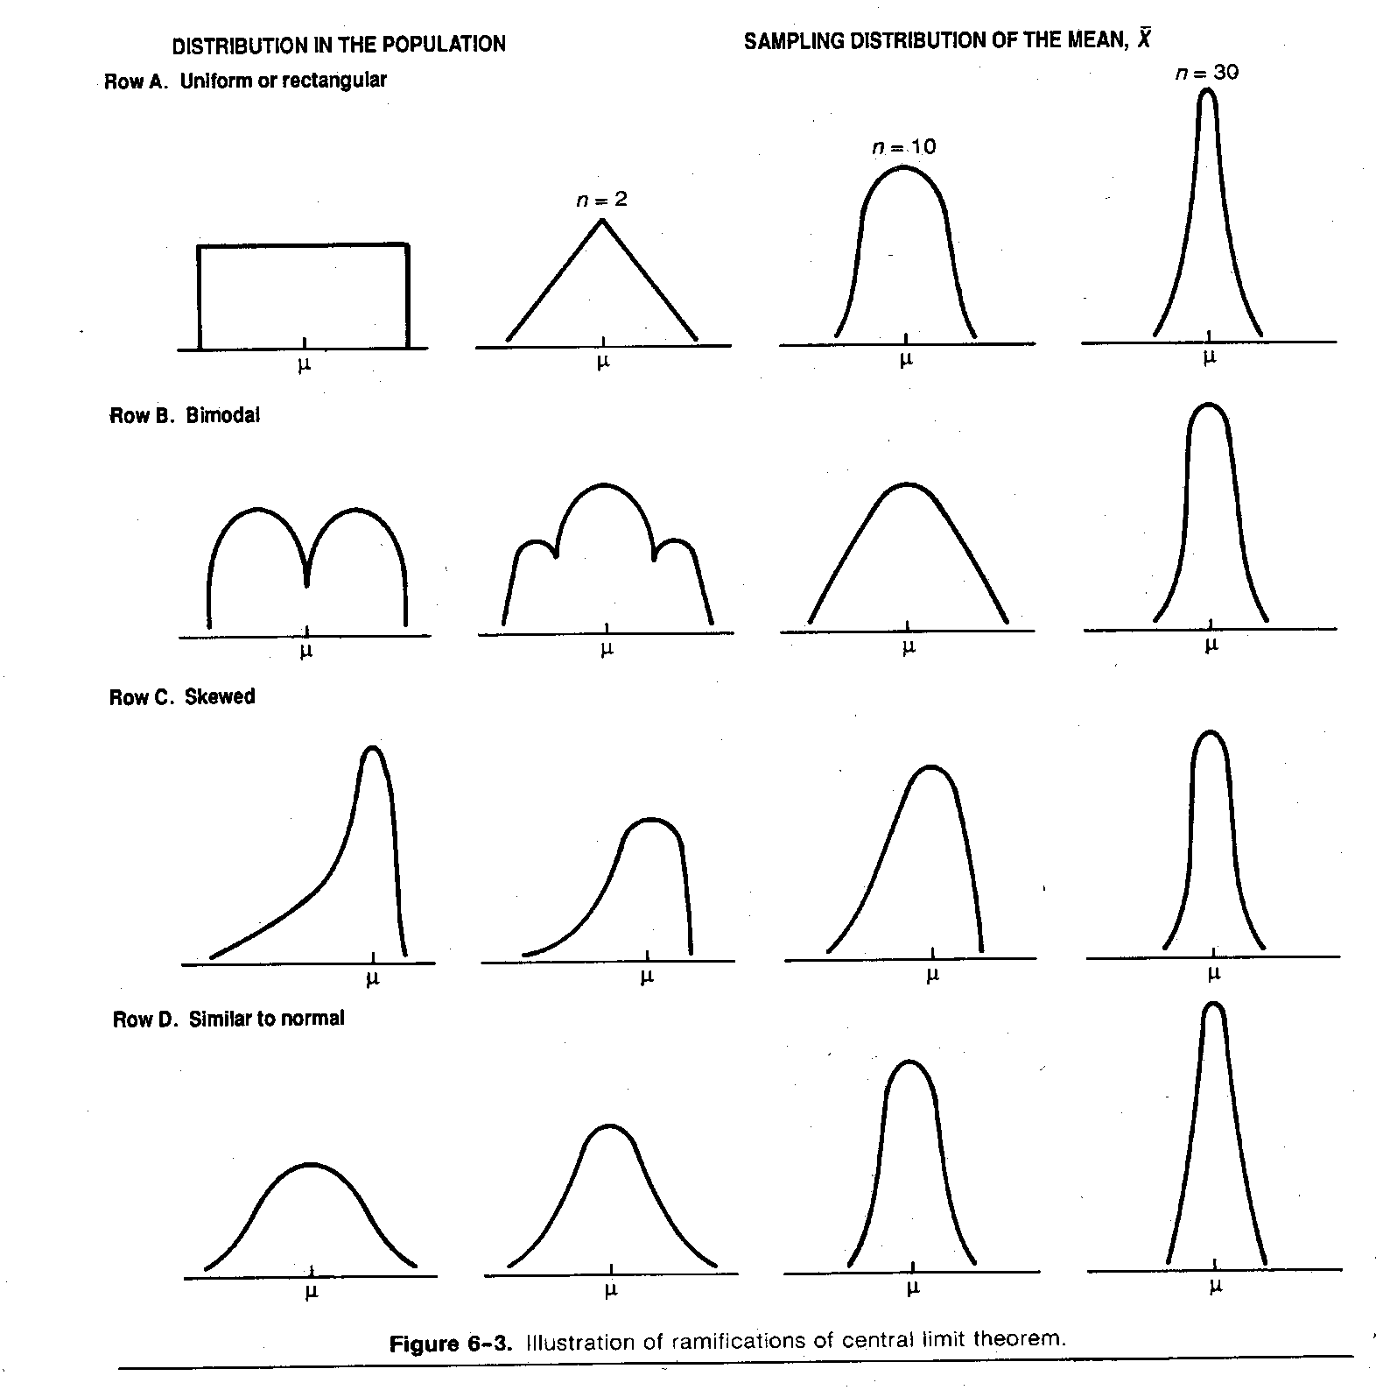

Slide 17
Unbiased estimators
An estimator is unbiased if the mean of the sample estimates is the parameter we are looking for.
Sample mean and proportion are unbiased estimators of population mean and probability (percentage)
Sample variance is a biased estimator of population variance, but not if we divided by n-1
That is why computers compute sample variance dividing by (n-1) instead of dividing by n.

Slide 18
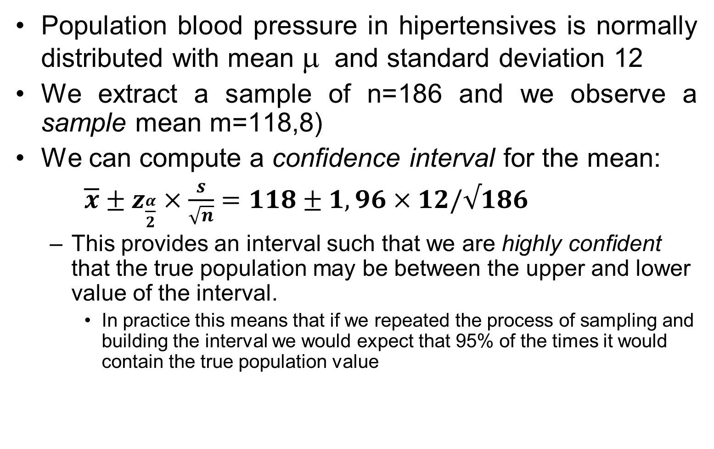
Confidence interval of Mean
Population blood pressure in hipertensives is normally distributed with mean μ and standard deviation 12
We extract a sample of n=186 and we observe a sample mean m=118,8)
We can compute a confidence interval for the mean:
$\overline{x}±z_{\frac{α}{2}}×\frac{s}{\sqrt{n}}=118±1,96×12/√186$
This provides an interval such that we are highly confident that the true population may be between the upper and lower value of the interval.
In practice this means that if we repeated the process of sampling and building the interval we would expect that 95% of the times it would contain the true population value

Slide 19
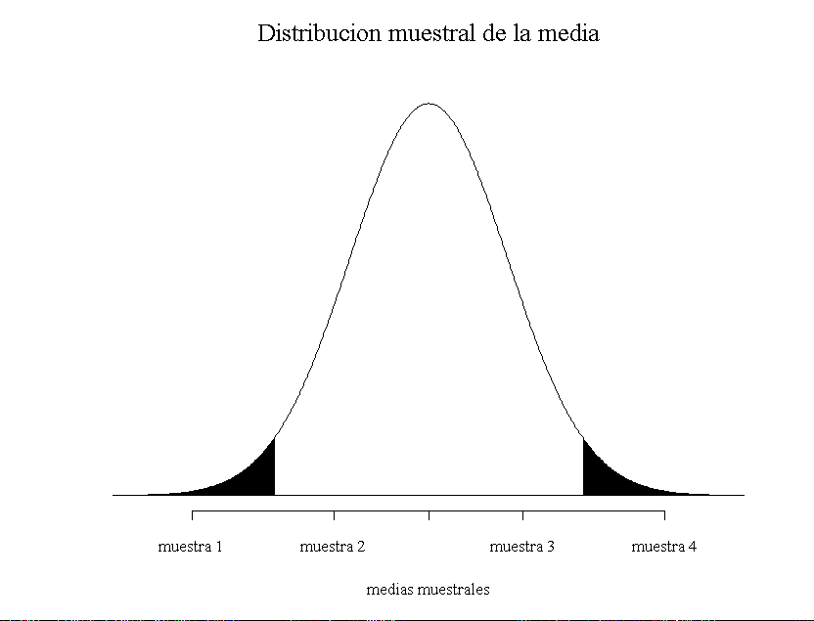
μ−1.96 σ/√186
μ+1.96 σ/√186
μ

Slide 20
m±1.96 σ/√186
m
μ
Population mean is outside de confidence interval

Slide 21
m±1.96 σ/√186
m
μ
Population mean is inside confidence interval

Slide 22
m±1.96 σ/√186
μ
m
Population mean is inside confidence interval

Slide 23
m±1.96 σ/√186
μ
m
Population mean its outside confidence interval

Slide 24
Confidence interval
PRECISION
PARAMETER
POSSIBLE VALUES
Estimator
Lower Bound
Upper Bound
Values in which we are confident that real population parameter is inside
With a prefixed confidence level (Usually 95%)

Slide 25
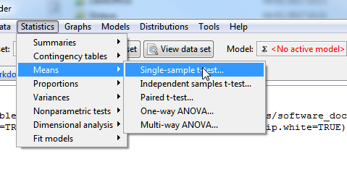
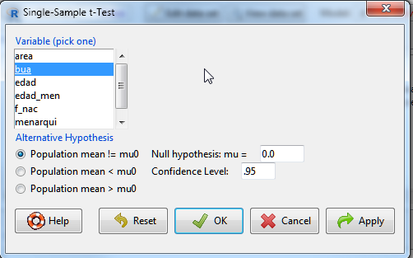
Confidence intervals in RCmdr

Slide 26
One Sample t-test
data: bua
t = 137.89, df = 999, p-value < 2.2e-16
alternative hypothesis: true mean is not equal to 0
95 percent confidence interval:
72.2539 74.3401
sample estimates:
mean of x
73.297

Slide 27
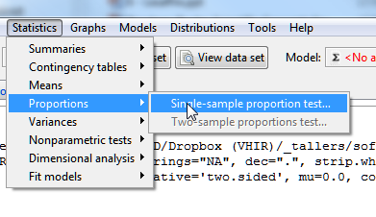
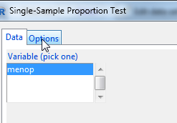
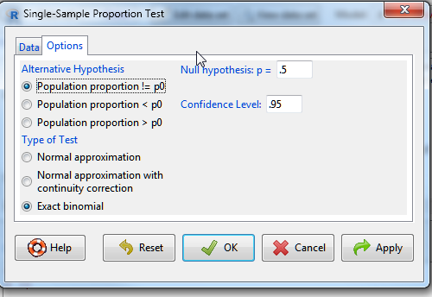
Confidence interval in RCmdr

Slide 28
Proportion Test Normal Aproximation
Frequency counts (test is for first level):
menop
NO SI
303 697
1-sample proportions test without continuity correction
data: rbind(.Table), null probability 0.5
X-squared = 155.24, df = 1, p-value < 2.2e-16
alternative hypothesis: true p is not equal to 0.5
95 percent confidence interval:
0.2753154 0.3321923
sample estimates:
p
0.303

Slide 29
Frequency counts (test is for first level):
menop
NO SI
303 697
Exact binomial test
data: rbind(.Table)
number of successes = 303, number of trials = 1000, p-value < 2.2e-16
alternative hypothesis: true probability of success is not equal to 0.5
95 percent confidence interval:
0.274632 0.332533
sample estimates:
probability of success
0.303

Slide 30
Sample size =10 , Mean=180, sd=20

Slide 31
Sample size =100 , Mean=180, sd=20

Slide 32
Sample size =100 , Mean=180, sd=20

Slide 33
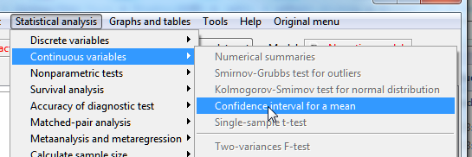
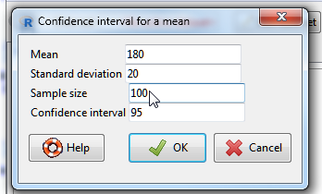
Confidence interval calculator (Plugin EzR)
95 %CI 176.032-183.968

Slide 34
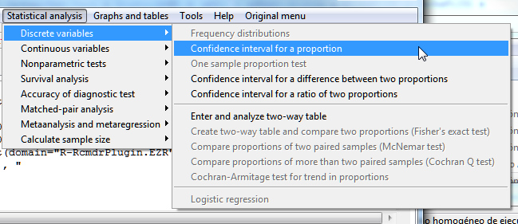
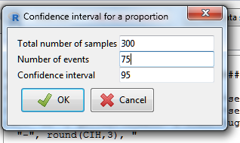
[1] Probability : 0.25
[1] 95% confidence interval : 0.202 - 0.303

Slide 35
Sample Size

Slide 36
Sample Size Calculation
Some questions must be answered before we can compute “sample size”
Precision (interval range) of estimations
Level of confidence of estimations
Sometimes (for proportions) it will help to have an idea of the value of the parameter we want to estimate

Slide 37
Sample Size Calculation
The question “what is the sample size” must be rephrased as:
What sample size is needed to estimate the mean, so that we have a high confidence (say 95%) that the estimation error will be less than a given threshold?

Slide 38
Sample SIZE for mean
If interval range is 10 ( precision =10/2=5), confidence levell is 95% and standard deviation is 20, sample size will be
n= 1.96² 20² / 5²= 62

Slide 39
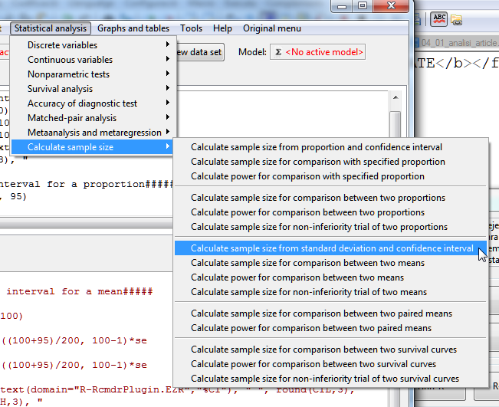

Slide 40
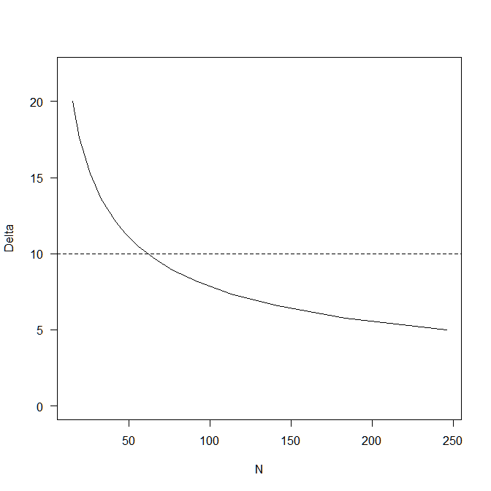
> SampleMeanCI(20, 10, 95)
Assumptions
Standard deviation 20
Confidence interval 10
Confidence level 0.95
Estimated
Required sample size 62

Slide 41
Sample size for proportion
Assume precision is 5% ( Interval = p±.05) and confidence level is 95%
If it is known that p is around 12.5%
n= 1.96² .125 (1-.125)/.05²= 168
If p is unknown maximum sample size will be if p=.50
n= 1.96² .5 (1-.5) /.05²= 384

Slide 42
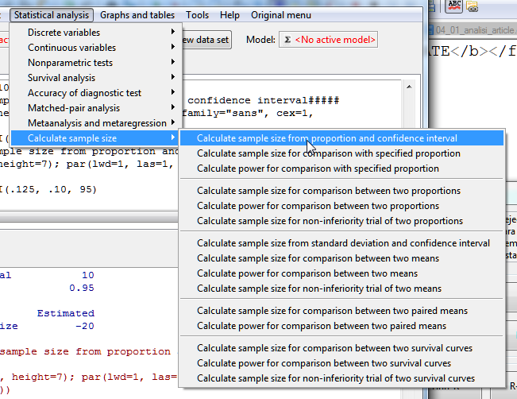
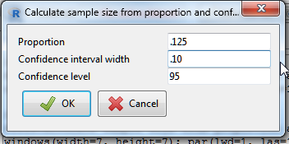
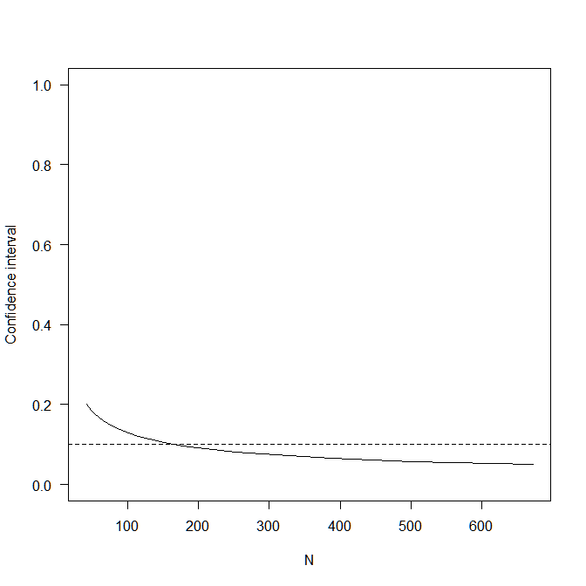
Assumptions
P 0.125
Confidence interval 0.1
Confidence level 0.95
Estimated
Required sample size 169

