Slide 1
DIAGNOSTICS TESTS. SENSITIVITY, SPECIFICITY AND ROC CURVES
Santi Perez Hoyos Miriam Mota Foix
santi.perezhoyos@vhir.org miriam.mota@vhir.org

Slide 2
OUTLINE
Diagnosis. Diagnostics tests
Sensitivity and specificity
Predictive values. Prevalence
Likelihood ratio
Receiver operator characteristic curves

Slide 3
OUTLINE
Diagnosis. Diagnostics tests
Sensitivity and specificity
Predictive values. Prevalence
Likelihood ratio
Receiver operator characteristic curves

Slide 4

Diagnosis. Diagnostics tests
Diagnosis
What's wrong with me doctor?
FOX

Slide 5
Diagnosis. Diagnostics tests
Diagnosis
Mmm …let me do some tests and valorate them
Foto: FOX

Slide 6
Diagnosis. Diagnostics tests
Diagnosis
Most important result of medical practice
Key that leads to treatment and prognosis
Other valid definitions
process of determining the nature of the morbid condition through examination.
careful examination of the facts to determine the nature of something
decision or opinion resulting from such examination or investigation..
Classification of individuals in healthy or sick

Slide 7
Diagnosis. Diagnostics tests
Process that leads to the diagnosis
Establish a presumption suspicion or hypothesis of existence of disease
Follow up on the clinical assumption and verify if this corresponds to the truth.
Uncertainty
Symptoms of a patient may be compatible with more than one disease
Biological variations from one individual to another
Instruments are imprecise
Patients are inaccurate to remember past events

Slide 8

Diagnosis. Diagnostics tests
Process that leads to the diagnosis
Different sources of information are used:
anamnesis of the patient
Physical exam
results of diagnostics tests
DIAGNOSTIC TEST
Procedure by which a diagnosis is confirmed or discarded

Slide 9
Diagnosis. Diagnostics tests
Diagnostics tests. What we desire?
Positive results in patients and negative results in healthy
Conditions to require a diagnostic test (I):
Validity: the degree to which a test measures what it is supposed to measure (sensitivity and specificity)
Reproducibility: ability of the test to offer the same results when its application is repeated in similar circumstances (biological, instrumental and technical variability)

Slide 10

Diagnosis. Diagnostics tests
Diagnostic test
Conditions to require a diagnostic test (II):
Safety: in the case of a positive result, what is the probability that this result indicates presence of the disease? (predictive values)
Easy to apply
Accepted by patients or the population in general
Minimal adverse effects
Economically bearable

Slide 11

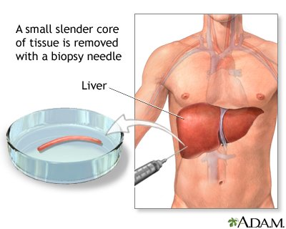

Diagnosis. Diagnostics tests
Relationship between the results of the test and the authentic diagnosis
Authentic diagnosis
Reference method

Slide 12
Diagnosis. Diagnostics tests
Relationship between the results of the test and the authentic diagnosis
expensive?
traumatic for the patient?
slow in getting results?
Reference method
A more accessible method (diagnostic test) is needed.
Classify patients the same as the reference method?

Slide 13
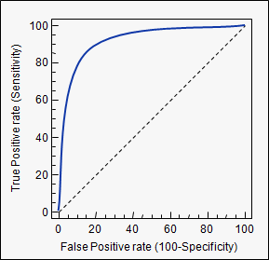
Diagnosis. Diagnostics tests
Relationship between the results of the test and the authentic diagnosis
In a diagnostic test with possible results:
Positive or Negative: Diagnostic table (contingency table)
Numerical values: ROC curve
 |  | Reference method
 |  | Sick | Healthy | TOTAL
Diagnostic | Positive | a | b | a+b
Test | Negative | c | d | c+d
 | TOTAL | a+c | b+d | a+b+c+d

Slide 14
Diagnosis. Diagnostics tests
Relationship between the results of the test and the authentic diagnosis
 |  | Reference method
 |  | Sick | Healthy | TOTAL
Diagnostic | Positive | a | b | a+b
Test | Negative | c | d | c+d
 | TOTAL | a+c | b+d | a+b+c+d
a = True positives (TP)
b = False positives (FP)
c = False negative (FN)
d = True negative (TN)

Slide 15
OUTLINE
Diagnosis. Diagnostics tests
Sensitivity and specificity
Predictive values. Prevalence
Likelihood ratio
Receiver operator characteristic curves

Slide 16


Sensitivity and specificity
Test +
Sensitivity
Disease
Prevalence
Test +
% False Positive
Healthy

Slide 17
Sensitivity and specificity
Sensitivity (S): refers to the ability of the test to correctly identify those patients with the disease.
S = P(Test+/Disease)
A test with 100% sensitivity correctly identifies all patients with the disease.
A test with 80% sensitivity detects 80% of patients with the disease (true positives) but 20% with the disease go undetected (false negatives).

Slide 18
Sensitivity and specificity
Disease
Test -
% False negative
Prevalence
Healthy
Test -
Specificity

Slide 19
Sensitivity and specificity
Specificity (E): refers to the ability of the test to correctly identify those patients without the disease.
E = P(Test -/no disease)
A test with 100% specificity correctly identifies all patients without the disease.
A test with 80% specificity correctly reports 80% of patients without the disease as test negative (true negatives) but 20% patients without the disease are incorrectly identified as test positive (false positives).

Slide 20
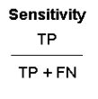

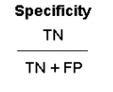

Sensitivity and specificity
Sentivity and specifity calculation,
 |  | Reference method
 |  | Sick | Healthy | TOTAL
Diagnostic | Positive | TP | FP | TP+FP
Test | Negative | FN | TN | FN+TN
 | TOTAL | TP+FN | FP+TN | TP+FP+FN+TN
 |  | Reference method
 |  | Sick | Healthy | TOTAL
Diagnostic | Positive | a | b | a+b
Test | Negative | c | d | c+d
 | TOTAL | a+c | b+d | a+b+c+d

Slide 21
Sensitivity and specificity
Test +
Sensitivity
Disease
Test -
% False negative
Prevalence
Test +
% False Positive
Healthy
Test -
Specificity

Slide 22
Sensitivity and specificity
Example.
Sample: n= 2.641 patients with suspected prostate cancer
1st test: rectal examination
Reference method: prostate biopsy
 |  | Biopsy result
 |  | Disease | Healthy | TOTAL
Rectal | Disease | 634 | 269 | 903
examination | Healthy | 487 | 1251 | 1738
 | TOTAL | 1121 | 1520 | 2641
Sensitivity = 634 / (634+487) = 0.5656 = 56.6% 43.4% with cancer had a normal rectal examination (false negatives)
Specificity = 1251 / (269+1251) = 0.8230 = 82.3%
Other tests are needed to refine the diagnosis (Ex. PSA)
17.7% of the patients without disease were incorrectly diagnosed(false positives)

Slide 23
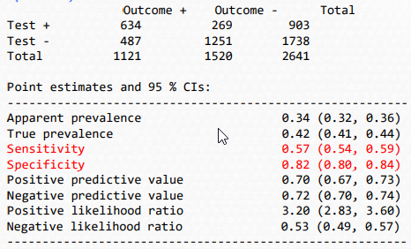
Sensitivity and specificity
Example with R
library(epiR)
table1 <- as.table(matrix(c(634,269,487,1251), nrow = 2, byrow = TRUE)) epi.tests(table1)

Slide 24
Sensitivity and specificity
Ideal values of sensitivity and specificity
0 ≥ S and E ≤ 1
High sensitivity when…
the test is used to identify a serious but treatable disease (e.g. cervical cancer).
Screening of population.
First test in a battery of test
High specificity when…
Diagnostic confirmation suggested by other data (no FP)
Avoid FP in expensive treatments or with high side effects

Slide 25
Sensitivity and specificity
Establish sensitivity and specificity
Selection of the group of patients:
Spectrum of patients: Patients used to validate the test should be different from those that will be applied in reality. "The healthy are very healthy and the sick very sick“. There are no stage.
Bias: In the evaluation of S and E, the result of the test should not be part of the information used to establish the diagnosis.
Chance: Usually S and E are evaluated in small samples (more imprecise), the real data (the population) require a large simple and confidence interval

Slide 26
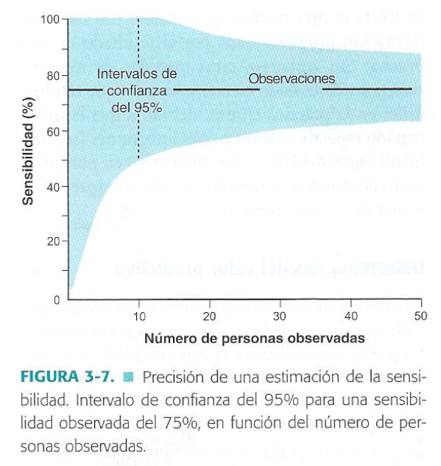
Sensitivity and specificity
Establish sensitivity and specificity

Slide 27
OUTLINE
Diagnosis. Diagnostics tests
Sensitivity and specificity
Predictive values. Prevalence
Likelihood ratio
Receiver operator characteristic curves

Slide 28

Predictive values. Prevalence
But…the patient is sick or not?
S and E help to decide if a test should be used or not, but once the result is known they do not provide any information
they are based on the prior knowledge (sick/healthy) of the individual

Slide 29
Predictive values. Prevalence
But…the patient is sick or not?
If my patient has had a positive / negative test result, what is the probability that patient suffer / not suffer from the disease
Positive predictive value
How likely is it that this patient has the disease given that the test result is positive?
PPV = P(Disease / Test +)
How likely is it that this patient does not have the disease given that the test result is negative?
Negative predictive value
NPV = P(no Disease / Test -)

Slide 30
Predictive values. Prevalence
+ Predictive Value
Test +
Test +
Sensitivity
Disease
Test +
Test +
Test -
+
% False negative
Prevalence
Test +
% False Positive
Healthy
Test -
Specificity

Slide 31
Predictive values. Prevalence
Test +
Sensitivity
Disease
Test -
% False negative
Prevalence
Test +
- Predictive Value
% False Positive
Test -
Healthy
Test -
º
Test -
+
Test -
Specificity

Slide 32
Predictive values. Prevalence
Disease
Healthy
PPV
True +
Sety
False + % FP
Test +
Test +
Test +
+
Test +
PPN
False -
% FN
True –
Especificity
Test -
Test -
º
Test -
+
Test -

Slide 33
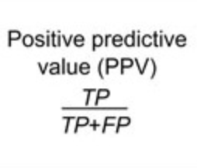
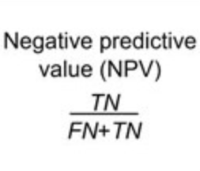


Predictive values. Prevalence
Predictive values
 |  | Reference method
 |  | Sick | Healthy | TOTAL
Diagnostic | Positive | a | b | a+b
Test | Negative | c | d | c+d
 | TOTAL | a+c | b+d | a+b+c+d

Slide 34
Predictive values. Prevalence
Example.
Sample: n= 2.641 patients with suspected prostate cancer
1st test: rectal examination
Reference method: prostate biopsy
 |  | Biopsy result
 |  | Disease | Healthy | TOTAL
Rectal | Disease | 634 | 269 | 903
examination | Healthy | 487 | 1251 | 1738
 | TOTAL | 1121 | 1520 | 2641
Positive predictive value = 634 / (269+634) = 70.21% 70.21% of the patients with abnormal digital rectal examination were correctly
diagnosed
Negative predictive value = 1251 / (487+1251) = 71.98%
71.98% with normal digital rectal examination were healthy

Slide 35
Predictive values. Prevalence
Example with R
Disease positive Disease negative Total
Test positive 634 269 903
Test negative 487 1251 1738
Total 1121 1520 2641
Point estimates and 95 % CIs:
---------------------------------------------------------
Estimation Lower CI Upper CI
Apparent prevalence 0.342 0.324 0.360
True prevalence 0.424 0.406 0.444
Sensitivity 0.566 0.536 0.595
Specificity 0.823 0.803 0.842
Positive predictive value 0.702 0.671 0.732
Negative predictive value 0.720 0.698 0.741
Diagnostic accuracy 0.714 0.696 0.731
Likelihood ratio of a positive test 3.196 2.835 3.603
Likelihood ratio of a negative test 0.528 0.492 0.567
---------------------------------------------------------

Slide 36
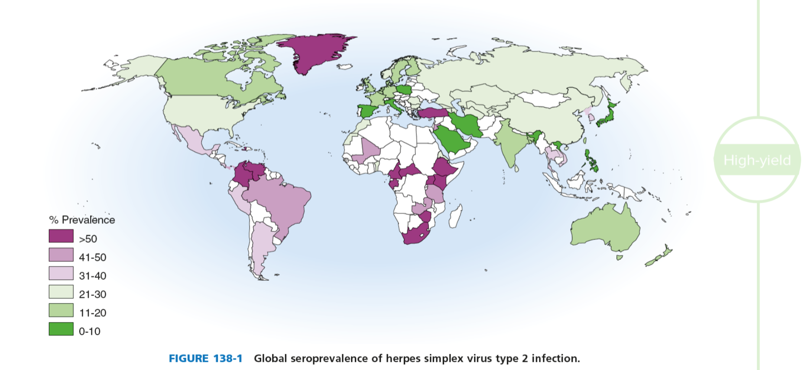
Predictive values. Prevalence
Prevalence
Proportion of people in a defined population who suffer from the disease at a specific time
Probability of having the disease before knowing the result of the test,

Slide 37
Predictive values. Prevalence
Prevalence calculation.
 |  | Biopsy result
 |  | Disease | Healthy | TOTAL
Rectal | Disease | 634 | 269 | 903
examination | Healthy | 487 | 1251 | 1738
 | TOTAL | 1121 | 1520 | 2641
Prevalence = All patient sick / All population = 1121/2641 = 42.45%

Slide 38
Predictive values. Prevalence
Example with R
Disease positive Disease negative Total
Test positive 634 269 903
Test negative 487 1251 1738
Total 1121 1520 2641
Point estimates and 95 % CIs:
---------------------------------------------------------
Estimation Lower CI Upper CI
Apparent prevalence 0.342 0.324 0.360
True prevalence 0.424 0.406 0.444
Sensitivity 0.566 0.536 0.595
Specificity 0.823 0.803 0.842
Positive predictive value 0.702 0.671 0.732
Negative predictive value 0.720 0.698 0.741
Diagnostic accuracy 0.714 0.696 0.731
Likelihood ratio of a positive test 3.196 2.835 3.603
Likelihood ratio of a negative test 0.528 0.492 0.567
---------------------------------------------------------

Slide 39
Predictive values. Prevalence
Dependence of PPV and NPV on disease prevalence
From the calculation of predictive values:
PPV =
TP
NPV =
TN
TP + FP
TN + FN
Changes in the composition of the population will alter their values
People with the disease and healthy
If the prevalence is low: a negative result in the test (healthy) will allow discarding the disease with greater security (high NPV). The positive result of the test (sick), will not allow confirming the diagnosis (low PPV)
Sensitivity and specificity are specific of the diagnostic test and they don’t depen on the population under study.

Slide 40
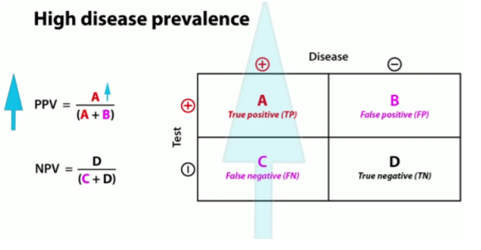
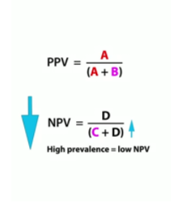
Predictive values. Prevalence
Dependence of PPV and NPV on disease prevalence
PPV increases with increasing disease prevalence
NPV decreases with increasing disease prevalence

Slide 41
Predictive values. Prevalence
Dependence of PPV and NPV on disease prevalence
Example: VIH diagnosis. Population 1.
 |  | Correct diagnosis
 |  | VIH+ | VIH- | TOTAL
Test | Positive | 5.970 | 13.970 | 19.940
result | Negative | 30 | 2.780.030 | 2.780.060
 | TOTAL | 6.000 | 2.794.000 | 2.800.000
Example: VIH diagnosis. Population 2.
 |  | Correct diagnosis
 |  | VIH+ | VIH- | TOTAL
Test | Positive | 796.000 | 10.000 | 806.000
result | Negative | 4.000 | 1.990.000 | 1.994.000
 | TOTAL | 800.000 | 2.000.000 | 2.800.000

Slide 42
Predictive values. Prevalence
Dependence of PPV and NPV on disease prevalence
Example: VIH diagnosis. Population 1.
 |  | Correct diagnosis
 |  | VIH+ | VIH- | TOTAL
Test | Positive | 5.970 | 13.970 | 19.940
result | Negative | 30 | 2.780.030 | 2.780.060
 | TOTAL | 6.000 | 2.794.000 | 2.800.000
Prevalence = 6.000 / 2.800.000 = 0.21%
Sensitivity = 5970 / 6000 = 99.5%
Specificity = 2.780.030 /2.794.000 = 99.5%
PPV = 5970 / 19940 = 29.9%
NPV = 2.780.030 / 2.780.60 = 99.9%
Only 29.9% of the individuals who tested positive, would be ill

Slide 43
Predictive values. Prevalence
Dependence of PPV and NPV on disease prevalence
Example: VIH diagnosis. Population 2.
 |  | Correct diagnosis
 |  | VIH+ | VIH- | TOTAL
Test | Positive | 796.000 | 10.000 | 806.000
result | Negative | 4.000 | 1.990.000 | 1.994.000
 | TOTAL | 800.000 | 2.000.000 | 2.800.000
Prevalence = 800.000 / 2.800.000 = 28.6%
Sensitivity = 796.000 / 800.000 = 99.5%
Specificity = 1.990.000 /2.000.000 = 99.5%
PPV = 796.000 / 806.000 = 98.7%
NPV = 1.990.000 / 2.000.000 = 99.8%
If the prevalence is high, a positive result tends to confirm the presence of the disease

Slide 44
OUTLINE
Diagnosis. Diagnostics tests
Sensitivity and specificity
Predictive values. Prevalence
Likelihood ratio
Receiver operator characteristic curves

Slide 45
Likelihood ratio
Likelihood ratio
How much more likely is it that a patient who tests positive has the disease compared with one who test negative,
Index to compare two methods (diagnostic tests) that do not depend on the prevalence in the population.
LR+ = P (positive test in ill) / P (positive test in healthy) =
= TP / FP =
= sensitivity / (1-specificity)
LR- = P (negative test in ill) / P (negative test in healthy) =
= FN / TN =
= (1-sensitivity) / specificity

Slide 46
Likelihood ratio
Test +
Likelihood Ratio +
Sensitivity
Disease
Sensitivity
Test -
% False negative
Prevalence
Test +
% False Positive
% False Positive
Healthy
Test -
Specificity

Slide 47
Likelihood ratio
Test +
Sensitivity
Disease
Test -
Likelihood Ratio -
% False negative
Prevalence
Test +
% False negative
% False Positive
Healthy
Test -
Specificity
Specificity

Slide 48
Likelihood ratio
Likelihood ratio
Interpretation: Positive Likelihood Ratio (LR+)
LR+ over 5 - 10: Significantly increases likelihood of the disease
LR+ between 0.2 to 5 (especially if close to 1): Does not modify the likelihood of the disease
LR+ below 0.1 - 0.2: Significantly decreases the likelihood of the disease.

Slide 49
Likelihood ratio
Example.
Sample: n= 2.641 patients with suspected prostate cancer
1st test: rectal examination
Reference method: prostate biopsy
 |  | Biopsy result
 |  | Disease | Healthy | TOTAL
Rectal | Disease | 634 | 269 | 903
examination | Healthy | 487 | 1251 | 1738
 | TOTAL | 1121 | 1520 | 2641
Sensitivity = 634 / (634+487) = 0.5656 = 56.6%
Specificity = 1251 / (269+1251) = 0.8230 = 82.3%
Prevalence = 1121/2641 = 42.45%
PPV = 634 / (269+634) = 70.21%
NPV = 1251 / (487+1251) = 71.98%
LR+ = 0.566 / (1-0.823) = 3.19
LR- = (1-0.566) / 0.823 = 0.53
Hay x3 veces más probabilidades de observar un tacto anormal en enfermos que en sanos

Slide 50
Likelihood ratio
Example.
Sample: n= 2.641 patients with suspected prostate cancer
1st test: rectal examination
Reference method: prostate biopsy
Disease positive Disease negative Total
Test positive 634 269 903
Test negative 487 1251 1738
Total 1121 1520 2641
Point estimates and 95 % CIs:
---------------------------------------------------------
Estimation Lower CI Upper CI
Apparent prevalence 0.342 0.324 0.360
True prevalence 0.424 0.406 0.444
Sensitivity 0.566 0.536 0.595
Specificity 0.823 0.803 0.842
Positive predictive value 0.702 0.671 0.732
Negative predictive value 0.720 0.698 0.741
Diagnostic accuracy 0.714 0.696 0.731
Likelihood ratio of a positive test 3.196 2.835 3.603
Likelihood ratio of a negative test 0.528 0.492 0.567
---------------------------------------------------------

Slide 51
Likelihood ratio
Exercise: In J Trop Pediatr in January 2006, a rapid serological test was presented for the diagnosis of Helicobacter pylori infection. It has been tested on 81 children. The results of usual microbiological tests to know if they are infected or not are also provided. Here are the results:
 |  | Microbiological test
 |  | Disease | Healthy | TOTAL
Quick | Positive | 24 | 1 | 25
Serological test | Negative | 3 | 53 | 56
 | TOTAL | 27 | 54 | 81
Calculate the following indices of assessment of a diagnostic test: sensitivity, specificity and predictive value of positive and negative results. Is the test useful?

Slide 52
Likelihood ratio
Exercise:
Disease positive Disease negative Total
Test positive 24 1 25
Test negative 3 53 56
Total 27 54 81
Point estimates and 95 % CIs:
---------------------------------------------------------
Estimation Lower CI Upper CI
Apparent prevalence 0.309 0.211 0.421
True prevalence 0.333 0.232 0.447
Sensitivity 0.889 0.708 0.976
Specificity 0.981 0.901 1.000
Positive predictive value 0.960 0.796 0.999
Negative predictive value 0.946 0.851 0.989
Diagnstic accuracy 0.951 0.878 0.986
Likelihood ratio of a positive test 48.000 6.854 336.133
Likelihood ratio of a negative test 0.113 0.039 0.329

Slide 53
OUTLINE
Diagnosis. Diagnostics tests
Sensitivity and specificity
Predictive values. Prevalence
Likelihood ratio
Receiver operator characteristic curves

Slide 54
Receiver operator characteristic curves (ROC)
Building of ROC curves
Positive
Negative
Until now we had tests with dichotomous results
generates a sensitivity and specificity value
It has to be chosen different cutting points that allow a dichotomous classification
Test with continuous results
Many values of sensitivity and specificity that vary according to the cut point chosen
Graphic representation

Slide 55
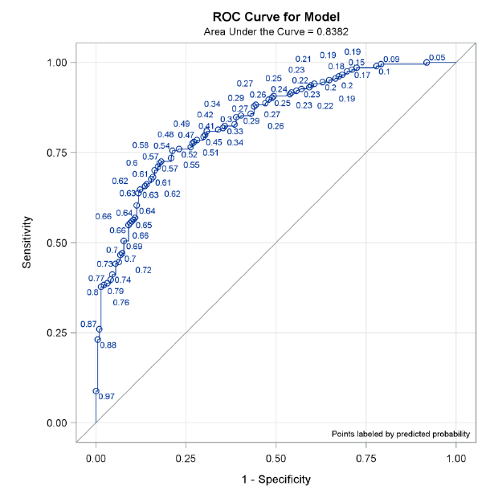
Receiver operator characteristic curves (ROC)
Building of ROC curves

Slide 56
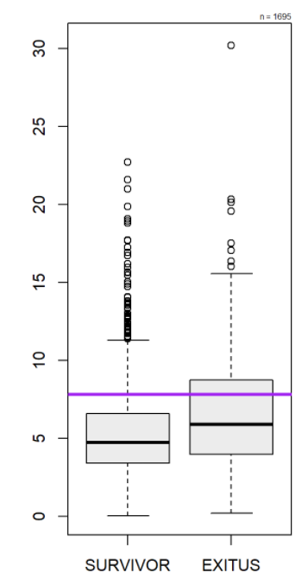
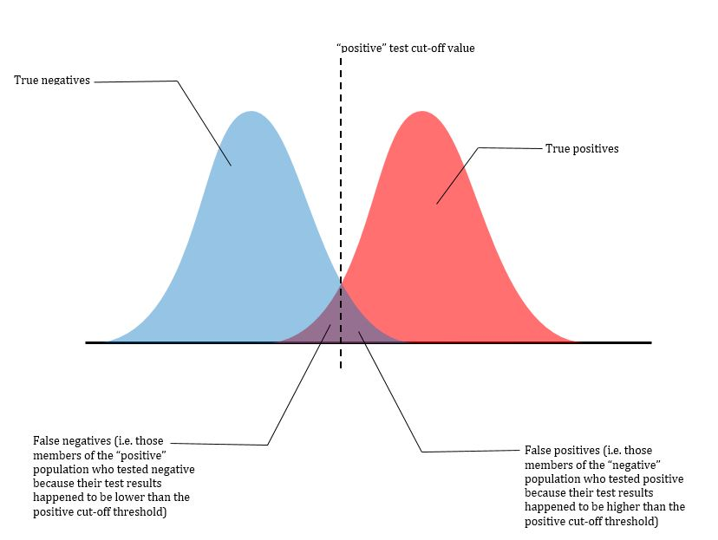
Receiver operator characteristic curves (ROC)
Building of ROC curves
CTL CSS
http://www.derangedphysiology.com/main/cicm-primary-exam/required-reading/research-methods-and-statistics/Chapter%203.0.5/receiver-operating-characteristic-roc-curve

Slide 57
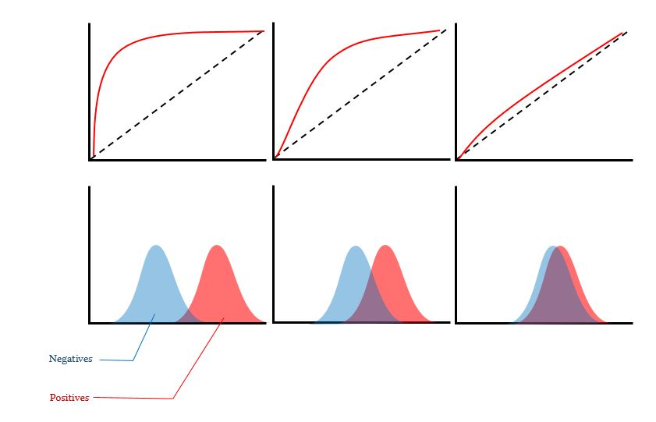
Receiver operator characteristic curves (ROC)
Building of ROC curves
http://www.derangedphysiology.com/main/cicm-primary-exam/required-reading/research-methods-and-statistics/Chapter%203.0.5/receiver-operating-characteristic-roc-curve

Slide 58
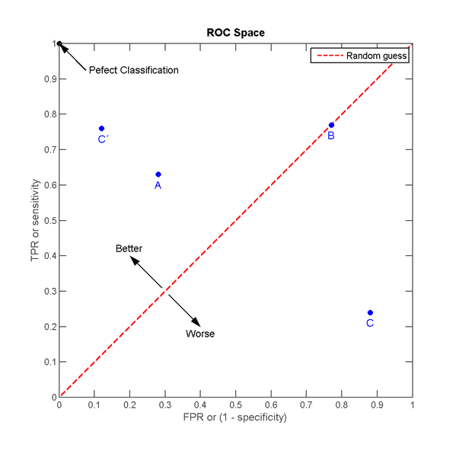
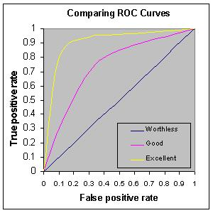
Receiver operator characteristic curves (ROC)
Receiver Operator Characteristic
Building of ROC curves

Slide 59
Receiver operator characteristic curves (ROC)
Example
Ultrasounds can be used to detect thinning of the uterus Wall (indicative of posible tumor). If the result is positive a biopsy is required
Cutoff for abnormal wall thickness | Sentivity (%) | Specificity (%) | 1-Specificity(%)
>4 mm | 99 | 50 | 50
>5 mm | 97 | 61 | 39
>10 mm | 83 | 80 | 20
>15 mm | 60 | 90 | 10
>20 mm | 40 | 95 | 5
>25 mm | 20 | 98 | 2
Objetive: To maximize the number of VP (correct diagnosis of cancer) with an aceptable number of FP (biopsies made when there was no cancer)

Slide 60
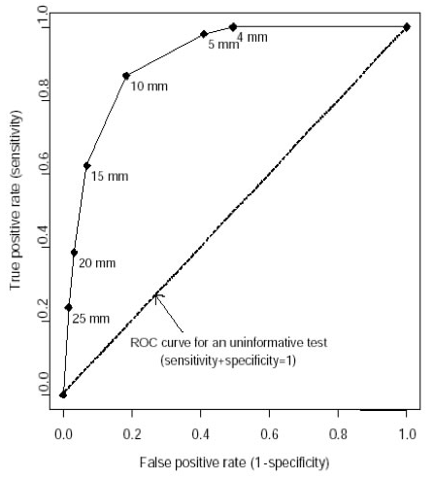
Receiver operator characteristic curves (ROC)
Example.

Slide 61
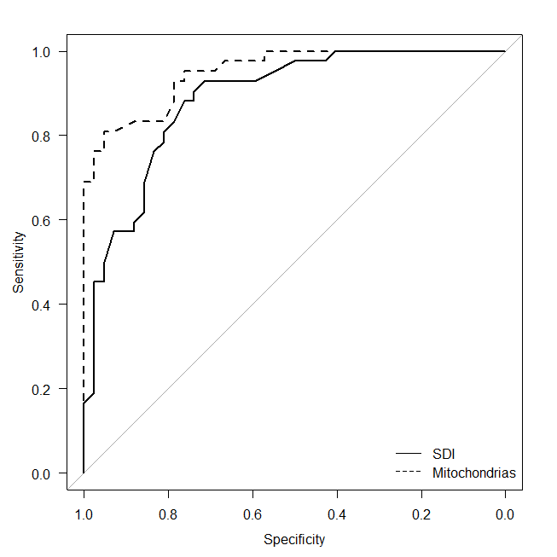
Receiver operator characteristic curves (ROC)
Comparison of ROC curves
Which of the two biomarkers is better?
AREA UNDER THE CURVE
0<AUC<1

Slide 62
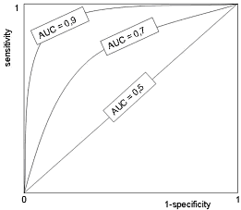
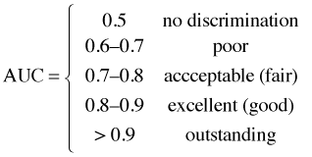
Receiver operator characteristic curves (ROC)
Comparison of ROC curves
AREA UNDER THE CURVE

Slide 63
Receiver operator characteristic curves (ROC)
Exercise. In R
Dataset: Osteoporosis.
To predict the clasificable variable, what diagnostic test do you think is best?
* body mass index
* bone density

Slide 64
Receiver operator characteristic curves (ROC)
Example with R
library(pROC)
roc_bua <- roc(osteoporosis$menop, osteoporosis$bua)
roc_imc <- roc(osteoporosis$menop, osteoporosis$imc)
#review the roc object
roc_bua
roc_imc
#plot the ROC
plot(roc_bua)
plot(roc_imc)
#get the "best" "threshold"
coords(roc_bua, "best", "threshold", transpose = TRUE)
coords(roc_imc, "best", "threshold", transpose = TRUE)
#test to compare the two ROC
roc.test(roc_bua, roc_imc)

Slide 65
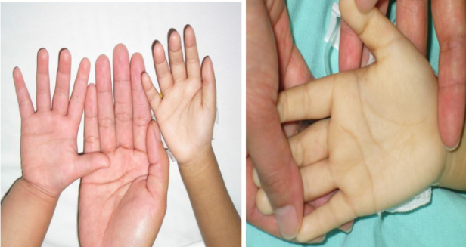
Likelihood ratio
Exercise: Calculate the same indices for the "palmar pallor sign" that was evaluated in a jungle region of Colombia to see if it could be of interest in the diagnosis of anemia. A blood count was taken in 167 children, so it was known whether they had anemia or not (48 yes, 119 no). The palmar pallor sign was positive in 16 anemics. In 95 non-anemic was negative. It is useful?

Slide 66
Likelihood ratio
Exercise: Calculate the same indices for the "palmar pallor sign" that was evaluated in a jungle region of Colombia to see if it could be of interest in the diagnosis of anemia. A blood count was taken in 167 children, so it was known whether they had anemia or not (48 yes, 119 no). The palmar pallor sign was positive in 16 anemics. In 95 non-anemic was negative. It is useful?
 |  | Anemia
 |  | Disease | Healthy | Total
Sign | Positive | 16 | 24 | 40
 | Negative | 32 | 95 | 127
 | Total | 48 | 119 | 167

Slide 67
Likelihood ratio
Exercise: Calculate the same indices for the "palmar pallor sign" that was evaluated in a jungle region of Colombia to see if it could be of interest in the diagnosis of anemia. A blood count was taken in 167 children, so it was known whether they had anemia or not (48 yes, 119 no). The palmar pallor sign was positive in 16 anemics. In 95 non-anemic was negative. It is useful?
Disease positive Disease negative Total
Test positive 16 32 48
Test negative 24 95 119
Total 40 127 167
Point estimates and 95 % CIs:
---------------------------------------------------------
Estimation Lower CI Upper CI
Apparent prevalence 0.287 0.220 0.362
True prevalence 0.240 0.177 0.312
Sensitivity 0.400 0.249 0.567
Specificity 0.748 0.663 0.821
Positive predictive value 0.333 0.204 0.484
Negative predictive value 0.798 0.715 0.866
Diagnostic accuracy 0.665 0.588 0.736
Likelihood ratio of a positive test 1.588 0.979 2.575
Likelihood ratio of a negative test 0.802 0.611 1.053
---------------------------------------------------------

