Slide 1
Statistics with R: Exploratory Data Analysis II and Plots with R
Basic Statistics with R
UEB-VHIR
Speaker: Mireia Ferrer (mireia.ferrer@vhir.org)
27/04/2021

Slide 2
TABLE OF CONTENTS
Elegant graphics for data analysis
From univariate to bivariate analysis
Bivariate analysis
Qualitative vs Qualitative
Qualitative vs Quantitative
Quantitative vs Quantitative
Correlation
Definition
Types of correlation (Pearson, Spearman)

Slide 3
TABLE OF CONTENTS
Elegant graphics for data analysis
From univariate to bivariate analysis
Bivariate analysis
Qualitative vs Qualitative
Qualitative vs Quantitative
Quantitative vs Quantitative
Correlation
Definition
Types of correlation (Pearson, Spearman)

Slide 4
Elegant graphics for data analysis
R is a powerful tool to plot your data
Hadley Wickham (2009) introduced a modern (and perhaps easier) way to plot your data: ggplot2 package
Extensions to ggplot2
GGally, ggrepel, …
Hadley Wickham book
http://moderngraphics11.pbworks.com/f/ggplot2-Book09hWickham.pdf
https://ggplot2-book.org/
https://www.rstudio.com/wp-content/uploads/2015/03/ggplot2-cheatsheet.pdf
STHDA (Statistical tools for high-throughput data analysis)
http://www.sthda.com/english/wiki/ggplot2-essentials
R Colors
http://www.stat.columbia.edu/~tzheng/files/Rcolor.pdf

Slide 5
Elegant graphics for data analysis
How ggplot2 works?
It is based on the Grammar of Graphics (Wilkinson 2005)
Grammar tells us that a graphic is a mapping of the data to the aesthetic attributes (position, colour, shape, size) of geometric objects (points, lines, bars, …).
Plot may also include statistical transformations (stats) of the data and information about plot’s coordinate system (coord).
Plot can be saved as an object in R
Complex plots can be built layer by layer, where each layer can come from a different dataset and have a different aesthetic mappings, making it possible to display data from multiple sources.

Slide 6
Elegant graphics for data analysis
Basic components of a ggplot include:
A data frame: stores all of the data that can be plotted
aesthetic mappings: describe how data are mapped to color, size, shape, location (eg. indicates x, y variables)
geoms (geometric objects): defines the type of graphics (histogram, box plot, line plot, density plot, dot plot, ….)
facets: split a plot in several panels
stats: statistical transformations like binning, quantiles, smoothing.
scales: what scale an aesthetic map uses (example: male = red, female = blue).
coordinate system: describes the system in which the locations of the geoms will be drawn
theme: font size, background colors, …
required
not required
(defaults provided)

Slide 7
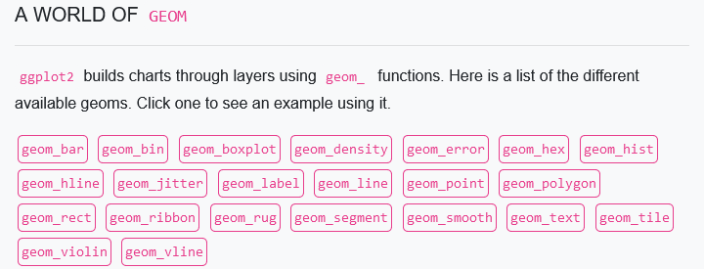
Elegant graphics for data analysis
Plot = ggplot(data, aes(x = var1, y = var2, …)) +
geom_X()
https://www.r-graph-gallery.com/ggplot2-package.html#LogoMenu

Slide 8
Elegant graphics for data analysis
How to install: install.packages("ggplot2")
First steps. Three key components:
Data
Aesthetic mappings between variables
At least one layer. Usually created with a geom function

Slide 9
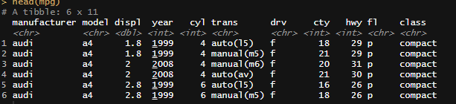
Elegant graphics for data analysis
The data: (https://ggplot2.tidyverse.org/reference/mpg.html)
head(mpg)
A data frame with 234 rows and 11 variables:
manufacturer: manufacturer name
model: model name
displ: engine displacement, in litres
year: year of manufacture
"type" of car
cyl: number of cylinders
trans: type of transmission
drv: the type of drive train, where f = front-wheel drive, r = rear wheel drive, 4 = 4wd
cty: city miles per gallon
hwy: highway miles per gallon
fl: fuel type
class

Slide 10
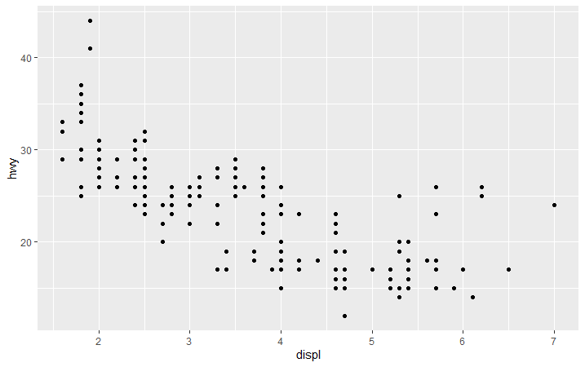
Elegant graphics for data analysis
The basic plot:
ggplot(mpg, aes(x = displ, y = hwy)) +
geom_point()

Slide 11
Elegant graphics for data analysis
Note that it can be assigned to an R object
p <- ggplot(mpg, aes(x = displ, y = hwy)) +
geom_point()
p

Slide 12
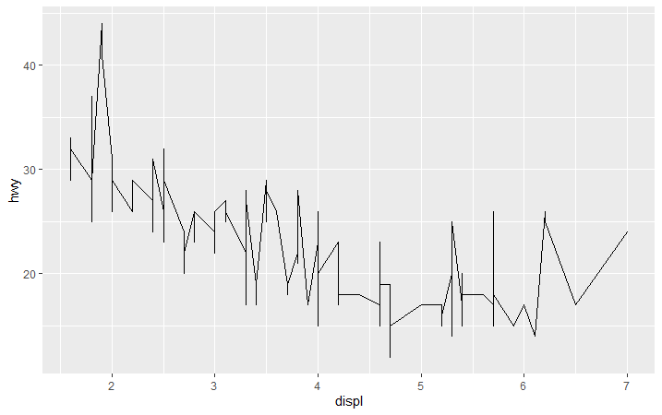
Elegant graphics for data analysis
Playing with geoms
ggplot(mpg, aes(x = displ, y = hwy)) +
geom_line()

Slide 13
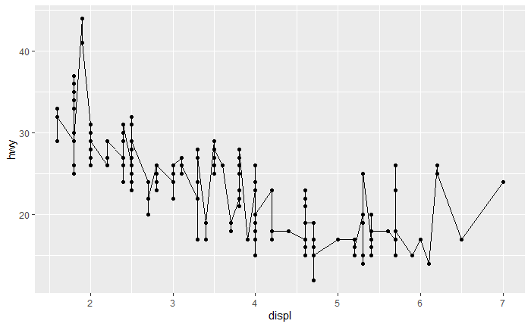
Elegant graphics for data analysis
Adding layers
ggplot(mpg, aes(x = displ, y = hwy)) +
geom_points() +
geom_lines()

Slide 14
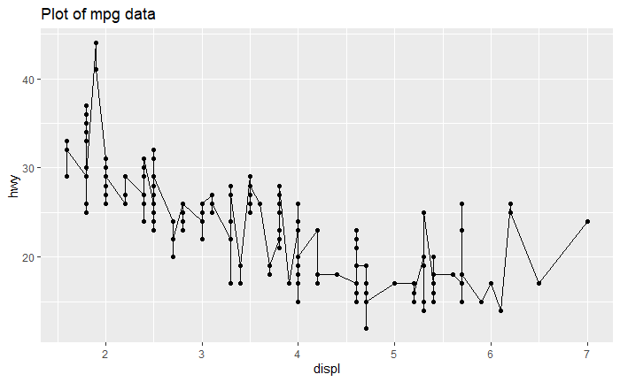
Elegant graphics for data analysis
Adding layers: title
ggplot(mpg, aes(x = displ, y = hwy)) +
geom_points() +
geom_lines() +
labs(title=“Plot of mpg data”)

Slide 15
Elegant graphics for data analysis
Adding layers: title
ggplot(mpg, aes(x = displ, y = hwy)) +
geom_points() +
geom_lines() +
labs(title=“Plot of mpg data”)
Format problems in R when copy+paste

Slide 16
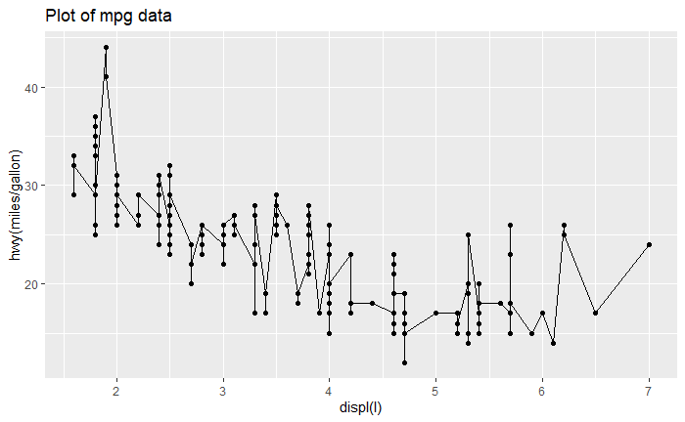
Elegant graphics for data analysis
Changing x, y labels
ggplot(mpg, aes(x = displ, y = hwy)) +
geom_points() +
geom_lines() +
labs(title=“Plot of mpg data”, x=“displ(l)”, y=“hwy(miles/gallon)”)

Slide 17
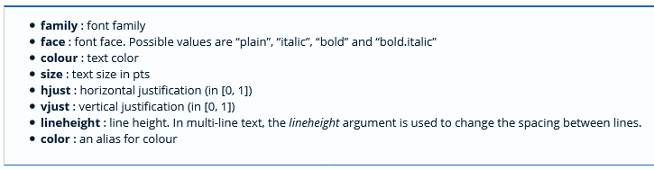
Elegant graphics for data analysis
Formatting labels
ggplot(mpg, aes(x = displ, y = hwy)) +
geom_points() +
geom_lines() +
labs(title=“Plot of mpg data”) +
theme(plot.title=element_text(face=“bold”, hjust=0.5))

Slide 18
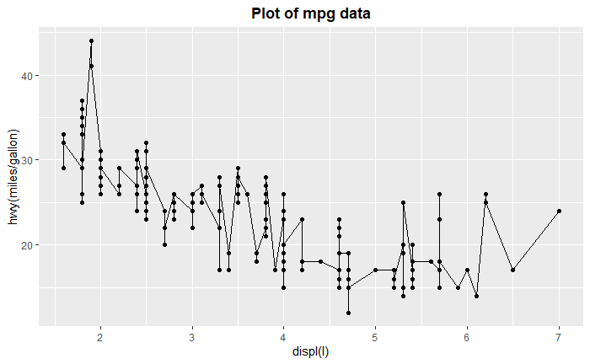
Elegant graphics for data analysis
Formatting labels
ggplot(mpg, aes(x = displ, y = hwy)) +
geom_points() +
geom_lines() +
labs(title=“Plot of mpg data”) +
theme(plot.title=element_text(face=“bold”, hjust=0.5))

Slide 19
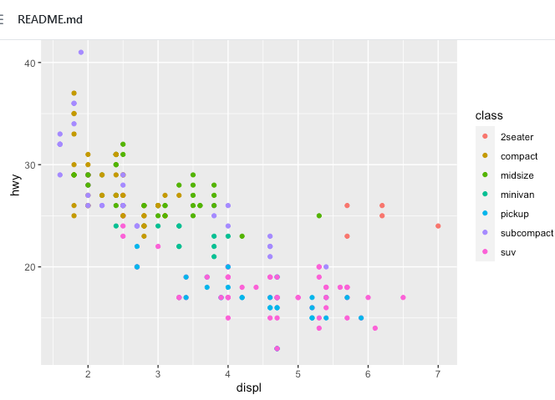
Elegant graphics for data analysis
Playing with aes
ggplot(mpg, aes(x = displ, y = hwy, color=class)) +
geom_point()

Slide 20
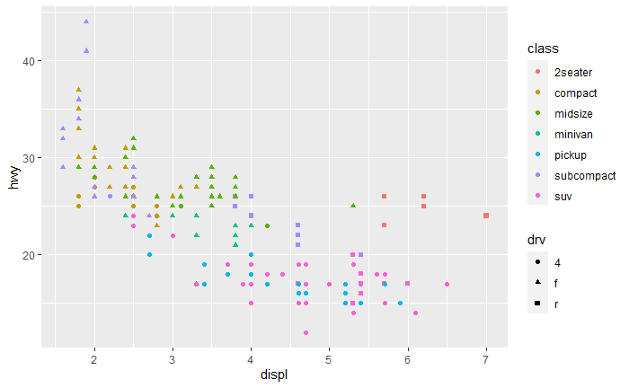
Elegant graphics for data analysis
Playing with aes
ggplot(mpg, aes(x = displ, y = hwy, color=class, shape=drv))+
geom_point()

Slide 21
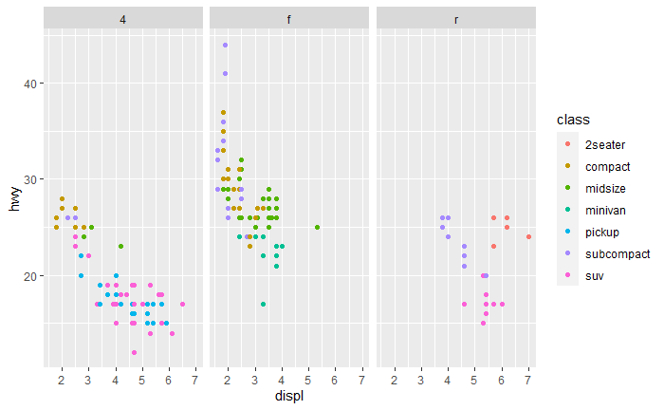
Elegant graphics for data analysis
Facets
ggplot(mpg, aes(x = displ, y = hwy, color=class)) +
geom_point() +
facet_grid(. ~ drv)

Slide 22
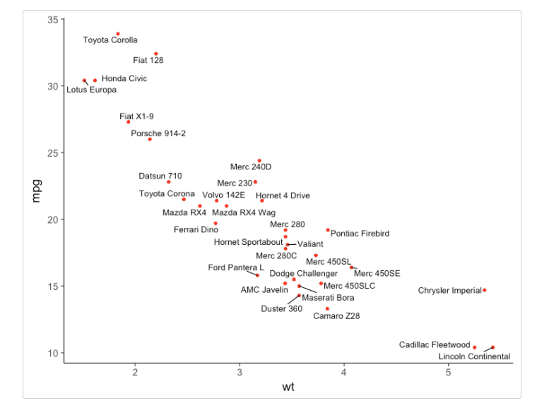
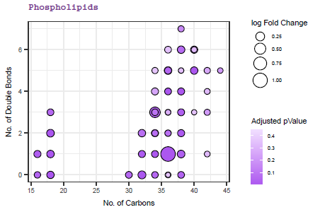
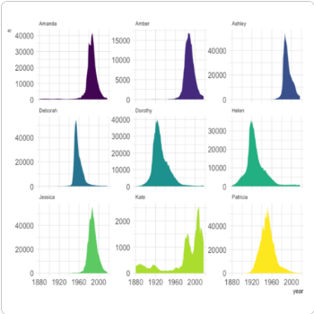
Elegant graphics for data analysis
And many more options
http://www.sthda.com/english/wiki/ggplot2-essentials
https://www.r-graph-gallery.com/ggplot2-package.html#LogoMenu
Extensions to ggplot2
GGally, ggrepel, …

Slide 23
TABLE OF CONTENTS
Elegant graphics for data analysis
From univariate to bivariate analysis
Bivariate analysis
Qualitative vs Qualitative
Qualitative vs Quantitative
Quantitative vs Quantitative
Correlation
Definition
Types of correlation (Pearson, Spearman)

Slide 24
From univariate to Bivariate analysis
Last week we learned…
We can analyse and describe each variable one by one, using graphs or numeric summaries.
Type of graph / summary will depend on variable type
Type of variable | Numeric summary | Graphs
Quantitative | Mean, median, sd, ... | Histogram, boxplot,..
Qualitative | Frequency tables | Barplot, pie chart,..

Slide 25
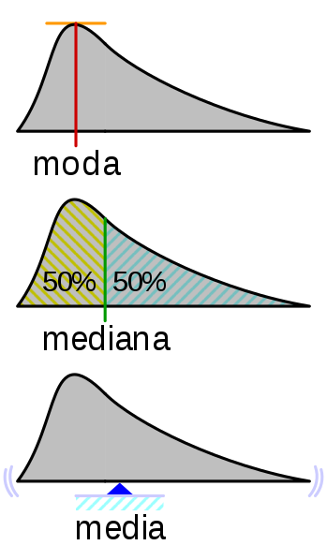
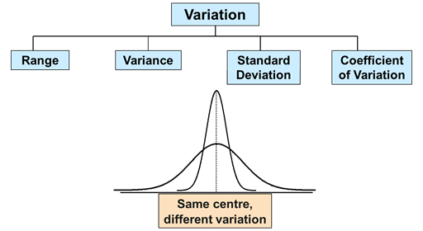
From univariate to Bivariate analysis
Last week we learned…
Descriptive statistics for QUANTITATIVE VARIABLES
Numeric summaries
Measures of central tendency Measures of dispersion

Slide 26
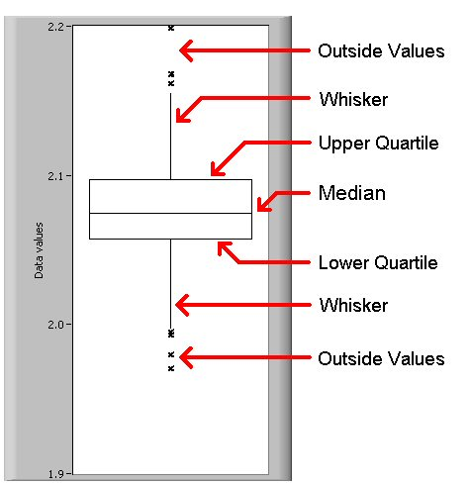
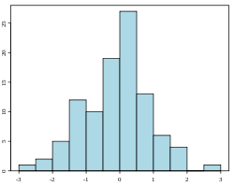
From univariate to Bivariate analysis
Last week we learned…
Descriptive statistics for QUANTITATIVE VARIABLES
Graphics:
Boxplot
Histogram
Freq
Variable (interval)

Slide 27
From univariate to Bivariate analysis
Last week we learned…
Descriptive statistics for QUANTITATIVE VARIABLES
Let’s do it in R!
# plots with basic R
hist(mpg$displ)
boxplot(mpg$displ)
# with ggplot2
...

Slide 28
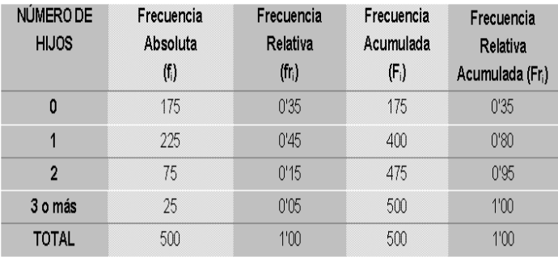
From univariate to Bivariate analysis
Last week we learned…
Descriptive statistics for QUALITATIVE VARIABLES
Numeric summaries
Frequency tables

Slide 29
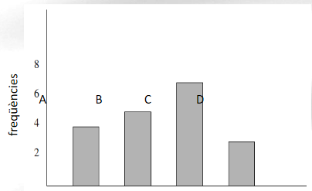
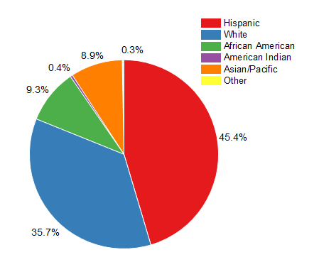
From univariate to Bivariate analysis
Last week we learned…
Descriptive statistics for QUALITATIVE VARIABLES
Graphics
Bar plot
Pie chart
categories

Slide 30
From univariate to Bivariate analysis
Last week we learned…
Descriptive statistics for QUALITATIVE VARIABLES
Let’s do it in R!
# plots with basic R
barplot(table(mpg$class))
# with ggplot2
...

Slide 31
From univariate to Bivariate analysis
In univariate analysis only one variable is analyzed each time
the purpose of the analysis is descriptive
If there are more than one variable in the dataset it could be interesting to guess if:
Does exist a relation between the two variables?
How important is this relation?
Which is the direction of the relation?

Slide 32
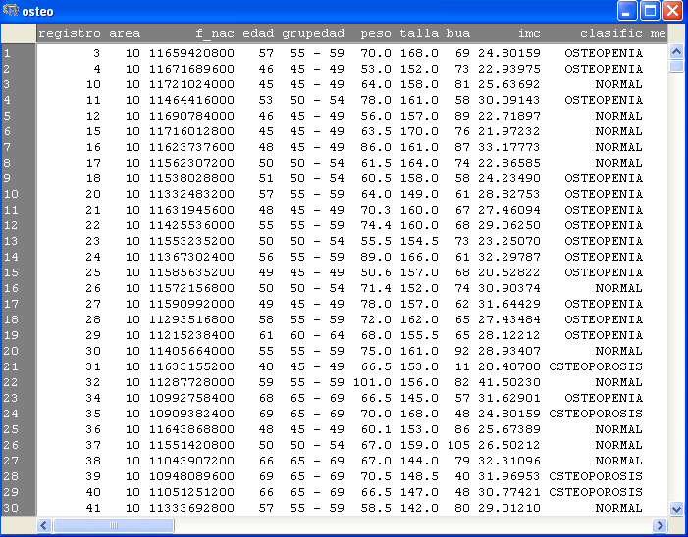
From univariate to Bivariate analysis

Slide 33
From univariate to Bivariate analysis

Slide 34
From univariate to Bivariate analysis

Slide 35
TABLE OF CONTENTS
Elegant graphics for data analysis
From univariate to bivariate analysis
Bivariate analysis
Qualitative vs Qualitative
Qualitative vs Quantitative
Quantitative vs Quantitative
Correlation
Definition
Types of correlation (Pearson, Spearman)

Slide 36
3. Bivariate analysis
Bivariate analysis
Involves the analysis of two variables for the purpose of determining the empirical relationship between them.
easiest way is to measure how those two variables simultaneously change together

Slide 37
3. Bivariate analysis
Bivariate analysis
Involves the analysis of two variables for the purpose of determining the empirical relationship between them.
easiest way is to measure how those two variables simultaneously change together
Major differentiating point between univariate and bivariate analysis (a part from the number of variables implicated) is that bivariate analysis goes beyond simply descriptive, since it studies the relationship between the two variables.

Slide 38

3. Bivariate analysis
Why bivariate analysis?
Let’s begin by asking if:
Our experience tells us “yes”, but how good is the correspondence?
People tend to marry other people of about the same age?
Sample of spousal ages of 10 White American Couples
Onlinestatbook (Authors: Rudy Guerra and David M. Lane)

Slide 39
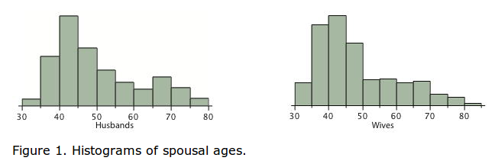
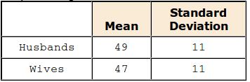
3. Bivariate analysis
Why bivariate analysis?
Onlinestatbook (Authors: Rudy Guerra and David M. Lane)

Slide 40
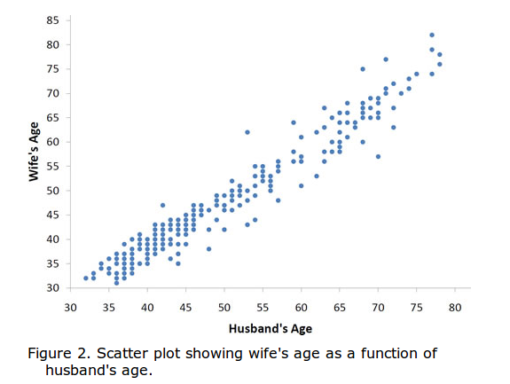
3. Bivariate analysis
Why bivariate analysis?
The older the husband the older the wife.
It is possible to know age of wives for an husband age.
Onlinestatbook (Authors: Rudy Guerra and David M. Lane)

Slide 41







3. Bivariate analysis
Some plots to study the relationship between two variables...
Quantitative

Slide 42
3. Bivariate analysis 3.1 Qualitative versus qualitative
The way to study the relation will depend on the variable types:
Two qualitative variables: contingency table
Used for organizing categorical variables and testing hypothesis with the chi-squared test for independence

Slide 43
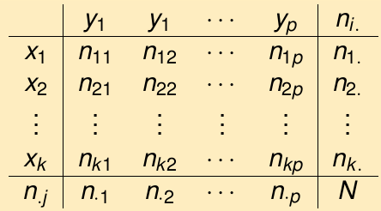

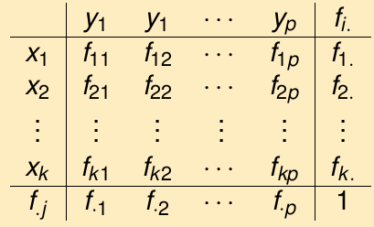
3. Bivariate analysis 3.1 Qualitative versus qualitative
The way to study the relation will depend on the variable types:
Two qualitative variables: contingency table
Used for organizing categorical variables and testing hypothesis with the chi-squared test for independence
Count of individuals that simultaneously presents variable 1 (x) and variable 2 (y)
Absolute
relative

Slide 44
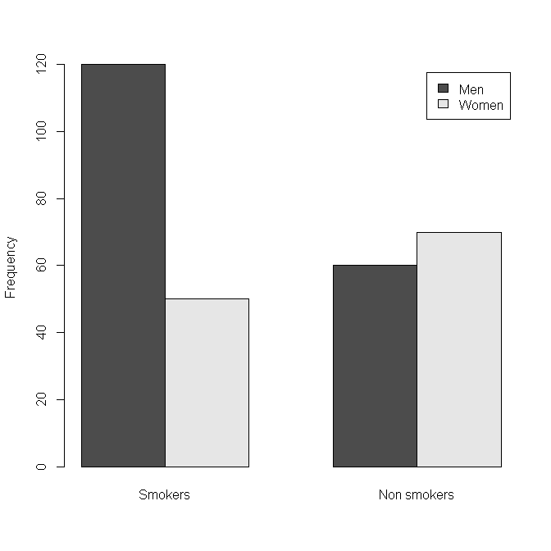
3. Bivariate analysis 3.1 Qualitative versus qualitative
A study wants to know if there are differences about smoking habits in men and women.
Gender | Smoking habits
1 | 1
2 | 1
1 | 0
1 | 0
1 | 0
1 | 1
2 | 1
... | ...
 | Smokers | Non Smoking | Total
Men | 120 | 60 | 180
Women | 50 | 70 | 120
Total | 170 | 130 | 300

Slide 45
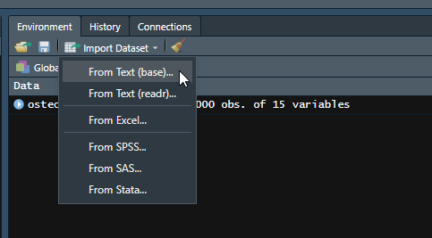
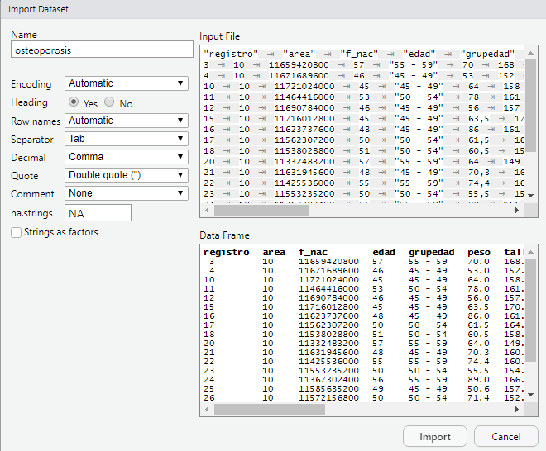
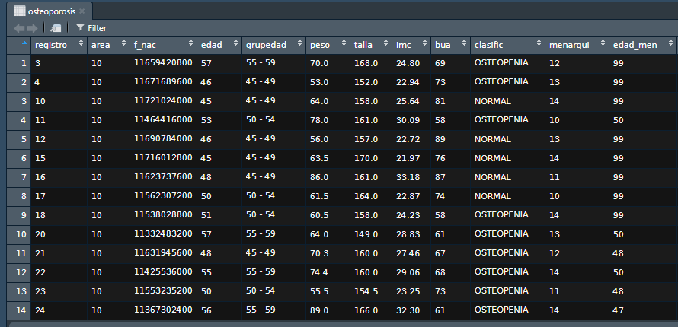
3. Bivariate analysis 3.1 Qualitative versus qualitative
Let´s do it in R :
Osteoporosis dataset (osteoporosis.txt)
Study if the group age (grupedad) of patients, influence in the illness type (classific):

Slide 46
3. Bivariate analysis 3.1 Qualitative versus qualitative

Slide 47
3. Bivariate analysis 3.1 Qualitative versus qualitative
table(osteoporosis$grupedad, osteoporosis$clasific)
prop.table(table(osteoporosis$grupedad, osteoporosis$clasific))
NORMAL OSTEOPENIA OSTEOPOROSIS
45 - 49 233 138 7
50 - 54 113 113 7
55 - 59 67 100 9
60 - 64 38 74 17
65 - 69 18 42 24
NORMAL OSTEOPENIA OSTEOPOROSIS
45 - 49 0.233 0.138 0.007
50 - 54 0.113 0.113 0.007
55 - 59 0.067 0.100 0.009
60 - 64 0.038 0.074 0.017
65 - 69 0.018 0.042 0.024

Slide 48
3. Bivariate analysis 3.1 Qualitative versus qualitative
Another way to introduce the data:
 | Smokers | Non Smoking | Total
Men | 120 | 60 | 180
Women | 50 | 70 | 120
Total | 170 | 130 | 300
tab <- matrix(data = c(120, 60, 50, 70), nrow = 2, ncol = 2, byrow = TRUE)
tab
colnames(tab) <- c("Smokers", "Nonsmokers")
rownames(tab) <- c("Men", "Women")
tab
Smokers Nonsmokers
Men 120 60
Women 50 70
[,1] [,2]
[1,] 120 60
[2,] 50 70

Slide 49
3. Bivariate analysis 3.1 Qualitative versus qualitative
Another way to introduce the data:
 | Smokers | Non Smoking | Total
Men | 120 | 60 | 180
Women | 50 | 70 | 120
Total | 170 | 130 | 300
prop.table(tab)
Smokers Nonsmokers
Men 0.4000000 0.2000000
Women 0.1666667 0.2333333

Slide 50
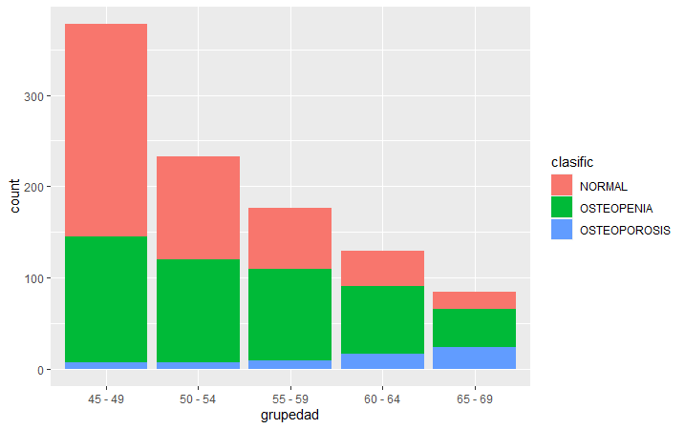
3. Bivariate analysis 3.1 Qualitative versus qualitative
Barplot with R
ggplot(data = osteoporosis, aes(x = grupedad)) +
geom_bar(aes(fill = clasific))

Slide 51
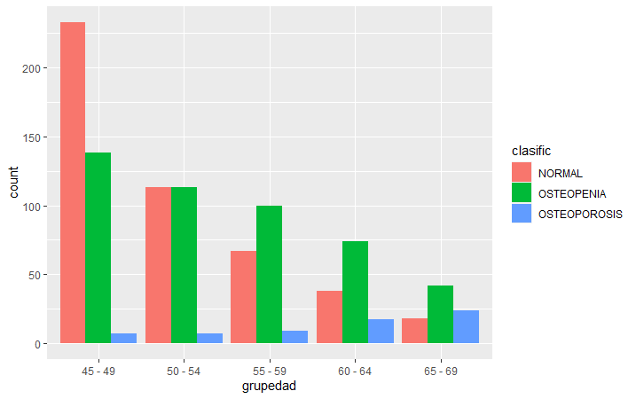
3. Bivariate analysis 3.1 Qualitative versus qualitative
ggplot(data = osteoporosis, aes(x = grupedad)) +
geom_bar(aes(fill = clasific), position = "dodge")

Slide 52
3. Bivariate analysis 3.1 Qualitative versus qualitative
Improving barplot
http://www.sthda.com/english/wiki/ggplot2-barplots-quick-start-guide-r-software-and-data-visualization
Change colors, legend position, labels and finally save it!
p + scale_fill_manual(values=c("#8618b1", "blanchedalmond", "red"))
p + theme(legend.position="bottom")
p + labs(x = "Age group", y = "Women", title = "Osteo disease classified by age group")
pdf("clasific_grupedad.pdf")
p + labs(x = "Age group", y = "Women", title = "Osteo disease classified by age group")
dev.off()

Slide 53
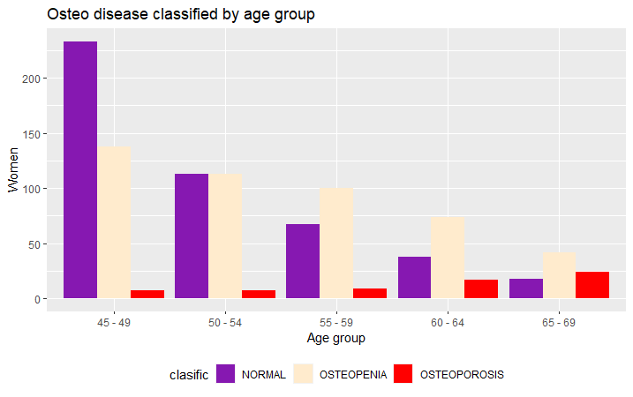
3. Bivariate analysis 3.1 Qualitative versus qualitative
Improving barplot

Slide 54
3. Bivariate analysis 3.2 Qualitative versus quantitative
The way to study the relation will depend on the variable types:
One qualitative variable and one quantitative variable: Table of statistics
Mean value of the variable in each category for each individual

Slide 55
3. Bivariate analysis 3.2 Qualitative versus quantitative

Slide 56
3. Bivariate analysis 3.2 Qualitative versus quantitative
Let´s do in R:
Osteoporosis dataset
Study if/how bone density (bua) changes in each group of age (grupedad)
with(osteo, tapply(bua, list(grupedad), mean, na.rm=TRUE))
45-49 50-54 55-59 60-64 65-69
78.75926 75.05150 71.43182 64.89147 60.66667

Slide 57
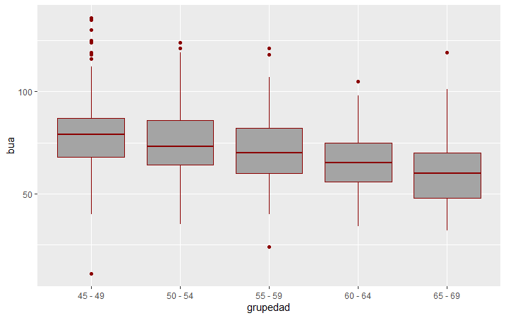
3. Bivariate analysis 3.2 Qualitative versus quantitative
Study if bone density (bua) is different in each group of age
bp <- ggplot(osteoporosis, aes(x = grupedad, y = bua)) +
geom_boxplot(fill='#A4A4A4', color="darkred")
bp

Slide 58
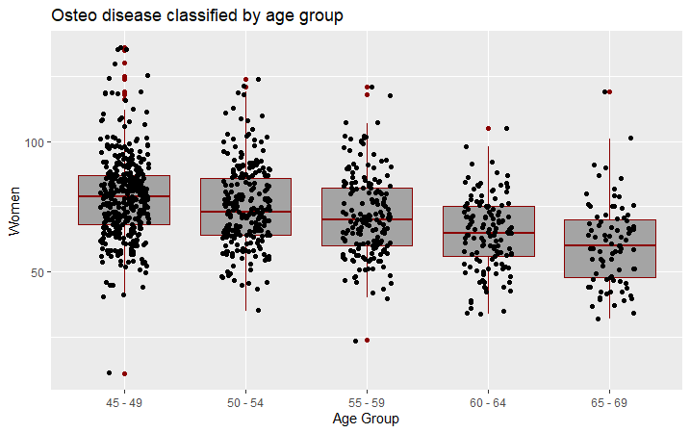
3. Bivariate analysis 3.2 Qualitative versus quantitative
Study if bone density (bua) is different in each group of age
# Box plot with points
# 0.2 : degree of jitter in x direction
bp + geom_jitter(shape = 16, position = position_jitter(0.2)) +
labs(x = "Age Group", y = "Women", title = "Osteo disease classified by age group")

Slide 59
3. Bivariate analysis
Exercise
Study the relationship between menop and group of illness (clasific)
Type of variables?
Type of numerical bivariate analysis?
Type of graphical bivariate analysis?
Study if peso is different in each group of illness (clasific).
Type of variables?
Type of numerical bivariate analysis?
Type of graphical bivariate analysis?

Slide 60
3. Bivariate analysis 3.3 Quantitative versus Quantitative
The way to study the relation will depend on the variable types:
Two quantitatives variables:

Slide 61
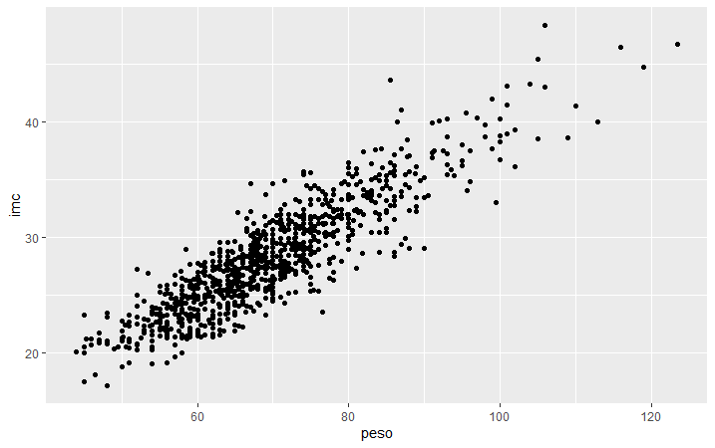
3. Bivariate analysis 3.3 Quantitative versus Quantitative
# Basic scatter plot
ggplot(osteoporosis, aes(x = peso, y = imc)) +
geom_point()
http://www.sthda.com/english/wiki/ggplot2-scatter-plots-quick-start-guide-r-software-and-data-visualization

Slide 62
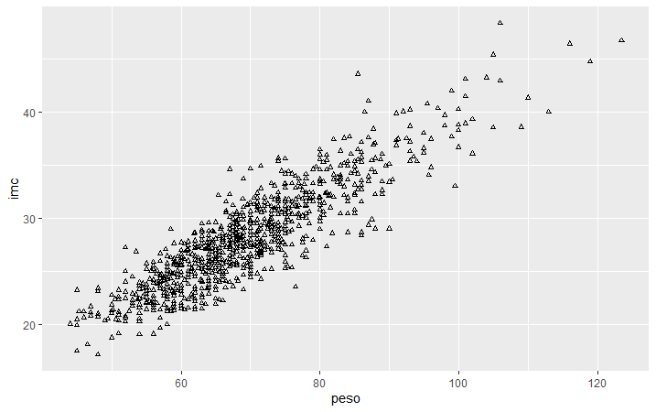
3. Bivariate analysis 3.3 Quantitative versus Quantitative
# Change the point size, and shape
ggplot(osteoporosis, aes(x = peso, y = imc)) +
geom_point(size = 1, shape = 1)

Slide 63
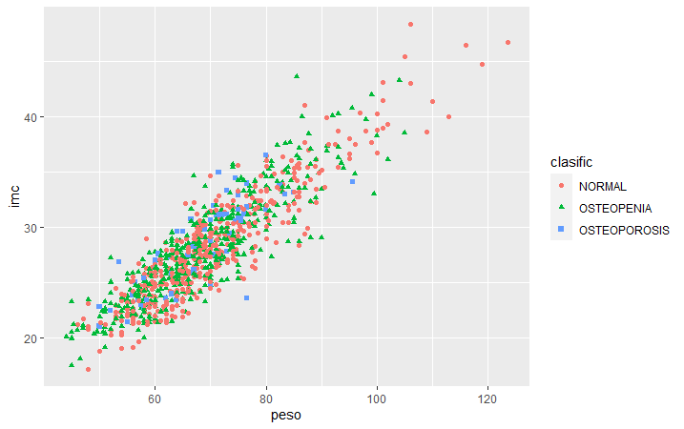
3. Bivariate analysis 3.3 Quantitative versus Quantitative
# Color the points depending of another variable
ggplot(osteoporosis, aes(x = peso, y = imc, color = clasific, shape = clasific)) +
geom_point()

Slide 64
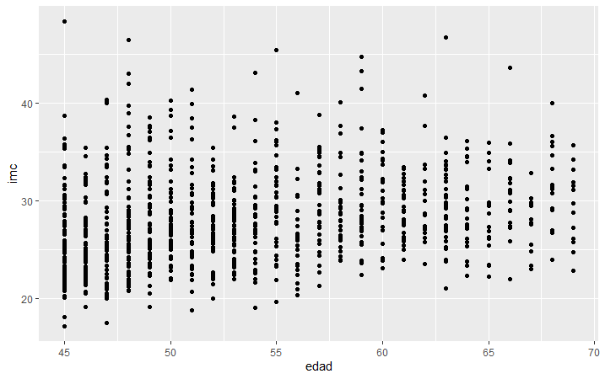
3. Bivariate analysis 3.3 Quantitative versus Quantitative
But not allways the correlation is good
ggplot(osteoporosis, aes(x = edad, y = imc)) +
geom_point()

Slide 65
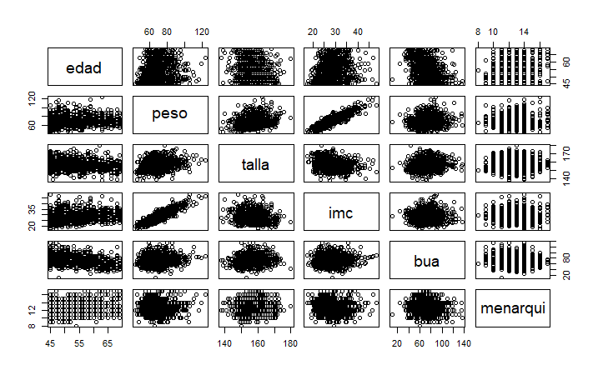
3. Bivariate analysis 3.3 Quantitative versus Quantitative
pairs(osteoporosis[, c("edad", "peso", "talla", "imc", "bua", "menarqui")])

Slide 66
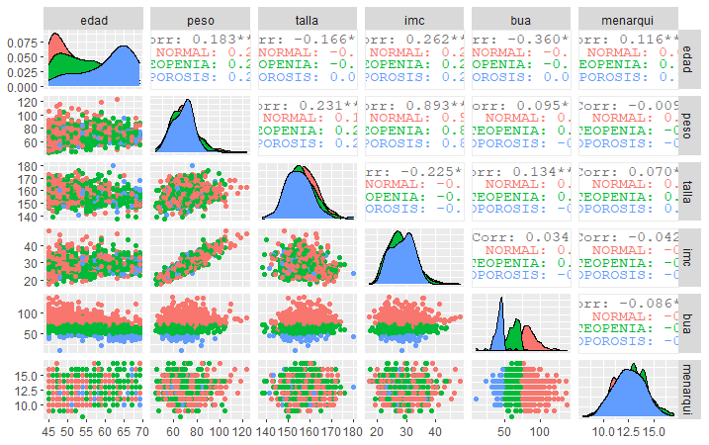
3. Bivariate analysis 3.3 Quantitative versus Quantitative
library(GGally)
ggpairs(osteoporosis, columns = c("edad", "peso", "talla", "imc", "bua", "menarqui"), ggplot2::aes(colour = clasific))

Slide 67
TABLE OF CONTENTS
Elegant graphics for data analysis
From univariate to bivariate analysis
Bivariate analysis
Qualitative vs Qualitative
Qualitative vs Quantitative
Quantitative vs Quantitative
Correlation
Definition
Types of correlation (Pearson, Spearman)

Slide 68
Correlation 1. Definition
Main characteristics of correlation analysis:
Correlation analysis allow:
Study the way of relation between the two variables
Quantify the intensity of relation
Correlation is not causation one thing does not causes the other
In the correlation analysis, the two variables have the same weigh
The correlation coefficient measures the strength of the relation

Slide 69
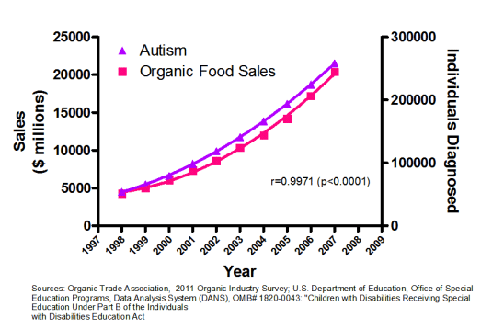
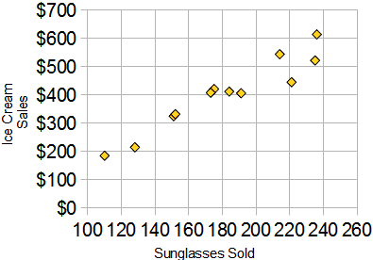
Correlation 1. Definition
Main characteristics of correlation analysis:
Correlation is not causation

Slide 70
Correlation 2. Types of correlation
Pearson correlation coefficient
Measures linear correlation between two variables
It is represented by letter r. It has no dimensions (no units)
Values go from -1 to +1
r=0 indicates no linear relation between the variables
r>0 indicates direct relation between the variables
r<0 indicates indirect relation between the variables
r=1/-1 indicates a perfect relation between the variables

Slide 71
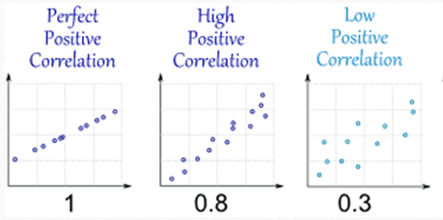
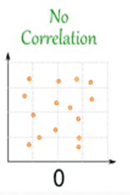
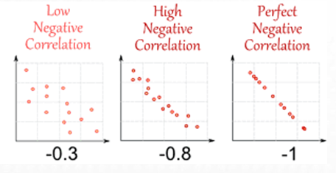
Correlation 2. Types of correlation
Pearson correlation coefficient. Examples

Slide 72
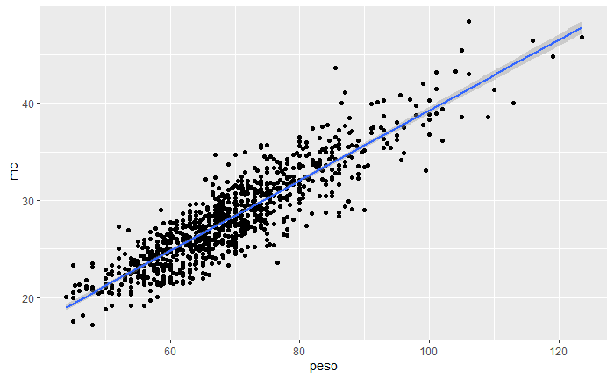
Correlation 2. Types of correlation
Pearson correlation coefficient. How to in R?
Study the relationship between peso and body mass index (imc):
cor(osteoporosis$peso, osteoporosis$imc, method = "pearson")
[1] 0.8927863

Slide 73
Correlation 2. Types of correlation
Pearson correlation coefficient. How to in R?
Bone density (bua) and age (edad) are correlated?

Slide 74
Correlation 2. Types of correlation
Pearson correlation coefficient. How to in R?
Bone density and age are correlated?
cor(osteoporosis$bua, osteoporosis$edad, method = "pearson")
[1] -0.3601883
Don’t forget to look the graphic!!

Slide 75
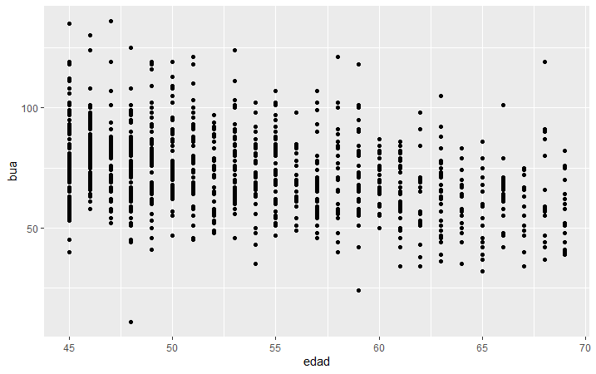
Correlation 2. Types of correlation
Pearson correlation coefficient. How to in R?
ggplot(osteoporosis, aes(x = edad, y = bua)) +
geom_point()

Slide 76
Correlation 2. Types of correlation
Non Parametric correlation: Spearman correlation coefficient
Pearson correlation coefficient is severely affected by outliers and if the relation is not lineal
Better to use Spearman correlation coefficient (use the ranks between the numbers instead the values) to calculate the correlation coefficient
Evaluates the monotonic relationship between the variables (not the linear relationship as Pearson does).
The variables tend to change together but not necessarily at a constant rate

Slide 77

Correlation 2. Types of correlation
Non Parametric correlation: Spearman correlation coefficient

Slide 78






Correlation 2. Types of correlation
Comparison of Pearson and Spearman coefficients.
Always examine a scatterplot to determine the form of the relationship

Slide 79
Correlation 2. Types of correlation
Spearman correlation coefficient. How to in R?
cor(osteoporosis$bua, osteoporosis$edad, method = "spearman")
[1] -0.3540295

Slide 80
Correlation 2. Types of correlation
Correlation matrix
cor(osteoporosis[, c("edad", "peso", "talla", "imc", "bua", "menarqui")])
edad peso talla imc bua menarqui
edad 1.0000000 0.182629245 -0.16635268 0.26173285 -0.36018834 0.115901253
peso 0.1826292 1.000000000 0.23110585 0.89278635 0.09467837 -0.008526465
talla -0.1663527 0.231105848 1.00000000 -0.22546438 0.13350207 0.070002843
imc 0.2617329 0.892786346 -0.22546438 1.00000000 0.03415938 -0.041607661
bua -0.3601883 0.094678365 0.13350207 0.03415938 1.00000000 -0.085935539
menarqui 0.1159013 -0.008526465 0.07000284 -0.04160766 -0.08593554 1.000000000

Slide 81
Correlation. Exercises
Exercise. An hypothetic study, published last year that exists a relation between age and systolic blood pressure (sbp)? Do you think is it true? Show a scatterplot of the values. If not, find another variable in the dataset that has a good correlation with systolic blood pressure.
Use dataset Framingham250.csv

