Slide 1








Principles of Hypothesis testing
UEB – VHIR
Santiago Pérez-Hoyos, Alex Sánchez-Pla, Miriam Mota and Ricardo Gonzalo
santi.perezhoyos@vhir.org

Slide 2








































The objectives of statistical inference
Hypothesis
Population
Samples
(sampling techniques)
Conclusions based
on the observed data
(Statistical inference)
(Parameters estimation)
(Hypothesis testing)
Generalization to
the population

Slide 3
Statistical Inference Questions
Parameter estimation:
After assuming population data follow a certain probability distribution (normal. Binomial, Poisson, etc) which are the value of the parameters that better fit the sample data.
Hypothesis testing:
We have an assumption about the population data parameters
Population mean is equal to 10
The mean in population A is equal to the mean in population B
Hypothesis testing tries to verify if sample data are compatible with that hypothesis

Slide 4

Hypothesis testing: Making decisions about populations
Guess that average bone density in women is
70...
But... why not to check median,
mode or other estimators?

Slide 5
Case study problem I
Our guess:
The average ''bua'' value in our population is 70.
The ''bua'' mean value in menopausic and non-menopausic women is not the same
Exercise 1):
Explore osteoporosis data in order to get an idea about our first guess
Do de same for the second question
- What other things you can figure out about the bone density in our population?

Slide 6
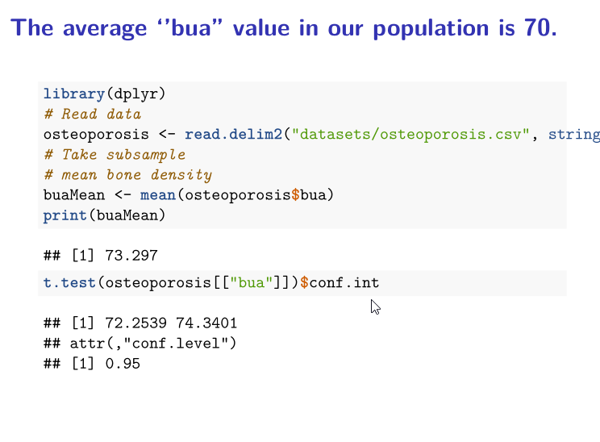

Slide 7
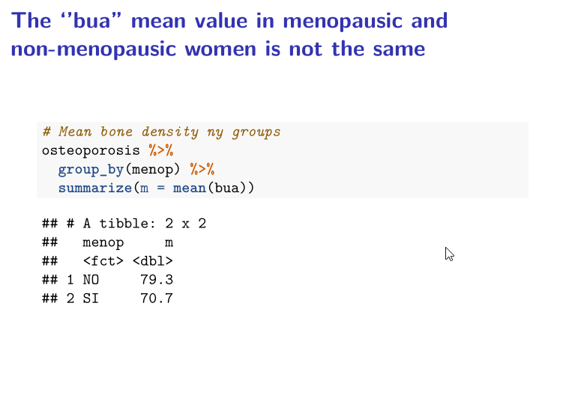

Slide 8
Case study problem II
Cohort study with new lung cancer cases after 12 years of follow up (The NHANES Epidemiologic Follow-up Study. Am J Epidemiol 1997;146:231-243)
Total lung cancer rate =132/ 5034=2.6%
After this outcome can we say that fruit consumption is a protective factor for lung cancer?
How can I say this results is not caused by sampling or random?

Slide 9
A framework for hypothesis testing

Slide 10
The "Null" and the "Alternative"
We can establish two basic hypothesis
Null Hypothesis (H₀)
Outcome is observed by chance.
No relationship among exposure and disease.
Alternative Hypothesis (H₁)
There is relationship among exposure and disease.

Slide 11
How to decide which hypothesis?
Select a test statistic that measures the discrepancy between data and null.
Two approaches
Look for a "cut-off" or "critical-value" such that values greater than this cut-off lead to rejecting the null hypothesis.
Compute the probability to observe values greater than what you have observed if the null were true.

Slide 12
Hypothesis Testing
Test population hypothesis from samples
Stablish Null Hypothesis(H₀)
Stablish Alternative Hypothesis (H_{α})
Select statistical test to calculate probability under Null Hypothesis
Decide after comparing test value with a critical value or probability under null hypothesis.

Slide 13
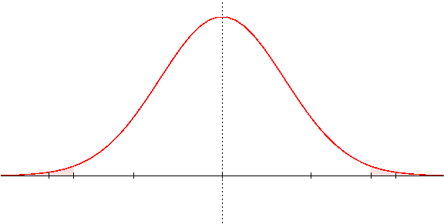
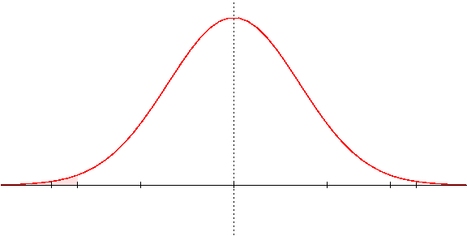
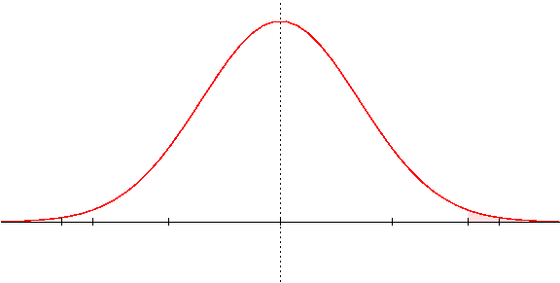
One-sided vs Two-sided
Critical value depends on the type of alternative Hypothesis
Two-sided
H₁: m ≠
One-sided
One-sided
H₁: m <
H₁: m >

Slide 14
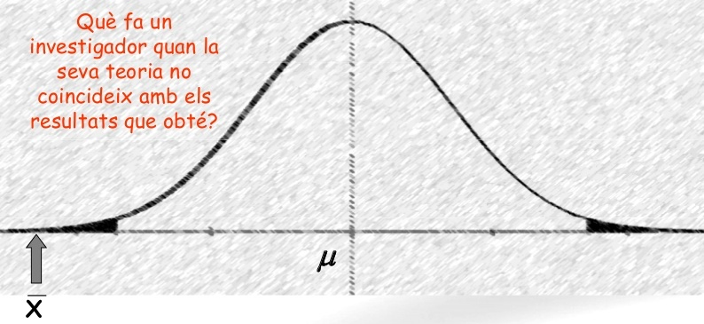
Example
Null hypothesis (H₀):
Alternative hypothesis (H_{α} =H_{a} =H₁): the opposite idea
Under the null hypothesis, if all the samples of a given size could be selected and their sample means could be computed the sampling distribuion would be:
H_{0:} The mean of BUA values is 70.0
H1: The mean of the bua values is not equal to 70.0 (Bilateral)
H1: The mean of the bua values is higher(lower) than 70.0 (Unilateral)
H₁ only accepted if clear evidence
that H₀ is not true
If observed mean = 18 H₀ is unlikely
= 70
= 18

Slide 15
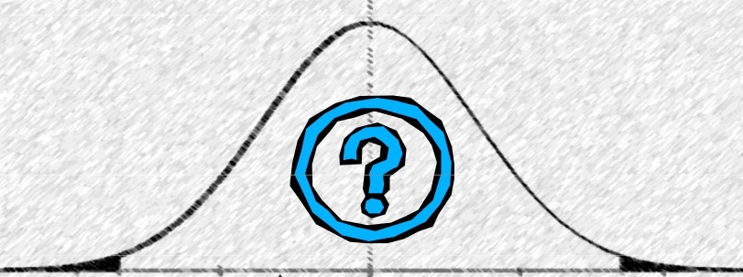
Accepting or rejecting the NULL
H₁ only accepted if clear evidence
that H₀ is not true
If observed mean = 18 H₀ is rejected
μ = 70
If observed mean = 58 H₀ can not be rejected
(it does not mean H₀
can be accepted!!)

Slide 16
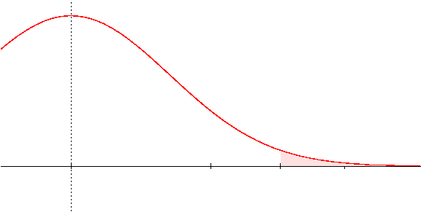
Critical Value
At which value of the sample mean does one change from non-rejecting to rejecting the null hypothesis?
A value is selected such that the probability that the sample mean exceeds it, if the null hypothesis is true, is “small”, (for example 5%).
This value is called “Critical Value” t_{α} and
the probability is called “significance level (α)” and it is set to be small.
α
Critical value: t_{α}

Slide 17
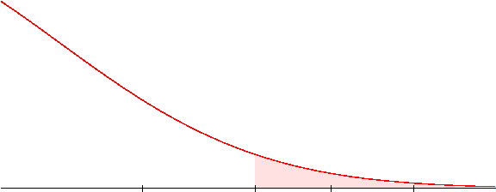
Example: Critical value and Sample mean
If σ =17, n =25 and α=0.05 the critical value is 79.7
With a sample mean of 74 we will not reject H₀
With a sample mean of 83 we will t reject H₀
We cannot reject
H₀: μ=70
We reject
H₀: μ=70
α
H₀: μ=70
_{79.7}

Slide 18
P values: The alternative
We have based our decision about rejecting H₀ on comparing sample mean (i.e. 73) with the critical value (i.e. 79.7)
Instead we can compare the probability of observing at least that sample mean (p value) with the significance level (α) (which is the probability of observing at least the critical value),
The probability is smaller than alfa if (and only if) the sample mean is bigger than the critical value.
In such situation we decide to reject H0
The probabiliy is bigger than alfa if (and only if) the sample mean is smaller than the critical value.
In such situation we cannot reject H0 so we accept it
Both criteria (critical value and p-value) are valid for testing hypotheses.

Slide 19
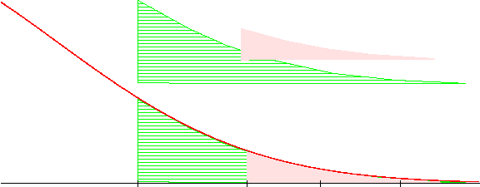
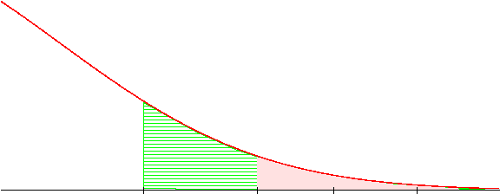
Example: P-value vs critical value
If σ =17, n =25 and the sample mean is 73 then
The probability that assuming that H0 is true, that is m=70, we can observe by chance a sample greater than 73 is: 0.406
pnorm(q=74, mean=70, sd=17, lower.tail=FALSE)
P
α
H₀: μ=70
We cannot reject the null hypothesis
P=0.406
α= 0.05

Slide 20
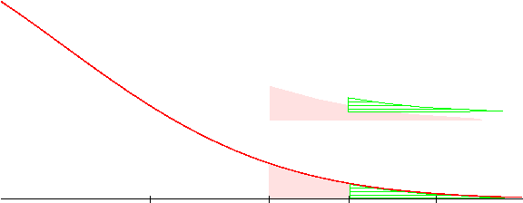
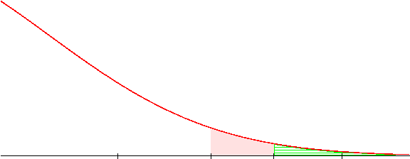
Example: P-value vs critical value
If σ =17, n =25 and the sample mean is 105 then
The probability that assuming that H₀ is true, that is μ=70, it can be obtained by chance a sample with a mean greater than 70 is: 0.019
pnorm(q=105, mean=70, sd=17, lower.tail=FALSE)
α
P
Reject H₀: μ=70
Accept H₁: μ>70
α
P
We usually say the test is statistically significant if p < α

Slide 21
Summary: α vs p
α and P are related but they are not the same …
About α
It is prefixed before experiment
Usually low ( 0.05)
Linked with critical value (“knowing one, the other is automatically known)
Unaffected by the sampling process.
About p
It is calculated after the experiment
Can take any values in (0,1)
After calculation one can know the achieved significance level.
Depends on the sampling process

Slide 22
Type of Hypothesis
Confirmation Hypothesis
Aim is to confirm hypothesis about parameters or distributions.
Goodness of fit test to verify hipothesis about the distribution of variable in population
Does populational blood pressure adjust to a normal distribution?
Test to verify values about a parameter.
Is the average ''bua'' value in our population equal to 70?
Is the proportion of lung cancer cases equal to 2.6%?

Slide 23
Type of Hypothesis
Independence Hypothesis
Aim is to test hypothesis for relation of variables in a population or no differences of a variable in two or more populations
Is the average ''bua'' value the same in menopausic and in no menopausic population?
Is the proportion of lung cancer cases the same in people with high or low fruit consumption?
Is CD4 lymphocytes count related with CD8 count in HIV positive?
Pruebas de independencia

Slide 24
Type of Test
Parametric Test
It is assumed that the variable under study follows a particular distribution and values about its parameters are tested
Distribution of proportion of lung cancer is binomial
H₀: p= 3%
BUA is the same in menopausic and non menopausic and variable is normal or symmetric
H₀: μ_{Menopausic}= μ_{Non} _{menopausic}
Distribution is binomial and proportion of lung cancer is the same in high and low fruit consummers
H₀: p_{High fruit}= p_{Low} _{fruit}

Slide 25
Type of Test
Non Parametric Test
No distribution is assumed and test are related to distribution not to values about parameters
Distribution of bua follow a normal distribution
Bua is the same in menopausic and non menopausic and variable is normal or symmetric
H₀: distribution in Menopausic= Distribution in non menopausic
Lung cancer is not related to fruit consumption. They are independent.

Slide 26
Hypothesis testing examples
Imagine we have the following beliefs (our reference documents state that this is "TRUE")
The average ''bua'' value in our population is 70.
The ''bua'' mean value in menopausic and non-menopausic women is not the same.
These beliefs can be checked through the corresponding hypothesis tests
H₀: μ_{bua}= 70, H₁: μ_{bua} <>70,
H₀: μ_{[bua, Menop]}= μ_{[bua, NoMenop]}, H₁: μ_{[bua, Menop]} <>μ_{[bua, NoMenop]}

Slide 27
The average ''bua'' value in our population is 70
# osteoAll is the dataset obtained reading osteoporosis.csv
t.test(osteoData$bua, alternative="less")
One Sample t-test
data: osteoData$bua
t = 23.161, df = 24, p-value = 1
alternative hypothesis: true mean is less than 0
95 percent confidence interval:
-Inf 79.6381
sample estimates:
mean of x
74.16
Haga clic para agregar texto

Slide 28
Ex The average ''bua'' is the same in "MENOP" and "Not MENOP"
t.test (bua~menop, alternative="two.sided", data=osteoData))
Welch Two Sample t-test
data: bua by menop t = 1.797,
df = 90.184, p-value = 0.07568
alternative hypothesis: true difference in means is not equal to 0
95 percent confidence interval:
-0.5399937 10.7761048
sample estimates:
mean in group NO mean in group SI
76.05556 70.93750

Slide 29
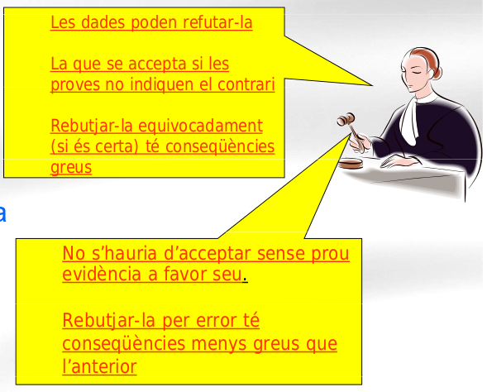
Errors and power in hypothesis testing
Data can lead to reject it
Accepted if data don't
show the contrary
Reject it by mistake (if it is true) has severe consequences
H₀
(innocent)
(not speculative)
Should not be accepted without enough evidence
Reject it erroneously has less dramatic consequences
H₁
(guilty)
(speculative)

Slide 30
Errors after testing
 |  | True
 |  | Innocent | Guilty
veredict | Innocent | OK | Error
 | Guilty | Error | OK

Slide 31
Errors and Right Decisions
 | Null Hypothesis True | Null Hypothesis False
Test does not reject null hypothesis | Right decision (1- α) | Type II Error β
Test rejects null hypothesis | Type I Error α | Right decision Power (1- β)

Slide 32
Power and Sample Size
In an ideal situation one might want to control for both probabilities of error.
Select a test such that, for example: P(Type I err) < 0.05 AND P(Type II err) < 0.3
In practice it is usually not possible and decreasing the probability of one error type increases the probability of the other.

Slide 33
Power and Sample Size (II)
In practice, there are only two ways yo increase power in a test
Increase sample size
Change the test so that, the effect to be detected, is bigger.
This can be reversed and in practice we aim at computing the sample size reuired to attain a certain power given a desired effect size to be detected.

Slide 34
The factors affecting sample size
Type I Error α
Probability of rejecting the Null Hypothesis when its true (5%)
Power 1- β(Type II Error)
Probability of rejecting the Null Hypothesis when its false (80%,90%)
Variability of the data σ²
Variance of the data
Minimum detectable difference betweeen the two groups to compare
Effect Size δ

Slide 35
Effect size=5, Sample size = 17, Power = 0.20
Z_{1- α} *ee
δ-Z_{1- β}*ee

Slide 36
Effect size=5, Sample size = 107, Power = 0.80
Z_{1- α} *ee
δ-Z_{1- β}*ee

Slide 37
Effect size=5, Sample size = 1070, Power >0.999
Z_{1- α} *ee
δ-Z_{1- β}*ee

Slide 38
An example sample size formula
We want
Z_{1- α} *ee=δ-Z_{1- β}*ee
We know α,β and ee=σ/√n

Slide 39
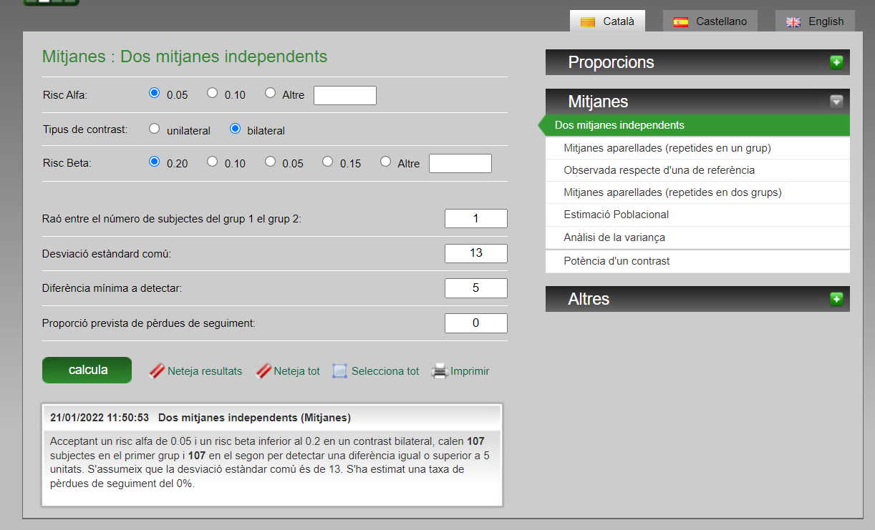
Sample size for mean differences

Slide 40
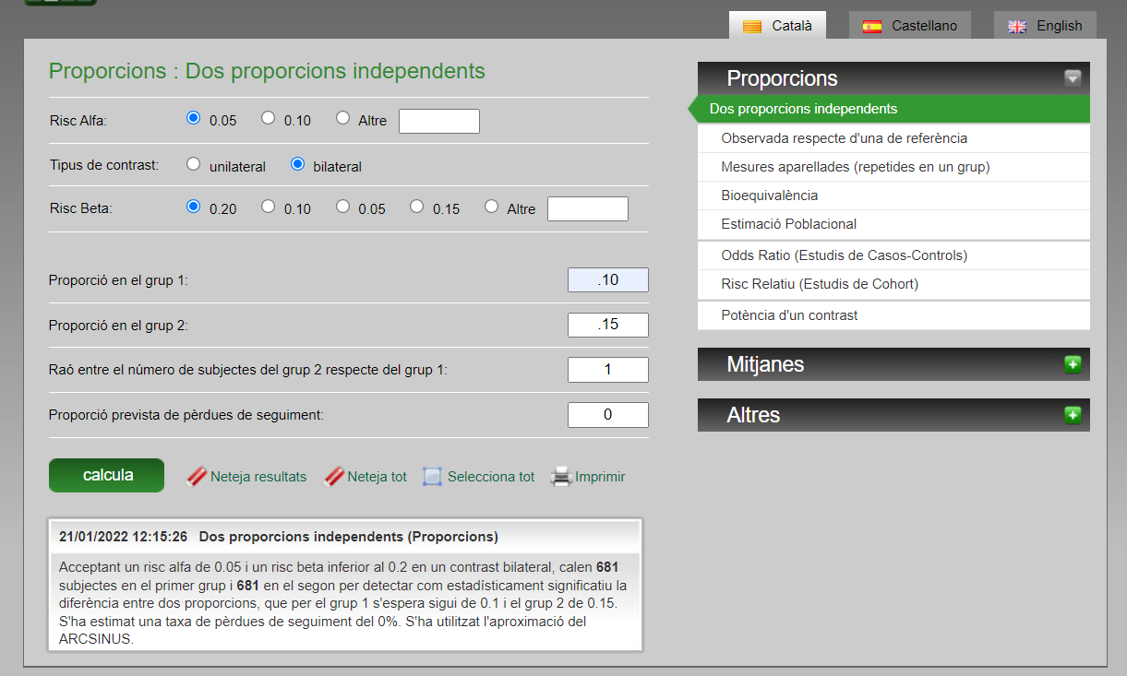
Sample size for differences in proportions

Slide 41
Some tips for sample size calcuations
Sample size goes up
for smaller α
For higher β
For smaller δ
For higher σ
For p closer to 50%
Sample size is higher for proportions than means
Sample size must be calculated a priori. Is not sensible to calculate power after
SD can be calculated from 95% CI
Upper-Lower limit of a CI is about 4 Standard Error and SE=s/√n
Some % of survivors can be obtained from Kaplan-Meier survival curves and can be used for calculations
Sample size is not an exact science and must be the product of calculations and reality

Slide 42
Common misunderstandings about the p-value

Slide 43
Common misunderstandings about the p-value
The p-value is not the probability that the null hypothesis is true, nor it is the probability that the alternative hypothesis is false (it is not connected to either of these).
The p-value cannot be used to figure out the probability of a hypothesis being true.
The p-value is not the probability of wrongly rejecting the null hypothesis.
The p-value is not the probability that replicating the experiment would yield the same conclusion.
The p-value does not indicate the size or importance of the observed effect. The two do vary together however: the larger the effect (effect size), the smaller sample size will be required to get a significant p-value.

Slide 44
Multiple Comparisons and múltiple testing

Slide 45
Testing hypothesis repeatedly
Every time we do a test there is a chance to take the wrong decision by rejecting the null hypothesis while it is TRUE.
If, instead, we do many tests simultaneously the probability that there is, by chance, at least one false positive increases and does not match the type I error probability anymore.
This increase in the probability of type I error has to be compensated in some way → multiple testing adjustments

Slide 46

To cross or not to cross?
The previous situation can be better understood with the “bridge analogy”.
Imagine you are an adventurer that has the option of to cross a bridge in order to escape from danger, find a treasure...
and that there is a post in front of the bridge stating:
“This bridge has broken only one out of 100 times"

Slide 47
To cross or not to cross?
Imagine you are an adventurer that has the option of to cross a bridge in order to escape from danger, find a treasure...
and that there is a post in front of the bridge stating:
“This bridge has broken only one out of 100 times“
So, the p-value of our metaphor is 0.01
You could accept that 1% is a risk small enough to pass the bridge and pursue your goal. OK

Slide 48

To cross or not to cross?
But... what do you decide if, in order to reach your goal, you have to cross hundreds of bridges of that kind?

Slide 49
To cross or not to cross?
But... what do you decide if, in order to reach your goal, you have to cross hundreds of bridges of that kind?
In this case, the probability of falling while crossing one of the bridges is obviously too high ('cause we have just one life).

Slide 50
To cross or not to cross?
Therefore, in this case (multiple testing), the p-value by itself is not a good reference for accepting or not statistical significance.
We must apply some type of adjustment to the p-values (allowing us to be safe in crossing all the bridges).

Slide 51

Some p-value adjustments
Bonferroni (α/k)
Post-Hoc test ANOVA (Tukey, Scheffe, Dunn-test)
False Discovery rate
Benjamini-Hochberg correction

Slide 52
Multiple comparisons vs multiple testing
There are two distinct situations where p-value adjustment may be necessary:
Post-hoc tests in ANOVA:
This is usually called multiple comparisons and common methods of adjustment are Tukey, Fisher HSD.
Testing many variables in the same study
This is usually called multiple testing and common methods of adjustment are Bonferroni, Holm or Benjamini and Hochberg (False Discovery Rate).

Slide 53
Multiple testing
When many variables are compared independently with the same test
Find differences between treated/untreated for a set of biomarkers such as cytokines.
Number of comparisons may be low (“dozens”)
Find differentially expressed genes, i.e. genes whose expression may change between conditions.
Number of comparisons high (“hundreds” to “thousands”)
This is usually called multiple testing and common methods are Bonferroni, Holm or Benjamini and Hochberg (False Discovery Rate).

Slide 54
Post-hoc ANOVA tests
If we wish to compare all means against all means he number of tests increases quickly (to compare all pairs of means if there are k groups (k*k-1)/2 tests are required).
This is usually called multiple comparisons and common methods of adjustment are Tukey, Fisher HSD or Bonferroni.

