Slide 1








Hypothesis Testing. Quantitative Variables
Basic Statistics with R
UEB-VHIR
Mireia Ferrer, Miriam Mota, Alex Sanchez and Santiago Perez-Hoyos
10/05/2021

Slide 2
Syllabus
INTRODUCTION
TYPE OF TEST
NORMALITY TEST
ONE GROUP COMPARISON
TWO GROUPS COMPARISON IN INDEPENDENT SAMPLES
TWO GROUPS COMPARISON IN DEPENDENT SAMPLES
MORE THAN TWO GROUPS COMPARISON IN INDEPENDENT SAMPLES
Multiple comparisons and mUltiple testing
3
5

Slide 3
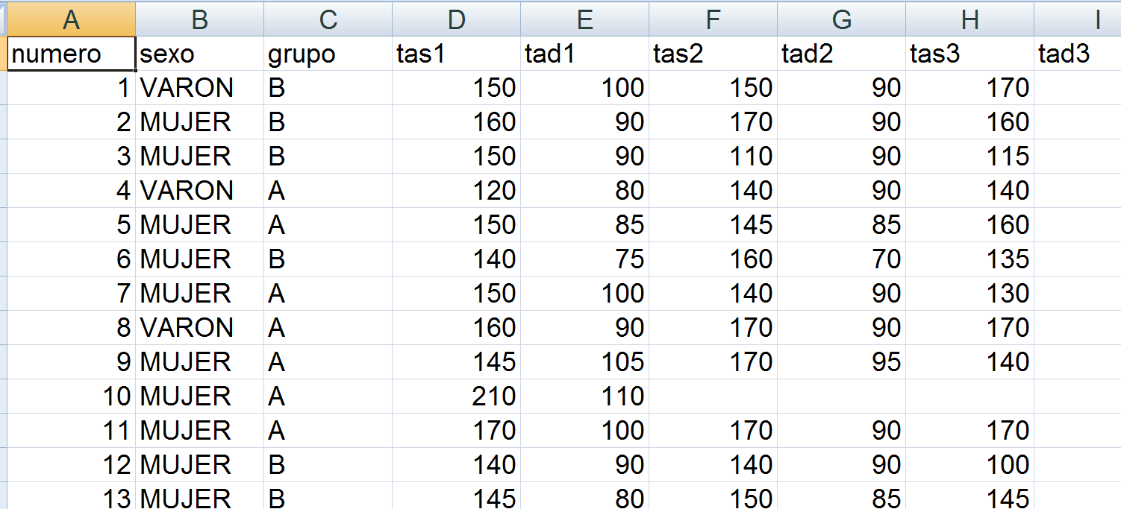
Example Data
A study was designed to compare two distinct hypertension control programs.
60 individuals with HTA were randomly assigned to either one or the other group (30 per group)
Blood pressure was measured each month during a year

Slide 4
Questions to solve
Are samples “comparable” at baseline?
Has there been a change in BP between month 1 (first measure) and month 12?

Slide 5
Syllabus
INTRODUCTION
NORMALITY TEST
ONE GROUP COMPARISON
TWO GROUPS COMPARISON IN INDEPENDENT SAMPLES
TWO GROUPS COMPARISON IN DEPENDENT SAMPLES
MORE THAN TWO GROUPS COMPARISON IN INDEPENDENT SAMPLES
MULTIPLE COMPARISONS AND MULTIPLE TESTING
3
5

Slide 6
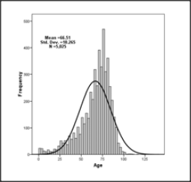
Normality test
Some parametrical test assume data come from a normal population
How can we check this assumption?
What can we do if assumption is false?

Slide 7
Testing normality
We can use graphical methods or hypothesis tests
Graphs
Check if it is a symmetric distribution
Probability graphs (QQ-plots)
Hypothesis test (Normality)
Kolmogorov‐Smirnov test
Kolmogorov-Liliefors test
Shapiro-Wilks test

Slide 8
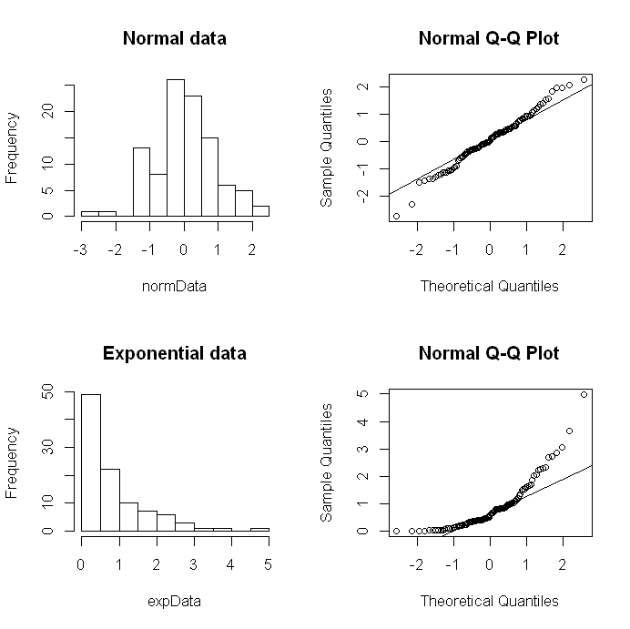
Histograms and QQ-plots
Histogram
It should be symmetric with gaussian shape.
QQ-plot
Dots should be over the diagonal line
Non normal data deviate from normal patterns.
Difficult to quantify if there are few data

Slide 9
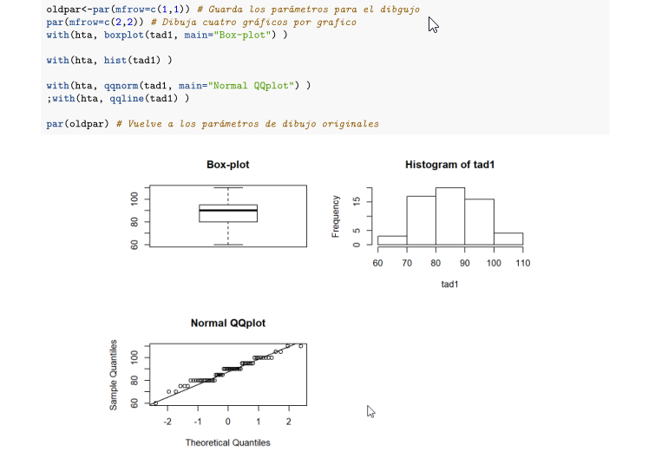

Slide 10
Normality test
Statistical normality test are more precise than graphs. It is possible to calculate a p-value.
The most used tests are Kolmogorov-Smirnov and Shapiro-Wilks test.
The hypothesis to test are:
H₀: Data follow a normal distribution
H₁ : Data do not follow a normal distribution

Slide 11
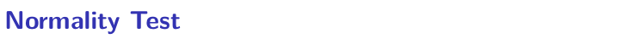
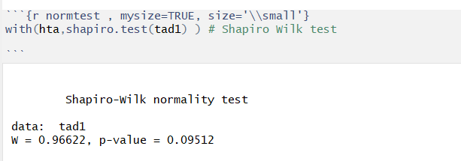

Slide 12
Syllabus
INTRODUCTION
NORMALITY TEST
ONE GROUP COMPARISON
TWO GROUPS COMPARISON IN INDEPENDENT SAMPLES
TWO GROUPS COMPARISON IN DEPENDENT SAMPLES
MORE THAN TWO GROUPS COMPARISON IN INDEPENDENT SAMPLES
MULTIPLE COMPARISONS AND MULTIPLE TESTING
3
5

Slide 13
One sample t-test
We do not use it very often.
Very similar to estimation questions. It can be solved calculating a confidence interval
Idea: We want to verify from a sample a previous hypothesis about the mean in a population
Can it be accepted that the initial TAD is 90 in Hipertensive patients?

Slide 14
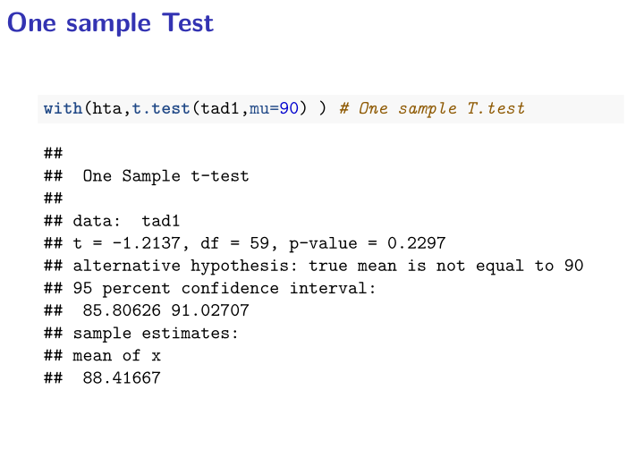

Slide 15
Exercise 1
Check the normality of tas1 variable in hta dataset
Can it be accepted that the initial TAS is 120 in Hipertensive patients?
Find the 95% confidence interval for the mean of tas1 variable
Extra: Can it be accepted that the initial TAS is higher than 120 in Hipertensive women?

Slide 16
Syllabus
INTRODUCTION
NORMALITY TEST
TWO GROUPS COMPARISON IN INDEPENDENT SAMPLES
TWO GROUPS COMPARISON IN DEPENDENT SAMPLES
MORE THAN TWO GROUPS COMPARISON IN INDEPENDENT SAMPLES
MULTIPLE COMPARISONS AND MULTIPLE TESTING
3
5

Slide 17
Questions to answer
Are samples comparable at baseline time
Is blood pressure comparable between first and 12th measures

Slide 18
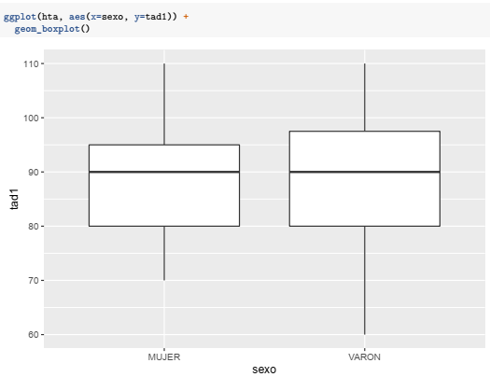
Boxplot tad1, by sexo

Slide 19
Compare a Quantitative variable in two groups
Null Hypothesis: There is not difference of the variable in two population or groups
Samples have been generated
INDEPENDENT
Selected individuals in a group have nothing to do with selected individuals in the other group.
DEPENDENT
Each individual in a group has a correspondent in other group.
These are paired data.

Slide 20
Two sample tests
EQUAL VARIANCES T-TEST
Yes
P>,05 Levene test for Homogeneity of Variances
Yes
UNEQUAL VARIANCES T--TEST(WELCH)
Normality
or n>30
No
no
Yes
NON-PARAMETRIC TESt : MANN-WHITNEY’S U or WILCOXON RANK-SUMS
Independent Groups
Yes
PAIRED T-TEST
No
Normality
ó n>30
No
NON-PARAMETRIC TEST: WILCOXON SIGNED-RANK

Slide 21
Two sample tests (1)
EQUAL VARIANCES T-TEST
Yes
P>,05 Levene test for Homogeneity of Variances
Yes
UNEQUAL VARIANCES T--TEST(WELCH)
Normality
or n>30
No
no
Yes
NON-PARAMETRIC TEST : U DE MANN-WHITNEY O SUM-RANK OF WILCOXON
Independent Groups
Data is normal (normality test) or sample size > 30.
Mean is a good summary statistic for this problem.
Test homogeneity of variances

Slide 22
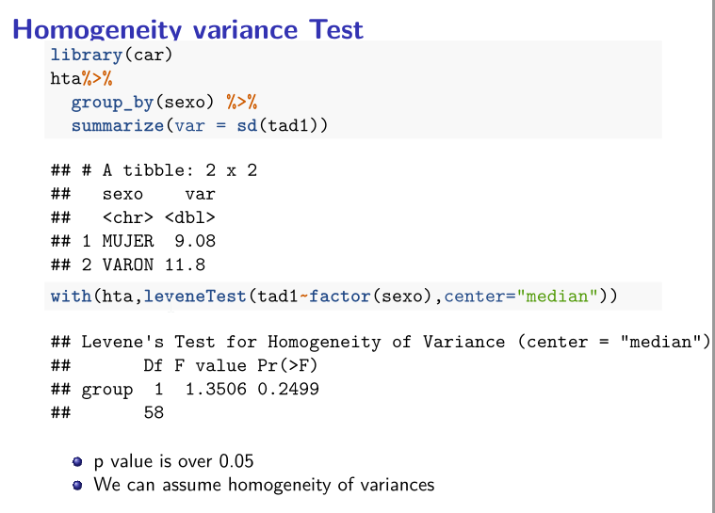

Slide 23
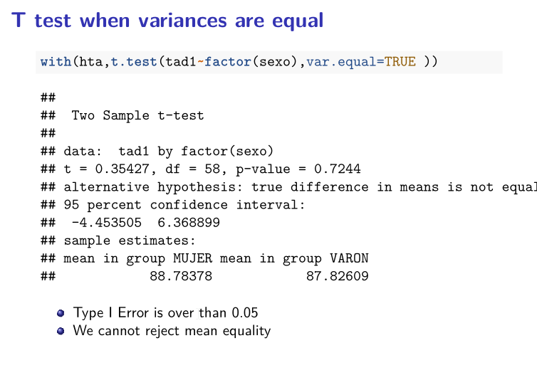

Slide 24
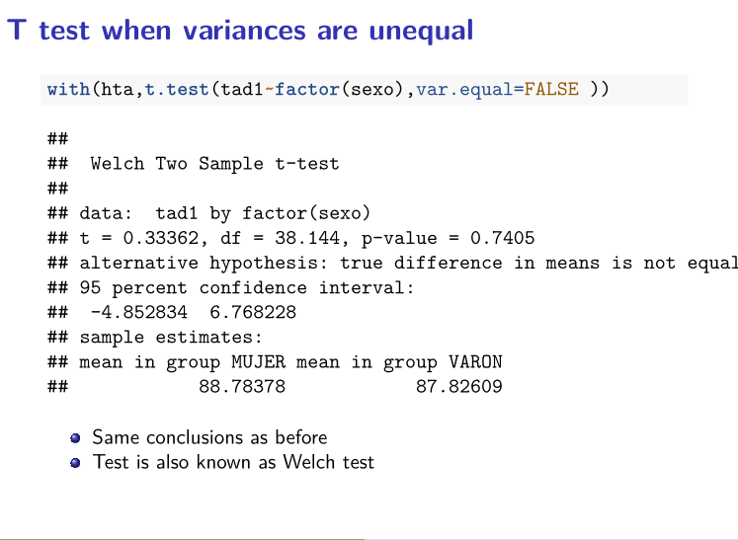

Slide 25
Two groups, data non normal
Normality
or n>30
no
Yes
NON-PARAMETRIC TEST: MANN-WHITNEY’S U O WILCOXON SUM-RANK
Independent Groups

Slide 26
Non parametric tests
If data distribution is unknown or mean is not the best way to summarize data …
Non parametric test are not based on the usual parameters from a distribution, such as μ or σ^{2.}
Instead they may be based …
On order statistics, such as median or percentiles
They take into account the whole distribution.

Slide 27
Test based on ranks (Wilcoxon)
Based on susbtituting original values by “ranks” in a joint sample
12, 5, 14, 16, 3 → ranks are: 3, 2, 4, 5, 1
Ranks only depend on the position of each value in the ordered sample.
120, 95, 121, 130, 3 have the same ranks as values in the first sample
☺ NP test are more robust than parametrics ones
☹ In the ideal situation where parametric tests are valid they are considered to be preferable.

Slide 28
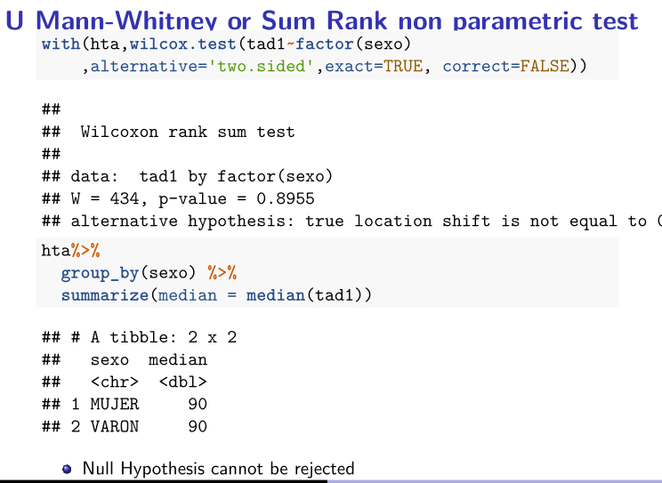

Slide 29
Exercise 2
Is TAD comparable at baseline time between groups?
What is the Hypothesis that we want to test? Describe the null hypothesis and the alternative hypothesis.
What test would be appropiate to perform to answer the question?
Answer the question
Apply a non-parametric test and compare the results

Slide 30
Questions to answer
Are samples comparable at baseline time?
Is blood pressure comparable between first and 12th measures?

Slide 31
Example Data
A study was designed to compare two distinct hypertension control programs.
60 individuals with HTA were randomly assigned to either one or the other group (30 per group)
Blood pressure was measured each month during a year

Slide 32
Syllabus
INTRODUCTION
NORMALITY TESTS
ONE GROUP COMPARISON
TWO GROUPS COMPARISON IN INDEPENDENT SAMPLES
TWO GROUPS COMPARISON IN DEPENDENT SAMPLES
MORE THAN TWO GROUPS COMPARISON IN INDEPENDENT SAMPLES
MULTIPLE COMPARISONS AND MULTIPLE TESTING
3
5

Slide 33
Two dependent groups
Independent Groups
Yes
PAIRED T-TEST
No
Normality
ó n>30
No
NON-PARAMETRIC TEST: WILCOXON SIGNED RANK

Slide 34
Questions to answer
Are samples comparable at baseline time?
Is blood pressure comparable between first and 12th measures?

Slide 35
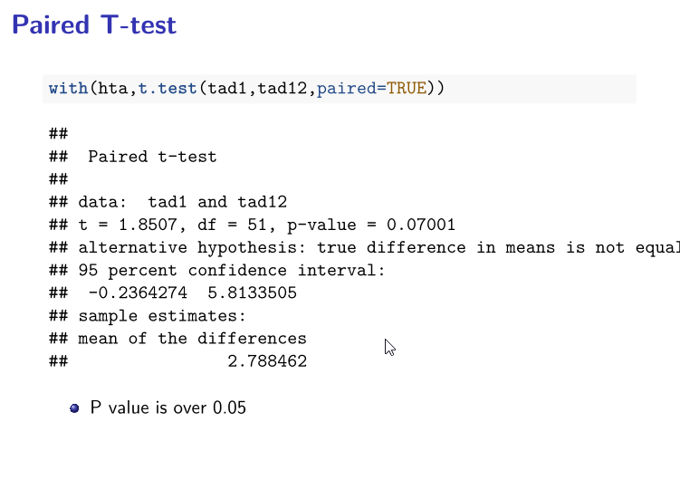

Slide 36
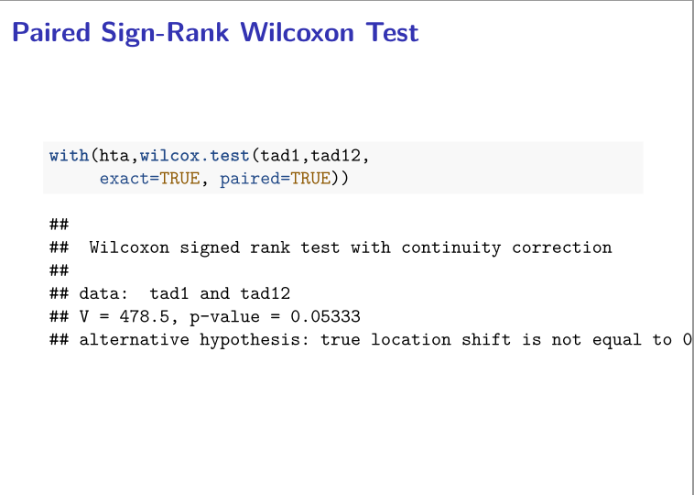

Slide 37
Exercise 3
Is sistolic blood pressure (TAS) comparable between first and 12th measures?

Slide 38
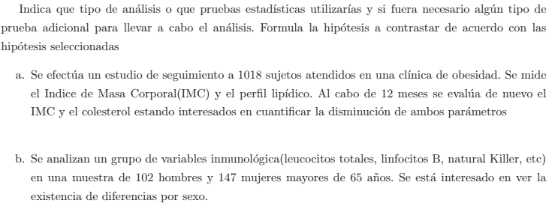
Exercise 4

Slide 39
Syllabus
INTRODUCTION
NORMALITY TEST
ONE GROUP COMPARISON
TWO GROUPS COMPARISON IN INDEPENDENT SAMPLES
TWO GROUPS COMPARISON IN DEPENDENT SAMPLES
MORE THAN TWO GROUPS COMPARISON IN INDEPENDENT SAMPLES
MULTIPLE COMPARISONS AND MULTIPLE TESTING
3
5

Slide 40



Question to answer
A pharmaceutical laboratory wants to test which of three drugs are better:
drug 1 drug 2 drug 3

Slide 41
Question to answer
Could we use Student's t test? We will see with and example:
A pharmaceutical laboratory wants to test which of three drugs are better:
To know which of the drugs is the best one, one could think to perform the following comparison using a t test:
drug 1 drug 2 drug 3

Slide 42
Question to answer
Could we use Student's t test? We will see with and example:
Comparisons with separate t test would be:
Chance of Type I error
Chance of Accept H0
vs
vs
vs
α = 5%
1−α =95%
α = 5%
1−α =95%
α = 5%
1−α =95%

Slide 43
Question to answer
Could we use Student's t test? We will see with and example:
Comparisons with t test would be:
Chance of Type I error
Chance of Accept H0
vs
vs
vs
α = 5%
1−α = 95%
α ≈ 10%
1−α = 95%*95%
α ≈ 15%
1−α = 95%*95%*95%

Slide 44
Question to answer
Could we use Student's t test? We will see with and example:
Comparisons with t test would be:
Chance of Type I error
Chance of Accept H0
vs
vs
vs
α = 5%
1−α = 95%
α ≈ 10%
1−α = 95%*95%
α ≈ 15%
1−α = 95%*95%*95%
Would be easier not reject the null hypothesis when it was wrong (more false positives)

Slide 45
Analysis of the variance
Null Hypothesis
The means of all population are equal
H₀ μ₁ =μ₂ =.... =μ_{k}
Alternative Hypothesis
Not all the means are equal. At least there are two different means
H_{a} ∃ i,j μ_{i} ≠μ_{j}

Slide 46
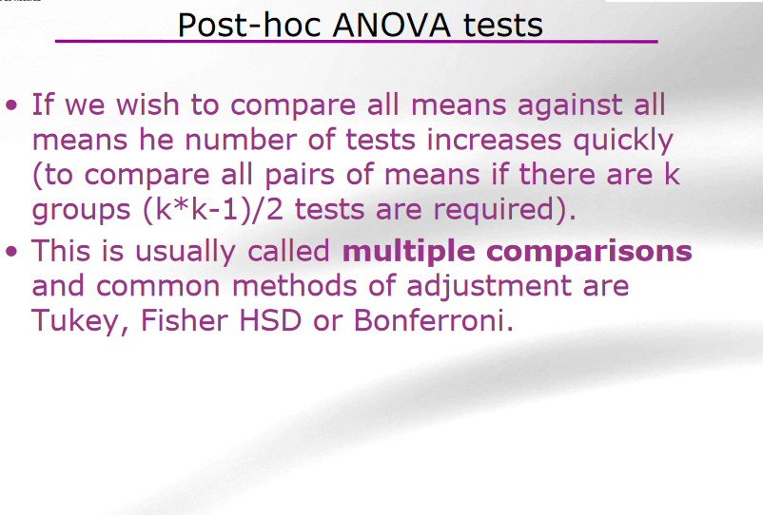

Slide 47
Three or more groups
ANOVA
Yes
Normality
Homocedasticity
No
Yes
KRUSKAL- WALLIS TEST
Independent Groups
REPEATED MEASURES ANOVA
No
Yes
Normality Homocedasticity
No
FRIEDMAN TEST

Slide 48
Three or more groups
ANOVA
Yes
Normality
Homocedasticity
No
Yes
KRUSKAL- WALLIS TEST
Independent Groups

Slide 49
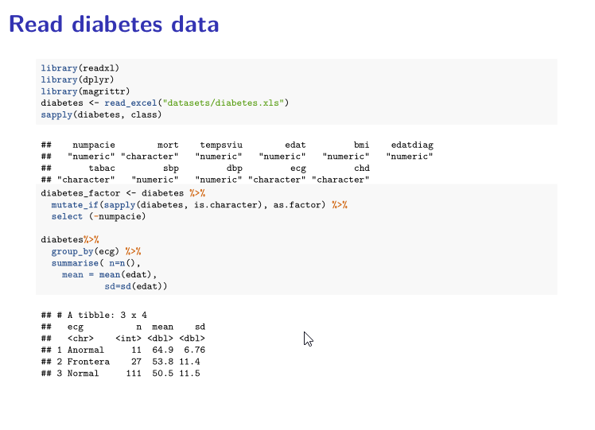

Slide 50
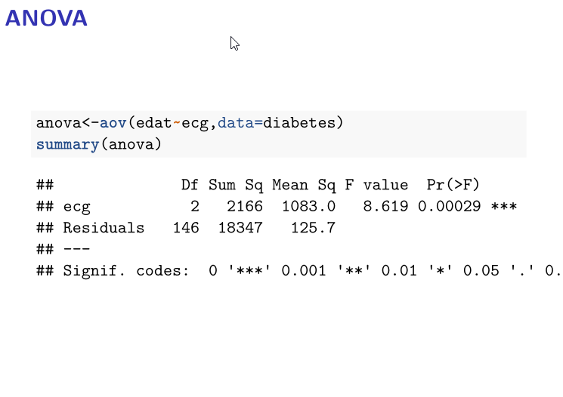

Slide 51
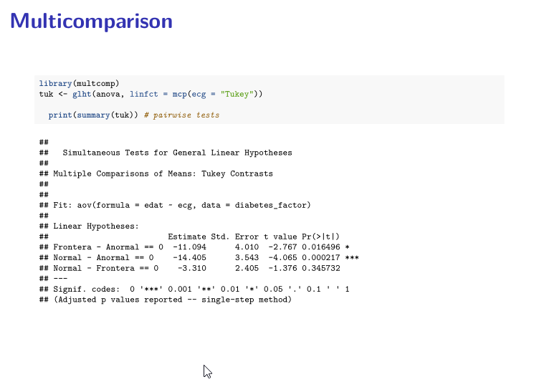

Slide 52
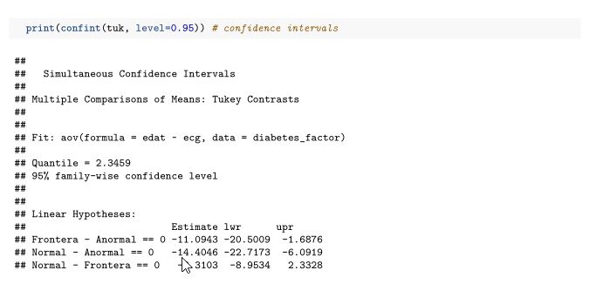

Slide 53
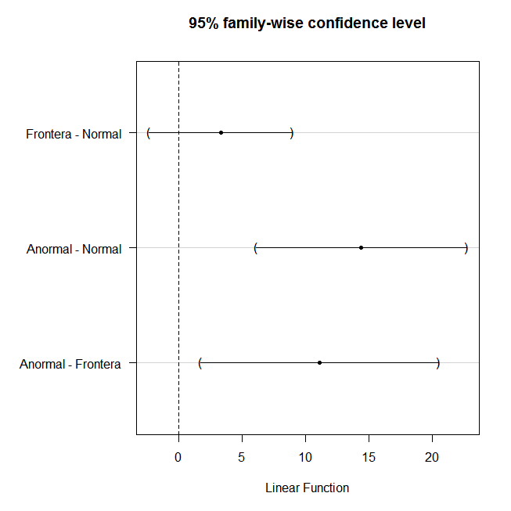
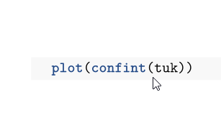
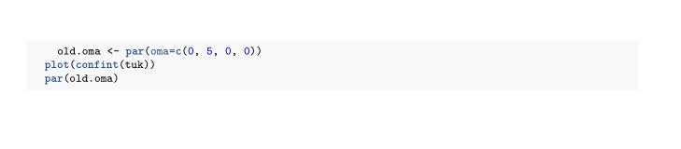

Slide 54
Three or more groups
ANOVA
Yes
Normality
Homocedasticity
No
Yes
KRUSKAL- WALLIS TEST
Independent Groups

Slide 55
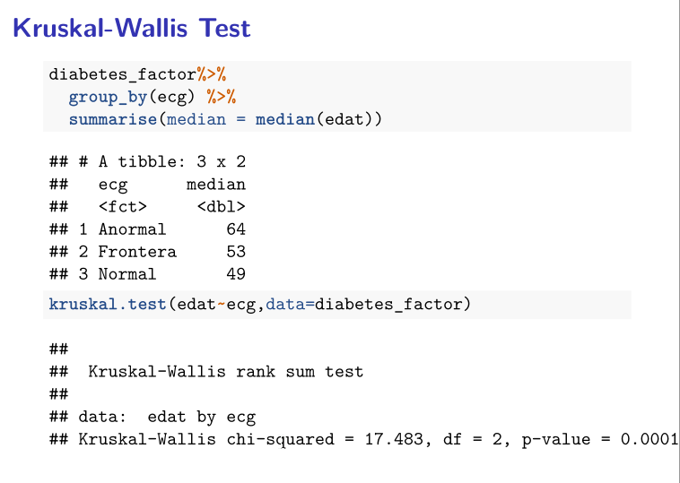

Slide 56
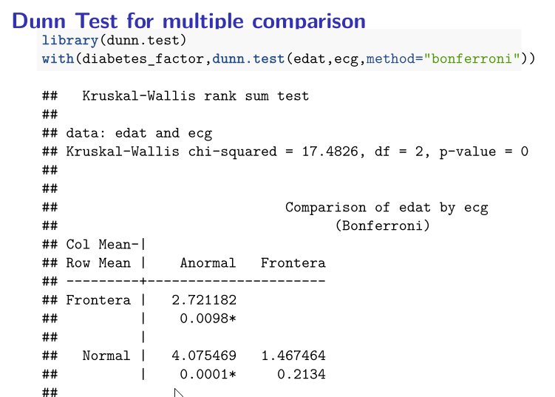

Slide 57
Exercise 5
Are there differences between systolic pressure (sbp) and ECG in diabetic patients?
For each variable, perform some descriptives and check normality assumptions
Set the hypothesis contrast and perform the test
If needed, apply a post-hoc test for multiple comparisons to test which groups are different.
Extra: Analyze the relation between the follow-up time (tempsviu) and the ECG.

Slide 58
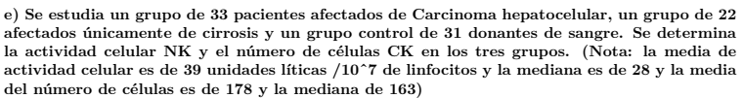
Exercise 6

