Slide 1








Hypothesis Testing . Quantitative Variables
Curs d'Estadística Bàsica per a la Recerca Biomèdica
UEB – VHIR
Miriam Mota, Santiago Pérez-Hoyos and Alex Sánchez
miriam.mota@vhir.org santi.perezhoyos@vhir.org

Slide 2
Syllabus
INTRODUCTION
TYPE OF TEST
NORMALITY TEST
ONE GROUP COMPARISON
TWO GROUPS COMPARISON IN INDEPENDENT SAMPLES
TWO GROUPS COMPARISON IN DEPENDENT SAMPLES
MORE THAN TWO GROUPS COMPARISON IN INDEPENDENT SAMPLES
Multiple comparisons and mUltiple testing
3
5

Slide 3
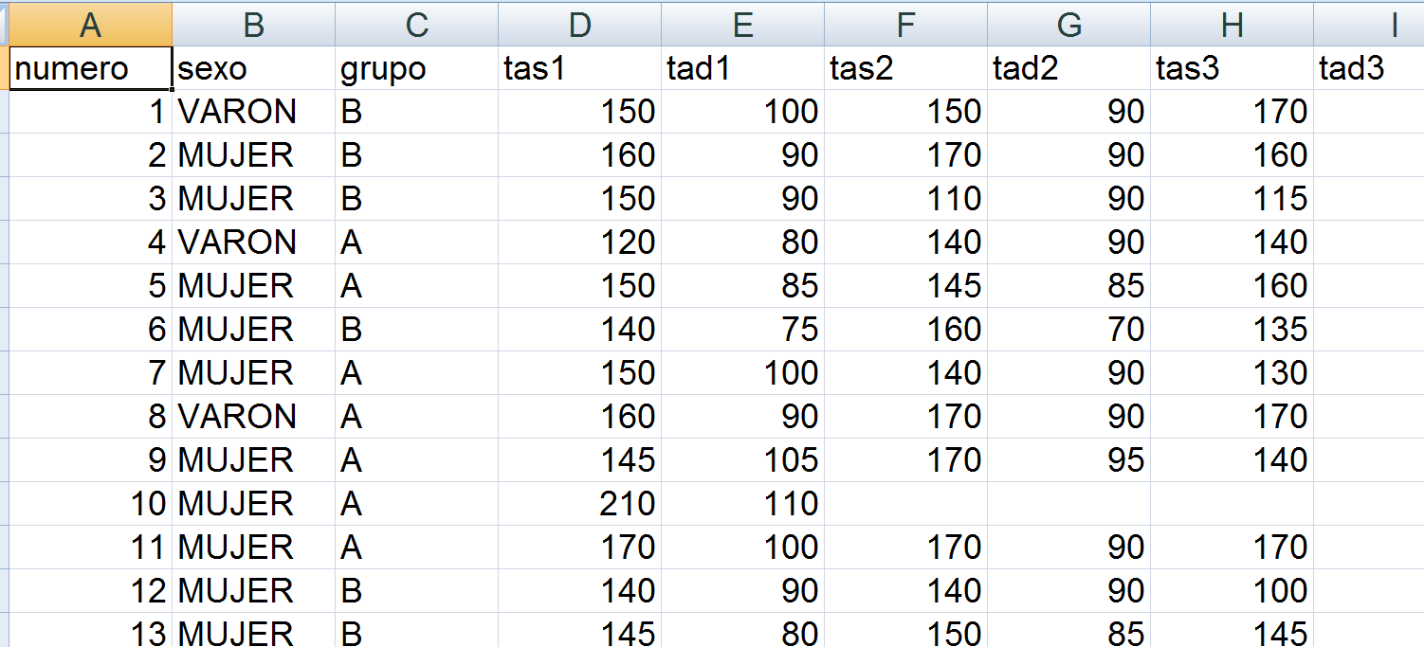
Example Data
A study was designed to compare two distinct hypertension control programs.
60 individuals with HTA were randomly assigned to either one or the other group (30 per group)
Blood pressure was measured each month during a year

Slide 4
Questions to solve
Are samples “comparable” at baseline?
Has there been a change in BP between month 1 (first measure) and month 12?

Slide 5
Syllabus
INTRODUCTION
TYPE OF TEST
NORMALITY TEST
ONE GROUP COMPARISONS
TWO GROUPS COMPARISON IN INDEPENDENT SAMPLES
TWO GROUPS COMPARISON IN DEPENDENT SAMPLES
MORE THAN TWO GROUPS COMPARISON IN INDEPENDENT SAMPLES
MULTIPLE COMPARISONS AND MULTIPLE TESTING
3
5

Slide 6
Type of Hypothesis
Confirmation Hypothesis
Aim is to confirm hypothesis about parameters or distributions.
Goodness of fit test to verify hypothesis about the distribution of variable in population
Does arterial pressure in the population follow a normal distribution?
Test to verify values about a parameter.
Is the average ''bua'' value in our population equal to 70?
Is the proportion of lung cancer cases equal to 2.6%?

Slide 7
Type of Hypothesis
Independence Hypothesis
Aim is to test hypothesis about
relation among variables in a population
Is CD4 lymphocytes count related with CD8 count in HIV positive?
differences in a variable among two or more populations.
Is the average ''bua'' value the same in menopausic and in no menopausic population?
Is the proportion of lung cancer cases the same in people with high or low fruit consumption?
Pruebas de independencia

Slide 8
Type of Test
Parametric Test
Assumes that the variable under study follows a particular distribution and Values about parameters are tested
Distribution of proportion of lung cancer is binomial
H₀: p= 3%
Mean BUA value is the same in menopausic and non menopausic (assuming variable is normal or symmetric)
H₀: μ_{Menopausic}= μ_{Non} _{menopausic}
Proportion of lung cancer is the same in high and low fruit consummers (assuming distribution of counts is binomial).
H₀: p_{High fruit}= p_{Low} _{fruit}

Slide 9
Type of Test
Non-Parametric Test
No distribution is assumed for the data,
Tests are about distribution not about is parameters
BUA distr. in Menopausic = BUA distr. in non-menopausic
Lung cancer is not related to fruit consumption. They are independent.

Slide 10
Syllabus
INTRODUCTION
TYPE OF TEST
NORMALITY TEST
ONE GROUP COMPARISON
TWO GROUPS COMPARISON IN INDEPENDENT SAMPLES
TWO GROUPS COMPARISON IN DEPENDENT SAMPLES
MORE THAN TWO GROUPS COMPARISON IN INDEPENDENT SAMPLES
MULTIPLE COMPARISONS AND MULTIPLE TESTING
3
5

Slide 11
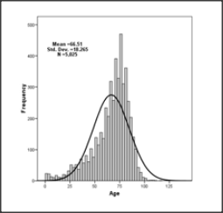
Normality test
Some parametrical test assume data come from a normal population
How can we check this assumption?
What can we do if assumption is false?

Slide 12
Testing normality
We can use graphical methods or hypothesis tests
Graphs
Check if it is a symmetric distribution
Probaility graphs (QQ-plots)
Hypothesis test (Normality)
Kolmogorov‐Smirnov test
Kolmogorov-Liliefors test
Shapiro-Wilks test

Slide 13
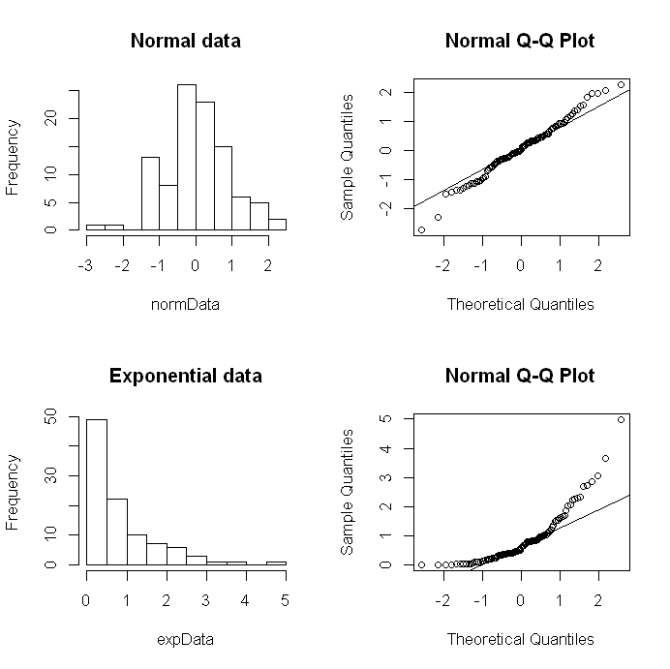
Histograms and QQ-plots
Histogram
It should be symmetric with gaussian shape.
QQ-plot
Dots should be over the diagonal line
Non normal data deviate from normal patterns.
Difficult to quantify if there are few data

Slide 14
Normality test
Statistical normality test are more precise than graphs. It is possible to calculate a p-value.
The most used tests are Kolmogorov-Smirnov and Shapiro-Wilks test.
The hypothesis to test are:
H₀: Data follow a normal distribution
H₁ : Data do not follow a normal distribution

Slide 15
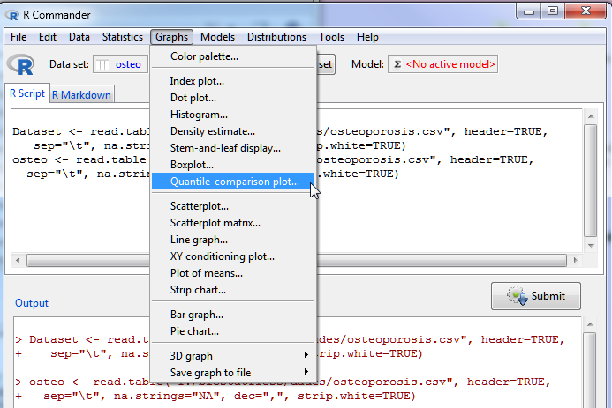
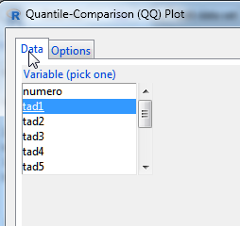
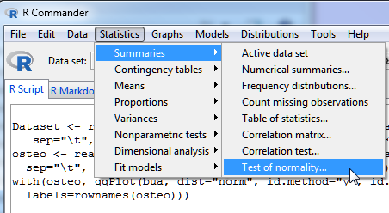
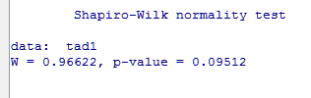

Slide 16
Syllabus
INTRODUCTION
TYPE OF TEST
NORMALITY TEST
ONE GROUP COMPARISON
TWO GROUPS COMPARISON IN INDEPENDENT SAMPLES
TWO GROUPS COMPARISON IN DEPENDENT SAMPLES
MORE THAN TWO GROUPS COMPARISON IN INDEPENDENT SAMPLES
MULTIPLE COMPARISONS AND MULTIPLE TESTING
3
5

Slide 17
One sample t-test
We do not use it very often.
Very similar to estimation questions. It can be solved calculalting a confidence itnerval
Idea: We want to verify form a sample a previous hypothesis about the mean in a population
Can it be accepted that the initial TAD is 90 in Hipertensive patients?

Slide 18
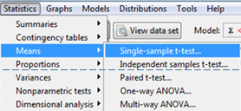
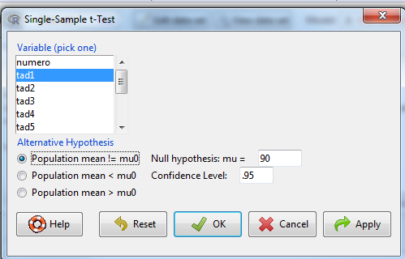

Slide 19
One Sample t-test
data: tad1
t = -1.2137, df = 59, p-value = 0.2297
alternative hypothesis: true mean is not equal to 90
95 percent confidence interval:
85.80626 91.02707
sample estimates:
mean of x
88.41667

Slide 20
Syllabus
INTRODUCTION
TYPE OF TEST
NORMALITY TEST
ONE GROUP COMPARISON
TWO GROUPS COMPARISON IN INDEPENDENT SAMPLES
TWO GROUPS COMPARISON IN DEPENDENT SAMPLES
MORE THAN TWO GROUPS COMPARISON IN INDEPENDENT SAMPLES
MULTIPLE COMPARISONS AND MULTIPLE TESTING
3
5

Slide 21
Questions to answer
Are samples comparable at baseline time
Is blood pressure comparable between first and 12th measures

Slide 22
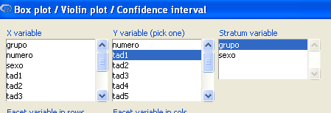
Boxplot TAD, by group

Slide 23
Compare a Quantitative variable in two groups
Null Hypothesis: There is not difference of the variable in two population or groups
Samples have been generated
INDEPENDENT
Selected individuals in a group have nothing to do with selected individuals in the other group.
DEPENDENT
Each individual in a group has a correspondent in other group.
These are paired data.

Slide 24
Two sample tests
EQUAL VARIANCES T-TEST
Yes
P>,05 Levene test for Homogeneity of Variances
Yes
UNEQUAL VARIANCES T--TEST(WELCH)
Normality
or n>30
No
no
Yes
NON-PARAMETRIC TESt : MANN-WHITNEY’S U or WILCOXON RANK-SUMS
Independent Groups
Yes
PAIRED T-TEST
No
Normality
ó n>30
No
NON-PARAMETRIC TEST: WILCOXON SIGNED-RANK

Slide 25
Two sample tests (1)
EQUAL VARIANCES T-TEST
Yes
P>,05 Levene test for Homogeneity of Variances
Yes
UNEQUAL VARIANCES T--TEST(WELCH)
Normality
or n>30
No
no
Yes
NON-PARAMETRIC TEST : U DE MANN-WHITNEY O SUM-RANK OF WILCOXON
Independent Groups
Data is normal (normality test) or sample size > 30.
Mean is a good summary statistic for this problem.
Test homogeneity of variances

Slide 26
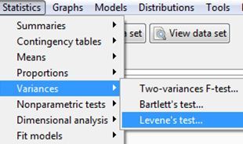
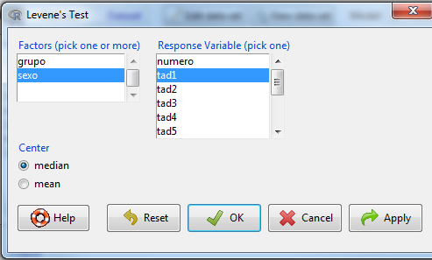
Testing variance homogeneity

Slide 27
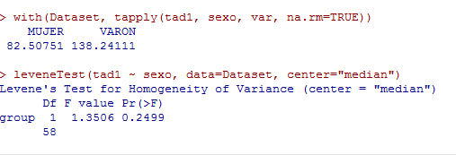
P value is over 0.05
We can assume homogeneity of variances

Slide 28
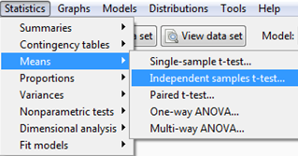
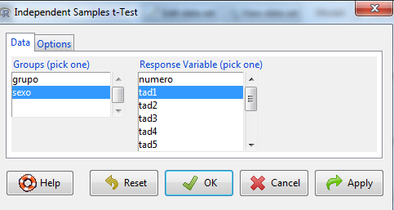
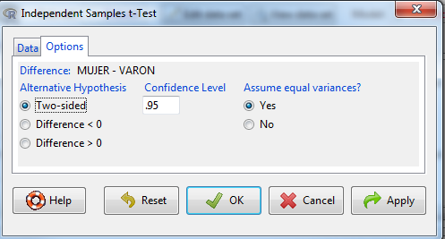
T-test when variances are equal

Slide 29
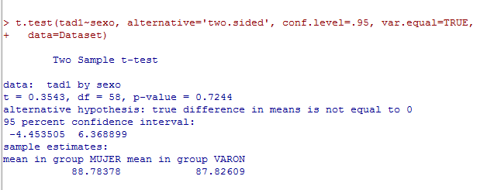
T-test when variances are equal
Differences are not statistically significant

Slide 30
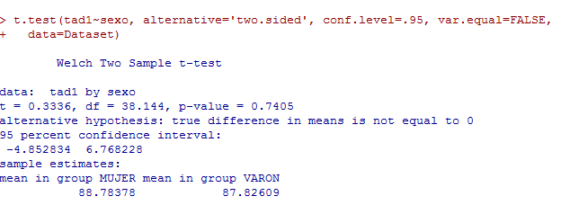
T-test when variances are not equal (Welch)
Differences are not statistically significant

Slide 31
Two groups, data non normal
Normality
or n>30
no
Yes
NON-PARAMETRIC TEST: MANN-WHITNEY’S U O WILCOXON SUM-RANK
Independent Groups

Slide 32
Non parametric tests
If data distribution is unknown or mean is not the best way to summarize data …
Non parametric test are not based on the usual parameters from a distribution, such as μ or σ^{2.}
Instead they may be based …
On order statistics, such as median or percentiles
They take into account the whole distribution.

Slide 33
Test based on ranks(Wilcoxon)
Based on susbtituting original values by “ranks” in a joint sample
12, 5, 14, 16, 3 → ranks are: 3, 2, 4, 5, 1
Ranks only depend on the position of each value in the ordered sample.
120, 95, 121, 130, 3 have the same ranks as values in the first sample
☺ NP test are more robust than parametrics ones
☹ In the ideal situation where parametric tests are valid they are considered to be preferable.

Slide 34
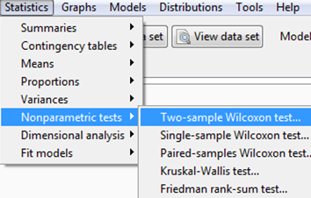
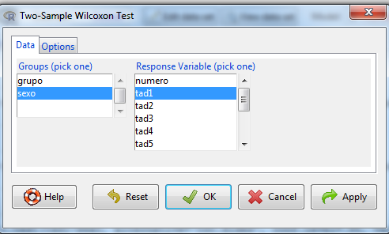
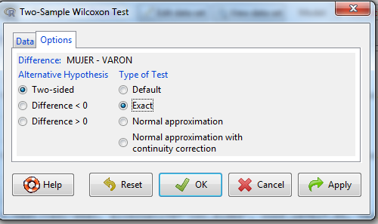
Mann Whitney’s U (Wilcoxon Rank-sum)

Slide 35
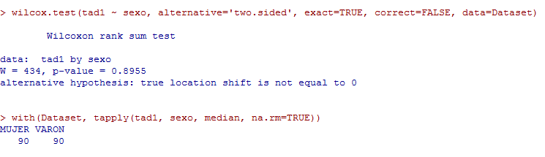
Mann Whitney’s U (Wilcoxon Rank-sum)
Differences are not significant

Slide 36
Questions to answer
Are samples comparable at baseline time?
Is blood pressure comparable between first and 12th measures?

Slide 37
Syllabus
INTRODUCTION
TYPES OF TESTS
NORMALITY TESTS
ONE GROUP COMPARISON
TWO GROUPS COMPARISON IN INDEPENDENT SAMPLES
TWO GROUPS COMPARISON IN DEPENDENT SAMPLES
MORE THAN TWO GROUPS COMPARISON IN INDEPENDENT SAMPLES
MULTIPLE COMPARISONS AND MULTIPLE TESTING
3
5

Slide 38
Two dependent groups
Independent Groups
Yes
PAIRED T-TEST
No
Normality
ó n>30
No
NON-PARAMETRIC TEST: WILCOXON SIGNED RANK

Slide 39
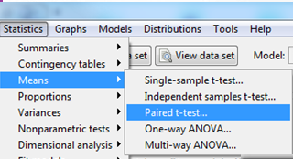
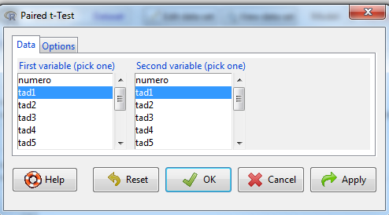
Paired t-test

Slide 40
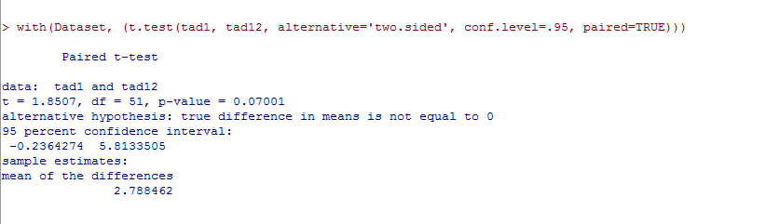
Paired t-test
Differences are not significant

Slide 41
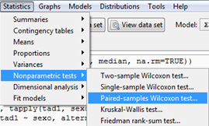
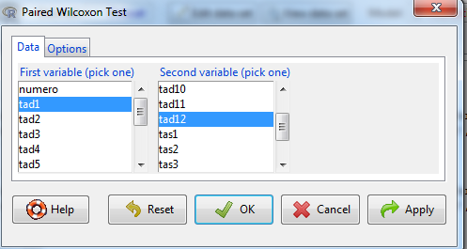
Wilcoxon signed-rank test

Slide 42
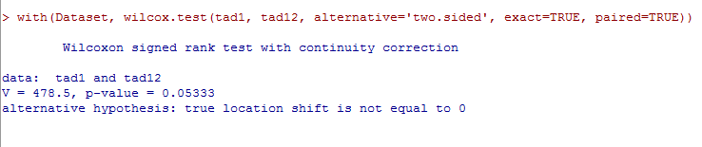
Wilcoxon signed-rank test

Slide 43
Syllabus
INTRODUCTION
TYPE OF TEST
NORMALITY TEST
ONE GROUP COMPARISON
TWO GROUPS COMPARISON IN INDEPENDENT SAMPLES
TWO GROUPS COMPARISON IN DEPENDENT SAMPLES
MORE THAN TWO GROUPS COMPARISON IN INDEPENDENT SAMPLES
MULTIPLE COMPARISONS AND MULTIPLE TESTING
3
5

Slide 44
Three or more groups
ANOVA
Yes
Normality
Homocedasticity
No
Yes
KRUSKAL- WALLIS TEST
Independent Groups
REPEATED MEASURES ANOVA
No
Yes
Normality Homocedasticity
No
FRIEDMAN TEST

Slide 45
Analysis of the variance
Null Hypothesis
The means of all population are equal
H₀ μ₁ =μ₂ =.... =μ_{k}
Alternative Hypothesis
Not all the means are equal. At least there are two different means
H_{a} ∃ i,j μ_{i} ≠μ_{j}

Slide 46
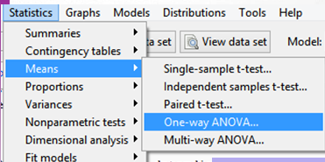
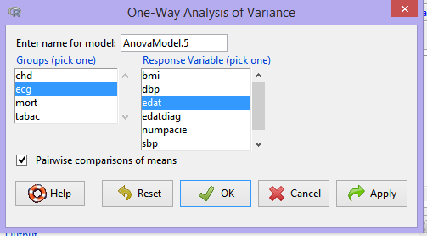
Anova in R Commander

Slide 47
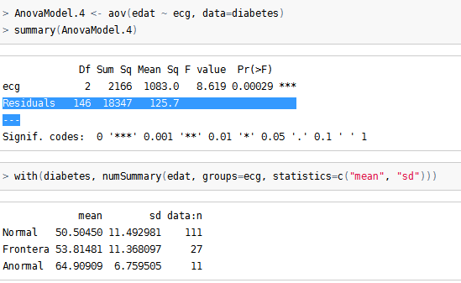

Slide 48
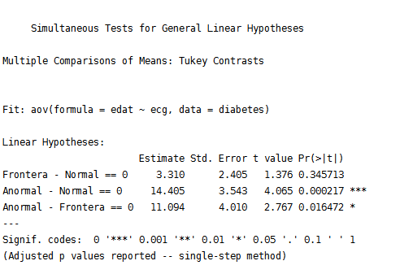

Slide 49
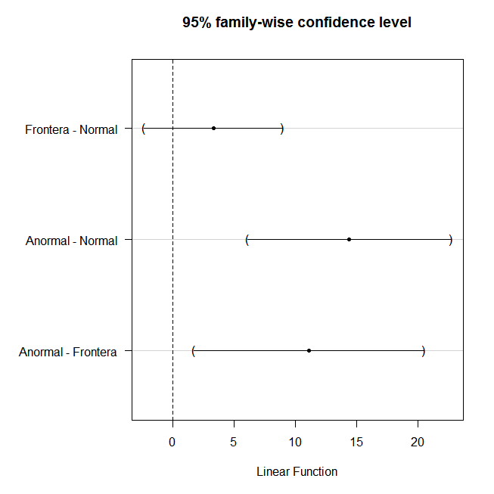

Slide 50
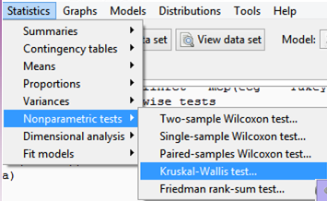
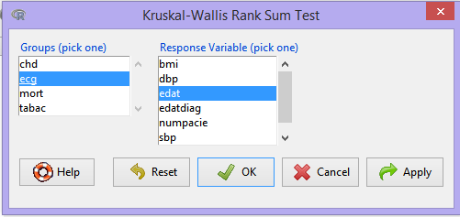
Kruskal-Wallis test
Is the non-parametric versión of ANOVA based on ranks

Slide 51
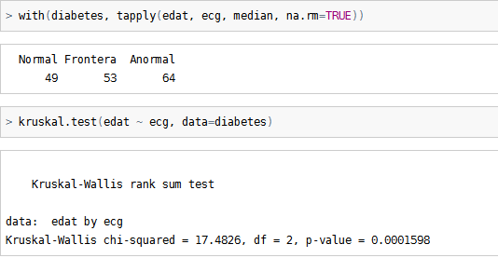
Kruskal-Wallis Test

Slide 52
Syllabus
INTRODUCTION
TYPE OF TEST
NORMALITY TEST
ONE GROUP COMPARISON
TWO GROUPS COMPARISON IN INDEPENDENT SAMPLES
TWO GROUPS COMPARISON IN DEPENDENT SAMPLES
MORE THAN TWO GROUPS COMPARISON IN INDEPENDENT SAMPLES
MULTIPLE COMPARISONS AND MULTIPLE TESTING
3
5

Slide 53
Multiple Comparisons and múltiple testing

Slide 54
Testing hypothesis repeatedly
Every time we do a test there is a chance to take the wrong decision by rejecting the null hypothesis while it is TRUE.
If, instead, we do many tests simultaneously the probability that there is, by chance, at least one false positive increases and does not match the type I error probability anymore.
This increase in the probability of type I error has to be compensated in some way → multiple testing adjustments

Slide 55

To cross or not to cross?
The previous situation can be better understood with the “bridge analogy”.
Imagine you are an adventurer that has the option of to cross a bridge in order to escape from danger, find a treasure...
and that there is a post in front of the bridge stating:
“This bridge has broken only one out of 100 times"

Slide 56
To cross or not to cross?
Imagine you are an adventurer that has the option of to cross a bridge in order to escape from danger, find a treasure...
and that there is a post in front of the bridge stating:
“This bridge has broken only one out of 100 times“
So, the p-value of our metaphor is 0.01
You could accept that 1% is a risk small enough to pass the bridge and pursue your goal. OK

Slide 57

To cross or not to cross?
But... what do you decide if, in order to reach your goal, you have to cross hundreds of bridges of that kind?

Slide 58
To cross or not to cross?
But... what do you decide if, in order to reach your goal, you have to cross hundreds of bridges of that kind?
In this case, the probability of falling while crossing one of the bridges is obviously too high ('cause we have just one life).

Slide 59
To cross or not to cross?
Therefore, in this case (multiple testing), the p-value by itself is not a good reference for accepting or not statistical significance.
We must apply some type of adjustment to the p-values (allowing us to be safe in crossing all the bridges).

Slide 60

Some p-value adjustments
Bonferroni (α/k)
Post-Hoc test ANOVA (Tukey, Scheffe, Dunn-test)
False Discovery rate
Benjamini-Hochberg correction

Slide 61
Multiple comparisons vs multiple testing
There are two distinct situations where p-value adjustment may be necessary:
Post-hoc tests in ANOVA:
This is usually called multiple comparisons and common methods of adjustment are Tukey, Fisher HSD.
Testing many variables in the same study
This is usually called multiple testing and common methods of adjustment are Bonferroni, Holm or Benjamini and Hochberg (False Discovery Rate).

Slide 62
Multiple testing
When many variables are compared independently with the same test
Find differences between treated/untreated for a set of biomarkers such as cytokines.
Number of comparisons may be low (“dozens”)
Find differentially expressed genes, i.e. genes whose expression may change between conditions.
Number of comparisons high (“hundreds” to “thousands”)
This is usually called multiple testing and common methods are Bonferroni, Holm or Benjamini and Hochberg (False Discovery Rate).

Slide 63
Post-hoc ANOVA tests
If we wish to compare all means against all means he number of tests increases quickly (to compare all pairs of means if there are k groups (k*k-1)/2 tests are required).
This is usually called multiple comparisons and common methods of adjustment are Tukey, Fisher HSD or Bonferroni.

Slide 64
Common misunderstandings about the p-value

Slide 65
Common misunderstandings about the p-value
The p-value is not the probability that the null hypothesis is true, nor it is the probability that the alternative hypothesis is false (it is not connected to either of these).
The p-value cannot be used to figure out the probability of a hypothesis being true.
The p-value is not the probability of wrongly rejecting the null hypothesis.
The p-value is not the probability that replicating the experiment would yield the same conclusion.
The p-value does not indicate the size or importance of the observed effect. The two do vary together however: the larger the effect (effect size), the smaller sample size will be required to get a significant p-value.

