Slide 1









Introduction to hypothesis tests
Curs d'Estadística Bàsica per a la Recerca Biomèdica
UEB – VHIR
Alex Sánchez-Pla & Santiago Pérez-Hoyos
{alex.sanchez,santi.perezhoyos}@vhir.org

Slide 2








































The objectives of statistical inference
Hypothesis
Population
Samples
(sampling techniques)
Conclusions based
on the observed data
(Statistical inference)
(Parameters estimation)
(Hypothesis testing)
Generalization to
the population

Slide 3
Statistical Inference Questions
Parameter estimation:
After assuming population data follow a certain probability distribution (Normal, Binomial, Poisson, etc) goal is find out which are the value of the parameters that fit best the sample data.
Hypothesis testing:
After making some assumptions about population distribution
We wish to check some statement about population parameters
Population mean is equal to 10
The mean in population A is equal to the mean in population B
The proportion of respondants/non-respondants is associated to treatment
Hypothesis testing tries to assess if sample data are compatible with the hypothesis assuming that samples differ from populations due to chance.

Slide 4

Hypothesis testing: Making decisions about populations
We believe average bone density in women is
70...
But... why not to check median,
mode or other estimators?

Slide 5
Case study problem I
A study was performed to study the relation between bone density, age and menopause in women.
The study had some previous beliefs that researchers wish to check in this study:
The average bone density (measured by variable "BUA") in the population analyzed is 70
BUA mean value is bigger in non-menopausic women than in menopausic or pre-menopausic ones.

Slide 6
Case study problem II
NHANES is an epidemiologic study where new lung cancer cases were recorded after 12 years of follow-up (Am J Epidemiol 1997;146:231-243
Given this outcome, can we conclude that fruit consumption "is a protective factor" for (i.e. is positively associated with less) lung cancer?
How can we know this result is not to due chance in sampling?

Slide 7
Exercise
Explore the osteoporosis data set and try to figure if the claims in case study I seem to be true or not.
Use the data in the table in case study II to figure out if the incidence of lung cancer is associated with fruit consumption.

Slide 8
The setting of hypothesis testing
We establish two basic hypotheses
Null Hypothesis (H₀)
Observed difference between outcome and population value is due to chance.
No relationship among exposure and disease.
Alternative Hypothesis (H₁)
Observed difference between outcome and population value is due to some "true effect".
There is relationship among exposure and disease.

Slide 9
¿How to decide which hypothesis is more likely?
Calculate probability (p) to observe differences in samples between both groups under the null hypothesis of no population differences,
In case study II we would want to compute the probability that the % of new cancer cases is the same in both groups
decide
Groups must be different
Low
p
High
decide
Groups can be equal

Slide 10
¿How to calculate this probability?
This probability …
Depends on the type of study.
Depends on type of variable.
Depends on the influence of other variables.
In practice we do not just calculate the probability because it is associated with the error made assuming that the null hypothesis is true
A step by step process is adopted to take the decisión about which hypothesis is considered to be true.

Slide 11
Hypothesis Testing Steps
Stablish Null Hypothesis(H₀)
Stablish Alternative Hypothesis (H_{α})
Select statistical test to calculate probability under Null Hypothesis
Take a sample and compute test value
Compare test value with a critical value and decide
If null hypothesis must be rejected
Or there is not enough evidence to reject null hypothesis

Slide 12
Hypothesis Testing by Example
Null Hypothesis(H₀):
Mean bone density is 70
Alternative Hypothesis (H_{α})
Mean bone density is not 70
Might also be " … greater than 70", "smaller than 70"
Select statistical test to calculate probability under Null Hypothesis
A reasonable measure to rely on: sample mean

Slide 13
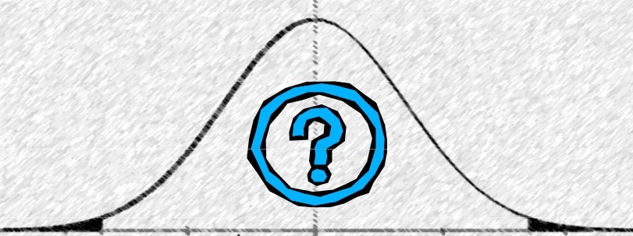
Accepting or rejecting the NULL
H₁ only accepted if clear evidence
that H₀ is not true
If observed mean = 18 H₀ is rejected
μ = 70
If observed mean = 58 H₀ can not be rejected (it does not mean H₀ can be accepted!!)

Slide 14
If the NULL were true ...
Most tests require some assumptions to be true (independently of H₀!)
Example:
The sample mean is approximately normal

Slide 15
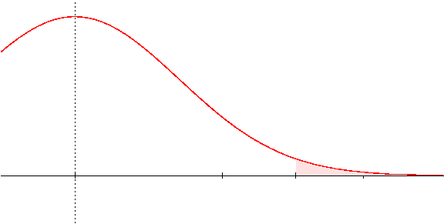
Critical Value
At which value of the sample mean does one change from non-rejecting to rejecting the null hypothesis?
A value is selected such that the probability that the sample mean exceeds it, if the null hypothesis is true, is “small”, (for example 5%).
This value is called “Critical Value” and
the probability is called “significance level (α)”
α
Critical value

Slide 16
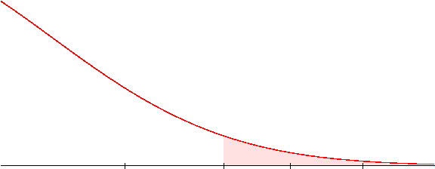
Example: Critical value and Sample mean
If σ =9, n =9 and α=0.05 the critical value will be 80
With a sample mean of 74 we will not reject H₀
With a sample mean of 80 we will reject H₀
We cannot reject
H₀: μ=70
We decide to reject H₀: μ=70
α
H₀: μ=70
₈₀

Slide 17
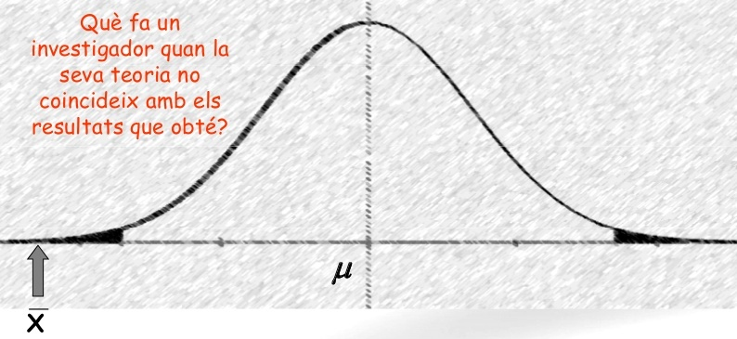
Example
Null hypothesis (H₀):
Alternative hypothesis (H_{α} =H_{a} =H₁): the opposite idea
Under the null hypothesis if all the samples of one size can be selected the sample distribition is as follows
H_{0:} The mean of BUA values is 70.0
H1: The mean of the bua values is not equal to 70.0 (Bilateral)
H1: The mean of the bua values is higher(lower) than 70.0 (Unilateral)
H₁ only accepted if clear evidence
that H₀ is not true
If observed mean = 18 H₀ is unlikely
= 70
= 18

Slide 18
P values: The alternative
We have based our decision about rejecting H₀ on comparing sample mean (i.e. 74) with the critical value (i.e. 80)
Instead we can compare the probability of observing at least that sample mean (p value) with the significance level (α) (which is the probability of observing at least the critical value),
The probabiliy is smaller than alfa if (and only if) the sample mean is bigger than the critical value.
In such situation we decide to reject H0
The probabiliy is bigger than alfa if (and only if) the sample mean is smaller than the critical value.
In such situation we cannot reject H0 so we accept it
Both criteria (critical value and p-value) are valid for testing hypotheses.

Slide 19
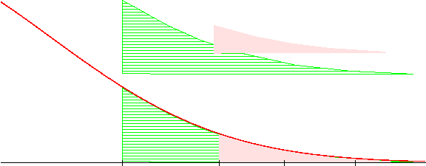
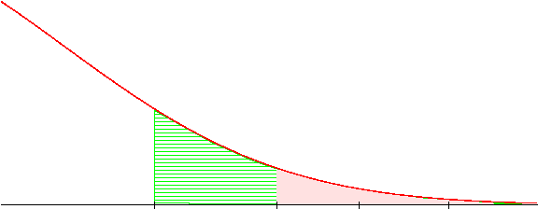
Example: P-value vs critical value
If σ =27, n =9 and the sample mean is 74 then
The probability that assuming that H₀ is true, that is m=70, we can observe by chance ...
a sample mean equal or greater than 74 is: 0.328
a sample mean equal or greater than 86 is 0.037
P
α
H₀: μ=70
We cannot reject the null hypothesis
P=0.33
P=0.037
α= 0.05

Slide 20
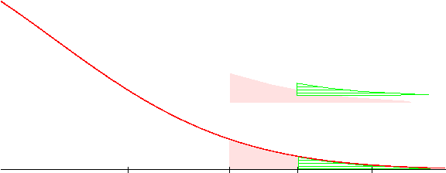
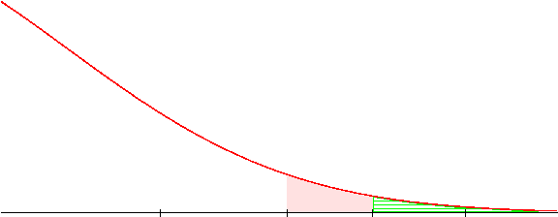
Example: P-value vs critical value
If σ =18, n =9 and the sample mean is 86 then
The probability that assuming that H₀ is true, that is μ=74, it can be obtained by chance a sample with a mean greater than 86 is: 0.0378
α
P
Reject H₀: μ=74
Accept H₁: μ>74
α
P
We usually say the test is statistically significant if p < α

Slide 21
Summary: α vs p
α and P are related but they are not the same …
About α
It is prefixed before experiment
Usually low ( 0.05)
Linked with critical value (“knowing one, the other is automatically known)
Unaffected by the sampling process.
About p
It is calculated after the experiment
Can take any values in (0,1)
After calculation one can know the achieved significance level.
Depends on the sampling process

Slide 22
Type of Hypothesis
Confirmation Hypothesis
Aim is to confirm hypothesis about parameters or distributions.
Goodness of fit test to verify hipothesis about the distribution of variable in population
Does arterial pression in the population follow a normal distribution?
Test to verify values about a parameter.
Is the average ''bua'' value in our population equal to 70?
Is the proportion of lung cancer cases equal to 2.6%?

Slide 23
Type of Hypothesis
Independence Hypothesis
Aim is to test hypothesis for relation of variables in a population or no differences of a variable in two or more populations
Is the average ''bua'' value the same in menopausic and in no menopausic population?
Is the proportion of lung cancer cases the same in people with high or low fruit consumption?
Is CD4 lymphocytes count related with CD8 count in HIV positive?
Pruebas de independencia

Slide 24
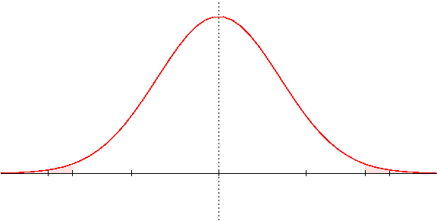
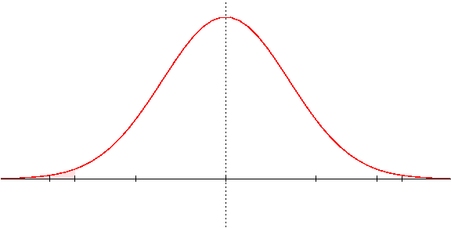
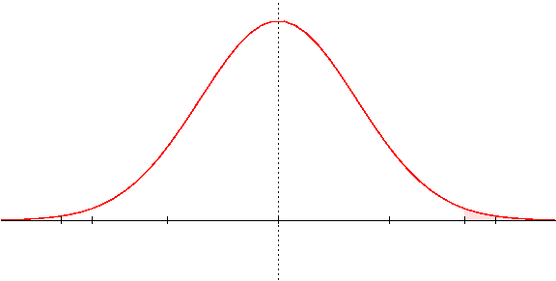
Unilateral vs Bilateral
Critical value depends on the type of alternative Hypothesis
Bilateral
H₁: m ≠
Unilateral
Unilateral
H₁: m <
H₁: m >

Slide 25
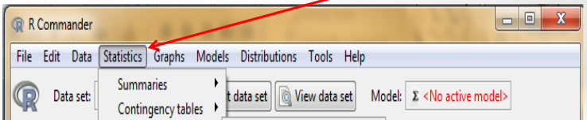
EExample: hypothesis testing with R-commander
Our assumptions:
The average ''bua'' value in our population is 70.
The ''bua'' mean value in menopausic and non-menopausic women is not the same.
Hint: look at this menu
Exercise 2):
- Test if the population mean bone density is 70.0 (Alternative “it is not 70”)
- Test if the population mean bone density is equal or not between groups
if we separate our observations by ''menop'' category

Slide 26
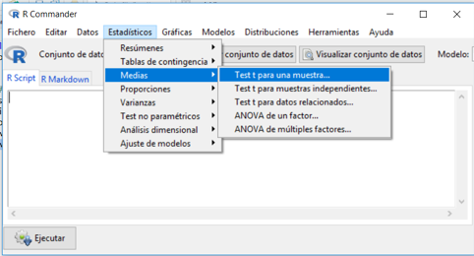
Exercise 2 – Solution (1)
# osteoAll is the dataset obtained reading osteoporosis.csv set.seed =123456 # change by your ID to obtain a distinct sample
index100<- sample( 1:nrow(osteoAll), 100)
osteo100 <- osteoAll[index100,]
with(osteo100, t.test (bua, mu=70, alternative="two.sided"))
t.test(bua, mu=70)
data: bua t = 1.8604, df = 99, p-value = 0.0658 alternative hypothesis: true mean is not equal to 70 95 percent confidence interval: 69.81491 75.74509 sample estimates: mean of x 72.78

Slide 27
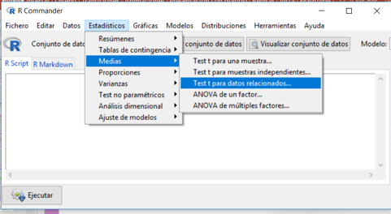
Exercise 2 – Solution (2)
# osteoAll is the dataset obtained reading osteoporosis.csv set.seed =123456 # change by your ID to obtain a distinct sample
index100<- sample( 1:nrow(osteoAll), 100)
osteo100 <- osteoAll[index100,]
with(osteo100, t.test (bua~menop, alternative="two.sided"))
Welch Two Sample t-test
data: bua by menop t = 1.797,
df = 90.184, p-value = 0.07568 alternative hypothesis: true difference in means is not equal to 0
95 percent confidence interval: -0.5399937 10.7761048
sample estimates: mean in group NO mean in group SI 76.05556 70.93750

Slide 28
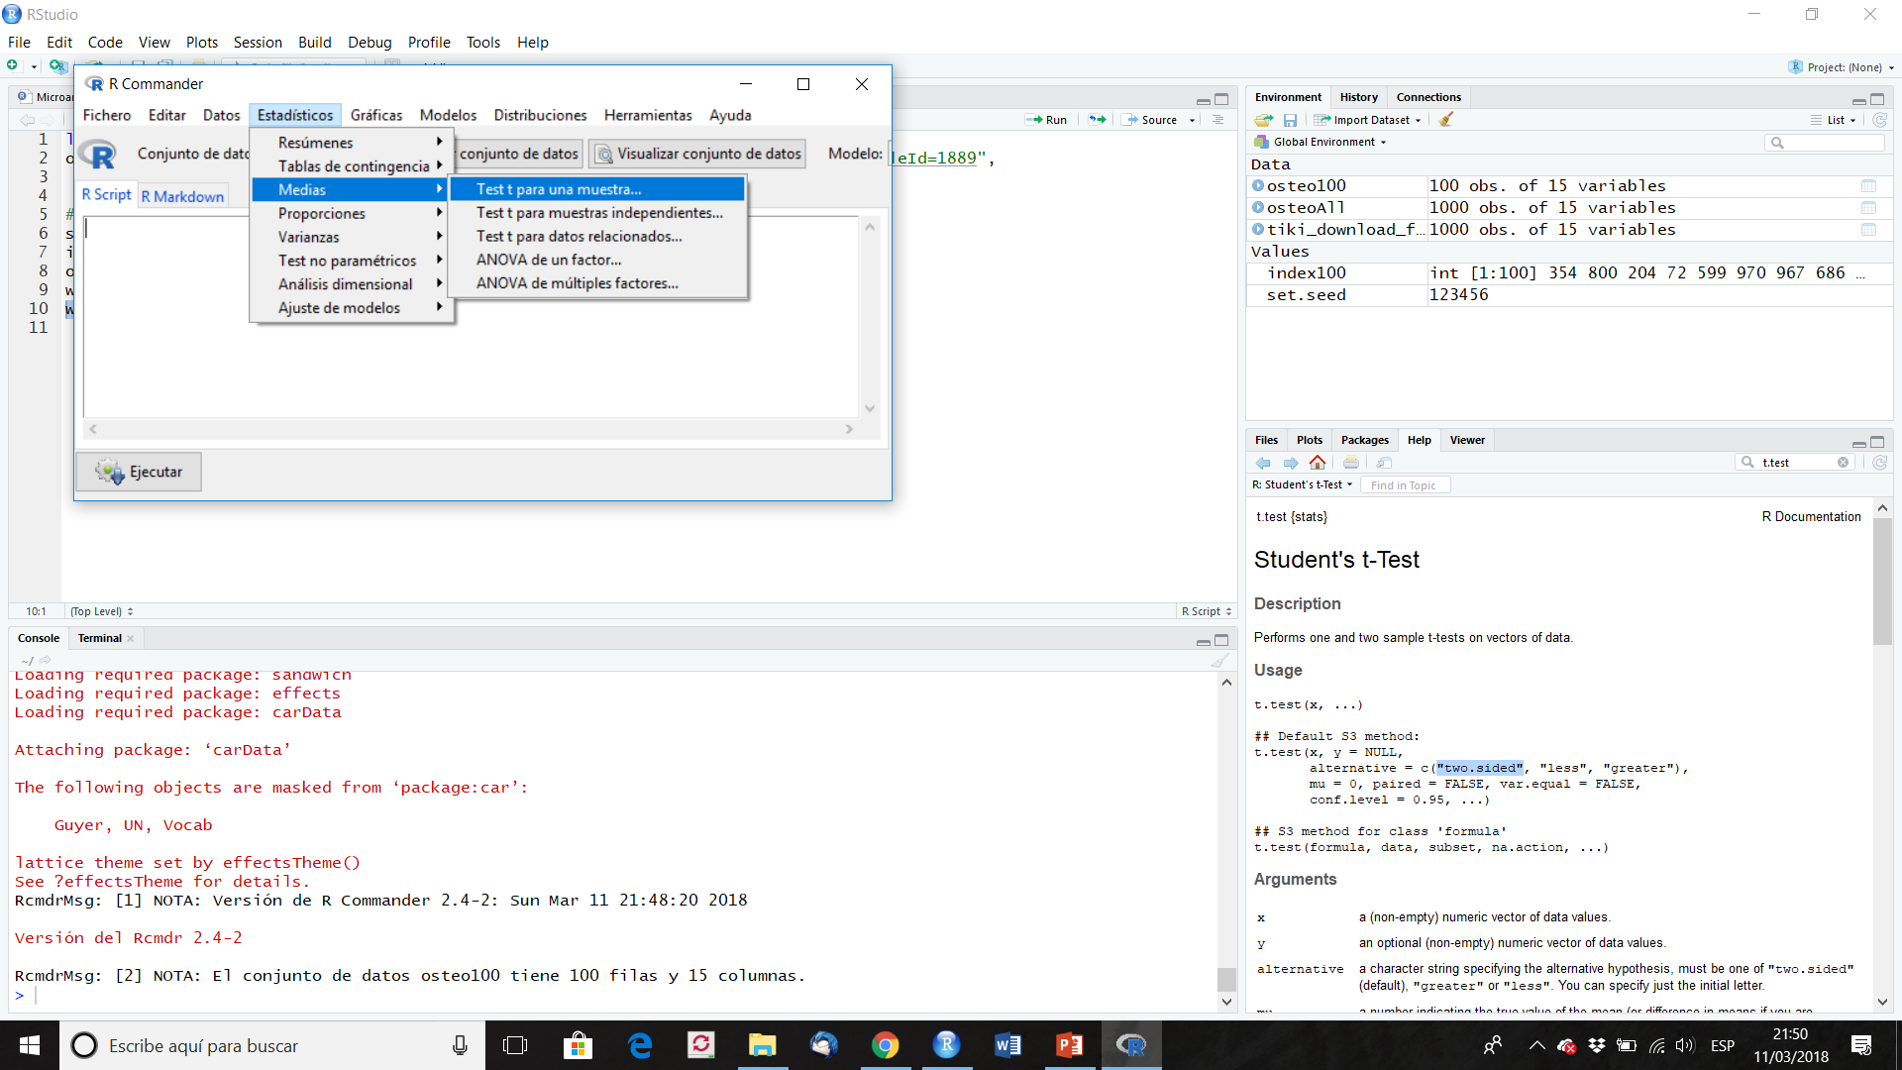

Slide 29


Slide 30
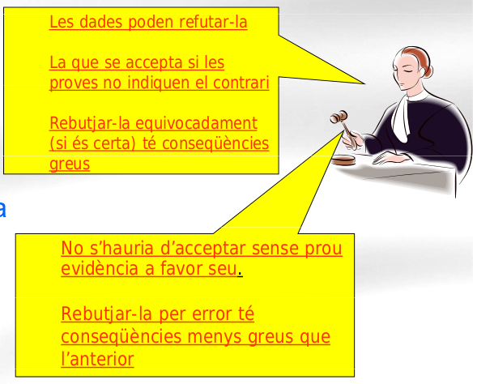
Errors and power (in hypothesis testing)
Data can lead to reject it
Accepted if data don't
show the contrary
Reject it by mistake (if it is true) has severe consequences
H₀
(innocent)
(not speculative)
Should not be accepted without enough evidence
Reject it erroneously has less dramatic consequences
H₁
(guilty)
(speculative)

Slide 31
Errors after Testing
 |  | True
 |  | Innocent | Guilty
veredict | Innocent | OK | Error
 | Guilty | Error | OK

Slide 32
Types of error
 | Null Hypothesis True | Null Hypothesis False
Test does not reject null hypothesis | ✓ | Type II Error β
Test rejects null hypothesis | Type I Error α | ✓ Power (1- β)

Slide 33
Common misunderstandings about the p-value

Slide 34
Common misunderstandings about the p-value
The p-value is not the probability that the null hypothesis is true, nor it is the probability that the alternative hypothesis is false (it is not connected to either of these).
The p-value cannot be used to figure out the probability of a hypothesis being true.
The p-value is not the probability of wrongly rejecting the null hypothesis.
The p-value is not the probability that replicating the experiment would yield the same conclusion.
The p-value does not indicate the size or importance of the observed effect. The two do vary together however: the larger the effect (effect size), the smaller sample size will be required to get a significant p-value.

