Slide 1








Descriptive Statitistics. Summary and Graphs
Curs d'Estadística Bàsica per a la Recerca Biomèdica
UEB – VHIR
Santiago Pérez-Hoyos
santi.perezhoyos@vhir.org

Slide 2
AIMS
Make an approach to key concepts of Statistics and in particular to Biostatistics.
Explain the different types of analysis, variables and other relevant concepts.
Learn how to make a statistical summary of some descriptive data.
Learn how to implement a descriptive statistics analysis with R and R-Commander.

Slide 3
Index
INTRODUCTION. ANALYSIS STRATEGY
VARIABLES CLASSIFICATION
SUMMARY MEASURES
  Measures of location/central tendency
  Measures of variability/dispersion
SUMMARY OF VARIABLES
  Contingency Tables
  Graphs
Examples & exercises
3
5

Slide 4
Index
INTRODUCTION. ANALYSIS STRATEGY
VARIABLES CLASSIFICATION
SUMMARY MEASURES
  Measures of location/central tendency
  Measures of variability/dispersion
SUMMARY OF VARIABLES
  Contingency Tables
  Graphs
Examples & exercises
3
5

Slide 5
GENERAL CONCEPTS
Population: It represents the largest group of individuals who want to study and generally usually inaccessible.
Sample: Subset of the population in which measurements are done. This sample should be representative of the original population (any individual has equal opportunity to be selected).
Variable: Feature measurable and observable that represents a concept of study
Measure: Procedure for assign quantitative or qualitative values ​​ to the characteristics of objects, people or events. If these procedures are not well measured the validity of the results is not guaranteed.

Slide 6
STEPS IN A STATISTICAL STUDY ANALSYIS
Make hypothesis about a population
Decide which data collect (Experimental design)
  Which individuals will be part of the study (samples)
  Which data must be collected for each individual (variables)
Collect Data
Describe (summarize) collected data
  Summary measures and graphs
  Point estimations and confidence intervals
Establish relations between two variables
  Set up Statistical Hypothesis test
  Check application conditions
  Calculate intensity relationship measures
Multivariable analysis . Modelling
  Consider effects of several variables on an outcome
  Regression models
  More complex models

Slide 7
Index
INTRODUCTION. ANALYSIS STRATEGY
VARIABLES CLASSIFICATION
SUMMARY MEASURES
  Measures of location/central tendency
  Measures of variability/dispersion
SUMMARY OF VARIABLES
  Contingency Tables
  Graphs
Examples & exercicis
3
5

Slide 8
TYPE OF VARIABLES
Event of
interest
Conceptual
definition
Operational
Definition
QUALITATIVE
NOMINAL
Measure qualities of an individual
Examples: Sex, Treatment, Disease
ORDINAL
Measure qualities but they are ordered
Examples: Educational level, Stage, Severity
QUANTITATIVE
DISCRETE
Take only a finite possible values
Examples: Nº of admissions, Nº of programmed visits
CONTINOUS
Can take an infinite number of values. Between two measures always can be another
Example: Stay time, Age, Cholesterol level

Slide 9
Variable classification in a Study
Response ,dependent or outcome variable
  One that answer the research question
Explain, independent or exposure variables
  They are those that are related to the causes of the events we want to study
Confounding or effect modifier variables
  Are those that can affect the relation between exposure and outcome variables
Universal variables
  Are those that can be exposures or confounders that always have to be considered. For example: sex, age, residence location, ethnic, etc.

Slide 10
Descriptive analysis
Data have to be organized to be useful (frequency or contingency tables)
Graph data before calculating summary measures
This actions can help to:
  Select the best summary measure
  Transform variables
  Detect outliers

Slide 11
Index
INTRODUCTION. ANALYSIS STRATEGY
VARIABLES CLASSIFICATION
SUMMARY MEASURES
  Measures of location/central tendency
  Measures of variability/dispersion
SUMMARY OF VARIABLES
  Contingency Tables
  Graphs
Examples & exercises
3
5

Slide 12
Quantitative Variables
We have a new variable (i.e. a biomarker and we want to summarize information)
  Around which values is the variable ?
  Values vary greatly between different individuals
  Data are grouped or not

Slide 13
Summary Measures
Location
  Mean
  Median
  Mode
Dispersion
  Range (Maximum-Minimum)
  Variance
  Standard Deviation
  Variation Coefficient
  Percentile
  Interquartile range (IQR) or Interquartile interval
Shape
  Asymmetry
  Kurtosis

Slide 14
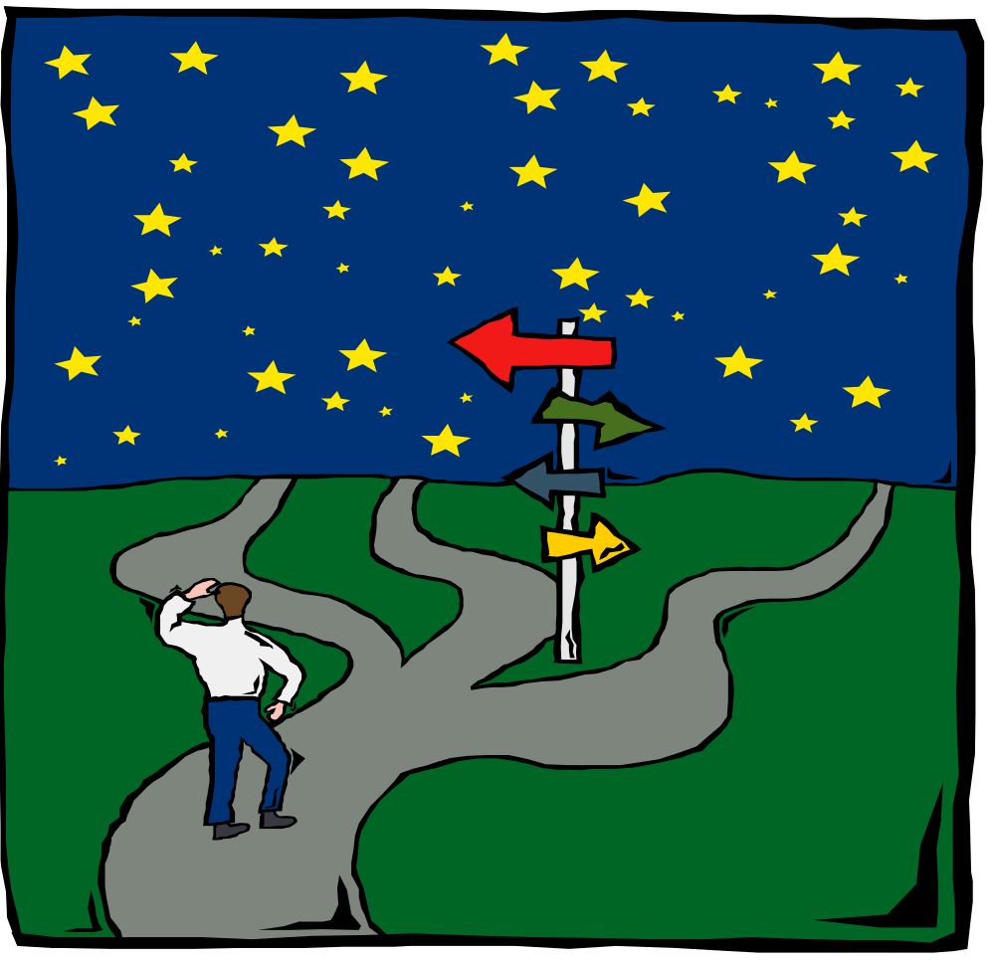
Location measures
  Mean
  Median
  Mode

Slide 15

Mean
μ
Useful to locate data .
Is the sum of observed values over sample size
Can be altered by extreme values
Example Stay days
3, 4, 6, 9, 12 Mean=6,8
3, 4, 6, 9, 20 Mean=8,4

Slide 16
Mediana
Is the point that divied in two parts the observations
Observations are ordered from lowest to highest and median is the central point
It is not altered by extreme observations
Obsv. 1
Obsv. 2
median
Obsv. n-1
Obsv. n
Example Stay days
3, 4, 6, 9, 12 Median=6
3, 4, 6, 9, 20 Median=6

Slide 17
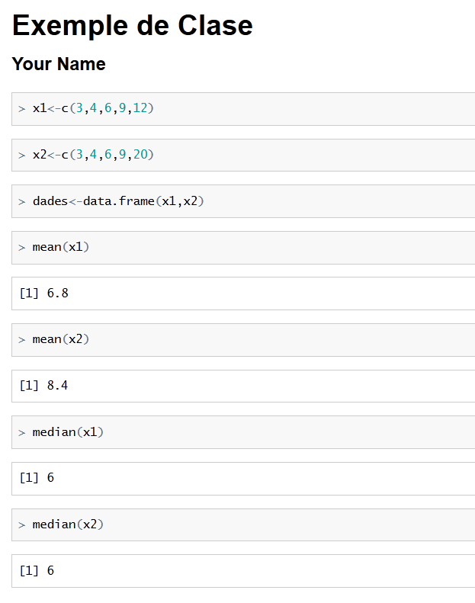
Exemple en R-Commander

Slide 18
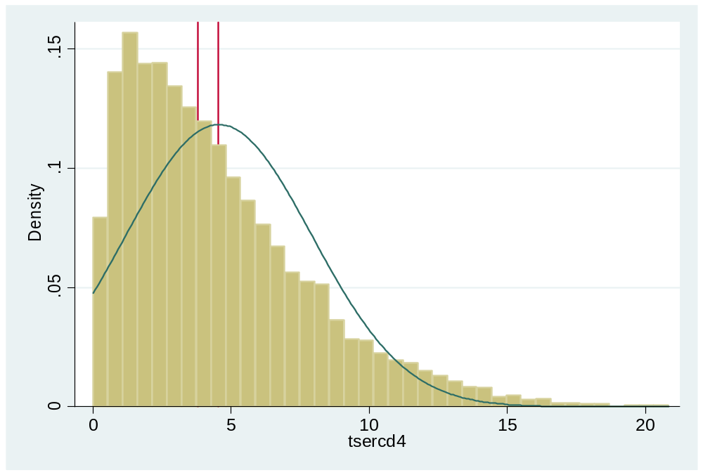
Mean or Median
Median
3.7
Mean
4.5
D.E.
3.7

Slide 19
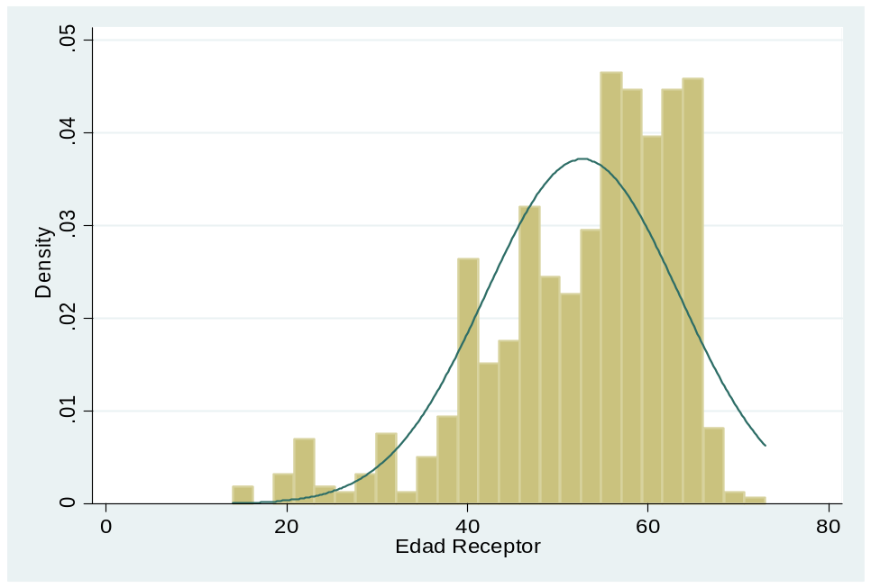
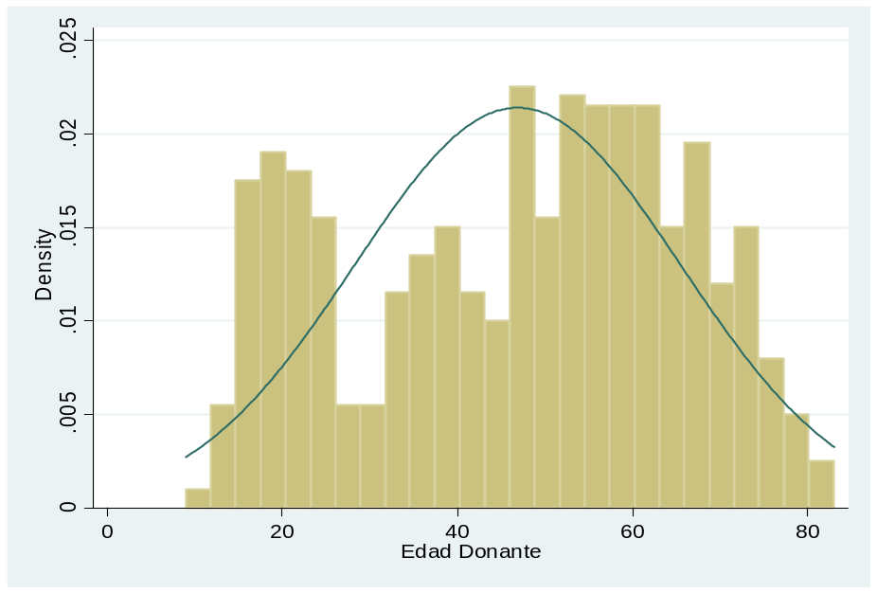
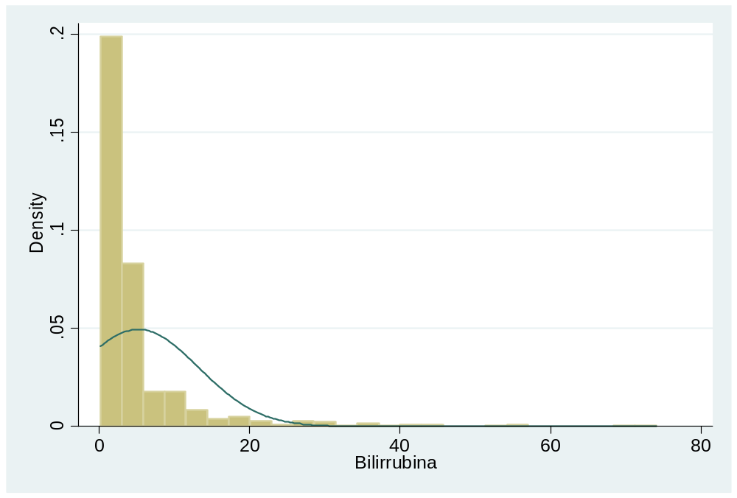
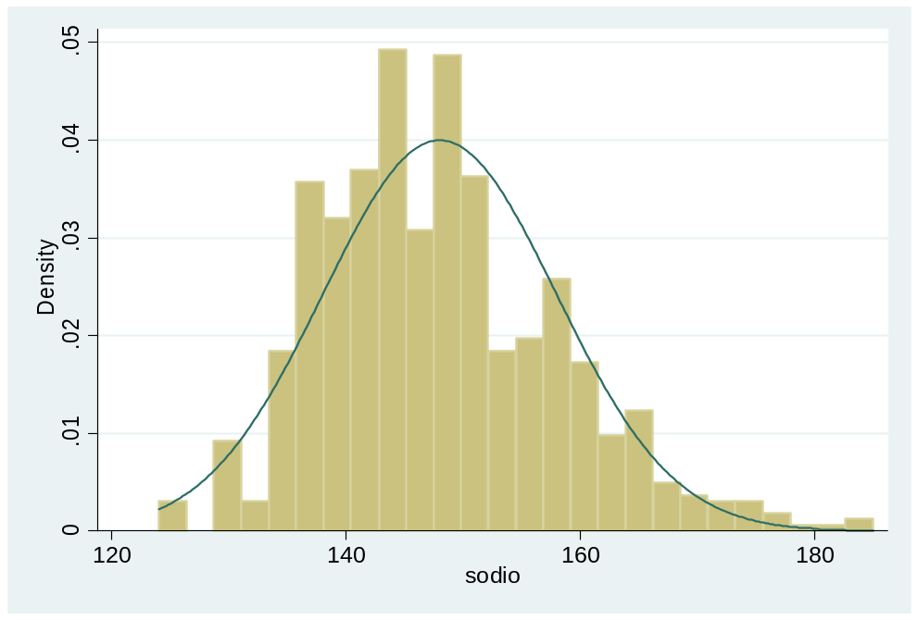
Transplant study (real data)

Slide 20
Geometric mean
Sometimes data are transformed. For example logarithmic scale
Mean is recalculated in transformed scale and exponentiated to come back to natural scale
The calculated value is the geometric mean
Days
Ln(Days)
Days
Ln(Days)
3
1,10
3
1,10
4
1,39
4
1,39
6
1,79
6
1,79
9
2,20
9
2,20
12
2,48
20
3,00
Mean
6,8
1,79
8,4
1,89
Geometric Mean
6,00
6,65

Slide 21
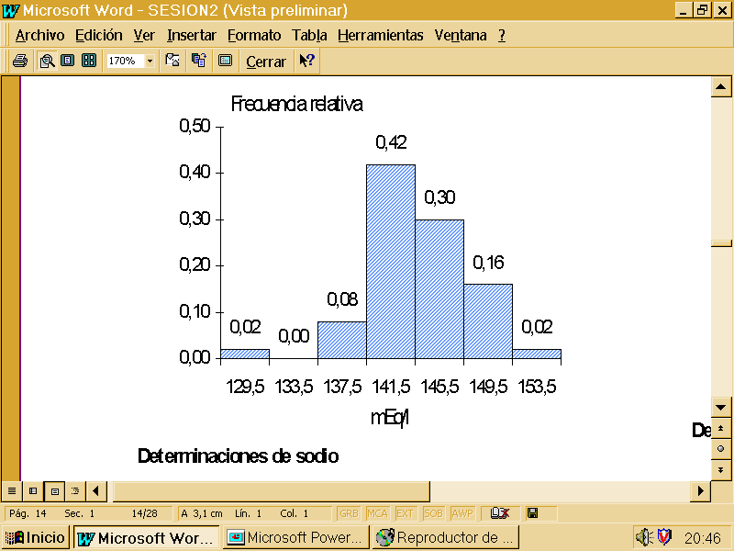
Mode
The most frequent value
May be not unique
In a quantitative variable is the maximum values of an histogram

Slide 22

Dispersion or variability measures
  Range ( Maximum-Minimum)
  Variance
  Standard Deviation
  Variation Coefficient
  Percentile
  Interquartile Range (IQR)

Slide 23
Range
Simplest measure of dispersion
Is the difference between maximum and minimum value of the observations
Range
μ
Minimum
Maximum
Example Stay days
3, 4, 6, 9, 12 Range=12-3=9
3, 4, 6, 9, 20 Range=20-3=17

Slide 24
Variance
Mean difference of observations from mean in squared scale
μ
Obsv. n-1
Obsv. n
Obsv. 1
Obsv. 2
d
d-mean
(d-mean)^2
d
d-mean
(d-mean)^2
Si se suman las desviaciones con respecto a la media, éstas se anulan
Por ello para evitar los signos se elevan las desviaciones al cuadrado, se suman y se dividen por el número de datos
3
-3,8
14,44
3
-5,4
29,16
4
-2,8
7,84
4
-4,4
19,36
6
-0,8
0,64
6
-2,4
5,76
9
2,2
4,84
9
0,6
0,36
12
5,2
27,04
20
11,6
134,56
Sum
σ²= suma(observación-media)²/nº observaciones
0
54,8
0
189,2
Sum/5
6,8
0
10,96
8,4
0
37,84

Slide 25
Standard Deviation
Squared root of the variance
It is measured in the same units than the variable
Example Stay days
3, 4, 6, 9, 12 Variance =10.96
Std. Dev.=3.31
3, 4, 6, 9, 20 Variance= 37.84
Std. Dev.= 6.15

Slide 26
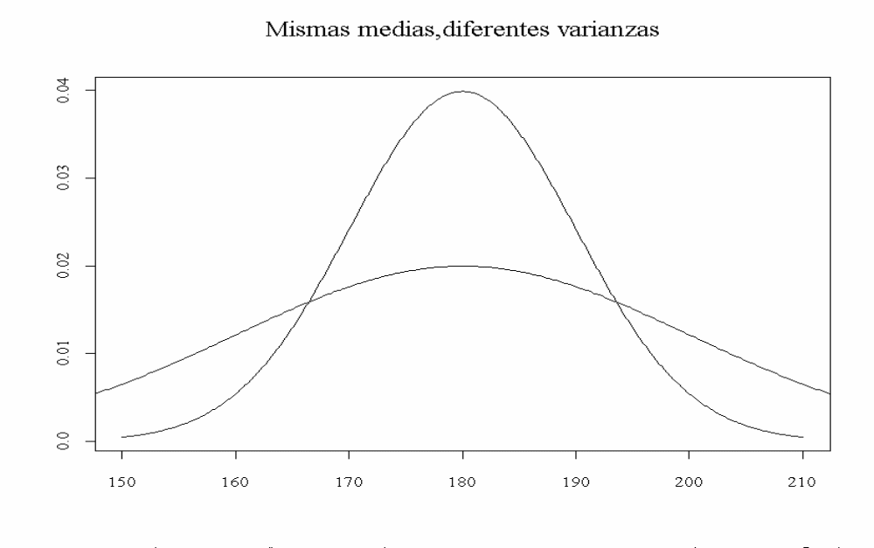
Same mean , different variances

Slide 27
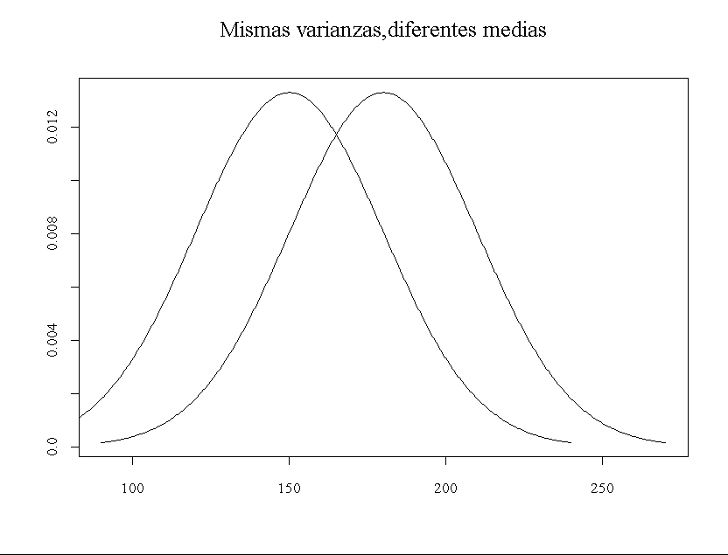
Same variances, different means

Slide 28
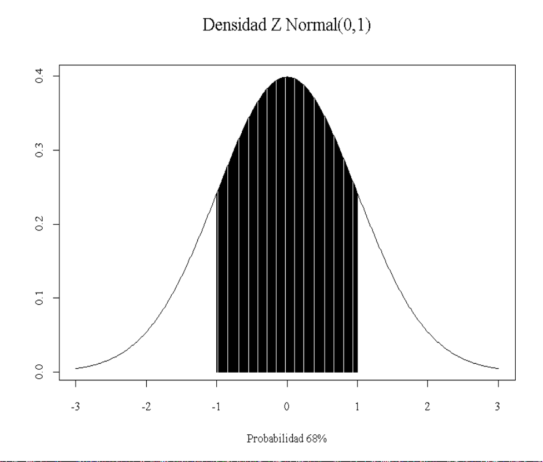
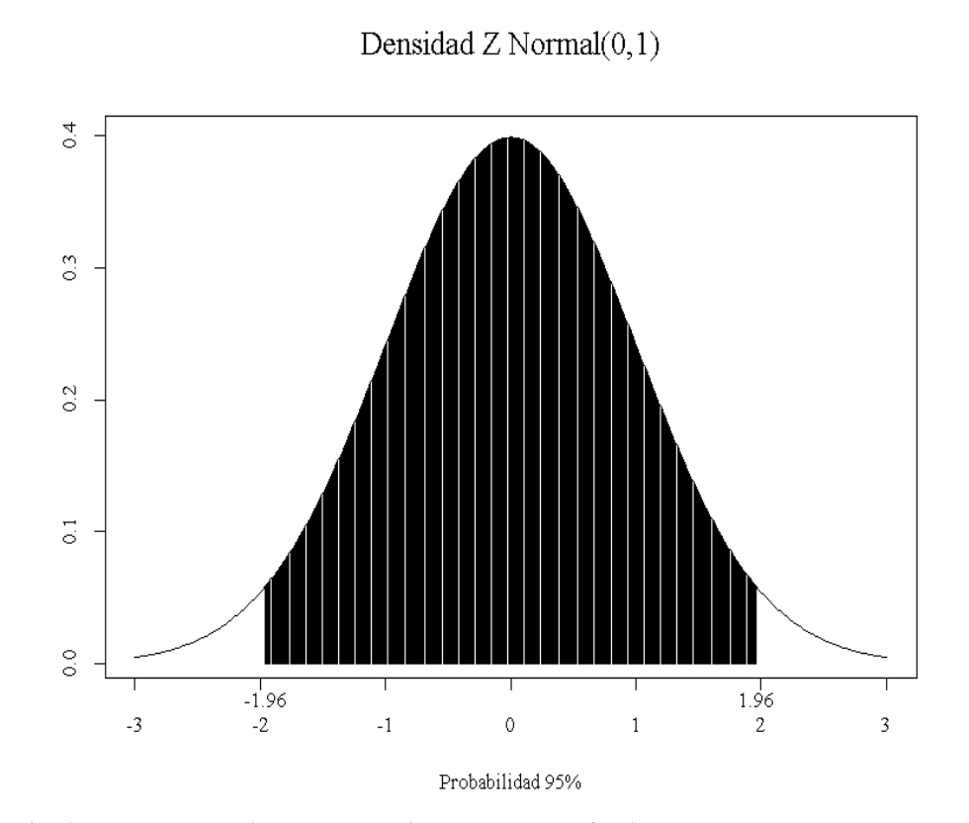
Normal distribution
Between μ (mean) ± 1 SD, there are about 68% of the probability.
Between μ (mean) ± 2 SD is about 95% of probability.

Slide 29
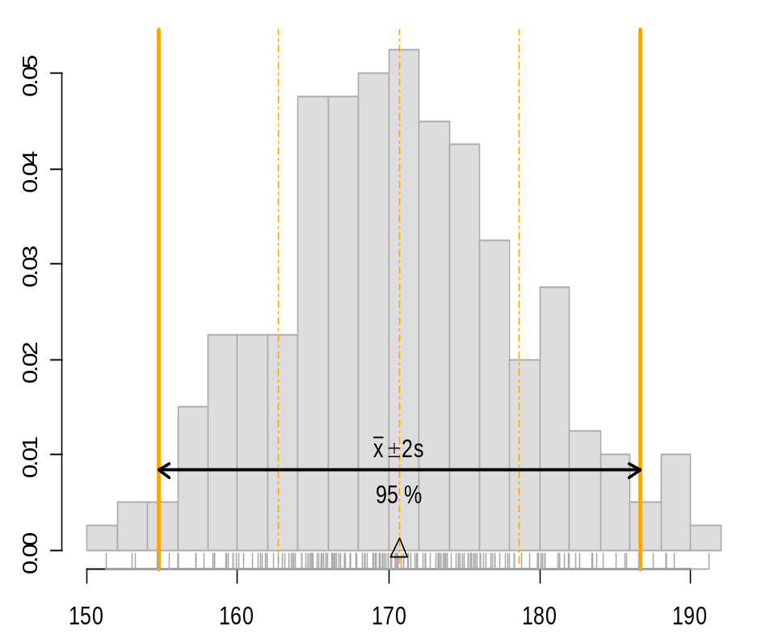


Symmetric distribution of data
0.05
0.04
0.03
0.02
0.01
x
?
s
68.5 %
0.00
150
160
170
180
190

Slide 30
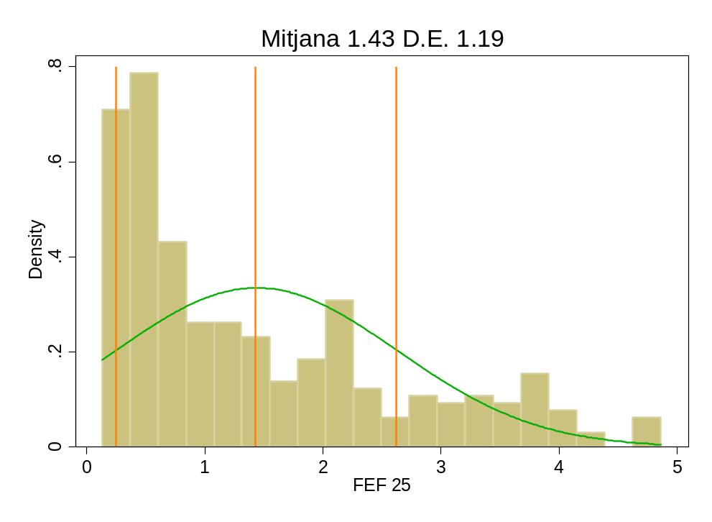
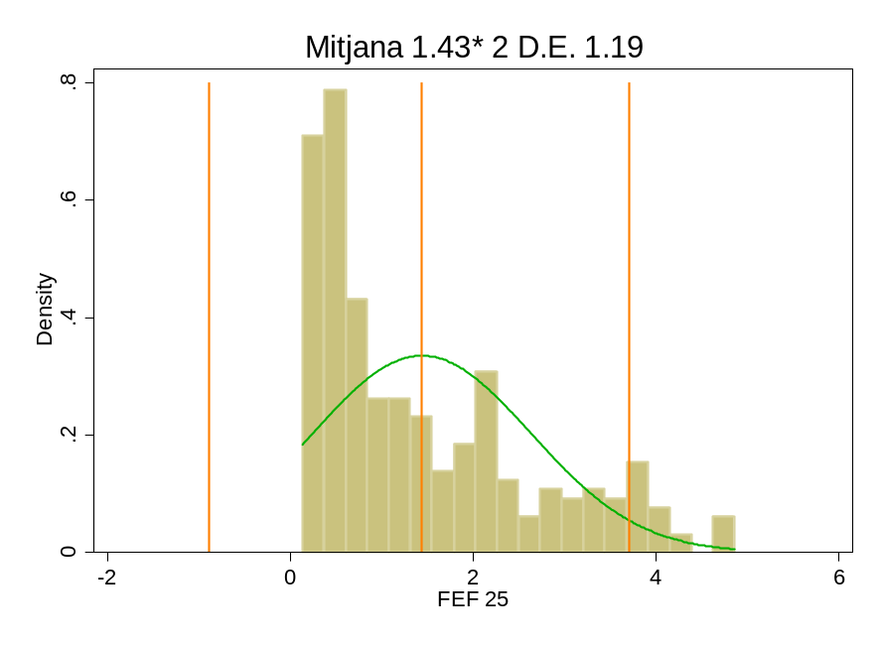
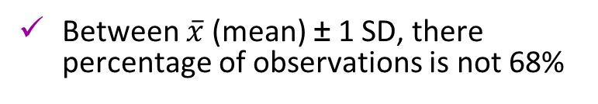
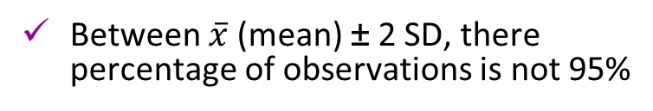
Asymmetric distribution of data

Slide 31
Coefficient of Variation (CV)
It is the ratio between standard deviation and mean
Allows to compare the variability of variables measured in different scales
Example Stay Days
3, 4, 6, 9, 12 Std. Dev.= 3.31 Mean = 6.8 Variation Coef.= 0.49
3, 4, 6, 9, 20 Std. Dev. = 6.15 Mean = 8.4 Variation Coef.= 0.73

Slide 32
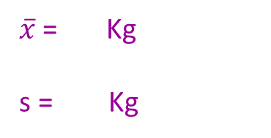
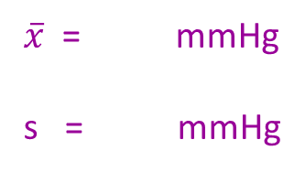
Example Variation Coefficient
Weight (Kg) of 5 patients → (70,60,56,83,79)
Blood Pression (mmHg) → 5 patients (150,170,135,180,19)
Which variable have more variation? Weight or Pression
CV_{WGT} =
CV_{BP} = %
Calculate CV

Slide 33
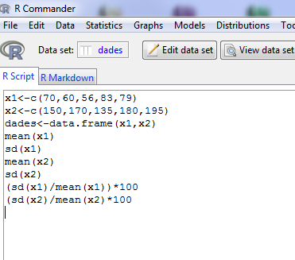

Slide 34
Example Variation Coefficient
X = 69.6 Kg
s = 11.67
Weight (Kg) of 5 patients → (70,60,56,83,79)
X = 166 mmHg
s = 23.82
Blood Pression (mmHg) 5 patients → (150,170,135,180,195)
Which variable have more variation? Weight or Pression
CV_{PES} = 16.7%
CV_{TA} = 14.3%
Calculate CV

Slide 35
Percentiles
Observations are ranked from minimum to maximum and the point that leaves below p% of observations is selected
There are some special percentiles
  Deciles are percentiles 10, 20, 30, 40, 50, 60, 70, 80, 90
  Quartiles are percentiles 25, 50, 75
  Quintiles are percentiles 20,40, 60,80
  They are not affected by extreme observations
  Interquartile range is difference between 25 and 75 percentile
Percentile
Obsv. 1
Obsv. 2
Obsv. n-1
Obsv. n

Slide 36
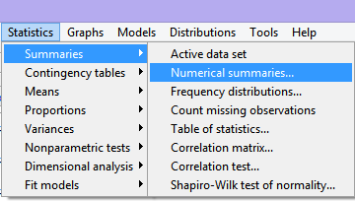
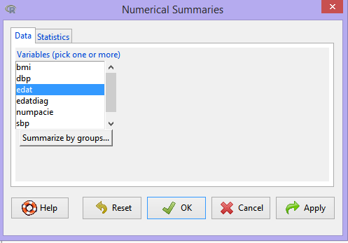
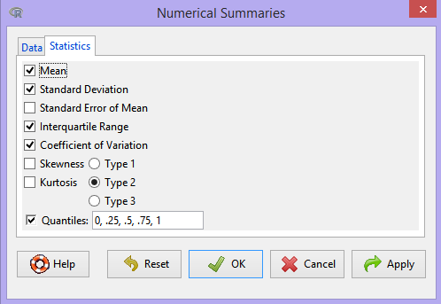
Summary meaures in R Commander

Slide 37

Summary measures in R Commander
Minimum
Maximum
Median

Slide 38
Syllabus
INTRODUCTION. ANALYSIS STRATEGY
VARIABLES CLASSIFICATION
SUMMARY MEASURES
  Measures of location/central tendency
  Measures of variability/dispersion
SUMMARY OF VARIABLES
  Contingency Tables
  Graphs
Examples & exercises
3
5

Slide 39
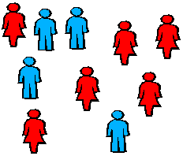
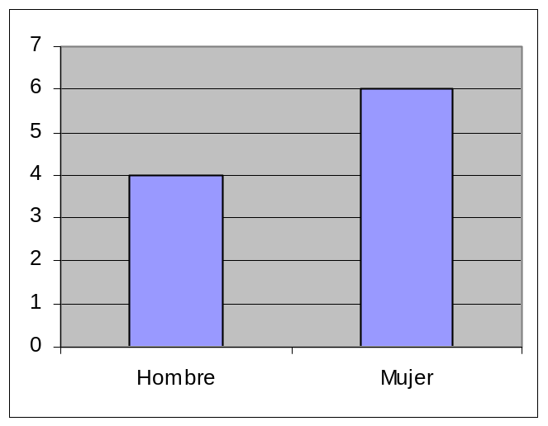
Summary of variables
Frequency tables and graphs are two equivalent ways to present information. Both expose in an ordered way the collected data.a.
Género | Frec.
Hombre | 4
Mujer | 6

Slide 40
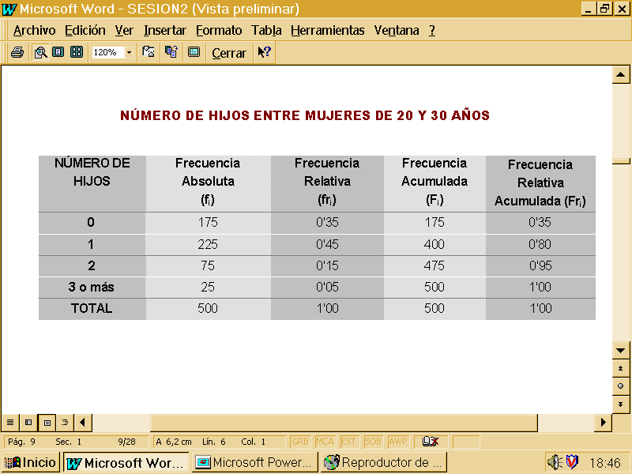
Frequency table

Slide 41
Frequency table
Catego ries

Slide 42
Taula de Freqüencia
Nº of subjects by category
Catego ries

Slide 43
Frequency table
Percentage of subjects
Freq /Total
Nº of subjects by category
Catego ries

Slide 44
Frequency table
Percentage of subjects
Freq /Total
Nº of subjects by category
Catego ries
Nº accumulated subects up to category
(Only ordinal or discrete variables)

Slide 45
Frequency table
Percentage of subjects
Freq /Total
Nº of subjects by category
Catego ries
Nº accumulated subects up to category
(Only ordinal or discrete variables)
Accumulated Frequency up to category
Freq Abs/Total

Slide 46
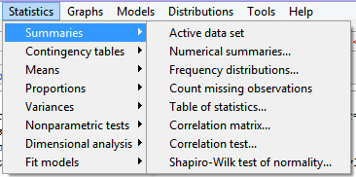
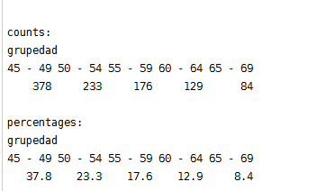
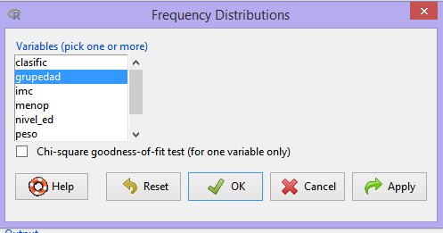
Frequency tables in R Commander

Slide 47
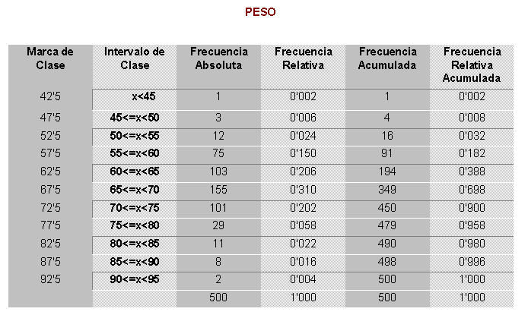
Frequency tables for quantitative variables

Slide 48
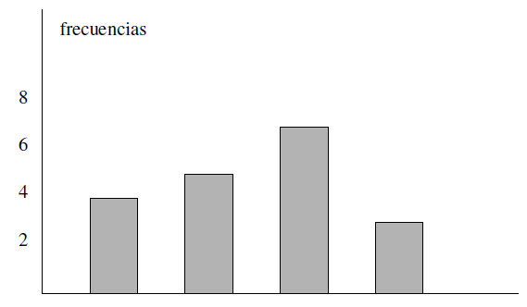
Bar Graph
Categorys are representened in X axis and frequencies in Y axis
freqüències
A B C D

Slide 49
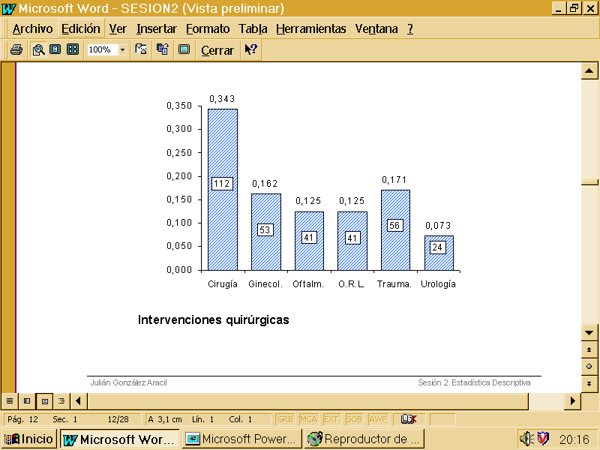
Bar Graph
For comparing two population better use relative frequencies
Relative frequency
Categories

Slide 50
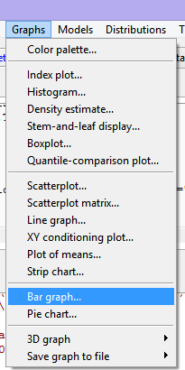
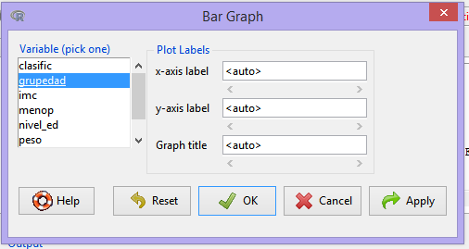
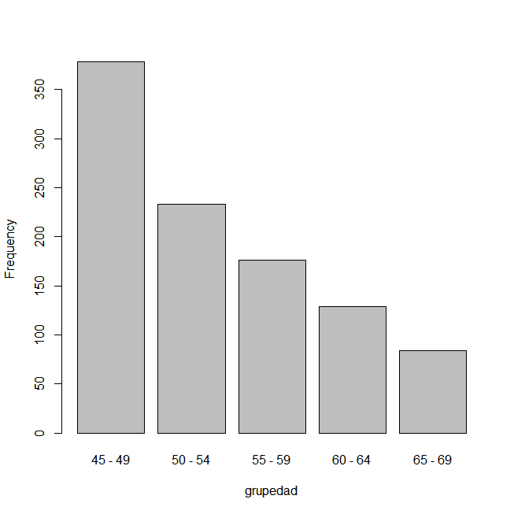
Graphs in R Commander

Slide 51
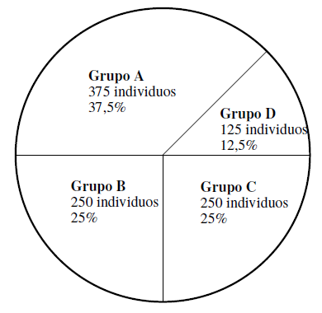
Pie Graph
s
s
s
s

Slide 52
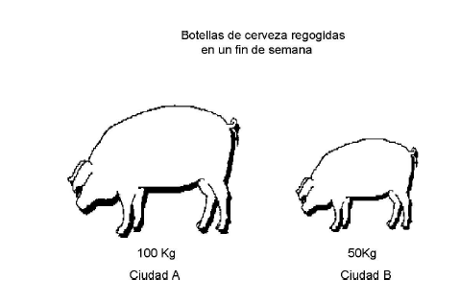
Pictograms
Expressed with drawings alluding to the subject of study frequencies of the modalities of the variable. The scaling of each design should be such that the area of ​​each of them should be proportional to the frequency category representing. Used by the media because they can be quickly understood by a general audience..
Ampolles de cervesa recollides
Ciutat A
Ciutat B

Slide 53
Histogram
Relative Frequency
Frequency poligon
Mid point interval
Interval

Slide 54
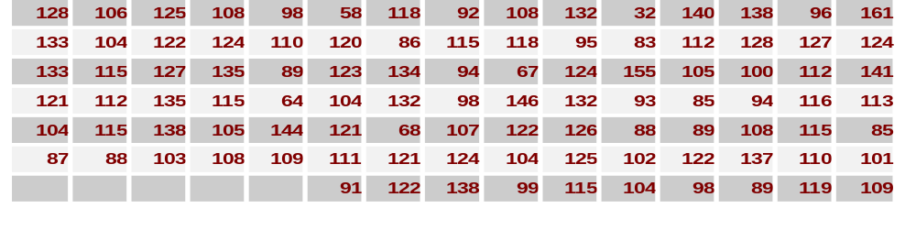
Steam and Leaf graph
3
4
5
6
7
8
9
10
11
12
13
14
15
16
2
8
7 8 4
6 3 5 8 9 5 9 7 8 9
8
2 6 5 4 8 3 4 1 9 8
6
8
5 0 4 7 8 4 2 1 4 9 4 5 3 8 9 8 4
8 5 8 2 2 6 3 5 1 0 5 9 5 0 5 2 5
8
5
0 7 4 3 4 1 2 6 1 4 2 2 8 5 2 4 7 1
2 8 4 2 2 7 8 8 3 3 5 5
0 1 6 4
5
1

Slide 55
Steam and Leaf graph
3
4
5
6
7
8
9
10
11
12
13
14
15
16
2
8
4 7 8
3 5 5 6 7 8 8 9 9 9
1 2 3 4 4 5 6 8 8 8 9
0 1 2 3 4 4 4 4 4 5 5 6 7 8 8 8 8 9 9
0 0 1 2 2 2 3 5 5 5 5 5 5 6 8 8 9
0 1 1 1 2 2 2 2 3 4 4 4 4 5 5 6 7 7 8 8
2 2 23 3 5 5 4 7 8 8 8
0 1 4 6
5
1

Slide 56
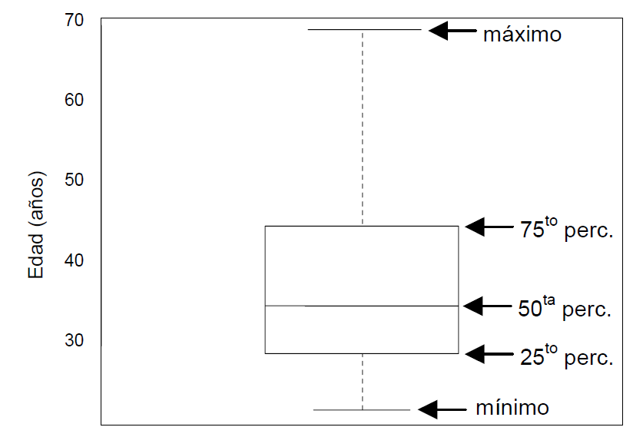
Boxplot
It is graphically represented the “five numbers": box are 25th and 75th percentiles, the middle line is the median (50th percentile) and the ends are the minimum and maximum values.
màxim
Edat (anys)
percentil 75
mediana
percentil 25
mínim

Slide 57
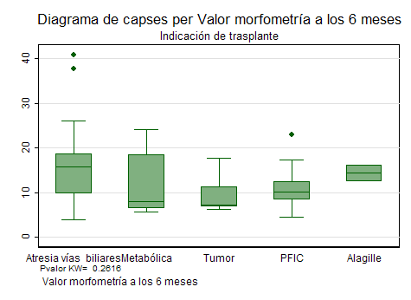
Boxplot
The boxplot is a quick way to identify outliers in the sample (they can not be "outliers")

Slide 58
Index
INTRODUCTION. ANALYSIS STRATEGY
VARIABLES CLASSIFICATION
SUMMARY MEASURES
  Measures of location/central tendency
  Measures of variability/dispersion
SUMMARY OF VARIABLES
  Contingency Tables
  Graphs
Examples & exercises
3
5

