Slide 1








Introduction to the course
Basics statistics for biomedical research course
UEB – VHIR
Mieia Ferrer¹,Ricardo Gonzalo¹ ,Miriam Mota¹, Santiago Pérez-Hoyos^{1,2},Álex Sánchez^{1,2}
1 Unitat d’Estadística i Bioinformàtica (UEB) VHIR
2 Departament d’Estadística. UB

Slide 2
Contingut
Where are we? What do we do?
Why this course
Objectives
Methods
Contents
Logistics

Slide 3
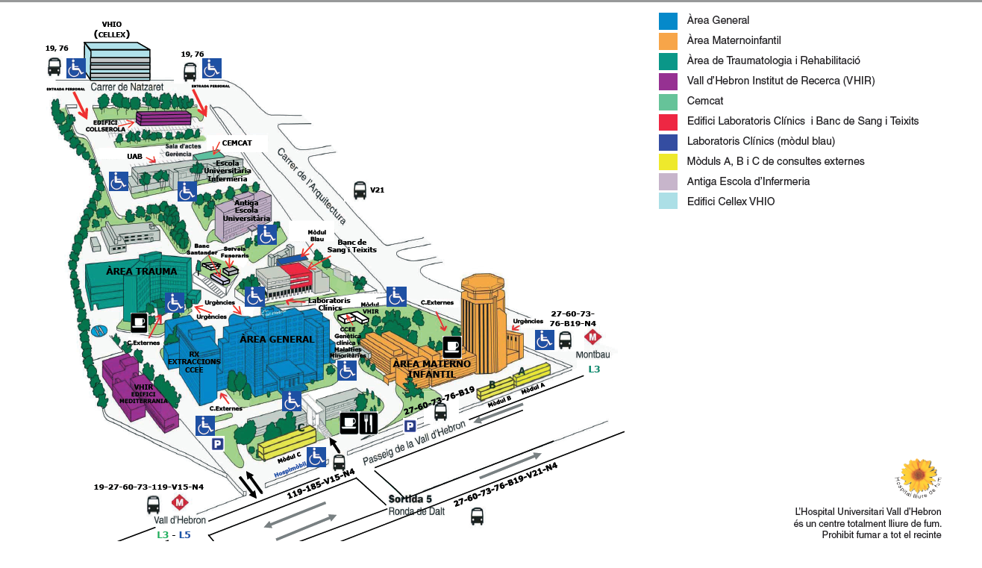
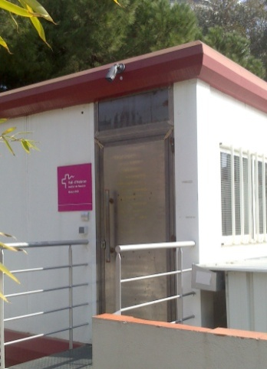
Unitat d’estadística i Bioinformàtica
Where we are

Slide 4
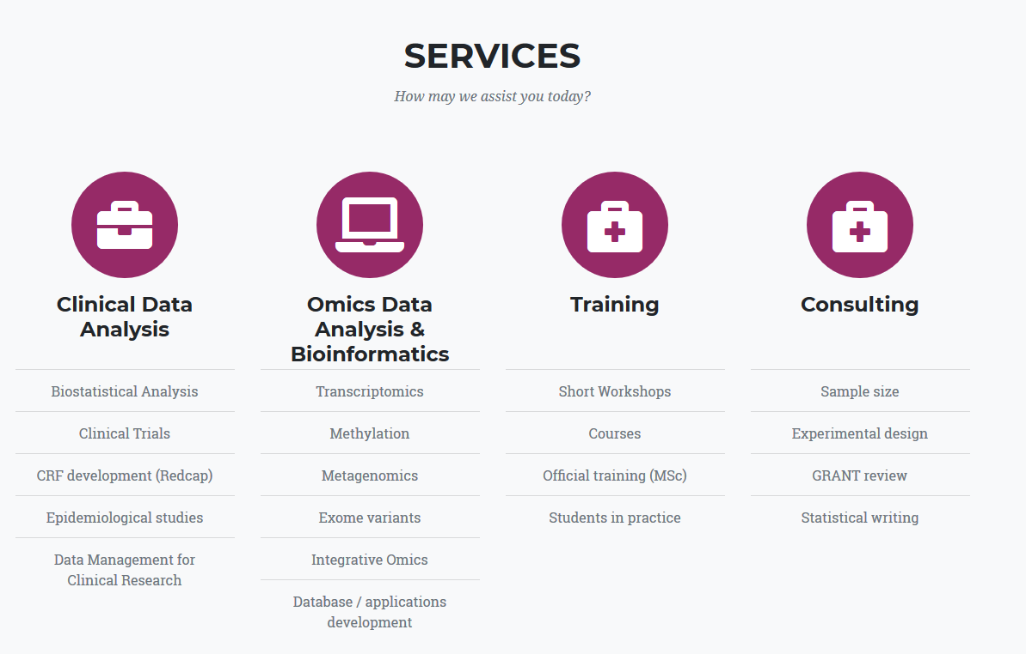
What we do

Slide 5
Why this course
A huge quantity of information is generated in clinical or lab research
A lot of people think statitics is complex or just ignore it
Other people think they can do by themselves
But what it is important is just:
Solve basics situations
Identify more complex situations and be able to communicate with an expert
“Hiring a statistician after de data has been collected is like hiring a physician when a patient is in the morgue: He might be able to tell you what went wrong , but he is unlikely to be able to fix it”
R.A. Fisher

Slide 6
Objectives
Main objective of the course is to provide a general overview of the principal statistical methods that can be useful in biomedical research and daily practise
At the end of the course the Student should
Recognize the main problems from a statistical point of view
Identify the basic methods to solve these problems
To use basic tools to carry out properly their own analysis
Identify when to applye each method
To be able to ask a professional statistician using the proper terminology to understand the solutions when problems increase their complexity

Slide 7

ueb.vhir.org

Slide 8
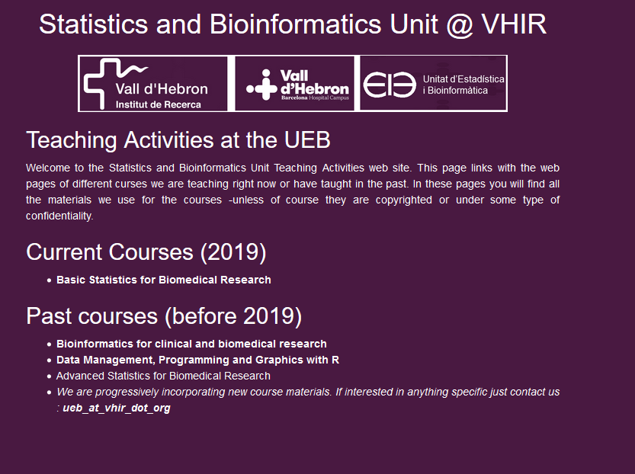
Course web access

Slide 9
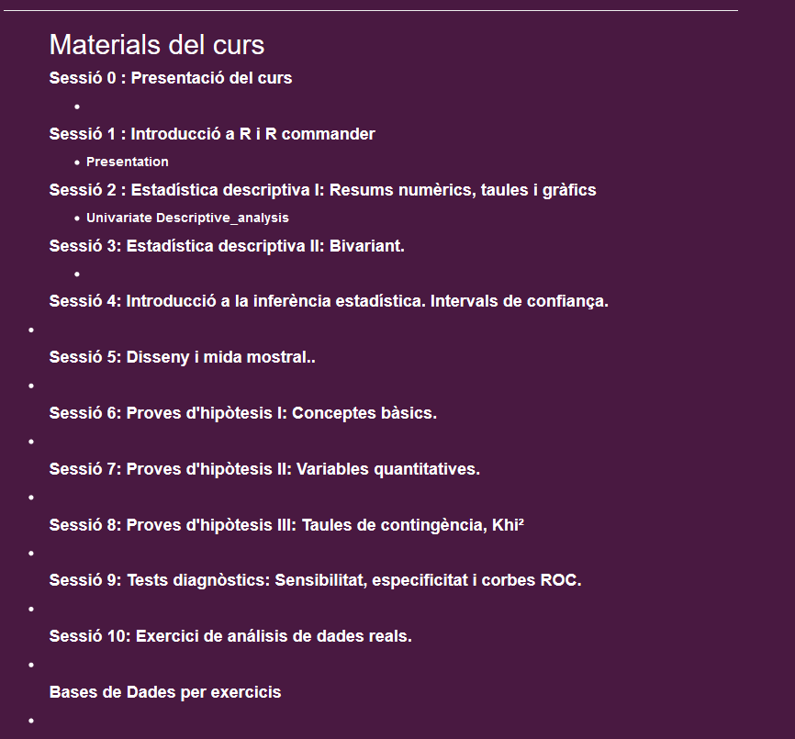

Slide 10
Methodology
This course is about applied statistics
Work with real data examples
Data analysis with R and R commander.
Theory is important , but dicusssion of real problems could help to understand statistics. Program is flexible and may be adapted to student neeed

Slide 11



How statistics do?
Nature
Real data
Generate
Observed data
“Studied nature”
Statistical methods

Slide 12
What do statistics
Description
Estimation
Summary measures. Graphs. CIs
Compare
Hypothesis testing
Relate or predict
Modelling or Regression

Slide 13

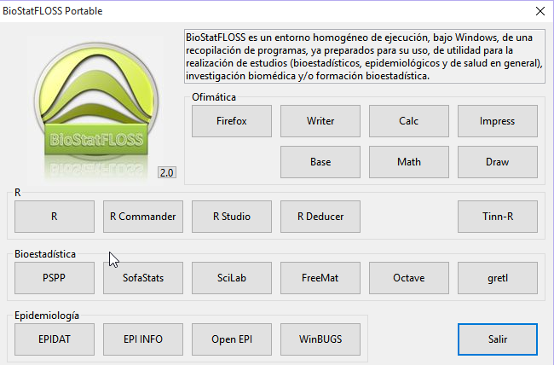
Materials

Slide 14
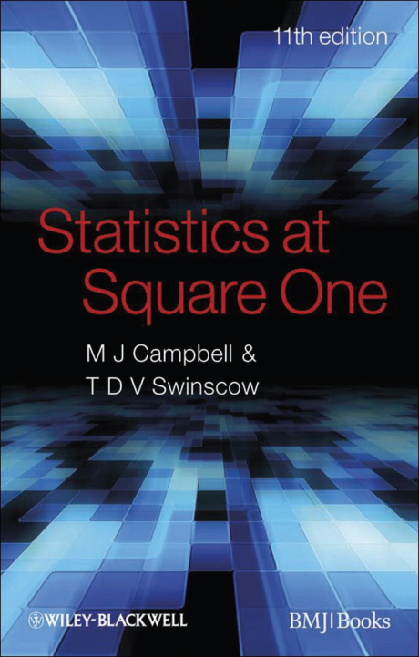
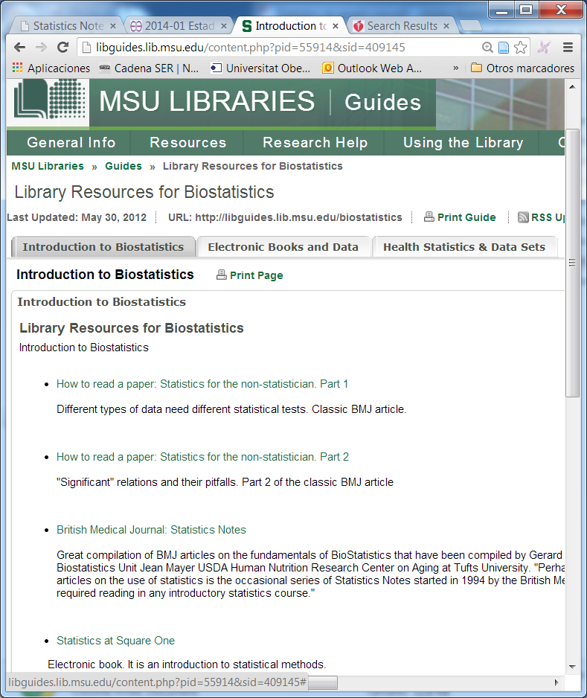
Resources
R and R-commander: Free software
Resources about basic statitistics
Course slides and exercise datasets
Some text or reference material

Slide 15
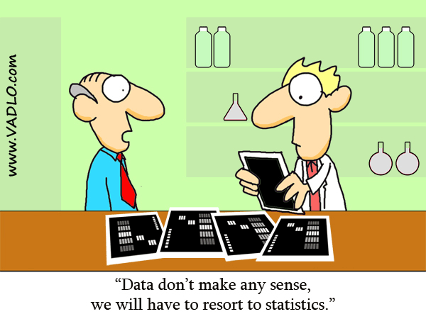
Have a good course !!!!

