Slide 1
ESTADÍSTICA DESCRIPTIVA II: ESTADÍSTICA DESCRIPTIVA BIVARIANT
Curs d'Estadística Bàsica per a la Recerca Biomèdica
UEB – VHIR
Ricardo Gonzalo Sanz Miriam Mota Foix
ricardo.gonzalo@vhir.org miriam.mota@vhir.org
23/01/2019

Slide 2
TABLE OF CONTENTS
From univariate to bivariate analysis
Bivariate analysis
Qualitative vs Qualitative
Qualitative vs Quantitative
Quantitative vs Quantitative
Correlation
Definition
Types of correlation (Pearson, Spearman)

Slide 3
TABLE OF CONTENTS
From univariate to bivariate analysis
Bivariate analysis
Qualitative vs Qualitative
Qualitative vs Quantitative
Quantitative vs Quantitative
Correlation
Definition
Types of correlation (Pearson, Spearman)

Slide 4
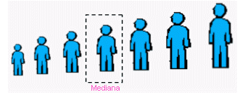
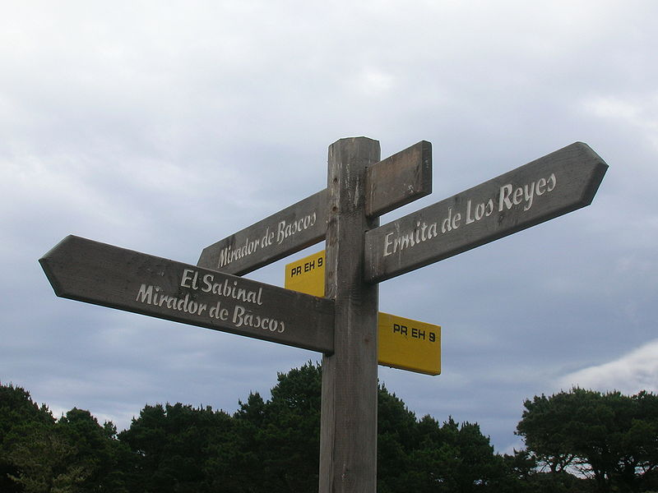
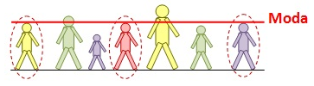
From univariate to Bivariate analysis
On Monday we learned…
We can analyse and describe each variable one by one:
With some measures:
Measures of central tendency Measures of dispersion

Slide 5
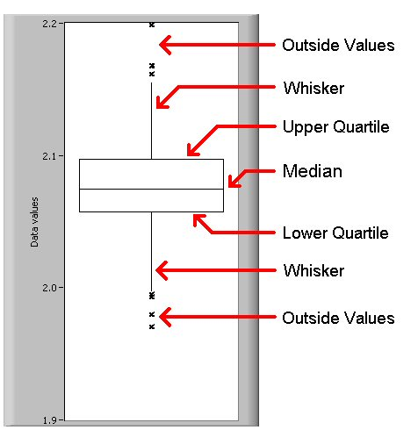
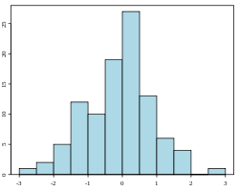
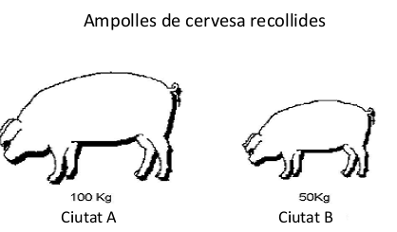
From univariate to Bivariate analysis
Some graphics

Slide 6
From univariate to Bivariate analysis
In univariate analysis only one variable is analyzed each time
the purpose of the analysis is descriptive
If there are more than one variable in the dataset it could be interesting to guess if:
Does exist a relation between the two variables?
How important is this relation?
Which is the direction of the relation?

Slide 7
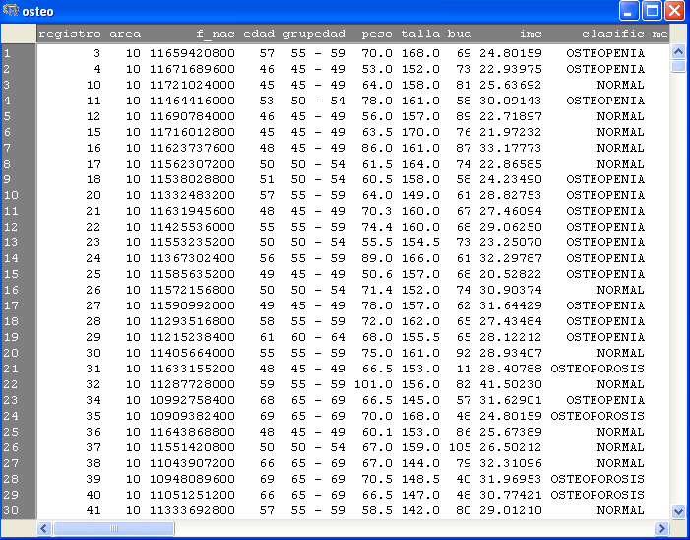
From univariate to Bivariate analysis

Slide 8
From univariate to Bivariate analysis

Slide 9
From univariate to Bivariate analysis

Slide 10
TABLE OF CONTENTS
From univariate to bivariate analysis
Bivariate analysis
Qualitative vs Qualitative
Qualitative vs Quantitative
Quantitative vs Quantitative
Correlation
Definition
Types of correlation (Pearson, Spearman)

Slide 11
2. Bivariate analysis
Bivariate analysis
Involves the analysis of two variables for the purpose of determining the empirical relationship between them.
easiest way is to measure how those two variables simultaneously change together

Slide 12
2. Bivariate analysis
Bivariate analysis
Involves the analysis of two variables for the purpose of determining the empirical relationship between them.
easiest way is to measure how those two variables simultaneously change together
Major differentiating point between univariate and bivariate analysis (a part from the number of variables implicated) is that bivariate analysis goes beyond simply descriptive, since it study the relationship between the two variables.

Slide 13

2. Bivariate analysis
Why bivariate analysis?
Let’s begin by asking if:
Our experience tells us “yes”, but how good is the correspondence?
People tend to marry other people of about the same age?
Sample of spousal ages of 10 White American Couples
Onlinestatbook (Authors: Rudy Guerra and David M. Lane)

Slide 14
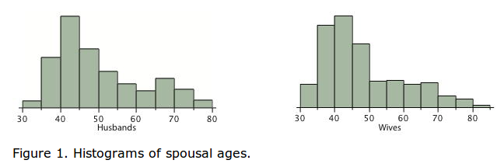
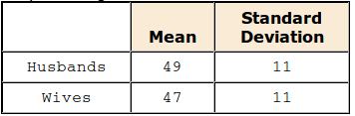
2. Bivariate analysis
Why bivariate analysis?
Onlinestatbook (Authors: Rudy Guerra and David M. Lane)

Slide 15
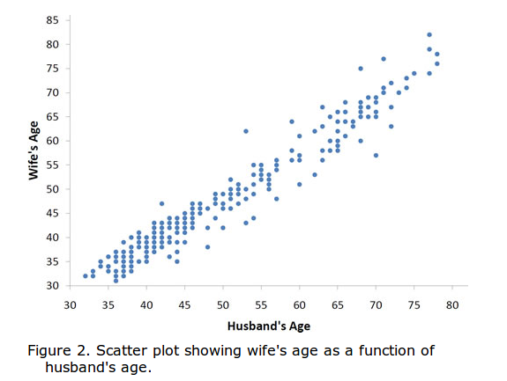
2. Bivariate analysis
Why bivariate analysis?
The older the husband the older the wife.
It is possible to know age of wives for an husband age.
Onlinestatbook (Authors: Rudy Guerra and David M. Lane)

Slide 16







2. Bivariate analysis
Some plots to study the relationship between two variables...
Quantitative

Slide 17
2. Bivariate analysis 2.1 Qualitative versus qualitative

Slide 18
2. Bivariate analysis 2.1 Qualitative versus qualitative
The way to study the relation will depend on the variable types:
Two qualitative variables: contingency table
Used for organizing categorical variables and testing hypothesis with the chi-squared test for independence

Slide 19
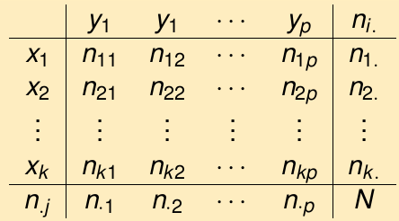

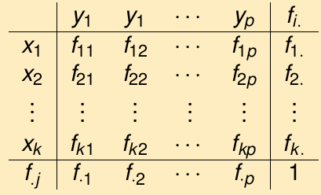
2. Bivariate analysis 2.1 Qualitative versus qualitative
The way to study the relation will depend on the variable types:
Two qualitative variables: contingency table
Used for organizing categorical variables and testing hypothesis with the chi-squared test for independence
Count of individuals that simultaneously presents variable 1 (x) and variable 2 (y)
Absolute
relative

Slide 20
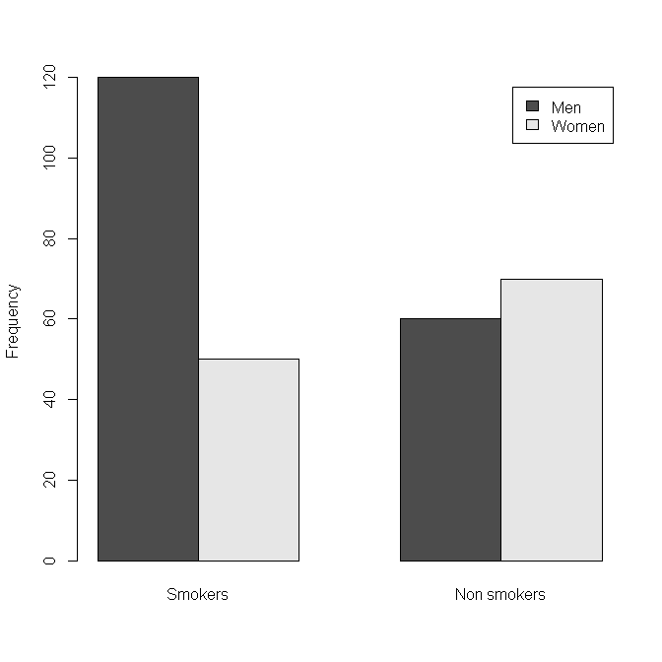
2. Bivariate analysis 2.1 Qualitative versus qualitative
An study wants to know if there are differences about smoking habits in men and women.
Gender | Smoking habits
1 | 1
2 | 1
1 | 0
1 | 0
1 | 0
1 | 1
2 | 1
... | ...
 | Smokers | Non Smoking | Total
Men | 120 | 60 | 180
Women | 50 | 70 | 120
Total | 170 | 130 | 300

Slide 21
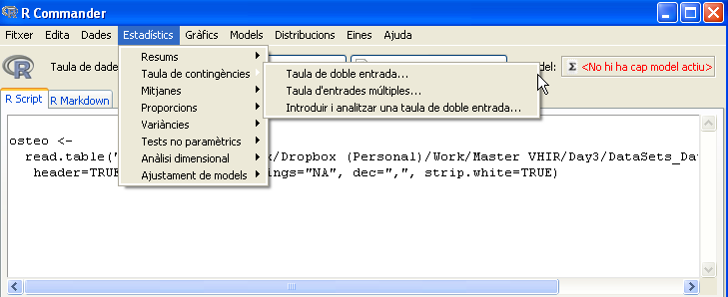
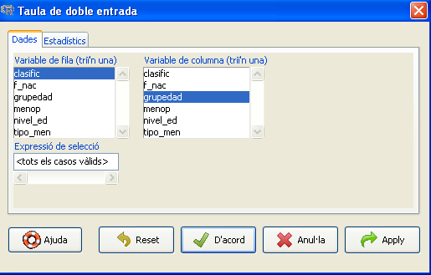
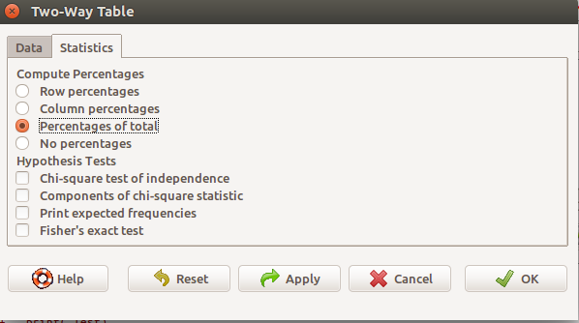
2. Bivariate analysis 2.1 Qualitative versus qualitative
Let´s do in R Commander:
Osteoporosis dataset
Study if the group age (grupedad) of patients, influence in the illness type (classific):

Slide 22
2. Bivariate analysis 2.1 Qualitative versus qualitative
Frequency table:
clasific
grupedad NORMAL OSTEOPENIA OSTEOPOROSIS
45 - 49 233 138 7
50 - 54 113 113 7
55 - 59 67 100 9
60 - 64 38 74 17
65 - 69 18 42 24
Total percentages:
NORMAL OSTEOPENIA OSTEOPOROSIS Total
45 - 49 23.3 13.8 0.7 37.8
50 - 54 11.3 11.3 0.7 23.3
55 - 59 6.7 10.0 0.9 17.6
60 - 64 3.8 7.4 1.7 12.9
65 - 69 1.8 4.2 2.4 8.4
Total 46.9 46.7 6.4 100.0

Slide 23
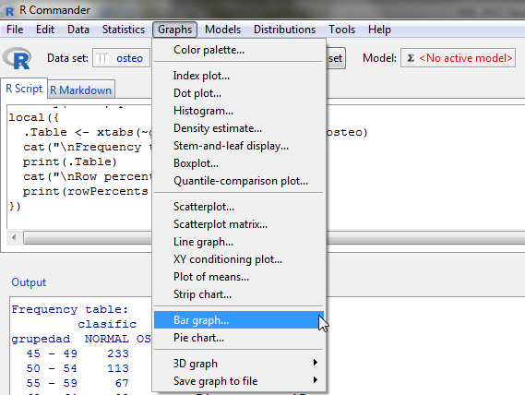
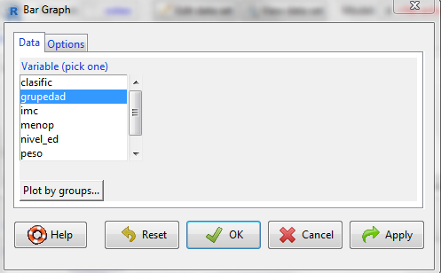
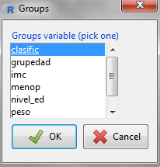
2. Bivariate analysis 2.1 Qualitative versus qualitative

Slide 24
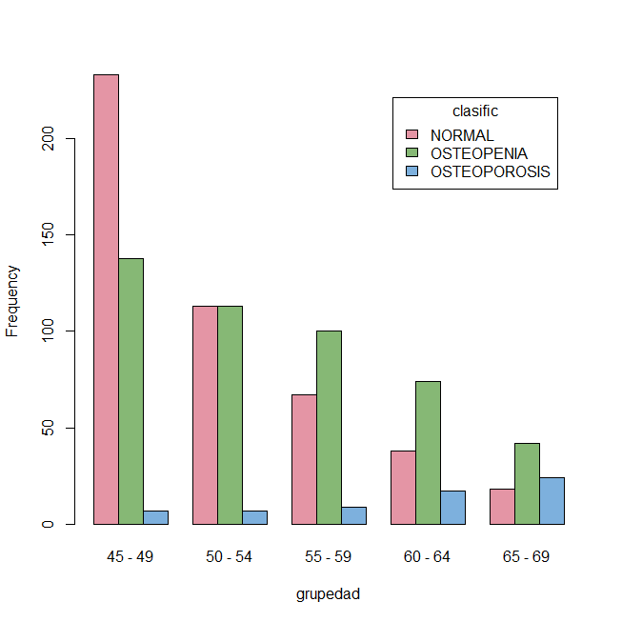
2. Bivariate analysis 2.1 Qualitative versus qualitative

Slide 25
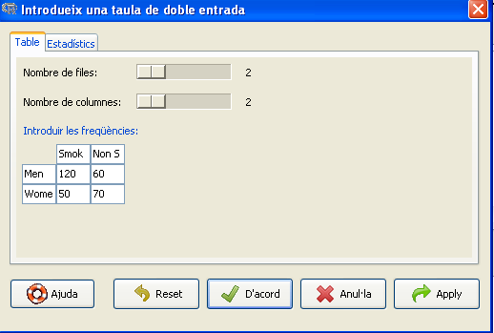
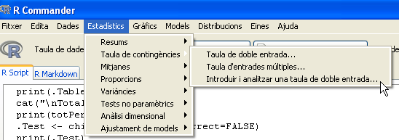
2. Bivariate analysis 2.1 Qualitative versus qualitative
Another way to introduce the data:
 | Smokers | Non Smoking | Total
Men | 120 | 60 | 180
Women | 50 | 70 | 120
Total | 170 | 130 | 300

Slide 26
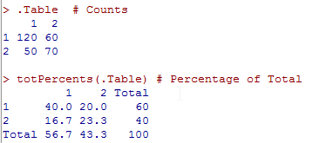
2. Bivariate analysis 2.1 Qualitative versus qualitative
Another way to introduce the data:
 | Smokers | Non Smoking | Total
Men | 120 | 60 | 180
Women | 50 | 0 | 120
Total | 170 | 130 | 300

Slide 27
2. Bivariate analysis 2.2 Qualitative versus quantitative

Slide 28
2. Bivariate analysis 2.2 Qualitative versus quantitative
The way to study the relation will depend on the variable types:
One qualitative variable and one quantitative variable: Table of statistics
Mean value of the variable in each category for each individual

Slide 29
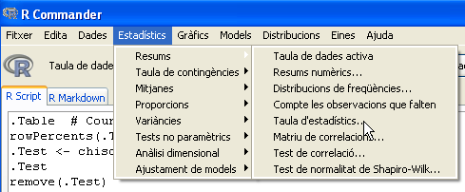
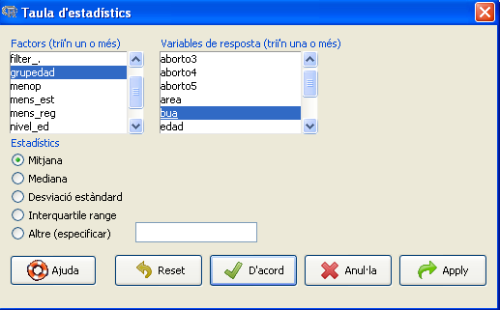
2. Bivariate analysis 2.2 Qualitative versus quantitative
Let´s do in R Commander:
Osteoporosis dataset
Study if bone density (bua) how change in each group of age

Slide 30
2. Bivariate analysis 2.2 Qualitative versus quantitative
Let´s do in R Commander:
Osteoporosis dataset
Study if bone density (bua) how change in each group of age
> with(osteo, tapply(bua, list(grupedad), mean, na.rm=TRUE))
45-49 50-54 55-59 60-64 65-69
78.75926 75.05150 71.43182 64.89147 60.66667

Slide 31
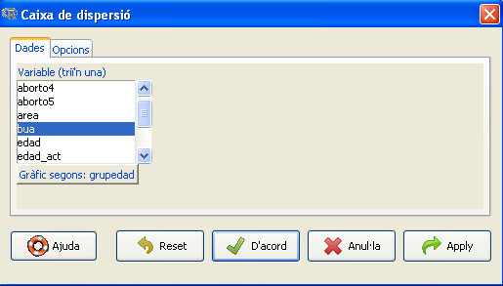
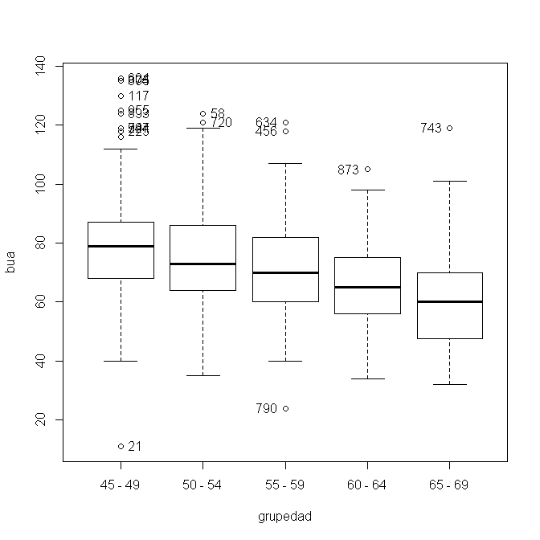
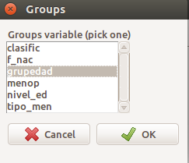
2. Bivariate analysis 2.2 Qualitative versus quantitative
Study if bone density (bua) is different in each group of age

Slide 32
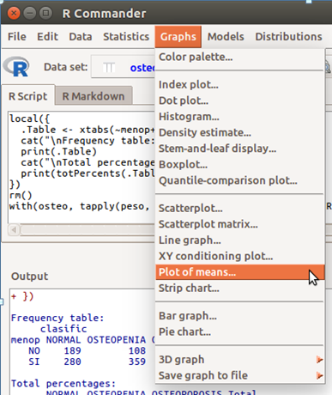
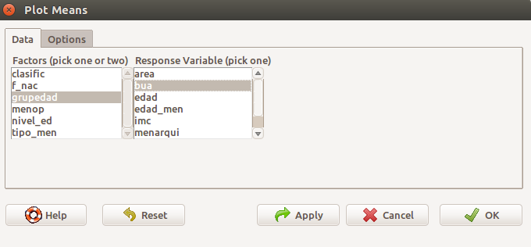
2. Bivariate analysis 2.2 Qualitative versus quantitative
Study if bone density (bua) is different in each group of age

Slide 33
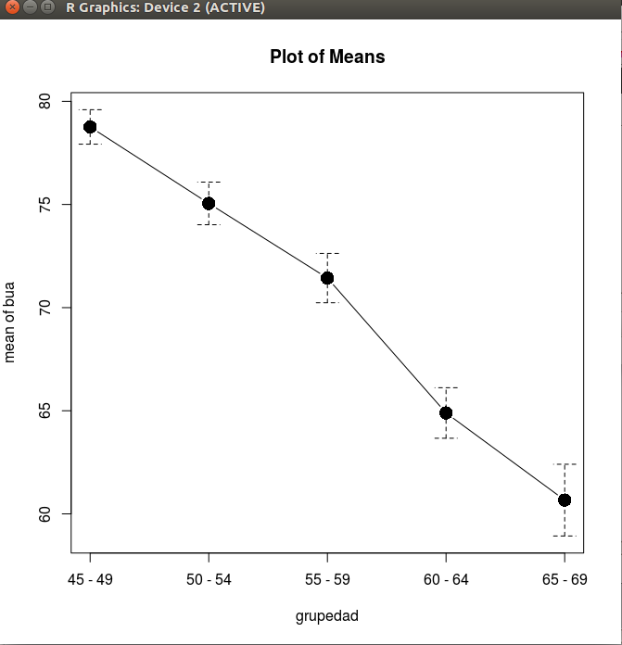
2. Bivariate analysis 2.2 Qualitative versus quantitative
Study if bone density (bua) is different in each group of age

Slide 34
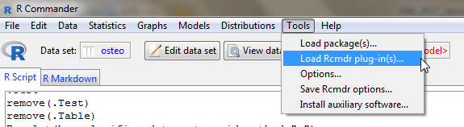
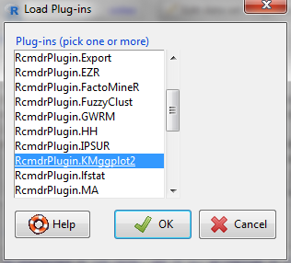
2. Bivariate analysis 2.2 Qualitative versus quantitative
Graphics with KMggplots2:

Slide 35
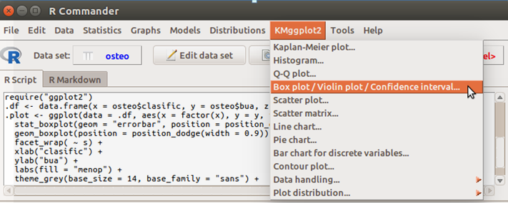
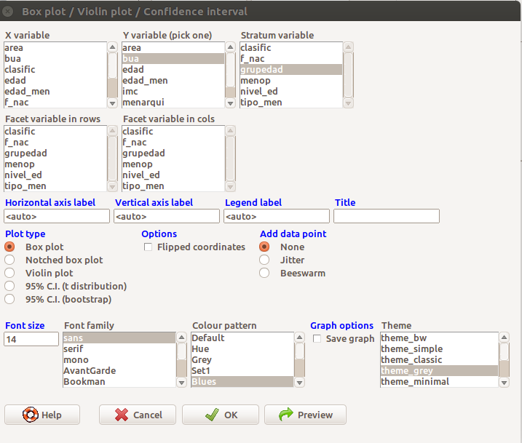
2. Bivariate analysis 2.2 Qualitative versus quantitative
Study if bone density (bua) is different in each group of age (with KMggplot2)

Slide 36
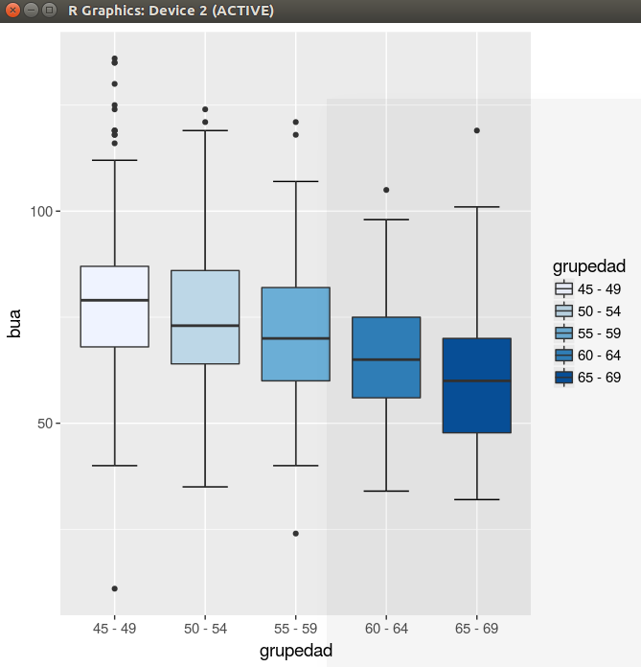
2. Bivariate analysis 2.2 Qualitative versus quantitative
Study if bone density (bua) is different in each group of age

Slide 37
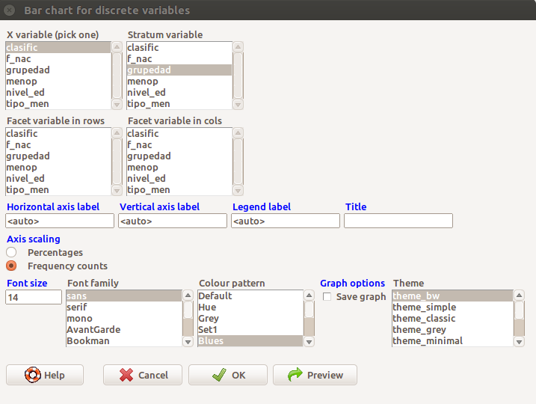
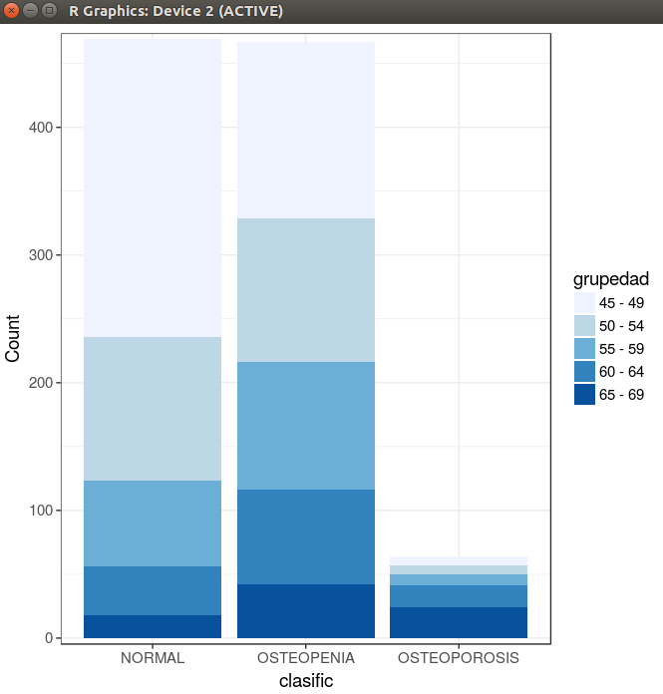
2. Bivariate analysis 2.1 Qualitative versus qualitative
Study if grupedad, influence in the illness type (classific) (with KMgglplots2)

Slide 38
2. Bivariate analysis
Exercise
Study if the relationship between menop and group of illness (classific)
Study if peso is different in each group of illness (classific).

Slide 39
2. Bivariate analysis 2.3 Quantitative versus Quantitative
The way to study the relation will depend on the variable types:
Two quantitatives variables:

Slide 40
2. Bivariate analysis 2.3 Quantitative versus Quantitative
The way to study the relation will depend on the variable types:
Two quantitatives variables:

Slide 41
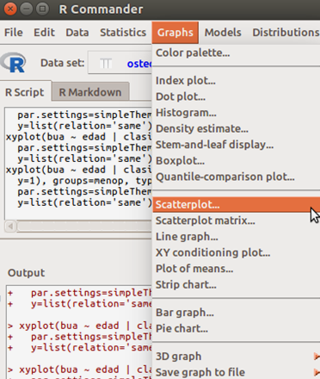
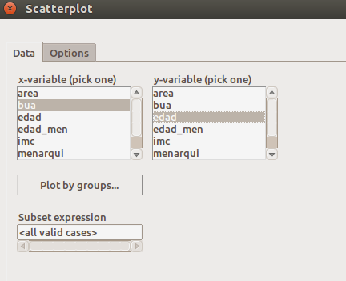
2. Bivariate analysis 2.3 Quantitative versus Quantitative
The way to study the relation will depend on the variable types:
Two quantitatives variables

Slide 42
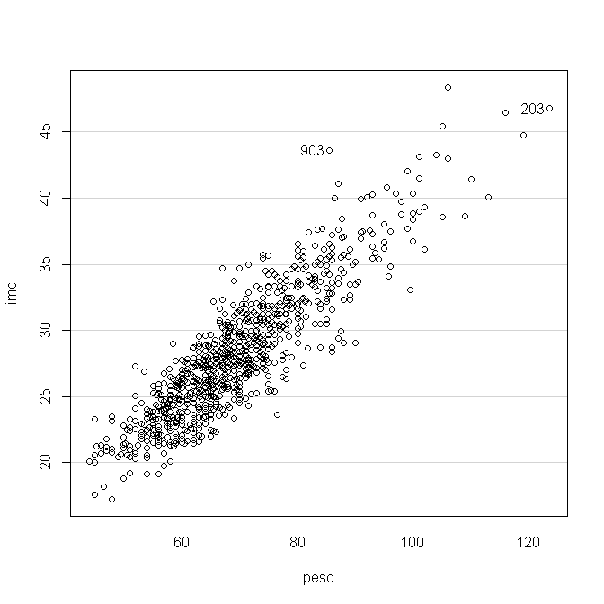
2. Bivariate analysis 2.3 Quantitative versus Quantitative
The way to study the relation will depend on the variable types:
Two quantitatives variables:

Slide 43
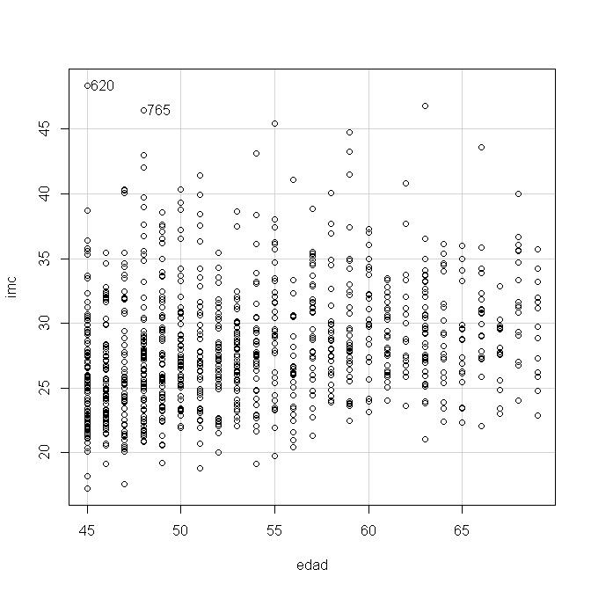
2. Bivariate analysis 2.3 Quantitative versus Quantitative
The way to study the relation will depend on the variable types:
Two quantitatives variables:

Slide 44
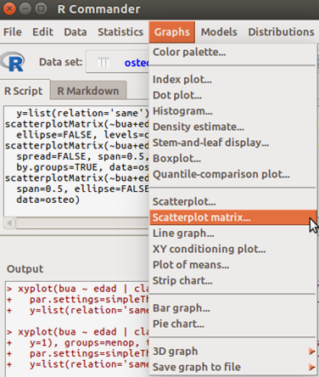
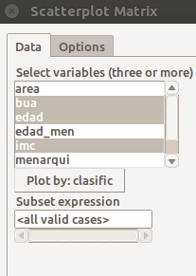
2. Bivariate analysis 2.3 Quantitative versus Quantitative
The way to study the relation will depend on the variable types:
Two quantitatives variables:

Slide 45
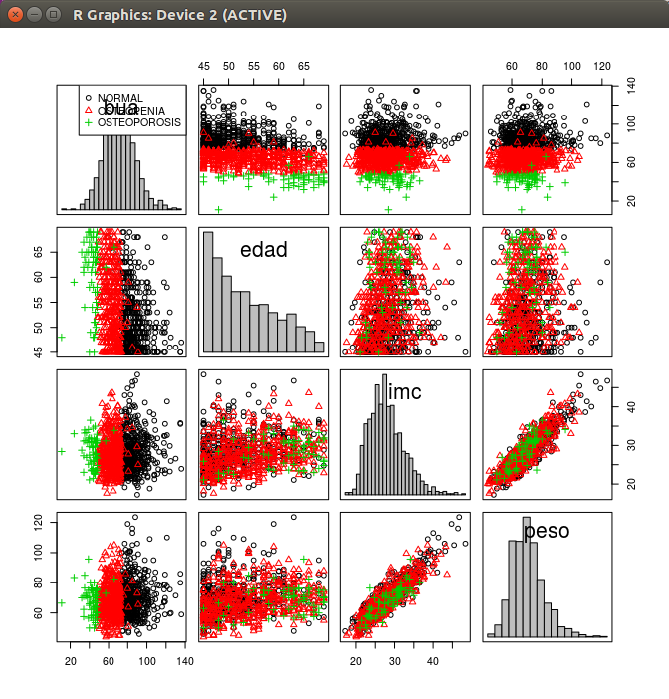
2. Bivariate analysis 2.3 Quantitative versus Quantitative
The way to study the relation will depend on the variable types:
Two quantitatives variables:

Slide 46
TABLE OF CONTENTS
From univariate to bivariate analysis
Bivariate analysis
Qualitative vs Qualitative
Qualitative vs Quantitative
Quantitative vs Quantitative
Correlation
Definition
Types of correlation (Pearson, Spearman)

Slide 47
Correlation 1. Definition
Main characteristics of correlation analysis:
Correlation analysis allow:
Study the way of relation between the two variables
Quantify the intensity of relation
Correlation is not causation one thing does not causes the other
In the correlation analysis, the two variables have the same weigh
The correlation coefficient measures the strength of the relation

Slide 48
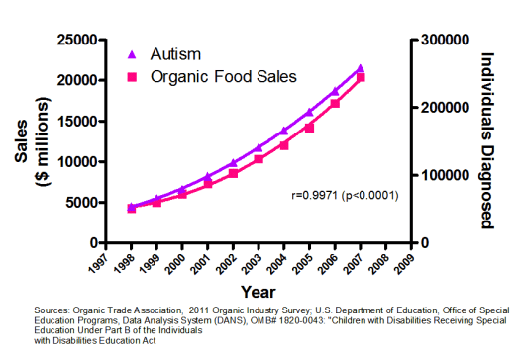
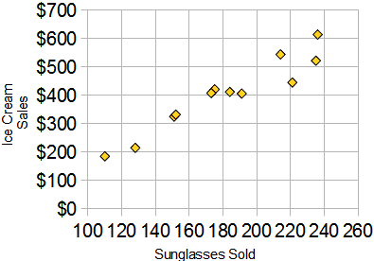
Correlation 1. Definition
Main characteristics of correlation analysis:
Correlation is not causation

Slide 49
Correlation 2. Types of correlation
Pearson correlation coefficient
It is represented by letter “r”. It has no dimensions (no units)
Values go from -1 to +1
r=0 indicates no linear relation between the variables
r>0 indicates direct relation between the variables
r<0 indicates indirect relation between the variables
r=1/-1 indicates a perfect relation between the variables

Slide 50
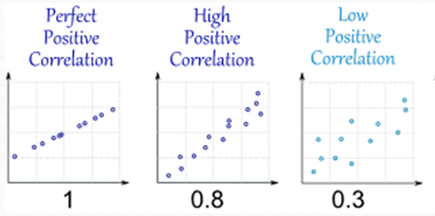
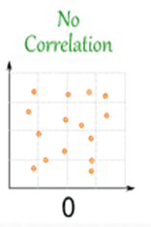
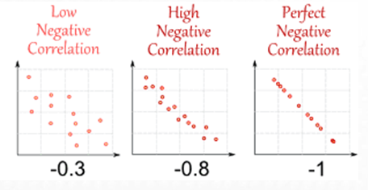
Correlation 2. Types of correlation
Pearson correlation coefficient. Examples

Slide 51

Correlation 2. Types of correlation
Study the relationship between peso and body mass index (imc):
imc peso
imc 1.0000000 0.8927967
peso 0.8927967 1.0000000

Slide 52



Correlation 2. Types of correlation
Pearson correlation coefficient. How to in R-commander?
Bone density and age are correlated?
Don’t forget to look the graphic!!

Slide 53


Correlation 2. Types of correlation

Slide 54

Correlation 2. Types of correlation
Pearson correlation coefficient. How to in R-commander?

Slide 55
Correlation 2. Types of correlation
Pearson correlation coefficient. How to in R-commander?
Exercise 1. Do you think that exists a relationship between peso and talla? What type of relationship? Show a scatterplot of the values.

Slide 56

Correlation. Exercises
Exercise 1. peso~talla
peso talla
peso 1.0000000 0.2311058
talla 0.2311058 1.0000000

Slide 57
Correlation 2. Types of correlation
Non Parametric correlation: Spearman correlation coefficient
Pearson correlation coefficient is severely affected by outliers and if the relation is not lineal
Better to use Spearman correlation coefficient (use the ranks between the numbers instead the values) to calculate the correlation coefficient
Evaluates the monotonic relationship between the variables (not the linear relationship as Pearson does).
The variables tend to change together but not necessarily at a constant rate

Slide 58

Correlation 2. Types of correlation
Non Parametric correlation: Spearman correlation coefficient

Slide 59






Correlation 2. Types of correlation
Comparison of Pearson and Spearman coefficients.
Always examine a scatterplot to determine the form of the relationship

Slide 60



Correlation 2. Types of correlation
Spearman correlation coefficient. How to in R-commander?

Slide 61
Correlation. Exercises
Exercise 2. An hypothetic study, published last year that exists a relation between age and systolic blood pressure (sbp)? Do you think is it true? Show a scatterplot of the values? If not, find another variable in the dataset that has a good correlation with systolic blood pressure.
Use dataset Framingham250.csv

