Slide 1

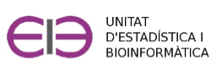

Introduction to R and R-commander
Curs d'Estadística Bàsica per a la Recerca Biomèdica
GRBIO-UEB-VHIR

Slide 2

Table of contents
●
Introduction to R
●
Introduction to Rcmdr
●
The Rcmdr menus
●
Loading data sets
●
Working with data sets
●
Using R scripts
●
Exporting results
●
Additional sources
●
Practice

Slide 3


Introduction to R
R is a language and environment for statistical computing and graphics.
R was developed in 1993 by Robert Gentleman and Ross Ihaka as a free alternative to a commercial software with similar capabilities, known as "the S language".
Currently maintained by the R Development Core Team
Freely available from the R-Project website: http://www.r-project.org/
Pushed by a variety of fields -apart of statistics- such as bioinformatics or ecology it has become a "de facto" standard in many fields for data exploration, manipulation, modelling and analysis.

Slide 4
Advantages of using R
It is free
Multi-platform (Linux, Mac, Windows)
Powerful in graphics generation
Powerful statistical tool (top statistical methods)
Is always growing in users and functionalities → Frequent updates (twice a year).
Flexible, open source, programming language → Useful for repetitive tasks.

Slide 5
Drawbacks of using R
It is a statistical language", that is, it is based on "commands" and used best in a console.
Compensated by IDEs/GUIS such as Rstudio/Rcmdr
Not so "user friendly" as SPSS or Graphpad
Much more powerful then the 2nd,
Much cheaper than the 1st
Supporting documentation is of variable quality
Frequent updates
Community-based: Pieces may be different depending on who creates them.
Partially solved by the tidyverse

Slide 6
Using R
In short, using R consists of:
Managing the right objects
Using appropriate functions.
At the beginning the problema is knowing …
Which type of objects are there,
What can be done with them.

Slide 7
An example
> expres <- c(1.02, 3.1, 0.8, 1.4, 2)
> logExp <- log (expres)
> sigExp1 <- t.test(logExp)
> sigExp2 <- wilcox.test(logExp)
Objects
Functions

Slide 8
Using R
In short, using R consists of:
Managing the right objects
Using appropriate functions.
At the beginning the problema is knowing
Which type of objects are there
What can be done with them.

Slide 9
R objects
R objects can be:
Data tables ("datasets"), text, dates,
But also more complicated things such as
Plots
Output of statistical tests
Fitted models
Objects are created
Reading data from a file
As the result of a computation
Assigning them a value

Slide 10
R functions
R functions represent something that can be done with an object :
Functions opérate with objects
Functions can return other objects
Functions can be
Incorporated in R "base"
Added to the system using "packages"
Created by the user for specific purposes

Slide 11
Example 2
# DATA
calcio <-c(11.0, 10.6, 10.5, 10.6, 10.4, 10.2, 9.5,
8.2, 7.5, 6.0, 5.0)
PTH <- c(0.5, 1.12, 1.23, 1.24, 1.31, 1.33, 2.10,
2.15, 2.43, 3.70, 4.27)
plot(calcio,PTH, main="Hormona Paratiroidea vs [Calcio]")
regres <- lm(PTH ~ calcio) # FIT A MODEL
# RESULTS
summary(regres)
abline(regres)
par(mfrow=c(2,2))
plot(regres)
Objetos
Funciones

Slide 12
Example 2: results
> summary(regres)
Call:
lm(formula = PTH ~ calcio)
Residuals:
Min 1Q Median 3Q Max
-0.37648 -0.11926 0.08052 0.11177 0.40454
Coefficients:
Estimate Std. Error t value Pr(>|t|)
(Intercept) 6.88232 0.35283 19.51 1.13e-08 ***
calcio -0.54599 0.03811 -14.33 1.68e-07 ***
---
Signif. codes: 0 ‘***’ 0.001 ‘**’ 0.01 ‘*’ 0.05 ‘.’ 0.1 ‘ ’ 1
Residual standard error: 0.2496 on 9 degrees of freedom
Multiple R-squared: 0.958, Adjusted R-squared: 0.9533
F-statistic: 205.3 on 1 and 9 DF, p-value: 1.680e-07

Slide 13
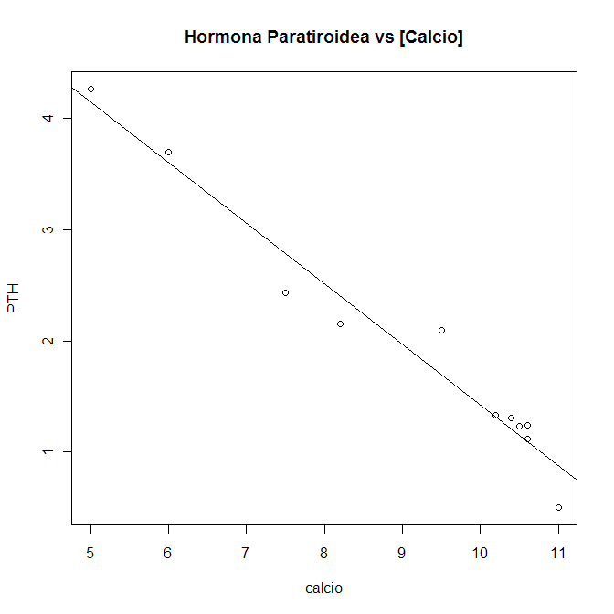
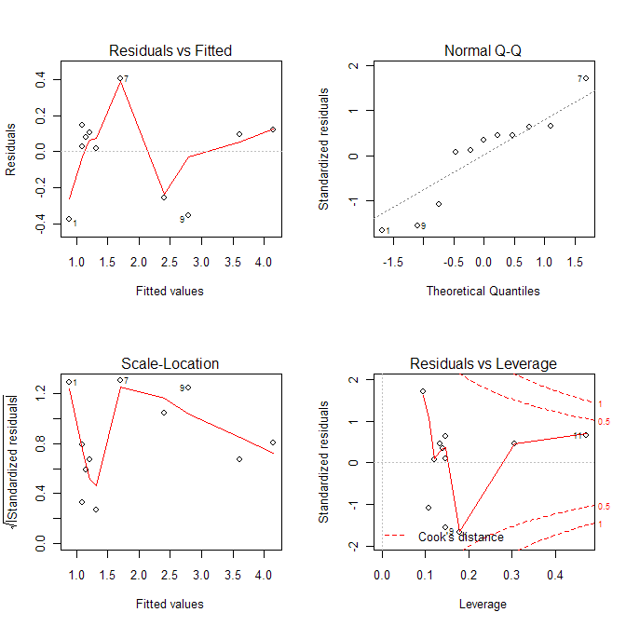
Example 2: plots

Slide 14
R GUIs and IDEs
Using R from the console can have a steep learning curve.
Simplified with GUIs and IDEs
Graphical User Interfaces (GUI)
Simplify using R in a point&click way
Menu-based Statistical analysis: R-commander
Integrated development environments (IDE)
Facilitates command-based use of R: RStudio

Slide 15
RStudio
Free IDE to facilitate Using R from the console.
Downloadable from https://rstudio.com
Has become so popular that some people confounds it with R.
It is only an interface but
Very user friendly
Specially Good for intermediate-level users

Slide 16
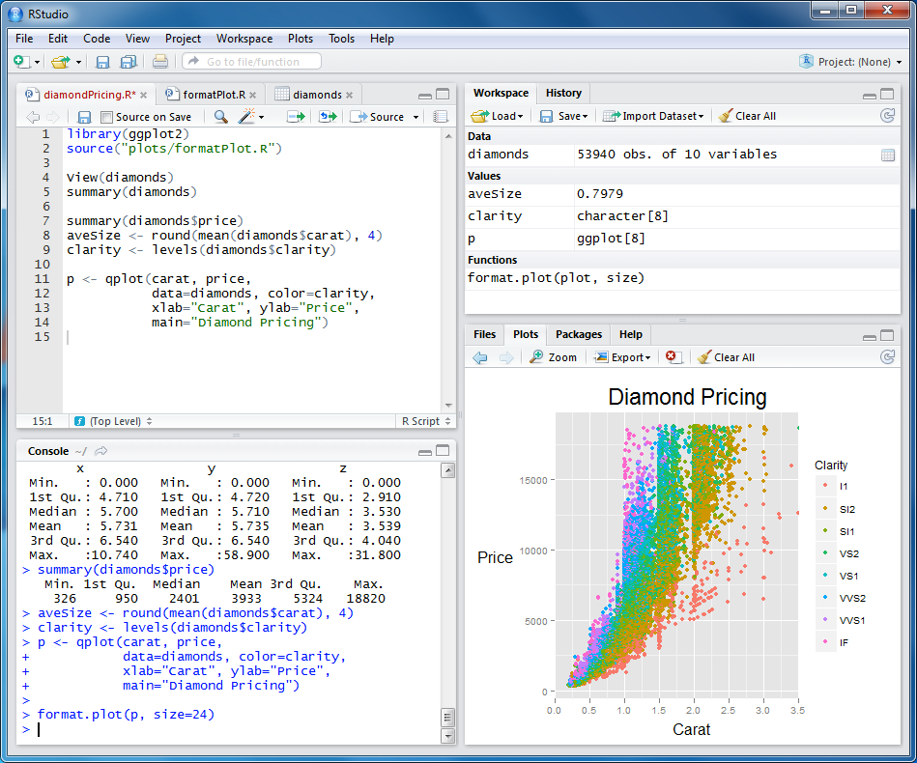
RStudio
Source
-scripts
-text edit
Input data,
Environment
& History
Files, plots,
packages,
help
Console
-commands
-output

Slide 17
R commander
Free GUI to facilitate doing statistical analyses with R.
Originally developed for statistics courses where there was no time to learn to use R through the console.
Has become very popular and has been adopted by many teaching institutions.

Slide 18
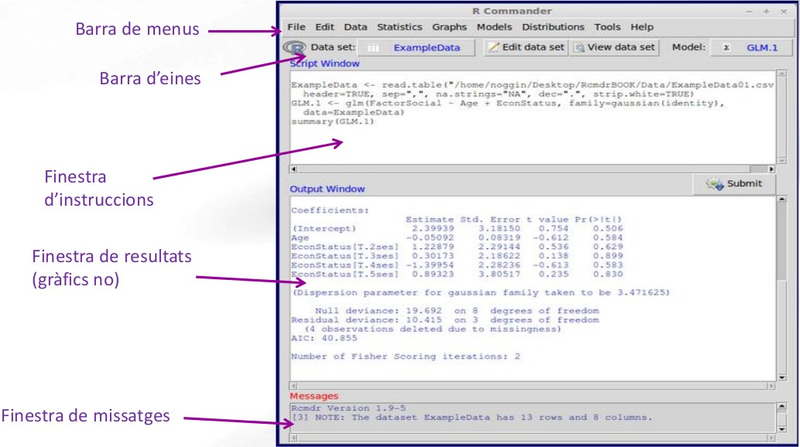
RCommander
●
Menu bar
Tool bar
Command
window
Text output
window
Messages window

Slide 19
RCommander
Menu bar
●
File: contains options to load and save files, define settings and exit.
●
Edit: options for editing output and log/script window contents.
●
Data: options to read and modify data.
●
Statistics: submenu containing options for basic statistical analysis
●
Graphs: contains options for creating simple statistical graphs
●
Models: options for obtaining numerical summaries, testing hypotheses
and regression models.
●
Distributions: options to calculate probabilities, obtain quantiles, and
get plots of already known statistical distributions.
●
Help: contains menus with info about how to work with R commander.

Slide 20
RCommander
Menu bar
Create / Load data
Editing and inspection of data files.
Data transformation / Creation of new variables.
Selection of subsets of data or subgroups of variables.
Conversion of numerical variables into factors.

Slide 21
RCommander
Menu bar
Summaries
Contingency tables
Mediums
Proportions
Variants
Non-parametric tests
Dimensional analysis (A. Multivariant)
Model adjustment (Regression)

Slide 22
RCommander
Tool bar
The program always works with a main set of data (active dataset).
With the active "dataset" we can:
- edit or visualize it
- Do analysis
- Build and use models
At any moment we can change the active dataset.

Slide 23
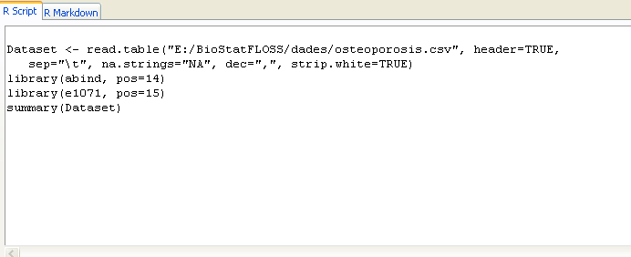
RCommander
Command window
The menu actions are converted into instructions in the Command window.

Slide 24
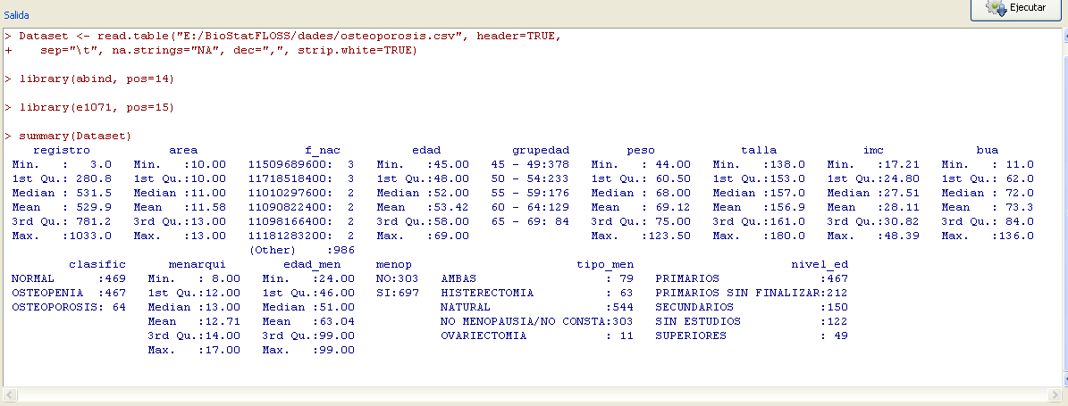
RCommander
Text output window
Message window

Slide 25
How does Rcmdr work
Similarly to other GUIS:
point-and-click
Without forgetting that it is an interface with R
Actions selected in menus
Become R commands (in command window)
That are automatically executed
Some "new concepts".
Active dataset
Active model

Slide 26
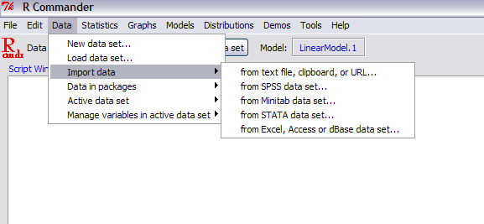
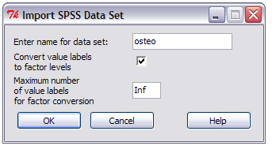
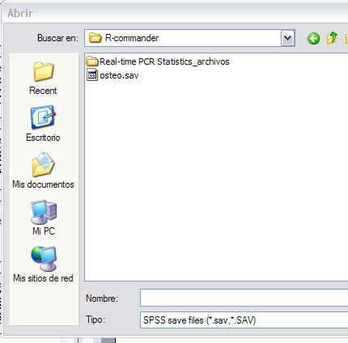
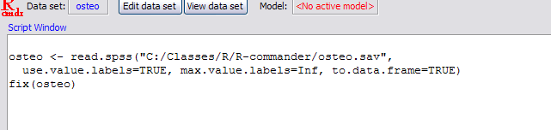
Data input (the first step!)

Slide 27
Data management (prior to analysis)
Actions defined through Rcmdr menú system are applied to a privileged dataset: the "active dataset".
The active dataset can be
Edited or visualized
Transformed row-wise (cases)
Add cases, Subset
Transformed columna-wise (variables)
Add new variables, recode variables
Any dataset can become "active dataset"

Slide 28
Data Analysis
R commander provides a series of standard statistical analyses that can be applied to the active dataset
Selecting options from menus
Configuring operations through forms
If a given analysis cannot be done in "basic" in R commander it may be available in extensions known as "Rcmdr-plugins"
Survival analysis
Multivariate statistics, …
MORE THAN 30 PLUGINS

Slide 29
Analysis reports
R commander results go either
To the output window
To the graphics window
Once the analyses are completed
We may need to copy and paste results to a Word document to create a report.
We may need to reproduce the analysis step-by-step
To check results
To extend or change the prior análisis.
R commander creates an Rmarkdown document
That, when run, generates an HTML or Word document
Containing the code from the analysis

Slide 30
Additional souRces
R manuals
* Intro for beginners http://cran.r-project.org/doc/contrib/rdebuts_es.pdf
* SimpleR http://cran.r-project.org/doc/contrib/Verzani-SimpleR.pdf
* Quick-R http://www.statmethods.net/
* Basic statistics with R and R-commander http://knuth.uca.es/ebrcmdr/
* Statistical methods with R and R-commander
http://cran.r-project.org/doc/contrib/Saez-Castillo-RRCmdrv21.pdf
* Try R http://tryr.codeschool.com/levels/1/challenges/1
R books
* Introductory Statistics with R
* R for SPSS and SAS users

