Slide 1








Sample Size calculations
Curs d'Estadística Bàsica per a la Recerca Biomèdica
UEB – VHIR
Santiago Pérez-Hoyos i Alex Sánchez-Pla
santi.perezhoyos@vhir.org
alex.sanchez@vhir.org

Slide 2








































The objective of statistical inference
Hypothesis
Population
Samples
(sampling techniques)
Conclusions based
on the observed data
(Statistical inference)
(Parameters estimation)
(Hypothesis testing)
Generalization to
the population

Slide 3
Sample Size in Statistical Studies
Statistical inference is used to generalize,
It helps obtain conclusions from samples,
and apply them to populations,
with a certain degree of (known) precision.
This can be made only if
Some assumptions hold (e.g. Normality)
The sample size is big enough as to warrant the desired precision.

Slide 4
Preliminaries
Before discussing sample size calculations there are several things to keep in mind
Type of calculations depend on study goal.
Estimation
Testing
Preliminary concepts to be used
Standard error of an estimator
Confidence interval
Type I and type II errors. Power of a test

Slide 5
Standard error of the mean
A measure of how variable is the sample mean when computed in distinct samples.
Standard deviation of the distribution of sample means
Usually it is defined as population standard deviation divided by squared root of sample size
It is estimated substituting population by sample deviation

Slide 6
Standard error of a proportion
The standard error of a proportion (SEP) is computed similarly to the SEM.
Instead of the standard deviation it uses the population proportion in the formula.
Because p is usually unknown it is subsituted by its estimator.
It is common to set: q=1-p

Slide 7
Confidence interval
PRECISION
PARAMETER
POSSIBLE VALUES
Estimator
Lower Bound
Upper Bound
Values in which we are confident that real population parameter is inside
With a prefixed confidence level (Usually 95%)

Slide 8
Formulas for confidence intervals
Data normally distributed
Population variance known (unrealistic assumption)
Population variance unkown, estimated by sample variance
Data: Counts of presence or absence of an event
Sample must be “big enough”
z_{ε/2} are quantiles of standard Normal N(0,1) distribution
1- ε | 0,90 | 0,95 | 0,99
z_{ε/2} | 1,64 | 1,96 | 2,58

Slide 9
Example: Confidence interval for the mean
Goal: Estimate ureic nitrogen concentracion in serum (SUN) in rats that have been eating a certain diet.
A sample of size 10 has been taken.
Confidence interval is computed from formula (2) above
> x10
1.648943 20.960346 22.915030 27.348437 14.613271 10.705787 -5.131364, 22.863318 41.924915 27.298092
> t.test(x10)
One Sample t-test
data: x10
t = 4.3016, df = 9, p-value = 0.001986
alternative hypothesis: true mean is not equal to 0
95 percent confidence interval:
8.778153 28.251202
sample estimates:
mean of x
18.51468

Slide 10
Confidence interval for a proportion
Problem
A molecular diagnosis lab is doing tests to detect hereditary venous pathology (PVH).
In a series of 150 affected patients 18 show in their genètic profile the AGx allele for the gene related with the disease.
With a confidence of 99% which is the estimation for the percentatge of AGx individuals between people affected by PVH?
Solution
Relative frequency in the sample:
Conditions that make the approximation reliable are verified
From this one may compute:
With a 99% confidence proportion is between 0.052 and 0.188

Slide 11
Computing confidence interval with R
> prop.test(x=18, n=150, conf.level = 0.99, correct = TRUE)
1-sample proportions test with continuity correction
data: 18 out of 150, null probability 0.5
X-squared = 85.127, df = 1, p-value < 2.2e-16
alternative hypothesis: true p is not equal to 0.5
99 percent confidence interval:
0.0648676 0.2088192
sample estimates:
p
0.12

Slide 12
Exercise
Simulate 3 random samples from a normal population of mean 15 and Standard deviation 2.
Sample sizes must be 9, 25 and 100 respectively
Compute a 95% confidence interval for the mean in each sample
Use the following code
x9 <- rnorm (n=9, mean=15, sd=2)
x25 <- rnorm (n=25, mean=15, sd=2)
x100 <- rnorm (n=100, mean=15, sd=2)
t.test(x9)
t.test(x25)
t.test(x100)
What do you observe?

Slide 13
Exercise
Simulate 3 random samples from a Binomial population of "true probability"=0.12=12%.
Sample sizes must be 25, 100 and 500 respectively
Compute a 95% confidence interval for the proportion in each sample
Use the following code
y25 <- rbinom (n=25, size=1,prob=0.12)
y100 <- rbinom (n=100, size=1,prob=0.12)
y500 <- rbinom (n=500, size=1,prob=0.12)
prop.test(sum(y25), length(y25), conf.level = 0.95, correct = TRUE)
prop.test(sum(y100), length(y100), conf.level = 0.95, correct = TRUE)
prop.test(sum(y500), length(y500), conf.level = 0.95, correct = TRUE)
What do you observe?

Slide 14
Sample Size

Slide 15
Sample Size Calculation
Some questions must be answered before we can compute the sample size needed to estimate the mean or percentage.
Precision (interval range) of estimations (“how accurate I want the estimate to be”?)
Level of confidence of estimations (“how confident will I be on the estimation”?)

Slide 16
Sample Size Calculation
The question “what is the sample size” must be rephrased as:
What sample size is needed
to estimate the mean, so that
we have a high confidence (say 95%)
that the estimation error will be less than a given threshold?

Slide 17
Sample size for mean
Example:
The sample size needed to estimate the mean with a confidence interval of width 10 (precision =10/2=5), a confidence level of 95%, if we know that the standard deviation is 20, will be:
n= 1.96² 20² / 5²= 62

Slide 18
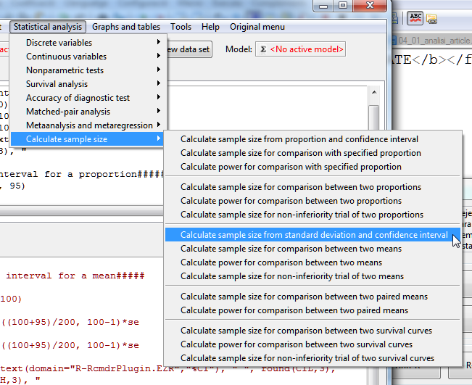
Computing Sample Size with eZR

Slide 19
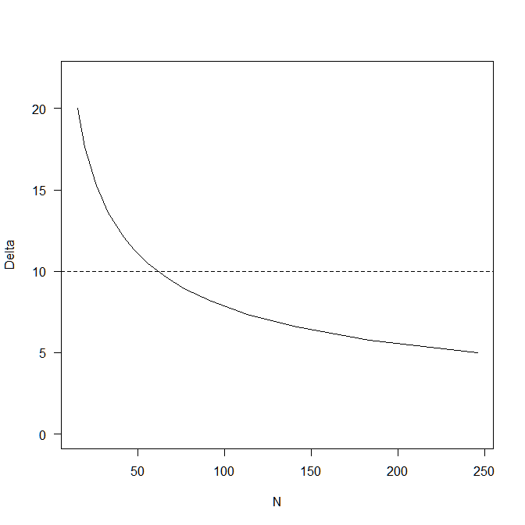
Computing Sample Size with eZR
> SampleMeanCI(20, 10, 95)
Assumptions
Standard deviation 20
Confidence interval 10
Confidence level 0.95
Estimated
Required sample size 62

Slide 20
Sample size for proportion
Assume precision is 5% ( Interval = p±.05) and confidence level is 95%
If it is known that p is around 12.5%
n= 1.96² .125 (1-.125)/.05²= 168
If p is unknown maximum sample size will be if p=.50
n= 1.96² .5 (1-.5) /.05²= 384

Slide 21
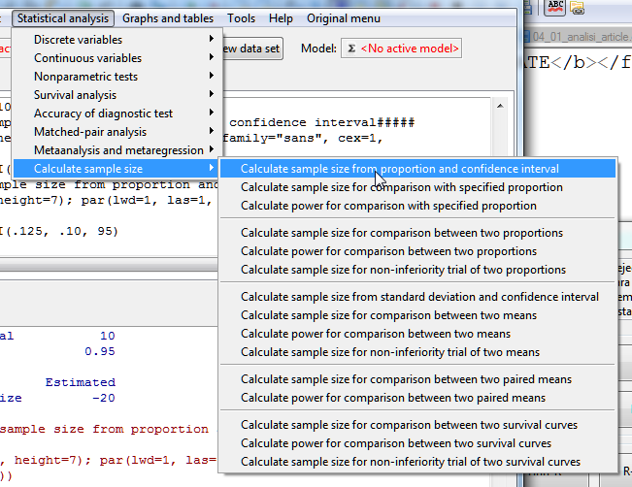
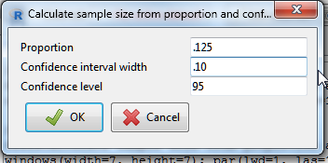
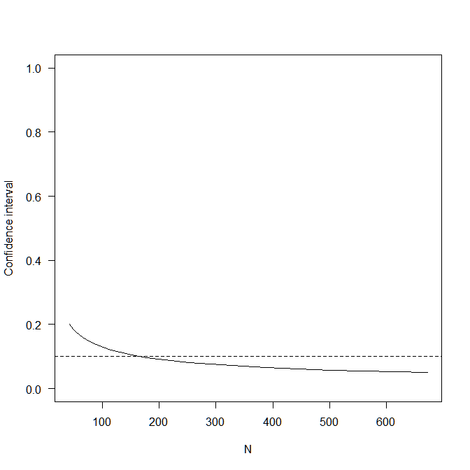
Computing Sample Size with eZR
Assumptions
P 0.125
Confidence interval 0.1
Confidence level 0.95
Estimated
Required sample size 169

Slide 22
Sample size calculations for testing
Similarly to sample size calculations for estimation, several points need to be considered so that the right question is:
What is the sample size needed to detect at least a difference Δ with the null hypothesis with a power β and a confidence (1-α)
The computations also need to know or estimate parameters such as standard deviation or the percentatge.

Slide 23
Examples
The question:
What sample size is needed to test the belief that systolic pressure in a hypertense population is 90 or bigger than that
Needs to be re-stated as:
What sample size is needed to test the belief that systolic pressure in a hypertense population is 90 or bigger than that with a difference of at least 5 units, a power of 80% and a confidence of 95% assumint that the standard deviation is 11?

Slide 24
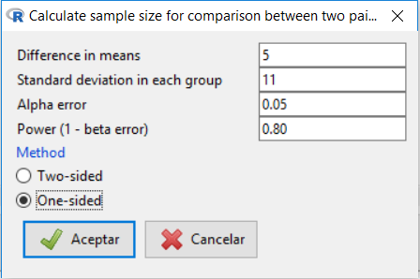
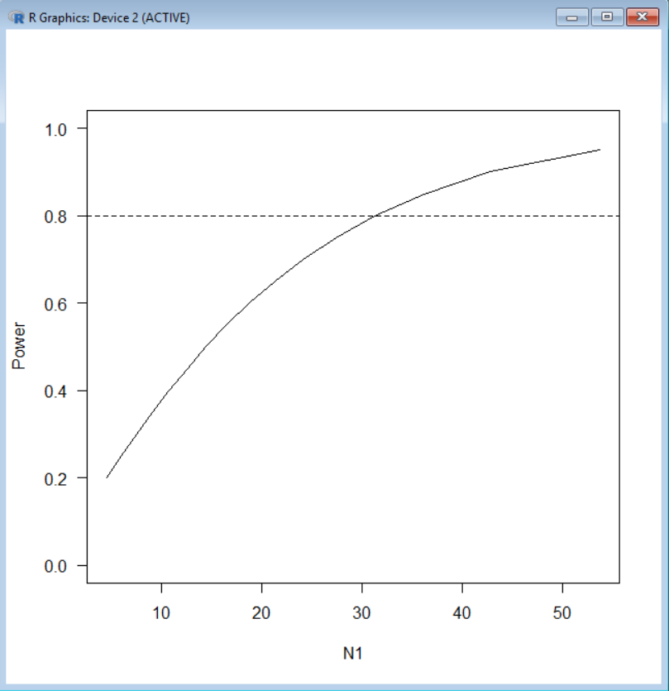
Computing sample size with eZR
eZR can only compute sample size for paired differences, so we cheat a little:
> SampleMeanPaired(5, 11, 0.05, 0.80, 1)
Assumptions
Difference in means 5
Standard deviation 11
Alpha 0.05
one.sided
Power 0.8
Required sample size Estimated
N 32

Slide 25
Recall: Truth, Decision, Errors
TRUTH → DECISION | Null Hypothesis True | Null Hypothesis False
Test does not reject null hypothesis | Significance level ✓ | Type II Error β
Test rejects null hypothesis | Type I Error α | ✓ Power (1- β)

Slide 26
Concept review: Power
The power of a test describes the probability of correctly rejecting the null hypothesis that is, rejecting H₀ when it is false.
A good test “controls” the probability of type I error and has a power “as big as possible”.
Control of type I error is warranted by the way the test is built (with a given high confidence).
Power cannot be warranted but it depends on
The minimum difference to be detected by the test
The sample size
The population variability

Slide 27
Factors affecting power
Power cannot be warranted simultaneously with type I error but it depends on:
The minimum difference to be detected by the test
The bigger the minimum difference → the bigger the power
The sample size
The bigger the sample size → The bigger the power
The population variability
The bigger the variability → The smaller the power
Usually three of the previous four are set and the fourth is computed.
This is called “power analysis”

Slide 28
Some examples using R
What is the minimum sample size needed to detect a difference of at least 5 among two groups whose standard deviation is 10 if one wishes to attain a power of 0.75?
What is the power attained if one uses a sample size of 20 (per group) to detect a minimum difference of 5 between two groups assuming that the standard deviation (in both groups) is 10.

Slide 29
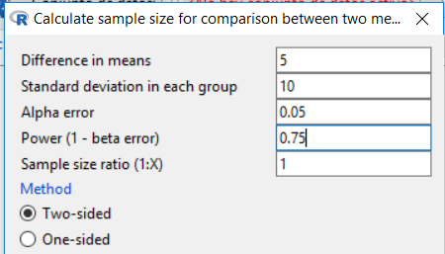
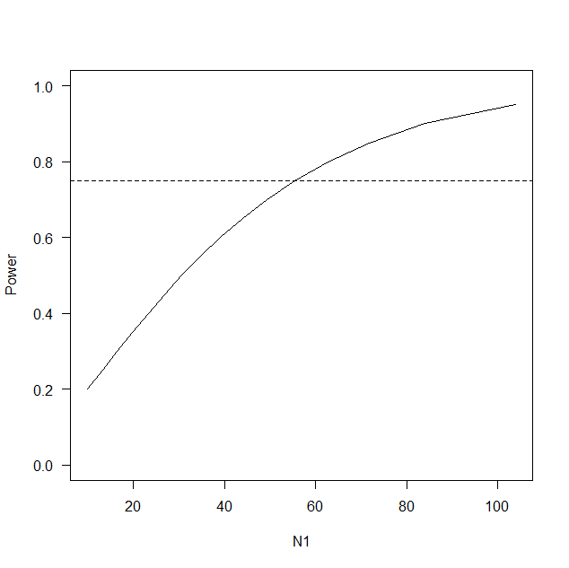
Some examples using R
Sample size from power
Assumptions
Difference in means 5
Standard deviation 10
Alpha 0.05
two-sided
Power 0.75
N2/N1 1
Required sample size Estimated
N1 56
N2 56

Slide 30
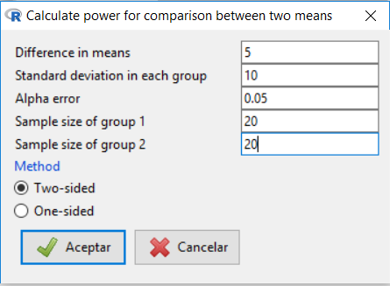
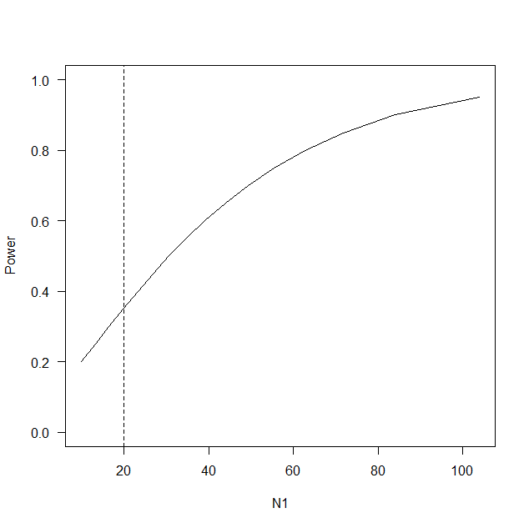
Some examples using R
Power from sample size
Assumptions
Difference in means 5
Standard deviation 10
Alpha 0.05
two-sided
Sample size
N1 20
N2 20
Estimated
Power 0.352

